Slide 1
INDemand Jobs
Occupational Profiles
Indiana Career Explorer
Labor Market Information
INDemand Ranking

Slide 2
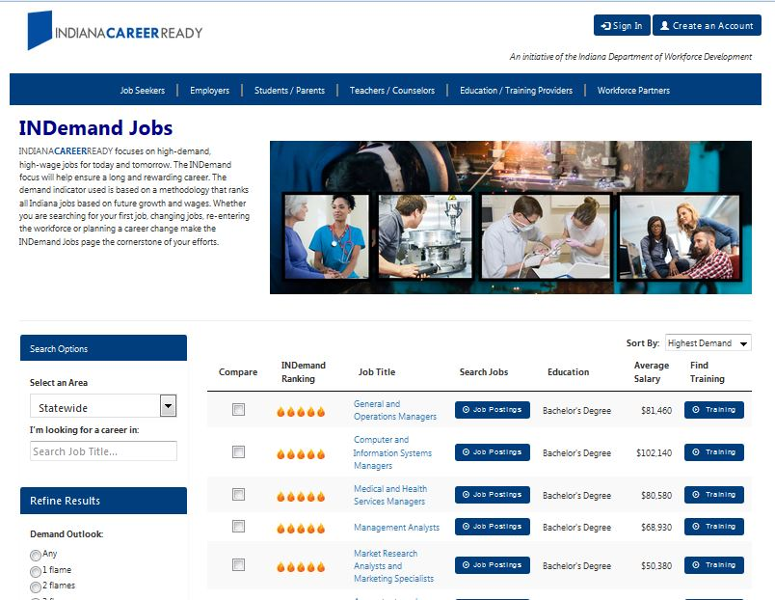
INDemand Jobs are based on future demand, percent change, wages, and real time labor market information

Slide 3
Occupational Projections
Projection inputs include state and national variables
State level
Covered and non-covered employment time series
Variables, i.e. Labor Force, Initial claims, Indiana leading index, Personal Income, Population, etc
Occupation staffing ratios per industry
Economic development activity
National level
National occupation-specific change and utilization rates by industry, i.e, effects from automation, robotics, offshoring, technology, etc.
National Projections
Variables, i.e. GDP, United States Labor Productivity, Prime interest rate %, Housing Starts, etc
Occupational projections are produced at the state level within a national consortium, The Projections Managing Partnership is funded by the U.S. Employment and Training Administration. Indiana is represented on the PMP Board.

Slide 4
INDemand Ranking Methodology Inputs
Short Term Total Projected Openings (33.33%)
Short Term Growth Openings (16.67%)
Short Term Percentage Change (16.67%)
Job Postings (16.67%)
Wages* (16.67%)
Long Term Total Projected Openings (40%)
Long Term Growth Openings (20%)
Long Term Percentage Change (20%)
Wages* (20%)
Short Term Score
Long Term Score
Average Score = INDemand Ranking
*As to wages, any occupation scoring 3 or 4 in the wage category cannot score higher than 3 Flames and any occupation scoring 1 or 2 in the wage category cannot score higher than 2 Flames.
(Source: National Wages were used for occupations with wages suppressed in Indiana)

Slide 5
INDemand Decile Ranking Method
For both short term projections and long term projections, each occupation is assigned a 1-10 score in each of the five categories by ranking how it performs in comparison to every other occupation in Indiana. The scoring method is determined by deciles, or in other words, a percentile system ranging from the 90th percentile and above, down to the 10th percentile and below. The score is weighted by category for both the short term and long term projected outlooks and then averaged to provide a final composite score.
Registered Nurse 29-1141
Total Projected Openings
Growth Openings
% Change
Wage
Job Postings
Short Term Ranking | Total Projected Openings X2 | 10
 | Growth | 10
 | Percent Change | 9
 | Wages | 8
 | Real Time LMI | 10
Short Term Final Score |  | 9.5
Long Term Ranking | Total Projected Openings X2 | 10
 | Growth | 10
 | Percent Change | 9
 | Wages | 8
Long Term Final Score |  | 9.4
Flame Ranking
*As to wages, any occupation scoring 3 or 4 in the wage category cannot score higher than 3 Flames and any occupation scoring 1 or 2 in the wage category cannot score higher than 2 Flames.
(Source: National Wages were used for occupations with wages suppressed in Indiana)

Slide 6
What’s Included? What’s Not?
Real time labor market analytics
Short and long term future projected demand
Rate of growth
Number of growth openings
Occupational change rates due to automation, changes in business practices, technological innovation, mergers & outsourcing
Economic development activity
Labor force projections
Wages
Education attainment or training value
Job vacancy or skills gap surveys
Supply vs demand gap
Number of openings threshold
Skills/Competencies

Slide 7
Real Time Labor Market Information
Real time labor market information is used to help understand local labor market patterns and opportunities
Burning Glass Technologies is the leading source for Real Time LMI
Codes millions of job postings from more than 40,000 online sources daily

Slide 8
Interactive Formula Visualization

Slide 9
INDemand Ranking: Policy & Decision Making
NextLevel Jobs
Eligible Training Providers
Career Technical Education

Slide 10
HOW DO STATES MEASURE In Demand JOBS?
80% - projected job openings
More states took an ordinal approach, ranking occupations by number of projected job openings, than taking a cardinal approach (only looking at occupations with at least 1,000 projected job openings, for example)
69% - growth rate from employment projections
51% - online job ads
31% - targeted industries
29% - supply and demand analysis
22% - job vacancy, skills gap, or other employer surveys
Note: 63% use a composite method of more than one metric
Source: Bureau of Labor Statistics State Survey, 2017

Slide 11
HOW DO STATES MEASURE In Demand JOBS?
States refine their lists with certain metrics:
75% - occupational wages
Usually mean or median OES wage for the state
53% - education and training levels
Some states have several lists of jobs in demand covering different levels
24% - base year minimum employment cutoff
22% - projected number of new jobs
Results of the BLS survey (Continued)

Slide 12
Other Formula Scenarios
 | DOUBLE OPENINGS (IN) | NO WEIGHT - BASELINE | DOUBLE WAGES
Ratings driver: 1. Growth 2. Percentage Change 3. Total Openings 4. Wages 5. Burning Glass Job Postings (only short term) | Demand and projections data | All categories equally (with projections / demand data taking a precedence because it has more categories in the formula) | Educational attainment and OES wages (due to the correlation between higher education and higher wages)
Number of 5-flame occupations | 16 | 12 | 16
5-flame occupations in No weight (baseline) that are not scoring 5 flames in other categories | Personal Financial Advisors Occupational Therapists | N/A | All
Number of advanced degree 5-flame occupations | 3 | 4 | 5

Slide 13
Other FORMULA scenarios – outcomes
Double weighting OPENINGS
Current methodology
90% occupations within 5 flame occupations were in the 75th percentile or above of wages
Wage rule prevents high churn, low pay occupations from elevating to 4 or 5 flame occupations
Current wage rule prevents low wage, high demand occupations from elevating on the ranking list
Double weighting the openings (to highlight high demand occupations within a range of education attainment level categories) elevated occupations requiring more than a high diploma
Post-secondary certificates are best represented by the current double-weighted demand method. Indiana would lose four 5 flame post-secondary certificate openings by moving to the single weighted opening methodology, and all post-secondary certificates are removed from the 5 flame category when using the double weighted wage method.
Double weighting WAGES
Bias towards Bachelor’s and even Master’s degree requirements
De-emphasizes jobs with an Associate’s degree, Certificate, or less, especially impacting Healthcare occupations, where the need is great
May misrepresent demand on EGR level rankings
(some EGRs do not have a robust representation in key industries – there would be misrepresentation of the demand when wage is driving the rankings, especially at the regional level)
Single weighting DEMAND
Equals a definite opportunity for job seekers
Water down demand opportunities by volume, but would be more holistic in terms of varying education attainment levels than double weight of wages

Slide 14
Fvalentine1@dwd.in.gov
Contact Information
Fran Valentine
Sr. Director, Research Analysis & Engagement
Indiana Department of Workforce Development

