Slide 1


Slide 2

MISSION:
Provide pathways for Hoosier citizens, businesses, & communities to take it to their Next Levels

Slide 3
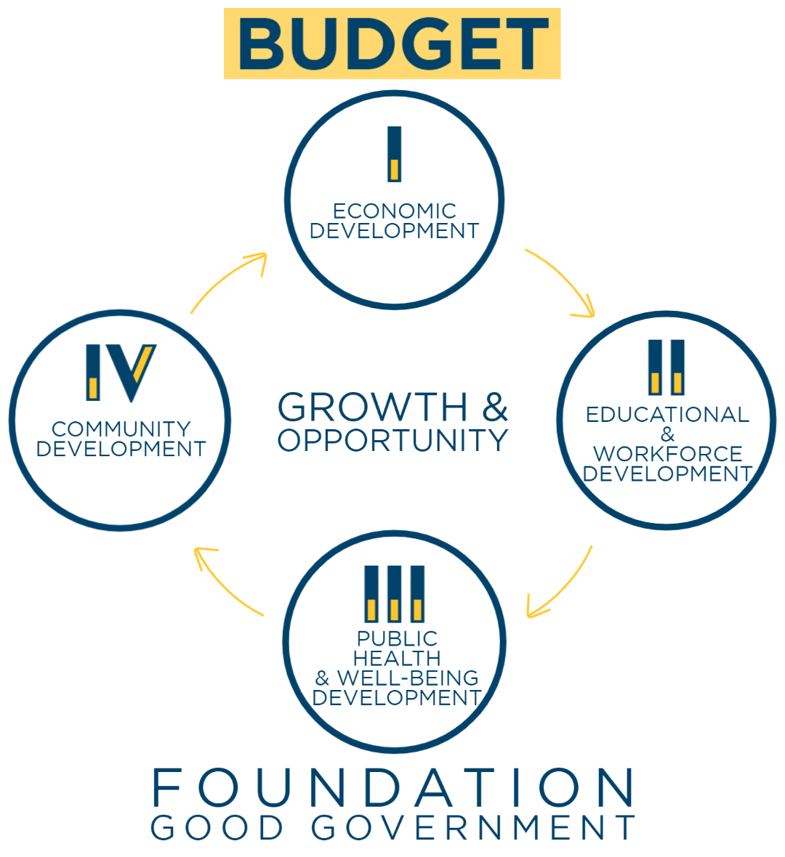

Slide 4
BUDGET
Pass 10th straight honestly balanced budget
Fund agency priorities
Maintain healthy reserves
Guarantee an additional $1B goes to pay down pre-96 teacher retirement fund
Follow through on cash funding mega projects in FY23
State Archives, State Park Inn, Blind & Deaf Schools, Westville Prison

Slide 5
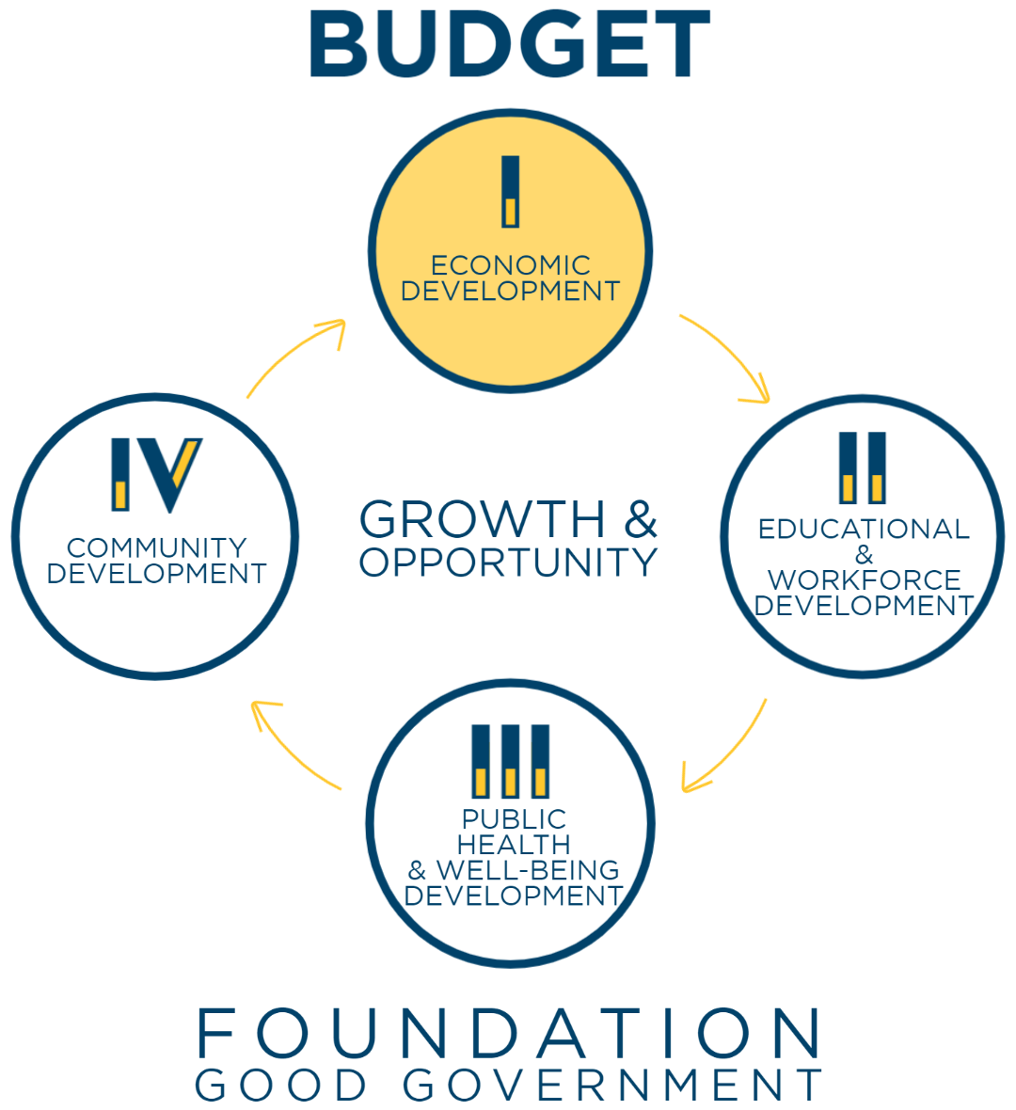

Slide 6
ECONOMIC DEVELOPMENT TOOLS
Modernize state economic development tools:
Establish $300M/yr deal closing fund
Formalize $300M/yr tax credit flexibility
New $150M revolving fund for site acquisition
Create Budget Committee process release valve
Continue investment in entrepreneurship, innovation and marketing
Double funding for Manufacturing Modernization grants ($40M over biennium)

Slide 7
DESTINATION PROMOTION
Increase tourism funding
Focus on connecting with Indiana college students & visitors
Support statewide sports bid fund

Slide 8
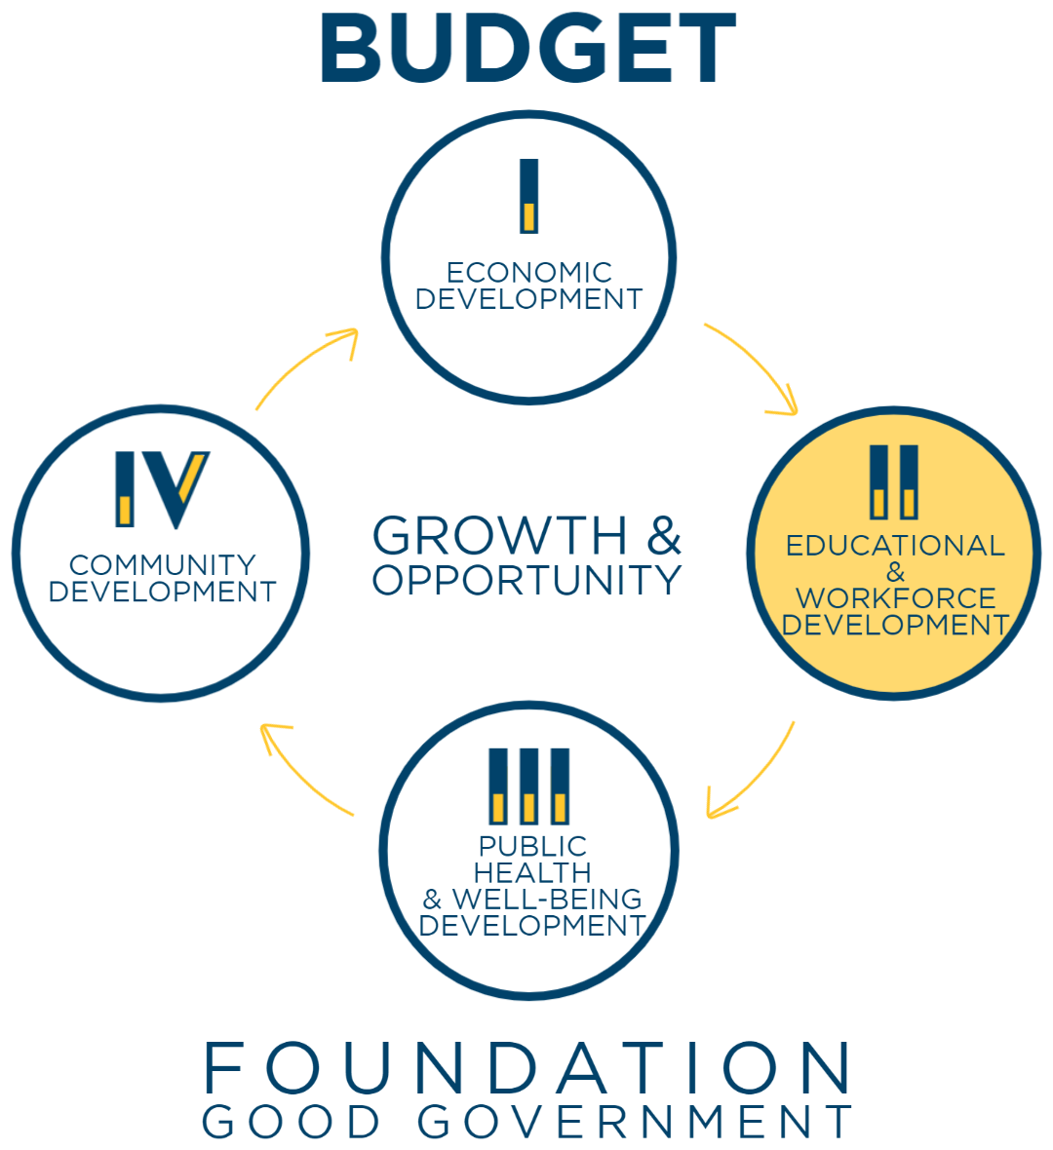

Slide 9
EDUCATIONAL & WORKFORCE DEVELOPMENT
A. Early Childhood
B. K-12
C. Post Secondary/Higher Education
D. Adult Learner Programs

Slide 10
A. EARLY CHILDHOOD
Establish a $25M Innovation Grant with federal funds to provide funding & licensing support for employer sponsored childcare options
Administratively reduce regulatory burdens for existing and new childcare providers
Modernize and update Paths to Quality to better measure kindergarten readiness standards
Expand access to the Child Care & Development Fund (CCDF) and On My Way Pre-K by raising eligibility criteria to allow another 5,000 more families to qualify

Slide 11
B. K-12 EDUCATION
Increase K-12 Tuition Support (+6% / +2%) by $1.157B totaling over $17.5B over the biennium
Eliminate textbook fees for Hoosier families
Indiana is 1 of 7 states that still allows schools to charge parents for textbooks & curriculum materials
By explicitly prohibiting these fees, we can deliver on the spirit of Indiana’s constitutional promise to provide a free education
State would provide $160M/yr ($39M current + $120M/yr) to cover curriculum materials for the families of over 1M students at ALL traditional public and charter schools as well as students who qualify for free and reduced lunch at non-public schools

Slide 12
Literacy Initiatives
GOAL = By 2027, 95% of students in the 3rd grade will demonstrate reading proficiency skills by implementing Science of Reading Program (81.6% passed 2021)
Continue expanding the Science of Reading in Indiana classrooms
Create new incentive program to reward schools & teachers that improve IREAD 3
Launch Dolly Parton's Imagination Library statewide to provide books every month to eligible kids ages birth to 5
Ensure high-quality STEM curriculum (DOE)
Restore JAG funding to pre-pandemic levels

Slide 13
C. POST SECONDARY/HIGHER EDUCATION
Significantly increase Higher Education funding (+6%, +2%) by $184M totaling over $3B for the biennium
Support Commission for Higher Education’s (CHE) new outcomes-based performance funding focused on retaining graduating students in Indiana
Automatically enroll all eligible students in the 21st Century Scholarship Program
Provide support for Martin University, Indiana’s only Predominantly Black Institution (PBI) serving many first-generation college and low-income minority students

Slide 14
D. ADULT LEARNER PROGRAMS
Expand Excel Centers across the state to expand access to adult learning
Increase funding for Graduation Alliance for adults to earn diploma or credentials online
Increase funding for Adult Education programs
Increase funding for Next Level Jobs ($29M/yr)
Triple funding for Workforce Ready grant program ($12M/yr)
Sustain Employer Training grant funding ($17M/yr)
Pilot program to incentivize UI recipients to obtain HS diploma
Fund key GWC recommendations ($7.5M/yr)
Increase INVETS program to recruit more veterans to move to Indiana and connect them to jobs/careers ($2M/yr)

Slide 15
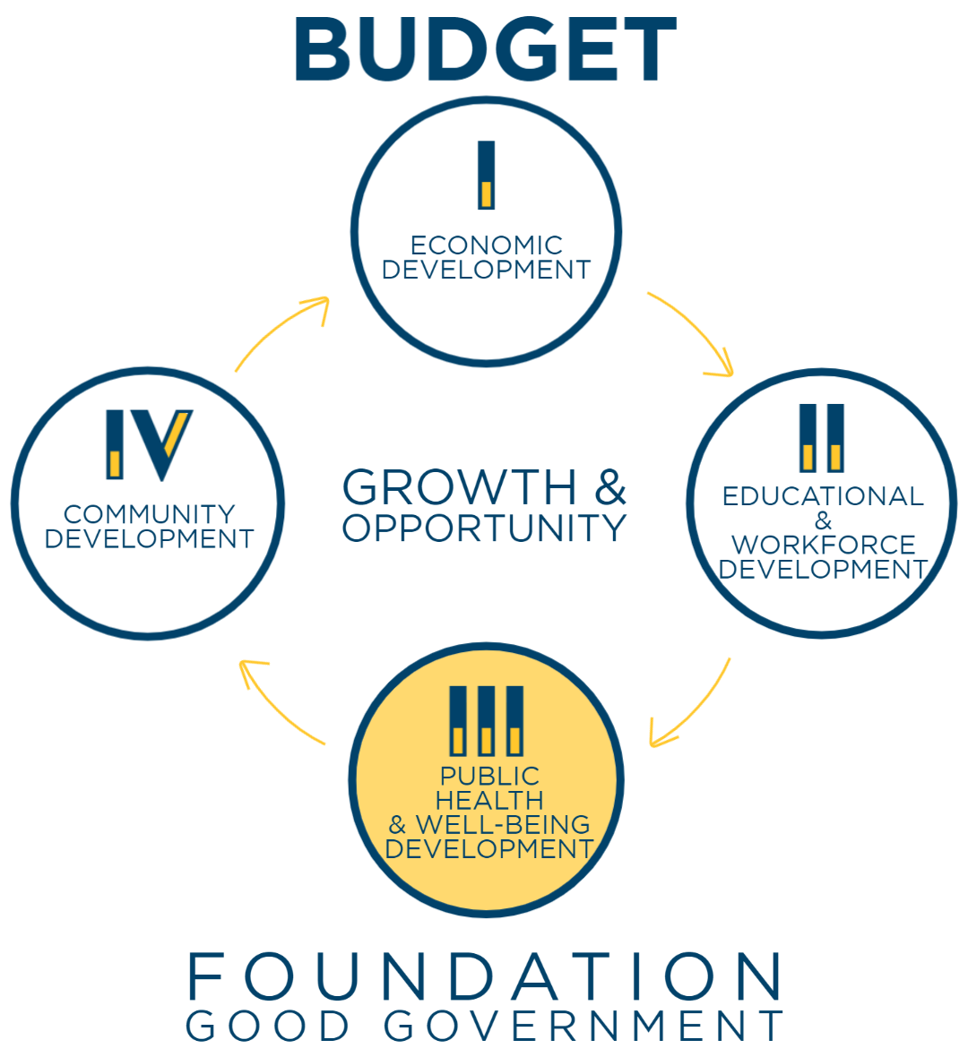

Slide 16
A. PUBLIC HEALTH COMMISSION
GOAL: Ensure all Hoosiers have access to foundational health services by increasing the state investment and providing stable, recurring, and accessible funding. Improve Indiana’s life expectancy and public health funding ranking among states through increased local access to core services.
Increase annual state public health appropriation +$120M/yr in FY23and +$227M in FY24
Out of these increases, $100M in 1st year and $200M in 2nd year will be solely dedicated to locals who opt-in for public health funding (up from $6.9M/yr)
Remainder of state level public health funding will assist in areas such as healthcare workforce planning, data analytics, emergency preparedness, and promoting child screenings & oral health programs
Complete 92 county rollout of My Healthy Baby program

Slide 17
B. MENTAL HEALTH
Expand 9-8-8
Expand local Crisis Stabilization Units
Continue transitioning to certified Community Behavioral Health Clinics
Further address veteran suicide with more local grants to veteran groups

Slide 18
C. DRUG ADDICTION
13,000 overdose deaths in the last 7 years
2,775 overdose deaths in 2021, up 483 from 2020
85%-90% of those deaths involved fentanyl
In 2023 we will:
Launch a new Treatment Finder program
Continue building regional system of recovery hubs
Invest national opioid settlement dollars to create more community substance use programs
Expand evidence-based treatment to incarcerated individuals in jails

Slide 19
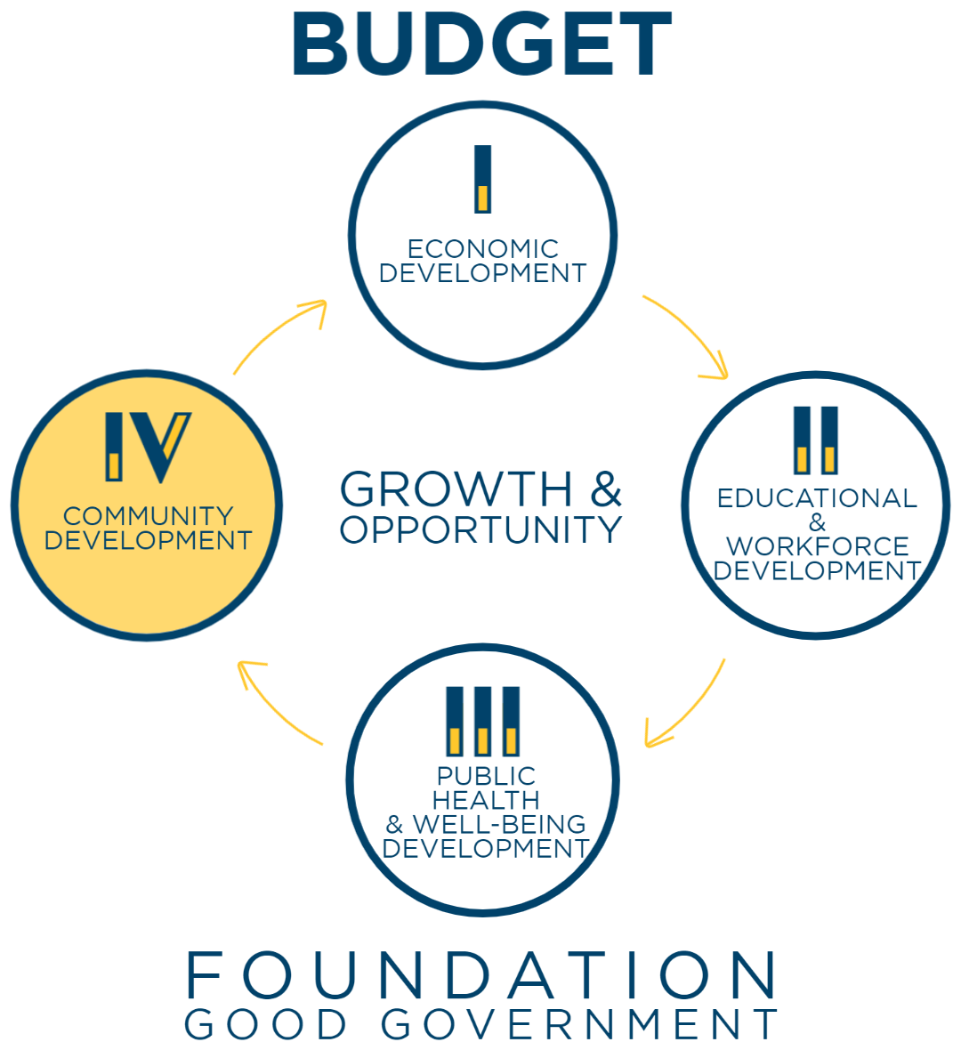

Slide 20
COMMUNITY DEVELOPMENT - CONNECTIONS
Fund READI 2.0 at $500M
Add $50M more for NextLevel Trails
Provide $25M more for land conservation
Invest Remaining NextLevel Broadband internet dollars and prepare for new federal dollars
Pursue more international & domestic direct flights
Support Gary Airport’s cargo development projects
Double state food bank funding to supplement locals

Slide 21
COMMUNITY DEVELOPMENT – PUBLIC SAFETY
Increase School Safety Fund from $19M to $25M/yr
Increase Indiana State Police starting pay ($53,690→$70,000)
Implement regional firefighter training (Hub & Spoke) Infrastructure by enhancing 14 sites, building 16 new sites and investing in mobile equipment
Provide critical PPE for volunteer firefighters
Support fully funding courts request to upgrade data and technology and expand key problem-solving courts

Slide 22
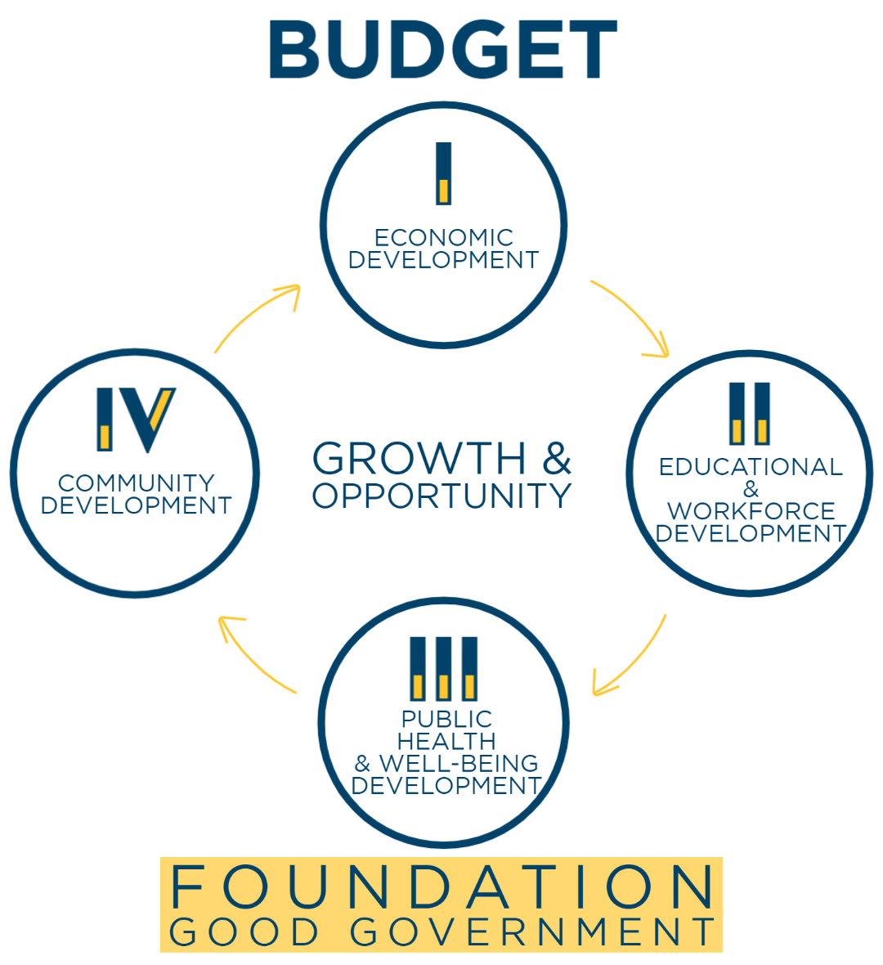

Slide 23
ALL ON A FOUNDATION OF
GOOD GOVERNMENT

