Slide 1
Pretrial Release
Balancing Public Safety Concerns and Constitutional Protections

Slide 2
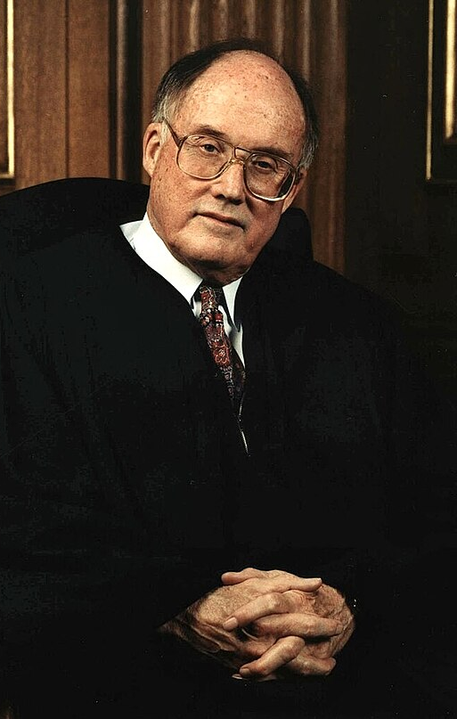
“In our society liberty is the norm, and detention prior to trial or without trial is the carefully limited exception.”
-- United States v. Salerno, 481 U.S. 739 (1987)

Slide 3

What we will cover
Facts about Pretrial Release
Foundations of the Right to Bail
Features of a Fair System

Slide 4
Facts to Frame the Issues
Indiana has a jail overcrowding problem driven by pre-trial detention
Many people are in jail facing non-violent charges
The rearrest rate for individuals on pretrial release is low

Slide 5
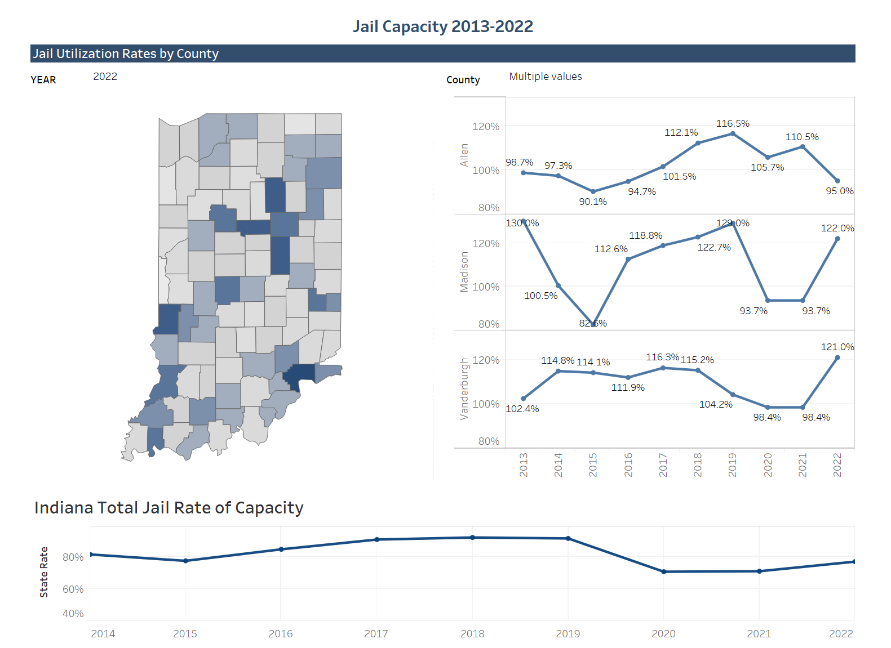

Slide 6
Functionally Overcrowded Statewide
24 jails overcrowded
14 jails over maximum capacity
77% statewide capacity

Slide 7
Low-Level Charges Were Common in August
Marion County
Theft (3rd)
Possession of Paraphernalia (9th)
Possession of Marijuana (10th)
Possession of Meth (7th)

Slide 8
Yet Pretrial Detainees are the Problem
25 jails > 80%
66 jails > 50%
Over 50% of the statewide jail population awaiting trial

Slide 9
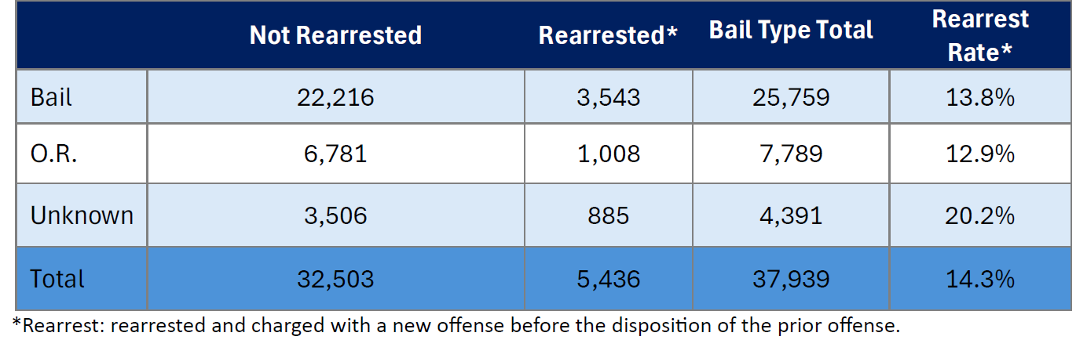
Which Seems Unnecessary When Rearrest Rate is Low

Slide 10
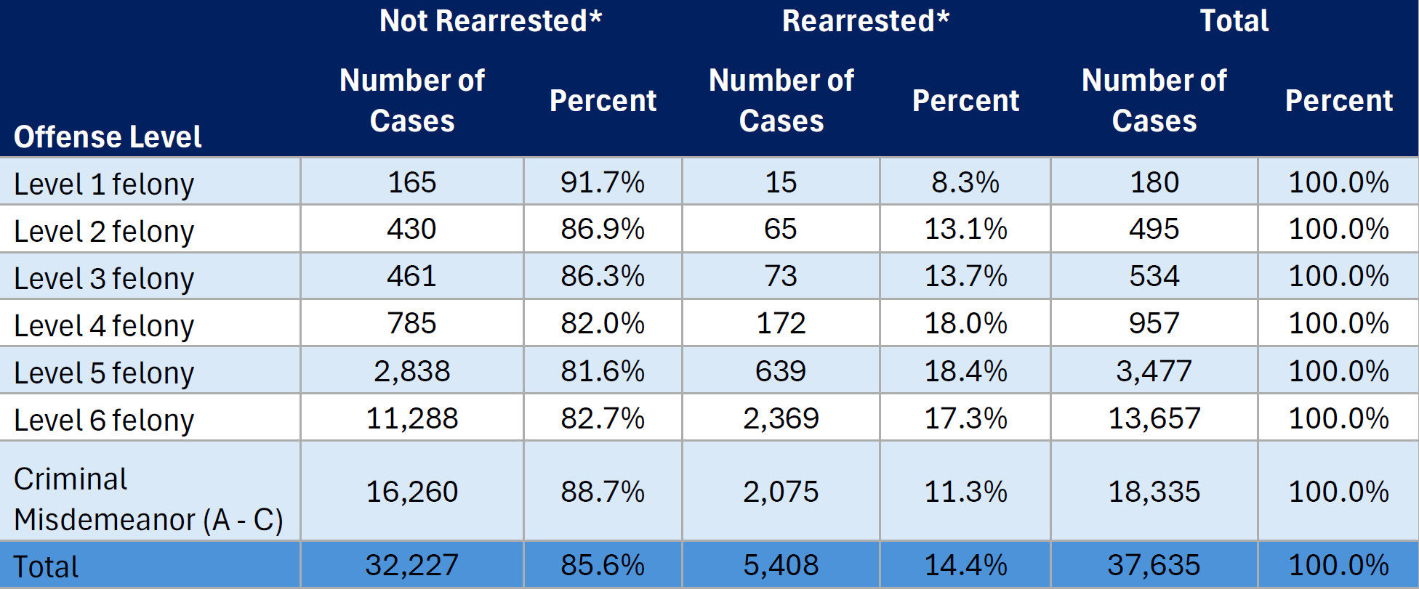
The Rate is Even Lower for Major Felonies

Slide 11

You May Be Thinking Even a 1% Rearrest Rate is Too High
But remember Blackstone’s Ratio…

Slide 12
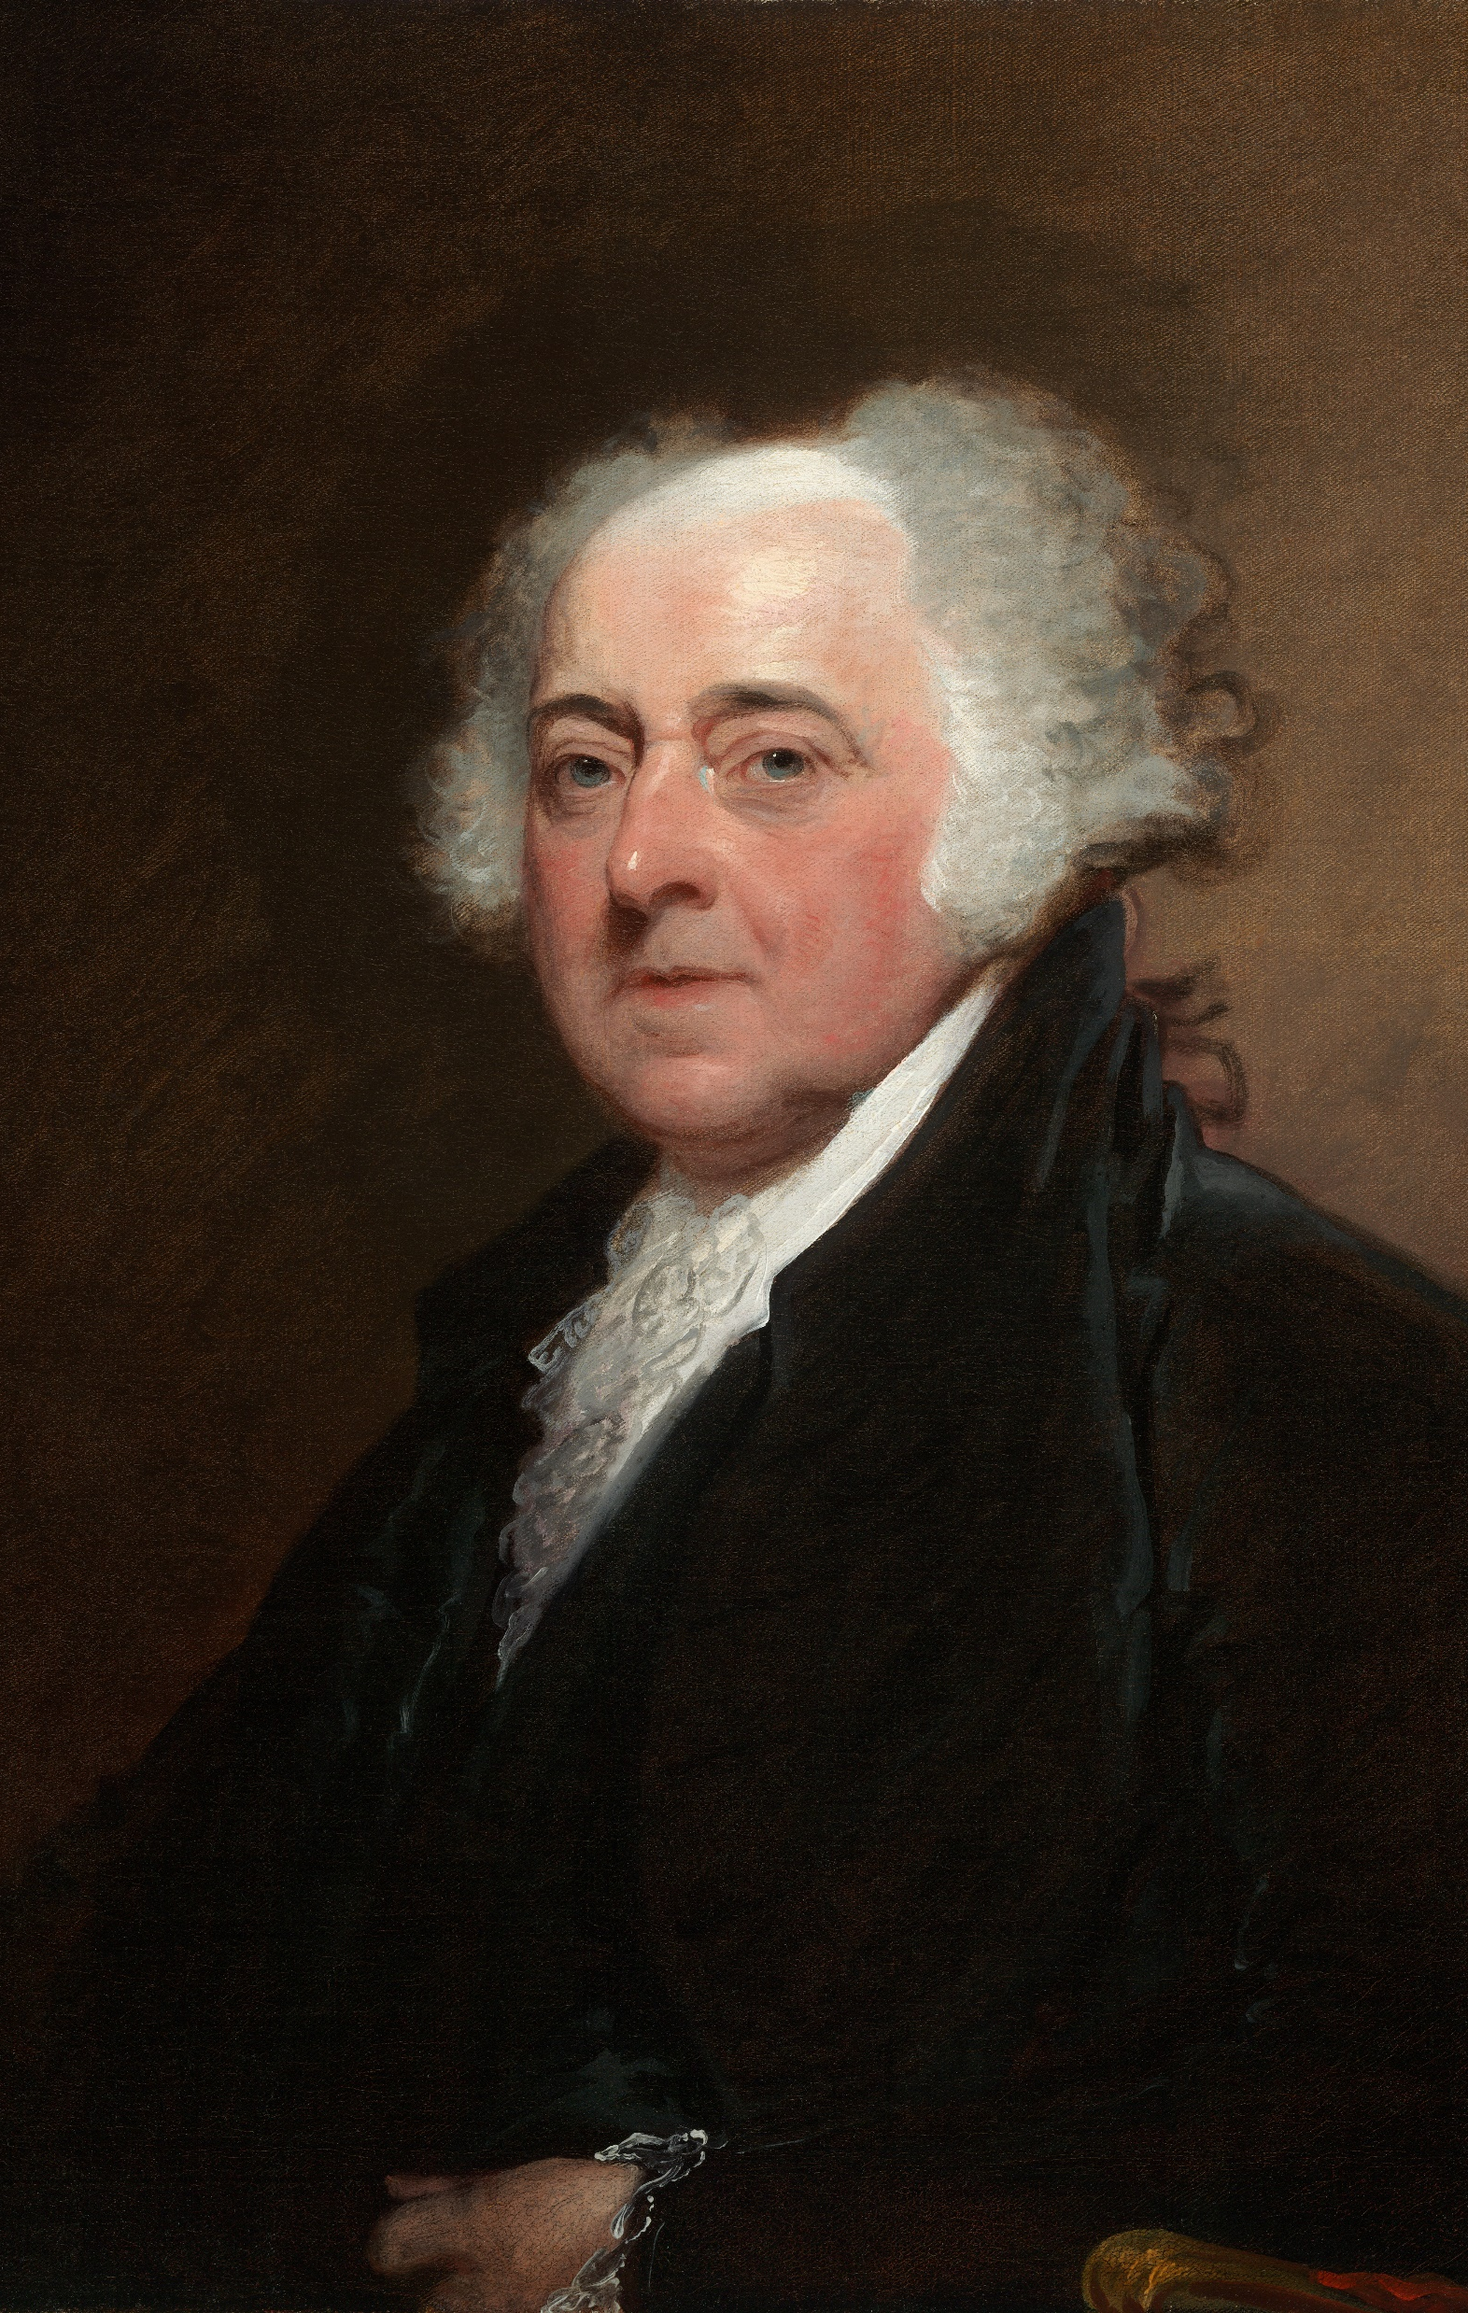
It is “more beneficial that many guilty persons should escape unpunished than one innocent person should suffer.”
-- John Adams

Slide 13
Speaking of the Framers: Legal Foundations and Current Realities
Original Intent: Presume innocence while securing trial attendance
Modern Use: Ensuring attendance while protecting the community
Impact: Those with means can go free while the indigent must stay in jail

Slide 14
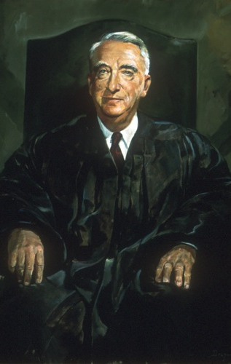
“Th[e] traditional right to freedom before conviction … serves to prevent the infliction of punishment prior to conviction. Unless this right to bail before trial is preserved, the presumption of innocence, secured only after centuries of struggle, would lose its meaning.”
-- Stack v. Boyle, 342 U.S. 1 (1951)

Slide 15
Historically Two Rights Worked in Tandem
No Excessive Bail
Most Offenses Bailable
Innocence Presumed

Slide 16
Pre-Trial Release was the Expectation and Bail was Meant to Secure Attendance at Trial
Offenses “bailable by sufficient sureties”
Sufficient sureties = Enough to secure attendance at trial
“The law confines the use of pre-trial detention to only one end: namely, that the criminal defendant be present for trial. This limitation is implicit in the concept of bail.”

Slide 17
Moving Away From Attendance to Dangerousness
1851–1996
Bail set “to assure the defendant's appearance in court”
1996–2016
Bail may reflect risks to “physical safety”
2016 to Present
Bail set using evidence-based tools to assess the risk of flight or reoffending

Slide 18
DeWees v. State (2022): Where We Are Today
Was a $50,000 cash-only bond for an 18-year-old young woman who drove three men to an armed burglary an abuse of the trial court’s discretion when she was still in high school and had no criminal record or evidence of prior bad character?
Notes:
DeWees: The young woman presented a moderate risk of reoffending, according to IRAS; the victim testified to the fear caused by the event; the offense was serious, and the amount of time she faced made her a flight risk.

Slide 19
DeWees v. State (2022): Where We Are Today
In a “close case,” the Court found $50,000 cash appropriate.
“[A] trial court can and should exercise [its] discretion to protect against the risk of flight or potential danger to the community. The trial court here did just that. And, so, we affirm its order denying the petitioner's motion for bond reduction or conditional pretrial release.”

Slide 20
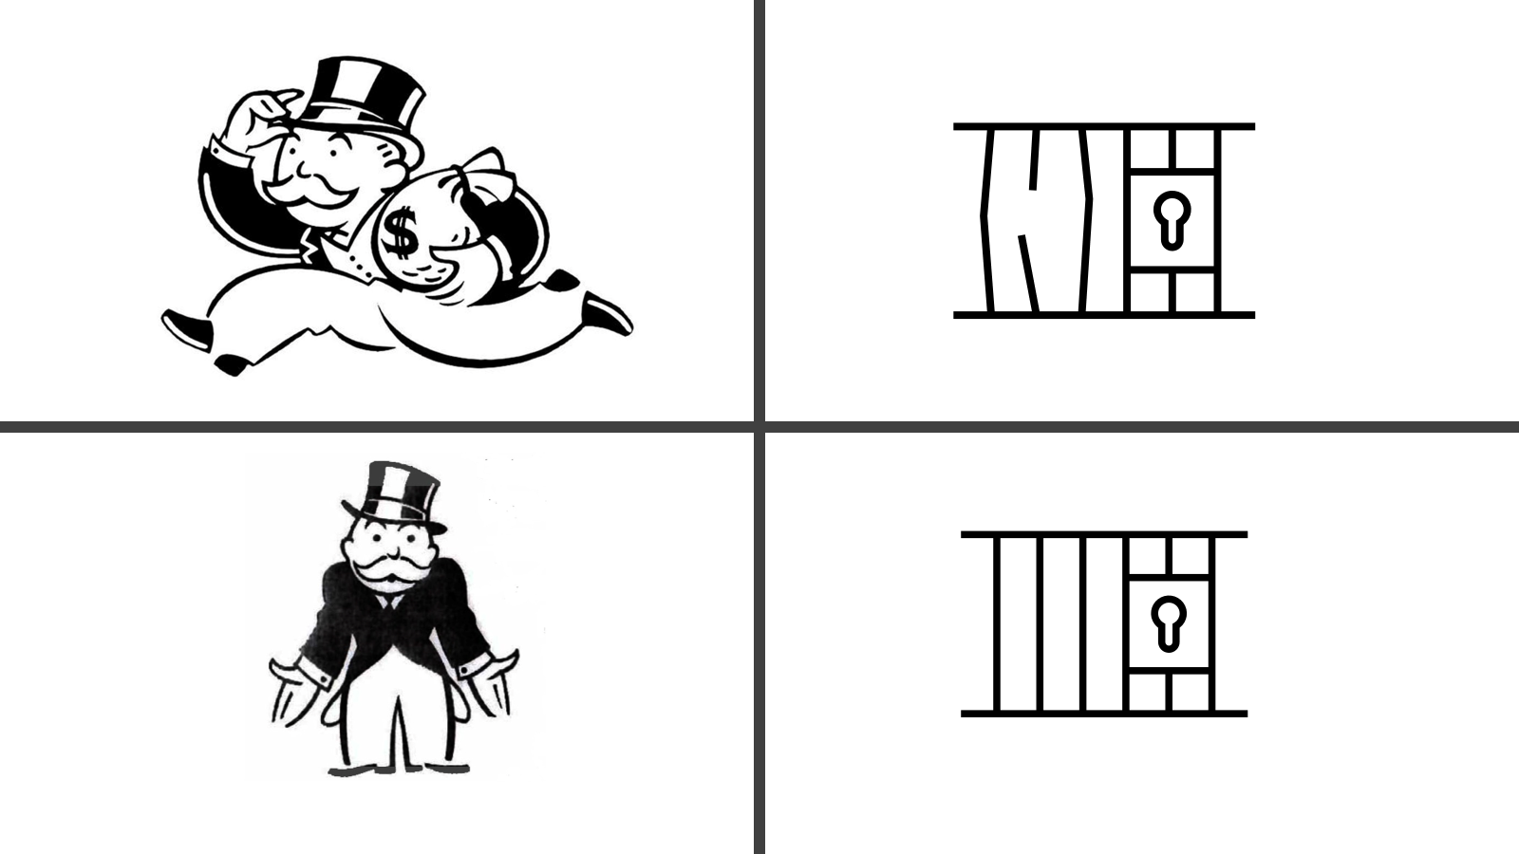
De Facto Preventive Detention for the Indigent

Slide 21
Features Going Forward
Constitutional release under least-restrictive, non-financial conditions
Evidence-based, unbiased assessments
Strong procedural protections for all pretrial detention decisions

Slide 22
Constitutional Release
Favor release without conditions, including financial conditions, unless the trial court finds circumstances that require otherwise
Current rule is that the trial court “should” release when there is no evidence of risk
We believe a fair rule would use “shall” instead of “should”
Create a progression of conditions and release options consistent with a defendant’s risk of nonappearance or rearrest like the Bail Reform Act of 1984.
First, release on personal recognizance
Then, released on a condition or combination of conditions

Slide 23
Very Few Secured Financial Conditions
Bail originally had little to do with money, but today a significant number of people are confined pretrial simply because they can’t afford the cost of freedom
A fair system would eliminate secured financial conditions or at least consider the accused’s ability to pay
If money bail persists, there should be regular review for people who have been subject to bail but remain in jail

Slide 24
Evidence-Based Decisions
Continued use of IRAS and IYAS while also continuously evaluating and refining these tools
Even an objective tool can produce inequitable results if the inputs are not calibrated to screen out unjustified assumptions

Slide 25
Procedural Protections
United States v. Salerno rejects a facial challenge to preventive detention but cautions that the interest in pretrial liberty is “fundamental”
Consequently, significant due process protections must be afforded to those whom the government wants to hold pretrial

Slide 26
Procedural Protections
An adversarial hearing within a reasonably short period of time after arrest at which the defendant has the right to counsel, to testify, and to present and cross-examine witnesses;
A judicial finding based on clear and convincing evidence that no conditions of release can reasonably assure the safety of the community or any person;
Pretrial detention orders based on written findings of fact and statement of reasons for decision;
Strict adherence to the jurisdiction’s speedy trial requirements; and
An opportunity for appeal or review of the detention order.

Slide 27

Questions?
Zach Stock
zstock@pdc.in.gov
317-234-9503

