Slide 1

Presentation to the Indiana Bail Commission
Justice Christopher M. Goff
Judge Mark E. Spitzer

Slide 2
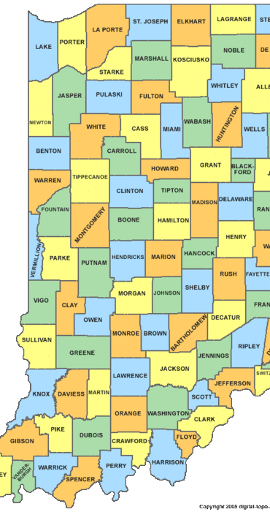

Overview of Indiana Law Relating to Pretrial Release

Slide 3
Why Bail? Defining the Issue. . .

Slide 4
Why Can’t We Just Lock Them Up?
We Can’t:
-There are about 26,000 jail beds in Indiana. Defendants held pretrial are held in jail, not prison
-There are about 200,000 criminal offenses filed each year, about 70-75,000 of which are felonies

Slide 5
Why Can’t We Just Lock Them Up?
2. We Shouldn’t:
-Indiana Const. Art. 1 Sec. 17:
“Offenses, other than murder or treason, shall be bailable by sufficient sureties.”
-United States Constitution, 8th Am. “Excessive bail shall not be required”
“In our society, liberty is the norm, and detention prior to trial or without trial is the carefully limited exception.” US v. Salerno, 481 U.S. 739 (1987)

Slide 6
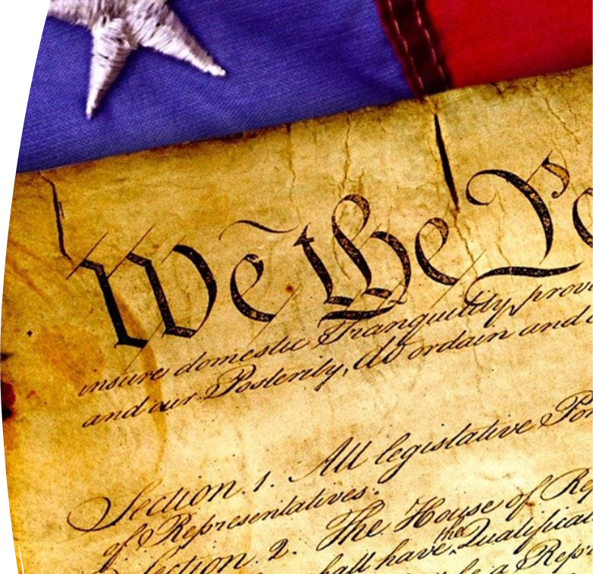
Presumption of Innocence
People on pretrial have not yet been convicted of a crime and are presumed to be innocent.
Absent a right to pretrial release, “the presumption of innocence… would lose its meaning.”
Stack v. Boyle, 342 U.S. 1 (1951)

Slide 7
Ind. Const., Art. 1, §17
Bailable and not bailable offenses
Section 17. Offenses, other than murder or treason, shall be bailable by sufficient sureties. Murder or treason shall not be bailable, when the proof is evident, or the presumption strong.

Slide 8
Why Not Cash Bail?
Not effective
Unfair
Unintended consequences
See Appr Research Summary “Financial Conditions of Release” advancingpretrial.org August 2024

Slide 9
IC 35-33-8
Bail and Bail Procedure

Slide 10
Rules of Criminal Procedure
Indiana Criminal Rule 2.6
If an arrestee does not present a substantial risk of flight or danger to themselves or others, the court should release the arrestee without money bail or surety subject to such restrictions and conditions as determined by the court except when:
The arrestee is charged with murder or treason.
The arrestee is on pre-trial release not related to the incident that is the basis for the present arrest.
The arrestee is on probation, parole or other community supervision.
https://www.in.gov/courts/rules/criminal/index.htm#_Toc152240485

Slide 11
Dewees v. State 180 N.E.3d 261 (Ind. 2022)
The Supreme Court held that clear and convincing evidence supported the trial court’s denial of defendant’s request for reduction of bail or conditional pretrial release.

Slide 12

Indiana Judges have a great deal of discretion when making decisions regarding pretrial release, but Indiana’s Constitution prohibits preventive detention.

Slide 13
Overview of Indiana Pretrial Certification Process
Indiana has adopted a “smart on crime” policy as it relates to pretrial release.
https://times.courts.in.gov/2019/12/20/smart-on-crime-stakeholders-attend-pretrial-summit/

Slide 14
Objectives of Evidence-Based Pretrial
Maximize Release
Maximize Court Appearance
Maximize Public Safety

Slide 15


Indiana judges are encouraged to distinguish between those defendants we are scared of and those we are mad at.
This or That

Slide 16
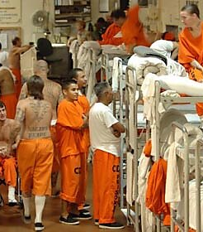
Jail Overcrowding Task Force
https://www.in.gov/courts/iocs/committees/jail-overcrowding/

Slide 17
Pretrial Release Committee
There are 43 pretrial agencies:
32 are certified and
11 are in the planning stage.
https://www.in.gov/courts/iocs/pretrial/committee/

Slide 18
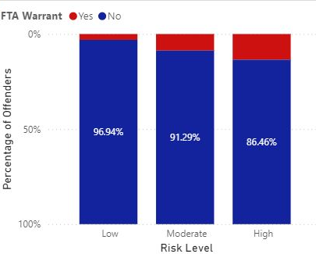
Court Appearance Rate
The percentage of released pretrial defendants who were assessed and who attended all scheduled pretrial court appearances.

Slide 19
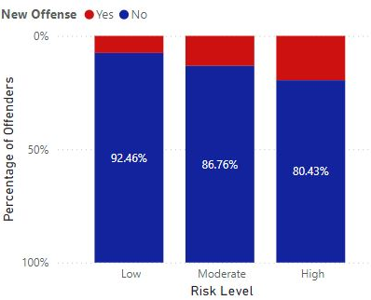
Public Safety Rate
The percentage of released pretrial defendants who were assessed and who are not charged with a new criminal offense that occurred during the pretrial stage.

Slide 20

Data Caveat
As this is a new program, and most of the pretrial agencies are newly formed, we are still working on standardizing data collection and making sure we collect complete and accurate data. As such, we are aware of some errors or omissions in the data and it should be viewed in that light.

Slide 21
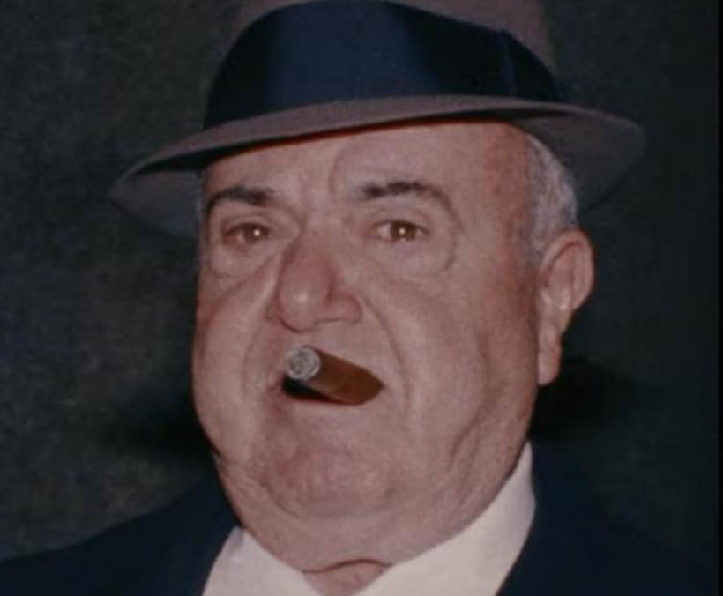
Overview of Bail Practices in Other Jurisdictions

Slide 22
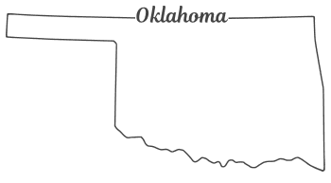
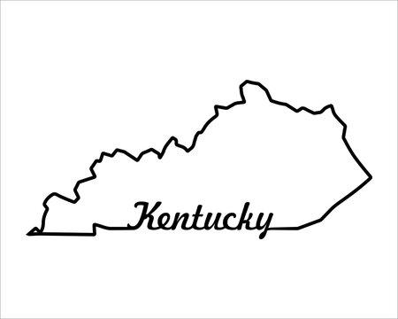
Bail Reform in Other States
Kentucky has been a leader in the pretrial field since 1976, when it banned commercial bail bonds. In 2013, Kentucky piloted an Administrative Pretrial Release Program in a handful of counties, which it then expanded statewide in 2017.
Following enactment of the federal Bail Reform Act of 1984, the state of Oklahoma amended its constitution, permitting denial of bail for certain violent offenses “on the grounds that no condition of release would assure the safety of the community or any person.”

Slide 23
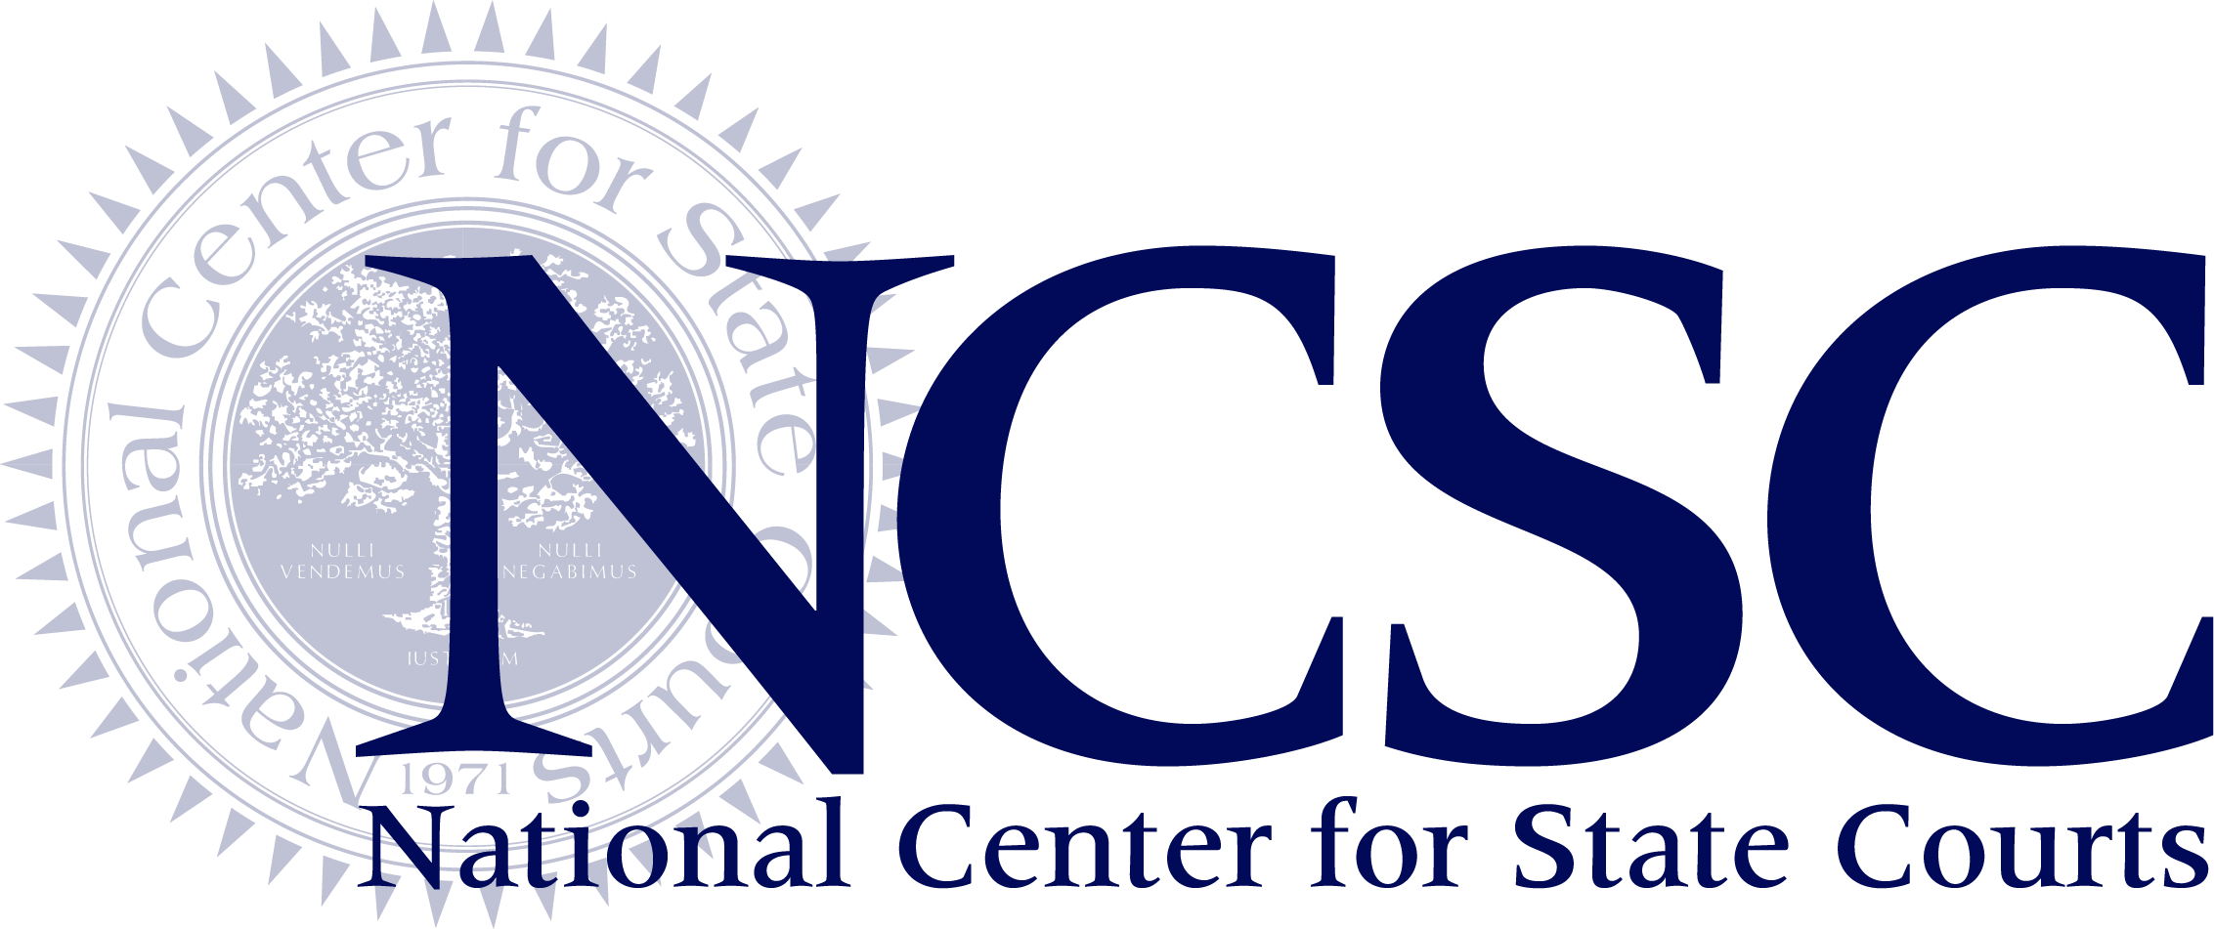
Pretrial Prevention Detention
White Paper
February 2020
https://www.ncsc.org/pjcc/topics/release-decisions/preventive-detention click on White Paper on Preventive Detention

Slide 24
Resources
Pretrial Practice manual https://www.in.gov/courts/iocs/files/pretrial-work-group-practices-manual.pdf
Indiana Constitution, Article 1, Section 17
Indiana Criminal Rule 2.6 https://www.in.gov/courts/rules/criminal/index.htm#_Toc152240485
Dewees v. State https://casetext.com/case/dewees-v-state-21
Court Times https://times.courts.in.gov/2019/12/20/smart-on-crime-stakeholders-attend-pretrial-summit/
Jail Overcrowding Task Force https://www.in.gov/courts/iocs/committees/jail-overcrowding/
Pretrial Release Committee https://www.in.gov/courts/iocs/pretrial/committee/
NCSC Pretrial Preventive Detention https://www.ncsc.org/pjcc/topics/release-decisions/preventive-detention (click on White Paper on Preventive Detention)

