Slide 2
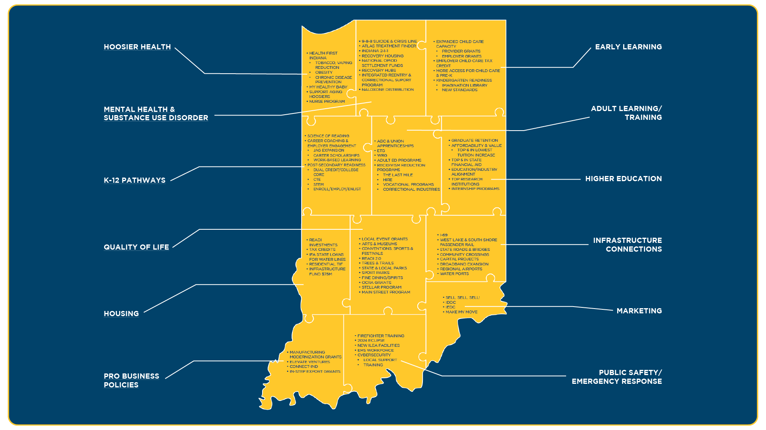

Slide 3
HOOSIER HEALTH
Health First Indiana
Pregnancy Programs
Nurse Family Partnership
PathWays for Aging at home
Lead testing
Smoking Cessation
Chronic disease prevention
Disability Services

Slide 4
Mental Health & Substance Use Disorder
9-8-8 suicide and Crisis Lifeline
Atlas online Treatment Finder
Indiana 2-1-1
Addiction Recovery Housing
National opioid settlement funds
Recovery hubs
Integrated reentry and correctional support program
Naloxone distribution

Slide 5
EARLY LEARNING
Expanded childcare capacity
Provider grants
Employer grants
More access to childcare and On My Way Pre-K
Kindergarten readiness
Imagination Library

Slide 6
K-12 EDUCATION
Literacy Resources
Career coaching and employer engagement
Jobs for America’s Graduates
High School Career scholarships & Work-based learning
Dual Credit/College Core
Career & Technical Education
STEM Curriculum
Enroll/employ/enlist
GPS Portal

Slide 7
ADULT LEARNING AND TRAINING
Next Level Jobs
Employer Training grant
Workforce Ready grant
Adult Ed programs
Recidivism reduction programs
The Last Mile
Hoosier Initiative for Reentry (HIRE)
Vocational programs
Correctional Industries
ABC and union apprenticeships

Slide 8
HIGHER EDUCATION
21st Century Scholars Program
Performance Funding Formula for graduate retention
Indiana Pre-Admissions Path to College
Employment Aid Readiness Network (EARN)

Slide 9
HOUSING
READI Investments
Low Income Housing Tax Credits
Residential TIF Zones
$75M Residential Housing Infrastructure Assistance Program

Slide 10
QUALITY OF LIFE
Amenities
READI 2.0
Next Level Trails
Plant 1 million trees
Arts and Museums
Conventions, Sports and Festivals
State and Local parks
Sport Parks
Fine Dining and Spirits
OCRA grants
Stellar program

Slide 11
INFRASTRUCTURE CONNECTIONS
I-69 corridor
West Lake and South Shore passenger rail
State roads and bridges
Local Community Crossings
Broadband expansion
Regional airports
Water ports

Slide 12
PRO BUSINESS ENVIRONMENT
Manufacturing Readiness Grants
Elevate Ventures
Entrepreneur ConnectIND Portal
Community Collaboration Fund for Entrepreneurs
In-Step Export Opportunities
Small Business Assistance

Slide 13
PUBLIC SAFETY/EMERGENCY RESPONSE
Firefighter Training Hubs
Indiana Law Enforcement Academy
State Police Labs
EMS workforce
Cybersecurity Hub

Slide 14
MARKETING
“Sell, sell, sell!”
Indiana Destination Development Corporation
Indiana Economic Development Corporation
Department of Natural Resources
MakeMyMove.com
allaroundindiana.com

Slide 15
2024 ADMINISTRATIVE & LEGISLATIVE INITIATIVES

Slide 16
EXPAND EARLY CHILDHOOD EDUCATION/CHILDCARE
“Access, Cost Quality”
Expand our childcare workforce to meet statewide childcare needs by
Adding early childcare training to be eligible for Next Level Jobs programs (WRG and ETG)
Changing rules to allow for 18+ caregivers to help with infants/toddlers at childcare facilities.
Streamlining licensing to allow teachers to seamlessly serve as substitute caregivers in childcare facilities.
Launch a comprehensive statewide study on early childhood educators’ compensation.
Provide automatic Child Care Development Fund and On My Way Pre-K to eligible childcare workers who are parents.

Slide 17
PROVIDE HOOSIER STUDENTS WITH FOUNDATIONAL SKILLS
Increase reading proficiency by simplifying and strengthening the state’s 3rd grade reading policy.
Give students the skills they need to meet modern workforce demands by requiring a computer science course to graduate from high school.
Establish annual transparency around non-curricular fees to deliver on our promise to parents.

Slide 18
INCREASE ACCESS TO HIGHER EDUCATION
Require all public universities to offer more 3-year degrees
Help more students obtain earned associate degrees from public universities

Slide 19
WORKFORCE
“Awareness & Access”
Grow Indiana’s workforce to fill the jobs of today and tomorrow
Dedicate Governor’s Workforce Cabinet funds to promoting awareness and access to Indiana’s NextLevel Jobs Programs via “One Stop to Start” campaign for employers and employees

Slide 20
MAKE IT EASIER FOR COMMUNITIES TO PREPARE AND RECOVER FROM DISASTERS
Make changes to the State Disaster Relief Fund to increase the maximum award for individual assistance, fund disaster mitigation, and simplify the public assistance program.

Slide 21
PUBLIC SAFETY
Create a task force to review bail reform efforts and their impact on public safety.

Slide 22
HEALTH
Create a comprehensive plan for the best way to support our aging across all sectors over the coming decade
Develop infrastructure to best coordinate delivery of services to high-acuity children

