Slide 1
Python Tips/Tricks Scripting Rest Service Downloads
Tom Laue
Citizens Energy Group

Slide 2
Overview

Slide 3
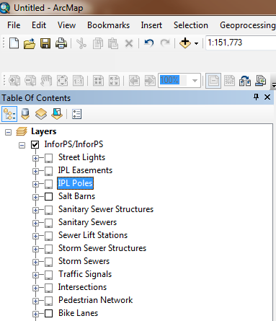
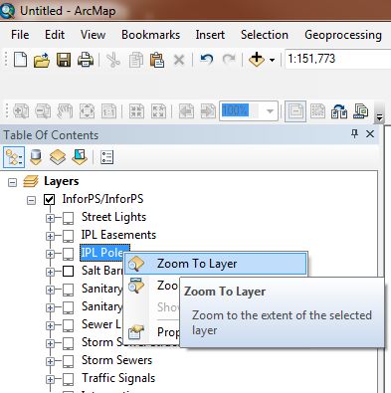
ArcMap: Can’t add individual rest services
Can’t add just one layer
No attributes
Notes:
Can’t symbolize features
Can’t query features
Can’t re-order this layer in our MXD

Slide 4
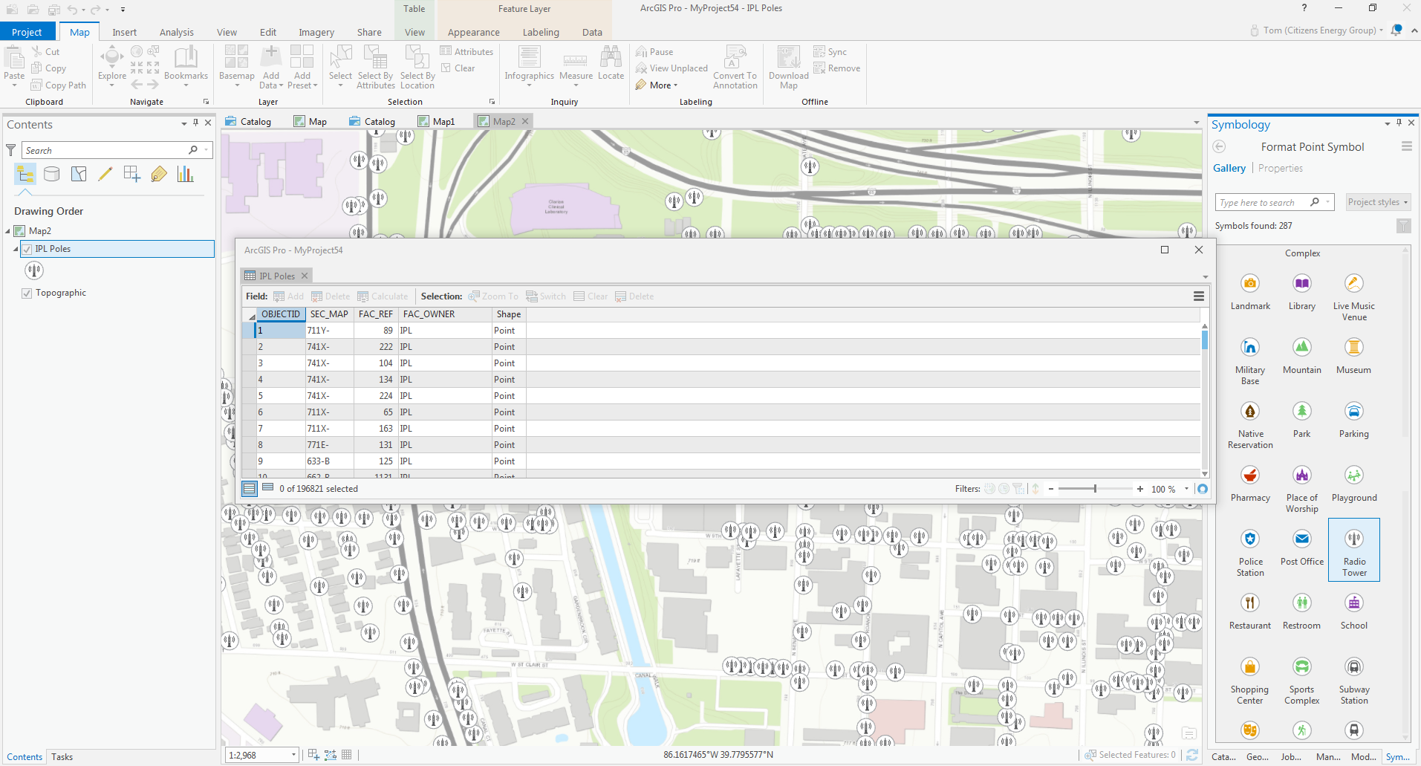
Services in Pro
Notes:
Pro allows us to add individual rest services
--query
--symbolize as we wish
But like many of you, we can’t upgrade yet to Pro so we’re forced to find ways to view rest service data but the way we want in ArcMap

Slide 5
Overview
Manual process to download landbase layers from the counties in our service area
Desired an automated method to update the landbase feature classes
Notes:
If we were all using ArcGIS Pro, we could simply add the REST service URLs to the maps and skip this whole process but we are still on the ESRI Utility Version 10.2.1

Slide 6
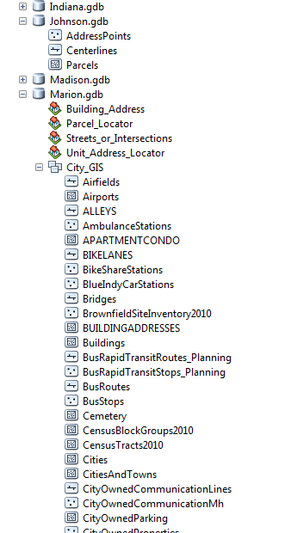
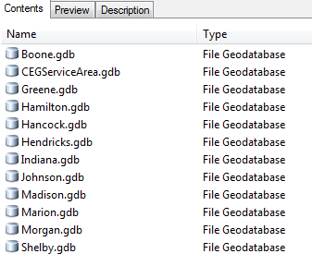
Databases
Notes:
Our main service area is Marion County and Westfield so the primary counties to download data are Marion, Hamilton and Johnson Counties
Some of these layers never change and never need to be re-downloaded, but layers like streets, parcels and DWP project layers need to be downloaded on a regular basis.

Slide 7



Download specifics
Hamilton County
6 feature classes
535,768 total features
Time: 33 mins
Johnson County
3 feature classes
138,002 total features
Time: 2 mins
Marion County
18 feature classes
2,275,929 total features
Time: 1 hr 45 mins

Slide 8
Exporting Rest Service URL to GDB
Notes:
I wanted to walk through the process if I was to do it by hand before showing how I approached it with a Python script

Slide 9
REST service links
Hamilton County
https://gis1.hamiltoncounty.in.gov/arcgis/rest/services
Johnson County
https://services2.arcgis.com/s5B7dXoVjGiD4IBE/ArcGIS/rest/services
Marion County
https://xmaps.indy.gov/arcgis/rest/services

Slide 10
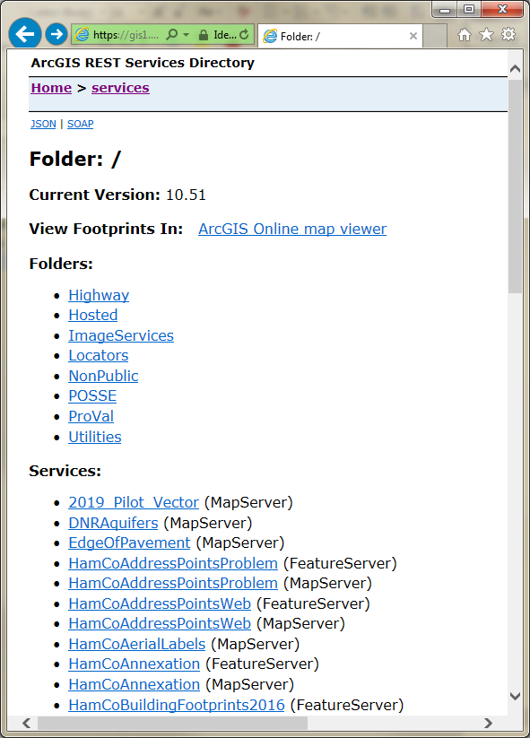
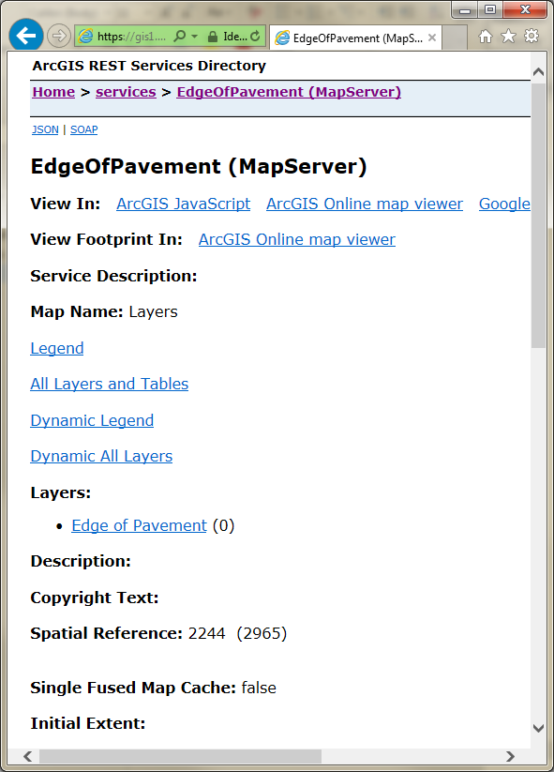

Slide 11
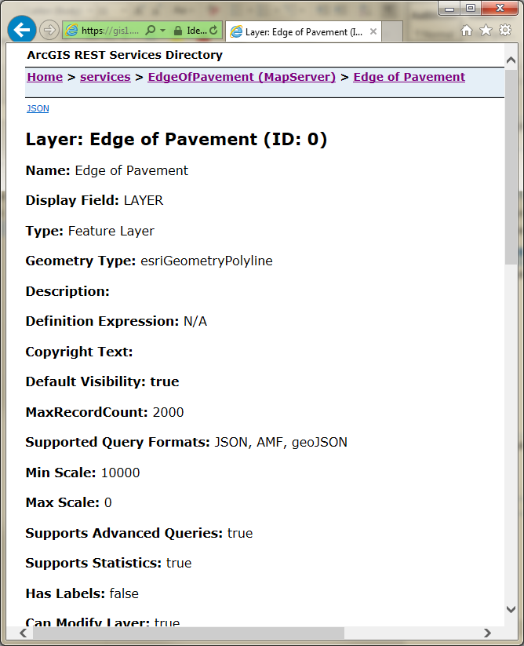
Copy the URL for this page:
https://gis1.hamiltoncounty.in.gov/arcgis/rest/services/EdgeOfPavement/MapServer/0

Slide 12
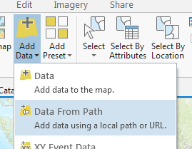
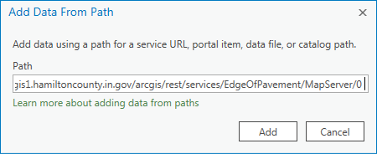
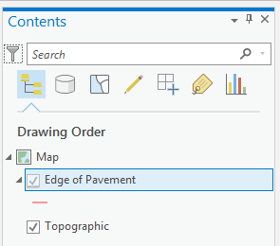
In ArcGIS Pro
Insert>New Map
Add Data>Data from Path
Paste in the URL

Slide 13
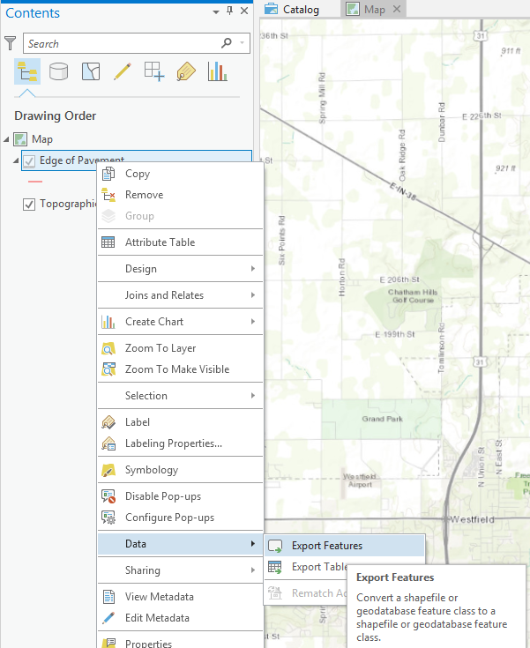
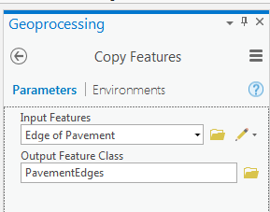
Export features in ArcGIS Pro
Notes:
It will usually run unless the file size is too big to download successfully.

Slide 14



Data Download flowchart
Production GDB
REST Service
Staging GDB
XCOPY
In ArcGIS Pro
Notes:
The Staging gdb has lock file 24 hrs a day so overwriting that data by most ESRI methods is impossible.
You can copy to Production via XCOPY in Python or a .bat batch file

Slide 15
Python Script

Slide 16
Script overview
Open Excel file and read the REST url and feature class name for exporting for each of the three counties
Verify the feature count of the REST URL matches the downloaded GDB feature class feature count
Copy the staging (downloaded) feature classes to the production geodatabase
Export “new” streets and parcels added since most recent GDB download
Email me any errors
Save script results to a .txt log file

Slide 17

Script Overview
Script downloads the three counties’ Rest Services
Does some error checking to make sure these steps were successful
Copy new streets and parcels to a separate feature class
Copy the downloaded features classes from the Staging to Production Geodatabase
Notes:
Ran with different functions.
so I can separately run the individual functions/portions if necessary

Slide 18
Export features in ArcGIS Pro
REST service URL
Output FeatureClass Name
Notes:
It will usually run unless the file size is too big to download successfully.

Slide 19
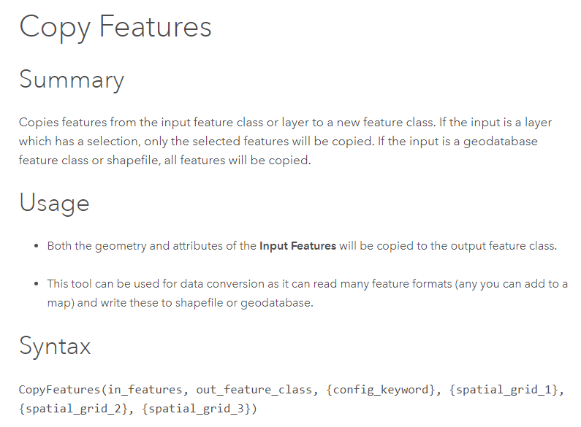
ArcGIS Pro CopyFeatures
Notes:
Two required parameters for the copy features tool: input features which is the REST url link and the output feature class

Slide 20
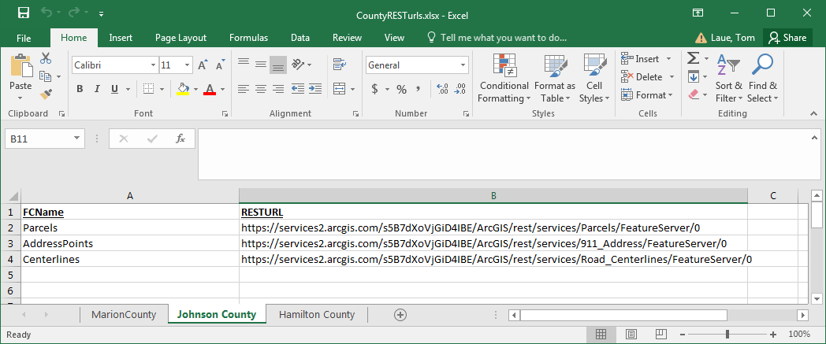
Excel file
Easier to update and read than hardcoding in Python
Notes:
I could have hardcoded these into the script but it’s easier to visualize and update in Excel rather than in Python code

Slide 21
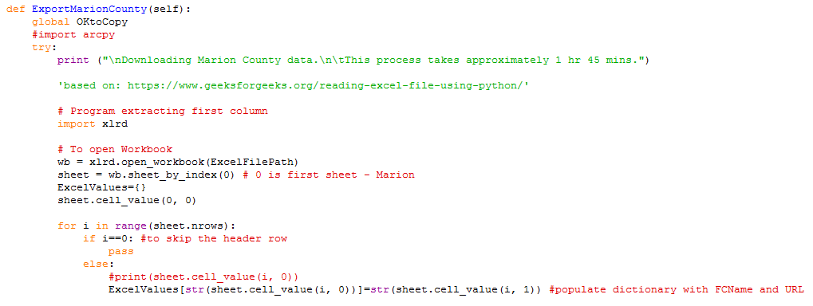
Excel file
Notes:
‘’’ https://www.geeksforgeeks.org/reading-excel-file-using-python/
def ExportMarionCounty(self):
global OKtoCopy
#import arcpy
try:
print ("\nDownloading Marion County data.\n\tThis process takes approximately 1 hr 45 mins.")
'based on: https://www.geeksforgeeks.org/reading-excel-file-using-python/'
# Program extracting first column
import xlrd
# To open Workbook
wb = xlrd.open_workbook(ExcelFilePath)
sheet = wb.sheet_by_index(0) # 0 is first sheet - Marion
ExcelValues={}
sheet.cell_value(0, 0)
for i in range(sheet.nrows):
if i==0: #to skip the header row
pass
else:
#print(sheet.cell_value(i, 0))
ExcelValues[str(sheet.cell_value(i, 0))]=str(sheet.cell_value(i, 1)) #populate dictionary with FCName and URL

Slide 22
Export using a For Loop:
For every row in the sheet, export the URL to the geodatabase
Note: this script must be run in Python 3x on a computer with ArcGIS Pro installed

Slide 23
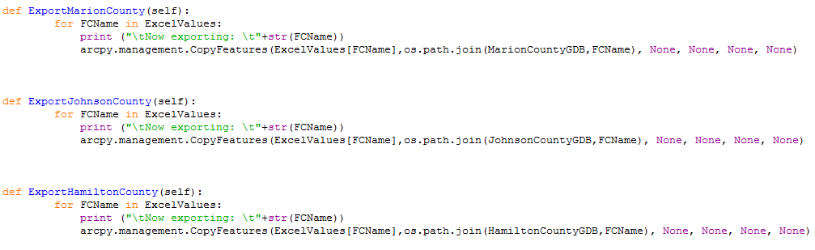

Simplified script

Slide 24
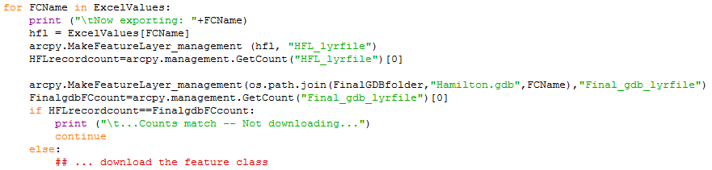
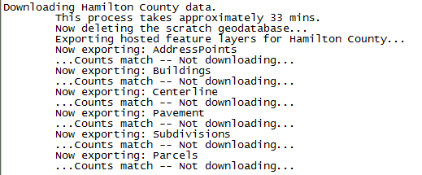
Compare counts before downloading
If the rest service and GDB counts are the same, you may wish to skip downloading.
Notes:
Attributes could change while the feature counts stay the same so you may not want to do this
arcpy.MakeFeatureLayer_management(os.path.join(FinalGDBfolder,"Hamilton.gdb",FCName),"Final_gdb_lyrfile")
FinalgdbFCcount=arcpy.management.GetCount("Final_gdb_lyrfile")[0]
if HFLrecordcount==FinalgdbFCcount:
print ("\t...Counts match -- Not downloading...")
continue
else:
DownloadAttempt=1
…download the

Slide 25
Finding New Streets and Parcels
If RestService Feature Count>GDB feature count:
Create List “NewList” of RestService UniqueIDs
Create List “OldList” of GDB Unique IDs
DifferentValues=set(NewList) - set(OldList)
if len(DifferentValues)>0:
CommaSeparatedNewIDs="'"+"','".join([str(x) for x in DifferentValues])+"'“
arcpy.MakeFeatureLayer_management (NewFC,"AddedFeatures",UniqueFieldName+ " IN ("+CommaSeparatedNewIDs+")")
arcpy.FeatureClassToFeatureClass_conversion ("AddedFeatures",NewFeaturesGDB,tempFC) arcpy.Append_management(tempFCpath,os.path.join(NewFeaturesGDB,FCName), "NO_TEST")
arcpy.Delete_management(tempFCpath)
Notes:
Figure out what your unique ID fields will be: parcel number, streetsegment ID
def ExportNewParcels_Streets(self):
## only run if count different
global OKtoCopy
if OKtoCopy is not False:
print ("\nIdentifying new parcels and streets -- exporting to geodatabase...")
wb = xlrd.open_workbook(ExcelFileDatabaseLocations)
sheet = wb.sheet_by_index(0) # 0 is first sheet
ExcelValues={}
sheet.cell_value(0, 0)
for i in range(sheet.nrows):
if i==0: #to skip the header row
pass
else:
#print(sheet.cell_value(i, 0))
ExcelValues[str(sheet.cell_value(i, 0))]=str(sheet.cell_value(i, 1))
#print (ExcelValues)
OldFC = str(sheet.cell_value(i, 0))
NewFC = str(sheet.cell_value(i, 1))
FCName = str(sheet.cell_value(i, 2))
UniqueFieldName = str(sheet.cell_value(i, 3))
FieldType = str(sheet.cell_value(i, 4))
#if feature count is the same, skip to the next feature class
arcpy.MakeFeatureLayer_management (OldFC, "OldFC_lyrfile")
OldFCCount=arcpy.management.GetCount("OldFC_lyrfile")
arcpy.MakeFeatureLayer_management (NewFC, "NewFC_lyrfile")
NewFCCount=arcpy.management.GetCount("NewFC_lyrfile")
if NewFCCount[0]>OldFCCount[0]:
OldList=[]
NewList=[]
with arcpy.da.SearchCursor(OldFC, UniqueFieldName) as search:
for row in search:
OldList.append(row[0])
with arcpy.da.SearchCursor(NewFC, UniqueFieldName) as search:
for row in search:
NewList.append(row[0])
print ("\tExporting "+FCName+"...")
DifferentValues=set(NewList) - set(OldList)
#format selection statement differently if the field is text or numeric
if str(' ') in DifferentValues:
DifferentValues.remove(' ')
if FieldType == "Numeric":
CommaSeparatedNewIDs=",".join([str(x) for x in DifferentValues])
if FieldType == "Text":
CommaSeparatedNewIDs="'"+"','".join([str(x) for x in DifferentValues])+"'"
if len(DifferentValues)>0: #only export if there are new features
arcpy.MakeFeatureLayer_management (NewFC,"AddedFeatures",UniqueFieldName+ " IN ("+CommaSeparatedNewIDs+")")
#make feature class in memory, add today's date
tempFC=FCName+"_temp"
tempFCpath=os.path.join(NewFeaturesGDB,tempFC)
arcpy.FeatureClassToFeatureClass_conversion ("AddedFeatures",NewFeaturesGDB,tempFC)
field = "DATE_ADDED"
arcpy.AddField_management(tempFCpath, field, "DATE")
with arcpy.da.UpdateCursor(tempFCpath, [field]) as rows:
for row in rows:
rows.updateRow([datetime.date.today()])
#change from export to append
arcpy.Append_management(tempFCpath,os.path.join(NewFeaturesGDB,FCName), "NO_TEST")
arcpy.Delete_management(tempFCpath)

Slide 26
Copying from Staging to Production GDB

Slide 27
Data Download flowchart
Production GDB
REST Service
Staging GDB
XCOPY
In ArcGIS Pro
Notes:
The Staging gdb has lock file 24 hrs a day so overwriting that data by most ESRI methods is impossible.
You can copy to Production via XCOPY in Python or a .bat batch file

Slide 28
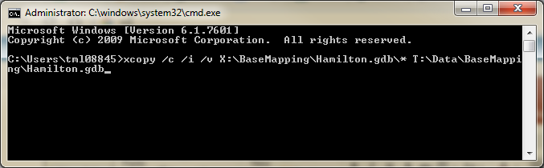
XCOPY
Copies all content from the source (X:/) to the destination (T:/)
We used XCOPY since it can overwrite a geodatabase while lock files are present
(see instructions in slide notes)
Notes:
Go to Windows start button
Type “cmd”
Copy and paste (right-click and choose page—CNTRL+V doesn’t work)
xcopy /c /i /v X:\BaseMapping\Hamilton.gdb\* T:\Data\BaseMapping\Hamilton.gdb
Note:
X:/ drive is staging gdb
T:/ drive is production gdb

Slide 29
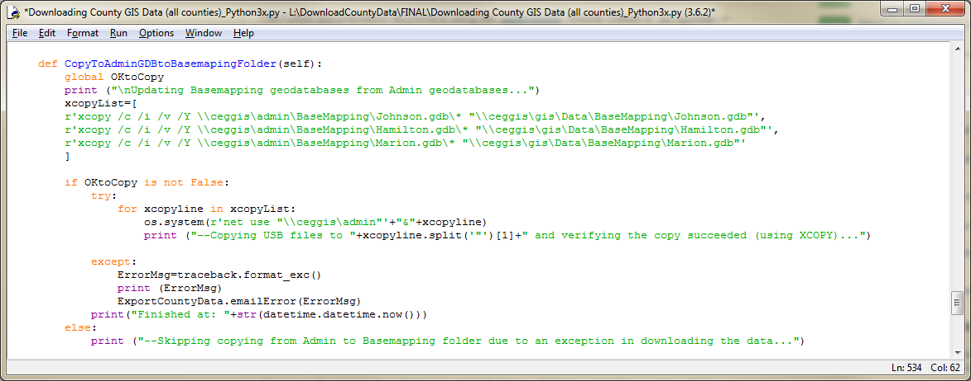
Running XCOPY in Python
Only runs if OKtoCopy is True (no errors found)
Notes:
def CopyToAdminGDBtoBasemapingFolder(self):
global OKtoCopy
print ("\nUpdating Basemapping geodatabases from Admin geodatabases...")
xcopyList=[
r'xcopy /c /i /v /Y \\ceggis\admin\BaseMapping\Johnson.gdb\* "\\ceggis\gis\Data\BaseMapping\Johnson.gdb"',
r'xcopy /c /i /v /Y \\ceggis\admin\BaseMapping\Hamilton.gdb\* "\\ceggis\gis\Data\BaseMapping\Hamilton.gdb"',
r'xcopy /c /i /v /Y \\ceggis\admin\BaseMapping\Marion.gdb\* "\\ceggis\gis\Data\BaseMapping\Marion.gdb"'
]
if OKtoCopy is not False:
try:
for xcopyline in xcopyList:
os.system(r'net use "\\ceggis\admin"'+"&"+xcopyline)
print ("--Copying USB files to "+xcopyline.split('"')[1]+" and verifying the copy succeeded (using XCOPY)...")
except:
ErrorMsg=traceback.format_exc()
print (ErrorMsg)
ExportCountyData.emailError(ErrorMsg)
print("Finished at: "+str(datetime.datetime.now()))
else:
print ("--Skipping copying from Admin to Basemapping folder due to an exception in downloading the data...")

Slide 30
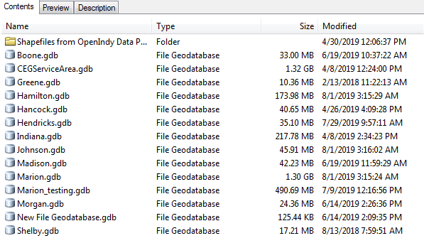
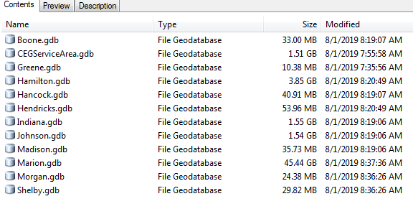
Geodatabase Bloating
Repetitively overwriting in a geodatabase leads to geodatabase bloating
Staging GDB
Production GDB

Slide 31
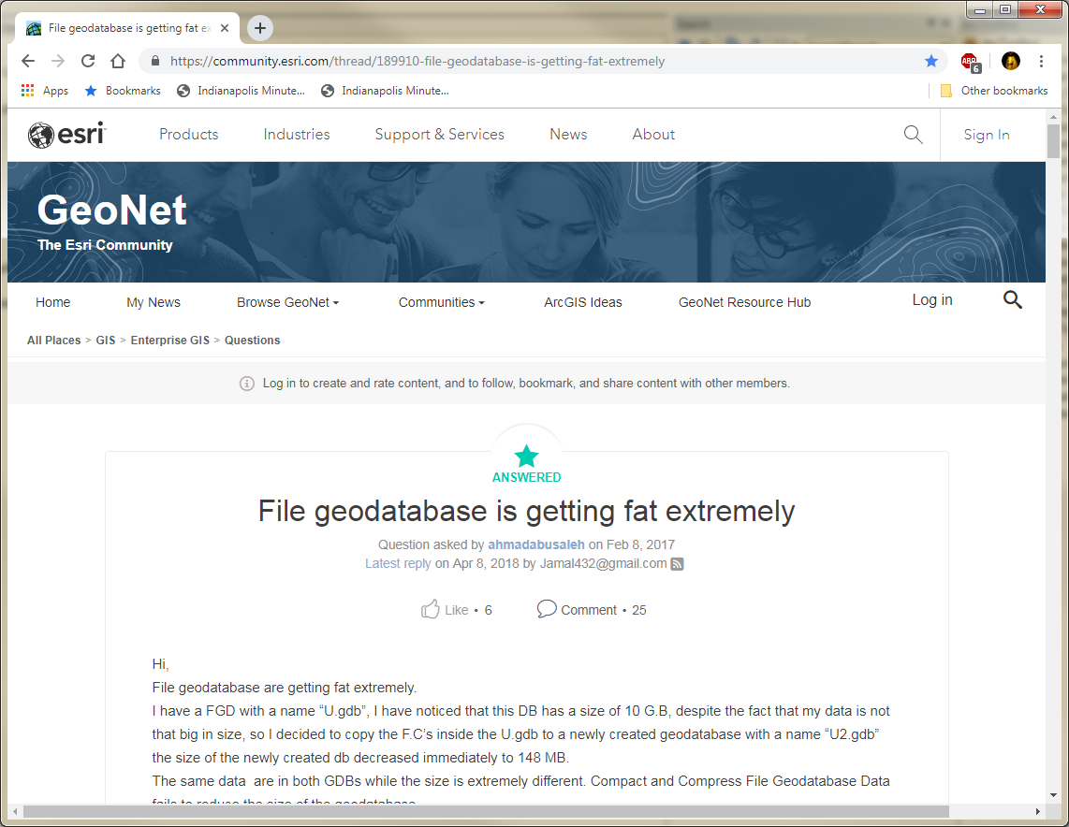
Geodatabase Bloating
Only solution is to delete the geodatabase, re-create it and re-import the feature classes
Notes:
Https://community.esri.com/thread/189910-file-geodatabase-is-getting-fat-extremely
Our geodatabase always has locks so deleting and recreating it isn’t possible

Slide 32
Other methods to copy data between feature classes
Feature Class to Feature Class
Truncate and Append the feature class
Copy tool
These all didn’t work because of geodatabase Locks

Slide 33
Scheduling the task

Slide 34
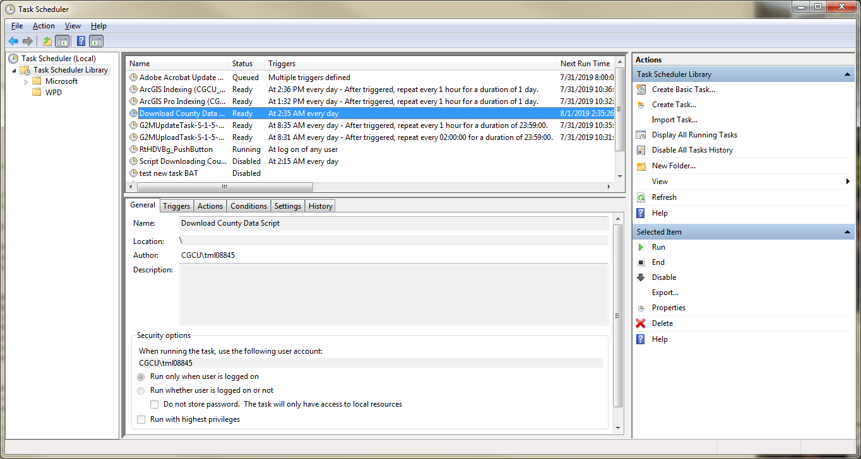
Task Scheduler
Notes:
Note: If the script is scheduled on your PC and your PC is off or offline, the script won’t run.

Slide 35
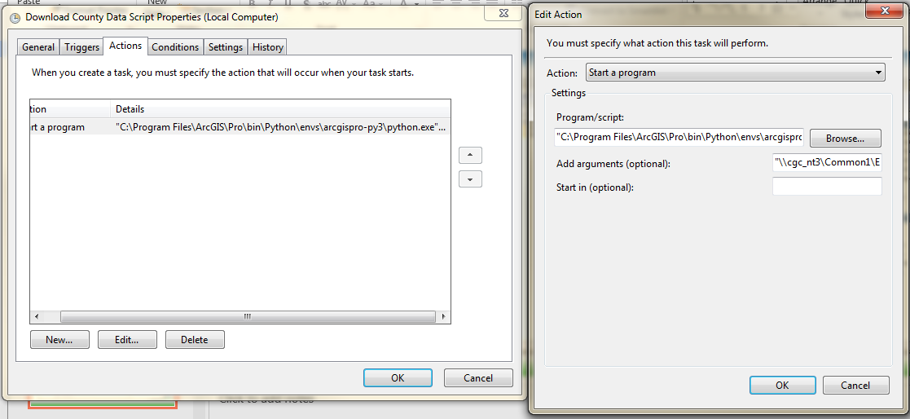
Task Scheduler – Run Script in Python 3
Program/Script: "C:\Program Files\ArcGIS\Pro\bin\Python\envs\arcgispro-py3\python.exe“
Add Arguments: "\\cgc_nt3\Common1\Engineering\ESRI\TML\DownloadCountyData\FINAL\Downloading County GIS Data (all counties)_Python3x.py"
Notes:
By default on my computer, Python files run in Python 2.7 which this script requires to be run in Python 3.x

Slide 36
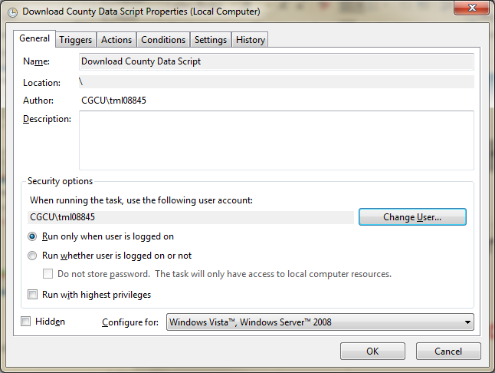
Task Scheduler Issues
Computer must be on and connected to the network
Windows Password updates break the scheduled task
Solution: recreate the scheduled task (or run with a login that doesn’t expire)
Notes:
I leave my computer locked overnight and it runs

Slide 37
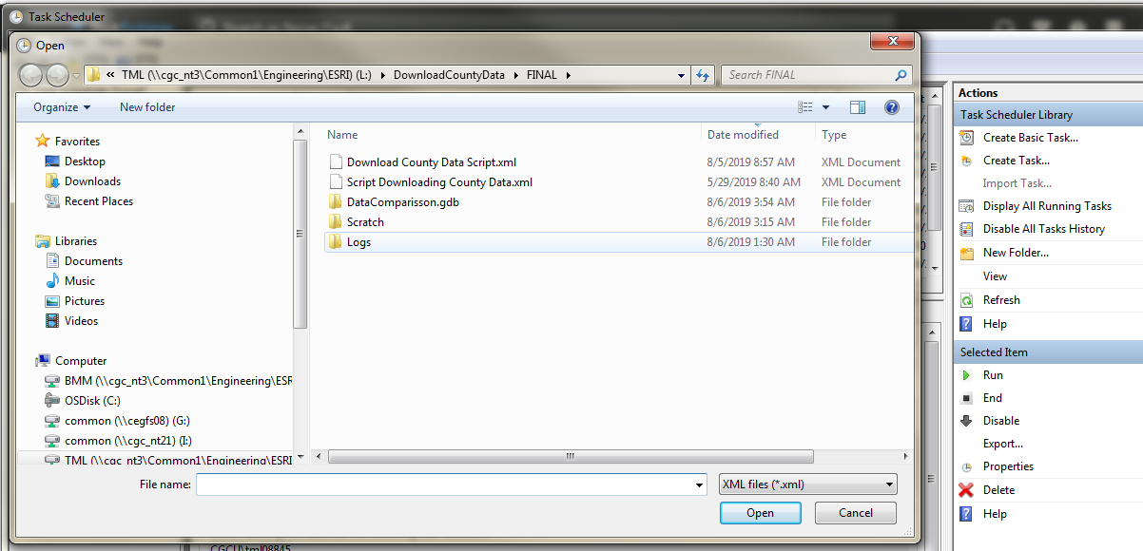
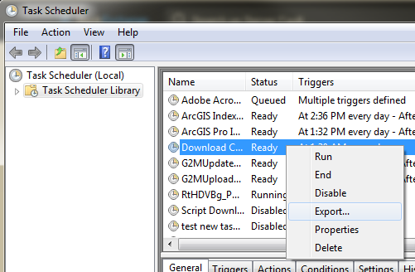
Task Scheduler – Importing Task
To save a task to another computer
Notes:
Export and import xml files
You can design and test the task on your computer, then export it to share it to the server or another computer.

Slide 38
Issues Encountered
Notes:
This script took a better part of two months dealing with numerous issues that came up

Slide 39
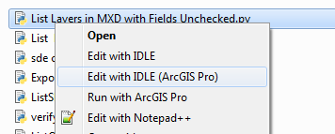
Multiple version of Python installed by ESRI
With ArcMap and Pro installed on a computer
Python 2.7 (from ArcMap)
Python 3.6 (from Pro)
Python 2 vs Python 3 scripts are not completely interchangeable
**ArcGIS Pro (specific) commands don’t run in Python 2.7**

Slide 40

Python 2 vs Python 3
There are also some differences in commands and syntax between Python 2.7 and Python 3 scripts.
Most but not all scripts written in Python 2.7 will run in Python 3
Print statement needs to be in parenthesis!
More info: https://pro.arcgis.com/en/pro-app/arcpy/get-started/python-migration-for-arcgis-pro.htm

Slide 41
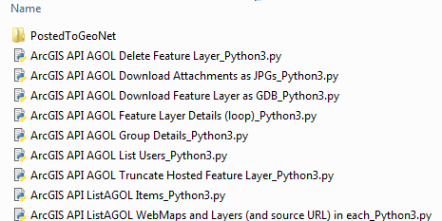
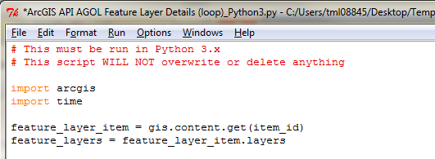
Multiple version of Python installed by ESRI
I’ve been naming scripts specifically if they are to be run in Python3 only

Slide 42
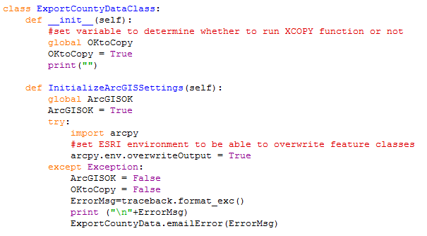
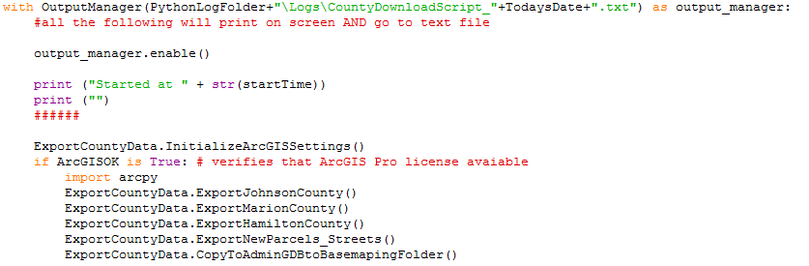
ArcGIS Pro license needed
Script must be run on a computer/server with Pro installed
If Pro is not logged in, the script will fail
Beginning of script
End of script
Notes:
class ExportCountyDataClass:
def __init__(self):
#set variable to determine whether to run XCOPY function or not
global OKtoCopy
OKtoCopy = True
print("")
def InitializeArcGISSettings(self):
global ArcGISOK
ArcGISOK = True
try:
import arcpy
#set ESRI environment to be able to overwrite feature classes
arcpy.env.overwriteOutput = True
except Exception:
ArcGISOK = False
OKtoCopy = False
ErrorMsg=traceback.format_exc()
print ("\n"+ErrorMsg)
ExportCountyData.emailError(ErrorMsg)
with OutputManager(PythonLogFolder+"\Logs\CountyDownloadScript_"+TodaysDate+".txt") as output_manager:
#all the following will print on screen AND go to text file
output_manager.enable()
print ("Started at " + str(startTime))
print ("")
######
ExportCountyData.InitializeArcGISSettings()
if ArcGISOK is True: # verifies that ArcGIS Pro license avaiable
import arcpy
ExportCountyData.ExportJohnsonCounty()
ExportCountyData.ExportMarionCounty()
ExportCountyData.ExportHamiltonCounty()
ExportCountyData.ExportNewParcels_Streets()
ExportCountyData.CopyToAdminGDBtoBasemapingFolder()

Slide 43
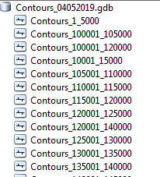
Download a service in pieces
Some REST services with thousands of features cannot always be downloaded using arcpy.CopyFeatures
Solution:
Download in pieces (ex. 5,000 at a time)
Append feature classes back together in scratch GDB
Hamilton County
FeatureClass | Count
AddressPoints | 141,478
Buildings | 148,417
Centerline | 20,513
Pavement | 89,931
Subdivisions | 1,853
Parcels | 133,561
Notes:
I tried this method to download a contour REST service with 2 million records but it would time out after 1 hr

Slide 44
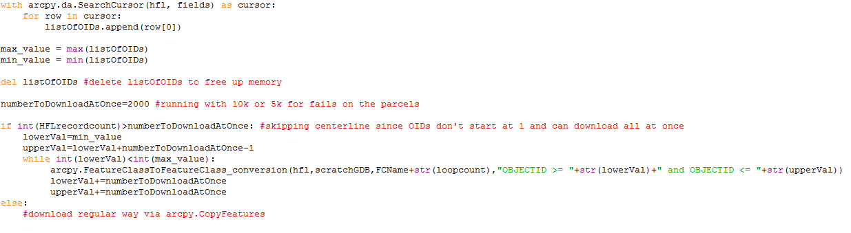
Downloading Large Layers
Get list of Object IDs
Get max and min Object IDs
Set number to download at once
If FeatureCount<Number to Download at once, download all features conventionally
Notes:
The smaller the numberTODownloadAtOnce, the longer the script takes
with arcpy.da.SearchCursor(hfl, fields) as cursor:
for row in cursor:
listOfOIDs.append(row[0])
max_value = max(listOfOIDs)
min_value = min(listOfOIDs)
del listOfOIDs #delete listOfOIDs to free up memory
numberToDownloadAtOnce=2000 #running with 10k or 5k for fails on the parcels
if int(HFLrecordcount)>numberToDownloadAtOnce: #skipping centerline since OIDs don't start at 1 and can download all at once
lowerVal=min_value
upperVal=lowerVal+numberToDownloadAtOnce-1
while int(lowerVal)<int(max_value):
arcpy.FeatureClassToFeatureClass_conversion(hfl,scratchGDB,FCName+str(loopcount),"OBJECTID >= "+str(lowerVal)+" and OBJECTID <= "+str(upperVal))
lowerVal+=numberToDownloadAtOnce
upperVal+=numberToDownloadAtOnce
else:
#download regular way via arcpy.CopyFeatures

Slide 45
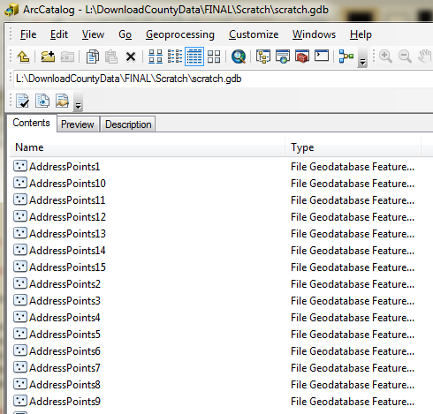
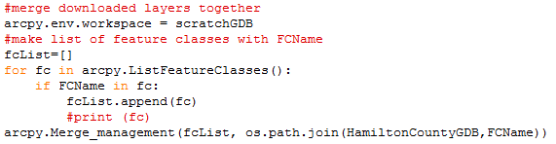
Downloading Large Layers
Create list of FCs to merge
Use arcpy.Merge_management to merge the features classes together
Notes:
#merge downloaded layers together
arcpy.env.workspace = scratchGDB
#make list of feature classes with FCName
fcList=[]
for fc in arcpy.ListFeatureClasses():
if FCName in fc:
fcList.append(fc)
#print (fc)
arcpy.Merge_management(fcList, os.path.join(HamiltonCountyGDB,FCName))

Slide 46
Error checking
Notes:
First purpose is to catch errors and prevent updating the Production GDB with incomplete data
Second is to notify me of the error so I can diagnose what happened and see if I can prevent that issue in the future

Slide 47
Errors checking
Errors I check for:
Downloaded feature count <> rest service feature count
Rest Service has no features (FeatureCount=0)
Script reports that the rest service doesn’t exist
Schema Lock on my GDB

Slide 48
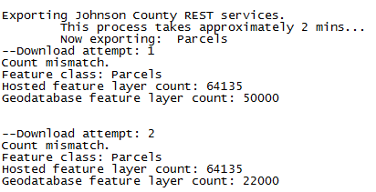
Verify Feature Counts
arcpy.CopyFeatures_management will complete, but no guarantee it downloaded all the features
Solution: arcpy.GetCount on both the rest service and gdb download to make sure all features downloaded

Slide 49
Verify Feature Counts
for FCName in ExcelValues:
#getcount on hosted layer
arcpy.MakeFeatureLayer_management (ExcelValues[FCName], "HFL_lyrfile")
HFLrecordcount=arcpy.management.GetCount("HFL_lyrfile")
arcpy.management.CopyFeatures(ExcelValues[FCName],os.path.join(JohnsonCountyGDB,FCName))
#getcount of gdb feature class downloaded
arcpy.MakeFeatureLayer_management(os.path.join(JohnsonCountyGDB,FCName),"gdb_lyrfile")
gdbFCcount=arcpy.management.GetCount("gdb_lyrfile")
if HFLrecordcount[0]!=gdbFCcount[0]: #compare hosted layer to downloaded feature counts
OKtoCopy = False
ErrorMsg="Download error--Count mismatch.\nFeature class: "+FCName+"\nHosted feature layer count: "+HFLrecordcount[0]+"\nGeodatabase feature layer count: "+gdbFCcount[0]+"\n\n"
ErrorMsg+=traceback.format_exc()
ExportCountyData.emailError(ErrorMsg)
Notes:
OKtoCopy controls if the portion that copies from staging to

Slide 50
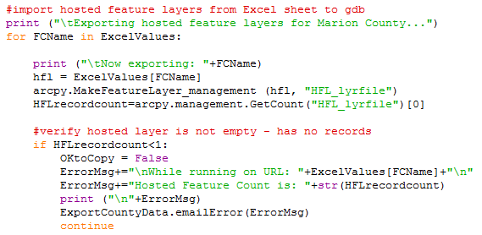
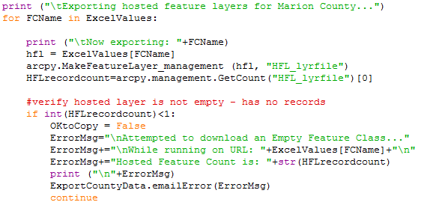
Verify REST service is not empty
If a layer is empty (which it shouldn’t be), you want to skip downloading it and email an error
Notes:
for FCName in ExcelValues:
print ("\tNow exporting: "+FCName)
hfl = ExcelValues[FCName]
arcpy.MakeFeatureLayer_management (hfl, "HFL_lyrfile")
HFLrecordcount=arcpy.management.GetCount("HFL_lyrfile")[0]
#verify hosted layer is not empty - has no records
if HFLrecordcount<1:
OKtoCopy = False
ErrorMsg+="\nWhile running on URL: "+ExcelValues[FCName]+"\n"
ErrorMsg+="Hosted Feature Count is: "+str(HFLrecordcount)
print ("\n"+ErrorMsg)
ExportCountyData.emailError(ErrorMsg)
continue

Slide 51
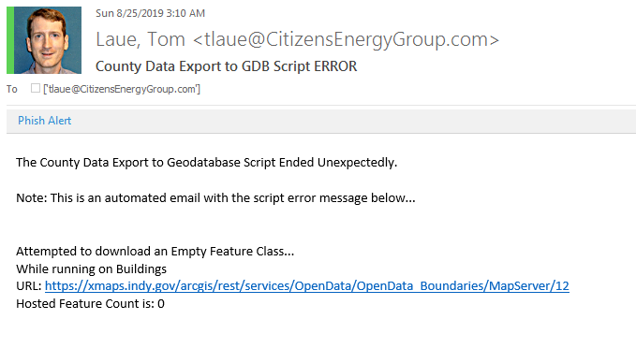
Verify REST service is not empty

Slide 52
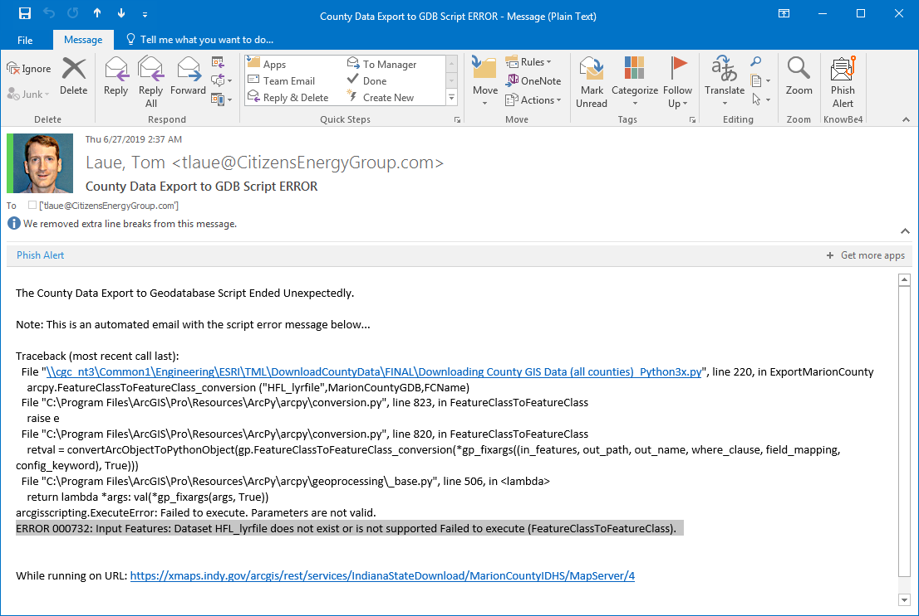
ERROR 000732: Input Features: Dataset does not Exist
Notes:
I don’t know what causes this error as after I get this error, I can access the layer just fine in ArcGIS Pro

Slide 53
ERROR 999999 and ERROR: code:503
arcgisscripting.ExecuteError: ERROR 999999: Error executing function.
The application is not licensed to create or modify schema for this type of data
ERROR: code:503, An error occurred., Service Unavailable.
Failed to execute (CopyFeatures).
Notes:
I don’t know the cause of or solution to this error
May be our IT mistakenly blocking external access?

Slide 54
ERROR: code:500
ERROR: code:500, Could not initialize class com.esri.arcgis.discovery.security.manager.WebSecurityManager, Internal server error. Failed to execute (FeatureClassToFeatureClass).
Notes:
Seems to be an error either with the external data not being available or an internal IT error with my access to the data

Slide 55
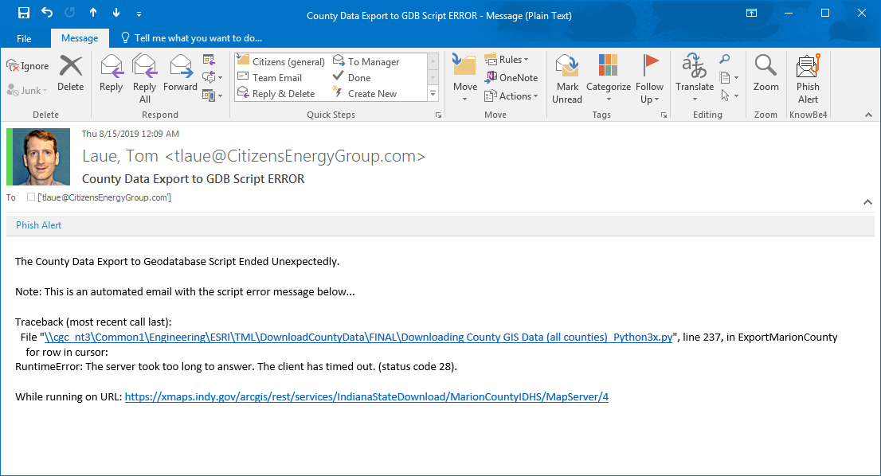
RuntimeError: server took too long to answer

Slide 56
Time the script runs is important
Try running the script at various times overnight if it is randomly failing:
Your IT may have processes which interfere with your script
External data may be down overnight causing your data download script to fail

Slide 57
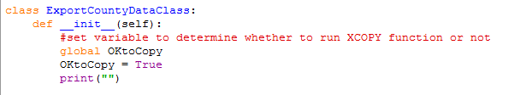
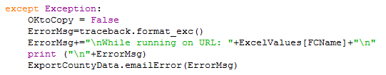
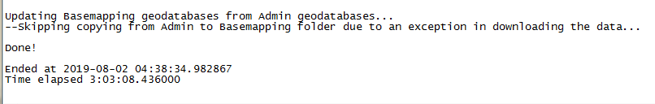
Production GDB only updated if no errors
Only copy from Staging GDB to Production GDB if no errors encountered
REST Service
Staging GDB
Production GDB
X
Notes:
If any layers fail to download or download and the feature counts don’t match, it won’t copy the Staging data to the Production geodatabase

Slide 58
Python suggestions

Slide 59
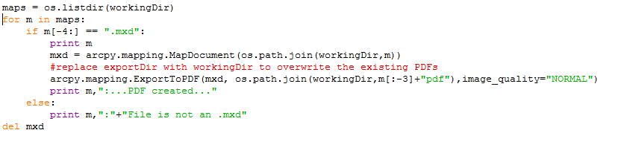
Use Print Statements!
To figure out where a script is failing…use print statements
Value stored in a variable
Is the variable a text or numeric variable?
Time a step took
FilePath the parameter is pointing to
Notes:
Variable:
Is it stored as a string or number
What value is stored in it—did the value get overwritten

Slide 60
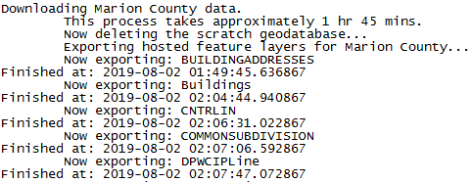

Using Print Statements
Time Completed
Time Elapsed
Notes:
When scripts are running, it’s nice to know while testing what values each variable has that that point.
Nice to know how long various steps took to run.
--Especially if you want to speed up a script and see what steps could be streamlined.

Slide 61
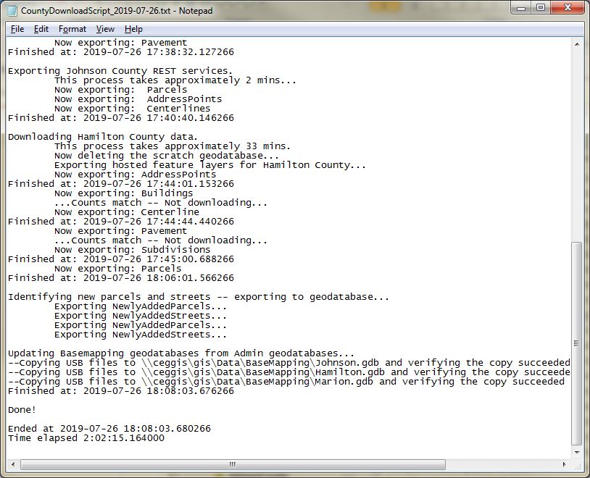
Logging to txt file
Log file stores every print statement Python makes running the script
Notes:
Has anybody ever closed the script results and then instantly wished they hadn’t because you wanted to review something in it but it’s already closed?
If you don’t get an error email you assume the script ran successfully, but to verify it did run, you can review the log file.

Slide 62

Logging to txt file
Notes:
Each night I have a log file to look back on:
-I can review to see when an error first started occurring
-Track down an error to a computer upgrade or other change
Note: if you run the script a second time in the same day, the log gets overwritten

Slide 63

Logging to text file
I used this methodology from stackoverflow
Notes:
https://stackoverflow.com/questions/50378970/write-results-to-file-using-the-least-amount-of-code?noredirect=1&lq=1

Slide 64

Logging to txt file
Everything I run and call is within the OutputManager with statement
Print statements will display on screen and in the log!
Notes:
This will print the statements on the screen as well as save the print statements between output_manager.enable() and output_manager.disable() to the text file

Slide 65

Emailing Errors
When errors or exceptions occur, I receive an email detailing the error message
Notes:
def emailError(self,error):
print ("Error message being prepared...")
import string
import smtplib
HOST = "mail.yourcompany.com" # ask IT for your host URL
PORT = 99 # ask IT for your port number
FROM = "\“Last, First\" <you@Email.com>"
TO = [“youraddress@Email.com"]
SUBJECT = "County Data Export to GDB Script ERROR"
BODY = "The County Data Export to Geodatabase Script Ended Unexpectedly.\n\n"
BODY += "Note: This is an automated email with the script error message below..."+ "\n\n"
BODY += str(error) + "\n\n"
body = "\r\n".join((
"From: %s" % FROM,
"To: %s" % TO,
"Subject: %s" % SUBJECT,
"",
BODY))
smtpserver = smtplib.SMTP(HOST,PORT)
smtpserver.ehlo()
smtpserver.sendmail(FROM, TO, body)
smtpserver.quit()

Slide 66


Emailing Errors
When errors and/or exceptions are encountered in the script, it calls the emailError function
Notes:
I only have it emailing me when it fails. Currently, I don’t get notified when it completes or when it fails to run (I check the log file for that).

Slide 67


Slide 68

Script Backups
Before making significant changes, I make script backups so I can revert (if necessary)

Slide 69

Table issues? – Convert to geodatabase table
Whenever I have issues querying, joining, etc a table, I create a geodatabase table or in_memory table
Notes:
Joining csv files, excel files, dbf fields just doesn’t always work correctly

Slide 70
Comment in script if it will delete data
I try to always identify in a script if it will delete/rename/modify data

Slide 71


User input before deletion
In scripts which delete or truncate features, you may want the user’s permission before proceeding
Notes:
#print the name of the feature to be deleted
print ("This script will truncate: \n\t"+str(flayer.properties.name)+"\t("+str(flayer.properties.type)+")\n")
#requires and input from user. Saves value in the variable varyear
deleteanswer = input("Please type y to continue or n to not delete the data in that "+str(flayer.properties.type)+": ")
#verifies with user that they do infact want to delete the files
if deleteanswer=='y' or deleteanswer=='Y':
flayer.manager.truncate() #truncates (deletes) all features in the feature class
print ("\n"+str(flayer.properties.name)+" successfully truncated.\n")
else:
print ("\n"+str(flayer.properties.name)+" was NOT truncated.\n")

Slide 72


Arcpy.Exists()
Verify that a feature class, mxd, etc exists
Helps in troubleshooting to determine if your filename/path variable is correct

Slide 73
Various ArcPy uses
Find unused Domain values
Find invalid values in a domained field
Delete Fields
List layers in an MXD, including:
Label expression, Def Query, Max/min scale range
Export symbology in MXD layers as .lyr files
Or import symoblogy from .lyr files
Import KML files to GDB
Open a file in it’s native program (ex. a PDF)
Modify layout elements in MXD
Notes:
The last one, you could have someone click a button to run GIS analysis and a report PDF is built and automatically opened for them to examine

Slide 74
Various ArcGIS API for Python
arcgis.gis module
Get details about your ArcGIS Online Account, including:
Lists
List AGOL Items and Details
List AGOL Groups and Details (content and members)
List AGOL Users (and their content)
List AGOL WebMaps and Layers in each
Layer actions:
Delete or Truncate Hosted Feature Layer
Download Attachments as JPGs
Download Feature Layer to GDB feature class

Slide 75
Non-GIS uses for Python
Download zipped files from FTP site
Zip or unzip files
Read from Excel files
Modify PDF files (ex. add bookmarks)
List of files in a folder
Delete, rename, copy files
Verify that a file or website exists (verify hyperlink path)
Send automated emails
Notes:
There are numerous functions of Python outside of ESRI are likely to be useful to your workflows
I have scripts that do these things if you want to contact me in the future I can send you the script.

Slide 76
ArcPy Resources

Slide 77

Your own scripts
I constantly pull pieces out of old scripts
Notes:
I also use scripts or script syntax other people have written to start from

Slide 78


Resources – ESRI Help
Each tool includes Python tool parameters and examples
Notes:
Look for the examples at the bottom of every help page

Slide 79

Resources - GIS.StackExchange.com
Notes:
Many people have asked and solved the same questions I’m running into

Slide 80

Resources – StackOverflow.com
Python related questions

Slide 81

Resources - GeoNet

Slide 82

Geoprocessing Results
Run a process in ArcMap
View the Geoprocessing Result and save as Python snippet
Notes:
This is especially useful for something where a projection file is needed and it’s hard to know how to script it.

Slide 83

DiffChecker.com
Compare old version of script syntax to new version to see differences

Slide 84

Final Tips
Don’t run any scripts on live data til you know that the process works
Comment your scripts
Some things are outside your control
Firewall issues
External data inaccessible
Windows updates breaking scripts
Notes:
I joked when I left my old job I would run a script that would delete any files with extensions: .gdb, .mxd and .py
--During production, Toy Story 2 almost got deleted off the server when a delete batch file started deleting all their finished video files
Just because a simple ESRI step should work doesn’t mean it actually will work
Know what you’re doing, but also have data backed up just incase
Backup old versions of scripts too just incase you royally mess something up, you have a fallback point.
-script with date in filename DownloadScript_06072019.py
Comments help you or the next person to use the script to understand what steps are doing.
--Please do this especially if you intend to share your script with anyone
----It’s very hard to understand a complex script someone else has written, even if it is commented well
There are some things you can’t control, but you can run catch them.
--ex. External data source is down—I can’t fix that but I can tell from the script log that happened

Slide 85
Contact me
Tom Laue GIS Analyst Citizens Energy Group phone: 317-927-5417 tlaue@citizensenergygroup.com
“Overcoming ESRI obstacles since 2004”
Notes:
If you have questions or ideas for improvement, let me know.
If I had a cute quote in my email footer it would be…
I say that kinda jokingly but also seriously….
I love working in GIS because we’re always finding new solutions to issues we face. Often the straightforward path doesn’t work as planned.
I’ve benefited so much from people sharing their tips and advice on online forums
--I encourage you to share what you’ve learned to your co-workers, to forums questions, and at conferences like this.
To me, the greatest compliment would be that something I share with someone saves them an afternoon or a week’s worth of work.

