Slide 1

If you don’t know where you’re going, you won’t know when you get there
FSSA All Staff Address 2019

Slide 2

Your 2018 Successes
Small brag:
Doubled the number of competitive grants awarded in 2018
#1 in nation for digital government in health and human services
Notes:
• Awarded 7 new grants over the last two years for over $72M:
– DMHA (3) - $63.8M
• CURES Grant: 2 year $10.9M annually
• State Opioid Response (SOR) grant: 2 year $18.1M annually
• COAP Grant: 3 year grant $5.8M over life of grant
– DDRS (1) - $392k
• Indiana Living Will Grant: 5 year grant $392k annually
– Aging (1) - $1.17M
• No Wrong Door Grant: 2 year grant $586k annually
– DFR (1) - $134K
• SNAP Integrity Grant: 1 year grant $134k
– OECOSL (1) - $6.9M
• Preschool Development Grant: 1 year grant $6.9M

Slide 3
2018 Successes
Community health worker integration
21st Century Cures Grant
OTP expansion
HIP renewal/Substance Use Disorder Waiver
Expanded On My Way Pre-K to 20 counties
OpenBeds/2-1-1 program
First statewide judicial MAT conference

Slide 4
2018 Successes (cont’d)
Home- & Community-Based Services waiver amendment for direct service professional wages
Implementation of LifeCourse framework innovation in case management
APS 211 24-hour call center
Leadership development program: Natural Born Pilots
Open Source Medicaid data hub
DOC Medicaid enrollment
Notes:
FSSA is committed to serving those with intellectual and developmental disabilities, and is focused on serving more members in the community. The reimbursement rates for ID/DD providers were increased by 5% in 2017, with 75% of this increase mandated to go towards increasing the wages of direct care staff. This is a total fiscal impact of $20 million in 2018. But more importantly, FSSA started the process this fall to take a holistic review of all of our waivers to ensure we are providing the right care, at the right time, in the right place, and a comprehensive analysis of reimbursement rates will be a component of that review.
As part of the CMS’ Home and Community Based Setting Rule, DDRS utilized the LifeCourse Framework to enhance person-centered planning for individuals with intellectual and developmental disabilities and their families. DDRS received national recognition for its innovative approach in reshaping service plans to be inclusive of all aspects of a person’s life, consider their vision of a good life and promote greater opportunities to be part of their communities.

Slide 5

Mission, Vision & Values Regroup

Slide 6
Existing FSSA Vision Statement
To become a high performance, integrated and interdependent agency, leveraging its resources across the continuum of services we provide in order to reliably and consistently serve our customers while acting as astute stewards of the state and federal money provided to us.

Slide 7
Draft Vision Statement
All Hoosiers live in fully engaged communities and reach their greatest emotional, mental and physical well-being.

Slide 8
Organizational Core Values
Excellence: To execute operational programming that is consistent and reliable, with ongoing outcomes evaluation.
Integrity: To establish the highest level of trust both internally and externally through honest, transparent and accountable interactions and communications.
Innovation: To encourage bold approaches to problem solving, allowing for failure, embracing change and inspiring creative solutions.

Slide 9
Organizational Core Values (Cont’d)
Compassion: To be present in the moment, exemplifying kindness and empathy.
Resilience: To withstand and recalibrate when faced with adversity.
Purpose: To take action driven by mission, goals and outcomes.
Inclusion: To listen while recognizing biases and offering a willingness to understand and accept everyone’s diverse cultures, perspectives and ideas.

Slide 10
Existing FSSA Mission Statement
To develop, finance and compassionately administer programs to provide health care and other social services to Hoosiers in need in order to enable them to achieve healthy, self-sufficient and productive lives.

Slide 11
Draft Mission Statement
To compassionately serve Hoosiers of all ages and connect them with social services, health care and their communities.

Slide 12
Feedback needed! Please send your thoughts, questions, suggestions to:
SecOffice.FSSA@fssa.in.gov

Slide 13

2019 Agency Priorities

Slide 14
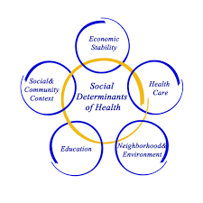
Office of Healthy Opportunities
Because good health begins where we live, learn, work and play.
Notes:
HIP was a good start, but it’s not enough. It’s a play on words – it started as an insurance plan. But, what if building a Healthy Indiana was the PLAN?
Did you know that despite every health care innovation of the last two decades, we haven’t made a dent in food security since the recession? And that those with food insecurity are the the majority of the high cost members of Medicaid programs? It’s all connected and we can’t nourish souls until we nourish bodies.
We created the Healthy Opportunities office to bring social determinants of health into health care. We started by asking 10 questions at the end of every Medicaid, SNAP and TANF application on August 4th. We have over 40,000 responses. People need us. And now, for the first time in the state of Indiana, we know what they need and where they are.

Slide 15
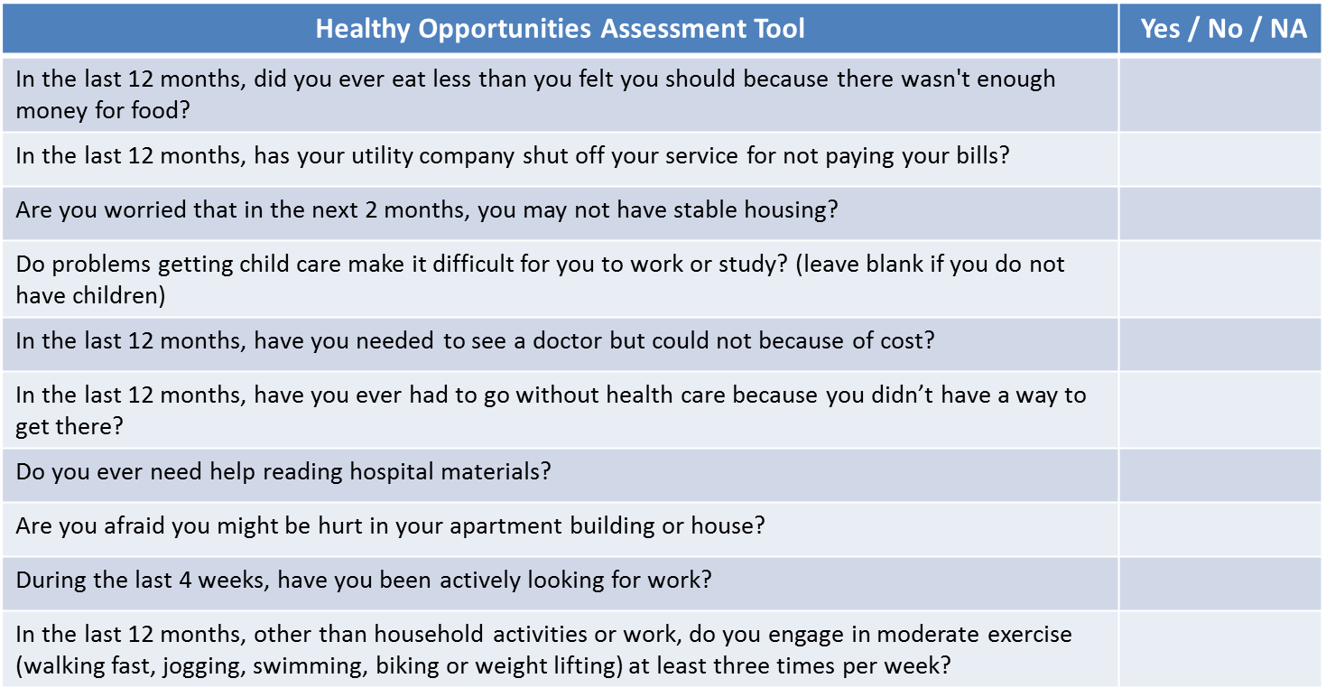
Social Context Screening: Live 8/18

Slide 16
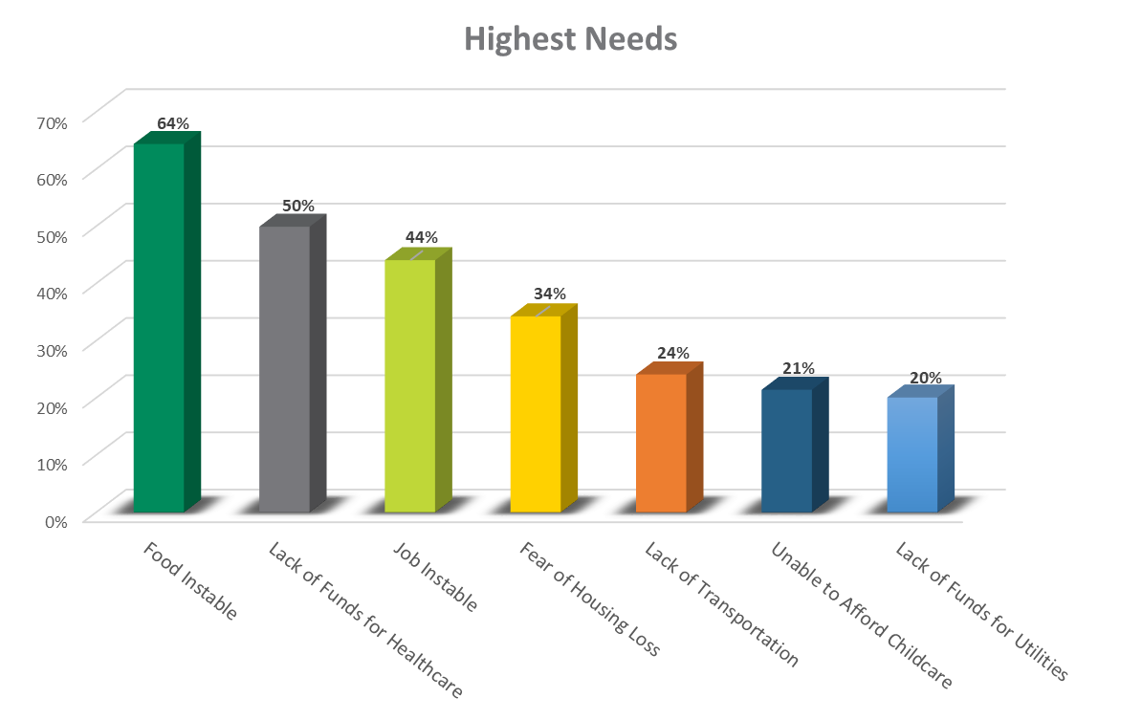
Key Learnings:
~75K Respondents
*16% Response Rate

Slide 17
Office of Healthy Opportunities Update
FSSA employee awareness campaign will:
  Build social determinants of health and health equity awareness.
  Identify compelling reasons for FSSA employees to learn about social context.
  Create a culture of compassion, empathy and awareness of social context and its core elements.

Slide 18
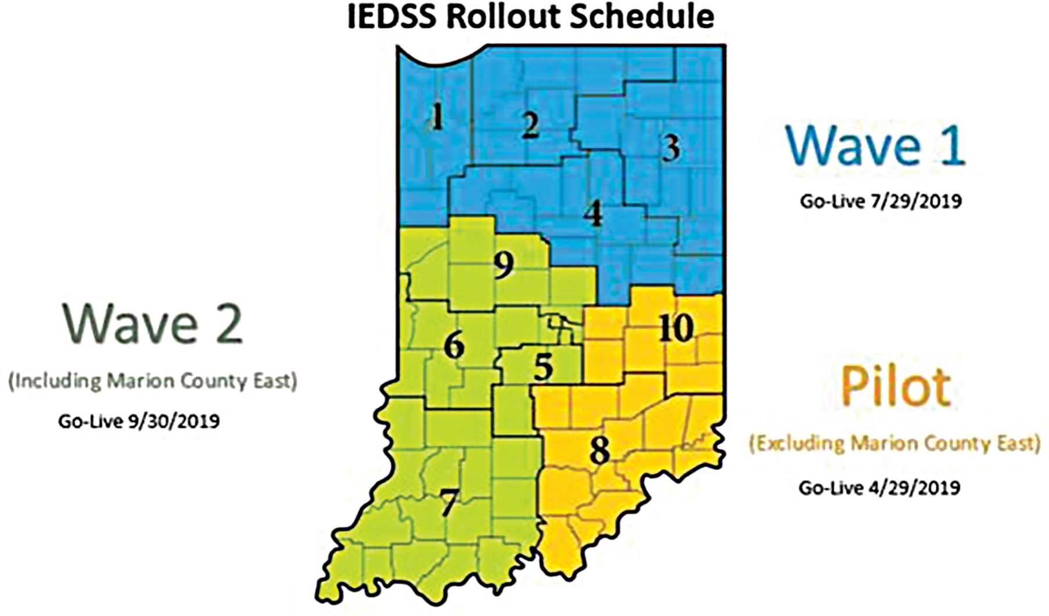

New Eligibility System
Notes:
Talking points for the importance/significance of IEDSS.
To help us better serve our members, the Indiana Family and Social Services Administration is updating and improving the internal system our employees use to determine member eligibility for SNAP, TANF and health coverage. FSSA calls the new system “IEDSS,” which stands for Indiana Eligibility Determination and Services System.
There will be no changes to the client-facing online systems or web pages, such as the FSSA Benefits Portal. Also, members will continue to be able to apply for benefits exactly the same way they do today: online; in our local office; by mail, fax or telephone.
As shown on this slide, member cases will move to the new system according to a regional phase-in schedule starting at the end of April 2019.
Members will receive a new case number in the mail when their case becomes part of IEDSS. The notices members receive in the mail about their benefits will also look different, but the information in these mailings will be the same.
FSSA will work closely with our federal partners during the implementation of the new system. We will look at key data points daily to monitor system performance so that accuracy and timeliness are not impacted.
Look for more communications from FSSA about the IEDSS rollout in the coming weeks.

Slide 19
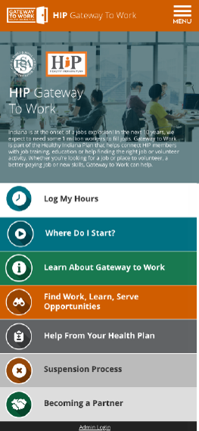
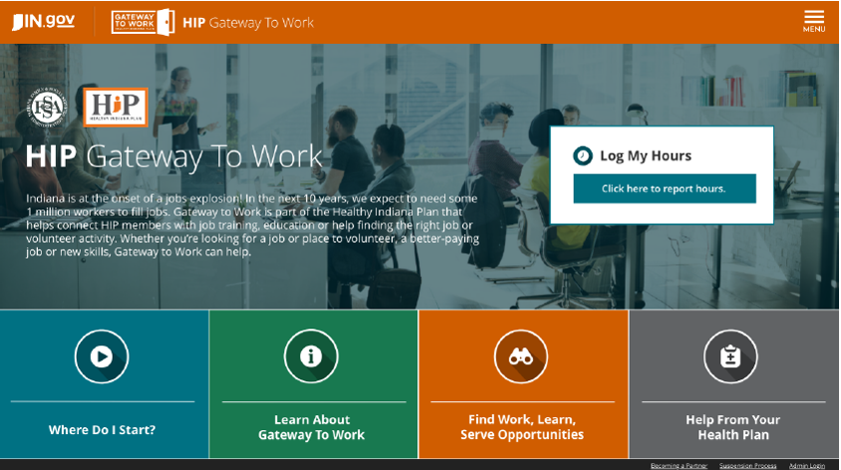

Gateway to Work
Gateway to Work Website effective Jan. 2019
Notes:
State tours x 3
Appropriate resources
Multiple ways to interface
Team at FSSA
>200 community partners
we have 90 unique organizations and 209 entries. (For instance, there are 89 Work Ones, 20 Ivy Techs, 13 Excel Centers, 22 Indpls Library sites).

Slide 20
Fixing the Cliff: HIP Bridge
HIP is a model program that allows for a transition to other insurance options for some Hoosiers
The implementation of Gateway to Work will assist with this transition
Some members have circumstances that make this difficult and need additional assistance for success
Working with federal partners on details
Goal implementation Q1 2020
Notes:
Why?
o As I have traveled the state and talked with business leaders, there is real excitement surrounding the Gateway to Work program as employers are in need of workforce participants during this period of record low unemployment in Indiana. However, we know the transition between HIP and private insurance can be confusing and complicated.
o We believe we have developed a model program with Gateway to Work, but we recognize successful participants may be faced with delays in coverage as they transition from HIP and onto private coverage. While Hoosiers with employer sponsored coverage are offered COBRA when they are between jobs, HIP participates currently do not have a similar option. We will work with our federal partners to ensure we can streamline to the process to encourage successful enrollment in commercial insurance.
- How?
o We will work with our federal partners on the design, but we are exploring options to both extend the amount of time that a rising HIP member can maintain coverage while they transition to insurance, and also exploring ways for a rising HIP members to utilize their power account as a tool to transition to insurance. Both of these potential options will help us continue to remove barriers so that Hoosiers can achieve the ultimate objective of moving to the workforce, increasing their income and their well-being.
- When?
o Our goal is to have these program enhancements in place beginning in 2020 to support members as the Gateway to Work hour requirement ramps up to 20 hours per week.

Slide 21
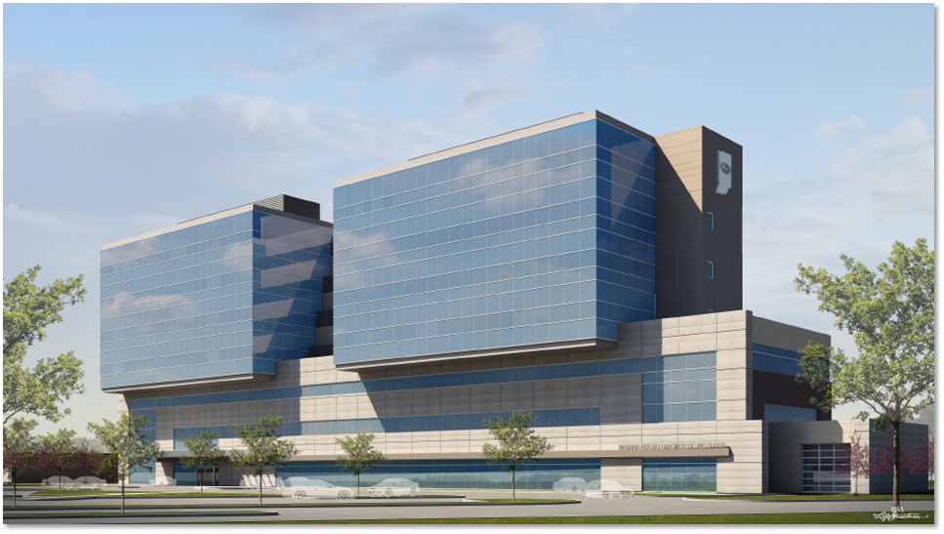

Indiana NeuroDiagnostic Institute (NDI)
Notes:
Comments: Intended as a catalyst to drive modernization through the State hospital network, one should infer that there will be care delivery and operational process enhancements promulgated by the NDI and adopted by existing State network hospitals. This will require that our other hospitals also staff up and increase staff skill base to facilitate state-of-the-art patient treatment. The seeds for this have been sown in 2016 and the success of the NDI meeting the two pillars above will need to result in similar outcomes at the five other State hospitals for Tx plans.
Statutory admission constraints prevent the State hospitals from treating patients whose principle problem is addiction. However substance abuse frequency accompanies severe behavioral health disease, and thus will be a distinct protocol at the NDI. This SUD treatment component will canvas all NDI units, as each unit is primarily designated for a core behavioral health condition and/or gender. Nevertheless, the objective to attack drug addiction will be one of many keystones for the NDI and we shall recruit resources to assist wherever possible and meritorious. Those resources may come to train and treat at the NDI, and apply that skill elsewhere.
The NDI, as a sole project, certainly is reflecting great government service. It is our goal, however, to take this opportunity to drive the need for excellence in all sectors of healthcare delivery across the entirety of our network. We shall continue to foster our ideas of better operational strategies/tactics, invite the systems integration with our State hospital peers for shared efficiencies/knowledge, and prove that the NDI is only the beginning for modernized State healthcare facilities delivering great government service to patients and our partners/communities.

Slide 22
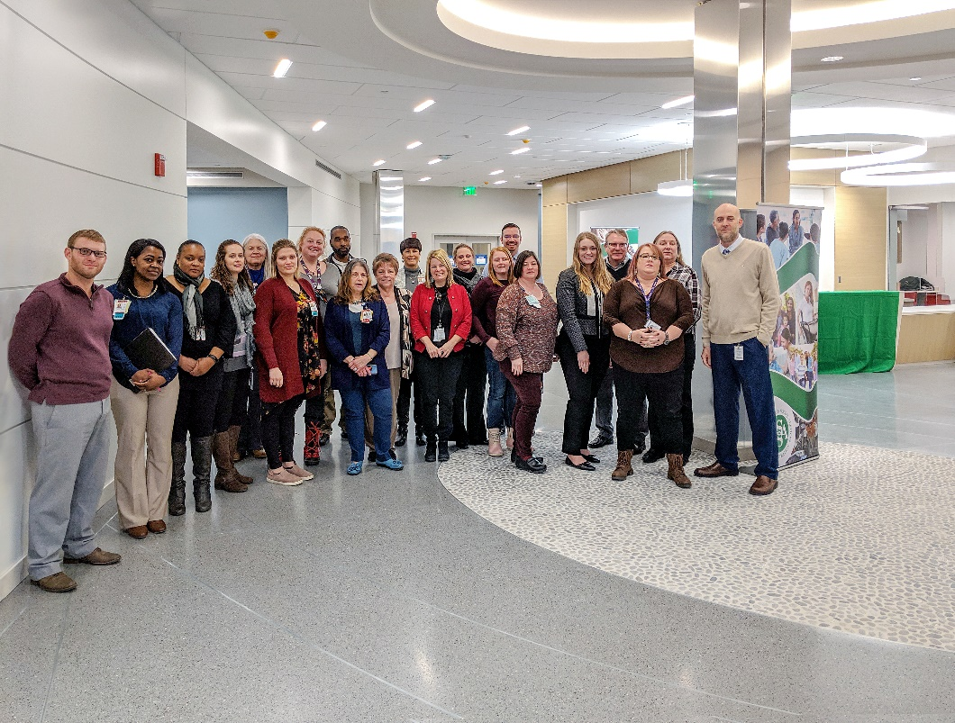

Indiana NeuroDiagnostic Institute
Notes:
Comments: Intended as a catalyst to drive modernization through the State hospital network, one should infer that there will be care delivery and operational process enhancements promulgated by the NDI and adopted by existing State network hospitals. This will require that our other hospitals also staff up and increase staff skill base to facilitate state-of-the-art patient treatment. The seeds for this have been sown in 2016 and the success of the NDI meeting the two pillars above will need to result in similar outcomes at the five other State hospitals for Tx plans.
Statutory admission constraints prevent the State hospitals from treating patients whose principle problem is addiction. However substance abuse frequency accompanies severe behavioral health disease, and thus will be a distinct protocol at the NDI. This SUD treatment component will canvas all NDI units, as each unit is primarily designated for a core behavioral health condition and/or gender. Nevertheless, the objective to attack drug addiction will be one of many keystones for the NDI and we shall recruit resources to assist wherever possible and meritorious. Those resources may come to train and treat at the NDI, and apply that skill elsewhere.
The NDI, as a sole project, certainly is reflecting great government service. It is our goal, however, to take this opportunity to drive the need for excellence in all sectors of healthcare delivery across the entirety of our network. We shall continue to foster our ideas of better operational strategies/tactics, invite the systems integration with our State hospital peers for shared efficiencies/knowledge, and prove that the NDI is only the beginning for modernized State healthcare facilities delivering great government service to patients and our partners/communities.

Slide 23
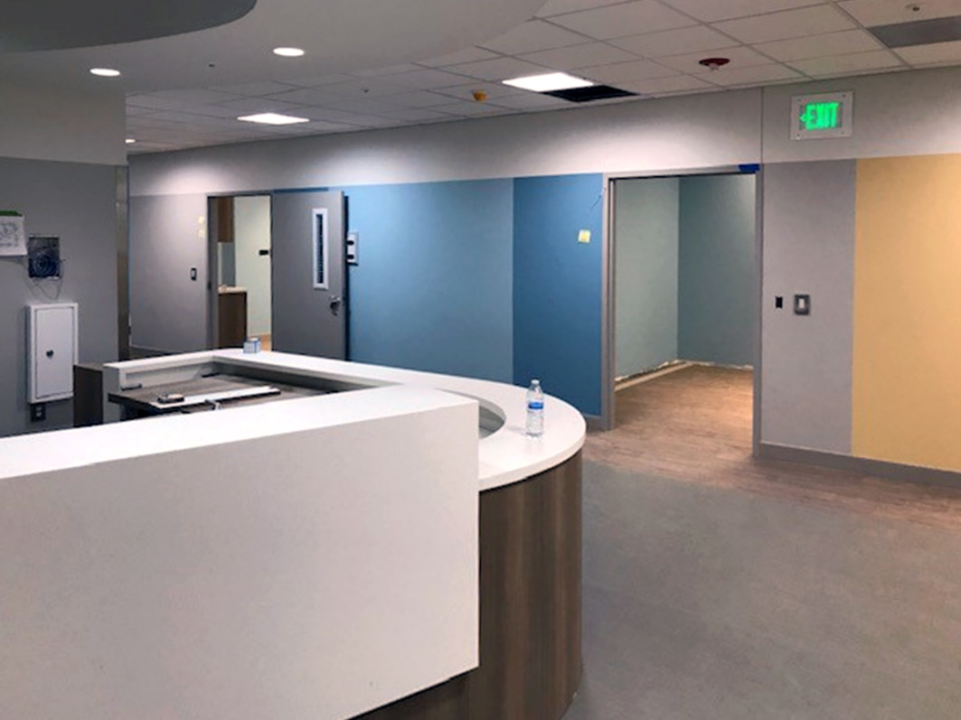
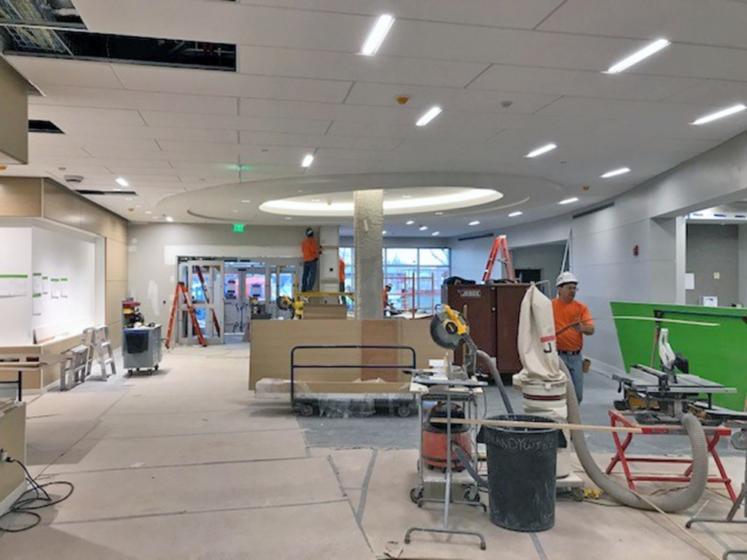
Indiana NeuroDiagnostic Institute
Notes:
Comments: Intended as a catalyst to drive modernization through the State hospital network, one should infer that there will be care delivery and operational process enhancements promulgated by the NDI and adopted by existing State network hospitals. This will require that our other hospitals also staff up and increase staff skill base to facilitate state-of-the-art patient treatment. The seeds for this have been sown in 2016 and the success of the NDI meeting the two pillars above will need to result in similar outcomes at the five other State hospitals for Tx plans.
Statutory admission constraints prevent the State hospitals from treating patients whose principle problem is addiction. However substance abuse frequency accompanies severe behavioral health disease, and thus will be a distinct protocol at the NDI. This SUD treatment component will canvas all NDI units, as each unit is primarily designated for a core behavioral health condition and/or gender. Nevertheless, the objective to attack drug addiction will be one of many keystones for the NDI and we shall recruit resources to assist wherever possible and meritorious. Those resources may come to train and treat at the NDI, and apply that skill elsewhere.
The NDI, as a sole project, certainly is reflecting great government service. It is our goal, however, to take this opportunity to drive the need for excellence in all sectors of healthcare delivery across the entirety of our network. We shall continue to foster our ideas of better operational strategies/tactics, invite the systems integration with our State hospital peers for shared efficiencies/knowledge, and prove that the NDI is only the beginning for modernized State healthcare facilities delivering great government service to patients and our partners/communities.

Slide 24
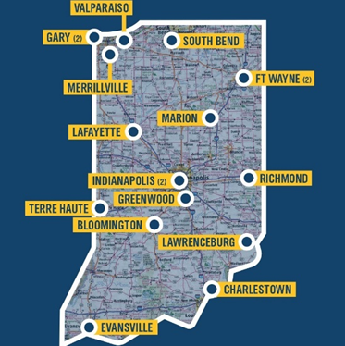

OTP expansion
Notes:
Gov Holcomb’s goal is to ensure that every Hoosier is within at least an hour’s drive of medication assisted treatment. An additional 9 OTPs have been authorized by the General Assembly to open this year. 2 licenses have been allocated to Hamilton Center, one for Knox County and one for Hendriks County. RFI is on the street to award the additional 7.

Slide 25
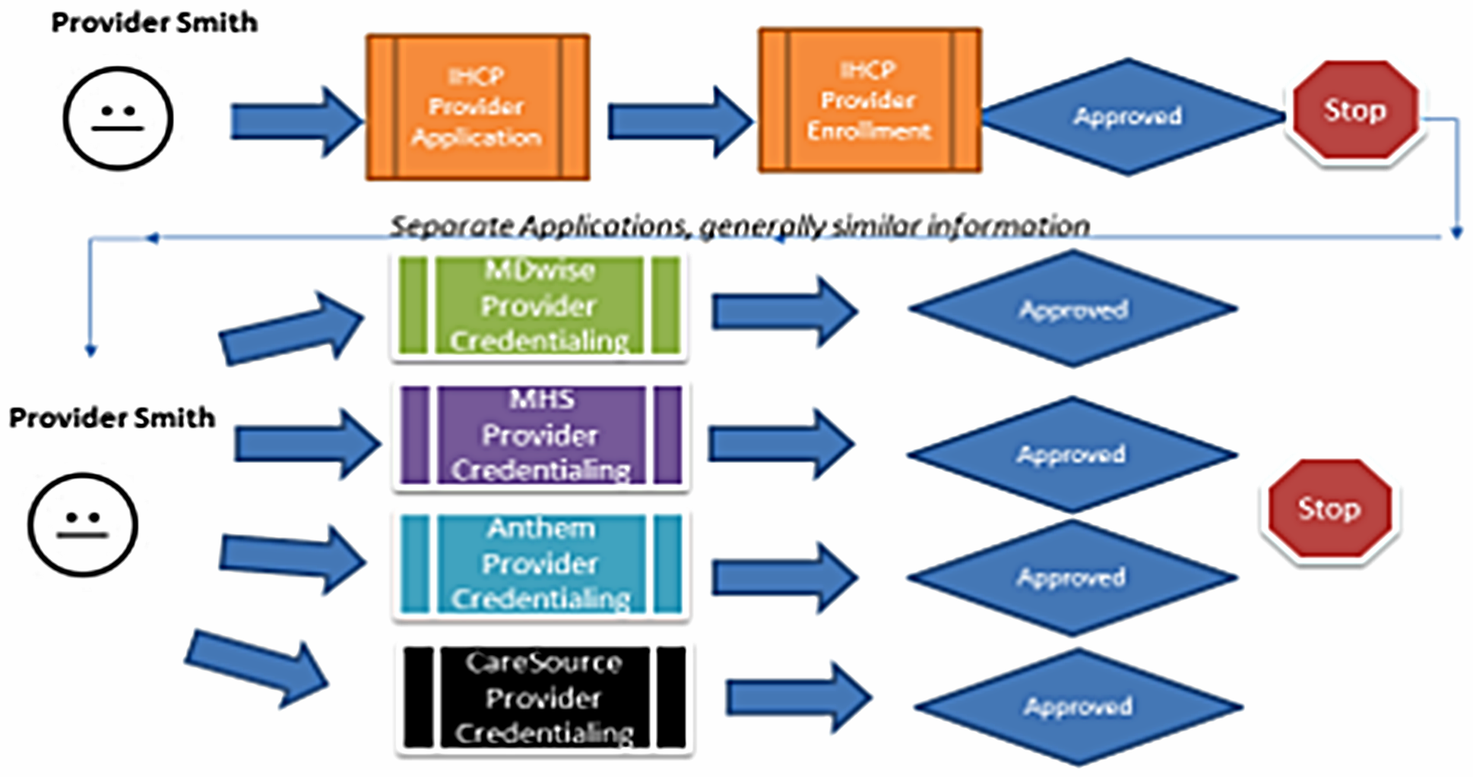


Five applications, five decisions
Notes:
Goal is to reduce duplication of effort and deliver a single decision on enrollment and credentialing
Current IHCP Enrollment and Credentialing Process:
Currently, Medicaid has over 50,000 enrolled providers that see our 1.4 million Medicaid members. In order to participate as a Medicaid provider, there is a multi-step process whereby a provider has to first submit an enrollment application with Medicaid and then upon approval, the provider goes through credentialing with each of our managed care health plans (we have four of them – Anthem, CareSource, MHS and MDwise). This means that today, a provider has to complete up to five separate but similar applications, with five different timelines, in order to become a fully enrolled and credentialed provider. This process can put providers on the sidelines for months before they can see patients and be reimbursed for those services. This is a frustration point for providers and health care businesses, and a barrier to care for Medicaid members.
In an effort to provide better services to our providers and our members, FSSA is streamlining the above application, enrollment, and credentialing processes and creating a “one stop shop” experience for providers. This summer, EnCred will be the centralized enrollment and credentialing hub, and Medicaid providers will only have to complete one application for enrollment and credentialing. This will speed the rate at which providers can complete the enrollment and credentialing process, so they can see patients and get reimbursed in a much timelier fashion. We are confident this will be a huge relief for providers and an important step in improving the services we as an agency provide to Hoosiers in need.

Slide 26
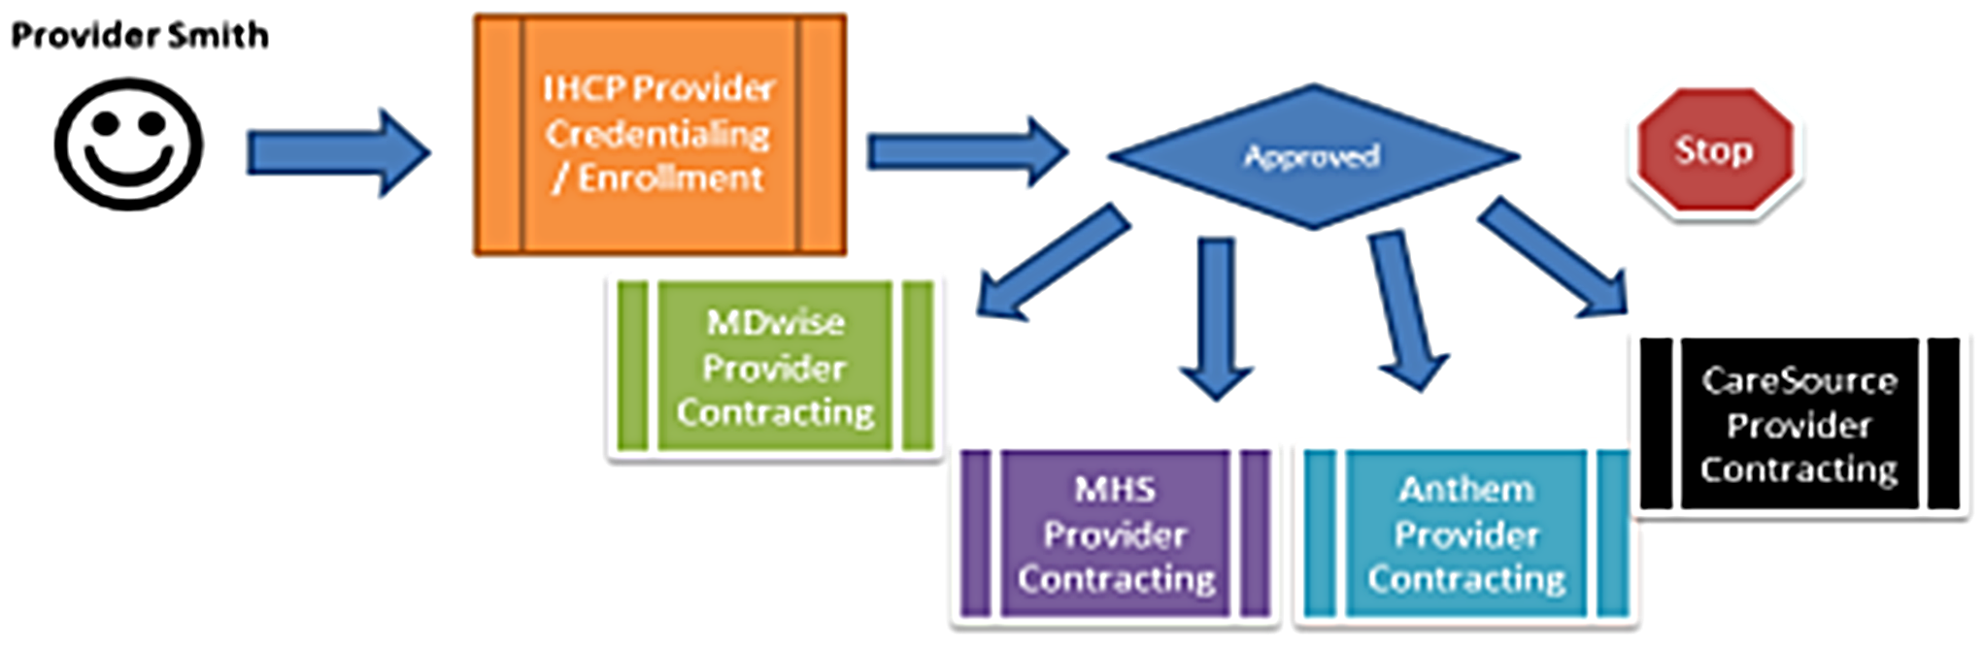

One application, one decision

Slide 27

PDG Grant
Awarded Preschool Development Grant of nearly $7M from HHS
Develop a strategic plan for the coordination and collaboration of Indiana’s early childhood education resources for birth to five-year-olds to address the following:
  Improve the quality of existing early education programs and identify best practices
  Assess gaps in the service delivery model, especially for low income and rural areas
  Incentivize local and regional entities to support high quality programs
  Strengthen Birth-5 workforce capacity through coordinated training and continuing education
  Improve B-pre-K data gathering and maintenance efforts
  Facilitate successful transitions for low income children to kindergarten

Slide 28
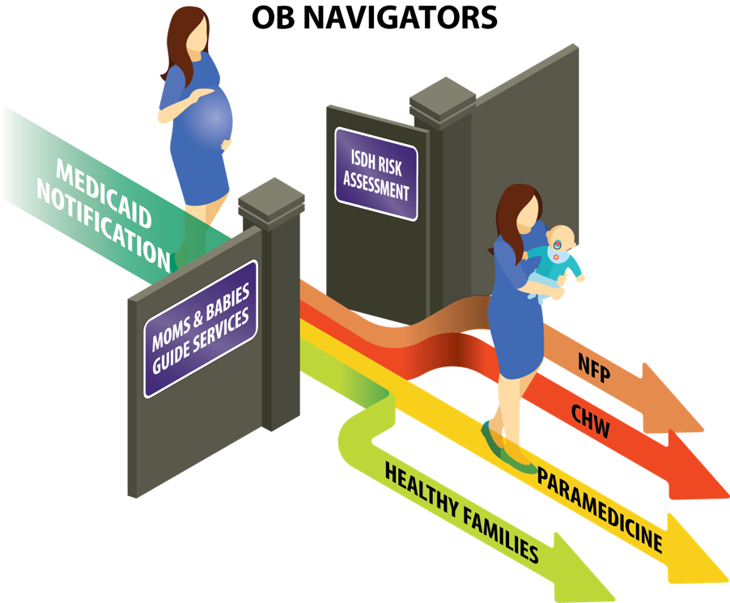

OB Navigator
Notes:
We need your help!

Slide 29
School Safety
Notes:
We need your help!

Slide 30
Staff Retention Strategy Update

Slide 31
10-point plan
Compensation package
Continuing education
Leadership development
Management training
Employee engagement
Employee advancement
Enhanced communication
Wellness strategy
Policy considerations
Connect to purpose

Slide 32
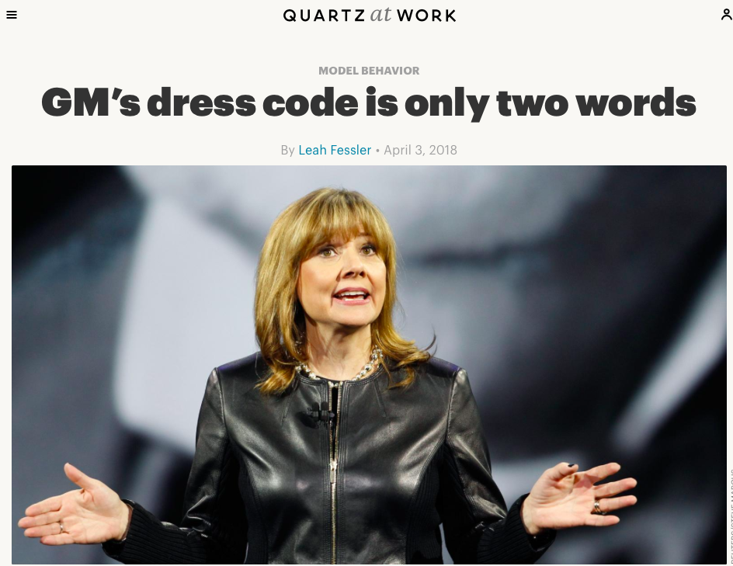
But First, A Story

Slide 33
#11 Dress for the Day
Our work is incredibly important
We are a 21st century advanced workforce
Professionalism is reflected in our appearance but not in a dress code that impairs individual choice and control

Slide 34
What Dress for the Day Is
Dress appropriately for the content of your day.
That’s it.

Slide 35

What Dress for the Day is

Slide 36


Slide 37
Ten things NOT to wear to work
Any outfit that was made to be worn to nightclubs.
Anything you would wear to the beach.
Any garment that's dirty, ripped or faded.
Anything that's too small for you.
Exercise wear.
Any garment with words on it, apart from our agency logo tee shirts and sweatshirts.
Anything see-through or backless.
Pajama bottoms or tops.
Flip-flops.
Anything you're not positive is appropriate for work.

Slide 38

Coming Soon: FSSA Logo Gear

Slide 39
Compensation package
Recommendations:
  Provide individual compensation package portfolio ☑
Notes:
Caitlin Floyd

Slide 40
Continuous education
Recommendations
  Tuition reimbursement
  Certificate partnerships and payment

Slide 41
Leadership development
Recommendations:
  Expansion of Natural Born Pilots ☑
  Skills training
  Leadership hotline/office hours
  Resource page

Slide 42
Management training
Recommendations:
  Monarch initiative ☑
  Pilot with DMHA ☑
  Enhanced manager support for onboarding with mentoring

Slide 43
Employee engagement
Recommendations:
  Secretary initiatives
    Friday Rounds
    Staff feedback sessions
    Regular division leadership meetings ☑
  TEDx programming

Slide 44
Employee advancement
Recommendations:
  Succession planning (SPD template) ☑

Slide 45
Enhanced communication
Recommendations:
  Pulse surveys
  Division newsletters ☑
  HUB mobile app

Slide 46
Wellness strategies
Recommendations:
  ICAN dogs (IDOA)
  Awards and recognitions team
  Regular agency events
  Community initiatives
  Office redesign

Slide 47
Policy considerations
Recommendations:
  Work from home
  Flex hours (DFR pilot)
  9-day work cycle ☑

Slide 48
Connect to Purpose
Recommendations:
  Publish metrics and dashboards
  (Secretary’s homepage)
  Announce successes
    Data
    Member stories
  Consumer advisory
  Mission/Vision redesign ☑

Slide 49
The Three Mantras
Bring people into care and access to our social programs as quickly and easily as possible.
Partner with members to find any additional needs.
Measure our progress using data we collect and employ continuous process improvement.

Slide 50



Enterprise Analytics & Business Intelligence
Division of Family Resources
Division of Disability & Rehabilitative Services
Office of Medicaid Policy & Planning
Office of Early Childhood & Out of School Learning
Division of Mental Health & Addiction
Secretary’s Portal
Division of Aging

Slide 51
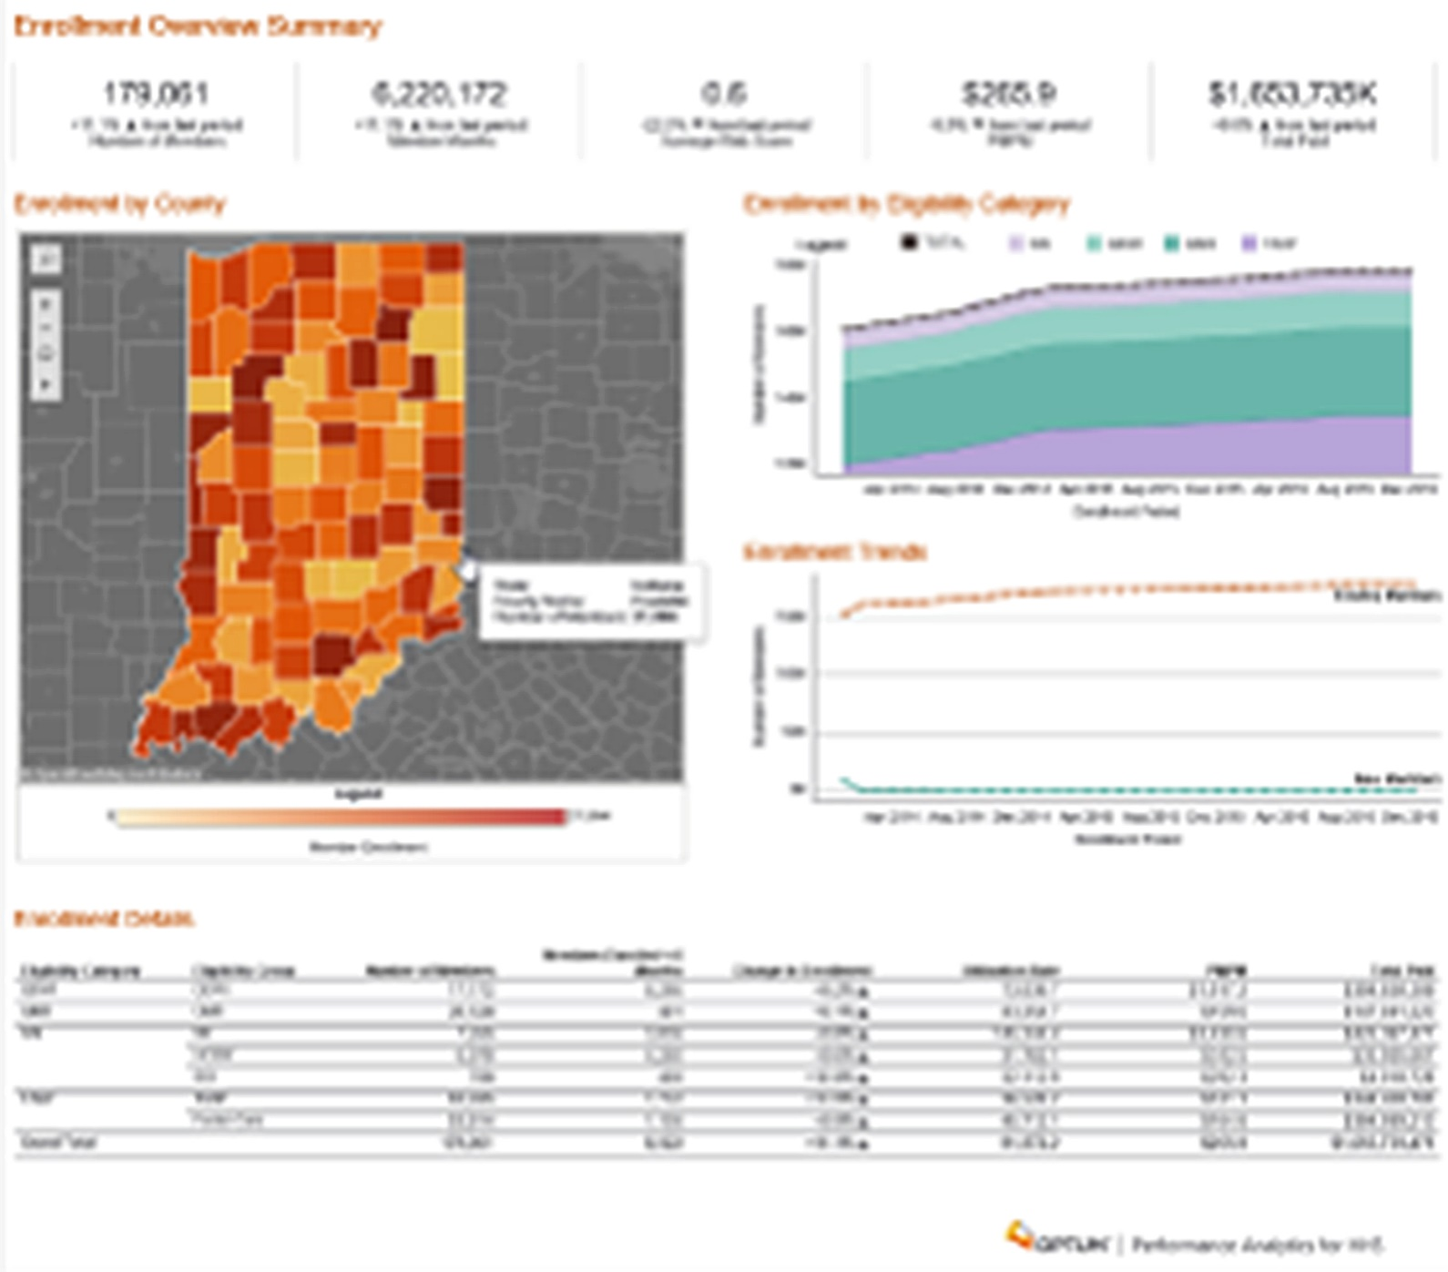

Slide 52
An FSSA Story
Begin with the end in mind.

Slide 53
Contact Information
Jennifer.Walthall@fssa.in.gov
@confectionsmd
Notes:
Office of Communications and Media, contact:
Jim Gavin, Director
317-234-0197
Jim.Gavin@fssa.in.gov
Marni Lemons, Deputy Director
317-234-5287
Marni.Lemons@fssa.in.gov
FSSA Website: www.fssa.in.gov
Follow us on Twitter: @FSSAIndiana

