Slide 1


The right skills, at the right time, in the right way. Indiana’s Demand Driven Workforce
Adult Education and Workforce Development Statewide Webinar
May 8, 2019
Marilyn Pitzulo | Adult Education Staff
Department of Workforce Development | Indiana ADULT EDUCATION
10 N. Senate Avenue, IGCS SE 203 | Indianapolis, IN 46204
AdultEd@dwd.in.gov

Slide 2

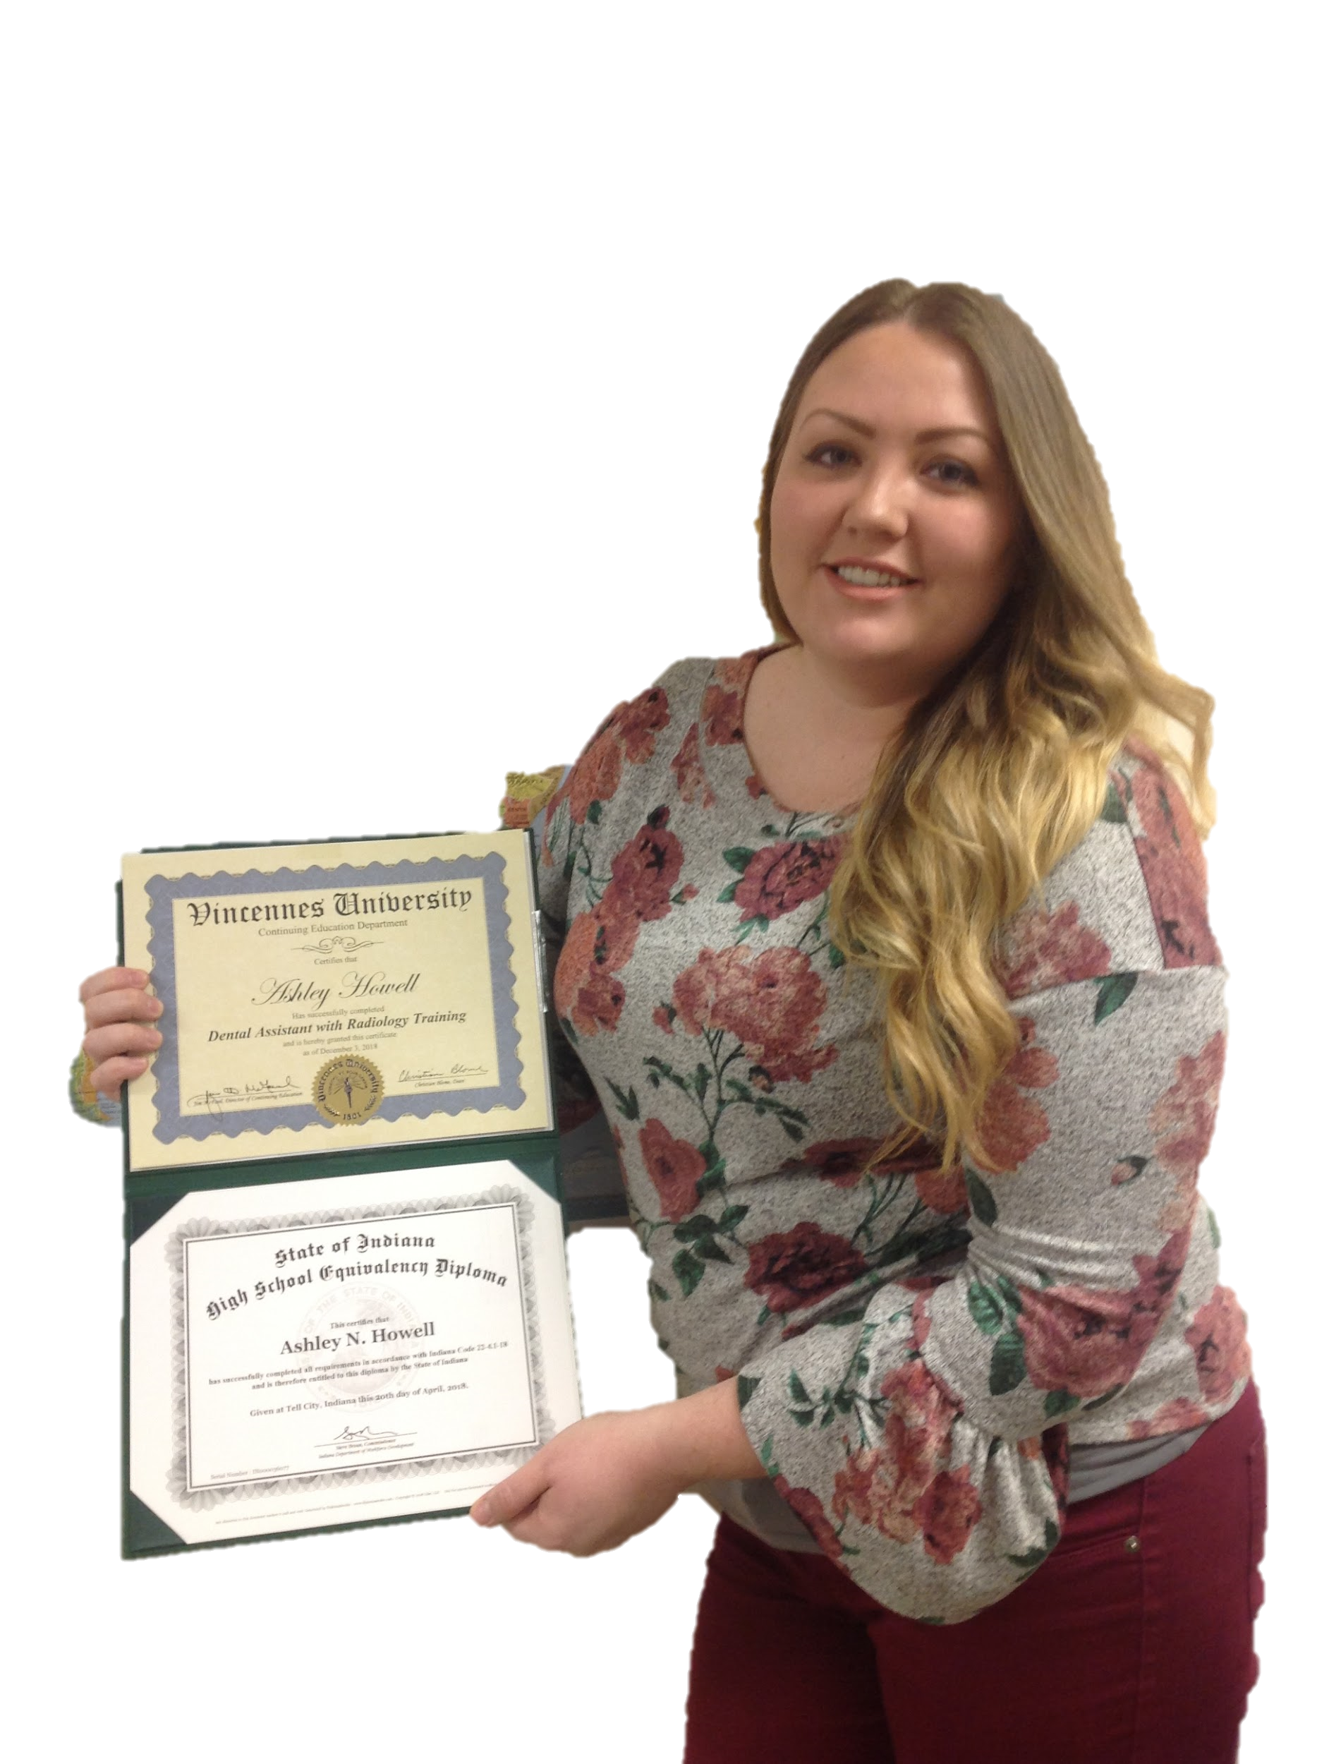

Indiana ADULT EDUCATION
Basic Skills. High School Equivalency. Short-term Training. Certifications and More.
Ashley Howell
In Her Own Words
“
During my freshman year of high school, my world was turned upside down when my father died by suicide. I stayed in school through my junior year, but I struggled with depression and school was not a priority.
“A few years later, I was married and staying at home with two small children. I always wanted to go back to school and get my HSE so that I could feel proud of myself. With both of my kids in school full-time, I finally had the time.”

Slide 3
Indiana ADULT EDUCATION
Basic Skills. High School Equivalency. Short-term Training. Certifications and More.
Ashley Howell
In Her Own Words
“
“Restarting my education changed my life. My kids have bragged about me to their teachers. They always have motivating and positive things to say and I am so proud that they can see me continuing to learn and improve.”
“Don't let your own thoughts of not being able to succeed hold you back.”
When I started attending Vincennes University adult Education’s HSE classes in Tell City, I had been out of school for 13 years. I began studying, passed six weeks later, and got my HSE. My success with the HSE inspired me to go even further. I took classes through VU adult education’s training program and received a certificate in Dental Assisting & Radiology. I am now working as a dental assistant and making plans to study to become a dental hygienist. “

Slide 4

Indiana ADULT EDUCATION
Basic Skills. High School Equivalency. Short-term Training. Certifications and More.
Celebrating Students and Volunteers
2019 STUDENT & VOLUNTEER RECOGNITION EVENT
Katie Franks
2018-19 Classroom Volunteer of the Year
Indy Reads' Student & Volunteer Recognition Event took place on Thursday, April 18, and brought together members of the community and friends and partners of Indy Reads to celebrate our classroom programs.
Joshua Jarvis
2018-19 Bookstore Volunteer of the Year
Indy Reads
Central Library
40 E St. Clair St.
Indianapolis, IN 46204
317.275.4040 info@indyreads.org
Pedro Tello Garcia
2018-19 Student of the Year

Slide 5
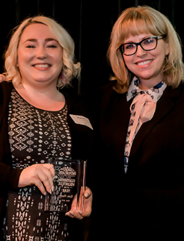

Indiana ADULT EDUCATION
Basic Skills. High School Equivalency. Short-term Training. Certifications and More.
Ryan King
Chief Executive Officer
2019 STUDENT & VOLUNTEER RECOGNITION EVENT
Indy Reads
Central Library
40 E St. Clair St.
Indianapolis, IN 46204
317.275.4040 info@indyreads.org
Our mission is to build the literacy, English language, and job readiness skills to empower adults and families to reach their full potential. And our vision is simple: 100% literacy for all.
Left – Katie Franks
2018-19 Classroom Volunteer of the Year
Joshua Jarvis
2018-19 Bookstore Volunteer of the Year

Slide 6
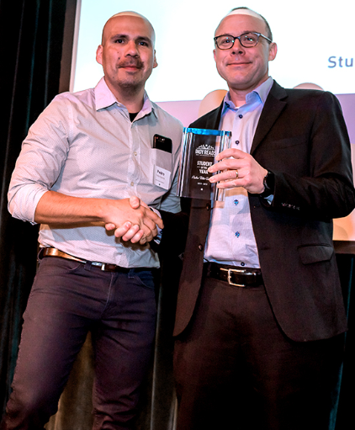

Indiana ADULT EDUCATION
Basic Skills. High School Equivalency. Short-term Training. Certifications and More.
Indy Reads 2018-19 Student of the Year
2019 STUDENT & VOLUNTEER RECOGNITION EVENT
Left – Pedro Tello Garcia
Indy Reads
Central Library
40 E St. Clair St.
Indianapolis, IN 46204
317.275.4040 info@indyreads.org
YouTube Video
https://youtu.be/7__mNg5cQIE

Slide 7

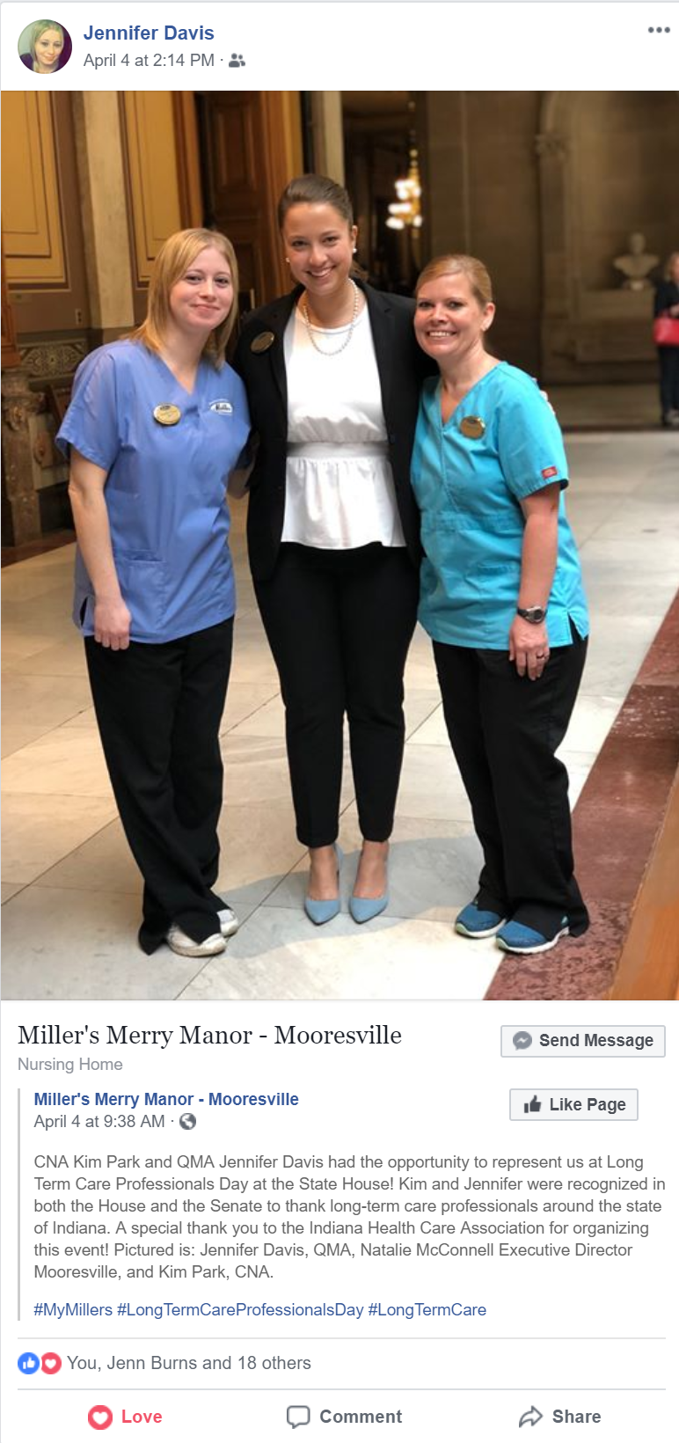
Indiana ADULT EDUCATION
Basic Skills. High School Equivalency. Short-term Training. Certifications and More.
Jennifer Davis A Journey to Confidence
taking care of residents at the Millers Merry Manor long-term care facility, but she wanted to take her career to the next level. “I was excited about becoming a medical assistant, but I doubted myself. The life coaches at Wayne Township Adult Ed and our teacher Stephanie Williamson kept encouraging and believing in me, even when I didn’t believe in myself,” she said. “When it
Jennifer Davis set out on a journey to earn her medical assisting license through Wayne Township Adult Education at a time when she wasn’t having much confidence in herself. She was a dedicated employee,

Slide 8
Indiana ADULT EDUCATION
Basic Skills. High School Equivalency. Short-term Training. Certifications and More.
Jennifer Davis A Journey to Confidence
each other and all passed the CCMA certification exam. Things are now looking up for Jennifer. She was selected for the CCMA position at work and was honored at the State House for Long -Term Care Professionals Day. Jennifer said, “I am happy that I will be able to provide for my twin girls as a medical assistant, and show them that hard work really does pay off. “
came time to do blood draws,” her teacher said, “she was so nervous, but I told her that if I trusted her, she should trust herself!” When it came time to take the state exam, Jennifer met outside of class with her classmates for extra study sessions. She and her study partners encouraged
“I am thankful for the people who believed in me along the way!” – Jennifer Davis

Slide 9

Indiana ADULT EDUCATION
Basic Skills. High School Equivalency. Short-term Training. Certifications and More.
CCMA Certification
Medical Assistant Certification
Christy McIntyre-Gray, Coordinator
MSD Wayne Township Schools
Wayne Township Adult Education
1155 S. High School Road Door #2
Indianapolis, IN 46241
Email Christine.McIntyre@wayne.k12.in.us
Cell 317.220.3658
Office 317.988.7968
A medical assistant is a multi-skilled allied health care professional that specializes in procedures commonly performed in the ambulatory health care setting. Medical assistants perform both clinical and administrative duties and assist a variety of providers including physicians, nurse practitioners and physician assistants. They typically work in medical offices, clinics, urgent care centers and may work in general medicine or specialty practices.
https://www.nhanow.com/certifications/clinical-medical-assistant

Slide 10
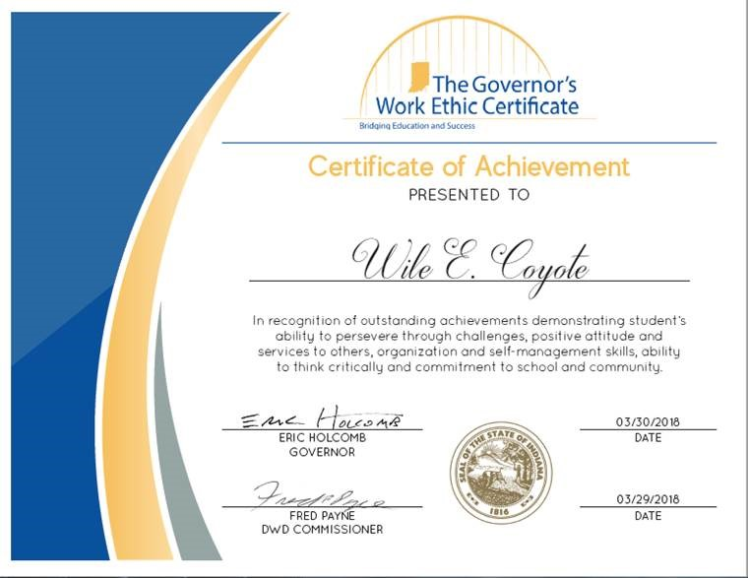
Youth Initiatives Updates
• IAACE presentation
Governor’s Work
• Ethic Certification
cmfitzgerald@dwd.in.gov
https://www.in.gov/dwd/3469.htm

Slide 11


program is open to anyone age 16 or older who is not attending a high school. It helps people prepare for the equivalency test, earn workforce
certification and even learn English as a second language.
“It’s really all about getting people into career training and employment,” said Robert Moore, director of the program.
The program serves about 500 people each year. Historically, there has been one ceremony in May to recognize their accomplishments. A second
ceremony was added in December this year.
“- 1
Indiana ADULT EDUCATION
Basic Skills. High School Equivalency. Short-term Training. Certifications and More.
New Contact for TABE
Mike Johnson
National Adult Education Director
Data Recognition Corporation
630-995-6712
mjohnson@datarecognitioncorp.com

Slide 12
NRS State Table 4 – 2018-2019 5-6-19

Slide 13
Indiana ADULT EDUCATION
Basic Skills. High School Equivalency. Short-term Training. Certifications and More.
Total
Enrollment
2018-2019* 2017-2018**
ABE/ELL 22,106 23,785
ELL
ABE
- 1,615
-64
7.05 PERCENT DECREASE
*Data as of 5.6.19 ** Data as of 5.14.18

Slide 14
Indiana ADULT EDUCATION
Basic Skills. High School Equivalency. Short-term Training. Certifications and More.
MEASURABLE SKILL GAINS
Basic Skills Remediation
NRS Table 4, Column H NRS Table 4, Column I
2017-2018* 2018-2019**
64%
– Indiana Target
2018-2019
56.86%
57.43%
Instructional IMPACT
*Data as of 5.6.18 **Data as of 5.6.19
Then one day, after nearly ten years of sticking to his dream of pursuing music, and becoming an accomplished Elvis and Johnny Cash impersonator, his father had a proposition for him. “He said he knew I had this dream of recording music in Memphis and basically told me he would pay for half of everything if I got my (HSE).”
So, after years out of traditional high school, and an attempt at another high school equivalency (HSE) program out of state, Bennett enrolled at the MACC for daily adult education afternoon classes. “The teacher was great- he motivated me when I needed to be motivated.” After about four months in class, Bennett passed his HSE test and received his diploma. Bennett says, “If it wasn’t for Mr. Smith keeping me on track, I would have never gotten it done.”
“If I can make it, anyone can make it,” says Bennett.

Slide 15
Indiana ADULT EDUCATION
Basic Skills. High School Equivalency. Short-term Training. Certifications and More.
MEASURABLE SKILL GAINS
NRS Table 4, Column H NRS Table 4, Column I
2017-2018* 2018-2019**
ELL MSG INCREASE
2.25 Percentage Points
ABE 59.06%
ELL 49.02%
ABE 59.29%
ELL 51.30%
*Data as of 5.14.18 **Data as of 5.6.19
Then one day, after nearly ten years of sticking to his dream of pursuing music, and becoming an accomplished Elvis and Johnny Cash impersonator, his father had a proposition for him. “He said he knew I had this dream of recording music in Memphis and basically told me he would pay for half of everything if I got my (HSE).”
So, after years out of traditional high school, and an attempt at another high school equivalency (HSE) program out of state, Bennett enrolled at the MACC for daily adult education afternoon classes. “The teacher was great- he motivated me when I needed to be motivated.” After about four months in class, Bennett passed his HSE test and received his diploma. Bennett says, “If it wasn’t for Mr. Smith keeping me on track, I would have never gotten it done.”
“If I can make it, anyone can make it,” says Bennett.

Slide 16
Indiana ADULT EDUCATION
Basic Skills. High School Equivalency. Short-term Training. Certifications and More.
ABE/ELL
Average Indiana
Contact Hours
2018-2019* 2017-2018**
ABE/ELL 74 hrs. 74 hrs.
No Change
*Data as of 5.6.19 ** Data as of 5.14.18

Slide 17
Indiana ADULT EDUCATION
Basic Skills. High School Equivalency. Short-term Training. Certifications and More.
No. Separated Before Gain
5.6.19
4,246 19.20%
5.14.18
5,306
22.30%
Separations DECREASE
3.1 Percentage Points

Slide 18
Indiana ADULT EDUCATION
Basic Skills. High School Equivalency. Short-term Training. Certifications and More.
5.6.19
No. Separated Before Gain
2018-2019
– ABE/ASE Levels 1-6 18.11% Separated
– ELL Levels 1-6 22.82% Separated

Slide 19
Indiana ADULT EDUCATION
Basic Skills. High School Equivalency. Short-term Training. Certifications and More.
Number
HSE Diplomas
2018-2019* 2017-2018**
ABE/ELL 3,104 3,616
HSE Diplomas
- 512
DOWN
*Data as of 5.6.19 ** Data as of 5.14.18
Reported by InTERS

Slide 20
Indiana ADULT EDUCATION
Basic Skills. High School Equivalency. Short-term Training. Certifications and More.
MEASURABLE SKILL GAIN
Basic Skills Remediation
NRS Table 4, Columns B, D, I
64%
– Indiana Target
2018-2019
Enrolled 22,106 (ABE/ELL)
Majority of ABE Students
– Level 3 (6,371)
Next Highest – Level 2 (5,971
Then one day, after nearly ten years of sticking to his dream of pursuing music, and becoming an accomplished Elvis and Johnny Cash impersonator, his father had a proposition for him. “He said he knew I had this dream of recording music in Memphis and basically told me he would pay for half of everything if I got my (HSE).”
So, after years out of traditional high school, and an attempt at another high school equivalency (HSE) program out of state, Bennett enrolled at the MACC for daily adult education afternoon classes. “The teacher was great- he motivated me when I needed to be motivated.” After about four months in class, Bennett passed his HSE test and received his diploma. Bennett says, “If it wasn’t for Mr. Smith keeping me on track, I would have never gotten it done.”
“If I can make it, anyone can make it,” says Bennett.

Slide 21
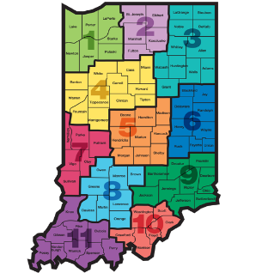
Indiana ADULT EDUCATION
Basic Skills. High School Equivalency. Short-term Training. Certifications and More.
High School Level
Moving Forward
2018-2019
ABE Levels 5-6
706 Students – 4%
5.6.19
ABE Levels 5-6
3,902 Students – 23%
5.14.18
GRADES
9-12

Slide 22
Indiana ADULT EDUCATION
Basic Skills. High School Equivalency. Short-term Training. Certifications and More.
High School Equivalencies
Moving Forward
2018-2019
Implications
TOTAL HSEs
3,104
5.6.19
ABE Level 3 – 1,420
ABE Level 4 – 860
ABE Level 2 – 494
Students may be ready at lower educational functioning levels to test
ABE Level 3 = Approx. Grade Range Equivalent 3-4
ABE Level 4 = Approx. Grade Range Equivalent 6-8
Administer TASC Readiness Assessment earlier

Slide 23
Indiana ADULT EDUCATION
Basic Skills. High School Equivalency. Short-term Training. Certifications and More.
Distance Education Measurable Skill Gains
Distance Ed
2018-2019
NRS Table 4C Column H
63.90%
ABE Enrolled 4,528
ELL Enrolled 1,305
Total 5,833
26% Participate in Distance Education
Data as of 5.6.19

Slide 24
Indiana ADULT EDUCATION
Basic Skills. High School Equivalency. Short-term Training. Certifications and More.
Participant Status
Program Enrollment
Employed | Unemployed
8,250 8,761
Not in Labor Force
5,058
Data as of 5.6.19

Slide 25
Indiana ADULT EDUCATION
Basic Skills. High School Equivalency. Short-term Training. Certifications and More.
Data as of 5.6.19
No. Enrolled Min. High School Diploma/HSE
U.S. – Non-U.S. Based Schooling
7,639
34.55%
29.31% PY 2017-2018
No. Enrolled With Some College or Degree
U.S. – Non-U.S. Based Schooling
2,930
13.25%
11.19% PY 2017-2018

Slide 26
Indiana ADULT EDUCATION
Basic Skills. High School Equivalency. Short-term Training. Certifications and More.
Professional Development
NEXT
STEPS
Moving Forward
2018-2019
New Teacher Training
May 10, 2019
– PDF Meeting, 10 a.m. - 3 p.m.
Wayne Township Adult Education
1155 S. High School Road Door #2 | Indianapolis, IN 46241
Contracted PD Trainings

Slide 27
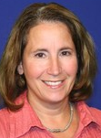


Indiana ADULT EDUCATION
Basic Skills. High School Equivalency. Short-term Training. Certifications and More.
Professional Development
Moving Forward
2018-2019
Establishing –
Workforce Education Initiatives
Integrating Education & Training (IETs)
Amplify Adult Education
Make-Up Meeting
May 14, 2019
10 a.m. – 3 p.m.
Ivy Tech Kokomo
1815 E. Morgan Street
Presenters | Denise Cox | Linda Warner

Slide 28


Indiana ADULT EDUCATION
Basic Skills. High School Equivalency. Short-term Training. Certifications and More.
Webinar
How to become a Workforce Ready Grant (non-credit bearing) Training Provider
This webinar will go over the program requirements, student eligibility, and steps required to become an eligible training provider for Indiana’s Workforce Ready Grant, non-credit bearing program. Becoming an eligible training provider for this program allows a training institution to train in high-demand, high-priority job sectors and receive student tuition payment directly from the state for eligible students.
June 20, 2019
10:30 – 11:30 a.m.
https://bit.ly/2PtsfX9

Slide 29
Indiana ADULT EDUCATION
Basic Skills. High School Equivalency. Short-term Training. Certifications and More.
REMINDER
PY19 GRANT INFORMATION
Award decisions are coming . . .
Your Grants Team is available to respond to your questions –
  Scott Mills smills1@dwd.in.gov 317.864.2248
  Donna Lovelady dlovelady@dwd.in.gov 317.233.9902

Slide 30
Indiana ADULT EDUCATION
Basic Skills. High School Equivalency. Short-term Training. Certifications and More.
FISCAL REMINDERS
Budget Modifications
  All requests for budget modifications must be submitted to our office (adulted@dwd.in.gov) by Monday, June 3, 2019. (Remember – a modification is required to move funds between Administrative and Program.)
Close Outs
  The DWD Finance Office will send close out packets out as usual. Remember to copy our office at the Adult Ed mailbox when you submit the final close out.
Reimbursements
  Follow up on any outstanding reimbursements before the end of the program year, June 30, 2019. Notify Cheryl Jones if any payment is overdue or an error has occurred.
  Notify Cheryl Jones if your final PY18 reimbursement will not be in by August 30, 2019.

Slide 31

Indiana ADULT EDUCATION
Basic Skills. High School Equivalency. Short-term Training. Certifications and More.
New
Workforce Initiative Coordinator
for Adult Education
Roy Melton
rmelton@dwd.in.gov
765.413.2216

Slide 32

WorkINdiana
Updates
REMINDER
REMINDER
REMINDER
REMINDER
Responsibility for WorkINdiana through the end of the program year will be a team effort.
Shruti will take over the majority of day-to-day tasks.
Marilyn will handle fiscal and contract management.
mpitzulo@dwd.in.gov
SShrivastava@dwd.IN.gov

Slide 33
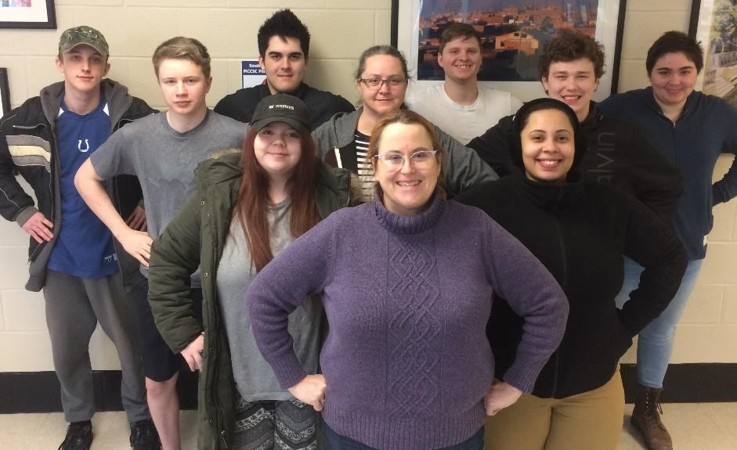
program is open to anyone age 16 or older who is not attending a high school. It helps people prepare for the equivalency test, earn workforce
certification and even learn English as a second language.
“It’s really all about getting people into career training and employment,” said Robert Moore, director of the program.
The program serves about 500 people each year. Historically, there has been one ceremony in May to recognize their accomplishments. A second
ceremony was added in December this year.
“- 1
Indiana ADULT EDUCATION
Basic Skills. High School Equivalency. Short-term Training. Certifications and More.
►Integrated Education & Training
IELCE | Short-term Training | Certifications
11 IELCE certifications and 214 IET certifications.
4 pending applications
IET Enrollment 2,505 53% goal
IELCE Enrollment 93 16% goal
Still Enrolled 1100
Dropped 236 16.80%
Completions 1169 83.20%
Certifications 907 77.59%
Broadview Boot Camp ONE = 9 NEW GRADUATES in 3 Days
Pictured Front row – Sheila Butler, teacher; Second row: Hailey Hignite, Latasha Hall; Third row: Jake Gordillo, Kimberly Chandler, Ian Heath; Fourth Row: Robert Hendrickson, Zion Langan, Hayden White and Indigo Wolf.

Slide 34
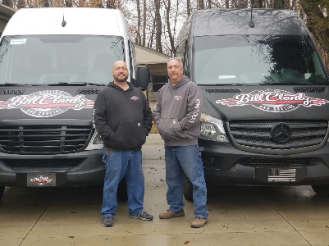
Indiana ADULT EDUCATION
Basic Skills. High School Equivalency. Short-term Training. Certifications and More.
Workforce Education
Initiative
81 WEI certifications
2 pending applications
WEI monthly data report statewide enrollments –
WEI Enrollments 832 19% of the goal
Still enrolled 697
Dropped 37 27.41%
Completed 98 72.59%
Certification 84 85.71%
Pictured are former adult education student Joe McElfresh, who enrolled in the Duncan Supply Heating, Ventilation, and Cooling (HVAC) class, located at Area 31 Career Center, and instructor Bill Clontz, owner and operator of Clontz Heating and Cooling.

Slide 35
STATEWIDE | Goal | To-Date
Enrollment | 1,800 | 1632
Enrollment Rate | --- | 91%
Still Enrolled | --- | 361
Completers | 1,440 | 1145
Completion Rate | 80% | 90%
Dropped | --- | 128
Dropped Rate | Below 10% | 10.05%
Certifications issued | 1,065 | 951
Certification Rate | 74% | 83%
Employment | 640 | 515
Employment Rate | 60% | 45%
  Shruti Shrivastava
  SShrivastava@dwd.in.gov
  WorkINdiana@dwd.in.gov
WorkINdiana
Updates
Statewide
.5% JAG enrollment
12.5% ERG utilization
25.5% TANF utilization

Slide 36
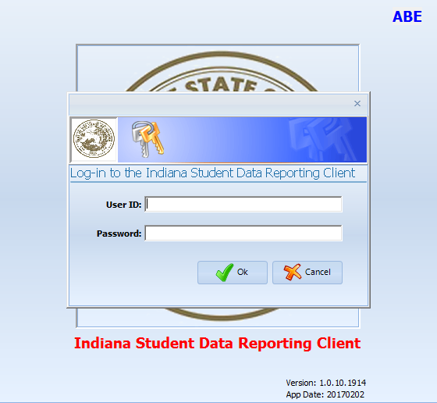
program is open to anyone age 16 or older who is not attending a high school. It helps people prepare for the equivalency test, earn workforce
certification and even learn English as a second language.
“It’s really all about getting people into career training and employment,” said Robert Moore, director of the program.
The program serves about 500 people each year. Historically, there has been one ceremony in May to recognize their accomplishments. A second
ceremony was added in December this year.
“- 1
InTERS
ADULT EDUCATION UPDATES, TRAININGS
Matt Crites
mcrites@dwd.in.gov
Brin Sisco
bsisco@dwd.in.gov

Slide 37
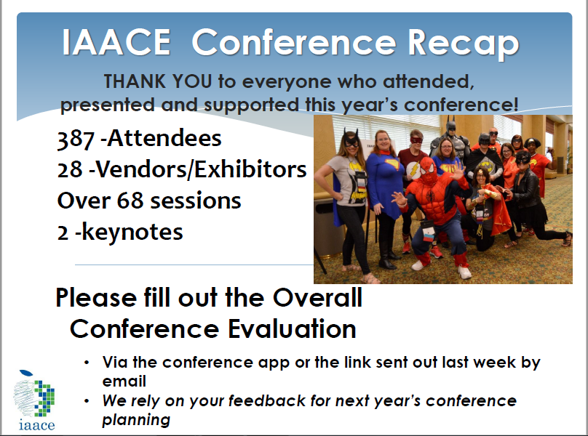
program is open to anyone age 16 or older who is not attending a high school. It helps people prepare for the equivalency test, earn workforce
certification and even learn English as a second language.
“It’s really all about getting people into career training and employment,” said Robert Moore, director of the program.
The program serves about 500 people each year. Historically, there has been one ceremony in May to recognize their accomplishments. A second
ceremony was added in December this year.
“- 1

Slide 38
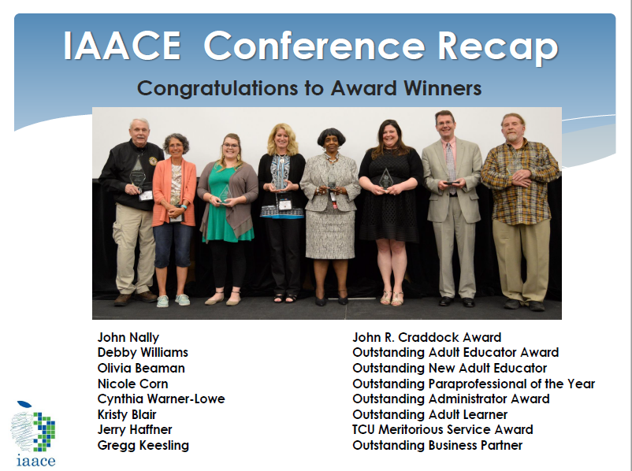
program is open to anyone age 16 or older who is not attending a high school. It helps people prepare for the equivalency test, earn workforce
certification and even learn English as a second language.
“It’s really all about getting people into career training and employment,” said Robert Moore, director of the program.
The program serves about 500 people each year. Historically, there has been one ceremony in May to recognize their accomplishments. A second
ceremony was added in December this year.
“- 1

Slide 39
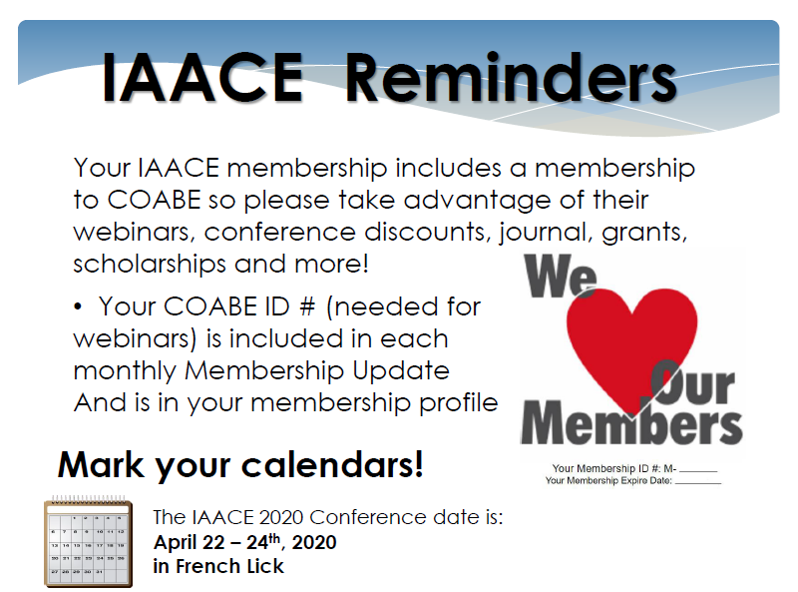
program is open to anyone age 16 or older who is not attending a high school. It helps people prepare for the equivalency test, earn workforce
certification and even learn English as a second language.
“It’s really all about getting people into career training and employment,” said Robert Moore, director of the program.
The program serves about 500 people each year. Historically, there has been one ceremony in May to recognize their accomplishments. A second
ceremony was added in December this year.
“- 1

Slide 40
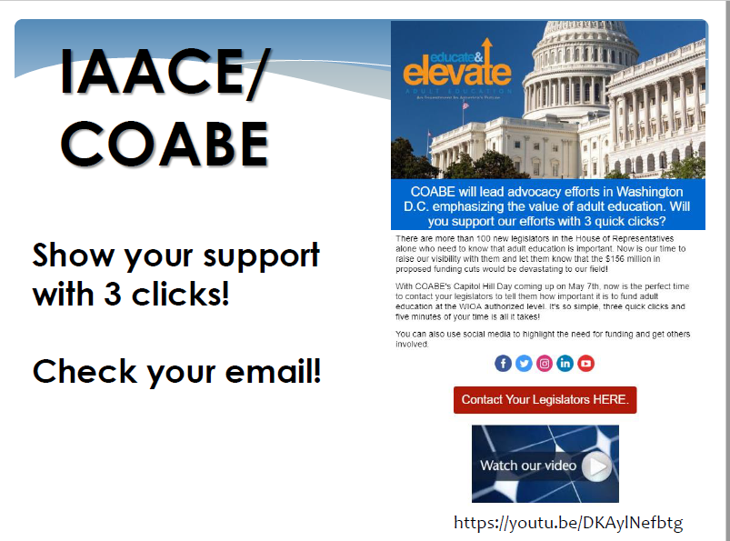
program is open to anyone age 16 or older who is not attending a high school. It helps people prepare for the equivalency test, earn workforce
certification and even learn English as a second language.
“It’s really all about getting people into career training and employment,” said Robert Moore, director of the program.
The program serves about 500 people each year. Historically, there has been one ceremony in May to recognize their accomplishments. A second
ceremony was added in December this year.
“- 1

Slide 41
program is open to anyone age 16 or older who is not attending a high school. It helps people prepare for the equivalency test, earn workforce
certification and even learn English as a second language.
“It’s really all about getting people into career training and employment,” said Robert Moore, director of the program.
The program serves about 500 people each year. Historically, there has been one ceremony in May to recognize their accomplishments. A second
ceremony was added in December this year.
“- 1
Next Adult Education & Workforce Development Statewide Webinar
6.12.19
10 to 11:30 a.m. ET
The right skills, at the right time, in the right way. Indiana’s Demand Driven Workforce

