Slide 1


The right skills, at the right time, in the right way. Indiana’s Demand Driven Workforce
Adult Education and Workforce Development Statewide Webinar
June 12, 2019
Marilyn Pitzulo | Adult Education Staff
Department of Workforce Development | Indiana ADULT EDUCATION
10 N. Senate Avenue, IGCS SE 203 | Indianapolis, IN 46204
AdultEd@dwd.in.gov

Slide 2

Indiana ADULT EDUCATION
Basic Skills. High School Equivalency. Short-term Training. Certifications and More.
Matthew
Breedlove
His Story Begins Loading Trucks
“I was nervous because I hadn’t been in school for 15 years or more. I didn’t know what to expect from class or myself.”
“
I left high school when I was 15 years old and started unloading trucks with an older brother for cash. When I turned 18 I was hired at McFarling Foods on the night shift, loading trucks. I worked my way to dayshift and worked will-call for 10 years before learning how to be a receiver, a job I did for the next five years. By that time, I had been married and we had two children. I wanted more out of my career, and that’s when I decided to get my HSE.”

Slide 3

Indiana ADULT EDUCATION
Basic Skills. High School Equivalency. Short-term Training. Certifications and More.
“
I (wanted to) find more options in my field – maybe do less with my back and more with my brain. I have a great support system with my wife and kids, so that made it easy.
“I checked into C9 and began the process. I was nervous because I hadn’t been in school for 15 years or more. I didn’t know what to expect from class or myself. I went to the classes they provided and worked hard with very approachable teachers. Within a few months, I had earned my HSE.”
Matthew Breedlove | Central Nine Career Center
“I (wanted more) options in my field-
maybe do less with my back and more with my brain.”

Slide 4
Indiana ADULT EDUCATION
Basic Skills. High School Equivalency. Short-term Training. Certifications and More.
“
Receiving my HSE gave me new confidence to pursue opportunities. I proved to myself that I could learn at a high level. I was also able to help my son with his high school math and show my kids that I value their education.
“I took this new confidence to a higher position in my company, Piazza Produce, as a specialty lead. Instead of unloading trucks, I am now responsible for buying and receiving product, communicating with vendors, and leading my department.”
Matthew Breedlove | His Family

Slide 5
Indiana ADULT EDUCATION
Basic Skills. High School Equivalency. Short-term Training. Certifications and More.
“I am earning more money, working with my brain, and continuing to learn new aspects of my field. I have also shown my kids the difference a little more education can make in a career.”
“Matt passed the HSE just after our graduation ceremony, so he had to wait an entire year to come back and walk across the stage. I was at the registration table a year later when he did just that, with a huge smile on his face, and I remember thinking, ‘This is why I do what I do.’”
--Carol Bible | HSE Lead Instructor
“A little education can make (a difference) in a career.”

Slide 6
Indiana ADULT EDUCATION
Basic Skills. High School Equivalency. Short-term Training. Certifications and More.
A Story of Courage and Determination
Smile Love
Win Htaw
“I was born in Burma, now known as Myanmar, but I was raised in Thailand. Due to the economic and political problems, my family fled from Myanmar to a refugee camp in Thailand when I was 10 years old. Living in the camp was very difficult; my house was made out of bamboo. We depended on food rations provided by the United Nations, and we did not receive any education.”
“In 2014, my mom and I finally were accepted to come to the United States. I was so excited and anxious to meet my dad and my brother’s family, but I was also scared wondering how we were going to survive not knowing the language. When I first arrived here, I did not know any English. Yet, I was so happy to go to school and reach my goal. Ever since I was a child, I have wanted to be a nurse.”
“My house was made out of bamboo (and) we depended on food rations.”

Slide 7
Indiana ADULT EDUCATION
Basic Skills. High School Equivalency. Short-term Training. Certifications and More.
A Story of Courage and Determination
“My caseworker took me to Anthis Career Center to register for English Language Learner classes. I started school in August of 2015. Learning a new language and new culture was a challenge to me. Sometimes I did not understand what the teacher said. However, I did not give up. I remember coming home from school and turning on the television and watching cartoons and other shows
because I wanted to understand what they were saying, and I wanted to talk like them. I read everything I saw. It took me three years to finish high school. At the beginning, I did not think I was going to be able to obtain my diploma. I (was) accepted to Ivy Tech College (and) will start school this fall for training for my dream job. I will keep going and never give up until I reach my goal.”
Smile Love
Win Htaw
“My house was made out of bamboo (and) we depended on food rations.”

Slide 8
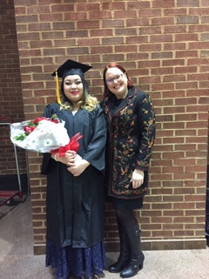

Indiana ADULT EDUCATION
Basic Skills. High School Equivalency. Short-term Training. Certifications and More.
A Story of Courage and Determination
“Smile has come to represent the ‘new’ American to me. She has acclimated to her environment and has flourished. My hope is that as she and her significant other raise their girl, with Burmese and Spanish speaking culture in mind, perhaps our society can move forward toward greater understanding and peace.” – Jennifer Bassett, Teacher
Smile Love
Win Htaw
“My house was made out of bamboo (and) we depended on food rations.”
“The Continuing Education Program serves adult students of all ages, many of whom have endured educational and personal struggles on their road to graduation.”

Slide 9

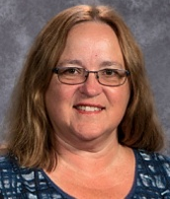
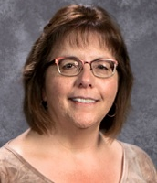
Indiana ADULT EDUCATION
Basic Skills. High School Equivalency. Short-term Training. Certifications and More.
Distance
Education
NRS Table 4C | NRS Table 4C | NRS Table 4C
Polly Redmond
Adult Basic Education Coordinator
Nancy Mitchell
Adult Basic Education
Assistant Site Manager
Hinds Career Center | 1105 N 19th St.
Elwood, IN 46036

Slide 10
Indiana ADULT EDUCATION
Basic Skills. High School Equivalency. Short-term Training. Certifications and More.
66%
Distance
Education
NRS Table 4C | NRS Table 4C | NRS Table 4C
Students Participate in Distance Education
Statewide Participation 26%
6.10.19

Slide 11
Hinds Adult Education
Distance Education

Slide 12
Hinds Distance Data
66% of our students do distance education.
Distance students in our program have 7% higher gains.
We introduce distance education during our orientation.
Distance is used to offset absences, much like real workforce comp time.
All teachers are expected to offer and encourage students to do distance.

Slide 13
Student Absence Chart
Students are allowed 5 absences before they are withdrawn from the program for 60 days.
1st Absence | 2nd Absence | 3rd Absence | 4th Absence | 5th Absence | 6th Absence: Withdrawn from Program for 60 Days
Note: If you are late to class or leave early that will also count against your attendance and you will receive a color.
The only way to make up for being late or for an absence is through Distance.

Slide 14
Distance Education
Distance Education is basically homework. It’s work that you do outside of your regular class. You can use distance time to make up for being tardy or missing a class.
To Get Credit for Distance
1) Have your teacher date and initial your homework at the place where you left off before you leave class. 2) Do the homework. 3) Turn in your distance work as soon as you get into class.
Counting Time
For most homework, you get 2 minutes per problem that you get right.*
For essay questions, you usually get 5 minutes per paragraph. If in doubt, ask your teacher.
*You don’t get time for problems that are incorrect. We also can’t give you time for work that you’re correcting because it’s difficult to tell which was done in class and which was done at home.
All time starts over on July 1st.

Slide 15


program is open to anyone age 16 or older who is not attending a high school. It helps people prepare for the equivalency test, earn workforce
certification and even learn English as a second language.
“It’s really all about getting people into career training and employment,” said Robert Moore, director of the program.
The program serves about 500 people each year. Historically, there has been one ceremony in May to recognize their accomplishments. A second
ceremony was added in December this year.
“- 1
Indiana ADULT EDUCATION
Basic Skills. High School Equivalency. Short-term Training. Certifications and More.
New Contact for TABE
Mike Johnson
National Adult Education Director
Data Recognition Corporation
630-995-6712
mjohnson@datarecognitioncorp.com

Slide 16

program is open to anyone age 16 or older who is not attending a high school. It helps people prepare for the equivalency test, earn workforce
certification and even learn English as a second language.
“It’s really all about getting people into career training and employment,” said Robert Moore, director of the program.
The program serves about 500 people each year. Historically, there has been one ceremony in May to recognize their accomplishments. A second
ceremony was added in December this year.
“- 1
Indiana ADULT EDUCATION
Basic Skills. High School Equivalency. Short-term Training. Certifications and More.
TASC Center Coordinators will receive an email with a link to complete a Data Recognition Corporation (DRC) survey. The survey is to better understand user satisfaction with the administration of the TASC Test. Results will be used by DRC to improve the TASC Test administration process. The survey should take no
more than 10 minutes to complete. Responses are being collected at an OPEN website with complete anonymity. All results will be combined for analysis.
Questions – Contact TASC Test Customer Support.
TASC
User
Survey
https://tasctest.com/contact-us/
Notes:
JH
TASC Center Coordinators will receive an email with a link to complete a Data Recognition Corporation (DRC) survey. The survey is to better understand user satisfaction with the administration of the TASC Test. Results will be used by DRC to improve the TASC Test administration process. The survey should take no more than 10 minutes to complete. All results will be combined for analysis. Questions – Contact TASC Test Customer Support.

Slide 17
NRS State Table 4 – 2018-2019 6-10-19

Slide 18
Indiana ADULT EDUCATION
Basic Skills. High School Equivalency. Short-term Training. Certifications and More.
Total
Enrollment
2018-2019* 2017-2018**
ABE/ELL 23,624 25,250
ELL
ABE
- 1,605
-21
6.43 PERCENT DECREASE
*Data as of 6.10.19 ** Data as of 6.11.18
Notes:
JH
Enrollment is down by more than 1,600 students. This is nearly a 7 percent decrease from a year ago; however, ELL enrollment is down by only 21 students from a year ago.

Slide 19
Indiana ADULT EDUCATION
Basic Skills. High School Equivalency. Short-term Training. Certifications and More.
MEASURABLE SKILL GAINS
Basic Skills Remediation
NRS Table 4, Column H NRS Table 4, Column I
2017-2018* 2018-2019**
64%
– Indiana Target
2018-2019
60.26%
62.80%
Instructional IMPACT
*Data as of 6.11.18 **Data as of 6.10.19
Then one day, after nearly ten years of sticking to his dream of pursuing music, and becoming an accomplished Elvis and Johnny Cash impersonator, his father had a proposition for him. “He said he knew I had this dream of recording music in Memphis and basically told me he would pay for half of everything if I got my (HSE).”
So, after years out of traditional high school, and an attempt at another high school equivalency (HSE) program out of state, Bennett enrolled at the MACC for daily adult education afternoon classes. “The teacher was great- he motivated me when I needed to be motivated.” After about four months in class, Bennett passed his HSE test and received his diploma. Bennett says, “If it wasn’t for Mr. Smith keeping me on track, I would have never gotten it done.”
“If I can make it, anyone can make it,” says Bennett.

Slide 20
Indiana ADULT EDUCATION
Basic Skills. High School Equivalency. Short-term Training. Certifications and More.
MEASURABLE SKILL GAINS
NRS Table 4, Column H NRS Table 4, Column I
2017-2018* 2018-2019**
ELL MSG INCREASE
3.40 Percentage Points
ABE 61.77%
ELL 54.66%
ABE 64.19%
ELL 58.06%
*Data as of 6.11.18 **Data as of 6.10.19
Then one day, after nearly ten years of sticking to his dream of pursuing music, and becoming an accomplished Elvis and Johnny Cash impersonator, his father had a proposition for him. “He said he knew I had this dream of recording music in Memphis and basically told me he would pay for half of everything if I got my (HSE).”
So, after years out of traditional high school, and an attempt at another high school equivalency (HSE) program out of state, Bennett enrolled at the MACC for daily adult education afternoon classes. “The teacher was great- he motivated me when I needed to be motivated.” After about four months in class, Bennett passed his HSE test and received his diploma. Bennett says, “If it wasn’t for Mr. Smith keeping me on track, I would have never gotten it done.”
“If I can make it, anyone can make it,” says Bennett.

Slide 21
Indiana ADULT EDUCATION
Basic Skills. High School Equivalency. Short-term Training. Certifications and More.
ABE/ELL
Average Indiana
Contact Hours
2018-2019* 2017-2018**
ABE/ELL 77 hrs. 76 hrs.
No Change
*Data as of 6.10.19 ** Data as of 6.11.18

Slide 22
Indiana ADULT EDUCATION
Basic Skills. High School Equivalency. Short-term Training. Certifications and More.
No. Separated Before Gain
6.10.19
4,967 21.02%
6.11.18
6,009
23.79%
Separations DECREASE
2.77 Percentage Points

Slide 23
Indiana ADULT EDUCATION
Basic Skills. High School Equivalency. Short-term Training. Certifications and More.
6.10.19
No. Separated Before Gain
2018-2019
– ABE/ASE Levels 1-6 19.69% Separated
– ELL Levels 1-6 25.58% Separated

Slide 24
Indiana ADULT EDUCATION
Basic Skills. High School Equivalency. Short-term Training. Certifications and More.
Number
HSE Diplomas
2018-2019* 2017-2018**
ABE/ELL 3,909 4,091
HSE Diplomas
- 182
DOWN
*Data as of 6.10.19 ** Data as of 6.11.18
Reported by InTERS

Slide 25
Indiana ADULT EDUCATION
Basic Skills. High School Equivalency. Short-term Training. Certifications and More.
Number
HSE Diplomas
4,778(Includes Walk-ins)
HSE Diplomas
- 691
DOWN
* Data as of 6.11.18
Reported by DRC | TASC

Slide 26
Indiana ADULT EDUCATION
Basic Skills. High School Equivalency. Short-term Training. Certifications and More.
Number
HSE Diplomas
4,778(Includes Walk-ins)
Percentage of Test Takers Passing Each Subtest
Reading 90.73%
Writing 91.70%
Mathematics 80.90%
Science 90.85%
Social Studies 94.19%
* Data as of 6.11.18
Reported by DRC | TASC

Slide 27
Indiana ADULT EDUCATION
Basic Skills. High School Equivalency. Short-term Training. Certifications and More.
MEASURABLE SKILL GAIN
Basic Skills Remediation
NRS Table 4, Columns B, D, I
64%
– Indiana Target
2018-2019
Enrolled 23,624 (ABE/ELL)
Majority of ABE Students
– Level 3 (6,896)
Next Highest – Level 2 (6,405)
Then one day, after nearly ten years of sticking to his dream of pursuing music, and becoming an accomplished Elvis and Johnny Cash impersonator, his father had a proposition for him. “He said he knew I had this dream of recording music in Memphis and basically told me he would pay for half of everything if I got my (HSE).”
So, after years out of traditional high school, and an attempt at another high school equivalency (HSE) program out of state, Bennett enrolled at the MACC for daily adult education afternoon classes. “The teacher was great- he motivated me when I needed to be motivated.” After about four months in class, Bennett passed his HSE test and received his diploma. Bennett says, “If it wasn’t for Mr. Smith keeping me on track, I would have never gotten it done.”
“If I can make it, anyone can make it,” says Bennett.

Slide 28
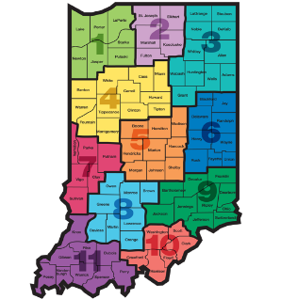
Indiana ADULT EDUCATION
Basic Skills. High School Equivalency. Short-term Training. Certifications and More.
High School Level
Moving Forward
2018-2019
ABE Levels 5-6
753 Students – 4%
6.10.19
ABE Levels 5-6
4,659 Students – 23%
6.11.18
GRADES
9-12

Slide 29
Indiana ADULT EDUCATION
Basic Skills. High School Equivalency. Short-term Training. Certifications and More.
High School Equivalencies
Moving Forward
2018-2019
Implications
TOTAL HSEs
3,909
6.10.19
ABE Level 3 – 1,826
ABE Level 4 – 1,042
ABE Level 2 – 662
Students may be ready at lower educational functioning levels to test
ABE Level 3 = Approx. Grade Range Equivalent 3-4
ABE Level 4 = Approx. Grade Range Equivalent 6-8
Administer TASC Readiness Assessment earlier

Slide 30
Indiana ADULT EDUCATION
Basic Skills. High School Equivalency. Short-term Training. Certifications and More.
Distance Education Measurable Skill Gains
Distance Ed
2018-2019
NRS Table 4C Column H
68.63%
ABE Enrolled 4,978
ELL Enrolled 1,337
Total 6,315
26% Participate in Distance Education
Data as of 6.10.19

Slide 31
Indiana ADULT EDUCATION
Basic Skills. High School Equivalency. Short-term Training. Certifications and More.
Participant Status
Program Enrollment
Employed | Unemployed
8,831 9,443
Not in Labor Force
5,348
Data as of 6.10.19

Slide 32
Indiana ADULT EDUCATION
Basic Skills. High School Equivalency. Short-term Training. Certifications and More.
Data as of 6.10.19
No. Enrolled Min. High School Diploma/HSE
U.S. – Non-U.S. Based Schooling
8,153
34.47%
29.31% PY 2017-2018
No. Enrolled With Some College or Degree
U.S. – Non-U.S. Based Schooling
3,106
13.13%
11.19% PY 2017-2018

Slide 33
Indiana ADULT EDUCATION
Basic Skills. High School Equivalency. Short-term Training. Certifications and More.
NRS Table 4B
EFL Gain for Pre- and Post-Testing Participants
Data is continuously reviewed to ensure its clean
All students are required to take the TASC practice test when they reach a certain level
Students will get half of their TASC test fees paid ($45) from a scholarship program if they take a pre- & post-test and get a gain, and then take the TASC practice test
Professional Development
Promising Practices

Slide 34
Indiana ADULT EDUCATION
Basic Skills. High School Equivalency. Short-term Training. Certifications and More.
NRS Table 4B
EFL Gain for Pre- and Post-Testing Participants
All students must pre- & post-test with a gain before entering an IET class. This ensures a student is motivated and ready for a certification class.
PDF reviews all pre-tests to see what is missing in order for a student to move to the next level, and then works with teachers to ensure they focus on what is lacking first.
Professional Development
Promising Practices

Slide 35

Indiana ADULT EDUCATION
Basic Skills. High School Equivalency. Short-term Training. Certifications and More.
NRS Table 4B
EFL Gain for Pre- and Post-Testing Participants
“McDowell Education Center is a supportive learning environment providing foundational skills, career counseling, and pathways to postsecondary training and employment for those pursuing their educational and career goals.”
Megan Shaff | Director
shaffm@bcsc.k12.in.us
McDowell Education Center
2700 McKinley Avenue, Columbus, IN 47201
97.63%
Professional Development
Promising Practices

Slide 36
program is open to anyone age 16 or older who is not attending a high school. It helps people prepare for the equivalency test, earn workforce
certification and even learn English as a second language.
“It’s really all about getting people into career training and employment,” said Robert Moore, director of the program.
The program serves about 500 people each year. Historically, there has been one ceremony in May to recognize their accomplishments. A second
ceremony was added in December this year.
“- 1
Indiana ADULT EDUCATION
Basic Skills. High School Equivalency. Short-term Training. Certifications and More.
Get Students Ready for HSE Testing
POST-TEST64% TARGET
Clean Up InTERS Errors
PROGRAM To Do LIST
Through
6.30.19
Start Today
Don’t Delay

Slide 37
Indiana ADULT EDUCATION
Basic Skills. High School Equivalency. Short-term Training. Certifications and More.
Professional Development
NEXT
STEPS
Moving Forward
2018-2019
Professional Development Project
Reflections from PDFs

Slide 38
Indiana ADULT EDUCATION
Basic Skills. High School Equivalency. Short-term Training. Certifications and More.
PDF
Reflections
► Our PD plan relied heavily on training teachers how to share resources so that we can use those resources to attain measurable skills gains.
► PDFs have worked with lower performing teachers and sites, observing classes, examining data, and sharing best practices to try to rectify the situation.
► ELL Table 4 measurable skills gain Column H/I in April 2018 was 49.6%; April 2019 it is 60.31%. This is a 10.71% increase.
► The follow-up activities validated and supported our role as PDFs in our programs.
Professional Development Facilitators’ Network

Slide 39
Indiana ADULT EDUCATION
Basic Skills. High School Equivalency. Short-term Training. Certifications and More.
PDF
Reflections
► Having specific goals provided three (very) important benefits.
We had a focus – we knew the end goal.
(2) We were strategic in the actions we took.
(3) We shared the goals with staff, giving them the opportunity to take personal responsibility to contribute to the accomplishment of our program goal.
Professional Development Facilitators’ Network

Slide 40
Indiana ADULT EDUCATION
Basic Skills. High School Equivalency. Short-term Training. Certifications and More.
PDF
Reflections
► I liked the February 2019 PD meeting in Indianapolis when the PD team helped us write the mandatory goals for the 2019/2020 year. Clear direction from the state is vital for sites and regions to follow and that meeting met those expectations.
► Many teachers did not know how to read Table 4 numbers until our focused professional development. We spent a lot of time working with teachers and data people to ensure better communications which enabled an increase in Table 4 percentages.
Professional Development Facilitators’ Network

Slide 41
Indiana ADULT EDUCATION
Basic Skills. High School Equivalency. Short-term Training. Certifications and More.
PDF
Reflections
► The ALPs and other (math) resources on the PDF team drive were very helpful to individual programs.
► It is always good to take the time and not only look at data, but also what was driving the data. What did we do right? What could be improved?
► When I did a site visit, I discovered two students were HSE ready and had been for quite some time, but the instructor was under the impression that he had to have multiple students ready before we could get the proctor to test.
Professional Development Facilitators’ Network

Slide 42
Indiana ADULT EDUCATION
Basic Skills. High School Equivalency. Short-term Training. Certifications and More.
REMINDER
PY19 GRANT INFORMATION
Award decisions announced . . .
Your Grants Team is available to respond to your questions –
  Scott Mills smills1@dwd.in.gov 317.864.2248
  Donna Lovelady dlovelady@dwd.in.gov 317.233.9902

Slide 43
Indiana ADULT EDUCATION
Basic Skills. High School Equivalency. Short-term Training. Certifications and More.
FISCAL REMINDERS
Budget Modifications
  All requests for budget modifications were due to our office (adulted@dwd.in.gov) by Monday, June 3, 2019. (Remember – a modification is required to move funds between Administrative and Program.)
Close Outs
  The DWD Finance Office will send close out packets out as usual. Remember to copy our office at the Adult Ed mailbox when you submit the final close out.
Reimbursements
  Follow up on any outstanding reimbursements before the end of the program year, June 30, 2019. Notify Cheryl Jones if any payment is overdue or an error has occurred.
  Notify Cheryl Jones if your final PY18 reimbursement will not be in by August 30, 2019.

Slide 44

Indiana ADULT EDUCATION
Basic Skills. High School Equivalency. Short-term Training. Certifications and More.
New
Workforce Initiative Coordinator
for Adult Education
Roy Melton
rmelton@dwd.in.gov
765.413.2216

Slide 45



Indiana ADULT EDUCATION
Basic Skills. High School Equivalency. Short-term Training. Certifications and More.
“My life has changed by getting the training I needed for a better paying job. The sky is the limit.”
– Sheldon Spence
CNC Machinist
Notes:
.

Slide 46
WorkINdiana
Updates
REMINDER
REMINDER
REMINDER
REMINDER
Responsibility for WorkINdiana through the end of the program year will be a team effort.
Shruti will take over the majority of day-to-day tasks.
Marilyn will handle fiscal and contract management.
mpitzulo@dwd.in.gov
SShrivastava@dwd.IN.gov

Slide 47


Indiana ADULT EDUCATION
Basic Skills. High School Equivalency. Short-term Training. Certifications and More.
Webinar
How to become a Workforce Ready Grant (non-credit bearing) Training Provider
This webinar will go over the program requirements, student eligibility, and steps required to become an eligible training provider for Indiana’s Workforce Ready Grant, non-credit bearing program. Becoming an eligible training provider for this program allows a training institution to train in high-demand, high-priority job sectors and receive student tuition payment directly from the state for eligible students.
June 20, 2019
10:30 – 11:30 a.m.
https://bit.ly/2PtsfX9

Slide 48
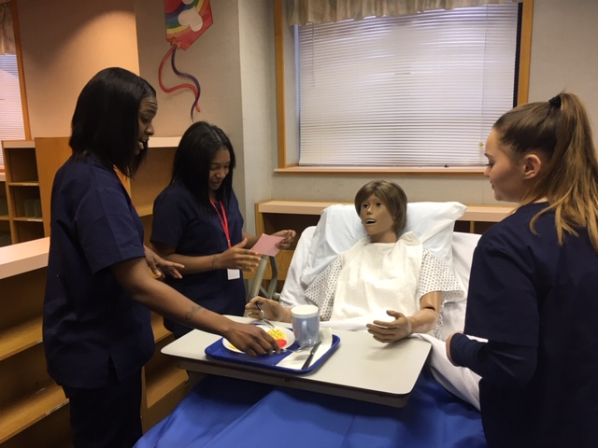
program is open to anyone age 16 or older who is not attending a high school. It helps people prepare for the equivalency test, earn workforce
certification and even learn English as a second language.
“It’s really all about getting people into career training and employment,” said Robert Moore, director of the program.
The program serves about 500 people each year. Historically, there has been one ceremony in May to recognize their accomplishments. A second
ceremony was added in December this year.
“- 1
Indiana ADULT EDUCATION
Basic Skills. High School Equivalency. Short-term Training. Certifications and More.
►Integrated Education & Training
IELCE | Short-term Training | Certifications
Certified Nursing Assistant (CNA) Classes
MSD Warren Township Adult Education Program
11 IELCE certifications and 216 IET certifications
4 pending applications
IET Enrollment 2,787 59.40% goal
IELCE Enrollment 93 16.00% goal
Still Enrolled 863
Dropped 305 15.58%
Completions 1,619 84.15%
Certifications 1,207 74.55%

Slide 49
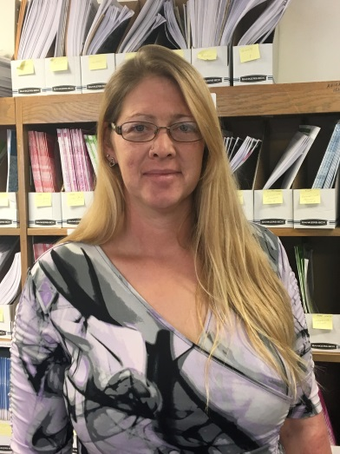
Indiana ADULT EDUCATION
Basic Skills. High School Equivalency. Short-term Training. Certifications and More.
Workforce Education
Initiative
“Passing the HSE is just a milestone. My ultimate goal is to be become an industrial electrician. I’ve had some family tell me to not do this and just get a job. So, I want to prove to them that I can be successful!”
89 WEI certifications
2 pending applications
WEI monthly data report statewide enrollments –
WEI Enrollments 925 21.4% of the goal
Still enrolled 757
Dropped 38 20.77%
Completed 145 79.23%
Certification 121 83.45%
- Tina Hines
Viigo County School Corporation Adult Education
Success Story

Slide 50
STATEWIDE | Goal | To-Date
Enrollment | 1,800 | 1716
Enrollment Rate | --- | 95%
Still Enrolled | --- | 210
Completers | 1,440 | 1343
Completion Rate | 80% | 89%
Dropped | --- | 163
Dropped Rate | Below 10% | 10.87%
Certifications issued | 1,065 | 1076
Certification Rate | 74% | 80%
Employment | 640 | 609
Employment Rate | 60% | 45%
  Shruti Shrivastava
  SShrivastava@dwd.in.gov
  WorkINdiana@dwd.in.gov
WorkINdiana
Updates
Statewide
5% JAG enrollment
8.3% ERG utilization
36% TANF utilization

Slide 51
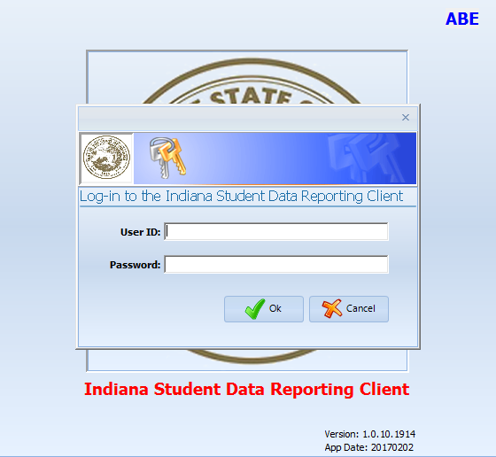
program is open to anyone age 16 or older who is not attending a high school. It helps people prepare for the equivalency test, earn workforce
certification and even learn English as a second language.
“It’s really all about getting people into career training and employment,” said Robert Moore, director of the program.
The program serves about 500 people each year. Historically, there has been one ceremony in May to recognize their accomplishments. A second
ceremony was added in December this year.
“- 1
InTERS
ADULT EDUCATION UPDATES, TRAININGS
Matt Crites
mcrites@dwd.in.gov
Brin Sisco
bsisco@dwd.in.gov

Slide 52
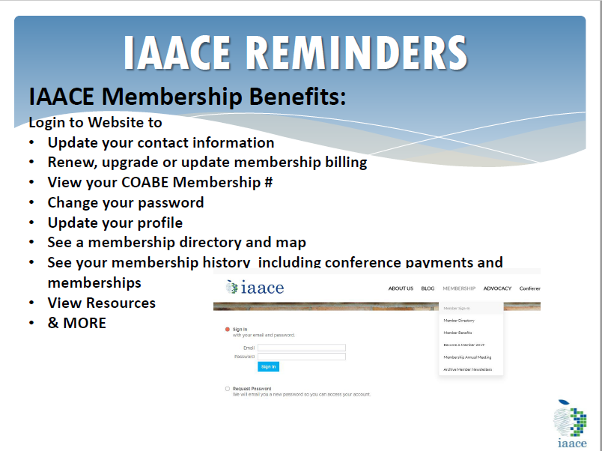
program is open to anyone age 16 or older who is not attending a high school. It helps people prepare for the equivalency test, earn workforce
certification and even learn English as a second language.
“It’s really all about getting people into career training and employment,” said Robert Moore, director of the program.
The program serves about 500 people each year. Historically, there has been one ceremony in May to recognize their accomplishments. A second
ceremony was added in December this year.
“- 1

Slide 53
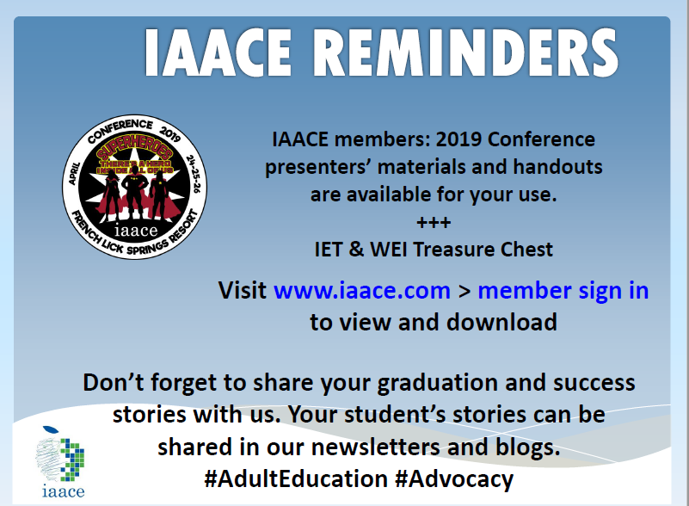
program is open to anyone age 16 or older who is not attending a high school. It helps people prepare for the equivalency test, earn workforce
certification and even learn English as a second language.
“It’s really all about getting people into career training and employment,” said Robert Moore, director of the program.
The program serves about 500 people each year. Historically, there has been one ceremony in May to recognize their accomplishments. A second
ceremony was added in December this year.
“- 1

Slide 54
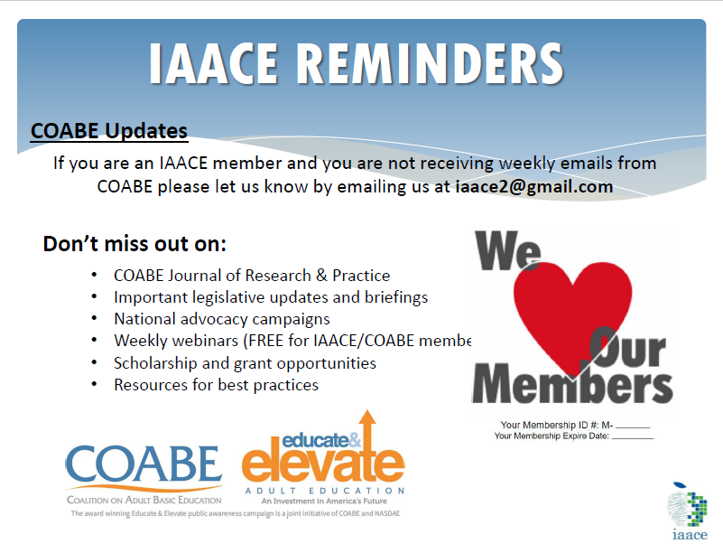
program is open to anyone age 16 or older who is not attending a high school. It helps people prepare for the equivalency test, earn workforce
certification and even learn English as a second language.
“It’s really all about getting people into career training and employment,” said Robert Moore, director of the program.
The program serves about 500 people each year. Historically, there has been one ceremony in May to recognize their accomplishments. A second
ceremony was added in December this year.
“- 1

Slide 55
program is open to anyone age 16 or older who is not attending a high school. It helps people prepare for the equivalency test, earn workforce
certification and even learn English as a second language.
“It’s really all about getting people into career training and employment,” said Robert Moore, director of the program.
The program serves about 500 people each year. Historically, there has been one ceremony in May to recognize their accomplishments. A second
ceremony was added in December this year.
“- 1
Next Adult Education & Workforce Development Statewide Webinar
7.10.19
10 to 11:30 a.m. ET
The right skills, at the right time, in the right way. Indiana’s Demand Driven Workforce

