Slide 1


The right skills, at the right time, in the right way. Indiana’s Demand Driven Workforce
Adult Education and Workforce Development Statewide Webinar
July 18, 2018
Marilyn Pitzulo | Adult Education Staff
Department of Workforce Development | Indiana ADULT EDUCATION
10 N. Senate Avenue, IGCS SE 203 | Indianapolis, IN 46204
AdultEd@dwd.in.gov

Slide 2
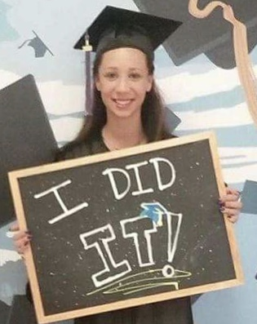
Indiana ADULT EDUCATION
Basic Skills. High School Equivalency. Short-term Training. Certifications and More.
Angelia Clevenger began adult education classes at the Winchester WorkOne after her mother signed her out of high school.
As a student with ADD/ADHD, she said, “There were just too many distractions and too much drama for me, I couldn’t concentrate.”
Because of her teacher and a small class size, it was possible for her to focus on education, and to keep on task with what needed to be done.
“Beginning of a Journey”
Angelia
Clevenger
Winchester, Indiana
“I WAS FAILING
EVERY CLASS
AND I DIDN’T CARE.”
Then one day, after nearly ten years of sticking to his dream of pursuing music, and becoming an accomplished Elvis and Johnny Cash impersonator, his father had a proposition for him. “He said he knew I had this dream of recording music in Memphis and basically told me he would pay for half of everything if I got my (HSE).”
So, after years out of traditional high school, and an attempt at another high school equivalency (HSE) program out of state, Bennett enrolled at the MACC for daily adult education afternoon classes. “The teacher was great- he motivated me when I needed to be motivated.” After about four months in class, Bennett passed his HSE test and received his diploma. Bennett says, “If it wasn’t for Mr. Smith keeping me on track, I would have never gotten it done.”
“If I can make it, anyone can make it,” says Bennett.

Slide 3


Indiana ADULT EDUCATION
Basic Skills. High School Equivalency. Short-term Training. Certifications and More.
“You just have to let anything that brings you down, be the motivation that pushes you forward.”
“I feel like if I didn’t go to the HSE classes I would still be in high school and not graduated and getting my CNA already.”
She is currently a home health aide and would like to someday work in a hospital.
All Heart Nurse's Aide Training Center in Winchester helped begin Angelia’s journey by paying for her CNA classes and test.
“Beginning of a Journey”
Angelia
Clevenger
Winchester, Indiana
Then one day, after nearly ten years of sticking to his dream of pursuing music, and becoming an accomplished Elvis and Johnny Cash impersonator, his father had a proposition for him. “He said he knew I had this dream of recording music in Memphis and basically told me he would pay for half of everything if I got my (HSE).”
So, after years out of traditional high school, and an attempt at another high school equivalency (HSE) program out of state, Bennett enrolled at the MACC for daily adult education afternoon classes. “The teacher was great- he motivated me when I needed to be motivated.” After about four months in class, Bennett passed his HSE test and received his diploma. Bennett says, “If it wasn’t for Mr. Smith keeping me on track, I would have never gotten it done.”
“If I can make it, anyone can make it,” says Bennett.

Slide 4
Indiana ADULT EDUCATION
Basic Skills. High School Equivalency. Short-term Training. Certifications and More.
“If you just put your mind to it, you can do it. That’s what I did!”
During her time with the CNA program, she went to school from 4 to 9 p.m. and then worked from 11 p.m. to 7 a.m. And, hardest of all, her best friend died while she was in the adult education program.
Her friend who would always call and ask about her classes pressed her to do her best. “He was my main support, so I knew it was time to get
serious about what I needed to do,” she said. “I started when I was 18 and finished when I was 18.”
“Beginning of a Journey”
“Angelia is the happiest student I’ve ever had,” recalling that, “she would bounce into class jubilant and cheerful every day.” – Teacher Julie Longwell
Angelia
Clevenger
Winchester, Indiana
Then one day, after nearly ten years of sticking to his dream of pursuing music, and becoming an accomplished Elvis and Johnny Cash impersonator, his father had a proposition for him. “He said he knew I had this dream of recording music in Memphis and basically told me he would pay for half of everything if I got my (HSE).”
So, after years out of traditional high school, and an attempt at another high school equivalency (HSE) program out of state, Bennett enrolled at the MACC for daily adult education afternoon classes. “The teacher was great- he motivated me when I needed to be motivated.” After about four months in class, Bennett passed his HSE test and received his diploma. Bennett says, “If it wasn’t for Mr. Smith keeping me on track, I would have never gotten it done.”
“If I can make it, anyone can make it,” says Bennett.

Slide 5
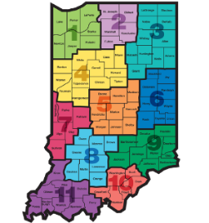
Indiana ADULT EDUCATION
Basic Skills. High School Equivalency. Short-term Training. Certifications and More.
How Did We Do?
Basic Skills
High School Equivalency
#1
INDIANA
Performance
Metrics
#2
Then one day, after nearly ten years of sticking to his dream of pursuing music, and becoming an accomplished Elvis and Johnny Cash impersonator, his father had a proposition for him. “He said he knew I had this dream of recording music in Memphis and basically told me he would pay for half of everything if I got my (HSE).”
So, after years out of traditional high school, and an attempt at another high school equivalency (HSE) program out of state, Bennett enrolled at the MACC for daily adult education afternoon classes. “The teacher was great- he motivated me when I needed to be motivated.” After about four months in class, Bennett passed his HSE test and received his diploma. Bennett says, “If it wasn’t for Mr. Smith keeping me on track, I would have never gotten it done.”
“If I can make it, anyone can make it,” says Bennett.

Slide 6
NRS State Table 4 7-16-18

Slide 7
Indiana ADULT EDUCATION
Basic Skills. High School Equivalency. Short-term Training. Certifications and More.
MEASURABLE SKILL GAIN
Basic Skills Remediation
NRS Table 4
2017-2018* 2016-2017
60%
– Indiana Target
63.06%
57.60%
Instructional IMPACT
*Data as of 7.16.18
Then one day, after nearly ten years of sticking to his dream of pursuing music, and becoming an accomplished Elvis and Johnny Cash impersonator, his father had a proposition for him. “He said he knew I had this dream of recording music in Memphis and basically told me he would pay for half of everything if I got my (HSE).”
So, after years out of traditional high school, and an attempt at another high school equivalency (HSE) program out of state, Bennett enrolled at the MACC for daily adult education afternoon classes. “The teacher was great- he motivated me when I needed to be motivated.” After about four months in class, Bennett passed his HSE test and received his diploma. Bennett says, “If it wasn’t for Mr. Smith keeping me on track, I would have never gotten it done.”
“If I can make it, anyone can make it,” says Bennett.

Slide 8
Indiana ADULT EDUCATION
Basic Skills. High School Equivalency. Short-term Training. Certifications and More.
#1 MEASURABLE SKILL GAIN
Basic Skills Remediation
NRS Table 4
60%
- Indiana Target
ABE 64.58% ELL 57.23%
63.06%
Data as of 7.16.18
Then one day, after nearly ten years of sticking to his dream of pursuing music, and becoming an accomplished Elvis and Johnny Cash impersonator, his father had a proposition for him. “He said he knew I had this dream of recording music in Memphis and basically told me he would pay for half of everything if I got my (HSE).”
So, after years out of traditional high school, and an attempt at another high school equivalency (HSE) program out of state, Bennett enrolled at the MACC for daily adult education afternoon classes. “The teacher was great- he motivated me when I needed to be motivated.” After about four months in class, Bennett passed his HSE test and received his diploma. Bennett says, “If it wasn’t for Mr. Smith keeping me on track, I would have never gotten it done.”
“If I can make it, anyone can make it,” says Bennett.

Slide 9

Indiana ADULT EDUCATION
Basic Skills. High School Equivalency. Short-term Training. Certifications and More.
MEASURABLE SKILL GAIN
Basic Skills Remediation
NRS Table 4
2017-2018 2016-2017
ABE 64.58% +4.92% 59.66%
ELL 57.23% + 6.42% 50.81%
TOTAL 63.06%* +5.46% 57.60%
60%
– Indiana Target
Instructional IMPACT
*Data as of 7.16.18
Then one day, after nearly ten years of sticking to his dream of pursuing music, and becoming an accomplished Elvis and Johnny Cash impersonator, his father had a proposition for him. “He said he knew I had this dream of recording music in Memphis and basically told me he would pay for half of everything if I got my (HSE).”
So, after years out of traditional high school, and an attempt at another high school equivalency (HSE) program out of state, Bennett enrolled at the MACC for daily adult education afternoon classes. “The teacher was great- he motivated me when I needed to be motivated.” After about four months in class, Bennett passed his HSE test and received his diploma. Bennett says, “If it wasn’t for Mr. Smith keeping me on track, I would have never gotten it done.”
“If I can make it, anyone can make it,” says Bennett.

Slide 10
Indiana ADULT EDUCATION
Basic Skills. High School Equivalency. Short-term Training. Certifications and More.
Distance Education Measurable Skill Gains
7.31.17
2016-2017
NRS Table 4C Column H
64.96%
7.16.18
2017-2018
NRS Table 4C
Column H
70.21%
Distance Ed
2016-2017
2017-2018*
*Data as of 7.16.18

Slide 11
Indiana ADULT EDUCATION
Basic Skills. High School Equivalency. Short-term Training. Certifications and More.
Distance Education Measurable Skill Gains
7-.13.18
2017-2018
ABE/ASE
NRS Table 4C Column H
69.34%
7.16.18
2017-2018
ELL
NRS Table 4C
Column H
74.75%
Distance Ed
2017-2018*
ABE/ASE
ELL
*Data as of 7.16.18

Slide 12
Indiana ADULT EDUCATION
Basic Skills. High School Equivalency. Short-term Training. Certifications and More.
No. Separated Before Gain
2016-2017
9,817
36.36%
2017-2018*
6,716
25.50%
*Data as of 7.16.18

Slide 13
Indiana ADULT EDUCATION
Basic Skills. High School Equivalency. Short-term Training. Certifications and More.
No. Separated Before Gain
– ABE/ASE Levels 1-6 (24.25% Separated)
– ELL Levels 1-6 (30.36% Separated)
6,716
No. Separated Before GAIN
No. Remaining
– ABE/ASE Levels 1-6 (11.17% Remaining)
– ELL Levels 1-6 (12.39% Remaining)
25.50%
*Data as of 7.16.18

Slide 14
Indiana ADULT EDUCATION
Basic Skills. High School Equivalency. Short-term Training. Certifications and More.
Enrollment
2017-1018 2016-2017
26,327 26,993
- 666
Down
Federal Adult Education Enrollment
Down 4% 2015-2016
43 States Decreased – Ranging 1 to 20%
*Data as of 7.16.18

Slide 15
Indiana ADULT EDUCATION
Basic Skills. High School Equivalency. Short-term Training. Certifications and More.
Enrollment
2017-1018 2016-2017
ABE 1-6 20,907 ↑ 20,720
ELL 1-6 5,420 ↓ 6,273
ELL
- 853
Down
*Data as of 7.16.18

Slide 16

Indiana ADULT EDUCATION
Basic Skills. High School Equivalency. Short-term Training. Certifications and More.
How Did We Do?
High School Equivalency
INDIANA
Performance
Metrics
Pass Rate
77.21%* 2017-2018
75.55% 2016-2017
*Data of 7.16.18

Slide 17


Indiana ADULT EDUCATION
Basic Skills. High School Equivalency. Short-term Training. Certifications and More.
TASC Summary All Indiana Examinees
2017-2018* 5,468
2016-2017 5,388
+ 80
*Data as of 6.8.18
InTERS Summary All Enrolled Indiana Examinees
2017-2018* 4,587
2016-2017 4,870
- 283
*Data of 7.16.18

Slide 18



Indiana ADULT EDUCATION
Basic Skills. High School Equivalency. Short-term Training. Certifications and More.
Paula Boffa-Taylor is retiring from DRC in August. Paula will be with TASC until August 9. Many of you worked closely with her over the years and may want to reach out and wish her well.
The new representative for Indiana will be Catherine Bienfait. Like Paula, Catherine has been with the TASC program since the beginning. Catherine was responsible for bringing New York State on board with TASC and is still their program manager.
Catherine
Bienfait
Data Recognition Corporation TASC
Then one day, after nearly ten years of sticking to his dream of pursuing music, and becoming an accomplished Elvis and Johnny Cash impersonator, his father had a proposition for him. “He said he knew I had this dream of recording music in Memphis and basically told me he would pay for half of everything if I got my (HSE).”
So, after years out of traditional high school, and an attempt at another high school equivalency (HSE) program out of state, Bennett enrolled at the MACC for daily adult education afternoon classes. “The teacher was great- he motivated me when I needed to be motivated.” After about four months in class, Bennett passed his HSE test and received his diploma. Bennett says, “If it wasn’t for Mr. Smith keeping me on track, I would have never gotten it done.”
“If I can make it, anyone can make it,” says Bennett.

Slide 19

program is open to anyone age 16 or older who is not attending a high school. It helps people prepare for the equivalency test, earn workforce
certification and even learn English as a second language.
“It’s really all about getting people into career training and employment,” said Robert Moore, director of the program.
The program serves about 500 people each year. Historically, there has been one ceremony in May to recognize their accomplishments. A second
ceremony was added in December this year.
“- 1
Indiana ADULT EDUCATION
Basic Skills. High School Equivalency. Short-term Training. Certifications and More.
2018-19 Grant
Program Performance Metrics
Performance Metric | Point Value
Adult Education Enrollment | 1 Point
Attained HSE | 1 Point
Measurable Skill Gain | 1 Point
Attained Certification | 1 Point
The 2018-2019 Program Performance Metrics will be used to award grants for 2019-2020

Slide 20
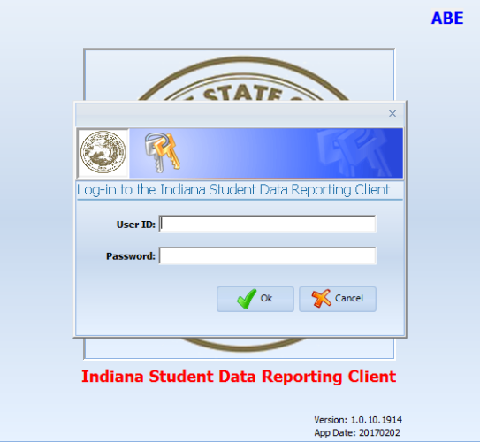
program is open to anyone age 16 or older who is not attending a high school. It helps people prepare for the equivalency test, earn workforce
certification and even learn English as a second language.
“It’s really all about getting people into career training and employment,” said Robert Moore, director of the program.
The program serves about 500 people each year. Historically, there has been one ceremony in May to recognize their accomplishments. A second
ceremony was added in December this year.
“- 1
InTERS
Data Security
User ID
Password
Do Not Share Log-ins

Slide 21


Indiana ADULT EDUCATION
Basic Skills. High School Equivalency. Short-term Training. Certifications and More.
“
CONTINUOUS PROGRAM IMPROVEMENT
This document presents (1) WIOA
performance indicators and other NRS
measures; (2) methodologies for collecting the measures; (3) training and technical assistance to States in collecting and reporting the measures; and (4) reporting tables, including the WIOA joint information collection request (ICR) instructions and forms.” NRS Technical Assistance Guide, p. 2
“The enactment of WIOA in 2014 created new requirements for accountability and performance.” NRS Technical Assistance Guide, p. 3 https://nrsweb.org/
Then one day, after nearly ten years of sticking to his dream of pursuing music, and becoming an accomplished Elvis and Johnny Cash impersonator, his father had a proposition for him. “He said he knew I had this dream of recording music in Memphis and basically told me he would pay for half of everything if I got my (HSE).”
So, after years out of traditional high school, and an attempt at another high school equivalency (HSE) program out of state, Bennett enrolled at the MACC for daily adult education afternoon classes. “The teacher was great- he motivated me when I needed to be motivated.” After about four months in class, Bennett passed his HSE test and received his diploma. Bennett says, “If it wasn’t for Mr. Smith keeping me on track, I would have never gotten it done.”
“If I can make it, anyone can make it,” says Bennett.

Slide 22

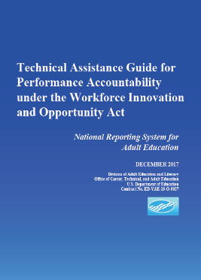
Indiana ADULT EDUCATION
Basic Skills. High School Equivalency. Short-term Training. Certifications and More.
New NRS TABLES
PROGRAM YEAR 2018-19
REPORTING ON OCTOBER 1, 2019
https://nrsweb.org/training-ta/nrs-reporting-tables-webinar
BEGINS
Page 154

Slide 23

Indiana ADULT EDUCATION
Basic Skills. High School Equivalency. Short-term Training. Certifications and More.
Changes to Tables 4 and 5 and New NRS Tables
Table 2A – Reportable Individuals by Age, Ethnicity, and Sex
Table 4 – Measurable Skills Gains (MSG) by Entry Level (columns added)
Table 4A – Educational Functioning Level Gain
Table 5 – Primary Indicators of Performance (column headings)
Table 11 – Outcome Achievement for Participants in Integrated Education & Training Programs

Slide 24
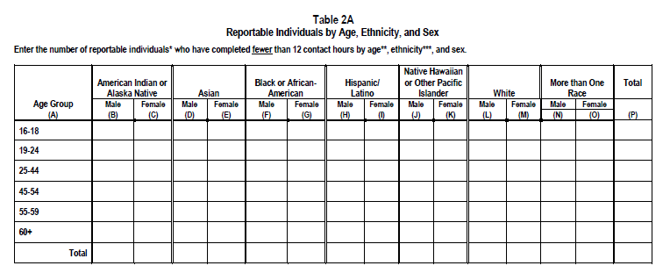

Indiana ADULT EDUCATION
Basic Skills. High School Equivalency. Short-term Training. Certifications and More.
NRS TABLE 2A
Reportable Individuals
Fewer than 12 hours
https://nrsweb.org/training-ta/webinars

Slide 25
Indiana ADULT EDUCATION
Basic Skills. High School Equivalency. Short-term Training. Certifications and More.
Participant | Reportable Individual
A reportable individual who has received services other than the services described in § 677.150(a)(3), after satisfying all applicable programmatic requirements for the provision of services, such as eligibility determination. | An individual who has taken action that demonstrates an intent to use program services and who meets specific reporting criteria of the program, including: (1) Individuals who provide identifying information; (2) Individuals who only use the self-service system; or (3) Individuals who only receive information-only services or activities.
For Title II, when an individual in an AEFLA program has completed at least 12 contact hours they are considered a participant. | An adult in an AEFLA program who has completed less than 12 contact hours.
Participants count towards accountability measures. | Reportable Individuals DO NOT count towards accountability measures.

Slide 26
Indiana ADULT EDUCATION
Basic Skills. High School Equivalency. Short-term Training. Certifications and More.
NRS TABLES FOR PROGRAM YEAR 2018-19 REPORTING ON OCTOBER 1, 2019
Table 2A Reportable Individuals by Age, Ethnicity, and Sex
Enter the number of reportable individuals* who have completed fewer than 12 contact hours by age**, ethnicity***, and sex.
Instructions for Completing Table 2A *Report, on this table, only individuals who have completed fewer than 12 contact hours in a period of participation. A reportable individual is an individual who has taken action that demonstrates an intent to use program services and who meets specific reporting criteria of an AEFLA program.
NRS Table 2 Instructions

Slide 27
Indiana ADULT EDUCATION
Basic Skills. High School Equivalency. Short-term Training. Certifications and More.
Registers for
Orientation
(No Show)
Attends Orientation
(No Show – Attends Partial)
Attends Class
(Leaves Before Pretesting)
Critical Control Points
Where Are We
Losing Students?
(Reportable Individuals)
Less than 12 Hours
2017-2018 – 5,923 Students*
*Data as of 7.16.18

Slide 28
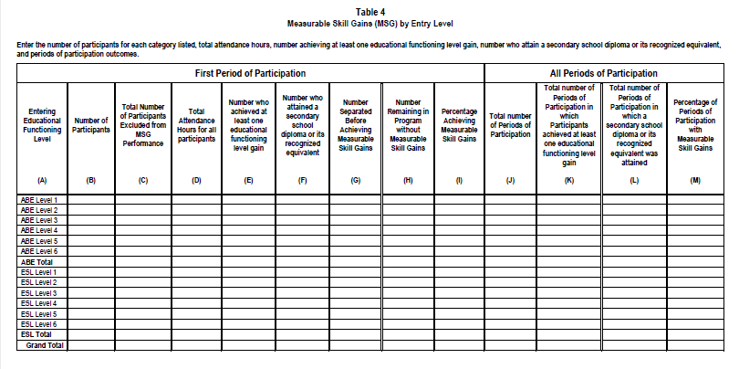
Indiana ADULT EDUCATION
Basic Skills. High School Equivalency. Short-term Training. Certifications and More.
NRS TABLE 4
Measurable Skill Gains by Entry Level

Slide 29
Indiana ADULT EDUCATION
Basic Skills. High School Equivalency. Short-term Training. Certifications and More.
#1
What is the purpose of the new columns?
  ► The new columns allow for the accounting of participants excluded from the MSG indicator, and a break out of EFL gain and secondary credential attainment within the Periods of Participation section for the MSG indicator.
Why are the new columns required?
► They enable the calculation of MSG without excluded participants. They allow disaggregated Periods of Participation values for the number of secondary credentials received and EFL gains for the MSG indicator.
NRS TABLE 4
Measurable Skill Gains by Entry Level
#2

Slide 30
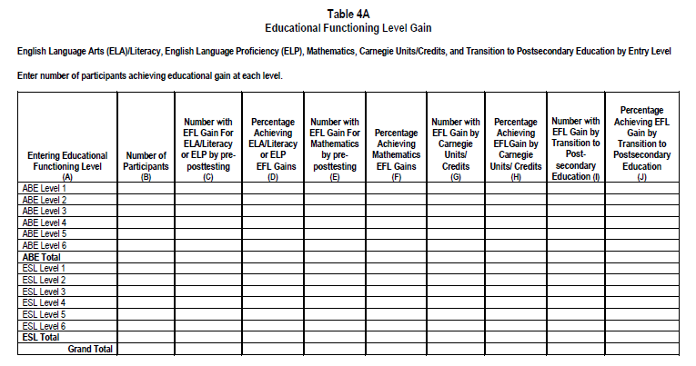
Indiana ADULT EDUCATION
Basic Skills. High School Equivalency. Short-term Training. Certifications and More.
NRS TABLE 4A
Measurable Skill Gains by Entry Level

Slide 31
Indiana ADULT EDUCATION
Basic Skills. High School Equivalency. Short-term Training. Certifications and More.
NRS TABLE 4A
Measurable Skill Gains by Entry Level
#1
Number with EFL Gain for ELA/Literacy or ELP by pre-posttesting
(Reading, Writing, Literacy Skills, Speaking, or Literacy Tests)
Percentage Achieving ELA/Literacy or ELP EFL Gains
Number with EFL Gain for Mathematics by pre-posttesting
Percentage Achieving Mathematics EFL Gains
#2

Slide 32
Indiana ADULT EDUCATION
Basic Skills. High School Equivalency. Short-term Training. Certifications and More.
NRS TABLE 4A
Measurable Skill Gains by Entry Level
#1
Number with EFL Gain by Carnegie Units/Credits
Percentage Achieving EFL Gain by Carnegie Units/ Credits
#2
Number with EFL Gain by Transition to Post-secondary Education
Percentage Achieving EFL Gain by Transition to Postsecondary Education

Slide 33
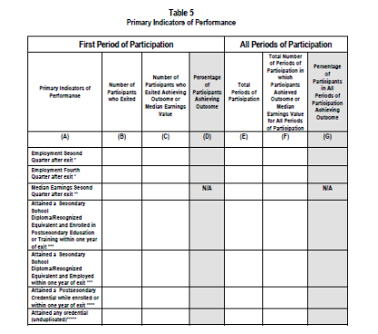
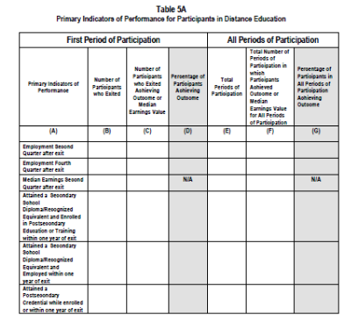
Indiana ADULT EDUCATION
Basic Skills. High School Equivalency. Short-term Training. Certifications and More.
NRS TABLE 5
Primary Indicators of Performance
Participants in Distance Education

Slide 34
Indiana ADULT EDUCATION
Basic Skills. High School Equivalency. Short-term Training. Certifications and More.
Table 5 Column Heading Changes
What is the purpose of the column heading changes?
  The new headings more clearly designate that the table should break out indicators achieved in the first period of participation (PoP) and to include indictors for all PoPs.
  NOTE: This change also applies to Tables 4, 4C, 5A, 8, 9, 10, and 11.
  The new row on Table 5 provides a single consolidated value for credential attainment that will be used for the Credential Rate indicator.
17
NRS TABLE 5
Primary Indicators of Performance

Slide 35
Indiana ADULT EDUCATION
Basic Skills. High School Equivalency. Short-term Training. Certifications and More.
Table 5 Column Heading Changes
NRS TABLE 5
Primary Indicators of Performance
Why are the new column heading changes required?
The new headings prevent confusion on how to complete the tables and show how all PoPs are included in the final calculation for performance reporting.
Why is the new row required?
The new row allows for transparency between NRS Table 5 and the Statewide Performance Report by providing the consolidated Credential Rate Indicator value.

Slide 36
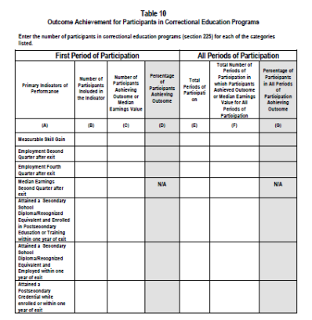
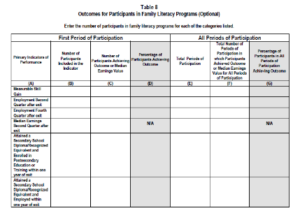
Indiana ADULT EDUCATION
Basic Skills. High School Equivalency. Short-term Training. Certifications and More.
NRS TABLES
8 &10
Primary Indicators of Performance
Outcomes for Participants in Family Literacy Programs (Optional)
Outcome Achievement for Participants in Correctional Education Programs

Slide 37
Indiana ADULT EDUCATION
Basic Skills. High School Equivalency. Short-term Training. Certifications and More.
NRS TABLES 8 & 10
Primary Indicators of Performance
Additional Column Heading Changes for Tables 8 & 10
What is the purpose of the column heading changes?
The new heading for Column B on tables 8 and 10 will note that the participant count should be all those included in the indicator for each row. NOTE: This header change will apply to Tables 9 and 11 as well.
Why ARE he new column heading changes required?
There were a lot of questions about tables 8 and 10 during the 2016–2017 program year’s data submission regarding who should go into Column B for the MSG Indicator row because the column header referred to exited participants.

Slide 38
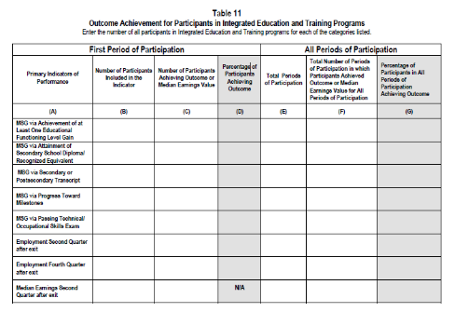
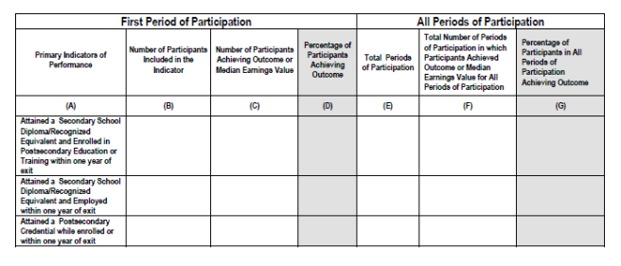
Indiana ADULT EDUCATION
Basic Skills. High School Equivalency. Short-term Training. Certifications and More.
Outcome Achievement for Participants in Integrated Education and Training Programs
NRS TABLE 11
Primary Indicators of Performance

Slide 39
Indiana ADULT EDUCATION
Basic Skills. High School Equivalency. Short-term Training. Certifications and More.
What is the purpose of the new table?
  The purpose of Table 11 is to capture outcomes for participants in integrated education and training (IET) programs in the first PoP and all PoPs. It also includes other ways to measure MSG used by Title I programs.
Why is the new table required?
  The data can be used to determine the type of gains participants in IET programs make and compare them with gains made by participants in other programs.
  It also will provide information about the use of the other methods for measuring MSG.
NRS TABLE 11 Primary Indicators of Performance

Slide 40


Indiana ADULT EDUCATION
Basic Skills. High School Equivalency. Short-term Training. Certifications and More.
program is open to anyone age 16 or older who is not attending a high school. It helps people prepare for the equivalency test, earn workforce
certification and even learn English as a second language.
“It’s really all about getting people into career training and employment,” said Robert Moore, director of the program.
The program serves about 500 people each year. Historically, there has been one ceremony in May to recognize their accomplishments. A second
ceremony was added in December this year.
“- 1
TEACHER’S Handbook
ADMINISTRATOR’S Handbook
*Posted –
AmplifyAE.org

Slide 41


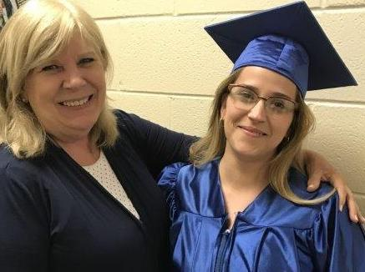
FISCAL MATTERS
Cassie Stephenson
Crawfordsville Adult Resource Academy
PY17 HOUSEKEEPING
Review all reimbursements requested and received
  ► Contact Cheryl Jones immediately if you have not received a reimbursement within the 35-40 day range. cjones@dwd.in.gov
You may continue to submit reimbursement requests for PY17 expenses (July 1, 2017 to June 30, 2018)
► Until you submit your close out OR August 15, 2018 (whichever comes first)
  The only exception to this expense timeframe was for the advanced purchase of TABE 11/12.

Slide 42


FISCAL MATTERS
CLOSE OUT PACKETS
Due to DWD Finance by August 15, 2018
Copy our office at adulted@dwd.in.gov when you email your completed close out to DWD Finance
Kenny
Anderson

Slide 43



FISCAL MATTERS
Emma Andrews | Son Gary Acton Jr.
PY18 FORMS
You should have received your PY18 backup and reimbursement forms
HOLD all reimbursement requests until your PY18 contract has been fully executed

Slide 44

Indiana ADULT EDUCATION
Basic Skills. High School Equivalency. Short-term Training. Certifications and More.
Professional Development
NEXT
STEPS
Moving Forward
2018-2019
► Regionally Delivered Professional Development
► Locally Delivered Professional Development
► State Initiatives
Professional Development Team*
South – Nancy Karazsia
Central – Dan DeVers
North – Jose Torres
*Continue as Adult Education Coordinators (AECs)

Slide 45
Indiana ADULT EDUCATION
Basic Skills. High School Equivalency. Short-term Training. Certifications and More.
Professional Development
NEXT
STEPS
Moving Forward
2018-2019
PDF – Director Statewide Meetings
August 17, 2018 - 9:00 a.m. – 3:00 p.m. Eastern Standard time
Elkhart – Elkhart Area Career Center - 2424 California Rd, Elkhart
August 24, 2018 - 9:00 a.m. – 3:00 p.m. Eastern Standard time
Indianapolis – Walker Career Center - 9651 E 21st St, Indianapolis
August 31, 2018 - 9:00 a.m. – 3:00 p.m. Eastern Standard time
Bedford – Stonegate Arts and Education Center - 405 I St., Bedford

Slide 46
Indiana ADULT EDUCATION
Basic Skills. High School Equivalency. Short-term Training. Certifications and More.
program is open to anyone age 16 or older who is not attending a high school. It helps people prepare for the equivalency test, earn workforce
certification and even learn English as a second language.
“It’s really all about getting people into career training and employment,” said Robert Moore, director of the program.
The program serves about 500 people each year. Historically, there has been one ceremony in May to recognize their accomplishments. A second
ceremony was added in December this year.
“- 1
Integrated Education & Training (IETs)
ADULT EDUCATION
IETs
Approved Through 7/12/2018
219
APPROVED PROGRAMS
16 IELCE APPROVED PROGRAMS
1,497
– TOTAL ENROLLED

Slide 47
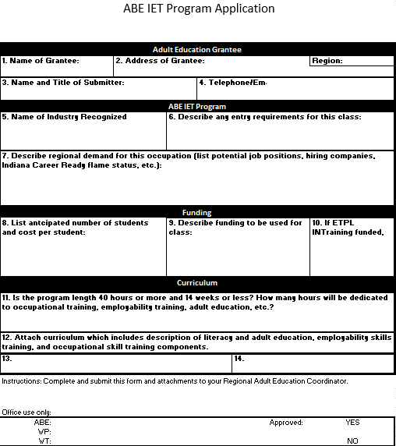
IET and IELCE Applications
Applications for already approved courses are NOT required
Utilize the rollover function in InTERS to carry over the course name and students
Any courses rolled over from 1718PY must utilize a curriculum that was previously approved
New InTERS forms are required for new courses entered into InTERS
If a program chooses to make changes to an approved curriculum, a new application and curriculum are required

Slide 48


Statewide
1,691 Total enrollment
271 Still enrolled
144 Dropped
1,276 Completed, 90%
1,094 Certified, 86%
  Jessica Gray
  Program Manager
  jgray1@dwd.in.gov
  workindiana@dwd.in.gov
  (317) 503-1006
Get to know us!
07/12/18

Slide 49


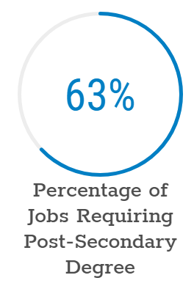
Education Workforce Innovation Network
https://iewin.org/

Slide 50


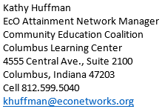
Educational pathways
Link to EcO Network Powerhouse Credential Crosswalk
http://econetworks.org/wp-content/uploads/Powerhouse-Credential-Crosswalk-FINAL-PUBLIC-DISTRIBUTION-5_22_2018-PDF.pdf

Slide 51

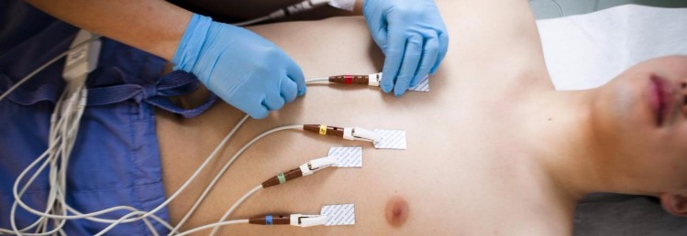

program is open to anyone age 16 or older who is not attending a high school. It helps people prepare for the equivalency test, earn workforce
certification and even learn English as a second language.
“It’s really all about getting people into career training and employment,” said Robert Moore, director of the program.
The program serves about 500 people each year. Historically, there has been one ceremony in May to recognize their accomplishments. A second
ceremony was added in December this year.
“- 1
WorkINdiana Career Certification
Indiana Hourly Wage
Projected Employment
INDemand Statewide Ranking
Certified EKG Technician (CET)
National Healthcareer Association
Set-up and administer EKGs
Provides credentials to perform Holter monitoring and stress testing
Entry level jobs may include: cardiovascular technician, echo/cardiac technologist, patient care technician, telemetry technician, and monitor technician
NHA CET: https://www.nhanow.com/certifications/ekg-technician
Entry
$13.79
Experienced
$26.57
10.18% increase
(2016-2026)

Slide 52
2018-2019 Program Year RFA
program is open to anyone age 16 or older who is not attending a high school. It helps people prepare for the equivalency test, earn workforce
certification and even learn English as a second language.
“It’s really all about getting people into career training and employment,” said Robert Moore, director of the program.
The program serves about 500 people each year. Historically, there has been one ceremony in May to recognize their accomplishments. A second
ceremony was added in December this year.
“- 1
Award letters issued 06/08/2018
Grant collaborations in process
WorkINdiana Professional Development training underway
Register at WorkINdiana@dwd.in.gov by 07/20/2018
Include attendee(s) name, position title, and training location
Attendees should be limited to the grantee’s grant, fiscal, and data point of contact
North
Central
South
07/31/18 – 10 a.m. – 3 p.m.
Elkhart Community Schools
2424 California Road
Elkhart, IN 46514
08/02/18 – 10 a.m. – 3 p.m.
Vincennes University
Gibson County Center
8100 US Highway 41
Fort Branch, IN 47648
FULL

Slide 53
program is open to anyone age 16 or older who is not attending a high school. It helps people prepare for the equivalency test, earn workforce
certification and even learn English as a second language.
“It’s really all about getting people into career training and employment,” said Robert Moore, director of the program.
The program serves about 500 people each year. Historically, there has been one ceremony in May to recognize their accomplishments. A second
ceremony was added in December this year.
“- 1
InTERS
ADULT EDUCATION UPDATES, TRAININGS
Matt Crites
mcrites@dwd.in.gov
Brin Sisco
bsisco@dwd.in.gov

Slide 54


program is open to anyone age 16 or older who is not attending a high school. It helps people prepare for the equivalency test, earn workforce
certification and even learn English as a second language.
“It’s really all about getting people into career training and employment,” said Robert Moore, director of the program.
The program serves about 500 people each year. Historically, there has been one ceremony in May to recognize their accomplishments. A second
ceremony was added in December this year.
“- 1
InTERS
ADULT EDUCATION UPDATES, TRAININGS
TABE 11 & 12
+ “If a student scores more than one NRS level above the targeted level, then a (+) sign will appear next to the scale score and their score will be set to the highest possible scale score, which is one above the targeted level. In this case, students may want to test with a higher TABE test in order to better assess their ability.”
- “The minus signs on TABE scale scores are simply a visual cue for teachers that a student was close to an Out of Range score on the low end of the range for that specific level. This visual cue will help teachers possibly prepare for students that might have longer learning paths before being ready to post test and demonstrate a gain to the next NRS level. Typically a student with a minus sign would not be a student that would be entered into a fast track or accelerated program.”
Online | Paper-based |Scale Scores | Grade Levels

Slide 55

program is open to anyone age 16 or older who is not attending a high school. It helps people prepare for the equivalency test, earn workforce
certification and even learn English as a second language.
“It’s really all about getting people into career training and employment,” said Robert Moore, director of the program.
The program serves about 500 people each year. Historically, there has been one ceremony in May to recognize their accomplishments. A second
ceremony was added in December this year.
“- 1
InTERS
ADULT EDUCATION UPDATES, TRAININGS
TABE 11 & 12
L (Literacy) –
Available only in paper & pencil
“TABE cannot measure some types of skills that an adult . . . may need to succeed in school, on the job, in the community, and in public life.” Source Data Recognition Corporation | CTB

Slide 56
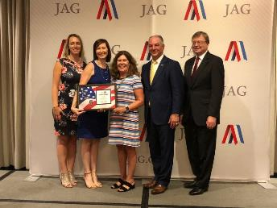
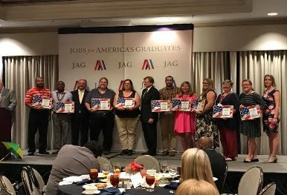
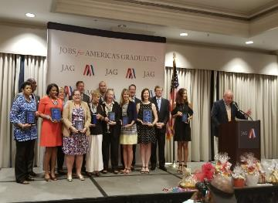
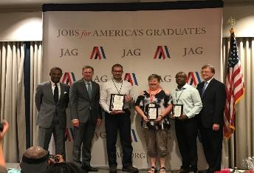
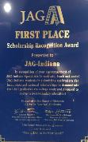

program is open to anyone age 16 or older who is not attending a high school. It helps people prepare for the equivalency test, earn workforce
certification and even learn English as a second language.
“It’s really all about getting people into career training and employment,” said Robert Moore, director of the program.
The program serves about 500 people each year. Historically, there has been one ceremony in May to recognize their accomplishments. A second
ceremony was added in December this year.
“- 1
JAG Indiana honored at National Training Seminar
INDIANA FIRST PLACE

Slide 57



program is open to anyone age 16 or older who is not attending a high school. It helps people prepare for the equivalency test, earn workforce
certification and even learn English as a second language.
“It’s really all about getting people into career training and employment,” said Robert Moore, director of the program.
The program serves about 500 people each year. Historically, there has been one ceremony in May to recognize their accomplishments. A second
ceremony was added in December this year.
“- 1
Young Adult Services
PY 17/18 ICC Report
At the end of PY 17/18, 25 percent of youths on an active case load throughout the year earned a credential
2,919 new youth participants in PY – 31.5 percent dropped

Slide 58
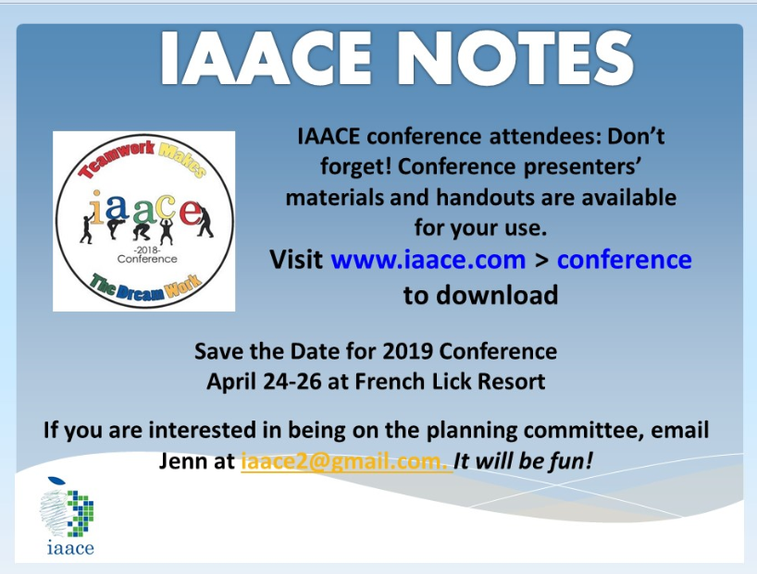

Slide 59
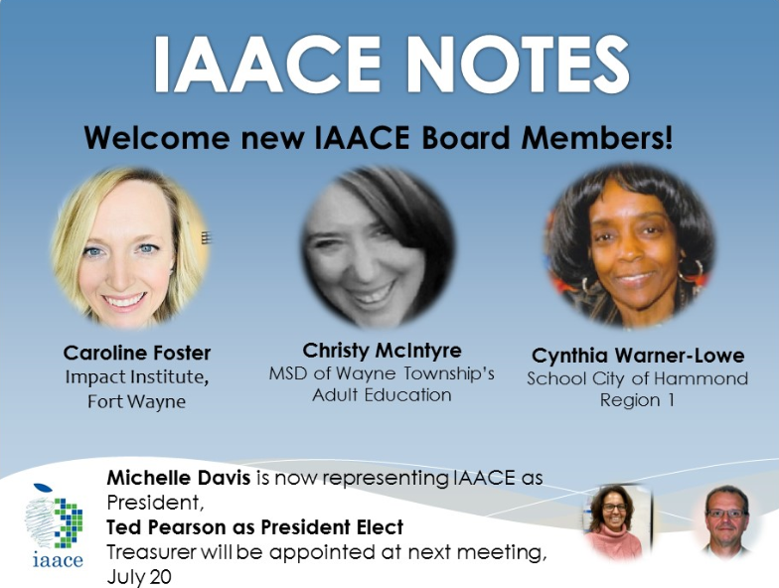

Slide 60
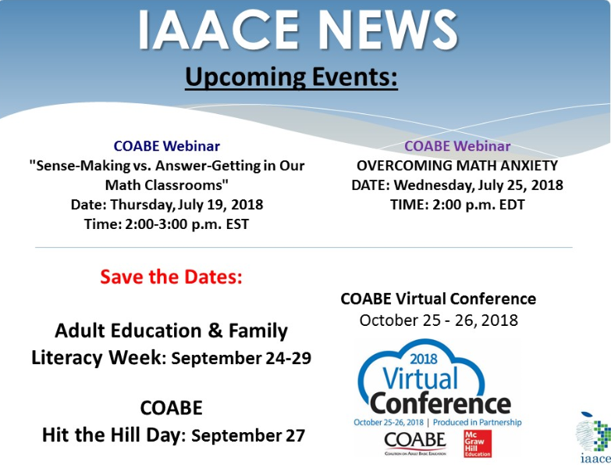

Slide 61
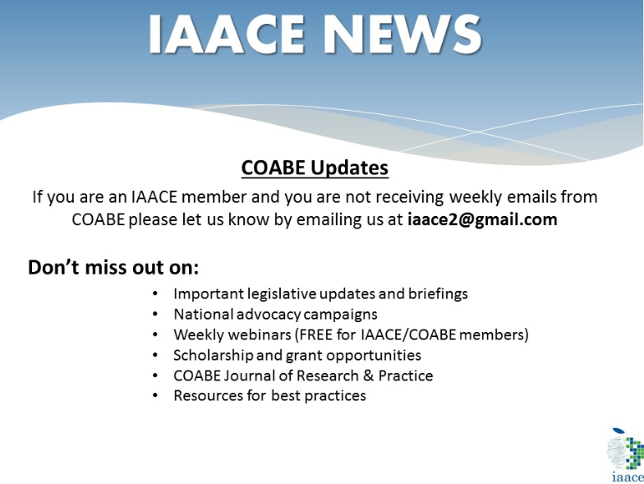

Slide 62
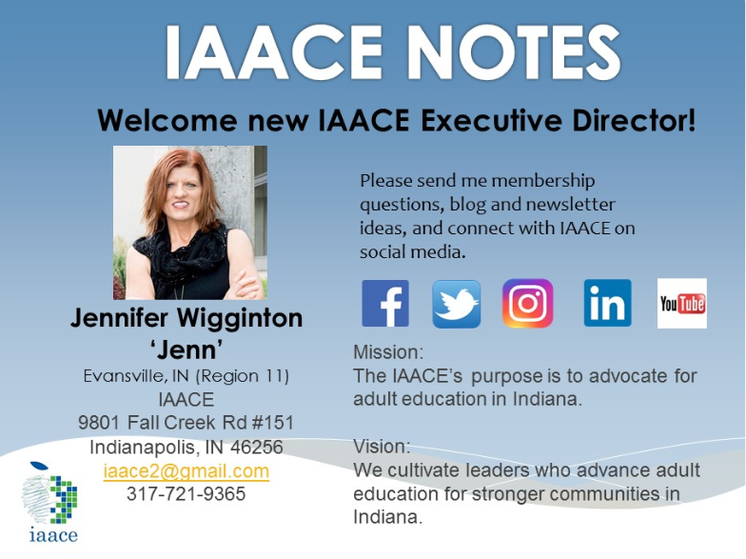

Slide 63
program is open to anyone age 16 or older who is not attending a high school. It helps people prepare for the equivalency test, earn workforce
certification and even learn English as a second language.
“It’s really all about getting people into career training and employment,” said Robert Moore, director of the program.
The program serves about 500 people each year. Historically, there has been one ceremony in May to recognize their accomplishments. A second
ceremony was added in December this year.
“- 1
Next Adult Education & Workforce Development Statewide Webinar
8.8.18
10 to 11:30 a.m. ET
The right skills, at the right time, in the right way. Indiana’s Demand Driven Workforce

