Slide 1
Equal Opportunity 101
Ensuring Equal Opportunity and Nondiscrimination under Section 188 of WIOA
July 2026

Slide 2
What is Equal Opportunity?
Race
Color
“No individual in the United States may, on the basis of race, color, religion, sex, national origin, age, disability, or political affiliation or belief, or, for beneficiaries, applicants, and participants only, on the basis of citizenship or participation in any WIOA Title I-financially assisted program or activity, be excluded from participation in, denied the benefits of, subjected to discrimination under, or denied employment in the administration of or in connection with any WIOA Title I-financially assisted program or activity.”
  -29 CFR 38.5
Age
Religion
Sex
Disability
Political Affiliation
National Origin
Citizenship
Participation in WIOA program

Slide 3
How Do You Ensure EO Is Being Provided?
Equal Opportunity Officers
Notice and Communication
Assurances, Policies, and Procedures
Disability Nondiscrimination/Accessibility
Data and Information Collection and Maintenance
Monitoring
Complaints

Slide 4
Equal Opportunity Officers
State EO Officer
Oversee development and implementation of Indiana’s Nondiscrimination Plan (NDP)
Serve as liaison with Department of Civil Rights Center
Monitor LWDA compliance with WIOA Title I EO and nondiscrimination requirements
Undergo and provide training and technical assistance to local EO Officers
Develop procedure for and investigate discrimination matters that fall in State level jurisdiction
Review DWD policies to ensure they are nondiscriminatory
Local EO Officer
Ensure overall implementation of the NDP
Report EO matters to the State EO Officer
Monitor compliance of regional WIOA Title I recipients
Undergo and provide training for staff and service providers
Process and investigate regional discrimination complaints
Review regional policies to ensure they are nondiscriminatory
Survey WorkOne offices to ensure compliance with accessibility requirements

Slide 5
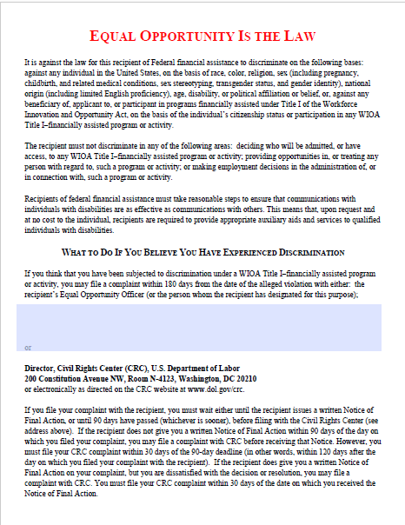
Notice and Communication:
EO is the Law Notice
  MUST:
    Be posted in prominent places around the office, including resource areas, and on website pages
    Be included in orientations, registrations, and in both employee and participant handbooks
    Have the local EO officer’s name and contact information
    Be provided to participants in appropriate languages
      Spanish is required to be posted in offices
    Be provided in appropriate formats
      Example: Large print for visual impairment
    Be disseminated in internal memos/other written communications with staff
    Be provided to each participant and employee and be part of their file

Slide 6
Notice and Communication:
EO Tagline
  “equal opportunity employer that administers equal opportunity programs. Free auxiliary aids and services are available upon request to individuals with disabilities (TDD/TTY Number: 1-800-743-3333). Free language interpretation and translation services are also available upon request.”
Must be on all recruitment brochures and other materials that are distributed or communicated to staff, clients, or the public including written, oral, electronic, or paper materials/communications that describe programs financially assisted under WIOA or the requirements for participation

Slide 7
Notice and Communication:
Limited English Proficiency (LEP)
Discrimination against LEP individuals falls under “national origin” (29 CFR 38.9)
An individual whose primary language for communication is not English and who has a limited ability to read, speak, write, and/or understand English.
LEP individuals may be competent in English for certain types of communication (e.g., speaking), but still be LEP for other purposes (e.g., reading or writing).
For languages spoken by a significant amount of the eligible population to be served, or likely to be encountered, recipients must translate vital information in written materials and have them readily available in hard copy or electronically.
Vital documents/information that is necessary for an individual to understand how to obtain any aid, benefit, service, and/or training must be translated or interpreted. This could be written or oral information.

Slide 8
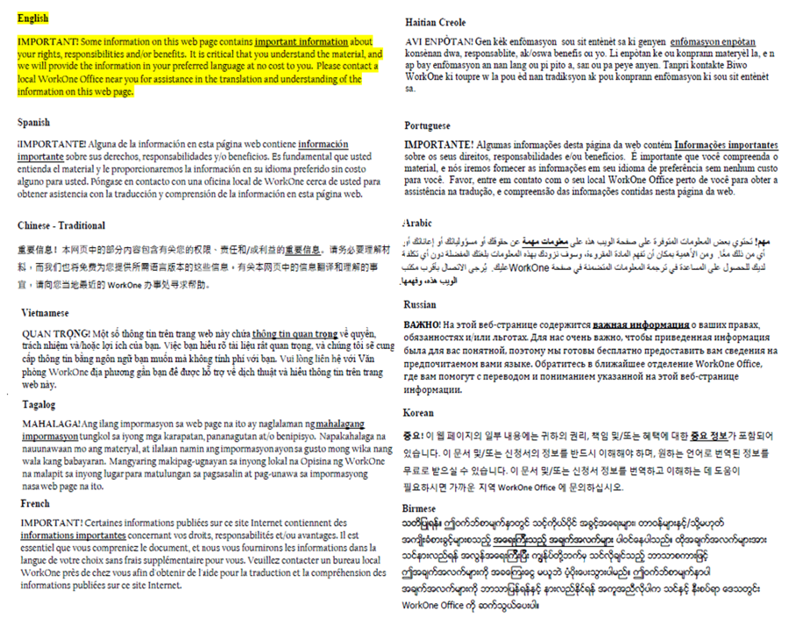
Vital Documents
Examples include, but are not limited to:
  Applications, consent, and complaint forms
  Notices about rights and responsibilities
  Rulebooks/instructions
  Written tests that do not assess English language competency, but competency for a particular license, job, or skill where English proficiency is not required
  Letters or notices that require a response for the beneficiary or application, participant, or employee
Babel Notice:
A short notice included in a document or electronic medium (e.g., Web site, “app,” email) in multiple languages informing the reader that the communication contains vital information, and explaining how to access language services to have the contents of the communication provided in other languages.

Slide 9
Language Services
  Vendors: IDOA: Procurement: All Current QPAs
    Specific to telephonic, video (scheduled and on-demand), in person, and document translation
  Cannot require LEP individuals to rely on their own interpreter except in emergency situations or if the individual decides to use their own interpreter
    Recipient can still provide their interpreter when they need to ensure accurate information
  Any services provided are at no cost to the client

Slide 10
Assurances, Policies, and Procedures
Your Local EO Officer will provide you with all regional policies and procedures that relate to Equal Opportunity and Nondiscrimination
DWD Policy 2016-09, Change 1: Equal Opportunity and Nondiscrimination Guidance Letter
  Attachment B provides required assurance language for contracts
    Smaller agreements such as OJTs, Work Experiences, etc. must include assurance as well, but can use the following reference:
    “The equal opportunity and nondiscrimination assurances at 29 CFR Part 38.25 apply to this contract/agreement.
All policies and procedures must be reviewed by the EO Officer to ensure they are nondiscriminatory

Slide 11

Disability and Accessibility
Physical Accessibility
Facilities must be accessible and usable by individuals with disabilities
  Includes access to bathrooms, adjustable work stations or adjustable computer settings (or in select
  offices –
  accessibility
  workstations),
  and access
  into the site
  location itself
  with ramps
  consistent
  with Americans with
  Disabilities Act’s (ADA) standards
Programmatic Accessibility
Must make reasonable modifications to policies, practices, and procedures
Must provide reasonable accommodations for individuals with disabilities
Must administer programs in the most integrated setting appropriate
Must communicate with persons with disabilities as effectively as with others
Must provide appropriate auxiliary aids or services where necessary

Slide 12
Data Information Collection and Maintenance
Data must be collected with regards to applicants, registrants, participants, terminees, employees, and applicants for employment.
Race/ethnicity, sex, age, disability status (where known), and limited English proficiency status and preferred language must be recorded.
Medical and Disability-Related Information
Any medical or disability-related information obtained about an individual (including information that could lead to the disclosure of a disability) must be collected separately and maintained in separate files, apart from any other information about the individual.
This information must be treated as confidential and whether in electronic or hard copy, must be locked or otherwise secured (for example, password protected).
Program staff documenting eligibility where disability is an eligible criterion for the program and first aid and safety personnel who need access to a participant’s medical condition in an emergency may be informed about an individual’s disability or medical condition and have access to related files.

Slide 13
Monitoring
Ensure compliance with the nondiscrimination and equal opportunity provisions of WIOA and where appropriate secure compliance when noncompliance is found
Statistical or quantifiable analysis of records collected regarding race/ethnicity, sex, LEP, age, and disability status, followed by an investigation into any significant differences found
Local Monitoring of Equal Opportunity Program
          - Conducted by your Local EO Officer at each of the WorkOne offices in the region
Annual Monitoring by State EO Officer
  - DWD Program Administration and Oversight Division will monitor region
Includes (but not limited to):
  - On site interviews with the Local EO Officer and WorkOne Staff and assessments of structural accessibility (including parking and restrooms), appropriate signage, program accessibility, and effective communication for persons with disabilities and LEP individuals
  -Desk review of local EO policies, job description of the Local EO Officer, EO Notice requirements, complaint procedures, and contracts, training agreements, and data analysis

Slide 14
Complaints of Discrimination
Discrimination Complaint
  I didn’t get approved for training because of my age or the case manager didn’t provide me an interpreter and therefore she/he discriminated against me because of my language barrier
Non-Discrimination Complaint
    I was not approved for a specific training that was not on the approved training provider list or the case manager didn’t provide me with accurate information

Slide 15
Discrimination Complaints
Complainant may file either with Local EO Officer or CRC
Complainant may file a complaint by completing and submitting CRC’s Complaint Information Form
  - can be obtained from your local EO Officer or from the CRC
  Complaints must be filed within 180 days of the alleged discrimination or retaliation
Complaints must be filed in writing (electronically or in hard copy)
Complaints must contain the complainant’s name, mailing address, email address (or another means of contact), identity of respondent, description of allegations, and written or electronic signature of complainant or their representative

Slide 16
Discrimination Complaint Procedures
Complaint procedures must include:
  Initial written notice to complainant acknowledging receipt of complaint, right to representation, notice of rights in EO poster, right to request and receive auxiliary aids at no cost, language assistance services
  A written statement of the issue(s) provided by complainant and whether Recipient will accept or reject each issue
  A period for investigation
  A period for attempt to resolve complaint, provision for alternative dispute resolution (ADP)
  A written Notice of Final Action
      Recipient will issue within 90 days of the date on which the complaint was filed
      Must include:
        Decision on issue(s) and explanation of reasons for the decision or description of the way parties resolved the issue
        Notice of right to file complaint with CRC within 30 days if dissatisfied
Your Local EO Officer will provide you with any regional specific procedures related to discrimination complaints.

Slide 17

Questions?
Authorities/References
  CRC External Enforcement
  Code of Federal Regulations 29 CFR 38
DWD Policy 2016-09, Change 1: Equal Opportunity and Nondiscrimination
  Americans with Disabilities Act
Indiana's Nondiscrimination Plan

