Slide 1

2018 IDVA Spring Conference
& Training
“Creating a Bridge for Our County Veterans and the State/Federal Department of Veterans Affairs”

Slide 2
Pension and Dependency & Indemnity Compensation (DIC) Benefits
By:
Cameron Lochner
Northeast Indiana District Service Officer

Slide 3

“Non-Service-Connected Pension
& Special Monthly Pension Programs”
VA Benefits: An Overview

Slide 4
Commonly Referred to as
“Pension, Widow’s Pension, Death Pension, Survivor’s Pension, and…….. Aid & Attendance???”

Slide 5
What is “Non-Service-Connected Pension
& Survivor’s Pension?”

Slide 6
What is “Non-Service-Connected Pension
& Survivor’s Pension?”
The Non-Service-Connected Pension & Survivor’s Pension benefit is a Basic Monetary Benefit paid to Wartime-Era Veterans who have Limited Income and Net-Worth. This benefit helps Veterans and their families cope with financial challenges by providing Supplemental Income through the Pension and Survivors Pension benefit programs.
Veterans who are more seriously disabled may qualify for an additional allowance with the “Aid & Attendance” or “Housebound” Program benefits.
Again…..this is a “Needs-Based” benefit with Income and Net-Worth limitations.

Slide 7
(Basic & Special Monthly Pension)
Three Categories to in Which to Qualify

Slide 8
Basic & Special Monthly Pension
The Pension benefits can easily broken down into three categories:
  Basic Pension
  Housebound Special Monthly Pension
  Aid & Attendance Special Monthly Pension

Slide 9
Basic & Special Monthly Pension
The Basic Pension benefit is paid to a qualified Wartime Era Veteran who meets certain Income and Net Worth Limitations and who is 65 years of age or older.
Qualified Wartime Era Veterans who meet these same Income and Net-Worth Limitations AND are under age 65 years of age must prove through medical examination/documentation that the Veteran is unable to find and sustain gainful employment due to Chronic or Permanent Disability.
Surviving Spouses of Qualified Wartime Era Veterans need only prove/meet Income and Net-Worth Limitations.

Slide 10
Basic & Special Monthly Pension
Veterans and Surviving Spouses who are more severely disabled may qualify for additional monetary support via the Special Monthly Pension Program. These two programs are the Housebound Program and the Aid & Attendance Program
The Housebound Program is an additional monetary benefit paid in addition to the Basic Pension Rate to Veterans/Surviving Spouses who are “Permanently Housebound” or substantially confined to his or her dwelling and the immediate premises by reason of disability or disabilities; meaning that the Veteran/Surviving Spouse are too disabled to leave their home without assistance from another person, but otherwise are able to manage their Activities of Daily Living (ADLs).
**Note: The Housebound Program can be added to other benefits as well such as Service-Connected Disability and Dependency & Indemnity Compensation.

Slide 11
Basic & Special Monthly Pension
The Aid & Attendance Program is a additional monetary benefit paid in addition to the Basic Pension Rate to Veterans/Surviving Spouses who require the regular “Aid and Attendance” of another person to manage their Activities of Daily Living (ADLs).
Need for the Aid & Attendance Program means helplessness or being so nearly helpless as to require the regular aid and attendance of another person to protect the Veteran or Claimant from the hazards of their daily environment.
**Note: The Aid & Attendance Program can be added to other benefits as well such as Service-Connected Disability and Dependency & Indemnity Compensation.

Slide 12
Basic & Special Monthly Pension
The Veteran/Surviving Spouse will be considered in need of Regular Aid & Attendance if he or she:
  Is a patient in a Nursing Home because of Mental or Physical Incapacity, OR
  Is Blind or so Nearly Blind as to have corrected Visual Acuity of 5/200 or less in both eyes or concentric contraction of the visual field to 5 degrees or less.
  Establishes a factual need for aid and attendance based on medical evidence that the individual is unable to perform basic self care tasks or Activities of Daily Living (ADLs) without the assistance of another person.
Examples of Activities of Daily Living (ADLs) include but are not limited to:
  Assistance with Dressing / Undressing
  Eating, Cooking & Preparing Meals
  Medications Management and/or Administering Self-Medical Care
  Assisting in Personal Hygiene (Showering, Bathing, Toileting, etc.)

Slide 13
Basic & Qualifying Eligibility
“Who Qualifies & How to Determine Eligibility”

Slide 14
Basic Eligibility Requirements
Basic eligibility requires that the Veteran was discharged from Military Service under conditions other than dishonorable AND served at least 90-days of Active Military Service; one day of that Active Military Service must have been service during a recognized “Wartime-Era.” If the Veteran entered Active-Duty Military Service after Sept 7, 1980 for Enlisted Personnel, and Oct 16, 1981 for an Officer, generally must have served at least 24-months or the full period (Guard/Reservists) for which called or ordered to active duty.
**Eligibility for any Pension related benefit is established via
the Active-Duty Military Service of the Veteran.

Slide 15
Basic Eligibility Requirements
“Recognized Wartime Eras or Periods”
World War II
Dec 7, 1941 to Dec 31, 1946
Korea
Jun 27,1950 to Jan 31, 1955
Vietnam
Aug 5, 1964 to May 7, 1975
Persian Gulf
Aug 2, 1990 – ending date TBD

Slide 16
Basic Eligibility Requirements
Surviving Spouses must prove via documentation that they were legally married to the Veteran at the time of the Veteran’s death. Furthermore, the marriage between the Veteran and Surviving Spouse must be of at least one year in length prior to the Veteran’s death. “Legal Marriage” is generally established based on the State Law in which the marriage took place.
Once Basic Eligibility has been established the Veteran or Surviving Spouse must meet certain Qualifying Eligibility requirements before entitlement to the Pension benefit.

Slide 17
Qualifying Eligibility Requirements
Qualifying Eligibility is specific to the individual benefit for which a Veteran/Surviving Spouse intends to apply. The Qualifying Eligibility requirements for the Pension benefit and its related benefits include:
  Countable family income is below a yearly limit set by law, AND
  Net Worth is not considered excessive (net worth generally should not be more than $80K), but could be considerably less depending on the clients age, cost of care, etc.
In addition to Income and Net Worth Limitations, Veterans/Surviving Spouses may need to meet the following Qualifying Eligibility requirements:
  Medical Need (if applicable)
  Certain qualifying medical expenses or “On-Going Medical Expenses” (if applicable)

Slide 18
DOCUMENTAION
REQUIRED

Slide 19
  VA Form 21-2680
  *Must be prepared by a Medical Doctor (M.D.) or a VA Primary Care Provider (PCP)
  **Note: “IF” a Veteran/Surviving Spouse is currently residing in a Nursing Home Facility, VA will concede that the Veteran/Surviving Spouse is in need of “Aid & Attendance” and there does not require the submission of VA Form 21-2680.

Slide 20
Documentation Required
Active-Duty Military Discharge or DD-214 (Original or Certified Copy)
Marriage certificate (if applicable)
Death certificate (if applicable)
Letter from Assisted Living showing:
  Date entered
  Cost for room and board along with cost of any medically related charges
  Amount paid by other sources
  Type of specialized care provided
    Must be providing a minimum of two (2) Medically Necessary Activities of Daily Living (ADLs)
  If Spouse resides in Assisted Living, separate the Spouses costs from the Veterans.

Slide 21
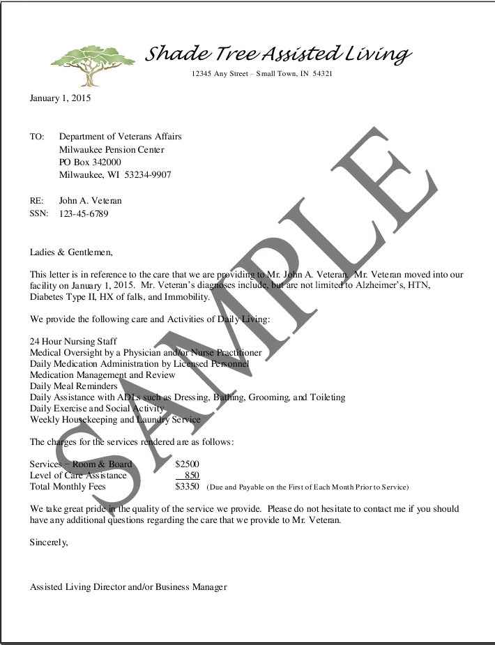
Documentation Required
“Sample” Assisted Living Facility Letter for
Assisted Living Healthcare

Slide 22
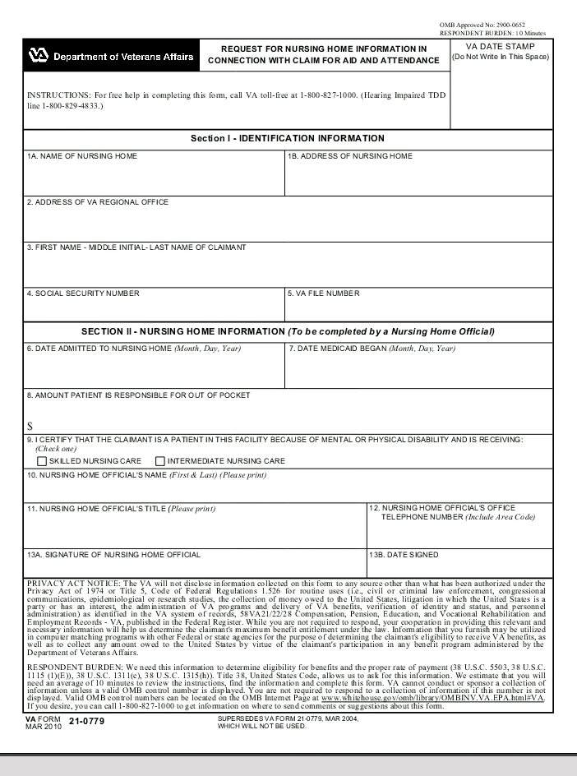
Documentation Required
VA Form 21-0779 for Nursing Home Healthcare

Slide 23
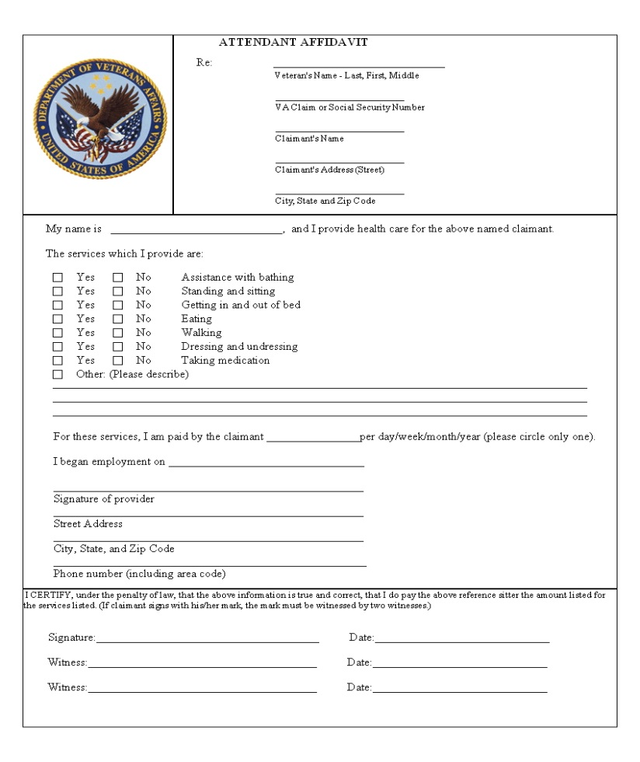
Documentation Required
Attendant Affidavit for In-Home Healthcare

Slide 24
Documentation Required
Provide Proof of Net Worth/Assets
  Types of Assets –
    Cash
    CD’s
    Stocks, Bonds, Mutual Funds, Etc.
    Annuities
    IRAs
    Checking and Savings
    Other Property (not primary residence), etc..
      If primary residence sells or rents changes Net Worth
  Burial and “Miller” Trust(s) are NOT counted as Net Worth

Slide 25
Documentation Required
Provide Proof of Income
  Types of Income – Non-Inclusive
    Social Security Award Letter or Current Bank Statements
    Pensions
    Retirement
    Interest Income
    Annuity(s), Stocks, Bonds, Etc. Disbursements
    Rental Property Income
    **The Department of Veterans Affairs does not currently have a “Look Back” mechanism to determine Income & Net Worth Limitations. However, VA does review “Previous Calendar Year IRS Tax Returns/Records” as part of their review for eligibility on EVERY application for the Pension benefit.

Slide 26
Documentation Required
Provide proof of Ongoing Medical Expenses
  Reduces Countable Income
Types of Ongoing Medical Expenses
  Nursing Home Care
      Nursing Home must provide a completed VA Form 21-0799
  Assisted Living Facility Care
      Facility must provide Affidavit/Statement identifying that they are providing a minimum of two (2) “Medically Necessary Activities of Daily Living (ADLs)
  In-Home Care
      Does not have to be a licensed caregiver to provide In-Home Care if Veteran or Claimant meets either the Housebound or Aid & Attendance Requirements.
      Must provide a signed Attendant Affidavit
  Health, Medical, Hospitalization Insurance Premiums

Slide 27
Non-Service-Connected Rate Table
**Remember Pension is Income Based**

Slide 28
EXAMPLE #1
Veteran without dependent(s) is living in an Assisted Living Facility that provides “Long-Term Inpatient Medical Care”. The Veteran has been determined to be in need of Special Monthly Pension at the “Aid & Attendance” rate.
Gross Annual Income:
  Veteran’s Gross Annual Income $24,000 ($2000 / month)
Annual Unreimbursed Ongoing Medical Expenses:
  Annual Cost for Assisted Living Care 27,600 (2,300 / month)
  Annual Cost for Medicare Part B 1,308 (109 / month)
  Subtract Veteran’s VA Deductible - 645 (54 / month)
  Claimed Unreimbursed Ongoing Medical Expenses $29,553 (2463 / month)
  Veteran’s Gross Annual Income $24,000
  Claimed Unreimbursed Ongoing Medical Expenses -29,553 $1795
  Leaves a Negative Net-Income Balance $ -5553.00 ÷ 12 = - 463
  $1795
*Since the Veteran’s Monthly Unreimbursed Ongoing Medical Expenses are “equal to or greater than” the Veteran’s Monthly Income, the Veteran would be entitled to the full pension amount of $21,531 a year, or $1,795 a month.

Slide 29
EXAMPLE #2
A Surviving Spouse of a Wartime-Era Veteran is living at home and paying for In-Home Healthcare. VA has determined that she is eligible for Special Monthly Pension at the “Aid & Attendance” rate.
Gross Annual Income:
  Surviving Spouse’s Gross Annual Income $10,800 ($900 / month)
Annual Unreimbursed Ongoing Medical Expenses:
  Annual cost of In-Home Healthcare 3,600 ($300 / month)
  Annual cost of Medicare Part B 1,308 ($109 / month)
  Subtract Spouse’s VA Deductible -433 ($36 / month)
  Claimed Unreimbursed Ongoing Medical Expenses $5,341 ($445 / month)
  Surviving Spouse’s Gross Annual Income $10,800
  Claimed Unreimbursed Ongoing Medical Expenses - 5,341 $ 1153
  Leaves a Positive Net-Income Balance $5,459 ÷ 12 = 455
$ 698
*Surviving Spouse would be entitled to an Adjusted Pension Benefit in the amount of $8,376 a year or $698 a month.

Slide 30
“Dependency & Indemnity Compensation (DIC)”
VA Benefits: An Overview

Slide 31
“What is “Dependency & Indemnity Compensation (DIC)?”

Slide 32
What is “Dependency & Indemnity Compensation (DIC)?”
“Dependency & Indemnity Compensation (DIC)”
Dependency & Indemnity Compensation (DIC) is a monthly compensation benefit paid to eligible Surviving Spouses or Dependent Children/Parent(s).
To qualify for this benefit program, the Claimant must be a Surviving Spouse, Dependent Child, or Dependent Parent of a Veteran who died while serving in Active Military Duty or as a result of a Service-Connected Disability, or other qualifying Veteran death. Basic and/or Qualifying Eligibility requirements may apply to this benefit (where applicable).

Slide 33
Point of Contacts
Thomas White
  Northwest Indiana District Service Officer
Cameron Lochner
  Northeast Indiana District Service Officer
Ken Hilton
  West Central Indiana District Service Officer
Mark Smith
  East Central Indiana District Service Officer
Desley Snyder
  Southwest Indiana District Service Officer
Joe Divito
  Southeast Indiana District Service Office

Slide 34

Questions???

Slide 35
Point of Contact
Cameron Lochner
Northeast Indiana District Service Officer
Indiana Department of Veterans Affairs
302 West Washington Street; Suite E-120
Indianapolis, IN 46204
Phone: 317-618-5543, Fax 317-232-7721
clochner@dva.in.gov

