Slide 1
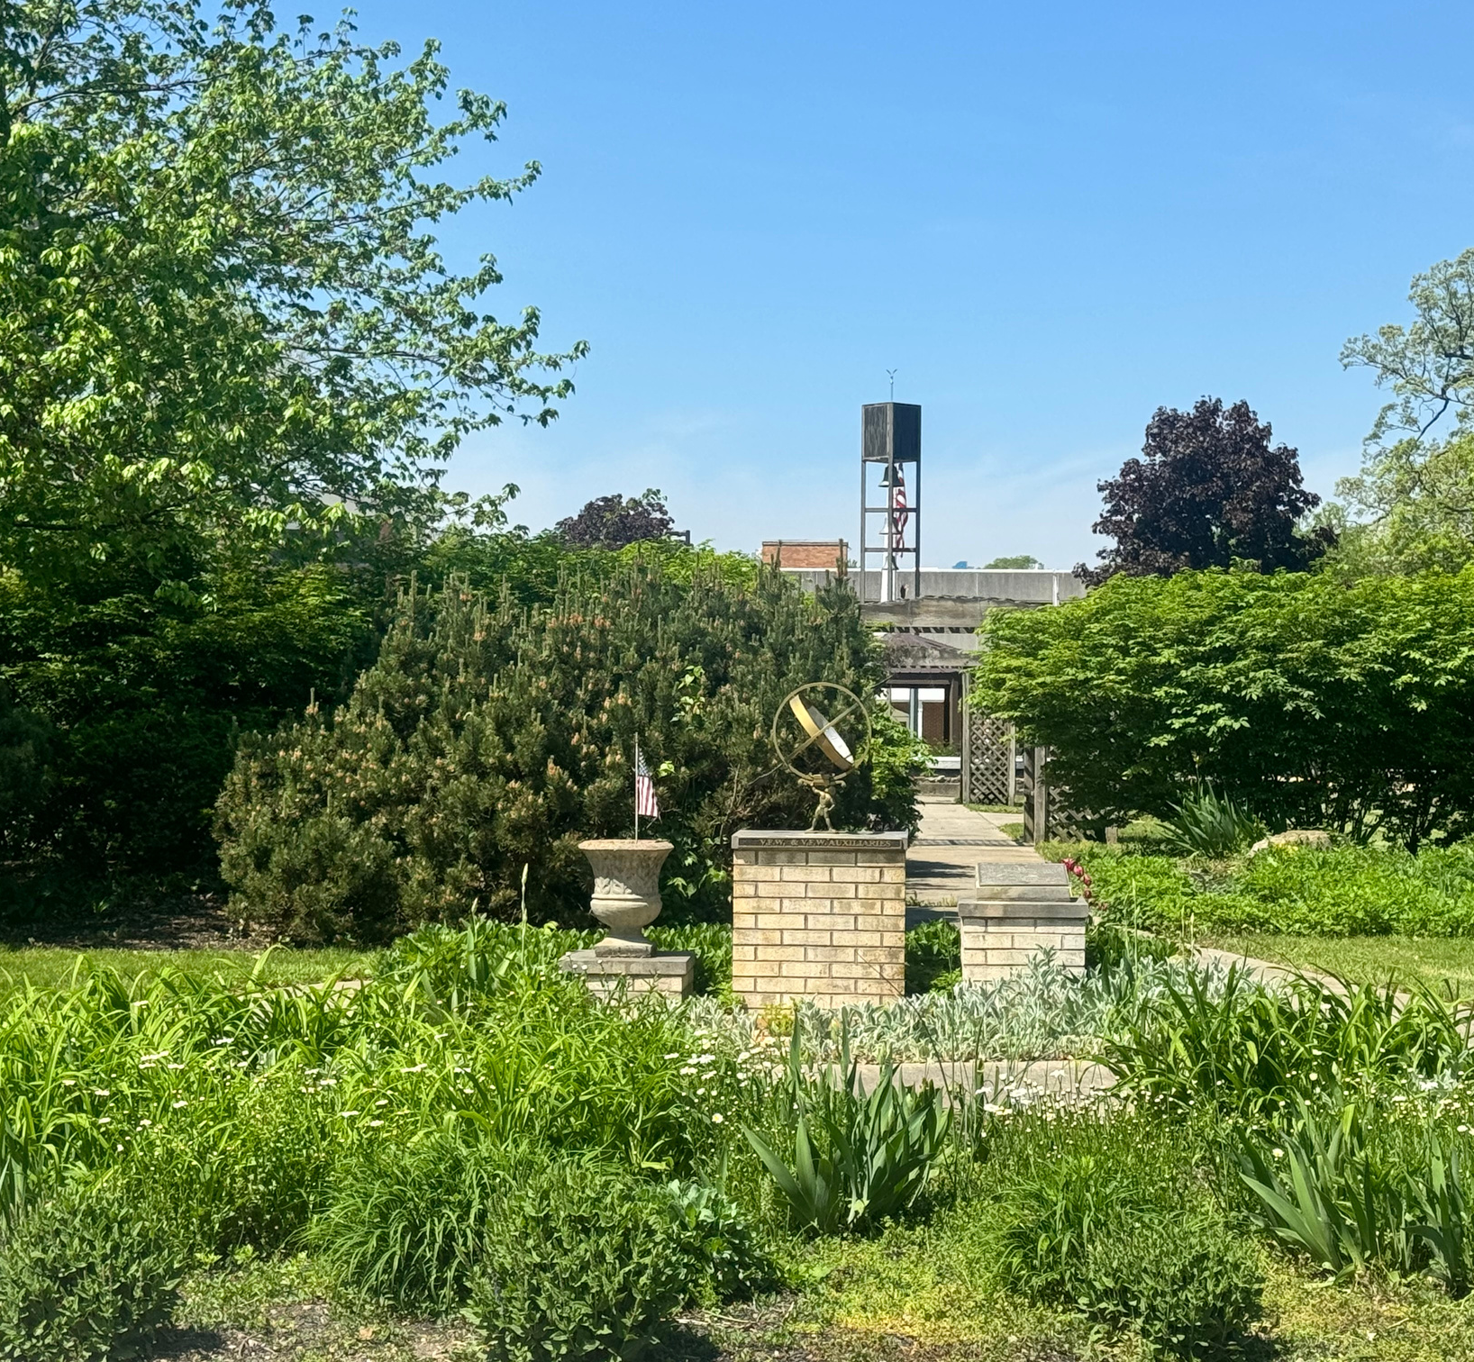

Indiana Veterans’ Home
2025
www.in.gov/ivh

Slide 2
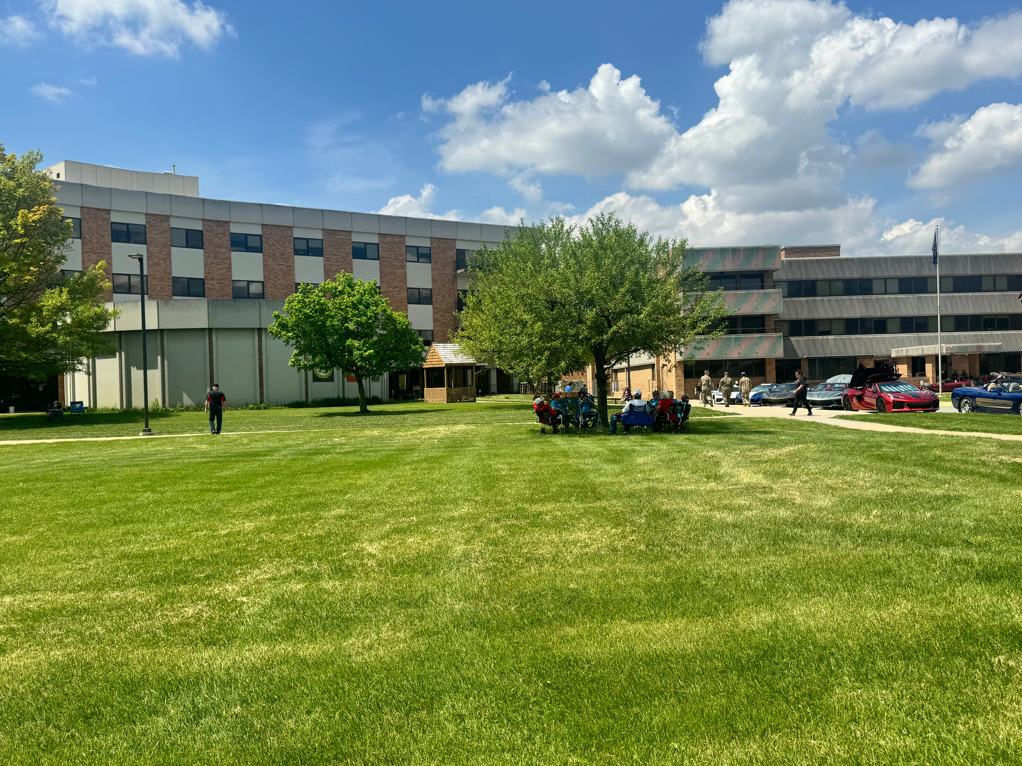
Located in West Lafayette, Indiana, the Indiana Veterans' Home (IVH) offers long-term skilled nursing care,
short-term rehabilitation, independent living, and memory care services to
honorably discharged Indiana veterans their spouses/widows, and Gold Star parents.
With a comprehensive array of on-site services offered in a home-like setting along with veteran-specific programming and events, IVH is the best choice for Hoosier veterans and their spouses.

Slide 3
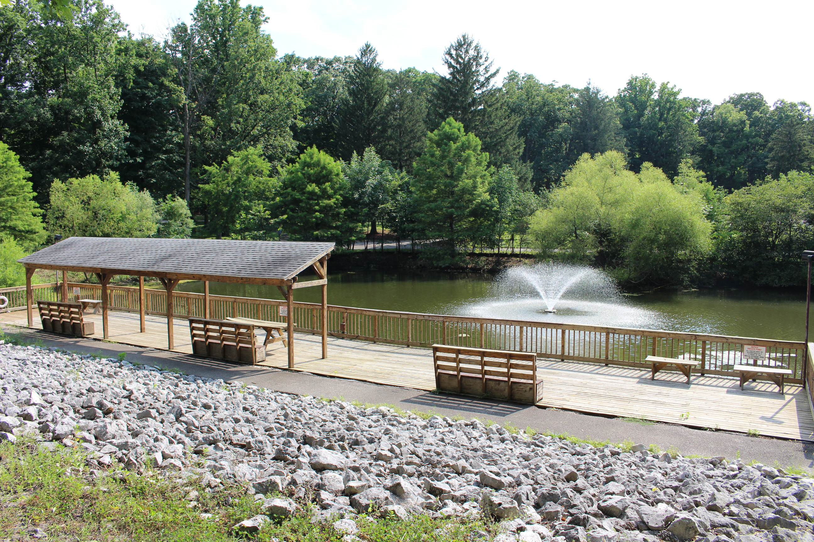
Your Home. You're Family.
The Indiana Veterans' Home is located in West Lafayette, Indiana.
Originally created to care for veterans of the Civil War, the Indiana Veterans’ Home welcomed its first resident in 1896. Located on 250+ acres in West Lafayette, IVH is a full-service care facility offering a complete array of services for residents.
Why IVH?
It is our privilege to serve Hoosier veterans and their spouses and we take that responsibility very seriously. Residents here enjoy newly renovated care units, our beautiful grounds and gardens, the resident library and media center, an on-site chapel, beauty shop, fishing pond, and our transportation services, along with a rich history and extensive recreational programming and events geared specifically for veterans. With our exclusive array of on-site services, expansive volunteer department, and tremendous support from the major veterans service organizations, IVH is truly the best option for Hoosier veterans and their spouses seeking independent living, long-term nursing care, short-term rehabilitation, or memory care.

Slide 4
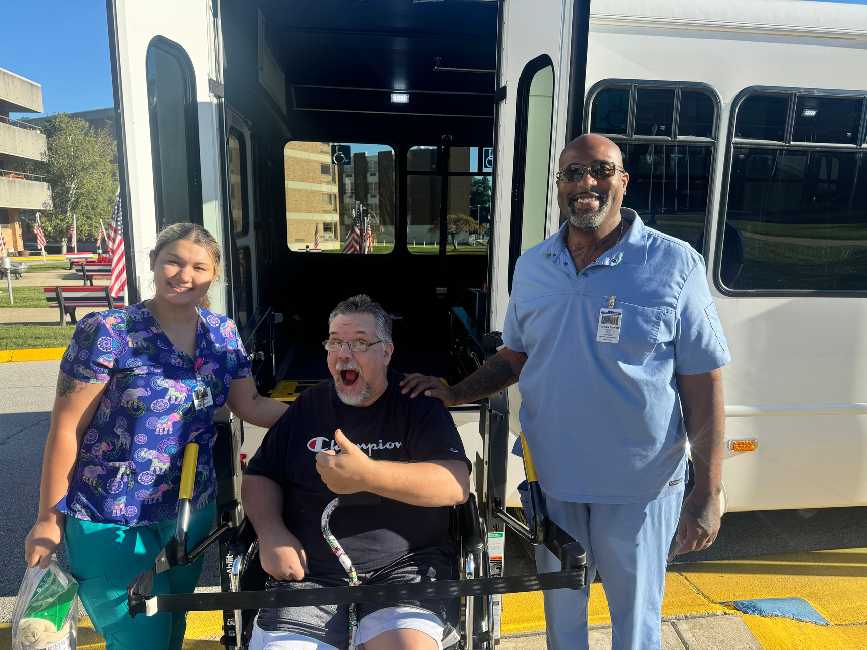
The Indiana Veterans' Home is a full-service care facility, offering a complete array of
on-site services for our residents.
Board-Certified Physicians
Premier Nursing Care
Physical and Occupational Therapy
Pharmacy
Podiatry
Dentistry
Optometry
On-site X-Ray Services
Transportation Services, including routes to the Indy VA
Certified Music and Art Therapy Programs
Resident Library and Media Center
Chapel and Full-Time Chaplain
Beauty Salon and Barber Shop
Fishing Pond
Resident Gardens
Resident Lounges and Game Rooms
Veterans' and patriotic events held year-round
Expansive network of volunteers and support from veterans groups

Slide 5
Admissions
The Indiana Veterans' Home is operated by the State of Indiana for the care of honorably discharged Indiana veterans and their spouses.
An honorably discharged veteran of the United States armed forces and/or the spouse (or surviving spouse) of an honorably discharged veteran of the United States armed forces is eligible to apply for residency at the Indiana Veterans' Home.
Applicants must be an Indiana resident for at least one (1) year immediately preceding application for admission. Residency waivers may apply for service members who enlisted from or discharged to the state of Indiana.
All applicants must pass a criminal background check conducted by the Indiana Veterans’ Home to be eligible for admission.
When IVH receives a referral, we have to review/discuss to ensure that we have the correct LOC and can meet their needs.
Questions? Contact the Admissions and Marketing Department for more information at Admissions&Marketing@ivh.in.gov or call (765) 497-8072.

Slide 6
Referrals
Fax the clinical referrals to (765) 497-8004
Our Clinical Liaison, Tara, will review the notes and conduct a bedside visit once we have the clinical referral, Military Data Screen or DD214, VA Face Sheet, and the backgrounds have been completed.
During the bedside visit, Tara will assist the veteran and/or family with completing the 2-page application and signing IVH’s PHI form.
After the bedside is completed, Tara will type out her report and email all the information to the Admissions Committee for review.
If currently in the hospital and need a decision ASAP, the committee will review as soon as possible to get an answer back to the Social Worker.
The Admissions Team will keep the Social Worker updated on where everything is in the process.
IVH is currently undergoing an internal restructuring process. As part of this transition, we will be placing new referrals for the nursing home side on a waiting list for approximately six months, effective immediately.
We understand the importance of timely placements, and we want to support you during this period. If you need assistance with identifying alternative placement options for veterans or their spouses, we would be happy to provide you with resources and recommendations.
Independent Living is still on an indefinite waitlist.

Slide 7
Tips & References
The Indiana Veterans’ Home is a long-term care nursing facility. Per regulations, we must ensure that an applicant meets the LOC standard before we can accept them.
The VA Higher Per Diem Program only pays the daily rate towards the Nursing Home Section per federal code. (Reference 38 U.S.C. § 1745)
The 70% or greater service-connected wartime Veteran is eligible for free nursing care at the Indiana Veterans’ Home. This benefit at the Indiana State Veterans Home has no income limitation. (Reference 38 U.S.C. § 1745)
· The Veteran is entitled to keep all social security, pensions, and other income that would normally be used to offset their cost in a long term care facility.
Even though we would like to accept every veteran that applies, we have to look at the needed LOC, can we safely meet their needs, and/or are they a risk to themselves or others.

Slide 8
Questions?

