Slide 1
Debt Management Center
https://www.va.gov/debtman/
Veterans, members of the Armed Forces and family members who incur debts as a result of their participation in most VA compensation, pension and education programs as well as home loans closed before January 1, 1990, receive letters from DMC notifying them of their rights as well as their obligation to reimburse the Department of Veterans Affairs.
If you have a debt with us, you may have questions concerning payment plans, amounts offset from your benefit payments and what to do if payment of the debt would cause hardship.
Many answers can be found this Web site.

Slide 2
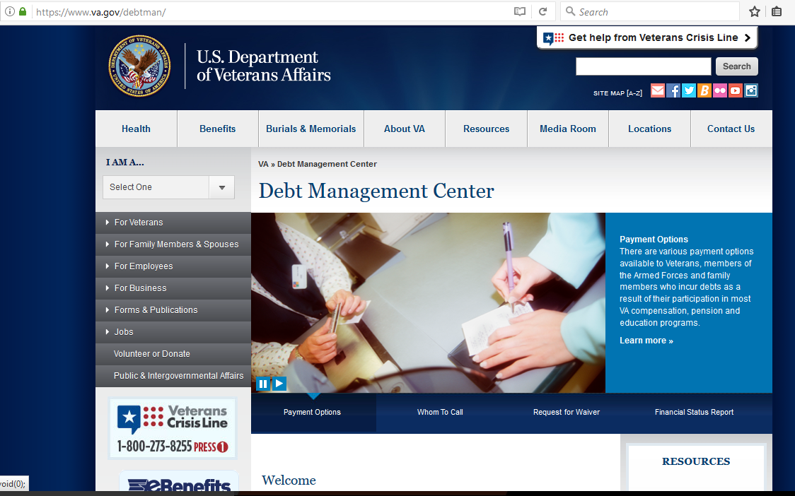
Debt Management Center
https://www.va.gov/debtman/
PAYMENTOPTIONS

Slide 3
Debt Management Center
https://www.va.gov/debtman/
If Paying the Entire Balance of a Debt
Call Debt Management Center, first, to confirm the balance.
1-800-827-0648
Pay ONLINE
Pay by PHONE
Pay by Western Union® Quick Collect®
Pay by Mail
Pay By MONTHLY PAYMENTS
Pay By MONTHLY OFFSETS
PAYMENT questions:
PHONE: 800-827-0648 EMAIL: dmc.ops@va.gov.

Slide 4
Debt Management Center
https://www.va.gov/debtman/
ONLINE (with Plastic Card or ACH Debit)
Please pay each debt separately at our online payment site. Those of you receiving monthly compensation, pension or educational benefits should call Debt Management Center before making an online payment. We want to be sure you are not overpaying your debt if we have offset benefits. Our telephone number is 1-800-827-0648.

Slide 5
Debt Management Center
https://www.va.gov/debtman/
PAY BY PHONE (1-800-827-0648)
From your bank account (ACH Direct Debit) or with a plastic card (any credit or debit card with Visa, MasterCard, American Express or Discover logos).
Our toll-free telephone business hours are 6:30a.m. to 6:00p.m. (Central).

Slide 6
Debt Management Center
https://www.va.gov/debtman/
PAY by Western Union® Quick Collect®
You may send us a payment from any nearby Western Union Agent location, or by visiting www.westernunion.com
The Western Union Agent or the website will require a host city code to complete the Quick Collect Transaction. Our host code is VADMC.

Slide 7
Debt Management Center
https://www.va.gov/debtman/
Pay by Mail
If you’re paying by mail: Please send us a separate check for each debt and include a payment remittance stub for each payment. Payment remittance stubs are printed at the bottom of our collection letters. You should have received a separate letter for each category of debt. Make sure to write your file number and deduction code on each check. The deduction code tells us what category of debt you’re paying (advance payment, housing allowance, tuition and fees, etc.). File numbers and deduction codes are printed on the left side of the payment remittance stubs and in the upper right of the letters. If you wish to send us one check for multiple debts, please enclose separate payment remittance stubs for each debt. If you do not have the collection letters, send us a note listing the debts you’re paying and the amounts you want applied to each debt.
Make your check or money order payable to the “U.S. Department of Veterans Affairs” and print your full name and VA file number or Social Security Number on the payment to ensure proper credit.

Slide 8
Debt Management Center
https://www.va.gov/debtman/
Pay By Monthly Payments
If you are unable to pay your debt in full, we will work with you to establish an acceptable monthly payment plan. To take advantage of this option, please mail a letter indicating the amount you can pay on a monthly basis along with a completed Financial Status Report.
Mail your letter and a completed Financial Status Report to the address listed above. To expedite the processing, you may fax your Letter and completed Financial Status Report to 1-612-970-5688.
Please be sure to complete Block 24B on the Financial Status Report to indicate the amount you propose to pay monthly. You may also send a payment with the correspondence. We will contact you and let you know if the proposed monthly payment plan is acceptable.

Slide 9
Debt Management Center
https://www.va.gov/debtman/
Pay By Monthly Offsets
If you receive a monthly benefit check from the VA and we advised you that we plan to offset the entire check amount to apply to your debt, you can request a smaller offset amount.
If the offset amount you propose can liquidate the debt within a one-year timeframe or less,
you do not need to complete a Financial Status Report.
If the timeframe exceeds one year, you need to follow the same procedures as specified in the
Pay By Monthly Payments section (previous slide).

Slide 10
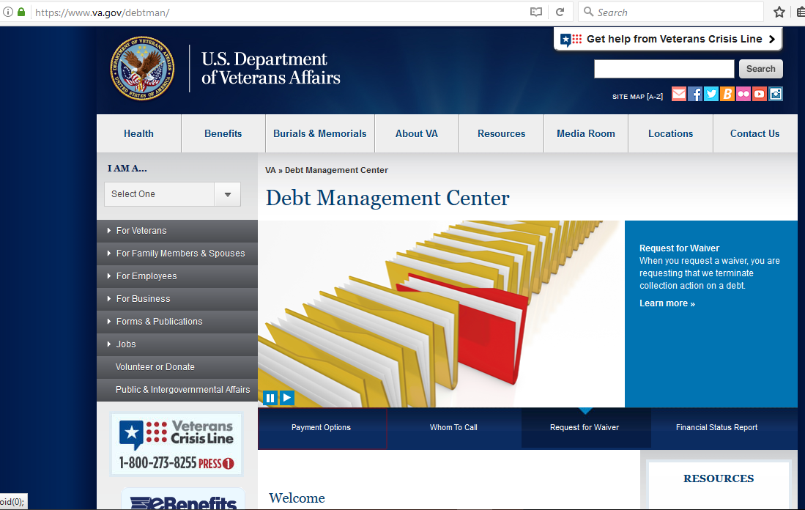
Debt Management Center
https://www.va.gov/debtman/
REQUEST A WAIVER

Slide 11
Debt Management Center
https://www.va.gov/debtman/
What you will find in the Waiver section…
What is a waiver?
What are the eligibility requirements for a waiver?
How do you apply for a waiver?
Can I request an oral hearing?
Are there time limitations associated with the waiver request?
Education, Pension and Disability Waiver Request Loan Guaranty Waiver Requests
What does it mean when your waiver is granted?
How are you notified of your waiver decision?

Slide 12
Debt Management Center
https://www.va.gov/debtman/
What is a waiver?
Requesting that VA terminate collection action on a debt.
If a waiver is granted in full or part, you will not be required to pay the amount that was waived.

Slide 13
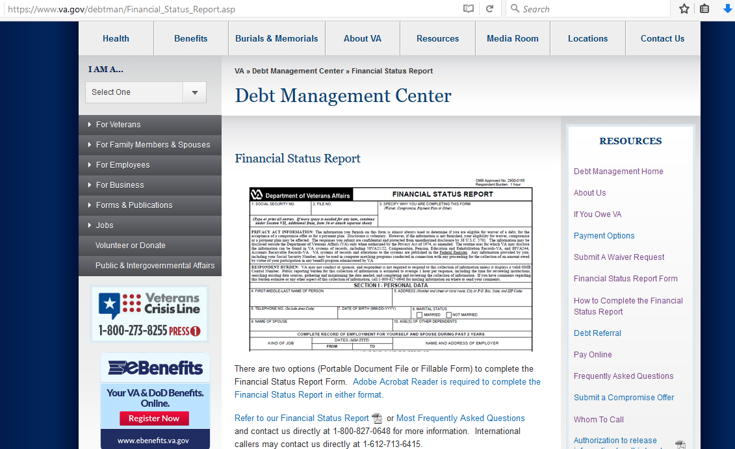
Debt Management Center
https://www.va.gov/debtman/
VA Form 5655
Learn More

Slide 14
Debt Management Center
https://www.va.gov/debtman/
CONTACT:
(800) 827-0648 Monday – Friday
6:30 am - 8:00 pm (CT) -- 7:30 am - 9:00 pm (ET)
The recommended time to call: Tue., Wed. & Thurs.
10:30am - 12:15 pm & 1:15 pm to 3:30 pm (CT)
11:30am - 1:15 pm & 2:15 pm to 4:30 pm (ET)
PHONE
SNAIL MAIL
U.S. Department of Veterans Affairs Debt Management Center P.O. Box 11930 St. Paul, MN 55111
EMAIL
https://iris.custhelp.va.gov/app/ask/

