Slide 1
2018 IDVA Spring/Summer Conference
“Creating a Bridge for Our County Veterans and the State/Federal Department of Veterans Affairs”

Slide 2
“Death & Burial Benefits/Programs”
Federal Benefits: An Overview
Department of Veterans’ Affairs (VA)

Slide 3
Benefit Categories
“Death & Burial Benefits/Programs”

Slide 4
Federal Benefit Categories
National Cemetery Burial
Burial & Plot Allowance(s)
Free Government Headstone/Marker
Free Government Medallion
Burial Flag(s)
President’s Memorial Certificate
Unclaimed Veterans’ Remains

Slide 5
National Cemetery Burial
“Death & Burial Benefits/Programs”

Slide 6
National Cemetery Burial

Slide 7
National Cemetery Burial
For “eligible” Veterans, burial benefits available include a gravesite in any of VA’s 135 national cemeteries with available space, opening and closing of the grave, perpetual care, a Government Headstone or Marker, a Burial Flag, and a Presidential Memorial Certificate, at no cost to the family.
Pre-eligibility may be determined. Qualifying for “pre-eligibility” does not provide for selection of a specific plot or gravesite, rather eligibility to be buried in a National Cemetery (where space is available).
The only active National Cemetery, currently accepting new internments in the State of Indiana, is located in Marion, IN (a new National Cemetery is currently under construction in Indianapolis, IN)

Slide 8
National Cemetery Burial
Basic Eligibility (Quick Summary)
Any member of the Armed Forces of the United States who dies on active duty.
Any Veteran who was discharged under conditions other than dishonorable. With certain exceptions, service beginning after September 7, 1980, as an enlisted person, and service after October 16, 1981, as an officer, must be for a minimum of 24 continuous months or the full period for which the person was called to active duty (as in the case of a Reservist called to active duty for a limited duration). Undesirable, bad conduct, and any other type of discharge other than honorable may or may not qualify the individual for Veterans benefits, depending upon a determination made by a VA Regional Office. Cases presenting multiple discharges of varying character are also referred for adjudication to a VA Regional Office.
Reservists and National Guard members who, at time of death, were entitled to retired pay under Chapter 1223, title 10, United States Code, or would have been entitled, but for being under the age of 60.

Slide 9
Burial & Plot Allowances
“Death & Burial Benefits/Programs”

Slide 10
Burial & Plot Allowances
Burial Allowance: VA will pay a burial and funeral allowance of up to $2,000 for Veterans who die from service-connected injuries. VA will pay a burial and funeral allowance of up to $300 for Veterans who, at the time of death from nonservice-connected injuries were entitled to receive pension or compensation or would have been entitled if they were not receiving military retirement pay. VA will pay a burial and funeral allowance of up to $734 when the Veteran’s death occurs in a VA facility, a VA-contracted nursing home or a state Veterans nursing home. In cases in which the Veteran’s death was not service-connected, claims must be filed within two years after burial or cremation.

Slide 11
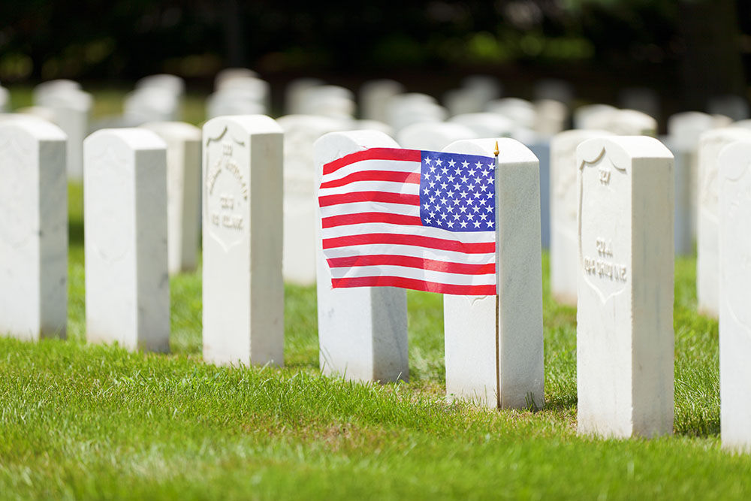
Burial & Plot Allowances
Plot Allowance: VA will pay a plot allowance of up to $734 when a Veteran is buried in a cemetery not under U.S. government jurisdiction “IF”: The Veteran was discharged from Active Duty because of disability incurred or aggravated in the line of duty; the Veteran was receiving Compensation or Pension or would have been if the Veteran was not receiving Military Retired Pay; or the Veteran died in a VA facility. The Plot Allowance may be paid to the state for the cost of a plot or interment in a state-owned cemetery reserved solely for Veteran burials if the Veteran is buried without charge. Burial expenses paid by the deceased’s employer or a state agency will not be reimbursed.

Slide 12
Free Government Headstone/Marker/Medallion(s)
“Death & Burial Benefits/Programs”

Slide 13
Free Government Headstone/Marker/Medallion(s)
Burial Headstones and Markers: VA is authorized to furnish, upon request, an inscribed headstone or marker for the unmarked grave of an eligible decedent at any national, state Veterans, tribal, or private cemetery. VA will deliver a headstone or marker at no cost, anywhere in the world. For Medal of Honor (MOH) recipients, VA is authorized to provide a supplemental headstone or marker if the recipient served in the Armed Forces on or after April 6, 1917 and is eligible for a headstone or marker (or would be but for the individual’s date of death), even if the grave is already marked with a private headstone or marker. For eligible Veterans or service members (who are not MOH recipients) buried in a private cemetery whose deaths occurred on or after Nov. 1, 1990, VA may furnish a government headstone or marker even if the grave is already marked with a private one.

Slide 14
Free Government Headstone/Marker/Medallion(s)
Spouses and Dependent Children are eligible for a Government Headstone or Marker only if they are buried in a National or State Veterans Cemetery.
Before requesting a headstone or marker for use in a private cemetery, eligible applicants should check with the cemetery to ensure the government-furnished headstone or marker will be accepted.
Applicants for burial headstones and markers include the decedent’s spouse or individual in a legal union with the decedent, the decedent’s child, parent or sibling, whether biological, adopted or step relation, and any lineal or collateral descendant of the decedent, personal representative, Veterans Service Organization, individual employed by state or local government responsible for serving Veterans, individuals with legal responsibility for the disposition of the unclaimed remains of the decedent or other matters related to interment or memorialization, or anyone if the decedent’s dates of service ended prior to April 6, 1917 (applies to others whose eligibility is derived). All installation fees at private cemeteries are the responsibility of the applicant.

Slide 15
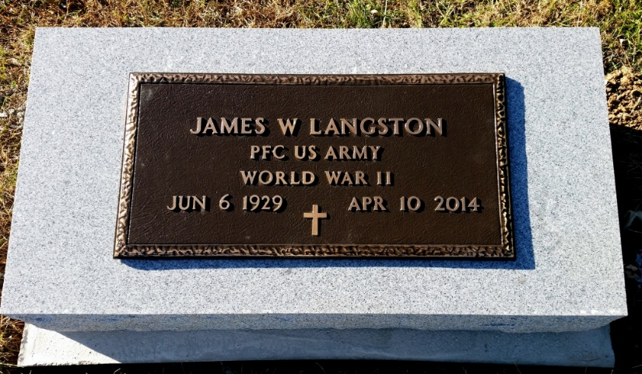
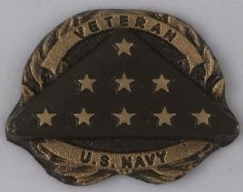
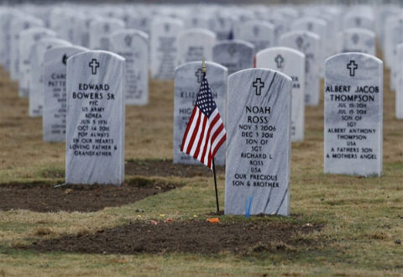
Free Government Headstone/Marker/Medallion(s)
Medallion in lieu of Government Headstone or Marker for Private Cemeteries: For decedents who served in the U.S. Armed Forces on or after April 6, 1917, and are eligible for VA memorialization benefits (or would be but for date of death), VA is authorized to provide a Medallion instead of a Headstone or Marker if the grave is in a private cemetery and already marked with a privately-purchased Headstone or Marker. The VA Medallion denotes the decedents’ status as a Veteran.

Slide 16
Burial Flag(S)
“Death & Burial Benefits/Programs”

Slide 17
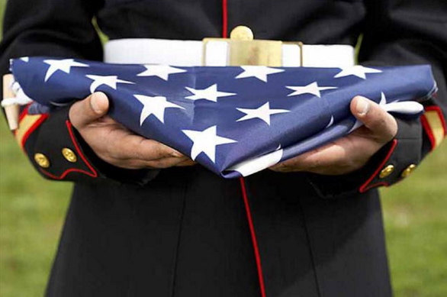
Burial Flag(s)
Burial Flags: VA will furnish a U.S. Burial Flag to recognize deceased Veterans who received an other than Dishonorable Discharge. This includes certain persons who served in the organized military forces of the Commonwealth of the Philippines while in service of the U.S Armed Forces and who died on or after April 25, 1951. Also eligible for a Burial Flag are Veterans who were entitled to retired pay for service in the Reserve or National Guard, or would have been entitled if over age 60; and members or former members of the Selected Reserve who served their initial obligation, or were discharged for a disability incurred or aggravated in the line of duty, or died while a member of the Selected Reserve.

Slide 18
Presidential Memorial Certificate
“Death & Burial Benefits/Programs”

Slide 19
Presidential Memorial Certificate
Presidential Memorial Certificates (PMCs): PMCs are issued to honor the memory of deceased persons VA finds eligible for burial in a National Cemetery. This includes persons who died on Active Military, Naval, or Air Service, members of Reserve Components of the Armed Forces, including Army or Air National Guard, members of the Army, Navy, or Air Force Reserve Officers’ Training Corps, or persons who at death were entitled to retired pay or would have been but for age. Eligible recipients include the Next-of-Kin, a Relative, Friend, or Authorized Service Representative acting on behalf of a relative or friend.

Slide 20
Unclaimed Veterans’ Remains
“Death & Burial Benefits/Programs”

Slide 21
Unclaimed Veterans’ Remains
Unclaimed Veterans Remains: “Unclaimed Veterans” are defined as those who die with no Next-of-Kin to claim their remains and insufficient funds to cover burial expenses. In addition to burial in a VA National, VA-funded State or Tribal Veterans Cemetery and a Government Headstone or Marker, there are monetary benefits associated with burial of Unclaimed Veterans remains. These monetary benefits include reimbursement for the cost of the casket or urn used for burial, reimbursement for transportation to a National, State or Tribal Cemetery, and a Burial Allowance and Plot Allowance.

Slide 22
“Death & Burial Benefits/Programs”
State Benefits: An Overview
Indiana Department of Veterans Affairs (IDVA)

Slide 23
State Benefit Categories
Indiana Veterans’ Memorial Cemetery
County Burial & Marker Placement/Setting Allowance(s)
Governor’s Memorial Certificate

Slide 24
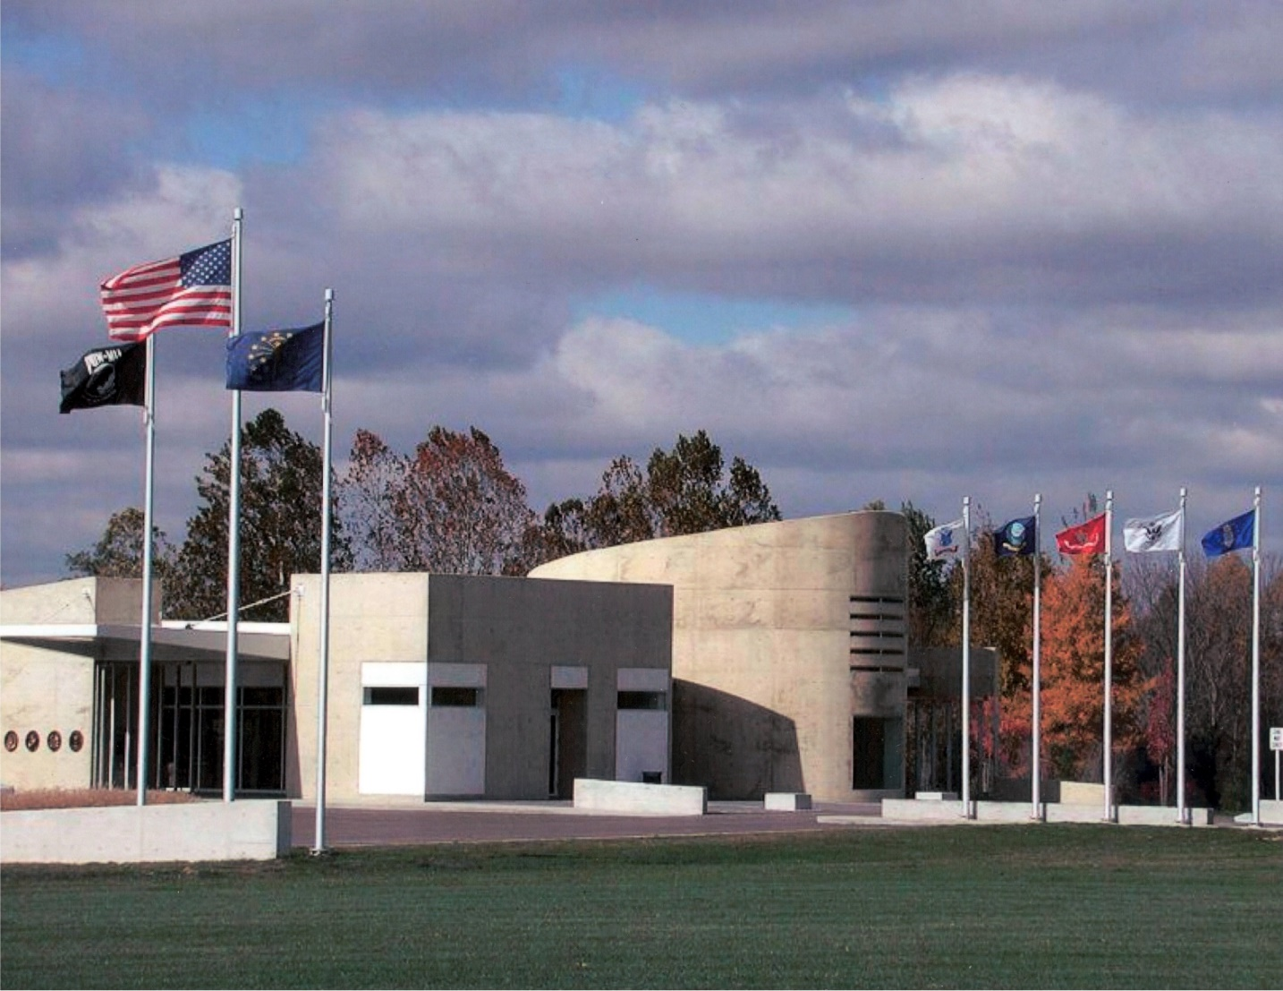
INDIANA VETERANS’ MEMORIAL CEMETERY
Indiana Veterans’ Memorial Cemetery Madison, Indiana
Located in Madison County, IN
The Indiana Veterans Memorial Cemetery opened for internments on December 1, 1999. The Cemetery is located adjacent to the Madison State Hospital and Clifty Falls State Park in Madison, Indiana. Any Hoosier Veteran eligible to be buried in a National Cemetery will be eligible for burial. The Spouse of an eligible Veteran will also be eligible to be burial.

Slide 25
COUNTY BURIAL & MARKER PLACEMENT/SETTING ALLOWANCE(S)
Honorably Discharged Veterans who served on Active Duty in the United States Armed Forces are generally eligible.
A one time payment in the amount of $100 to $1500 as a County Burial Allowance, issued by the respective county for which the eligible Veteran resided at the time of death, may be claimed by the Surviving Spouse, Next-of-Kin, or Interested Third Party (to whom incurred expenses for the cost of burial/interment/funeral/etc.).
“IF” a Government Headstone/Marker/Medallion was claimed/ordered through the Federal Department of Veterans’ Affairs for the deceased Veteran, then an additional allowance may be claimed to assist in the offset of the expense incurred to have that Government Headstone/Marker/Medallion placed or set onto the plot of the deceased Veteran. This amount varies from county to county and generally has a maximum allowable reimbursement amount.

Slide 26
Governor’s Memorial Certificate
The Governor’s Memorial Certificate is a certificate signed by the Governor of Indiana in memorial appreciation for the service of a deceased Hoosier Veteran.
The Hoosier Veteran must have received an Honorably Discharged from Active Military Service from the United States Armed Forces.

Slide 27
Questions???

Slide 28
Point of Contact
Cameron Lochner
Northeast Indiana District Service Officer
Indiana Department of Veterans Affairs
302 West Washington Street; Suite E-120
Indianapolis, IN 46204
Phone: 317-618-5543, Fax 317-232-7721
clochner@dva.in.gov

