Slide 1
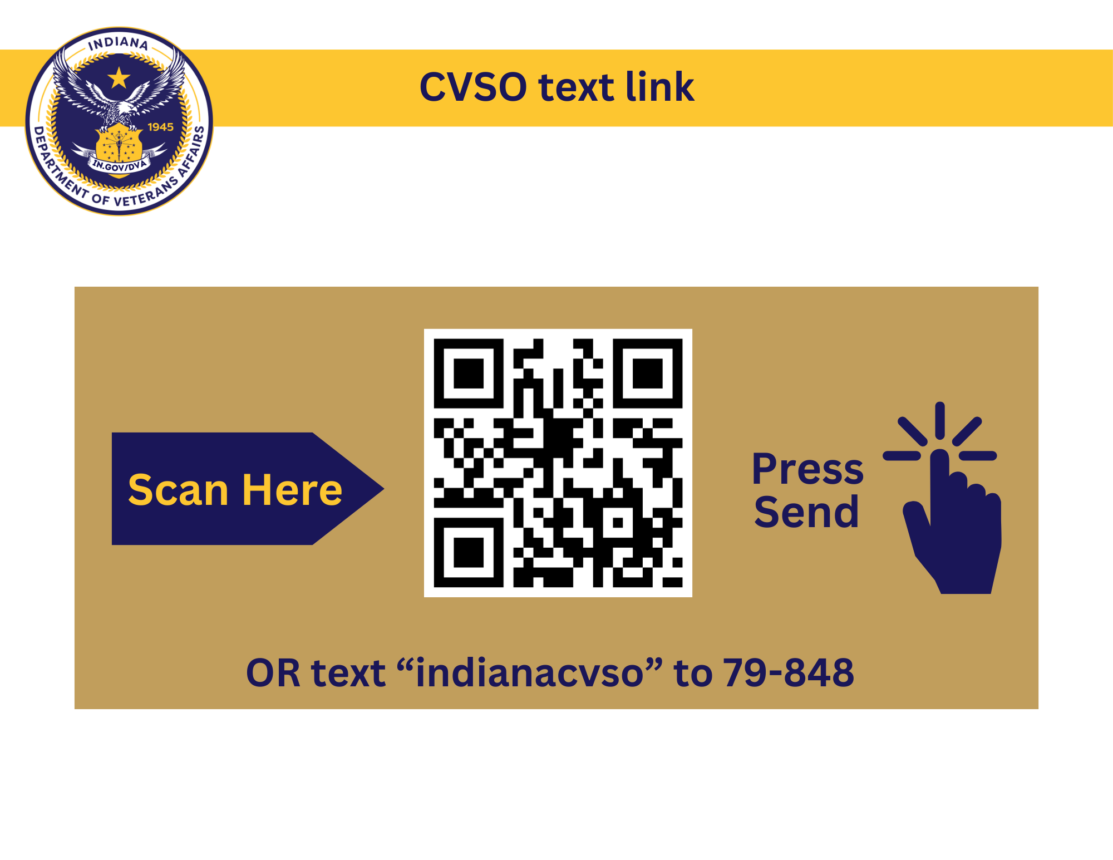


CONNECT
WITH IDVA

