Slide 1

U.S. Department of Veterans Affairs
Indianapolis Regional Office
Indiana CVSO Meeting
June 12, 2019

Slide 2
Agenda
High Level Look at Regional Office
Detailed discussion:
  Streamlining Claims
  Blue Water Navy
Question and Answer

Slide 3
Indianapolis Regional Office
560 employees – 70-80% are Veterans
Three (3) business lines plus support functions:
  Veterans Service Center
  Fiduciary Hub
  Vocational Rehabilitation & Employment

Slide 4
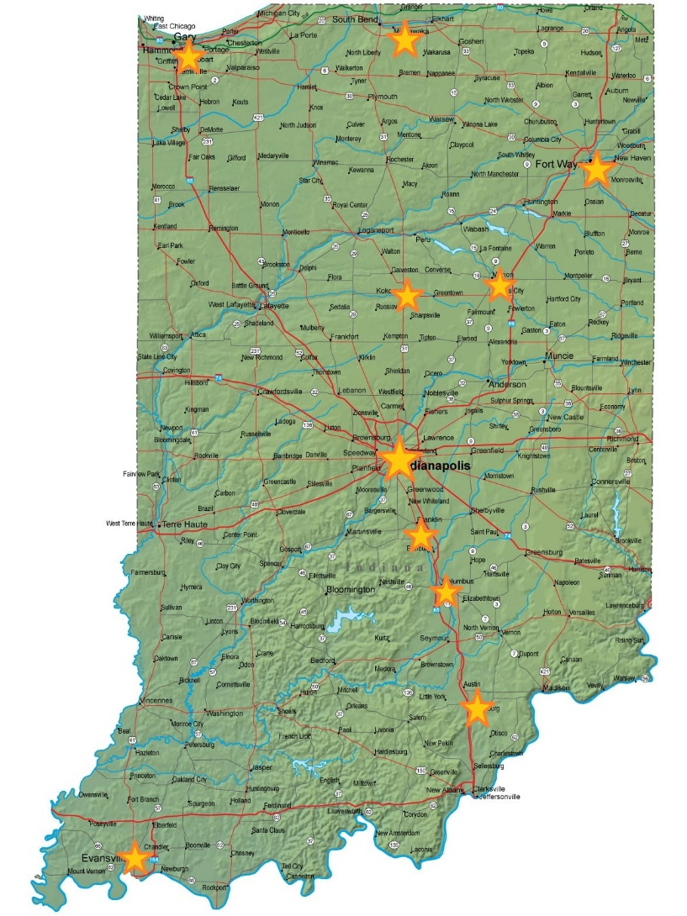
Statewide Presence
Indianapolis – Regional Office
Fort Wayne – VR&E and Comp
Marion – VR&E and Comp
Camp Atterbury – MSCs (Comp)
Gary – VR&E
South Bend/Mishawaka – VR&E
Kokomo – VR&E
Columbus – VR&E
Scottsburg – VR&E
Evansville – VR&E
Vincennes – VR&E

Slide 5

Statewide Impact
409,836 Veterans in the state
4th largest Army National Guard
93,000 Veterans and 6,300 dependents receive benefits
Over $125 million paid monthly in comp & VR&E benefits
Over $1.5 billion paid annually in comp & VR&E benefits

Slide 6
Contact Information
Michael Stephens, Director
(317) 916-3400
National Help Line
1-800-827-1000
Local CVSO Line
(317) 916-3738

Slide 7
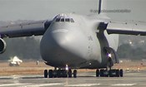

Streamlining Claims

Slide 8
Discussion Topics
Prescribed Form
Pin Point Claim Details
Current Diagnosis
Presumptive Facts

Slide 9
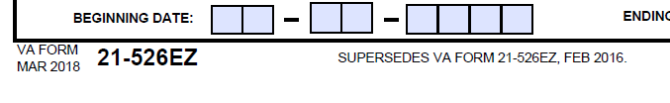
Prescribed Form
21-526 EZ (March 2018)
20-0995
Obsolete Forms (526b, forms 1 year after update)
  VA website - https://www.va.gov/vaforms/search_action.asp

Slide 10
Pin Point Claim Details
Submit everything at the beginning (if possible)
Avoid submitting multiple 526 forms
38 U.S.C. 5103 – Duty to Assist
  Complete the 5103 if possible

Slide 11
Current Diagnosis
Completed DBQs
https://benefits.va.gov/COMPENSATION/dbq_ListByDBQFormName.asp
Private Medical Record
21-4142 / 21-4142a
21-4138 with lay statement

Slide 12




Presumptive Facts
Boots on the ground
21-4138

Slide 13
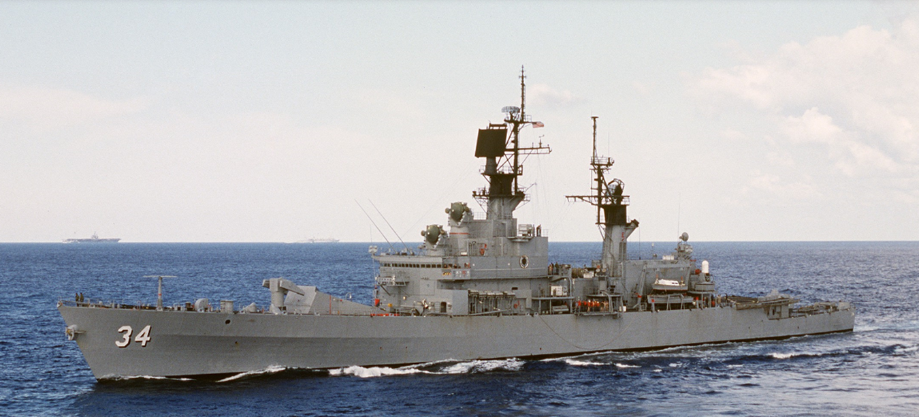
Blue Water Navy

Slide 14
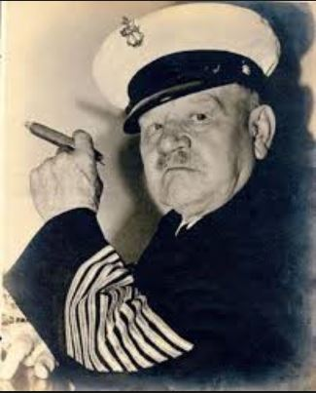
Discussion Topics
Procopio Basics
Affected Claims
Interim Processing
Tools:
  Deck Logs
  Preliminary Ship Locator Tool

Slide 15
Procopio Basics
Procopio v. Wilkie
Major court decision in January 2019
Intent: Extend Agent Orange presumptive conditions to Veterans who served in the territorial sea of the Republic of Vietnam
“Blue Water”
  12-nautical miles
  Between January 9, 1962 and May 7, 1975

Slide 16
Affected Claims
AO-presumptive conditions claimed by blue water Veterans that can’t be granted without consideration of Procopio
Not Affected:
Conditions that are not AO-presumptive
Claims that can be granted on another basis

Slide 17
Interim Processing
Ratings – do not rate, control end product
Claims – track as AO-Blue Water
Appeals – track as Appeal Pending Procopio

Slide 18
Interim Processing
VBA will make evidence-based determinations that involve:
  Presence during the specified period and on a Navy vessels, and
  Location of vessel
NOTE: Issue if Nehmer applies is pending

Slide 19
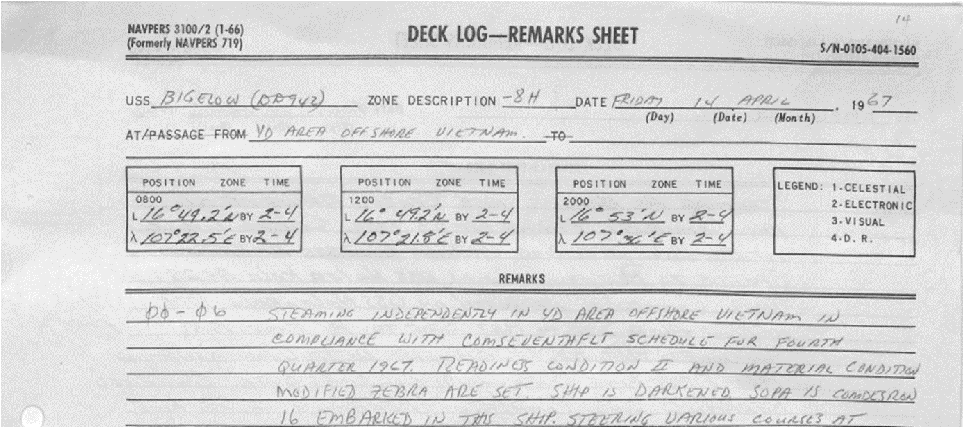
Tools – Deck Logs
USS BIGELOW (DD 942) for April 14, 1967

Slide 20
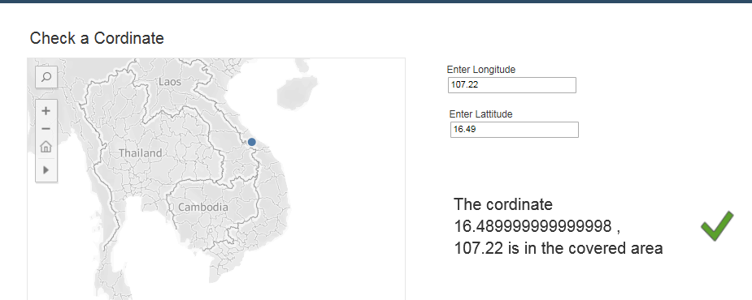
Tools – Preliminary Ship Locator Tool

Slide 21

Questions

