Slide 1

Indiana’s
Governor’s Challenge
To Prevent Suicide Among Service Members, Veterans, their Families and Caregivers (SMVF-CG)
Effective suicide prevention takes a combination of people, effort, and imagination. TOGETHER we can achieve far-reaching statewide improvements in policy, practice, and implementation.
Join us.

Slide 2
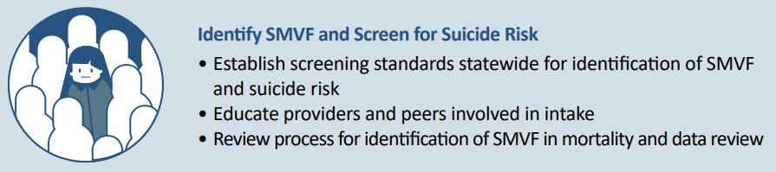
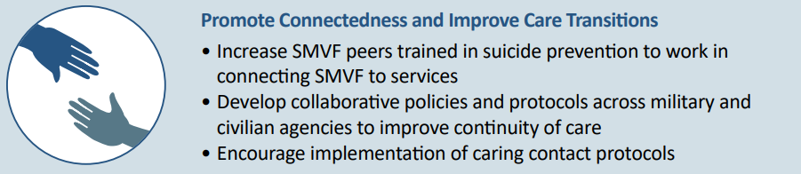
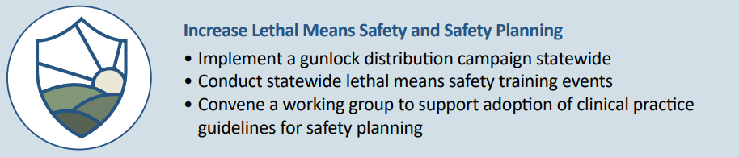
Governor’s and Mayor’s Challenges to Prevent Suicide Among Service Members, Veterans, and their Families
Priority 1
Priority 2
Priority 3

Slide 3



IGC: Identifying Your Veteran Community
“DO you have a
family member
that ever served
in the military?”
Priority 1
“Have you ever
Served in
the military?”
IGC is utilizing an SMS to Identify and communicate with the Veteran Community
Community Partners can JOIN IN the IDVA SMS text communication

Slide 4
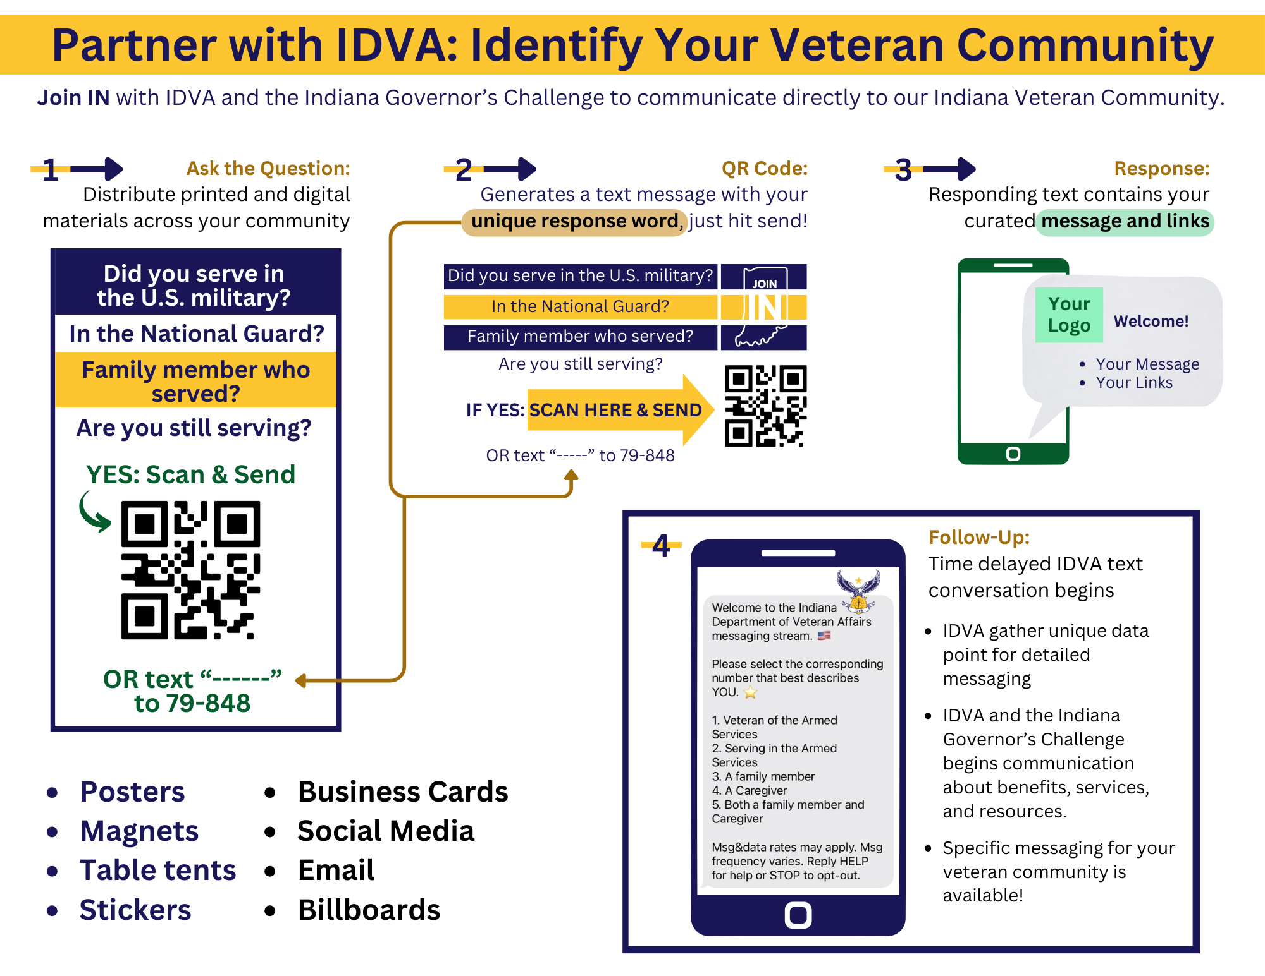
SMS
Journey

Slide 5
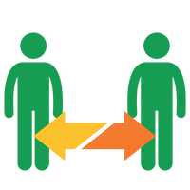
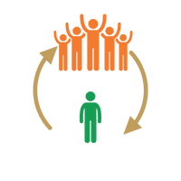
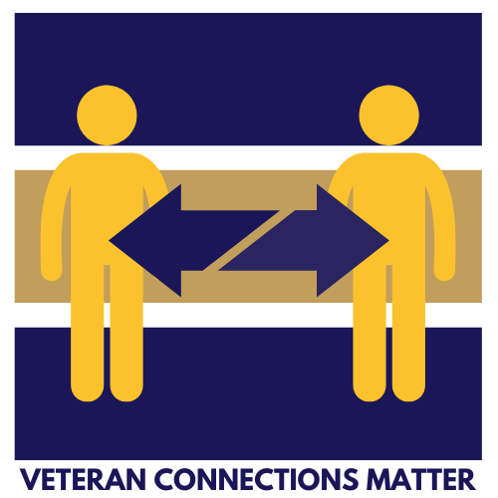
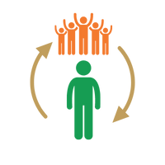

IGC: Curating Connection
Vet to Vet
Social
Recreational
Clinical
Service Based
Priority 2
Community to Vet
Celebrate veterans at existing community event
We are you; We welcome you
Vet to Community
Local veteran community invitation to the public
We are you; We welcome you
Vet 2 Self
Mental Health Wellness is Fitness
Exercise = strength, peace and well being
  Physically AND Mentally

Slide 6
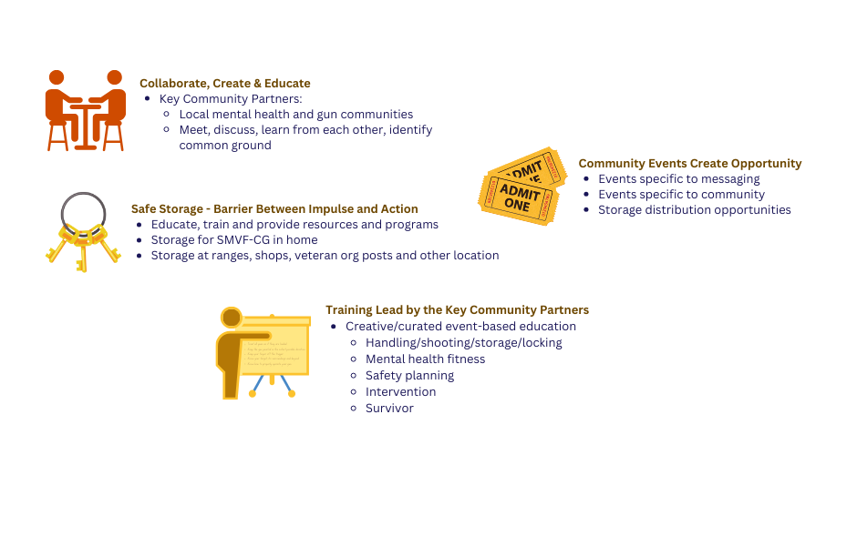

IGC: 3 Lethal Means Safety
Priority 3

Slide 7
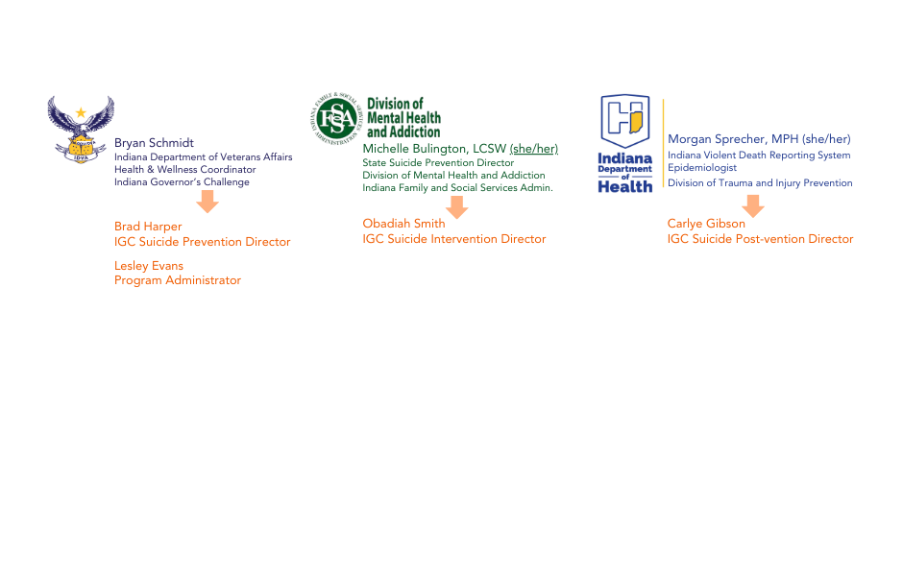
IGC: The Team
Joseph DeVito, IDVA Outreach Director

Slide 8
IDVA: Prevention
Easy to Say, Challenging to Implement
Basic Needs
Employment
Family and Social Supports
Finances & Benefits
Higher Education
Housing and Homelessness
Legal
Mental Health and Substance Use
Physical Health
Spirituality

Slide 9
IDVA: Prevention
Community involvement plays a pivotal role in preventing military veteran suicides by fostering a supportive environment, increasing access to resources, and reducing social isolation among veterans​

Slide 10



IDVA: Prevention
Strategies for Action
Identify and Support People at Risk
Strengthen Economic Supports
Create Protective Environments
Improve Access and Delivery of Suicide Care
Promote Healthy Connections
Teach Coping and Problem-Solving Skills
Lessen Harms and Prevent Future Risk
Priority Groups:
    Identifying SMVF-CG
    Creating Connection
    Lethal Means Storage, Safety, Planning & Training

Slide 11
FSSA: Intervention
“Suicide intervention is not just about saving lives; it's about offering hope, empathy, understanding, and support to those in the darkest moments of their lives. Together, we can be the beacon of hope and light that guides individuals to healing, resilience and well being”
Obadiah Smith Jr

Slide 12

FSSA: Intervention
Intervention At Its Best

Slide 13
FSSA: Intervention
Why Suicide Intervention
  To prevent someone from dying by suicide and connecting them with appropriate mental health resources and implementing strategies to address underlying issues contributing to their distress.
  Non-Clinical Way of Intervention
  Effective
  Preserving life
  It’s identifying suicidal behaviors, effectively demonstrating the depth, severity of empathic listing skill to someone you care about.
  Assessment
  Solution
  Resources
  Follow up
  Promotion of Self Care

Slide 14

IDOH: Post-Vention
What is Postvention?
Suicide Postvention is a form of Prevention
Statistically a person is at a higher likelihood to die by suicide when they have known someone who died by suicide
Individuals do not feel that they need to prepare for a suicide death and therefore are not prepared to decrease risk of future suicide

Slide 15
IDOH: Post-Vention
Creating Postvention Initiatives in Your Community
Four key items for postvention initiatives
Learning the communities needs and planning to address needs
Ability to provide immediate and long-term support to families and the community
Tailored response to survivors of suicide loss. Having resources and services that are specific to their needs
Knowing that lived experiences of survivors of suicide loss can help with planning and implementation of postvention efforts

Slide 16

IDOH: Post-Vention
Postvention Resources
Local Outreach to Suicide Survivors (L.O.S.S.) teams
  https://www.lossteam.com/
The Connect Program – Creating a community postvention response Plan
  https://theconnectprogram.org/
Tragedy Assistance Program for Survivors (TAPS)
  https://www.taps.org/
Support and Bereavement Groups

Slide 17
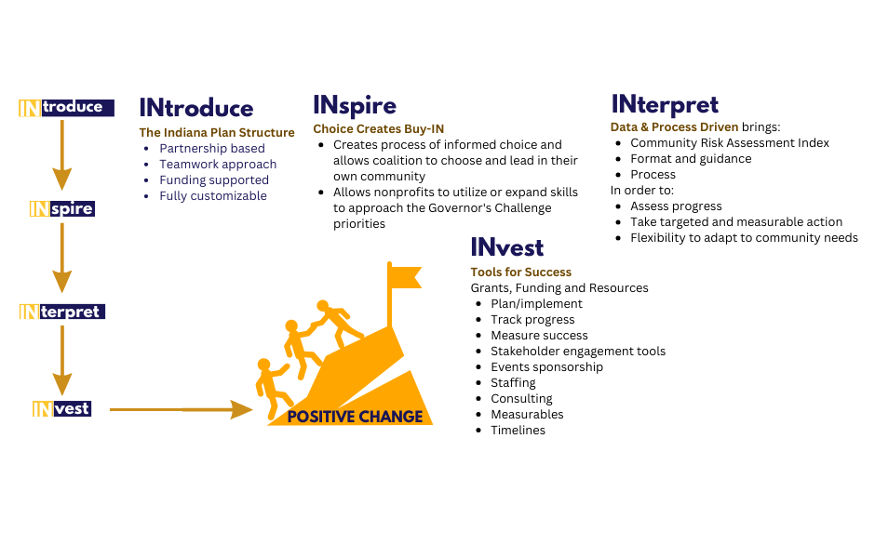
IGC: Community Coalition Rollout

Slide 18
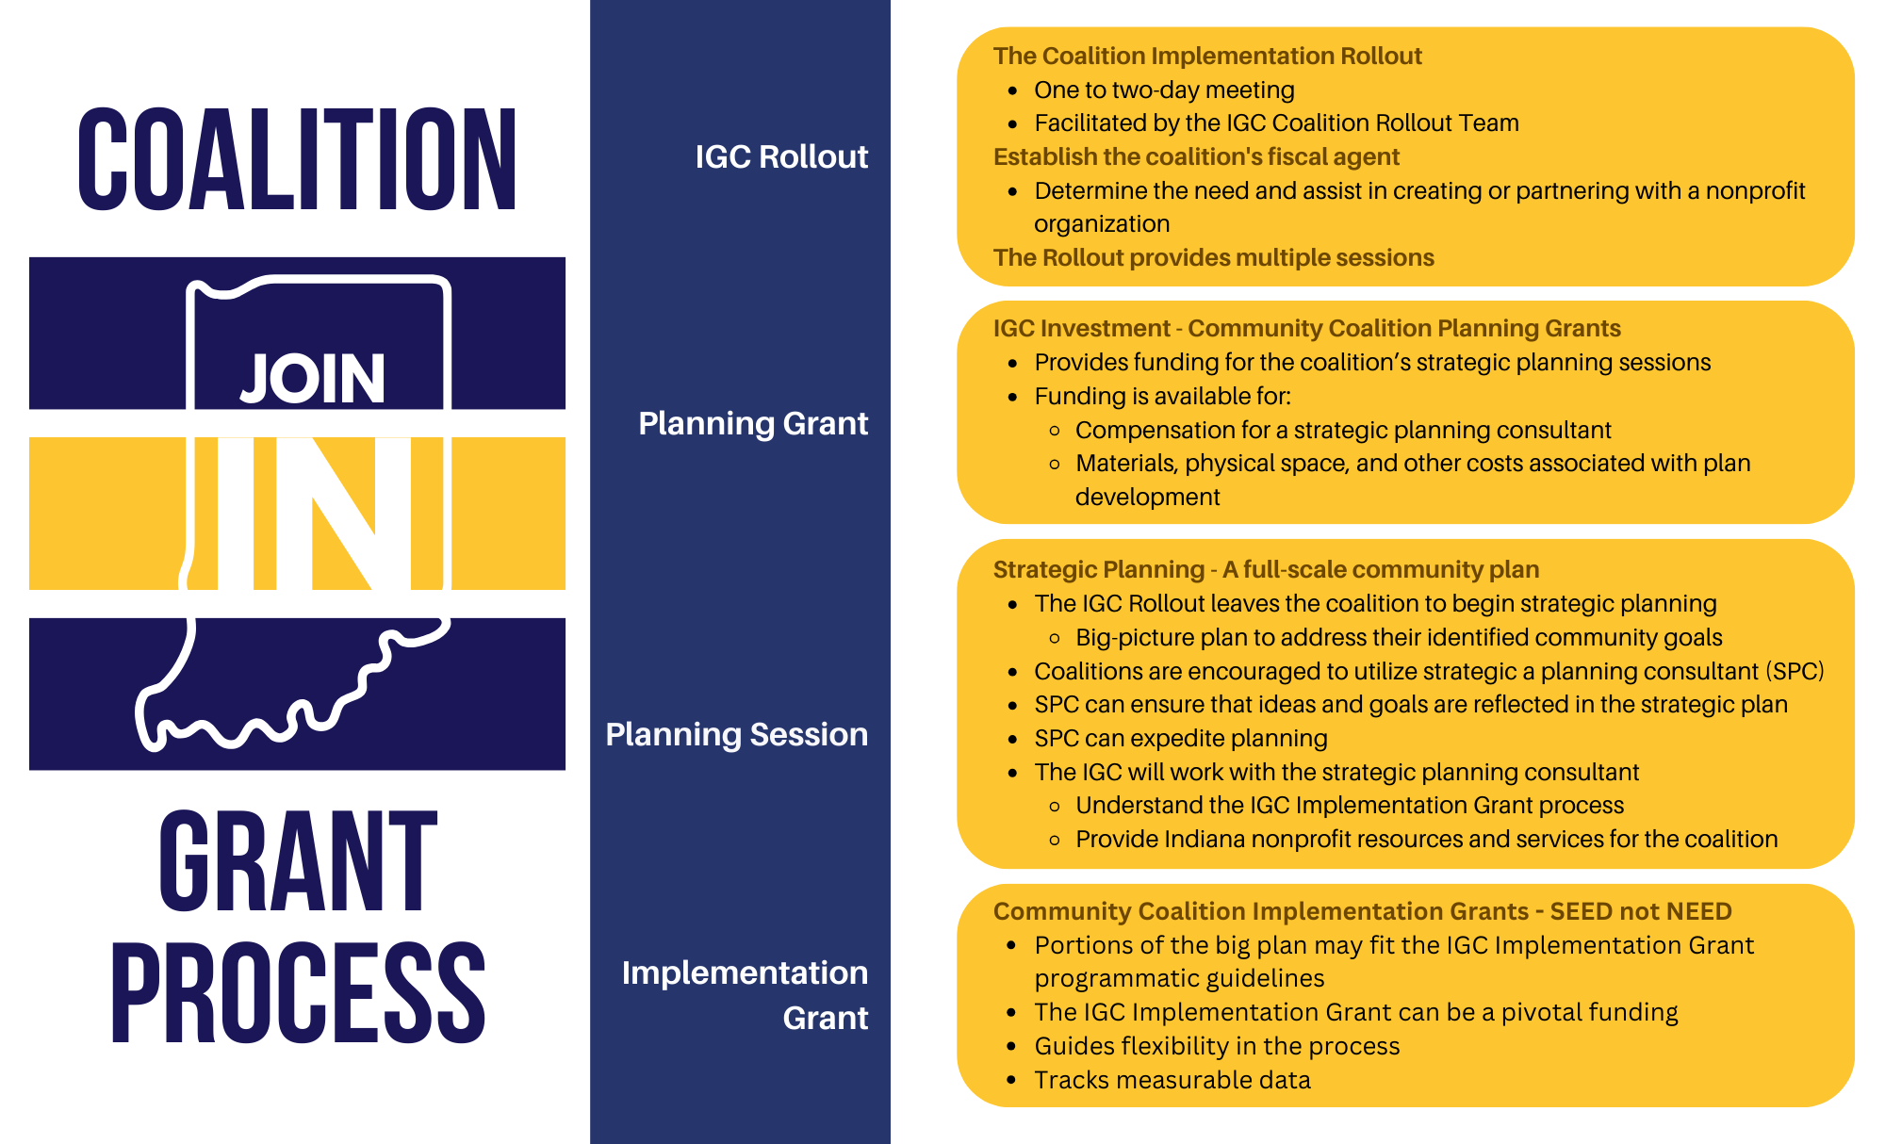
Coalition Funding

Slide 19
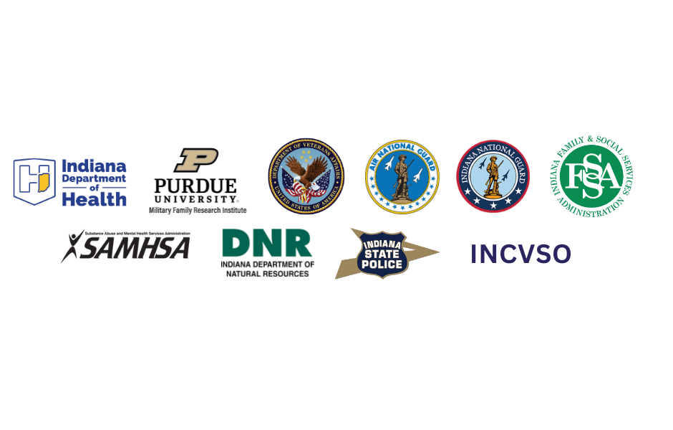
IGC: Direction
Community Data + Partnership = Direction

Slide 20
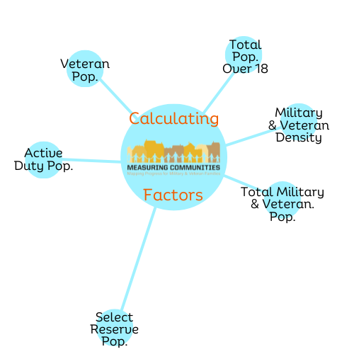
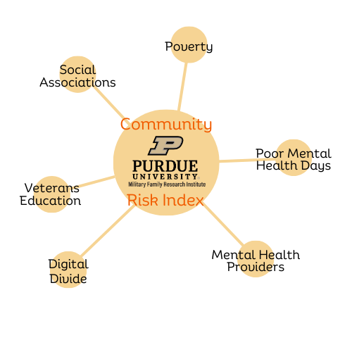
Data: MFRI Community Risk Index

Slide 21
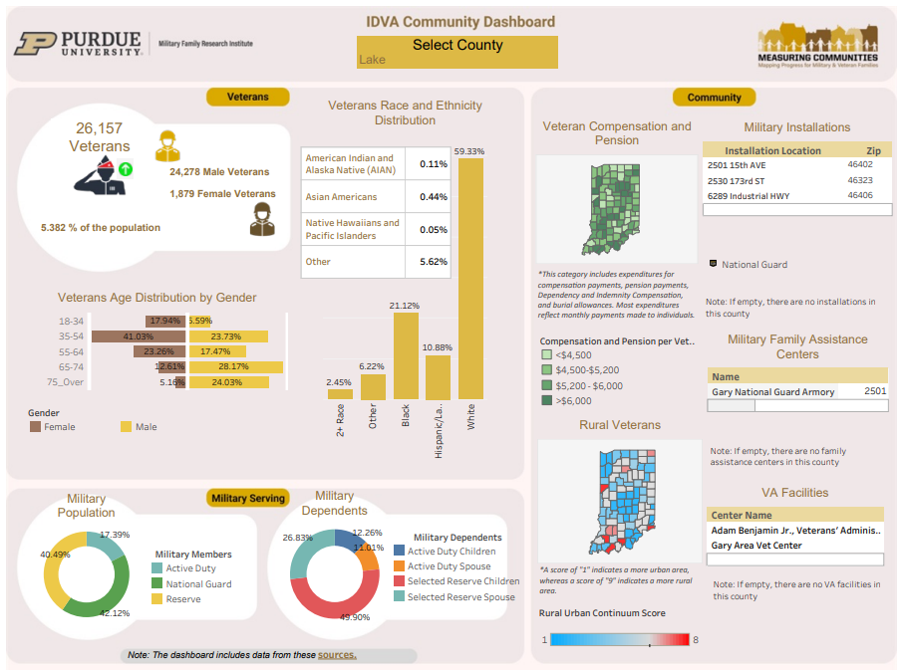
Data: MFRI Community Dashboard

Slide 22
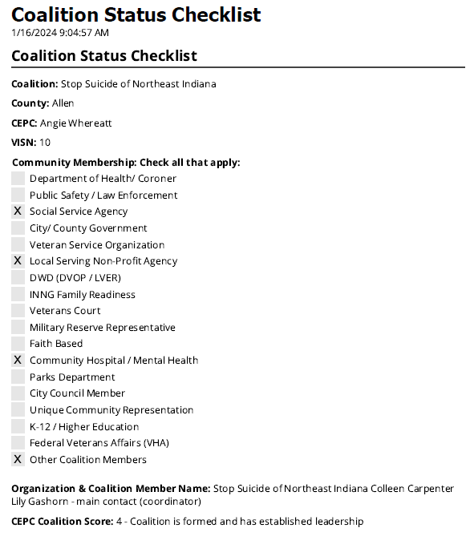
CEPC: Coalition Status Checklist
https://in.accessgov.com/dva/Forms/Page/dva/coalition-status-checklist/1?asAdmin=false

Slide 23
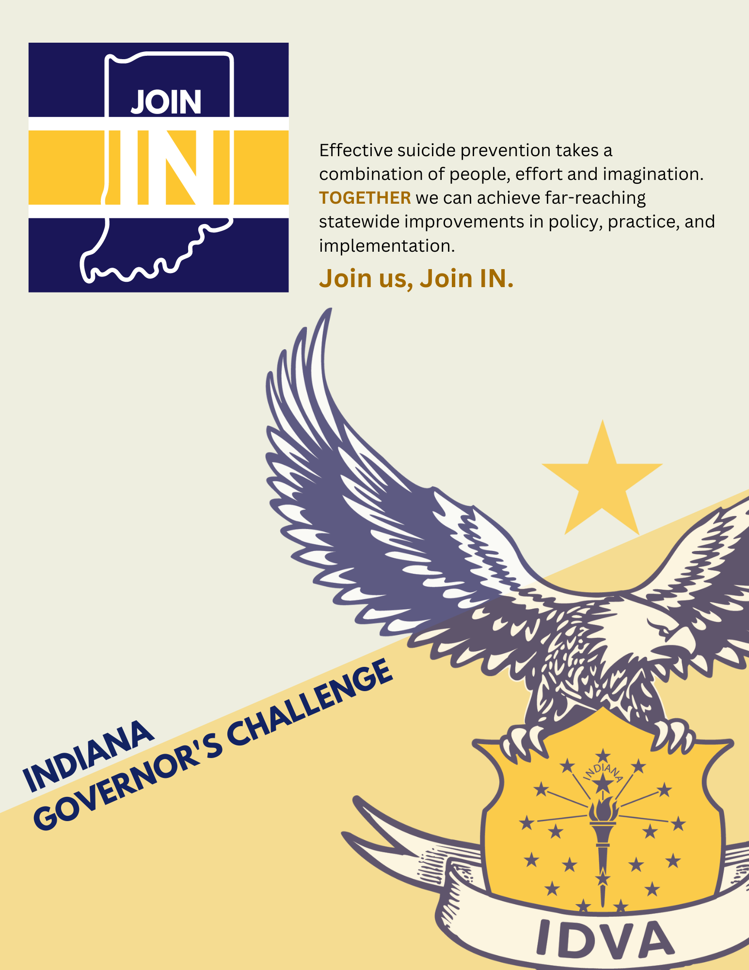
IGC Plan Book
https://simplebooklet.com/gcbook

Slide 24

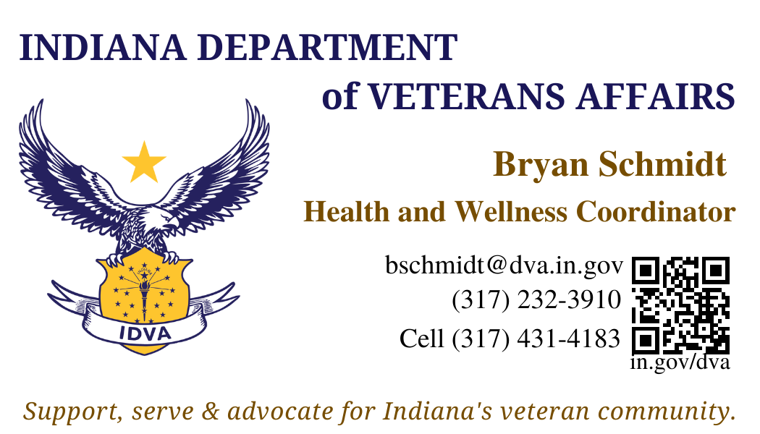
IGC
You can JOIN IN.
Indiana will make a difference, be a leader and change lives. Be a part of the team, Join IN.

