Slide 1

Indianapolis Regional Office
County Veteran Service Officer Conference
Indiana War Memorial, Indianapolis
June 24, 2025

Slide 2

Workload Updates
Rating Claims
National inventory 736,829
133.5 Average Days to Complete FYTD
Non-Rating Claims
National inventory 378,224
74.1 Average Days to Complete
Pension Claims
National inventory 31,840
146 Average Days to Complete
Notes:
Updated 6/23/2025

Slide 3
Workload Updates
Legacy Appeals
Approximately 28,343 pending
Appeals Modernization Act Cases
Appeal Type | Number Pending | ADP | Completions | ADC
Higher-Level Review | 72,064 | 46.0 | 73,901 | 82.4
Supplemental Review | 163,747 | 77.1 | 172,804 | 90.7
Notes:
Updated 1/30/2025

Slide 4

Pact Act Claims
PACT Act
2,307,283 claims received since August 10, 2022
323,901 claims still pending; 112.3 ADP
2,450,061 claims rated since August 10, 2022; 163.7 ADC
Notes:
Updated 1/30/2025

Slide 5
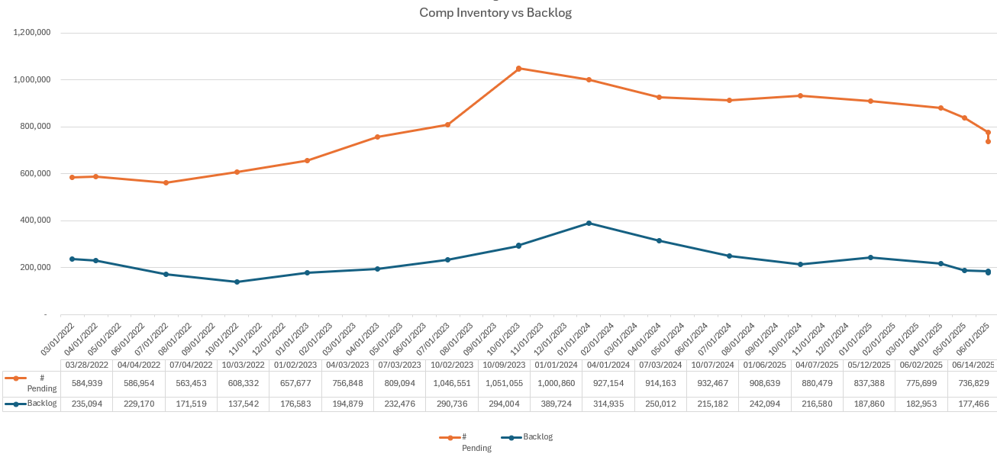
Inventory vs Backlog

Slide 6
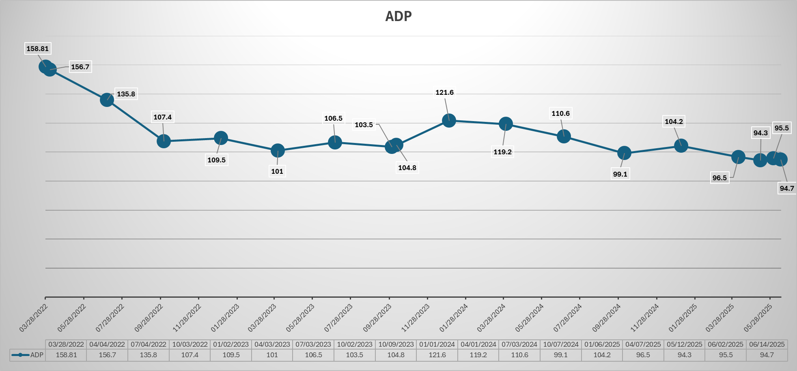

Slide 7

Questions

