Slide 1

Indiana’s
Community Challenge
To Prevent Suicide Among Service Members, Veterans, their Families and Caregivers (SMVF-CG)
Effective suicide prevention takes a combination of people, effort, and imagination. TOGETHER we can achieve far-reaching statewide improvements in policy, practice, and implementation.
Join us.

Slide 2
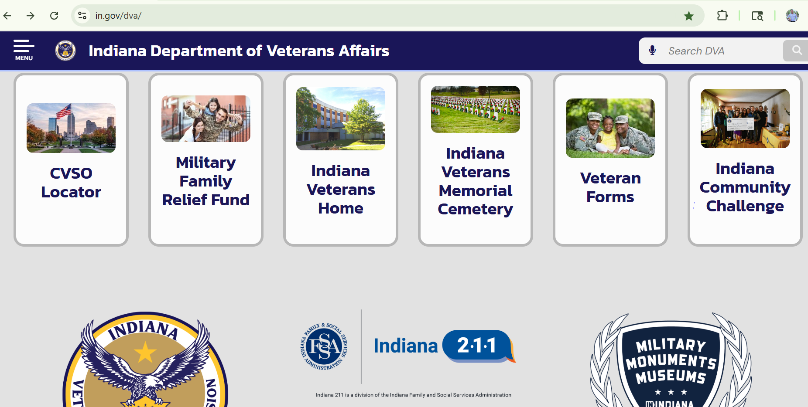

Slide 3
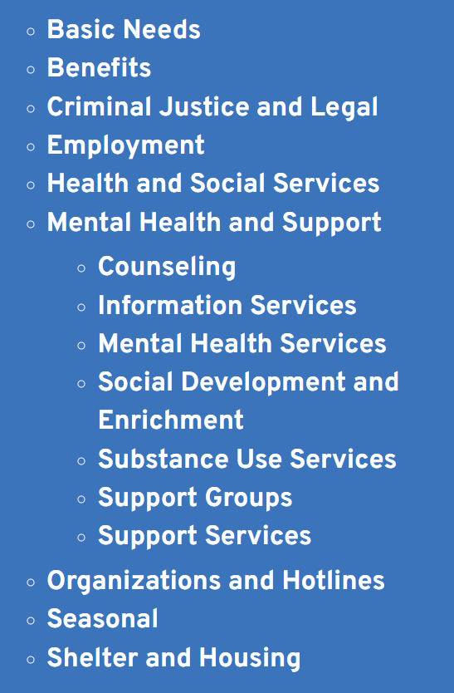

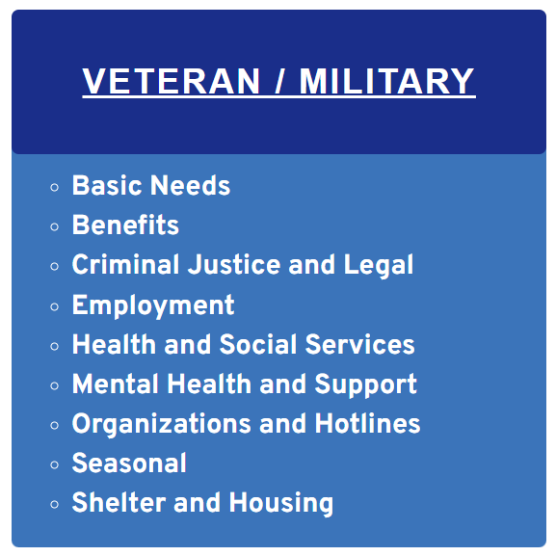
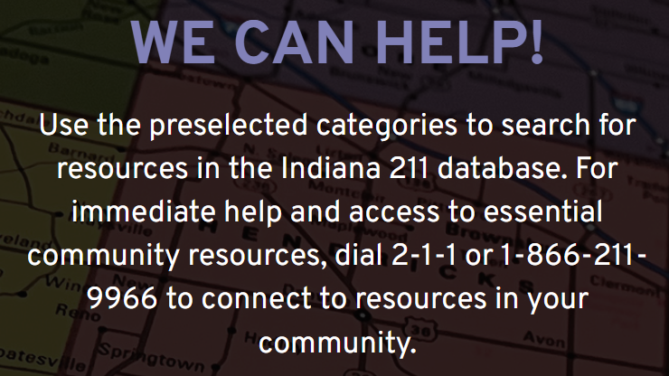

Slide 5
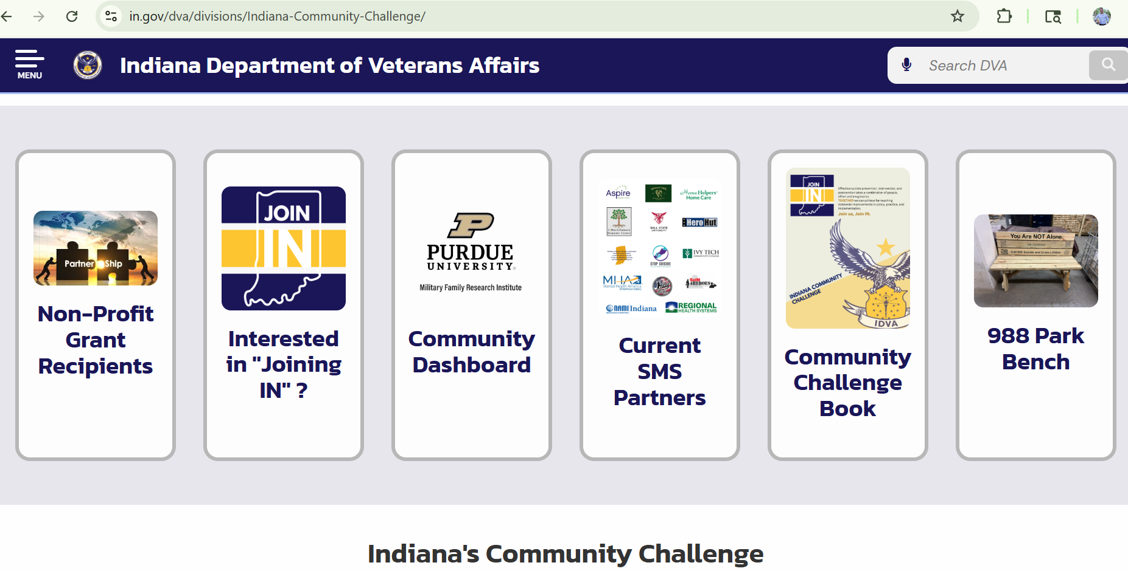

Slide 6
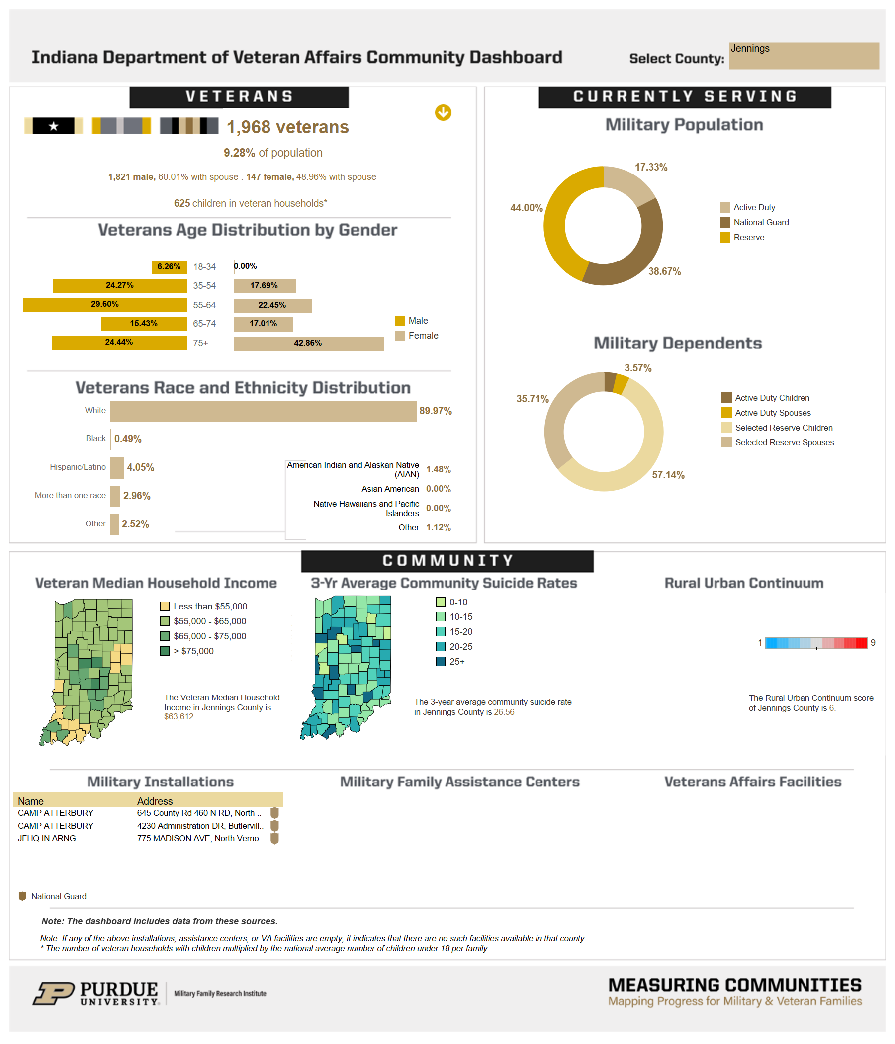
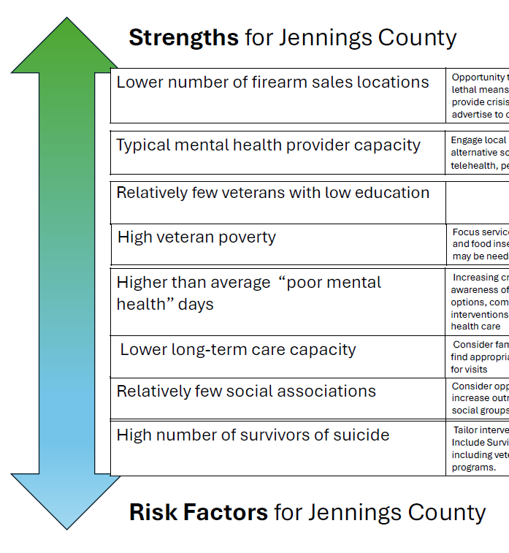

Slide 8












Slide 9













Slide 10











Slide 11
Non-Profit Grant Recipients
32 FY26 Recipients - $1,250,000
Eliminating homelessness, preventing near-term homelessness, and providing safe & secure living conditions
Assisting veterans in moving from public housing assistance programs to home ownership; or stable, long-term rental status
Assisting veterans with federal and state resources
Providing therapeutic services
Providing job training & job search assistance
Preventing veteran suicide
Notes:
Unique Opportunity

Slide 12
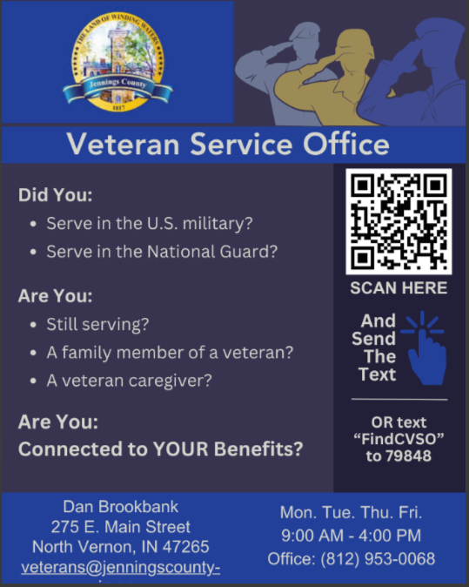
We need your help to find veterans that would benefit the most from these services!
VSO’s
Peer To Peer
Libraries
Parks Dept
Sports Rec
Clothing / Food Pantry
Faith Based
City / County / State Gov
Schools
Community Resources

Slide 13
SMS Phase 1
Please select the corresponding number that best describes YOU.
Veteran of the Armed Services
Serving in the Armed Services
A family member
A Caregiver
Both a family member and a Caregiver
Resource Provider
Branch?
First name? ✍️
Relationship?
To help match you with your CVSO and your Soldier & Family Readiness Center, tell us in which county do you live?
You have a local County Veteran Service Officer (CVSO) to assist with Veteran & Dependant benefits, Services, and Resources.

Slide 14
SMS Phase 2
Are you enrolled in VA Healthcare?
Do you have a service-connected disability rating from the VA?
Did you serve in any of the following wartime periods?
Do you anticipate discharge from service before January 01, 2028?
Are there children in your home dependent upon you for financial support?
How would you describe your gender?

Slide 15
SMS Data
Users Relationship Family Member Caregiver Both Veteran Still Serving
7897 425 209 23 136 2828 87
Dependents Male Female Partners
228 442 443 39
VA disability VA Healthcare
406 444
Airforce Army Coast Guard Marines Navy NG SF Combo
523 1300 18 430 582 2 2 218

