Slide 1
Candid COVID-19 Conversations
Presented by:
Christina Shepard, Outreach Coordinator on behalf of
Dr. Mark Triboletti, PharmD, MBA, BCPS
Associate Chief, Pharmacy Procurement & Informatics
Facility COVID-19 Vaccine Coordinator
Veteran Health Indiana
May 18, 2021

Slide 2
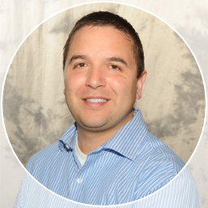
About Me
PharmD (Purdue Univ)
Residency-Trained
MBA (Butler Univ)
VA for 12 years
Oversee COVID-19 Vaccine Clinic at VHI

Slide 3
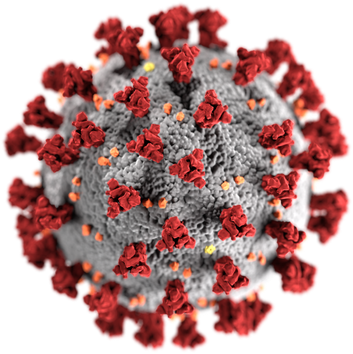
COVID-19 Virus Basics
Infection caused by the SARS-CoV-2 virus
Results in a range of illnesses from mild symptoms to death
Morbidity/mortality is unpredictable
Some groups are more likely to get severe disease – 65 and older or certain medical conditions

Slide 4
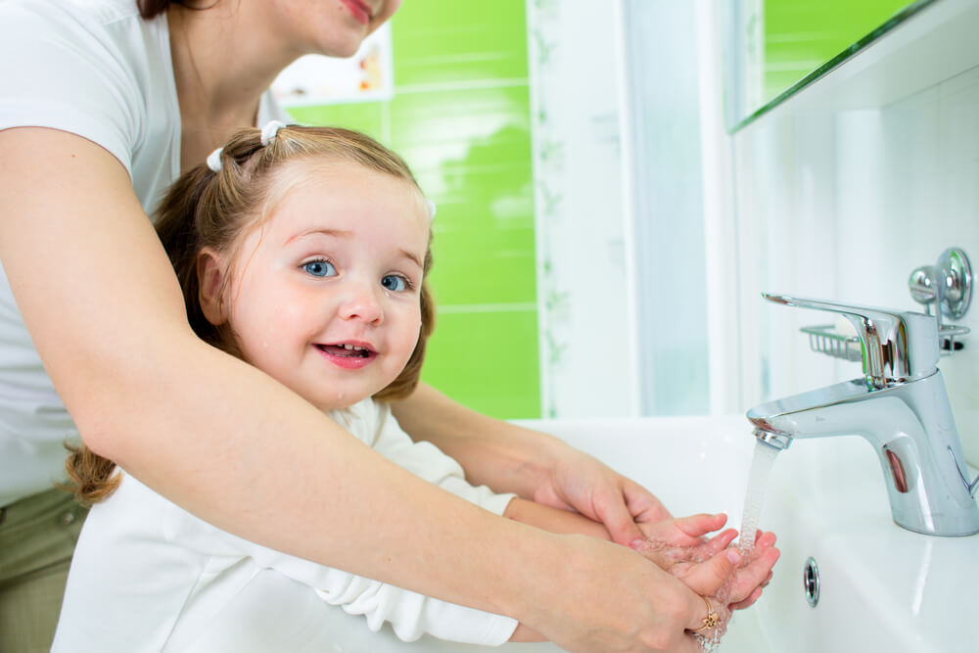
Prevention of COVID-19
Wear a mask that covers your mouth and nose
Avoid close contact with others - stay at least 6 feet (about 2 arm lengths) from other people
Avoid crowds and poorly ventilated spaces
Wash hands often with soap and water
Use an alcohol-based hand sanitizer with at least 60% alcohol if soap and water are not available
Avoid touching your eyes, nose, and mouth with unwashed hands​
Clean and disinfect frequently touched ​surfaces daily
Get a COVID-19 vaccine

Slide 5
Why Get the Vaccine?
Getting the virus that causes COVID-19 may offer some natural protection, known as an antibody or immune. But experts don’t know how long this protection lasts.​ COVID-19+ individuals have been reinfected.
The risk of severe illness and death from COVID-19 far outweighs any benefits of natural immunity.​
COVID-19 vaccination will help protect you by building immunity without the risk of severe illness.
May help protect you from getting severely ill even if you get infected with COVID-19.
To date, 25% of Hoosiers have been vaccinated.

Slide 6
Types of Vaccines
Vaccine | Janssen | Pfizer-BioNTech | Moderna
Efficacy | 86% in preventing severe disease in US patients | 95% for prevention of COVID-19 >7 days post-dose 2 | 94% for prevention of COVID-19 >14 days post-dose 2
Contraindications | Severe reactions to any vaccine components (polysorbate-80) | Severe reactions to previous mRNA vaccine or components such as polyethylene glycol (PEG) | Severe reactions to previous mRNA vaccine or components such as polyethylene glycol (PEG)
Common Adverse Events/Side Effects | Injection site pain (49%) Headache (40%) Fatigue (38%) Myalgia (33%) Nausea (14%) | Injection site pain (84%) Fatigue (63%) Headache (55%) Myalgia (38%) Greater with dose 2 than 1 | Injection site pain (92%) Fatigue (70%) Headache (65%) Myalgia (62%) Greater with dose 2 than 1
Adverse Events of Interest | Anaphylaxis, thromboembolic events | Anaphylaxis/allergic reactions, lymphadenopathies | Anaphylaxis/allergic reactions, lymphadenopathies

Slide 7
Vaccine Efficacy Key Take-aways
1. Efficacy between vaccines is not comparable. All phase 3 trials differed by calendar time and geography and different circulating variants.
2. CDC states no preference for any of the three authorized vaccines.
3. All three vaccines prevent against severe illness, hospitalization, and death.

Slide 8
Key Facts about the COVID-19 Vaccine
Getting vaccinated can help prevent getting sick with COVID-19
People who have already gotten sick with COVID-19 may still benefit from getting vaccinated
COVID-19 vaccines cannot give you COVID-19
COVID-19 vaccines will not cause you to test positive on COVID-19 viral tests*
https://www.cdc.gov/coronavirus/2019-ncov/vaccines/about-vaccines/vaccine-myths.html

Slide 9
What is an EUA?
EUA = Emergency Use Authorization
Tool used by FDA during public health emergencies to provide more timely access to critical products
Same steps are taken as full-term clinical trials, but in a consolidated timeline
So was it rushed?

Slide 10
Operation Warp Speed Timeline
Activities/Phases | Operation Warp Speed Timeline | Key Processes
Research & Development Phase I Clinical Trials (Typically done separately but done concurrently) | 5 months | Understood DNA of the virus in days instead of years Used vaccine platforms developed for other diseases
Phase II Clinical Trials Phase III Clinical Trials (Typically done separately but done concurrently) | 6 months | Large scale Phase III trials of 30,000 people allowed for rapid collection/analysis for safety/efficacy Two promising candidates identified
Manufacturing | 9 months | US Govt funded manufacturing of the most promising candidates during Phase III trials to ensure availability promptly upon final approval
Distribution | 3 months | CDC leads distribution planning Planning for distribution began before vaccines were approved or authorized

Slide 11
Vaccine Safety
COVID-19 vaccines are being held to the same safety standards as all vaccines.
Before Authorization
After Authorization
FDA carefully reviews all safety data from clinical trials.
ACIP reviews all safety data before recommending use.
FDA and CDC closely monitor vaccine safety and side effects. There are systems in place that allow CDC and FDA to watch for safety issues.

Slide 12
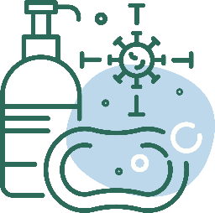
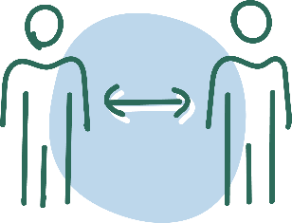
After Receiving the Vaccine
Continue COVID-19 prevention measures:
Cover your nose and mouth with a mask.
Stay at least 6 feet from people who don’t live with you.
Avoid crowds and poorly ventilated spaces.
Wash your hands.
Clean and disinfect frequently touched surfaces.

Slide 13
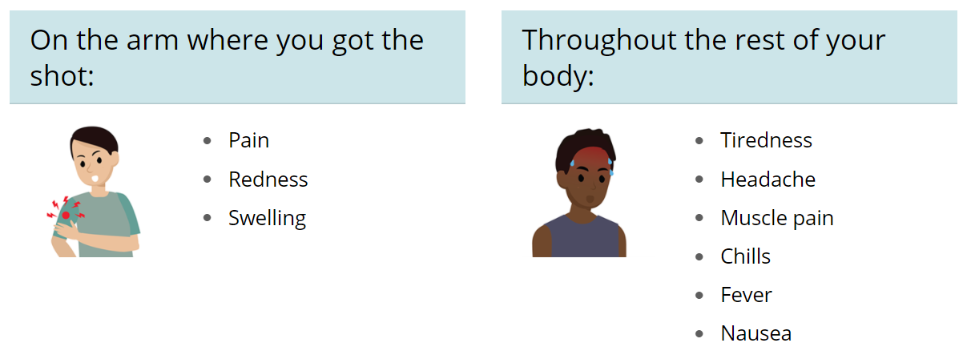
Managing Vaccine Side Effects
May take acetaminophen after vaccination
Moving the arm throughout the day can minimize pain/tenderness
Most side effects subside within 24-48 hours
Same side effects after dose 2 but may be more intense

Slide 14
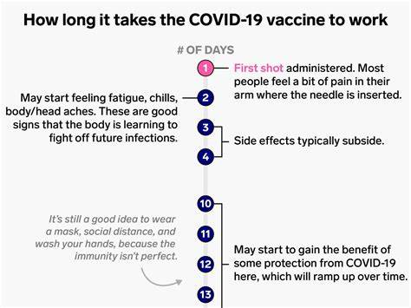
Vaccine Timeline to Efficacy

Slide 15
Vaccine Myth Busters
I can’t get the vaccine because I’m pregnant.
This will become an annual vaccine to make big pharma rich.
I had COVID so I need to wait 90 days to get the vaccine.
There is no evidence to suggest the vaccine is harmful in any way to the fetus.
Studies show antibodies now cross the placenta to protect baby.
The frequency of vaccinations vary by the type of pathogen.
Some vaccines are annual, some are every 10 years.
Antibody levels continue to be collected from those who participated in clinical trials to establish the duration of immunity.
While those who had COVID may have a few months of natural immunity, there is no need to wait 90 days unless you received the antibody infusion.
New data suggests waiting until out of isolation period and recovered from illness.

Slide 16
Vaccine Myth Busters
I don’t need to wear a mask since I received both doses of COVID-19 vaccine.
Guidance changes as more and more people get vaccinated.
The vaccine will change my DNA.
It doesn’t change one’s DNA at all.
Do not need to wear mask when indoors with others who are fully vaccinated.
Do not need to wear mask when indoors with unvaccinated people from 1 other household unless any of those people has an increased risk for severe illness from COVID-19
It uses mRNA which is a short piece of genetic material that teaches your body how to make spike proteins which are found on the outside of the COVID-19 virus which then helps to boost your protection.
The vaccine will get me infected with COVID-19.
These vaccine “prime the pump” to have your body recognize the virus if it’s seen in the future.
mRNA vaccines do not use the virus material.
The single-shot traditional vaccine uses dead virus which cannot cause COVID-19 infection.

Slide 17
Janssen Discussion
CDC and FDA recommended a pause in the use of Janssen vaccine - lasted 10 days – resumed April 24, 2021
Safety reporting revealed an increased risk of a rare but serious blood clot
Nearly all reports were in women younger than 50
How rare?
7 in 1 million women under 50
39 in 1 million with COVID-19 will get a blood clot
1 in 4,000 chance of getting in a fatal car accident in Indiana
CDC and FDA determined benefits outweigh risks

Slide 18
Janssen Discussion: Key Takeaways
Our safety surveillance system works
Advise all Janssen recipients of the risk but especially women under 50
Monitor for symptoms of a blood clot within 3 weeks of vaccine
Shortness of breath
Severe headaches
Chest pain
Leg swelling
Persistent abdominal pain
Blood clots have not been observed with Pfizer or Moderna vaccines after >200 million doses administered

Slide 19
Availability of Vaccines at VA
Available at medical centers and many outlying community-based outpatient clinics (CBOCs)
Moderna and Janssen
Usually same-day availability
Eligibilities:
Anyone who has served
Spouses
Caregivers

Slide 20
Veteran Health Indiana COVID-19 Vaccine Clinic
Indianapolis VA medical center: Walk-in availability or by appointment (Moderna)
CBOCs: Appointment only (Janssen)
Terre Haute
Bloomington
Martinsville
Shelbyville
Wakeman
West Lafayette
Indy West
Vaccine call center: 317-988-4899

Slide 21
Northern Indiana VA COVID-19 Vaccine Clinic
Walk-in availability or by appointment (Moderna and Janssen):
Ft Wayne
Marion
St. Joseph County Clinic
Vaccine call center: 1-800-360-8387 ext 75113

Slide 22
Credible Sources for Vaccine Information
Centers for Disease Control and Prevention
Advisory Committee on Immunization Practices
World Health Organization Vaccine Safety Net
Immunization Action Coalition
Medical Library Association

Slide 23
Questions and Answers
Open Discussion
I can be reached at Mark.Triboletti@VA.gov with any follow-up questions you may have.

