Slide 1
eBenefits Training 101
March 2013
Trainers: Frank Bryceland

Slide 2
eBenefits Training 101 Overview
Website Overview
  History
  Website Statistics
  Purpose and Importance
  Users
  Navigation Overview
  Registration
  Overview
  Basic eBenefits Account
  Premium eBenefits Account
  DS Access Station
  Registration Wizard
  Features
  Top 20 Features
  Mobile Access
  More Information on Features
Promotion
  Promotion Goals
  Promotional Materials and Strategies
  Scenarios
  Resources & Referrals

Slide 3
eBenefits Training 101 Objectives
After this training, you will be able to:
  Direct users to www.ebenefits.va.gov.
  Understand basic content and navigation of the site.
  Explain general registration requirements for Basic and Premium Accounts.
  Know how users can enroll in eBenefits using the online DS Logon Registration Wizard or in person.
  Understand and promote top eBenefits features.
  Reference contacts and key resources for questions, referrals and common troubleshooting.

Slide 4
WEBSITE
Overview
eBenefits 101
What’s Inside:
  History
  Website Statistics
  Purpose and Importance
  Users
  Navigation Overview
  Checkpoint Summary

Slide 5
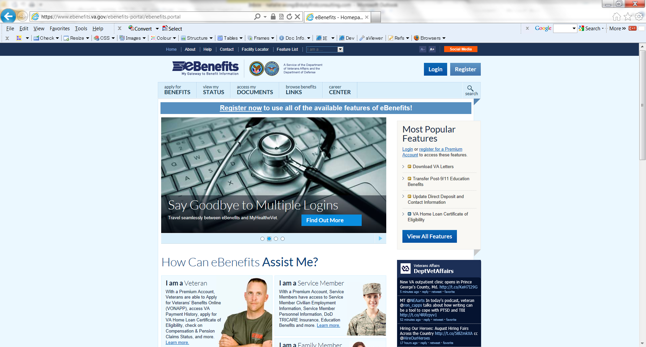
Website Overview: History
  eBenefits (www.ebenefits.va.gov) is a joint VA/DoD Web portal that provides self-service capabilities to Veterans, Service members, their families and caregivers.
  Development of eBenefits was initiated in March of 2007 at the recommendation of the President’s Commission on Care for America’s Returning Wounded Warriors (Dole/Shalala).
  With quarterly releases, eBenefits continues to evolve as a “one-stop shop” for Veterans, Service members and their families.
Notes:
eBenefits is a joint VA/DoD Web portal that provides self-service capabilities to Veterans, Service members, their families and caregivers. The URL is www.ebenefits.va.gov. The development of eBenefits was initiated in March of 2007 at the recommendation of the President’s Commission on Care for America’s Returning Wounded Warriors (also referred to as Dole/Shalala). With quarterly releases, eBenefits continues to evolve as a “one-stop shop” for Veterans, Service members and their families to access and manage their benefits and military information.

Slide 6
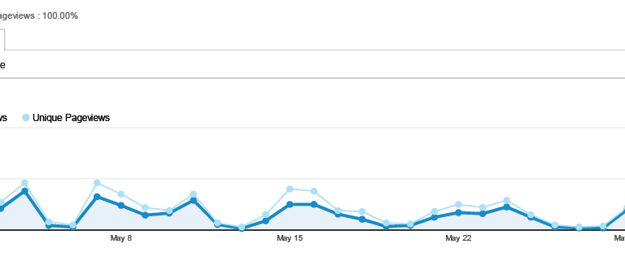
Website Overview : Website Statistics
eBenefits Statistics-
In the month of February 2013, there were over 2.4 Million registered eBenefits users. Used in over 180 countries.
Number of claims status views: over 17.7 Million to date
Home Loan COE: 217K to date
OMPF (DD 214): 238K to date
Letter Generator: 1.9 Million
January 2013: over 4.02 Million site visits

Slide 7
Website Overview : Purpose and Importance
  Provides a secure, single, personalized online point of entry to access numerous VA and DoD applications and services.
  Offers access to over 50 self-service tools (through online transactions, without needing to call or visit VA).
  Facilitates improved customer service and access for Veterans to VA information and services.
  Helps Veterans manage their claims.
  Provides links to other sites that provide information about military and Veteran benefits and services.

Slide 8

Website Overview : eBenefits Users
  Veterans
  Service members
  Family members eligible for benefits (legal dependents over age 18)

Slide 9
Website Overview : Website Navigation Overview
Login/Register Authenticate with a basic or premium account
Claims Status
View your Claims Status here
Features
View all Features that are available to eBenefits users

Slide 10
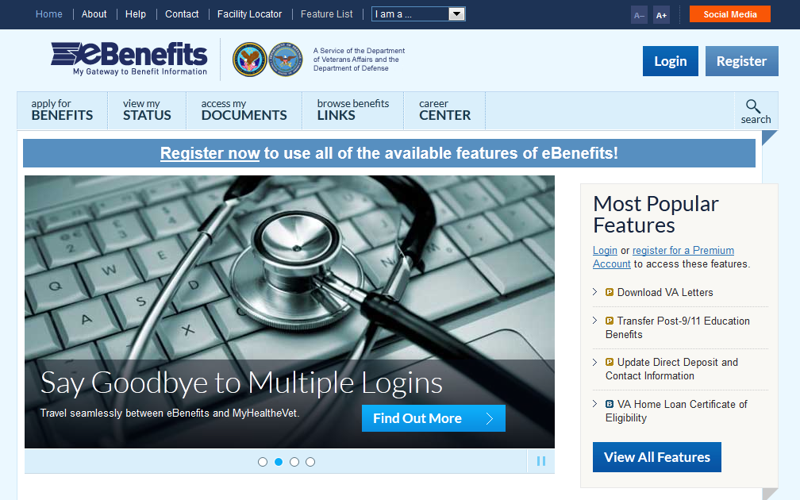
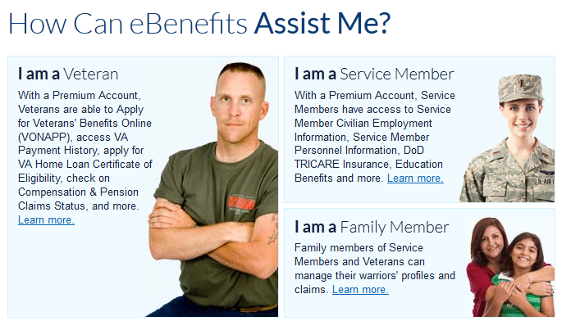
Website Overview : Website Navigation Overview
Overview of Main Navigation
  Login / Register
  Apply for Benefits
  View Status
  Access Documents
  Browse Benefits Links
  Career Center
Overview by Audience
  I am a Veteran
  I am a Service member
  I am a Family member
Overview of Features
  See upcoming modules

Slide 11
Website Overview : Checkpoint Summary
  eBenefits is a joint VA/DoD Web portal.
  Visit eBenefits at www.ebenefits.va.gov.
  eBenefits is available to Veterans, Service members and eligible family members.
  eBenefits provides resources and self-service capabilities to research, access and manage VA and military benefits and personal information.

Slide 12
Registration
eBenefits 101
What’s Inside:
  Overview
  Basic and Premium Accounts
  Registration Wizard
  Checkpoint Summary

Slide 13
Registration: Overview
Before a user can use eBenefits, they…
  Must be listed in the Defense Enrollment Eligibility Reporting System (DEERS).
  Obtain a DS Logon (Level 1 – Basic or Level 2 – Premium).
DEERS is the system of record that determines who is officially eligible for military benefits and entitlements.
A DS Logon is a secure identity (username and password) used by various VA and DoD websites, including eBenefits.

Slide 14
Registration: Basic eBenefits Account
eBenefits Basic Account (DS Logon Level 1):
  Self-Register in eBenefits using online Registration Wizard or in person at an RO or TRICARE Service Center.
  Only requires that user be registered in DEERS.
  Provides limited access to eBenefits features.
    Favorite links
    Categories of benefits that are of interest
    VA home loan certificate of eligibility
  No access to personally-identifiable information (PII) from VA or DoD.
  Lower form of access that is easier to obtain because in-person or remote identity verification is not required.

Slide 15
Registration: Premium eBenefits Account
eBenefits Premium Account (DS Logon Level 2):
  Requires another level of identity verification (online, by phone, or in-person) for access to PII and given HIPAA requirements.
  Provides unlimited access to eBenefits features.
  Highest level of access, allows users to access PII through VA and DoD applications and services.
    Claim status
    VA payment history
    TRICARE information
    Military separation documents (for Veterans)
Note: Creating a Premium Account by visiting an RO or TRICARE office without having a Basic Account will require users to receive an activation code from DoD within 6-12 days at their mailing address on record.

Slide 16
Registration: Premium eBenefits Account
In Person Proofing:
  The Level 2 DS Logon is available to users at all VA Regional Offices and TRICARE Service Centers (TSCs) via in person proofing using the DS Access Station software.
    One piece of photo identification issued by a state or the Federal government
    Second piece of identification, such as a birth certificate or social security card
Remote Proofing:
  Veterans and Service members can obtain a Level 2 DS Logon online using the DS Logon Registration Wizard’s online identity authentication tool.
  Military retirees can use their DFAS MyPay logon and password to self-authenticate and obtain their DS Logon online.
  Veterans and Service members holding DoD Common Access Cards (CAC) may use these cards to obtain a DS Logon online.
  Upgraded MyHealtheVet users with a DS Logon now have instant access to eBenefits (via single sign on).
  Veterans in receipt of monetary benefits from VA via direct deposit can obtain a DS Logon account via telephone (NIST 800-63 compliant).

Slide 17
Registration: Wizard
The eBenefits DS Logon Account Registration Wizard is a DoD online self-service application that allows online registration and identity authentication.
To obtain a DS Logon using the Wizard, users must:
  Be registered in DEERS
  Create a Basic Account first
  Build a user ID
  Create a secure identity through answering 5 questions
  Answer three personal questions correctly to confirm identity for upgrade to Premium Account Status. A fourth question may be asked if you miss one.

Slide 18
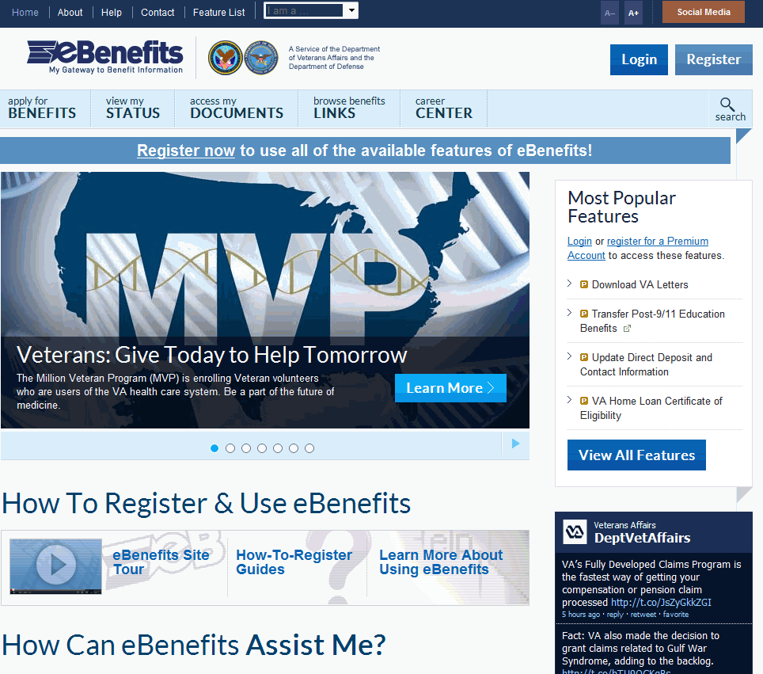
Registration: Overview

Slide 19
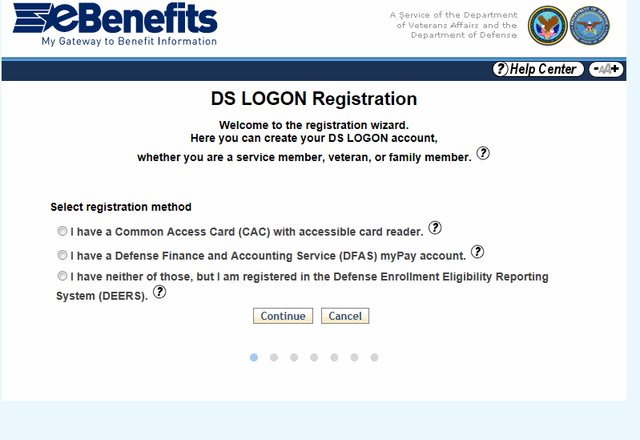
Registration: Wizard
Obtaining a DS Logon Level 1 Credential (eBenefits Basic Account):

Slide 20
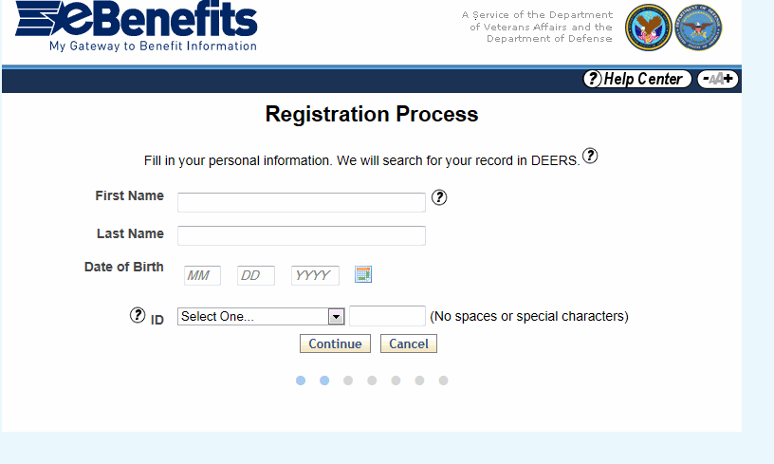
Registration: Wizard
Obtaining a DS Logon Level 1 Credential (eBenefits Basic Account):

Slide 21
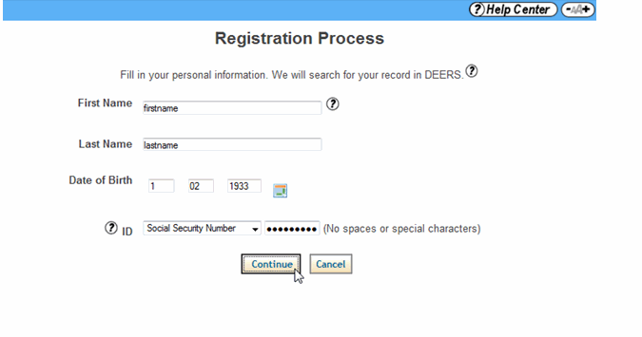
Registration: Wizard
Obtaining a DS Logon Level 1 Credential (eBenefits Basic Account):

Slide 22
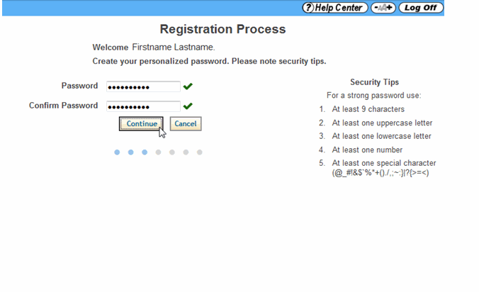
Registration: Wizard
The Veteran will move on to the next phase and will be required to Create a password. Once a password is created and confirmed, click Continue.

Slide 23
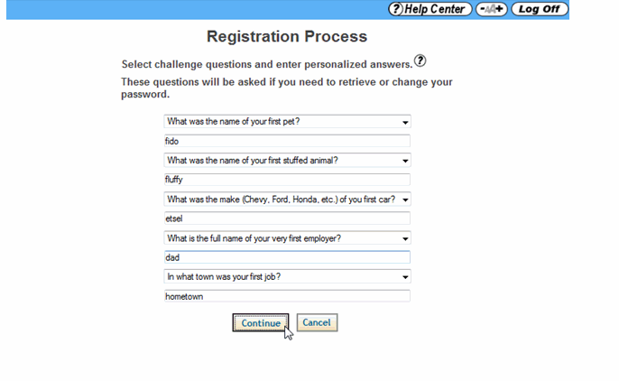
Registration: Wizard
User will be select “Challenge Questions” from those provided.
After completing five challenge questions, click Continue

Slide 24
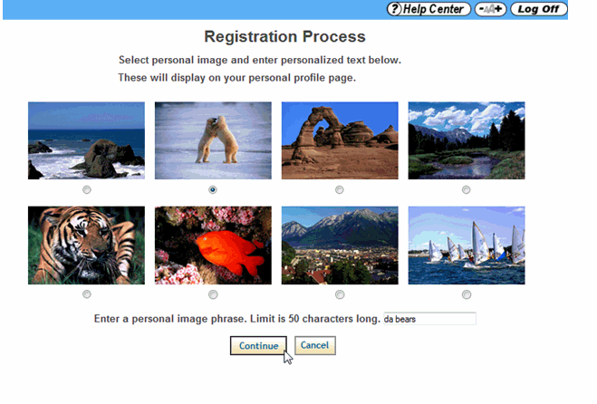
Registration: Wizard
Select one image and create a short phrase.

Slide 25
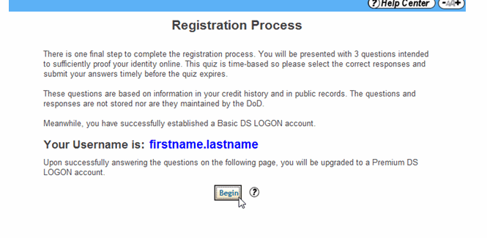
Registration: Wizard
Veteran now has eBenefits Basic (Level I) account.
  Note: Username should be written down as shown below.
Note: May have a number for common
last names

Slide 26
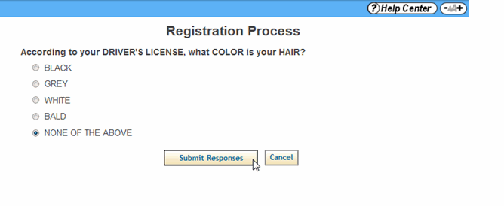
Registration: Wizard
The user will have four minutes to select the correct answers to the Remote Proofing Quiz. Once the user has answered the questions, click Submit Responses. If the user answers one question incorrectly, an extra question will be asked.

Slide 27
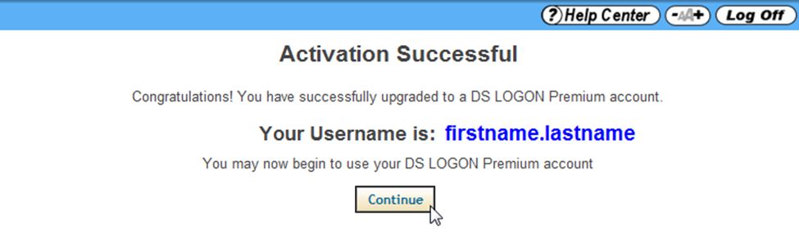
Registration: Wizard
Note: Users should log back into the www.ebenefits.va.gov portal instead of logging in from this page.

Slide 28
Registration: Checkpoint Summary
  Users must be in DEERS.
  To use eBenefits, users must register for a DS Logon account.
  There are two types of eBenefits Accounts: Basic and Premium.
  Basic Accounts provide limited access to features.
  Premium Accounts provide unlimited access to over 50 features and require identity proofing.
  Users may register for a Basic Account online.
  Users may register for a Premium Account online, by phone, or go in person to a VA Regional Office or Tricare Service Center.
  The eBenefits Registration Wizard allows users to obtain both a Level 1 and Level 2 DS Logon online (using remote proofing).

Slide 29
Features
eBenefits 101
Site Content
  Top 20 Features
  Mobile Access
  More Information on Features
  Checkpoint Summary

Slide 30
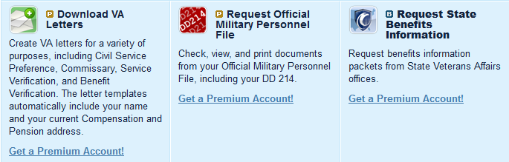
eBenefits: Top 20 Features
Access & Download VA Documents:
  Home Loan Certificate of Eligibility (COE) – Veterans and Service members can generate and print their Certificate of Eligibility for a VA Guaranteed Loan.
  Preference Letters – Veterans can create VA letters for a variety of purposes, including Civil Service Preference, Commissary (DoD Identification Card), Service Verification, and Benefit Verification. The letter templates automatically include the user’s name and current Compensation and Pension address.
  Access & Download Official Military Personnel File (OMPF) – including
  DD Form-214
  Apply for Benefits
  Where applicable, users can apply for Compensation, Pension, Education, Burial and Vocational Rehabilitation & Employment (VR&E) Benefits online through the Veterans Online Application (VONAPP).

Slide 31
eBenefits: Top 20 Features
  Review claims and appeal status
  Veterans and Service members can view the status of their claims/appeal.
Apply for benefits and manage your claims (via VONAPP Direct Connect)
  An online wizard recognizes Claimants upon login and helps them make changes to marital status, dependents and school verifications with guided assistance from VONAPP Direct Connect (VDC).
  Check Post-9/11 GI Bill status
  Veterans and Service members can view entitlement and school enrollment information for Post-9/11 GI Bill Education benefits.

Slide 32
eBenefits: Top 20 Features
  7. Transfer Post-9/11 GI Bill
  Service members: If eligible for the Post-9/11 GI Bill program, may transfer educational benefits to eligible dependents listed in DEERS. Veterans may review, modify, or revoke a transfer request made while as a Service member.
  8. Search for Employment: VetSuccess & VA for Vets
  Veterans and Service members can search VetSuccess for jobs and find useful tips on completing resumes, cover letters, job applications, and interviewing. VA for Vets enables Veterans to search for employment within VA and other organizations, and receive employment counseling and support.
  9. Order medical equipment
  Veterans can place online orders for prosthetic socks and hearing aid batteries.

Slide 33
eBenefits: Top 20 Features
  10. Edit profile
  Complete personal profile and customize the content seen on the eBenefits portal.
  11. SGLI Life Insurance
  Service members may view the amounts of coverage and coverage dates for their Group Life Insurance (SGLI).
  12. Benefits Explorer
  Allows users to interact with a display that presents benefit information at different stages in their career or personal lifecycle. View a personalized list of possible benefits based on their eBenefits profile and allows them to fine-tune the results to suit their needs.

Slide 34
eBenefits: Top 20 Features
  13. Search for Representatives
  Search for and print detailed information on accredited Attorneys, Claims Agents, and Veterans Service Organizations. Users can also download and print representative appointment forms.
  14. VA Payment History
  Monitor VA Compensation and Pension, Education, and Vocational Rehabilitation & Employment (VR&E) benefits payments.
  15. Premium Access to VA TAP Online Courses
  Learn about VA Federal benefits in the Transition Assistance Program (TAP). Users complete benefit courses electronically to develop an understanding of all VA benefits they may be entitled to as they transition into Veteran status.
  16. Mobile Find a Facility Function
  Locates VA and DOD facilities using the smart device’s GPS location – it also provides users with the option to map directions or call a facility.

Slide 35
eBenefits: Top 20 Features
  17. Health Benefits Eligibility Check
  A calculator to assess whether Veterans qualify for VA health care benefits. (Eligibility is based on financial considerations.)
  18. Premium Access to Specialty Adapted Housing Grant Application and Claim Status
  Apply online for a Specially Adapted Housing (SAH) Grant. Users can also check the status of SAH-related claims.
  19. Premium Access to DoD TRICARE Health Insurance
  View TRICARE medical, dental, and pharmacy information.
  20. Premium Access to Veterans’ Group Life Insurance (VGLI)
  Users may view and update information related to their VGLI policy. Download forms and print their Certificate of Insurance. Provides for the conversion of Service members’ Group Life Insurance (SGLI) to a renewable term life insurance policy within 120 days of separation from active duty service.

Slide 36
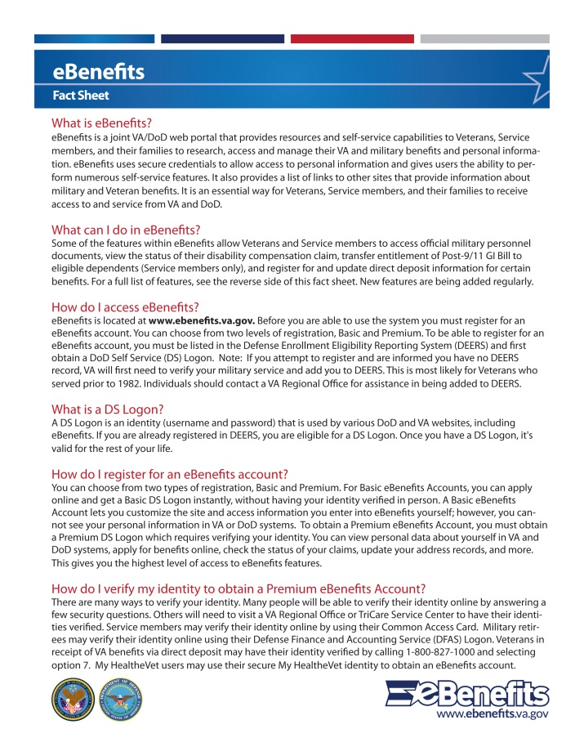
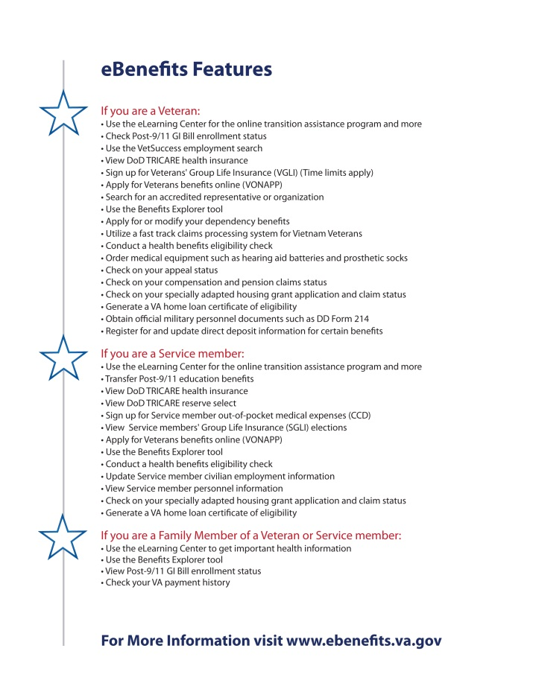
eBenefits: Features – Veterans
eBenefits Fact Sheet

Slide 37
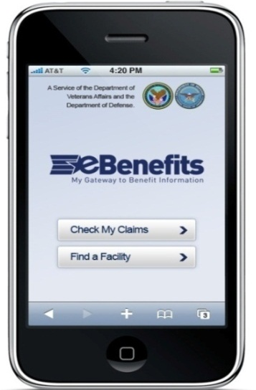
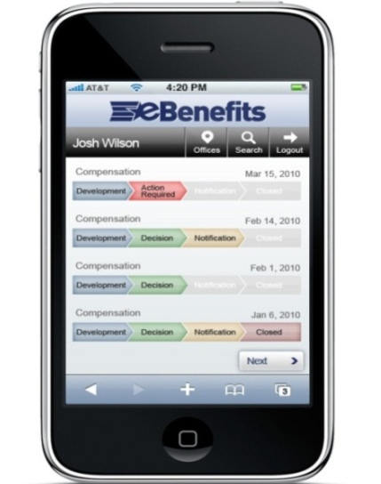
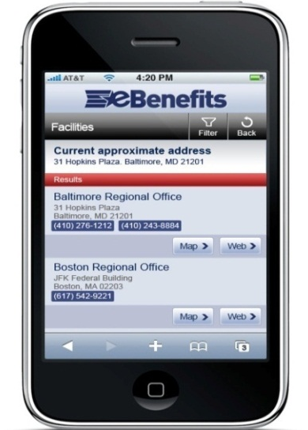
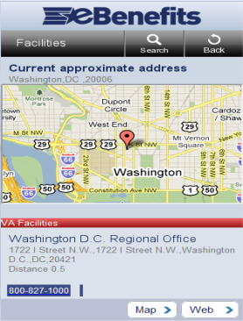
Features: Mobile Access – Beyond the Desktop
eBenefits self service is available from mobile devices (https://m.eBenefits.va.gov)
  The mobile Find a Facility feature locates VA and DOD facilities using the smart device’s GPS location – it also provides users with the option to map directions or call a facility.
  The mobile C&P Claims Status feature provides access to claims information consistent with status details available in the My eBenefits Dashboard.
  The mobile VA Payment History feature allows users to monitor their Compensation and Pension, Education, and Vocational Rehabilitation benefits payments.
  The mobile Appeals Status feature allows users to view the status of their appeals.
  The mobile application is optimized for most Smartphones.

Slide 38
Features: More Information
  Check our eBenefits website for upcoming changes
    https://www.ebenefits.va.gov/ebenefits-portal/ebenefits.portal?_nfpb=true&_portlet.async=false&_pageLabel=FeatureListMain
  Access Top 10 and Top 20 eBenefits Features fact sheets and
  eBenefits Quickbook (September 2012)

Slide 39
Features: Checkpoint Summary
  There are over 50 features available on eBenefits.
  Top features on the site include reviewing claims status, downloading VA forms/letters, and applying for benefits.
  eBenefits mobile application is available at http://m.ebenefits.va.gov.
  Refer to the eBenefits fact sheet and Quick Book for information on the website and features.
  Check out the eBenefits website to view upcoming features.

Slide 40
Promotion
eBenefits 101
Promotion
  Promotion Goals
  Promotional Materials and Strategies
  Scenarios
  Resources and Referrals
  Checkpoint Summary

Slide 41
Promotion: Goals
eBenefits Promotion Goals
  Increase awareness of eBenefits and Premium Account enrollment.
  Increase Veteran use of eBenefits as a method of self-service.
  Engage stakeholders who influence, or interact with, Veterans, Service members, dependents and caregivers to promote enrollment in eBenefits.

Slide 42
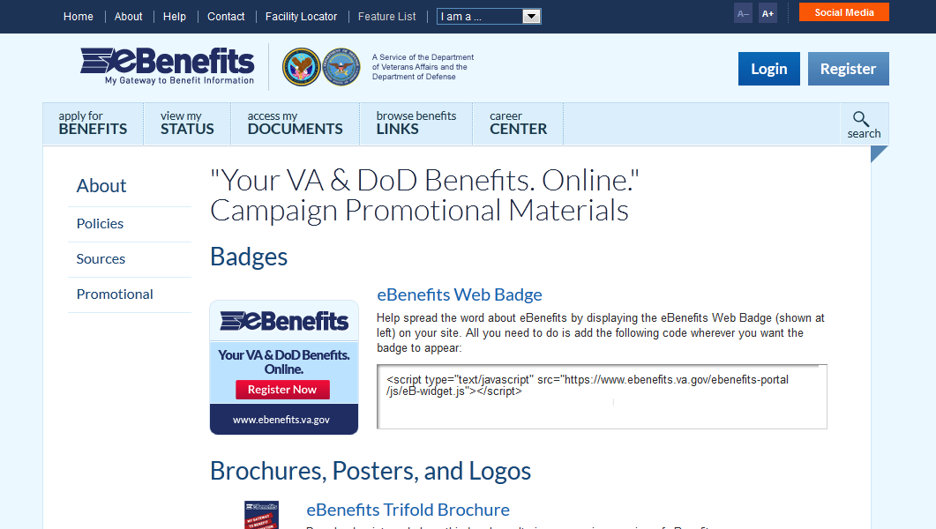
Promotion: Website - Where to Access eBenefits Materials
To view, download, and/or share eBenefits Promotional Materials, visit:
https://www.ebenefits.va.gov/ebenefits-portal/pages/PromotionalMaterials
  Click “About” link in the header of the site
  Click “Promotional” in the left-hand sidebar

Slide 43

Promotion: Materials
Materials include:
  Fact sheets
  Brochure
  Posters
  Flyer/advertisements
  Web badge
  Logo
  NASCAR Radio PSAs
  TV PSA (Fall 2012)
  Quickbook (End of September)

Slide 44


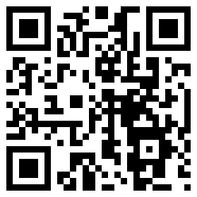
Promotion: Web Badge, logo and QR scan code
  Encourage your Website managers to post our Web badge on their Websites.
  The Web badge (also called a widget) provides Veterans with a direct link to www.ebenefits.va.gov.
  Use the official logos for all materials discussing eBenefits.
  Scanning the QR Code will direct individuals to the eBenefits Website.

Slide 45
Promotion: Scenarios
You are someone who assists Veterans
  A person comes to you and asks, “How do I get an eBenefits account?”
    Tell them to visit www.ebenefits.va.gov and follow the steps in the Registration Wizard.
  A person comes up to you and asks, “Can I get an update on my claim’s status?”
    Ask them if they have an eBenefits account online. If they don’t have an account yet, tell them they can register for a free Premium account at www.ebenefits.va.gov to view their claim status.
  A person comes to you and says, “I was told I have to be registered in DEERS. What is DEERS and how do I register?”
    Use the eBenefits fact sheet to tell the person what DEERS is and provide them with the number: 1-800-827-1000 option 7 to confirm they are in DEERS.
  Someone says to you, “I have a myHealtheVet account. Can I use that to get an eBenefits account?”
    Let them know that there is a single sign on feature that allows upgraded myHealtheVet account users with a DS Logon to automatically access eBenefits at the Premium Level.

Slide 46
Promotion: Resources
Resources
  IRIS https://iris.custhelp.com
  State resources: http://www.va.gov/statedva.htm
  County resources: http://www.nacvso.org/modules.php?name=Content&pa=showpage&pid=10
  Health Resource Center (HRC): 877-222-VETS (8387)
  Call Center: 1-800-827-1000 – Option 7

Slide 47
Promotion: Checkpoint Summary
  eBenefits promotional materials are available on the eBenefits website at: https://www.ebenefits.va.gov/ebenefits-portal/pages/PromotionalMaterials.
  If a Veteran or family member expresses interest in eBenefits, give him or her a copy of the eBenefits fact sheet or other materials as appropriate.
  Refer them to appropriate contact and referral resources.
  Help encourage Veteran self-service and empowerment and reduce the number of calls to call centers by referring Veterans to eBenefits.

Slide 48
Question and Answer
Questions?

