Slide 1
INCE Admin Guide
INCE ADMIN GUIDE
Adding a School/Office
Counselor Account
A step-by-step guide for school administrators on Indiana Career Explorer

Slide 2
Three steps to add a new counselor
OVERVIEW
School and office admins can add counselor (case manager) accounts directly from the Administrator Dashboard. Here's the full process at a glance.
1
2
3
Log in to the
Admin Dashboard
Go to School/Office
Counselors
Fill out their
information
→
→
Access your school's Administrator Dashboard using your admin credentials.
Under User Management, open the School/Office Counselors page.
Enter the new counselor's details to create their case manager account.
Once created, the new admin receives an email invitation to set their own password.
Indiana Career Explorer (INCE) · Admin Guide
2

Slide 3
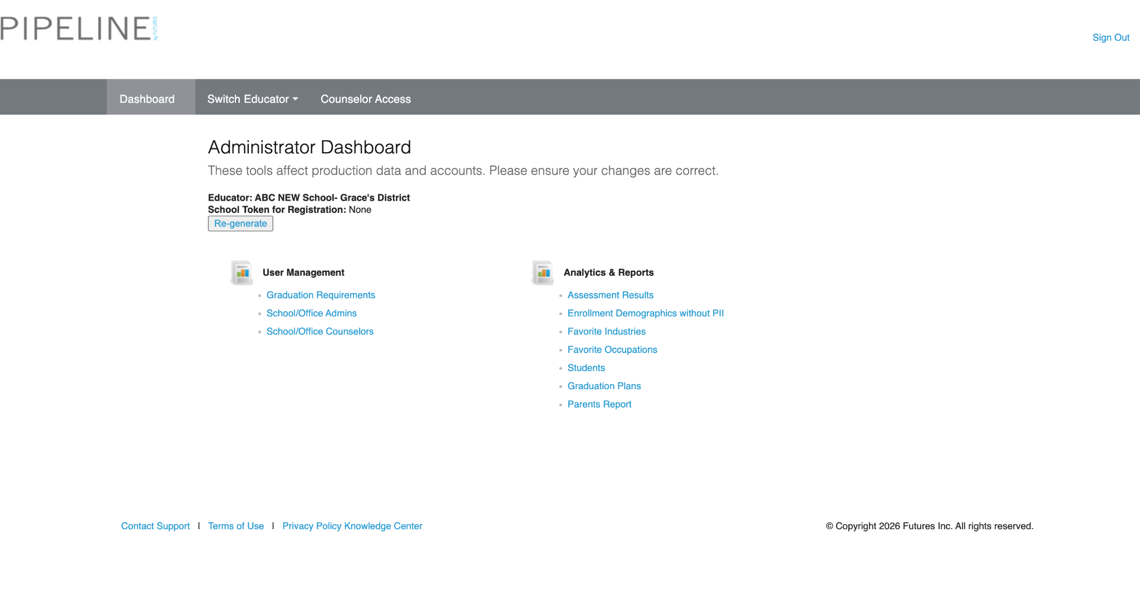
Log in to your Admin Dashboard
1
STEP 1
Every school and office admin has access to the Administrator Dashboard. This is the central hub for managing users, graduation requirements, and reports for your school.
⚠
Heads up: These tools affect production data and accounts. Please double-check your entries before submitting any changes.
Indiana Career Explorer (INCE) · Admin Guide
3

Slide 4
Getting familiar with your admin tools
i
WHAT'S IN THE DASHBOARD
User Management
Analytics & Reports
Also available
School/Office Admins
Assessment Results
Graduation Requirements
School/Office Counselors
Enrollment Demographics (no PII)
Favorite Industries
Favorite Occupations
Students
Graduation Plans
Parents Report
Counselor accounts live under User Management → School/Office Counselors — that's where Step 2 picks up.
Indiana Career Explorer (INCE) · Admin Guide
4

Slide 5
Open School/Office Counselors
2
STEP 2
From User Management, select School/Office Counselors. This is where you'll add and manage counselor (case manager) accounts for your school.
Admin Dashboard
›
User Management
›
School/Office Counselors
Link
indianacareerexplorer.com/school_admin/school_counselors
Tip
You can also click directly into School/Office Counselors from the User Management menu on your dashboard home screen — no need to type the URL.
Indiana Career Explorer (INCE) · Admin Guide
5

Slide 6
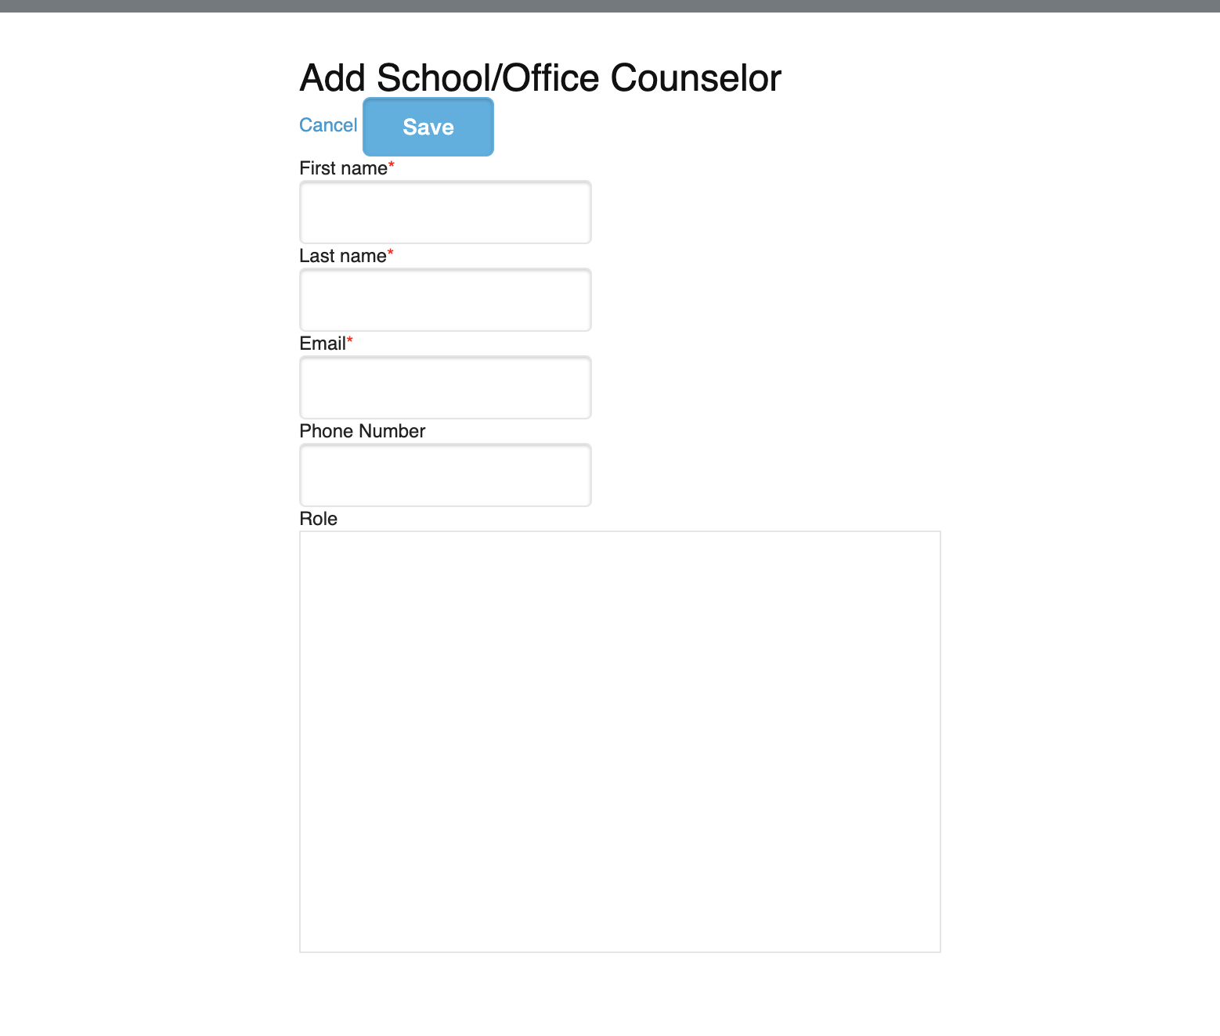
Fill out the counselor's information
3
STEP 3
On the School/Office Counselors page, add a new case manager by entering their information. Submitting the form creates their account.
⚠
Important: Account creation will error if the user already has an account. Check with the counselor first if you're not sure whether they've registered before.
Indiana Career Explorer (INCE) · Admin Guide
6

Slide 7
The new counselor sets their
own password
WHAT HAPPENS NEXT
✉ New Message
Subject: Welcome to Indiana Career Explorer
Once their account is created, the new administrator receives an automated message from the platform with a secure link. They'll use that link to set their own password and log in for the first time.
You've been added as a School/Office Counselor for ABC New School. Click below to create your password and access your dashboard.
Create Your Password
This link is unique to each new admin and only works once.
Indiana Career Explorer (INCE) · Admin Guide
7

Slide 8
Quick reference
RECAP
1
Log in
Access the Administrator Dashboard with your admin credentials.
2
Navigate
Go to User Management → School/Office Counselors.
3
Add counselor
Fill out their info and submit to create the account.
4
Done
They receive an email to set their password and log in.
Questions?
Reach out to the INCE support team any time this process needs a hand.
Indiana Career Explorer (INCE) · Admin Guide
8

