Slide 1


Meaningful Distance Learning for Hoosier Educators & Students
IDOE & IU HIGH SCHOOL

Slide 2
Learning to teach online is not learning to teach all over again. … You possess a wealth of knowledge, experience, and expertise that will guide you in developing robust, pedagogically sound learning environments that facilitate meaningful learning for both students and teachers. Use that experience. Rely on that expertise. Reach out to other educators and ask for help.”
Fostering valuable learning experiences by transforming current teaching practices:
Practical pedagogical approaches from online practitioners
(Itow, 2020)

Slide 3
Lighten your load.
Phase I
Phase II
Phase III
Fall 2020
Spring-Summer 2021
Fall 2021 and Beyond
Immediately Useable Courses
Flexible
Modular
Webinars for Use
Additional Resources at blogs.iu.edu/iuhs
(articles, webinars, chats)
Course Design Academy
Pedagogy
Relationships & Connections
Tools & Strategies
Revised Courses & Professional Development
Adaptable Courses
Learning Opportunities
Certificates &
License Additions

Slide 4
Immediately Useable Courses
PHASE I: FALL 2020

Slide 5

Course Materials Available this Fall
November 2, 2020
  courses in “Common Cartridge” files
  https://www.doe.in.gov/elearning/indiana-university-turnkey-courses
  Common Cartridge used with LMS
  (e.g., Canvas, Schoology, Moodle, PowerSchool, etc.)
  (not exportable to Google Classroom)
November-December
  more courses in “Common Cartridge” files
  Google Docs versions of all courses
  (can use with Google Classroom)
Notes:
Sharing our materials You need to review theml. Change what you want.

Slide 6
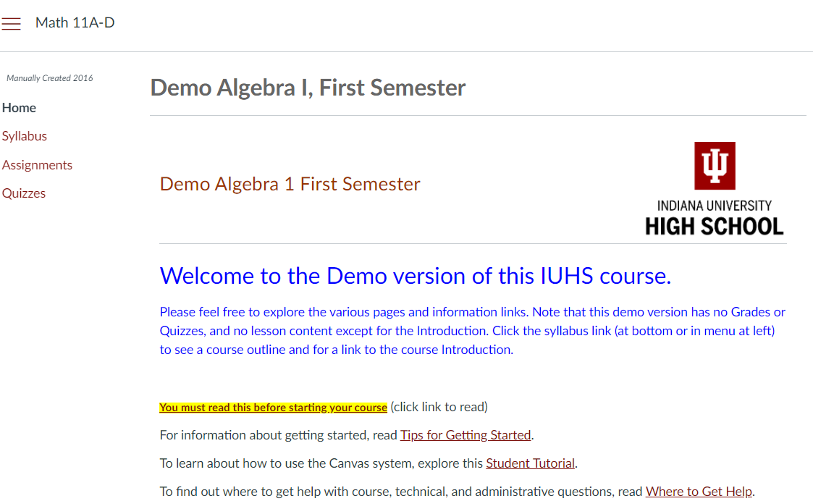
Course Materials Available this Fall
Notes:
Sharing our materials You need to review them. Change what you want. This is what a school-specific version looks like.

Slide 7

What this is.
Resources to lighten your load
  Full course materials to adopt, adapt, & adjust
  Supplements and complements to your existing practice

Slide 8

Course design and possibilities.
Asynchronous design; unlimited possibilities
  Assist hybrid models
  Supplement synchronous environments
Modular on purpose

Slide 9

What this is not.
NOT fully instructed courses
NOT a directive
NOT a replacement of you or your expertise

Slide 10

Assessments: Use professional judgement.
The assessments provided in these course materials were built for students taking a course in its entirety.
BEFORE using an assessment, review and adjust it Do not test students on materials not learned.

Slide 11

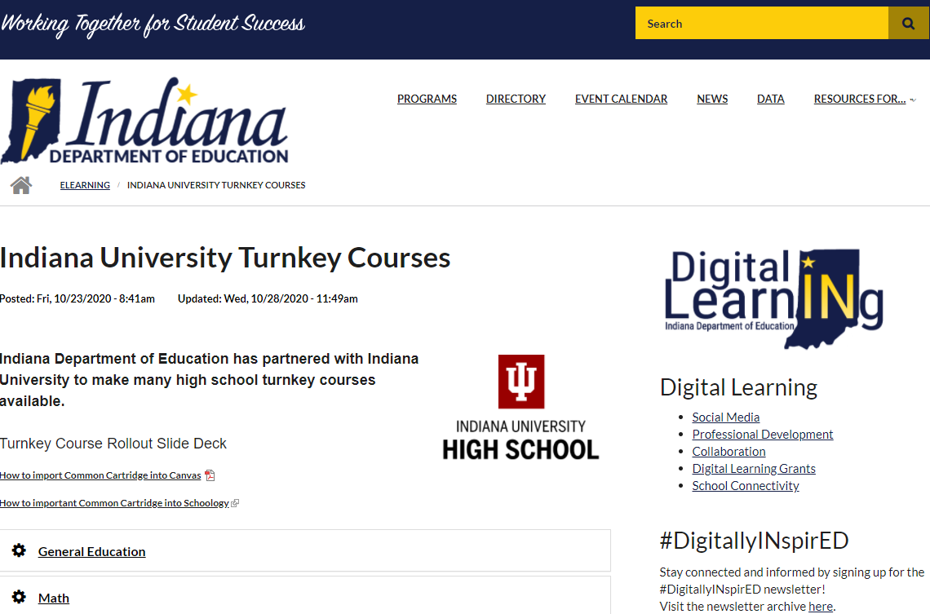
How to access course materials.
https://www.doe.in.gov/elearning/indiana-university-turnkey-coursesinstructions

Slide 12

Webinar: How to use course materials
Information about webinars for course material use:
Date: Tuesday, November 17, 2020
Time: 5:00p EST
Link: https://tinyurl.com/coursetutorial

Slide 13

Teaching Resources and Materials
Available Now
https://blogs.iu.edu/iuhs
Articles
Screenside Chats
Educational Eavesdropping Webinars

Slide 14
Course Design Academy
PHASE II: SPRING-SUMMER 2021

Slide 15

Learn, Design, Influence
Pedagogy
Relationships & Connections
Tools & Strategies

Slide 16

Interested? Participate!
Email Rebecca Itow to express your interest:
rcitow@indiana.edu

Slide 17
Revised Courses &
Professional Development
PHASE III: FALL2021 AND BEYOND

Slide 18

Teaching Resources and Materials
Available Fall 2021
Course Guides
Student/Family Support Guides
Accommodation/Modification Guides
Even more
  Articles
  Screenside Chats
  Educational Eavesdropping Webinars

Slide 19

Professional Development
Asynchronous, self-paced learning opportunities
Certificates
License Additions

Slide 20
Jennifer Jensen, PhD
Director of Teaching and Learning
jjensen@doe.in.gov
Jennifer S. Watson
Senior Digital Learning Specialist
jwatson3@doe.in.gov
Rebecca C. Itow, PhD
Principal, IU High School
rcitow@indiana.edu
@EducateIN
@iuhighschool
https://www.doe.in.gov/elearning/indiana-university-turnkey-courses

