Slide 1

Alternate Assessment Participation Webinar
2019-2020 School Year
Stephanie Thompson, Office of Student Assessment
Sarah Mohr, Office of Special Education
Notes:
Stephanie: Welcome everyone. I am Stephanie Thompson with the Office of Student Assessment.
Sarah: And I am Sarah Mohr with the Office of Special Education.

Slide 2
Agenda
Communicate ESSA’s accountability requirements for the Alternate Assessment:
1% calculation
Requirements for the state
Requirements for corporations/charter schools
Notes:
Sarah: During the presentation today, we will communicate ESSA’s accountability requirements for the Alternate Assessment including the 1% calculation, specific requirements for the state, and the subsequent requirements for public corporations and charter schools.

Slide 3
ESSA Accountability Requirements for the Alternate Assessment
NCLB | ESSA
States were required to cap the proficient scores on the Alternate Assessment of corporations at 1%. | States are required to cap the participation of students on the Alternate Assessment at 1%.
Meaning, corporations and schools could only count 1% of their Alternate Assessment scores as proficient or higher in each subject. | Meaning, a state cannot exceed 1% of its total student population tested with the Alternate Assessment.
Notes:
Stephanie
The Every Student Succeeds Act, or ESSA, changed the way the 1% cap was calculated, beginning with the 2017-2018 school year.
Under No Child Left Behind, states were required to cap the proficient scores on the Alternate Assessment of public school corporations and charter schools at 1%. Meaning, only 1% of Alternate Assessment scores could be counted as proficient or higher in each subject regardless of how many students were assessed or participated. There was no cap on how many students could participate.
Under ESSA, states are required to cap the participation rate on the Alternate Assessment to 1% per subject area at the state level. If a state exceeds 1% of its total student population tested with the Alternate Assessment that state must submit a waiver to USED.

Slide 4
Accountability Calculation for the Alternate Assessment
Calculation:
The total population of students in the state by subject who participate in the Alternate Assessment during the 2018-2019 school year (I AM)
-------------------------------------------------------------------------------------
The total number of students in the state by subject who participate in testing during the 2018-2019 school year (ISTEP+/ILEARN and I AM)
Indiana is currently at 1.14%
Notes:
Stephanie
This calculation is based on participation not proficiency: the total population of students in the state by subject who participate in the Alternate Assessment during the 2018-2019 school year DIVIDED BY the total number of students in the state by subject who participate in testing during the 2018-2019 school year (ISTEP/ILEARN/I AM).
Indiana is currently at 1.14% based the 2018-2019 school year data. This number is down from 1.2% based on the 2017-2018 school year data.

Slide 5
Requirements for Indiana
Based on the 2018-2019 school year participation rate of 1.14%, Indiana submitted a waiver extension request to USED that includes data, a plan, and a timeline.
Indiana anticipates going over 1% again for the 2019-2020 school year. Therefore Indiana must:
Identify corporations that went over 1%.
Verify that districts followed Alternate Assessment participation guidance.
Provide support and oversight to districts.
Address any disproportionality.
Notes:
Sarah
Based on the 2018-19 school year participation rate of 1.14%, Indiana submitted a waiver extension request to US Department of Education that includes data, a plan, and a timeline. Indiana anticipates going over 1% again for the 2019-20 school year. For this reason, Indiana must:
identify corporations that went over 1%
verify districts that followed Alternate Assessment participation guidance
provide support and oversight to districts
address any disproportionality

Slide 6
Requirements for Corporations That Assessed More Than 1% in 2018-2019
All corporations that assessed more than 1% of their students on the Alternate Assessment in 2018-2019 must submit a survey that will be available in January of 2020.
Submissions must be completed by Friday, February 21, 2020.
Corporations submitting the survey may be subject to further review by the department to obtain additional clarification on the submitted information.
All corporation surveys will be publicly available per USED guidance.
https://www.doe.in.gov/accountability/aa-essa-1cap
Notes:
Sarah
All corporations that assessed more than 1% of their students on the Alternate Assessment in 2018-2019 must submit a survey that will be available in January of 2020.
Submissions must be completed by Friday, February 21, 2020.
Corporations submitting the survey may be subject to further review by the department to obtain additional clarification on the submitted information.
All corporation surveys will be publicly available per USED guidance. You can view submissions for the February 2019 survey on IDOE’s Alternate Assessment ESSA’s 1% Cap page found at the address shown on this slide.

Slide 7
Survey Information for Corporations that Assessed More than 1% in 2018-2019
Corporations must provide a brief description of one of the following options:
Corporation does not anticipate exceeding the 1% participation cap for the 2019-2020 school year (explain reasoning)
Corporation has school, community, or health program that draws large number of families of students with significant intellectual disabilities to area (describe or name program)
Corporation has small overall student population (provide overall student population)
Other: Corporation to provide brief justification of variables not covered in the previous options
Notes:
Stephanie
Within the survey there are 4 options from which corporations may choose:
The corporation does not anticipate exceeding the 1% participation cap for the 2019-2020 school year. If this option is selected, the corporation must explain their reasoning.
The corporation has a school, community, or health program that draws a large number of families of students with significant intellectual disabilities to the area. If this option is selected, the corporation must describe or name the program.
The corporation has a small overall student population. If this option is selected, the corporation must provide the overall student population as a number.
And finally, other. If this option is selected the corporation must provide a brief justification of variables not covered in the previous options.

Slide 8
Survey Information for Corporations that Assessed More than 1% in 2018-2019
Corporations must provide assurances that the appropriate stakeholders have:
watched the Alternate Assessment Participation Training Webinar and agree the appropriate students will participate in the Alternate Assessment during the 2019-2020 school year.
reviewed the Alternate Assessment Participation Guidance, Flowchart, and FAQ provided on the IDOE website and agree the appropriate students will participate in the Alternate Assessment during the 2019-2020 school year.
reviewed disproportionality data from IDOE and agree the appropriate students will participate in the Alternate Assessment during the 2019-2020 school year.
Notes:
Stephanie
Additionally, corporations must submit assurances that appropriate stakeholders have
Watched the Alternate Assessment Participation Training Webinar and agree the appropriate students will participate in the Alternate Assessment during the 2019-2020 school year.
Reviewed the Alternate Assessment Participation Guidance, Flowchart, and FAQ provided on the IDOE website and agree the appropriate students will participate in the Alternate Assessment during the 2019-2020 school year.
Reviewed disproportionality data from IDOE and agree the appropriate students will participate in the Alternate Assessment during the 2019-2020 school year.
The next few slides go into more detail about the participation guidance resource documents and how to review eligibility data.

Slide 9
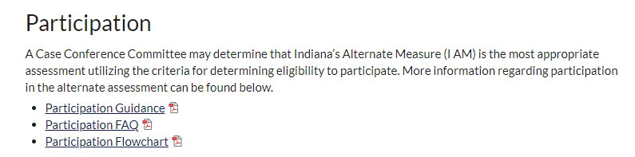
Review Participation Guidance
Criteria for Determining Participation in the Alternate Assessment
(I AM) can be found in the following locations:
https://www.doe.in.gov/assessment/iam
https://www.doe.in.gov/accountability/aa-essa-1cap
Notes:
Sarah
Students who meet specific eligibility criteria can participate in I AM. The criteria, along with a flow chart and FAQ, can be found in the following locations on the IDOE website:.

Slide 10
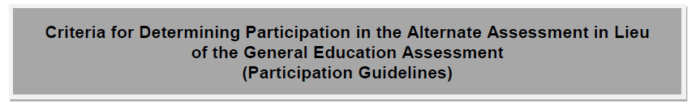
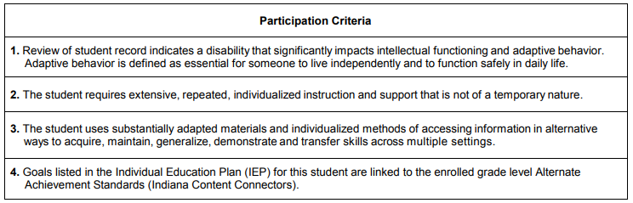
Notes:
Sarah
This is a screenshot of the participation criteria for the alternate assessment. The 4 questions here are also embedded in the Indiana IEP system.

Slide 11
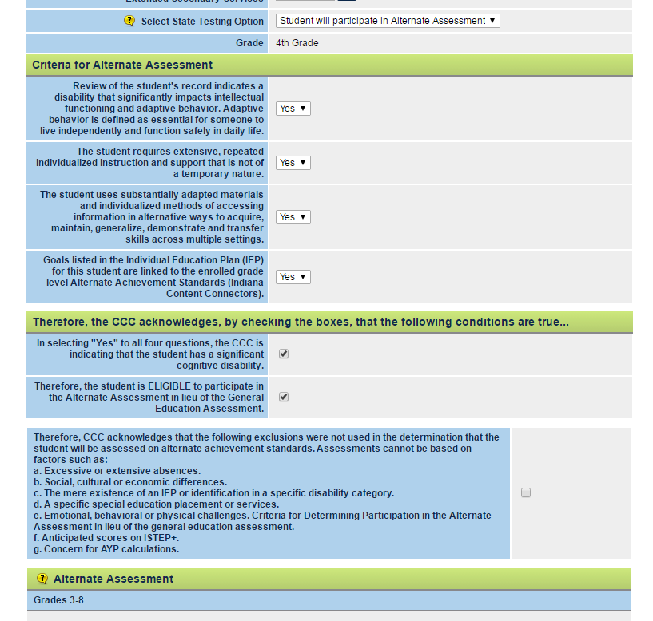
Notes:
Sarah
This is a screenshot of the criteria for determining eligibility to participate in an Alternate Assessment found in the Indiana IEP system. The Case Conference Committee must discuss the 4 criteria questions. If yes is selected for all of them, they acknowledge the student has a significant intellectual disability and is eligible to participate in an the alternate assessment.
If yes cannot be selected for all 4 criteria, this student does not qualify for participation in the Alternate Assessment. It should be noted that the majority of students when provided appropriate services and supports, should receive appropriate instruction on grade level standards and taking ILEARN or ISTEP+.

Slide 12
Participation Decision for Indiana's Alternate Assessment FAQ
Who decides that a student should participate in the Indiana Alternate Assessment?
The Case Conference Committee (CCC) makes the determination of a student’s participation in statewide assessments. No one member of the CCC makes this decision. Parents, teachers, and administrators make the decision based on evidence and adherence to the Indiana Criteria for Determining Participation in the Alternate Assessment in Lieu of the General Education Assessment.
Notes:
Stephanie
An additional support on our website is the Participation Decision for Indiana’s Academic Assessment FAQ. There are 7 questions but we want to focus on 3 for now. The first is ‘Who decides that a student should participate in the Indiana Alternate Assessment?’ The Case Conference Committee as a group makes the determination on which assessment a student will participate.

Slide 13
Participation Decision for Indiana's Alternate Assessment FAQ (continued)
How do we know that a student has a “significant intellectual disability”?
A significant intellectual disability will be pervasive, affecting student learning across content areas and in social and community settings.
Determinations for student participation in statewide assessments must be evidence-centered and made individually for each student by the CCC.
Students should not automatically be assigned to the Alternate Assessment based on their identified disability category.
Academic deficits or difficulties alone do not indicate that a student has a significant intellectual disability.
Notes:
Stephanie
The next question is ‘How do we know that a student has a ‘significant intellectual disability’?’
Most students, but not all, with significant intellectual disabilities have intellectual disabilities, multiple disabilities, or autism. Not all students with these disabilities are considered to have a “significant intellectual disability.” Further, a significant intellectual disability will be pervasive, affecting student learning across content areas and in social and community settings.
Determinations for student participation in statewide assessments must be evidence-centered and made individually for each student by the Case Conference Committee.
Students should not automatically be assigned to the Alternate Assessment based on their identified disability category.
Performing 3-4 grade levels below peers without disabilities is also not, by itself, evidence of a significant intellectual disability.

Slide 14
Participation Decision for Indiana's Alternate Assessment FAQ (continued)
If a student has been tested in the past on an Alternate Assessment, but the current CCC determines that the student does not meet the Indiana Participation Guidelines, can the student be assigned to the general assessment?
Yes. The CCC must ensure that the student receives appropriate instruction on the Indiana Academic Standards and participates in the required general assessments for the student’s current grade level with or without accommodations.
Notes:
Sarah
Another question from the FAQ is ‘If a student has been tested in the past on an Alternate Assessment, but the current Case Conference Committee determines that the student does not meet the Indiana Participation Guidelines, can the student be assigned to the general assessment?
The answer is yes. The Case Conference Committee must ensure that the student receives appropriate instruction on the Indiana Academic Standards and participates in the required general assessments for the student’s current grade level with or without accommodations.

Slide 15
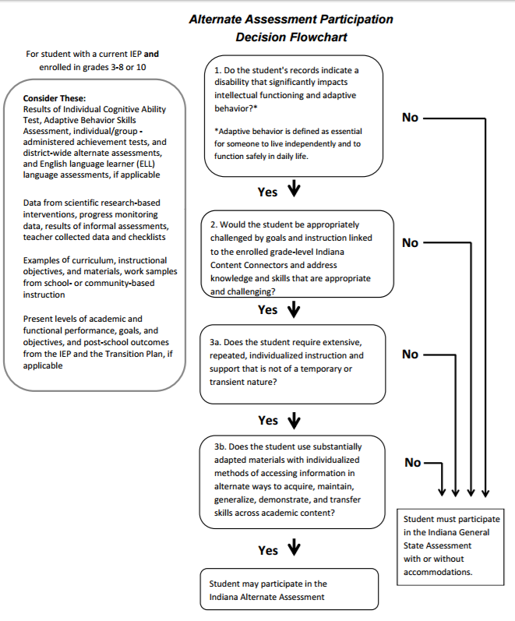
Notes:
Sarah
The third resource document on our website is an Alternate Assessment Participation Decision Flowchart. This would be beneficial to share with parents when Case Conference Committees meet and discuss assessment options.

Slide 16
Review Eligibility Data
01 = Multiple Disabilities | 899 | 13.06%
02 = Orthopedic Impairment | 104 | 1.51%
03 = Blind or Low Vision | 21 | 0.31%
04 = Deaf or Hard of Hearing | 40 | 0.58%
05 = Emotional Disability (Full Time) | 73 | 1.06%
06 = Emotional Disability (Other) | 8 | 0.12%
07 = Specific Learning Disability | 62 | 0.90%
08 = Developmental Delay (Ages 3-5A only) | 9 | 0.13%
09 = Language or Speech Impairment | 15 | 0.22%
10 = Mild Cognitive Disability | 1457 | 21.18%
11 = Moderate Cognitive Disability | 1624 | 23.61%
12 = Severe Cognitive Disability | 128 | 1.86%
14 = Deaf-blind | 6 | 0.09%
15 = Autism Spectrum Disorder | 2023 | 29.41%
16 = Traumatic Brain Injury | 52 | 0.76%
17 = Other Health Impairment | 321 | 4.67%
Notes:
Stephanie
This chart shows the statewide I AM data by disability category. We suggest corporations pull this data locally from ORS. When you look at Indiana’s overall data a few things are notable. For example, it is surprising to see that 15 students with a primary disability category of Language or Speech Impairment participated in I AM last year. Also, 104 students have a primary disability category of Orthopedic Impairment. Additionally, there were 62 students with Specific Learning Disabilities that participated in I AM.
If you are having trouble pulling this data from ORS, please contact me, Stephanie Thompson. My contact information is included on the last slide.

Slide 17
Available Website Resources:
US Department of Education Letter to States
Indiana Department of Education, Office of Student Assessment: www.doe.in.gov/assessment
I AM Alternate Assessment: https://www.doe.in.gov/assessment/iam
Indiana Department of Education, Office of Special Education: www.doe.in.gov/specialed
Project SUCCESS: www.projectsuccessindiana.com
PATINS: www.patinsproject.com
Notes:
Sarah
Here are a few resources related to this topic that can be found online. Project SUCCESS and PATINS are two of Indiana’s free resource centers that corporations are welcome to contact.

Slide 18
Contacts
Office of Student Assessment: Stephanie Thompson
sthompson2@doe.in.gov
317-234-2377
Office of Special Education: Sarah Mohr
smohr@doe.in.gov
317-232-9153
Notes:
Sarah
Please feel free to reach out to either of us if you have further questions.

Slide 19
Thank you
Notes:
Stephanie
Thank you for viewing this recording.

