Slide 1
Employability Skills Innovation and Implementation Grant

Slide 2
According to “The High Demand for Durable Skills” report from America Succeeds, the demand for employability skills is as important to a student’s career path as our focus on increasing educational attainment.
www.Americasucceeds.org
Notes:
Kelsey

Slide 3
Why are employability skills important?
Employability skills are also often referred to as soft skills, work-readiness skills or foundational skills. They often improve your performance, minimize errors and promote collaboration with your coworkers, enabling you to perform your role more effectively.
Personal characteristics, habits, and attitudes influence how you interact with others. Employers value employability skills because they regard these as indications of how you get along with other team members and customers, and how efficiently you are likely to handle your job performance and career success.
Notes:
Kelsey

Slide 4
Purpose of the grant
The purpose of this grant is to encourage and support schools as they work to embed into their curriculum the three Indiana Employability Skills highlighted within the Indiana Graduates Prepared to Success (Indiana GPS) framework: communication, collaboration and work ethic.
This includes supporting opportunities to implement these skills throughout the K-12 continuum and designing competency-based platforms, badges and/or micro-credentials that assess student readiness in communication, collaboration, and work ethic using the standards of the Indiana Employability Skills.
By supporting the development of skills-based performance assessments and competency-based rubrics, we can ensure these micro-credentials and badges will carry currency with external stakeholders alongside a high school diploma and other credentials students earn in high school.
Notes:
Kelsey

Slide 5
What is the Goal
Primary goals of the grant:
Schools, in partnership with external stakeholders, will develop programming to measure student readiness and proficiency in the skills of communication, collaboration and work ethic.
Schools will increase the number of students mastering the Indiana Employability Skills standards of communication, collaboration and work ethic as measured through micro-credentials and badges.
Schools will implement systemic programming that has transferability with and validity from internal and external stakeholders around the skills of communication, collaboration, and work ethic.
Notes:
Michelle

Slide 6
Where Employability Fits within a WHOLE CHILD APPROACH
1:1 Counseling
Referral to Outside Counseling/Wrap-around Services
Alternative Education Setting
1:1 Academic Supports
Tier 3
FEW
Data Informed Interventions
Multi-Tiered, Multi-Domain Systems of Support
Small Group Instruction
Small Group Counseling using Evidence-based Practices
Mentoring
SOME
Tier 2
Data Informed Interventions
Employability Skills and Standards
Positive Behavior Interventions & Support
Core Academic Curriculum
School-wide Activities/ Educational Neuroscience
1:1 Career Advising
ALL
Tier 1
Behavior & Attendance
Academics
Student Well-being
College & Career
Notes:
Michelle

Slide 7
What are the Grant Components?

Slide 8
components
Schools submit innovation implementation plans focused on the Indiana Employability Skills of communication, collaboration, and work ethic for K-12 students.
Successful Applications will address:
Transferability
Validity
Data Collection
High Quality Partnerships
Notes:
Kelsey

Slide 9
Transferability
Transferability
Student proficiency of the Indiana Employability Skills means these essential qualities can be applied in any environment.
Successful applications will demonstrate how students will master communication, collaboration and work ethic throughout the K-Career continuum.
Notes:
Michelle

Slide 10
Validity
Validity
Successful applications will demonstrate how:
Skill development is measured;
Skill measurement is differentiated between internal experiences (classroom) and external experiences (extracurricular, co-curricular, work-based learning);
Local/regional industry partners helped support skills being developed;
Student completion of micro-credentials provide external currency (preferential hiring, mentorship, career ladder, scholarships, college credit, etc.) to students; and
Skill development qualifies for Graduation Pathways (work-, project-, and service-based learning).
Notes:
Michelle

Slide 11
Data Collection
Data Collection
Data will help us understand the value of micro-credentials and badges, effectiveness of school implementation, and ultimately, determine the success of the ESSI grant.
All data must be reported to the Indiana Department of Education (IDOE) in the required data sharing format.
Notes:
Kelsey

Slide 12
High Quality Partnerships
High Quality Partnerships
Defined as partnerships with local and/or regional/state businesses, universities and/or colleges, or other stakeholders who provide external endorsement and engagement.
Notes:
Kelsey

Slide 13
Application Components & Rubrics

Slide 14
Application components & rubrics
Section | Points Possible
Project Narrative | 0
Program Abstract | 8
Need & Local Data | 12
Component 1 - Transferability & Portability | 20
Component 2 - Data Collection | 12
Component 3 - Quality Partnerships | 8
Budget Summary | 5
Budget Narrative | 5
TOTAL | 70
Notes:
Michelle

Slide 15
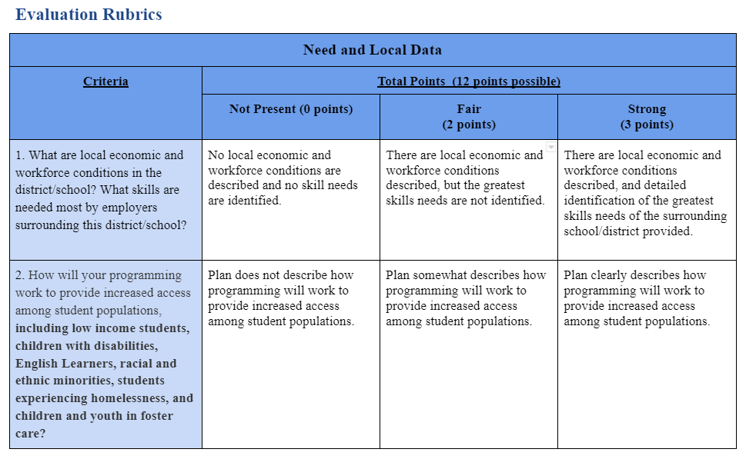
Application components & rubrics
RUBRICS
Notes:
Kelsey

Slide 16
Grant TImeline
Important Dates
April 21, 2022: Applications open
May 27, 2022: Applications due; must be submitted through the Online Form
July 2022: Anticipated date of awards announcement
September 30, 2023: Encumbrance date
December 15, 2023: Reimbursement date deadline
Grant Timeline
July 2022 - December 2023
Grant Support
K-8 application - Engagement@doe.in.gov
9-12 application - StudentPathways@doe.in.gov
Budget
$7 Million
From ESSER II
Notes:
Michelle

Slide 17
Learning Lab- Vendor Spotlight
Go to: Indiana Learning Lab
Register or Log In
Go to Learning > Live > May 5th
Notes:
Kelsey

Slide 18
Questions
ESII Grant FAQs
Please enter your questions in the chat.

Slide 19
Thank you!

