Slide 1

Clever Guide

Slide 2
Teachers

Slide 3
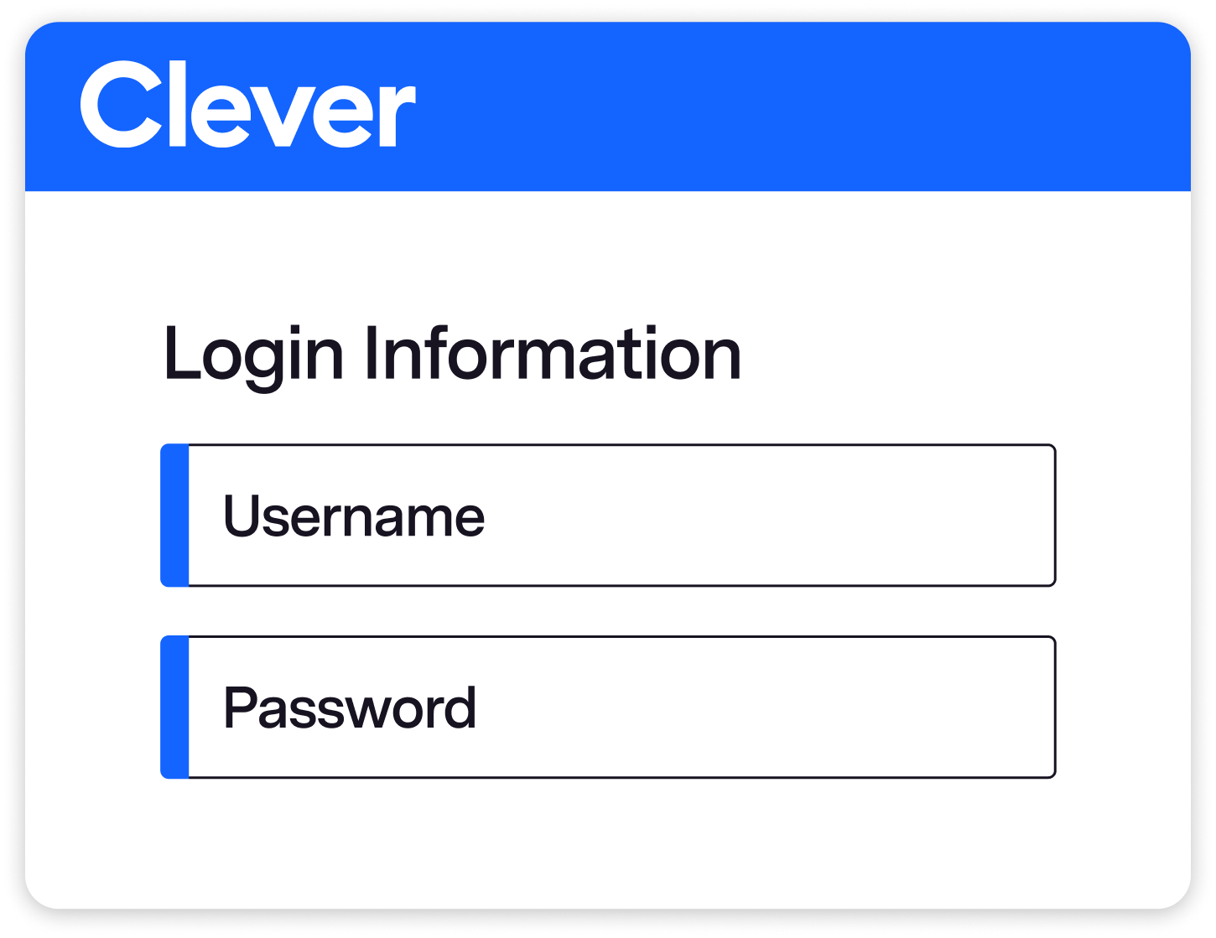
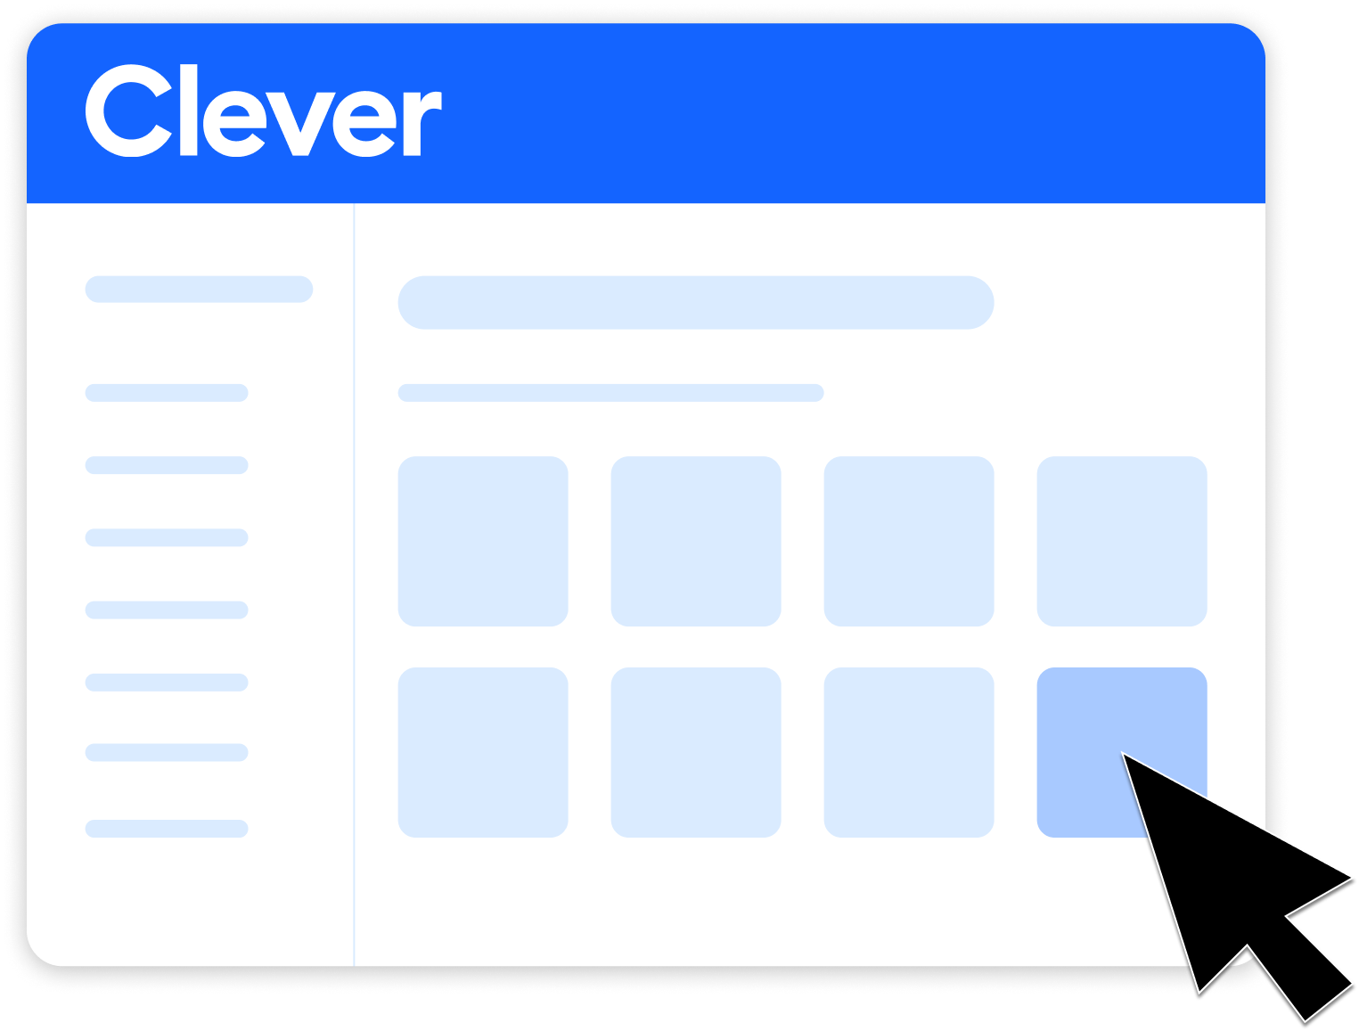

With Clever, there’s more time to teach and learn.
Clever includes single sign-on (SSO), meaning you and your students can log into Indiana Career Explorer with one click by logging into Clever. Plus, your classes are shared directly with Indiana Career Explorer.
User types credentials into Clever
User clicks app in Clever Portal
User signed into the app
Notes:
A key feature of Clever is Single Sign on, or SSO for short. By signing in to Clever, you and your students can log into Indiana Career Explorer with one click, by clicking the Indiana Career Explorer icon on Clever Portal.

Slide 4

Notes:
Direct link to video: https://www.youtube.com/watch?v=lGRC3xmSuIo

Slide 5
Clever brings all your applications into one secure portal and provides single sign-on (SSO) for everyone in the district.
Access Indiana Career Explorer with three easy steps.

Slide 6
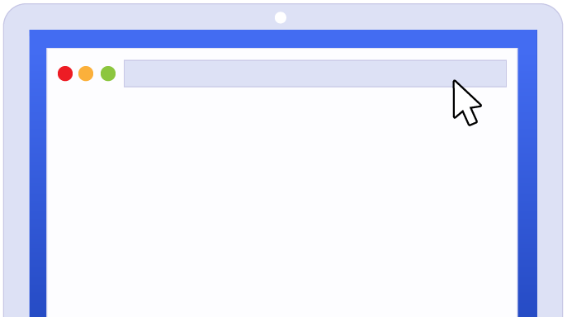
Step 1
Visit clever.com/in/{your district host name}
Notes:
NOTE: If you’re not sure of the district’s short name, you can have teachers log in by going to Clever.com then clicking the down arrow on the Log in button in the top right corner.

Slide 7

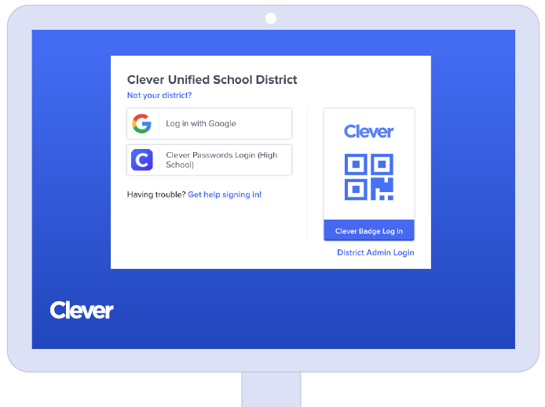

Tip: Your Clever District Administrator manages your Clever login credentials.
Step 2
Log in with your credentials
Login paths
Log in with Google
Log in with Active Directory
Log in with Clever Passwords
Clever Badges (Pre K - 3)
Notes:
You will log in to Clever using your district-provided login method. If you are unsure of your username or password, please contact your district technical support.

Slide 8

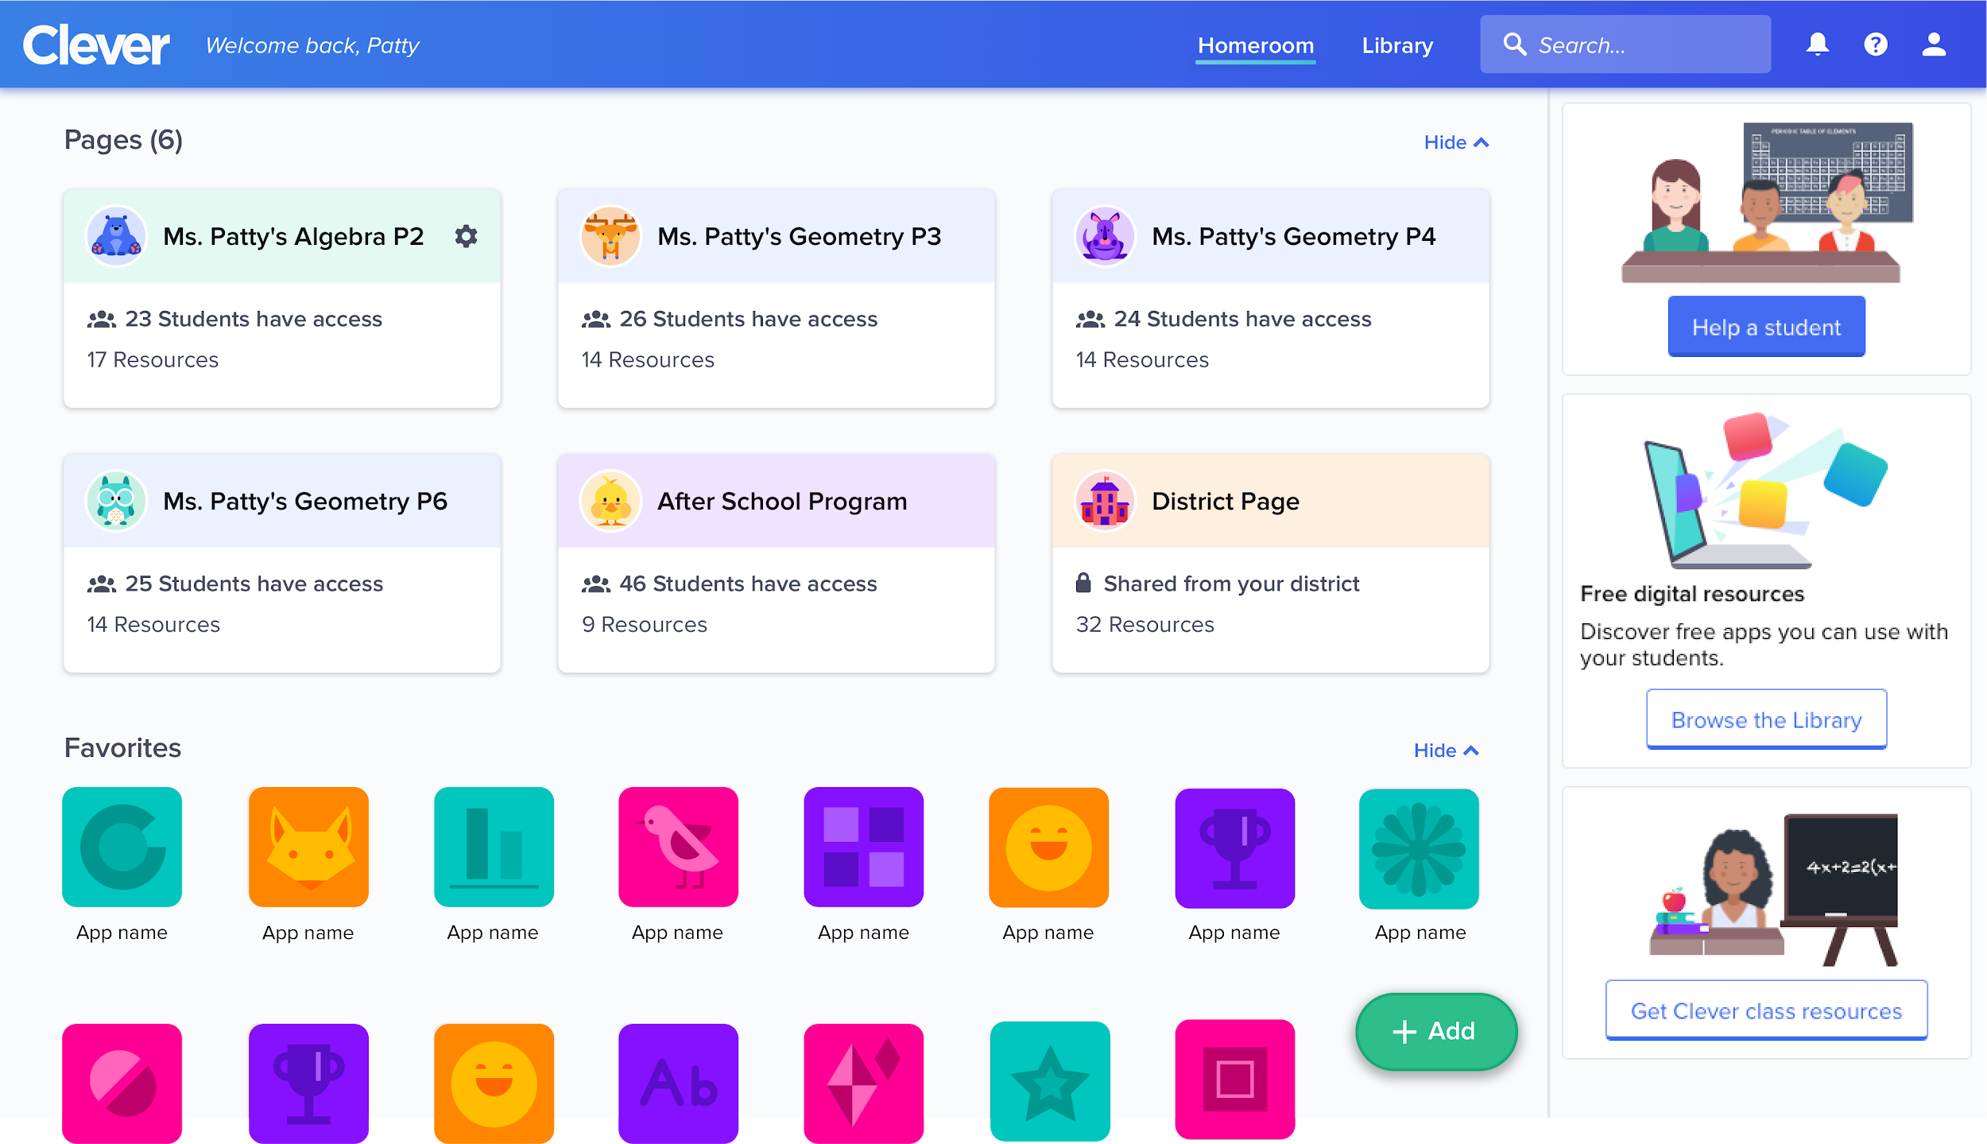
Tip: Favorite our application and add it to your teacher pages.
Step 3
Click on Indiana Career Explorer
Notes:
Once in the Clever Portal, simply click on the Indiana Career Explorer application and you will be automatically logged in!

Slide 9
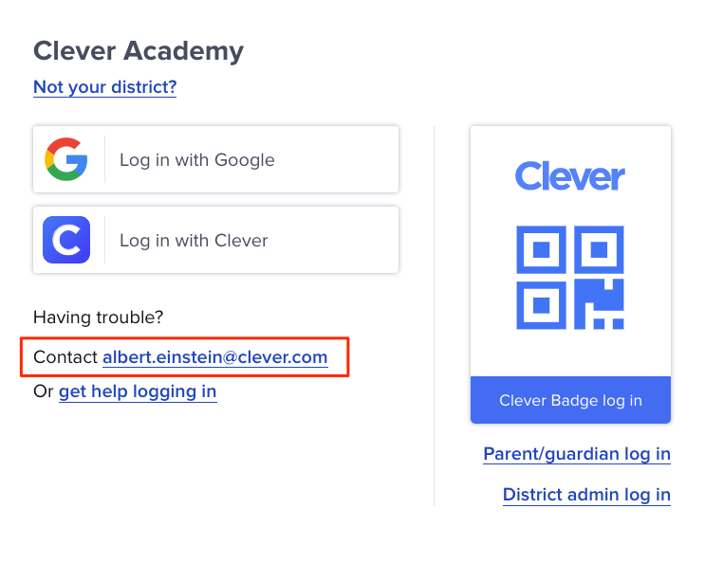
Tip: After you click on an application from the Clever Portal, your experience within the product is controlled from the application's end. If you are running into an issue within the application, please contact our support team for help.
Need Help?
Contact your district support contact
Login problems
Roster issues
Adding co-teachers
Notes:
If you or your student are unable to log in to Clever, please contact your district tech support contact. The tech support contact is listed on your school’s Clever login page.
Similarly, if there is a problem with your class roster in Clever or Indiana Career Explorer, reach out to your district tech support contact. All roster information is managed by your district.

Slide 10
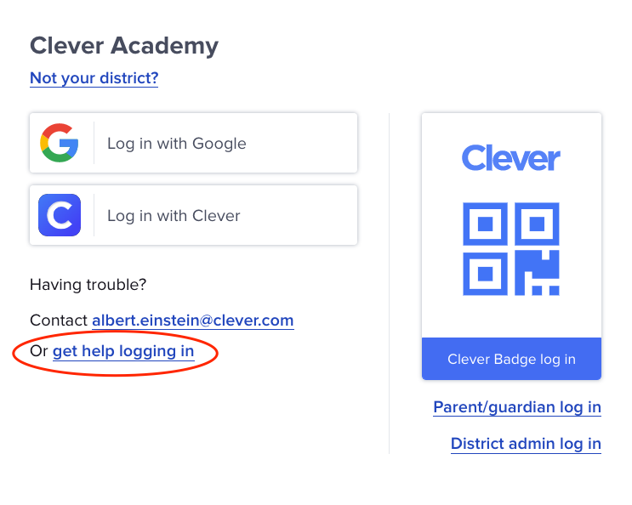
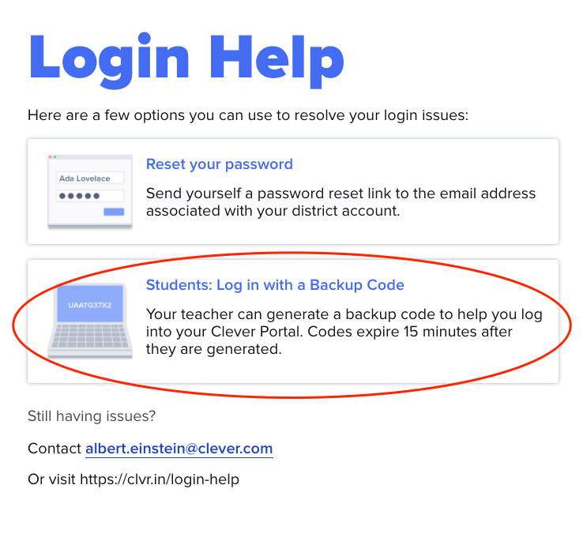
Backup login codes
A backup code is a code made of 7 letters and numbers that students can use to log in if their normal login isn’t working.
Step 1: Teacher creates a backup login code for the student in Clever Portal
Step 2: Student clicks “Get help logging in” and selects “Log in with a Backup Code”
Notes:
For students, you can always generate a backup login code for a student who can’t log in. This will give them one-time access to Clever so they can access learning.
It is important to note that while backup login codes are a great temporary solution, you will still need to reach out to your IT team to get the original login issue resolved.

Slide 11
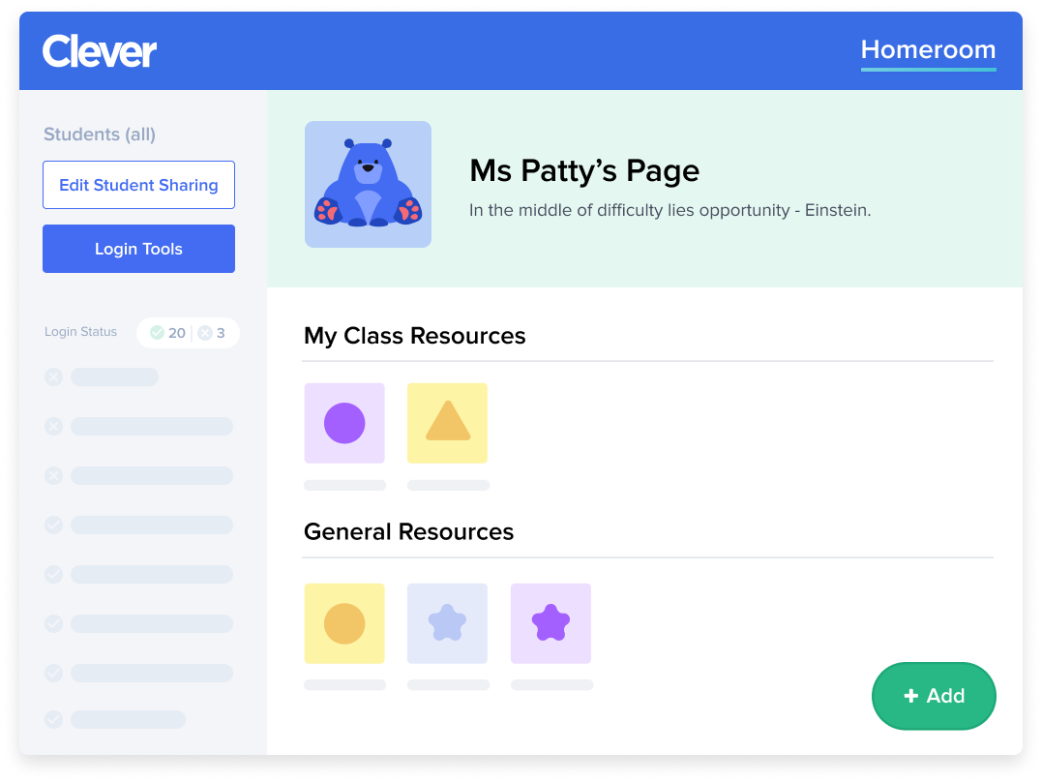
Teacher Pages
Add Indiana Career Explorer to your Teacher Page with just a few simple steps:
Click + Add
Select App
Search for Indiana Career Explorer
Click Add Indiana Career Explorer
Notes:
Teachers can create their own custom pages of digital resources for their classes. Students will find these teacher picks alongside district applications when they log in to their portals.
To add Indiana Career Explorer to your teacher page, click the Add button in the bottom right of your teacher page and follow the directions found here.

Slide 12

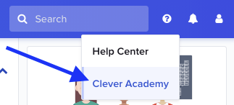

Learn more about Clever
Clever Academy offers free online professional development courses for educators, allowing them to become proficient in the technical skills to use Clever to its fullest potential.
To get started, go to your Clever account, click and select Clever Academy!

Slide 13
Clever Admins

Slide 14
Simplify edtech data management with Clever
Security and reliability
Your trusted implementation
partner
Interoperable
data systems
Simplify
classroom engagement
Create equitable digital learning experiences
Single Sign-On
Automated rostering
Full encryption in transit and at rest
Secure, cloud-hosted infrastructure
Student Data Privacy Pledge
One, easy platform for all users
Setup in one day
Free online training
World-class support
Smarter data sharing
Integrate with any SIS
OAuth and IMS OneRoster® support
Compatible with open standards
IMS TrustEd Apps Seal and founding member
CommonSense Privacy Program’s highest possible rating
Customizable teacher pages
Clever Badges
Clever Library
Tech coach experience
Messaging
Clever Parents
Always free rostering and portal for schools
Works with every SIS and any application
Analytics and data to assess equitable access
Building equitable opportunities, products, and communities
70% of US K-12 Schools use Clever to achieve their instructional vision
Notes:
The most widely used single sign-on portal in K-12 education, Clever streamlines implementation with secure accounts, data management and easy classroom access. Fast, simple edtech implementation means that all of your edtech resources are in one place ready for students to learn.

Slide 15
Connecting with Indiana Career Explorer
STEP 1
STEP 2
STEP 3
STEP 4
STEP 1
Create Clever Account
Add Indiana Career Explorer
Set sharing permissions
Train Teachers
Notes:
Indiana Career Explorer has partnered with Clever for SSO. Setup is a few easy steps, primarily consisting of adding the Indiana Career Explorer application and setting sharing permissions in your Clever Dashboard.

Slide 16
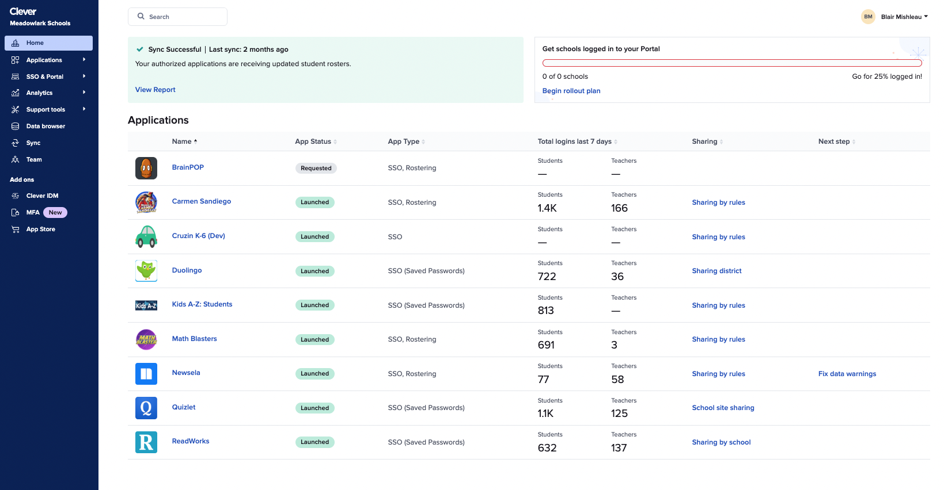
Step 1
Accept your invitation to join Clever!
The setup process will consist of:
Creating a data connection with your SIS
Adding Indiana Career Explorer
Configuring Clever logins
Setting up the Clever Portal
Notes:
Optional: If district already has a Clever Account you can skip. “Since you are already on Clever, you will start the process at Step 2)
You will be receiving an invitation to set up your Clever account. Clever’s onboarding team will work closely with you to configure a connection with your student information (SIS) and setup SSO.

Slide 17
Step 2
Visit clever.com/applications/add/pipeline-ince
Notes:
To add the Indiana Career Explorer application, you can use the above link or search for the application in the “Add Applications” section of the Clever Dashboard.

Slide 18
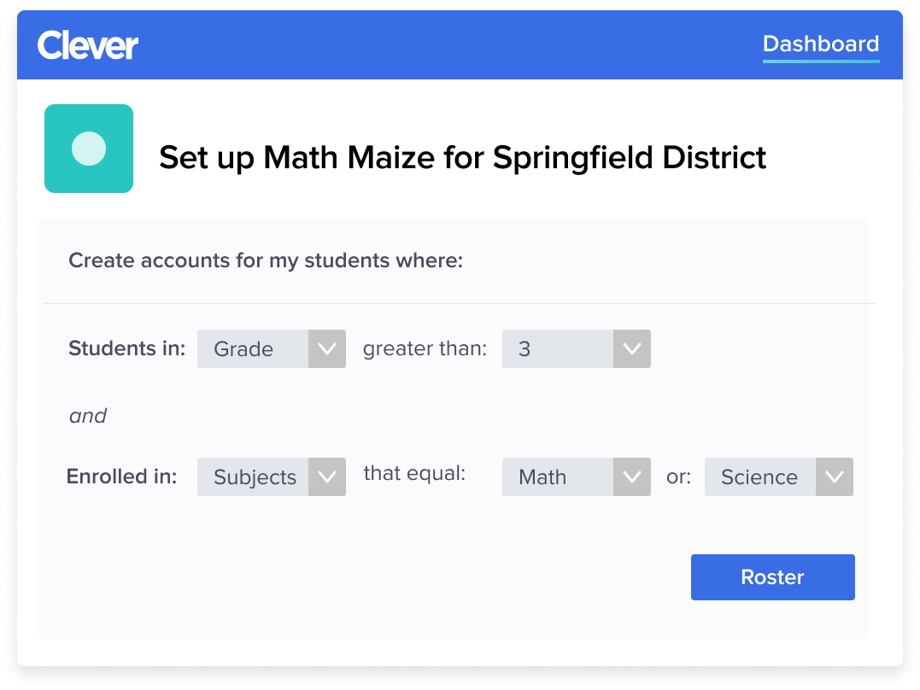
Step 3
Configure user access
Your district will be creating accounts for:
Your k-12 students
Notes:
Once the application has been added, you will configure user access. These sharing permissions control what data we will have access to when creating accounts for your users. Additionally, it will determine which users will be able to see Indiana Career Explorer in the Clever Portal.

Slide 19

Step 4
Train teachers
How to log in to Clever
How to use Indiana Career Explorer
Notes:
The final step is to train your teachers! It is important that teachers know how they and their students will access and use Indiana Career Explorer in their classroom. Clever offers free trainings for teachers that can be accessed directly from Clever. It can also be accessed by going to Clever.Academy

Slide 20
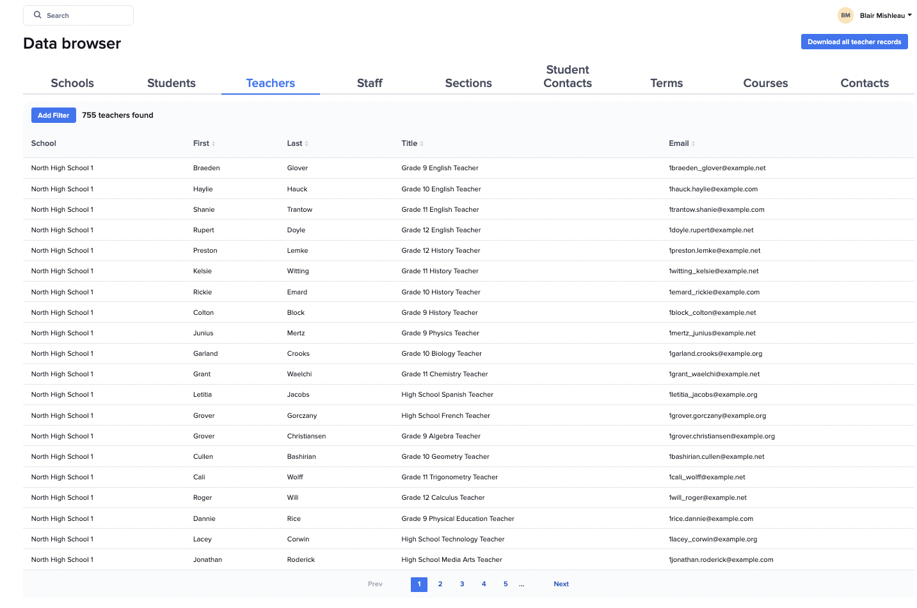
Troubleshooting
Data incorrect in Clever
Most common solutions:
Fix data in SIS
Review Clever troubleshooting documentation
Contact Clever Support
Notes:
The source of truth for all data in Indiana Career Explorer is your SIS and then Clever. As such, it data is incorrect in Indiana Career Explorer, the issue will likely need to be resolved in your SIS or with the help of Clever.

Slide 21
Troubleshooting
Data incorrect in Indiana Career Explorer
Most common solutions:
Confirm data is correct in your SIS
Confirm data is correct in Clever
Confirm record is shared with Indiana Career Explorer
Wait 24 hrs – data is synced by Indiana Career Explorer once per day
Contact Indiana Career Explorer Support
Notes:
If data is incorrect in Indiana Career Explorer, there are a few simple steps to take when troubleshooting. Begin by confirming the data is correct in your SIS and Clever and that the data is shared with Indiana Career Explorer. After following these steps, if the data is still incorrect in Indiana Career Explorer, reach out to our support team and we will be happy to help!

Slide 22

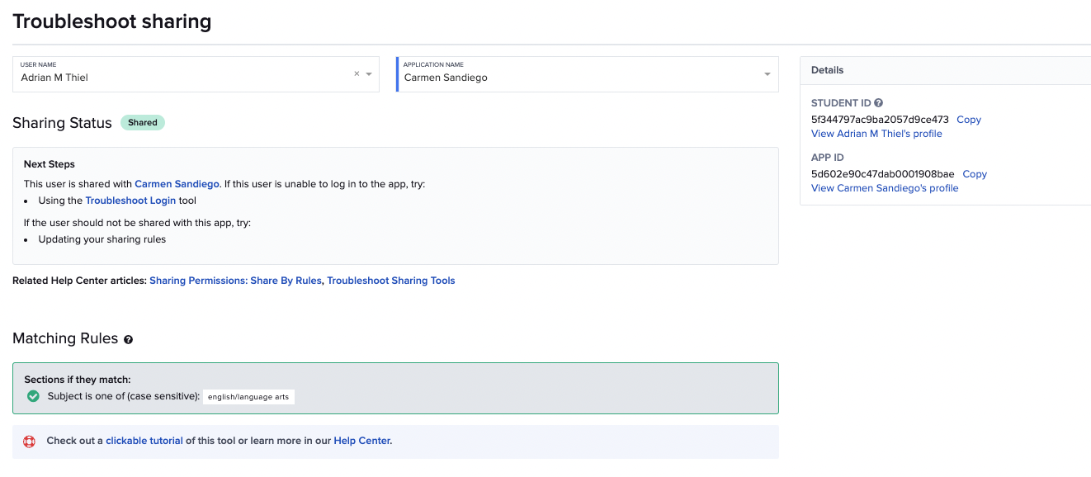
Troubleshooting
User Access
Support Tools > Troubleshoot Sharing
Identifies why a user does not have access application.
Most common solutions:
Adjust sharing permissions
Fix enrollments in SIS
Notes:
If a user does not see the Indiana Career Explorer icon in the Clever Portal, it is likely because they are not shared with our application. Clever has a wonderful tool called “Troubleshoot Sharing” that can be used to help identify why the user is not shared. More details on this tool can be found in Clever’s help center.

Slide 23
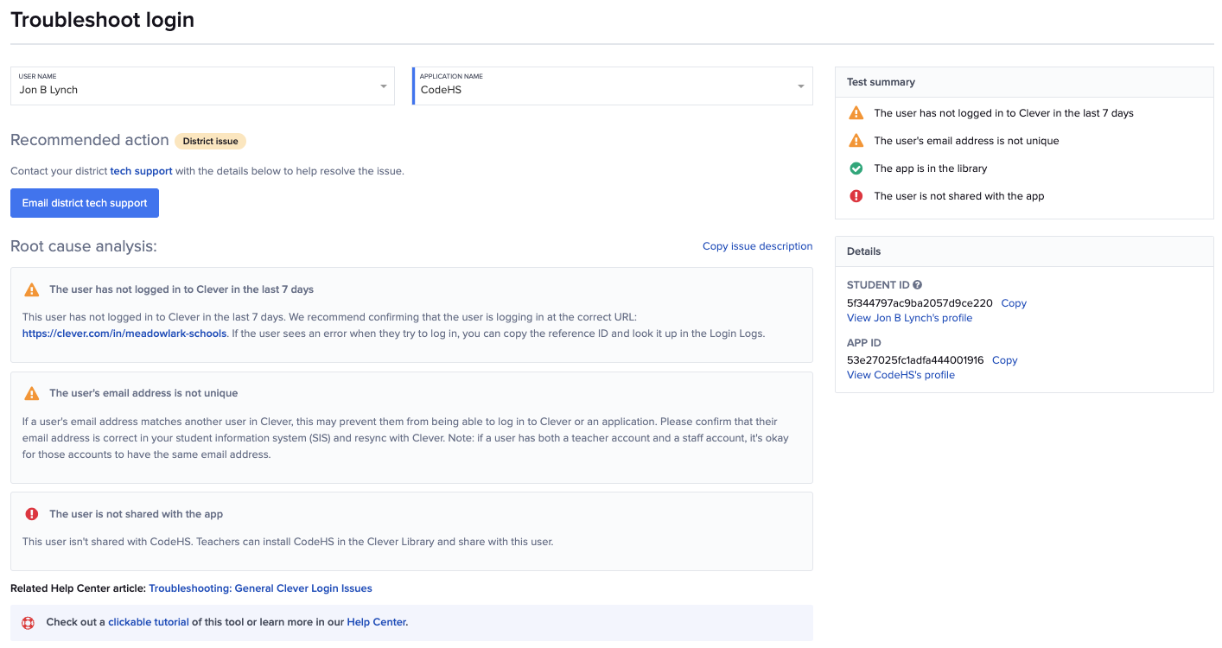
Troubleshooting
Logins to Indiana Career Explorer
Support Tools > Troubleshoot Login
Identifies why a user is unable to log in to an application
Most common solutions:
Allow 24 hrs for account to be created
Contact Indiana Career Explorer support
Notes:
If a user encounters a problem after clicking on the Indiana Career Explorer icon in the Clever Portal, please reach out to our team. If the user has been shared for more than 24 hrs, the issue will need to be investigated and resolved by our team.

Slide 24

Tips & Tricks
Managing data
Add co-teachers in Clever
Create custom sections
Create custom teachers or staff
Syncing custom fields
Sharing demographic fields with apps
Notes:
We also wanted to provide links to some common questions and processes that admins encounter when managing data in Clever.

Slide 25
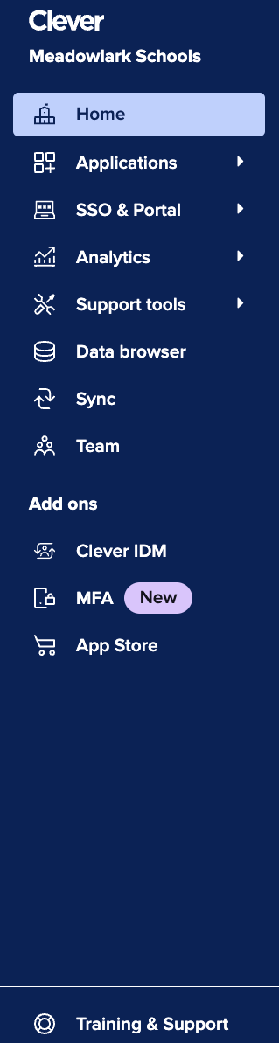
Learn more about Clever
Clever Academy offers free online professional development courses for education professionals, allowing them to become proficient in the technical skills to use Clever to its fullest potential.
To get started, go to your Clever account and select Clever Academy
Notes:
As mentioned, Clever Academy is a tremendous resource for both teachers and administrators. Clever offers both certification and quick start courses for administrators – we highly recommend them! You can access Clever Academy by clicking on the link in the Clever Dashboard.

Slide 26
Clever Support
SUPPORT CHANNEL | WEB ADDRESS | AVAILABILITY
Web & Phone Support | support.clever.com | 7:00 AM - 8:00 PM ET
Knowledge Base | support.clever.com | 24/7
Clever Academy | clever.academy | 24/7
Resource Hub | clever.com/resource-hub/district-admins | 24/7
System Status | status.clever.com | 24/7
Notes:
If you require help from Clever’s support team, you can reach them using the following information. Also provided are helpful resources such as Clever’s status page.

Slide 27
Indiana Career Explorer Support
SUPPORT CHANNEL | WEB ADDRESS OR NUMBER | AVAILABILITY
Web Support | http://futuresinc.zendesk.com/requests/anonymous/new# | 24/7
Notes:
Also included is information on how you can contact Indiana Career Explorer should you need help.

