Slide 1
USDA FOODS: FORECASTING FOR THE FUTURE
UTILIZING THE TOOLS AVAILABLE
Cathy Sparks – National Commodity Director
Cathy.sparks@asmwaypoint.com
812-272-9778

Slide 2
Communication is key
Forecasting – Processorlink calculator; K12 On Target planner or a spreadsheet calculator
Distributor- your bid should have your estimated quantities needed.
Bid Awards –they should be given to your distributor & manufacturer rep (Broker) ASAP
Processors need this for production purposes
Completed Calculators can provide number of cases each month
Assigns the correct distributor in Processorlink & K12 Foodservices
Helps the manufacturer with production numbers
Utilize this tool for completing State Survey

Slide 3
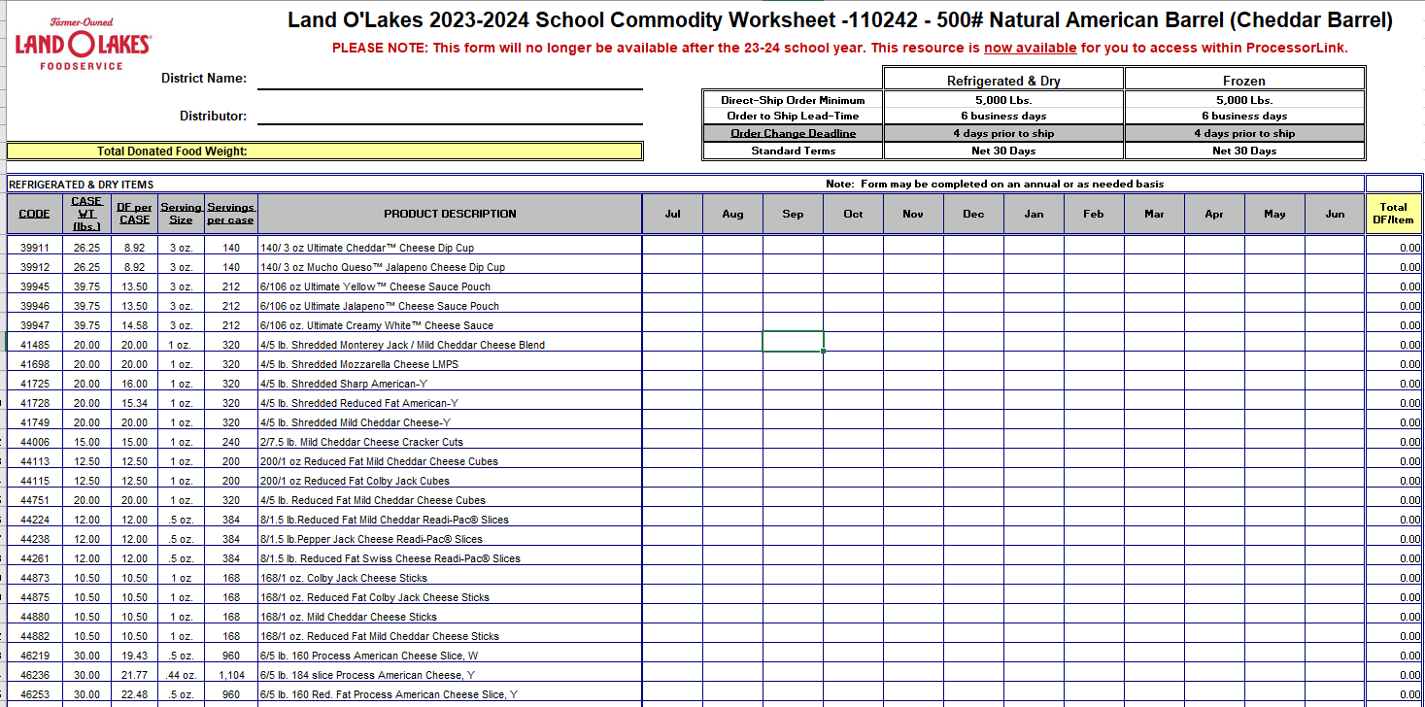

Slide 4
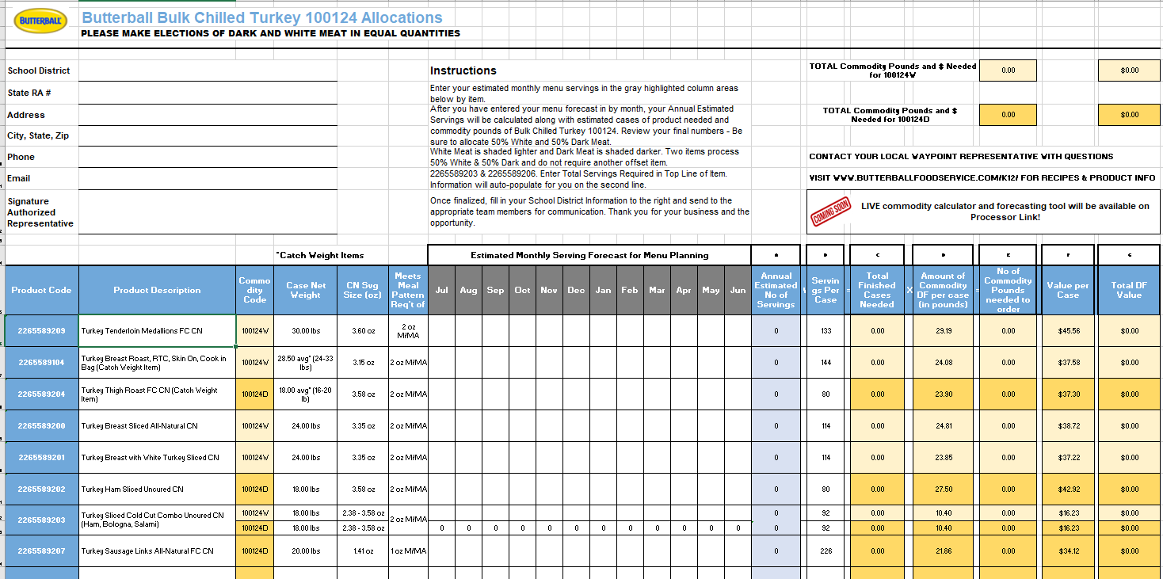

Slide 5
Commodity Planning Made Easy
Commodity Processors who partner with Fidelis Information Systems
offer the ProcessorLink Calculator Service.
This new service offers you…
One‐stop management of your commodity diversions across all participating processors
Customized display showing historical purchase data to help guide you in product selection
Streamlined forecasting communication with your manufacturing partners
For more information on this powerful new planning tool, log into your ProcessorLink account. If you don’t have an account – follow the instructions below.
go to www.processorlink.com
select need an account
select school
complete the electronic form that pops up

Slide 7
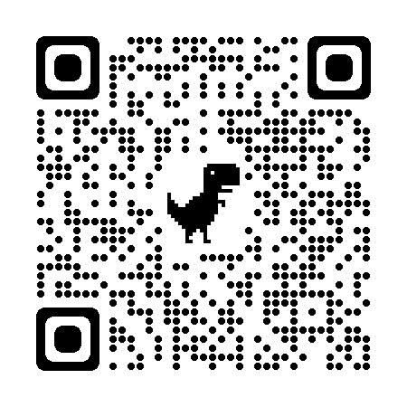
Commodity Planning Made Easy
Commodity processors partnering with K12 Foodservice now offer the commodity planner
This new service offers you…
One‐stop management of your commodity diversions across all participating processors
Customized display showing historical purchase data to help guide you in product selection
Streamlined forecasting communication with your manufacturing partners
For more information on this powerful new planning tool, log into your K12 Foodservice account. Look for
If you don’t have access–scan the QR code or go to https://www.k12foodservice.com and follow the instructions below.
click on
Select I am a Recipient Agency
Follow the instructions

Slide 8
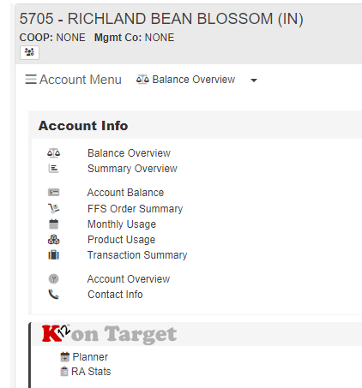

Slide 9
Please feel free to call or email with any questions
Cathy Sparks
Cathy.sparks@asmwaypoint.com
812-272-9778

