Slide 1

Annual SFSP Sponsor Staff Training
Spring 2026
Created as a Resource for Sponsors to Train Staff in Program Requirements

Slide 2
ATTENTION! IDOE Disclaimer
Please note that this training tool is not an all-encompassing resource that covers every single aspect of SFSP operations in depth. As a result, this tool should be viewed as a sample staff training document that can be edited by the sponsor.
When training your staff and volunteers, make sure all aspects critical to your specific operations are addressed.
Sponsors who qualify and are approved for rural non-congregate (NC) meal service option may utilize the last portion of this resource for conducting NC meal service staff training. Remember to cover in detail the NC meal service Integrity Plan and all the requirements that are applicable to the meal service method(s) approved for your sponsorship.

Slide 3
Training Key:
This training includes four separate sessions.
Each session is divided by the different color of slides as shown below.
When the color changes, you may be able to dismiss some of the attendees based on their job duties and training needs.
1. Site Staff Training – Light green slides highlight the primary topics for Site Staff
2. Site Supervisors* – Gray slides highlight the primary topics for Site Supervisors
3. Site Monitors** – Gold tone slides highlight the primary topics for Site Monitors
4. Non-Congregate Meal Service*** - Slides in orange tone highlight the primary topics for Non-Congregate
Meal Service
*Site Supervisors should stay for the first 2 sessions
**Site Monitors should complete the entire training
*** Applicable only to approved sponsors in eligible rural areas

Slide 4
Preliminary Reminders
All SFSP employees and/or volunteers are required to be trained in program requirements annually prior to program start date.
Make sure each participant records and signs their name on the training sign-in sheet.
Maintain a written record of all the training documentation, including the topics covered and sign-in sheets.

Slide 5
SFSP SITE STAFF TRAINING
SFSP = Summer Food Service Program
The SFSP is funded by the United States Department of Agriculture (USDA)
All rules and regulations are federal (national) requirements
The SFSP is locally administered by the Indiana Department of Education (IDOE)

Slide 6

SFSP Purpose
SFSP IS…
A program to provide nutritious meals to eligible children during times when school is not in session
SFSP is NOT…
A program to feed adults
Designed to provide children with all food that they need in a day
SFSP SPONSORS MAY QUALIFY AND BE APPROVED TO OPERATE…
In-person meal service sites
Non-congregate meal service sites located in rural areas

Slide 7
USDA
Funds the program.
Creates the rules for the program.
Oversees the IDOE administration of program.
IDOE
Approves sponsoring organizations as well as new sites.
Trains sponsors on program regulations.
Monitors sponsors for compliance.
Conducts SFSP Administrative Reviews according to USDA requirements.
Local Sponsoring Agency
Provides free meals that meet meal pattern requirements.
Ensures daily compliance with all USDA regulations.
Allocates federal funds to provide nutritious meals to children 18 and under.
Provides meals at approved meal service sites during approved mealtimes.
Self-monitors to ensure continued compliance at each site.

Slide 8

Site Selection
Sites must be in approved areas that qualify based on specific criteria.
Sites may not be moved to a new location without prior approval from the IDOE.
Site locations should be chosen with accessibility in mind and located where children can gather safely and easily.

Slide 9
Site Rules
Meals are only available to children 18 and younger. If older, the child must be enrolled as a student in a K-12 school program.
Persons with disabilities who are over the age of 18 must be enrolled in the local K-12 school to receive meals. For reference, students with mental disabilities may graduate later, around the age of 21 or 22.
Pregnant women over the age of 18 do not qualify for a free meal.
Small children who are not eating solid foods (younger than 6 months) or who are too young to eat the food provided should not be served a meal.
If meals are offered for adult consumption, all children must be served first if there is concern of running out of meals, and adults must pay for meals.

Slide 10
Program Adult vs. Non-Program Adult
Program Adult- An employee or volunteer who has a job duty specific to SFSP.
For example: a meal server, a custodian with program related duties, kitchen staff.
Non-Program Adult- A person over the age of 18 who does not have a specific job duty within the SFSP. This can include employees or volunteers who do not work with the meal service operation.
For example, parents who bring their kids to the site, daycare staff who bring children to a site, camp counselors who do not help with SFSP in any way, custodians who do not work in the cafeteria.

Slide 11
Program Adult vs. Non-Program Adult Meals
SFSP Sponsors may, but are not required to, provide program adults one meal free of charge. This is considered an allowable expense. Meals must be marked on the daily meal count form in the appropriate adult meal section but never claimed for reimbursement! Reimbursement is only for meals served to children.
If the site offers meals to Non-Program adults, the meals must either be purchased, or donations must be obtained from an outside source to cover the cost of the meals.
At in-person sites, it is recommended that all adult meals be eaten on site to avoid confusion among children about what foods may be taken off site.
Some sites solicit donations from community partners to serve non-program adults free of charge.
Each sponsor must set a non-program adult meal price.
Adult meals must be counted and recorded in the appropriate section of a daily meal count form
Money for the adult meals must be deposited into the SFSP account

Slide 12


Site Rules
Meals must be served within the approved meal service time.
Times may be changed throughout the summer, but prior approval must be obtained from the IDOE before serving meals at the new time.
It is best to keep meal service time consistent throughout the summer to ensure regular attendance.
Changes to the meal service must be communicated to the field specialist and DOE office staff via email/phone and may take several days to approve.
All meals served outside of the approved meal service time are ineligible for reimbursement.
If a household shows up after meal service has concluded, provide a written reminder of the scheduled meal service time.

Slide 13

Site Rules
For outdoor sites, inclement weather may result in the cancellation of meal service.
An inclement weather plan should be determined prior to the start of the program season and documented in the site information sheet in CNPweb.
Discuss alternate meal service plans with the local SFSP director.
Make sure all staff are trained to follow the inclement weather plan and participants are informed about the change in location. Use proper signage, if applicable.

Slide 14
Site Rules for Congregate Site
Congregate sites may determine if participants will be allowed to take ONE item, a grain, vegetable or fruit, off site when leaving.
This may come from a participant’s meal or from the share table but cannot exceed one item.
Due to food safety concerns, a meat/meat alternate or milk are not allowed to be taken off site.
Sponsors have the authority to limit meal consumption to the site and not allow any item to be taken off site. This should be clearly communicated with participants and caregivers through appropriate signage.

Slide 15


Share Table
Will the site establish a share table for items participants will not eat?

Slide 16
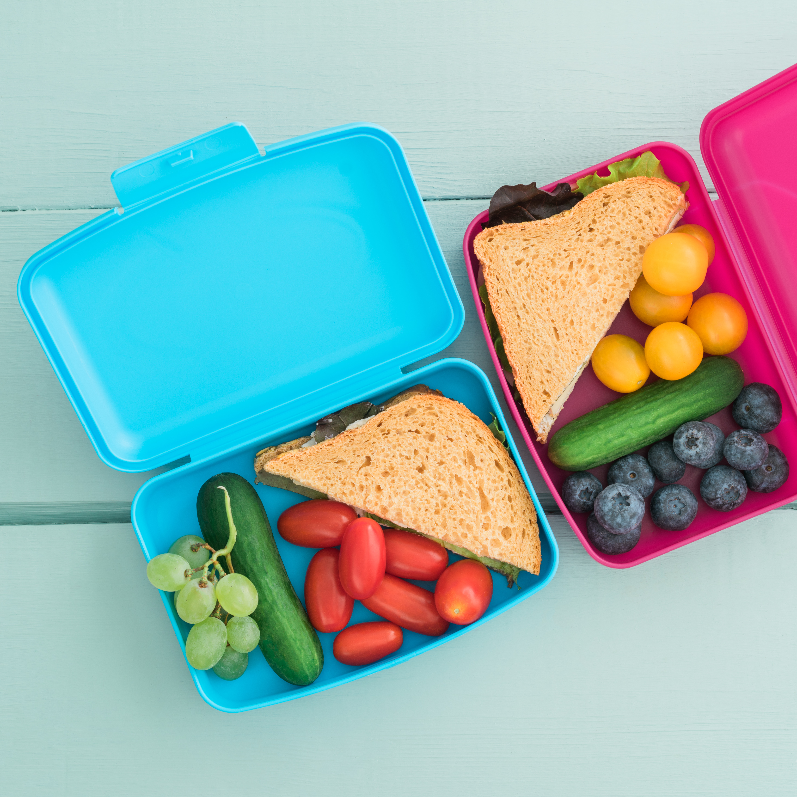
Share Table Reminders
If the site opts to operate a share table, items on the share table may only be consumed by children and youth age 18 and younger.
A Share Table is a designated area where unopened, individually wrapped food items may be placed for participants who are still hungry.
Share tables must meet all requirements established by the local health department.
If sites determine they will allow participants to take ONE item, a grain, vegetable or fruit, off site when leaving, this can come from their own meal or from the share table but cannot exceed one item.

Slide 17
Share Table Reminders
Only pre-packaged items may go on the share table.
For example: cheese sticks, goldfish cracker packages, milk cartons, juice boxes, apples, oranges, banana, packages of baby carrots, uncrustable sandwiches
Items that have been opened or contaminated must be thrown away.
Items should be kept at food safe temperatures.
If milk is placed on a share table, it is best to have a cooler or a bowl with ice to keep the milk at a food safe temperature, but milk cannot be taken off site.
Share table items may be stored and put out the following day if held at food safe temperatures.
Make sure that any perishable items (milk) are checked for expiration if kept more than one day.

Slide 18
Meal Pattern
Menus are planned to meet the minimum SFSP meal pattern requirements.
Each Breakfast meal must include:
1 serving bread/grain
½ cup of fruit or vegetable
8 oz of milk
Each Snack Must include 2 of the following: Pick any 2!
1 oz meat or meat alternate
1 serving of bread or grain
¾ cup of fruit or veg (6 oz juice)
8 oz of milk
Each Lunch Meal must include:
2 oz of meat or meat alternate
1 serving of bread or grain
¾ cup total fruit and/or vegetable in 2 different varieties
For example: ¼ cup carrots and ½ cup of peaches
8 oz of milk
Sites must not change the planned menu without the SFSP Director’s
approval and changes must be documented on the written menu!

Slide 19
Meal Pattern
Children must take all the planned menu items unless the site is approved to use Offer versus Serve which requires additional training.
Milk is a required component of breakfast and lunch/supper. No substitution of water or juice is allowable.
Fruit and vegetable are grouped into one component. You may serve 2 different fruit options or 2 different veggie options or one of each at lunch (totaling ¾ cup or more). A wide variety is encouraged!
Not all food substitutions are equal! Before making substitutions to the planned menu, please contact the SFSP director for approval. All substitutions must be documented on the menus or production records.
If any food donations are received on site, ensure that this is documented, including where the donation came from, date, and quantity.

Slide 20
Congregate Meals
All meals must be consumed on site
No off-site meal consumption is allowed at (traditional) congregate sites.
Meals must be consumed in the designated meal service area and in the presence of site staff.
If meal service ends at 12:30 and staff leave at 12:32, they should collect all trash prior to leaving the site.
If a participant continually leaves the site with food after being explained the site rules, site staff may decline to serve the child.

Slide 21
Children must be present to receive a meal
Meals can only be served to children present at the meal site.
Children must remain on site to consume the meal.
Where determined to be available, adults may purchase meals at the set adult meal price.
There are no exceptions to this requirement at a congregate site!

Slide 22
Non-Congregate Meal Service
Allowed only in rural areas where non-congregate sites have been pre-approved by the State Agency
Eligible and approved Sponsors may utilize these meal service options:
Parent/Guardian Pick-up Option: Parents and guardians are permitted to pick up meals for children in their household.
Home Delivery Option: Meals are delivered to homes.

Slide 23
Local Program Procedures
Let’s take a few moments to discuss procedures and processes that are specific to our SFSP operations:
Daily Documentation
Food Safety Procedures
Food Packaging
Ensuring Program Integrity throughout the summer (a written Integrity Plan is required for all sponsors operating rural non-congregate meal service sites)

Slide 24

Meal Counting
For meals meeting the meal pattern, each meal served will be documented on the daily meal count form.
This form is to be completed as the children go through the line at the point where the child receives their complete meal.
The form cannot be completed before the meal or after the meal is served, it must be filled out during the meal service.
One person must stand at the end of the meal service line to document the meal each child receives.
To avoid miscounting, the person assigned to document the meal count should not be distracted by other tasks (example: plating the food).

Slide 25
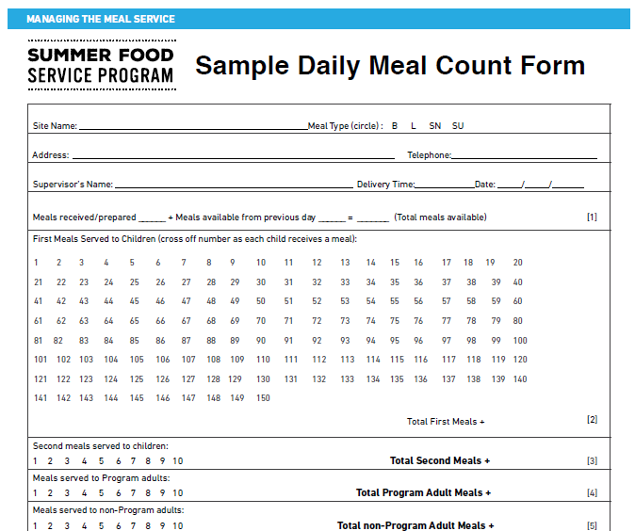
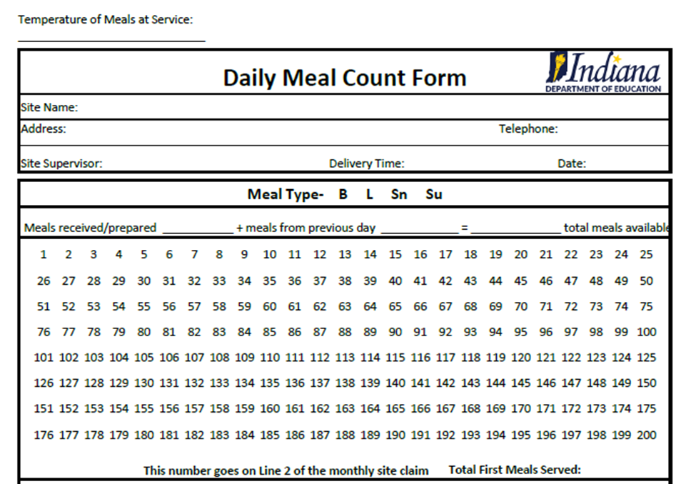
Let’s Review Meal Counting Form
Each site is required to use the USDA daily meal count form or one of the IDOE pre-approved daily meal count forms. Make sure to complete all the sections of this form!

Slide 26
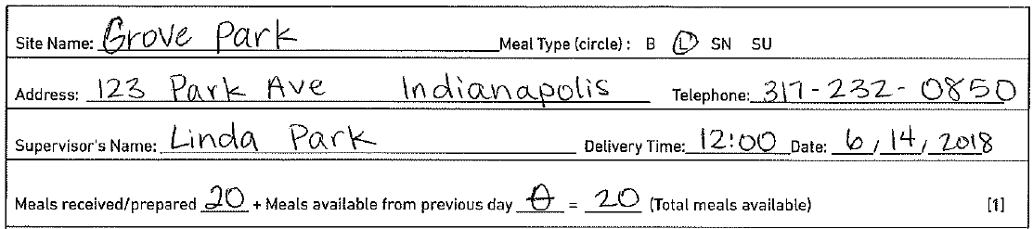
Meal Count Form
This should be the address of the site, not the sponsor! This is the same address as listed in CNPweb!
Phone number for the site, not sponsor.
Site name is important!! This and the address can be pre-filled for ease of use.
Meal Type is required for claiming!
2026
The site supervisor for the day must be listed. This person must be trained in Site Supervisor Responsibilities! A trained site supervisor must always be present!
The number of meals available must be completed on a daily basis. If you claim more meals than the number here, the extra meals may be disallowed by IDOE.
Delivery time and date are important to ensure food safety!!

Slide 27
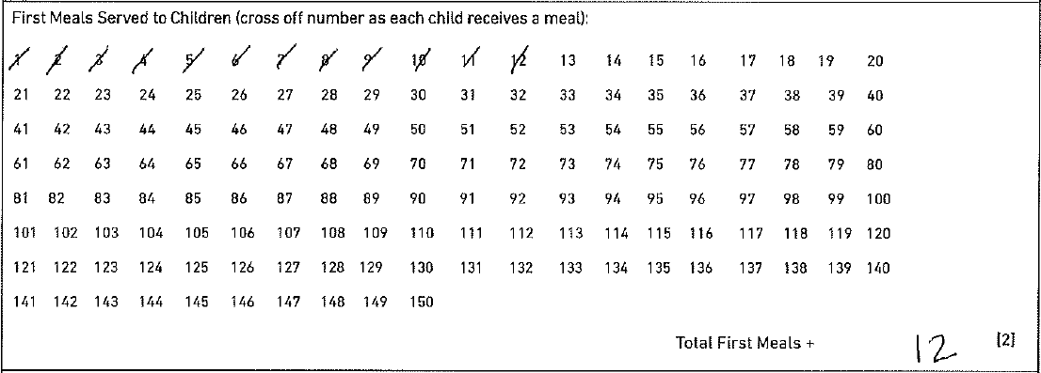
Meal Count Form
Only first meals served to children are counted in this section. Meals must be counted individually. No lines through all the numbers, no circle of the final number! Each meal must be counted individually!
The total number of meals served must be included and match the number of individual meal count marks!

Slide 28
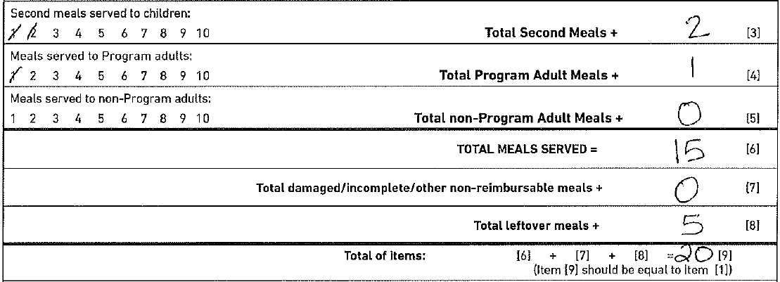
Meal Count Form
Individual meal counting is still required. All these must be complete meals, not just one component or leftovers.
Totals matching the meal counts must be listed.
Total all meals served and left over meals and add to get the number of meals available for the day.
This total should be the number of meals you listed as available for the day!!!

Slide 29
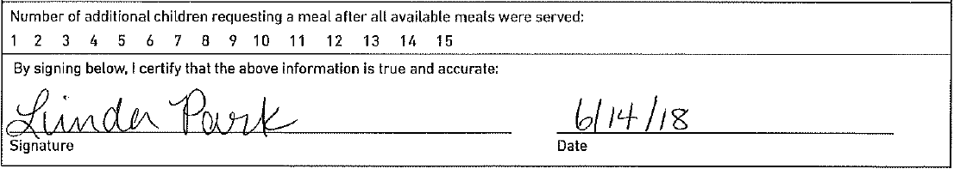
Meal Count Form
Count meals here if: you served all available meals prior to the end of the meal service time and there are additional children requesting a meal. Count the total number of kids up to the end of the approved meal service time.
6/14/2026
Signature and Date are REQUIRED. The form should be signed by the person counting meals on the day of meal service. The person counting meals should not sign to site supervisor’s name in this line, they should sign their name on the line. The sponsor may require the site supervisor to also sign off of the meal count form if they desire.

Slide 30
Meal Count Form
Meals will be disallowed by the IDOE if meal count records are not complete.
Examples of disallowances may include:
Meals are not counted individually: one line through many numbers or one mark on the final meal count would indicate meals are not marked individually
Missing required information such as total number of meals available, not dated or missing signature
More meals were claimed than the number of meals available
Exact same meal counts repeat daily with no variation

Slide 31

Meal Counting Questions?
Since this is a critical aspect of SFSP and is directly related to program reimbursement, please make sure you understand all the requirements.
Ask questions!

Slide 32
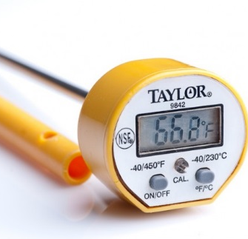
Food Safety
It is critical that food is kept at food safe temperatures during the hot summer months
Sites may utilize Time or Temperature Control
Whether using time or temperature to control bacteria growth, documentation must be kept to demonstrate proper food safety practices
In the event of a food borne illness outbreak, the health department will ask to see documentation that proper food safety controls were established and followed during the SFSP operation

Slide 33

Food Safety
Time as a control:
When using time control, food may be taken out of temperature holding (hot or cold) for up to 4 hours prior to service. Once the 4 hour time limit has been reached, all food items must be discarded.
When using this method, sites must document what time food was taken out of temperature control and what time the items were discarded.
Keep in mind if opting to utilize this method, that participants are more likely to eat food items kept at their ideal temperature. Kids don’t like warm milk!

Slide 34
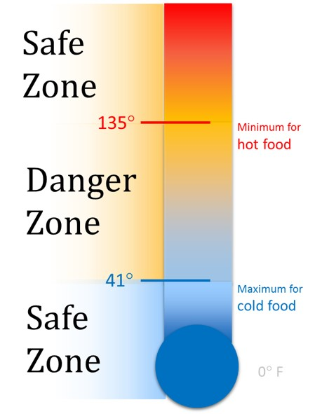
Food Safety
When utilizing temperature as a control, document that food is maintained at proper temperature:
Cold items: below 41 degrees
Hot items: 135 degrees or above
Proper equipment must be in place - steam tables or chafing dishes for hot items and coolers and ice packs or cold tables for cold items
Sites must document the receiving temperature as well as hot or cold holding temperatures for all items being served
A temperature log is required, and thermometers must be used at the site level to document proper holding temperatures.

Slide 35

Food Safety
If all meal items are packaged and placed into bags in the central kitchen and site staff only hand out a bag and milk carton, the requirement may not be applicable
Be mindful of surroundings- if the wind is blowing grass or dust into the meal service area, shield food from the debris so it does not contaminate your food items
Hairnets and gloves must be worn by staff serving open food items

Slide 36
Daily Site Reminders
Meal service area should be inspected daily, free from garbage and safe for children
Greet children with a smile and “How are you today?”
All meals served must contain all the required food components
Count meals individually as children go through the line
Clean up the meal service area and throw away all trash
Ensure children have enough time to finish eating before leaving the site
If in doubt, ask the site supervisor!

Slide 37



Questions?
Any questions about meal service or general program compliance?

Slide 38
Civil Rights
Civil Rights help to ensure that all program participants are treated fairly and that benefits are equally accessible to all participants
Discrimination occurs when a person or groups of people are treated unequally
Discrimination may be intentional or unintentional
The protected classes in child nutrition programs include Race, Color, National Origin, Age, Sex, and Disability
All participants should be treated the same

Slide 39

Civil Rights
Civil Rights Laws require:
Equal treatment for everyone
Equal access to all programs and activities
Elimination of barriers that prevent or deter people from receiving benefits
Dignity and respect for all
Ensure that discrimination, prejudice and stereotyping do not exist
Knowledge of both rights and responsibilities

Slide 40

Civil Rights
Who is responsible for Civil Rights compliance?
Is Civil Rights training required annually for all staff and program volunteers?
The correct answer is YES!

Slide 41
Civil Rights
Non-discrimination statements must be included on all materials sent to households in reference to any child nutrition program.
Contact your SFSP director for the correct statement to be included on all your resource materials, including social media pages.
Before sending out any flyers or informational papers, ensure that the non-discrimination statement is included!
Camp Sponsors: The statement should be included on any application with the potential participants and their households!

Slide 42
Civil Rights
Is there a need to communicate to participants a language other than English?
If yes, please ensure that all program materials are provided in all languages necessary to fully communicate with your participating households
The IDOE has no Civil Rights posters for distribution at this time. ☹

Slide 43
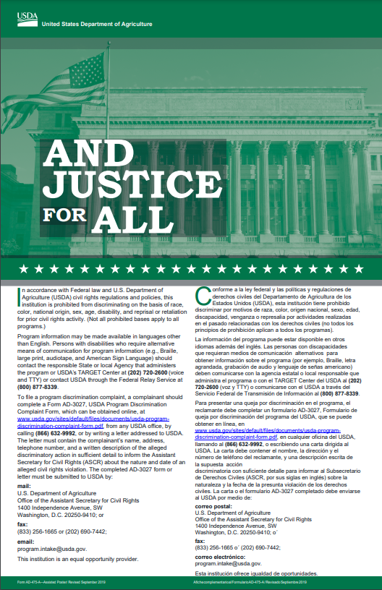
Civil Rights
The “And Justice for All” poster must be visible to program participants at every SFSP meal service site
Utilize the full 11x17 inch size posters
If print options are limited, smaller, 8.5 x11’ and black & white copies may be acceptable
Print more posters from the IDOE Civil Rights website

Slide 44
Civil Rights
A part of the Civil Rights compliance requirement is completing the Racial/Ethnic Data form
Annual data collection must be completed by sponsor staff for each site, but may not be collected using visual observation
Sponsors can use school data or county demographic information for completing the form or county data found on STATS America webpage
If SFSP information is listed on agency website, a direct link to the Civil Rights page must be included on sponsor webpage

Slide 45
Civil Rights Complaints
It is a basic right for individuals to file a civil rights complaint at any time
Complaints may be given verbally or in writing
Complaints may be given anonymously
Complaints may be filed at any time up to 6 months after the incident has occurred
Complaints must be logged correctly and reported to either the USDA office of Civil Rights or to the IDOE

Slide 46
Civil Rights
Information to be collected when processing a civil rights complaint:
Who: Contact Information of Complainant
What: Description of Incident(s)
When: Date of the Incident
Where: Location of Occurrence
Who Else: Possible Witnesses
Next, contact your SFSP Director!

Slide 47
Civil Rights
Everyone has a responsibility to ensure all people are treated equally
Civil Rights complaints are to be taken seriously
All complaints must be reported to the USDA, whether considered valid or not
Report the complaint as it was described to you, if it is a verbal complaint

Slide 48
Civil Rights
Meal Substitutions
Meal substitutions must be made for students with an allergy or disability
If a substitution can be made within the meal pattern it does not require a note by a medical authority
For example: A child states that they are lactose intolerant, and soy milk is available. No doctor’s note is required, but it can be requested to make sure the most appropriate substitution is provided.
Substitutions made with a doctor’s note must follow what the documentation says, and substitutions are allowable outside of the meal pattern
For example: The note states the child is allergic to milk and soy, so juice should be substituted at lunch. As long as the note is signed by someone with prescriptive authority, the meal pattern change is authorized. Keep the doctor’s note available for review by State Agency field specialist.

Slide 49

Site Supervisor Training
All site staff who will not be site supervisors or monitors may be dismissed at this time.

Slide 50
Site Supervisor
What is a site supervisor’s role?
To ensure meal compliance for each meal service under your authority
Serve meals to all children who come to the site according to the approved site information sheet
Provide excellent customer service to all participants and caregivers treating everyone with kindness
As a trained site supervisor, it is your responsibility to be present during each meal service by observing actual meal service the entire service period

Slide 51

Site Supervisor
Responsibilities
Ensure each meal served is reimbursable
Maintain meal count documentation
Maintain meal pattern compliance documentation
Maintain delivery receipts as needed
Communicate with Sponsor about meal delivery changes
Ensure food safety
Ensure civil rights compliance
Inform your SFSP director of the need for a change in meal service time or meal type
Submit all appropriate documentation to the central office on a daily/weekly basis
Keep your site looking clean and safe

Slide 52
Managing Reimbursable Meal Service
Each child must be offered the minimum required components according to the meal pattern
Each meal claimed must contain the minimum required items according to the approved service method
At congregate sites, each meal claimed must be eaten on site
Children should be served before adults
Only meals served to children may be claimed for reimbursement, all other meals must be documented in the correct section of the daily meal count form

Slide 53
Maintaining Meal Count Documentation
Ensure
Ensure all meals are counted at the point of service
Ensure
Ensure there is one person designated to count meals on each meal service line
Ensure
Ensure the person counting meals is trained in how to complete the daily meal count form
Review
Review all meal count sheets for accuracy and entirety

Slide 54
Maintain Meal Pattern Compliance Documentation
Keep recipes and CN labels for items served
Each site must track what is offered in a meal by maintaining:
A Detailed Menu with serving sizes
and/or
Production Record - completed for each meal
Substitutions must be documented every time they are made
Discuss with the Program Director how to properly maintain menu documentation

Slide 55
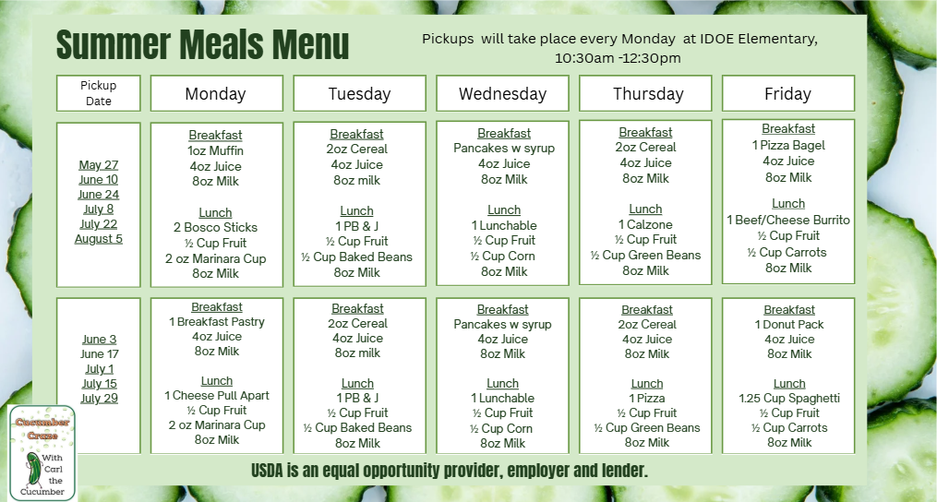
Menu Example for RNC Multi-Day Distribution Site
Menu lists all items offered and the exact serving sizes

Slide 56
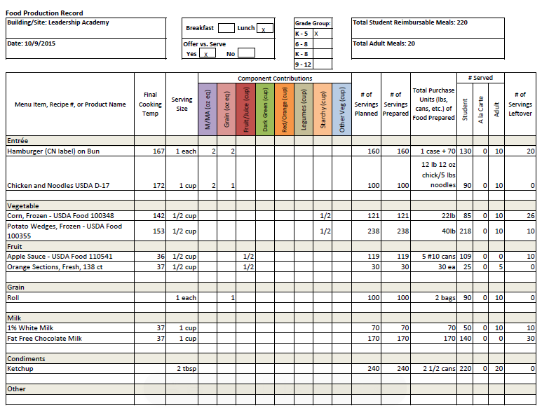
Production Record Example

Slide 57
Maintain Delivery Receipts
If serving vended meals, the vendor must provide documentation of how many meals are delivered
Meal delivery slips may be maintained at the sponsor level, however, a daily sign off or delivery confirmation slip of how many meals were delivered at each site should be standard practice at the site level
If receiving raw or fresh foods, maintain delivery receipts and invoices
Check to ensure food is delivered at proper temperature and in good condition

Slide 58
Communicate Meal Delivery Changes
Sponsors insert here how meal delivery changes should be handled:
Who should site staff contact with questions?
Is there a phone number or email?
Is there a cut-off time?
Do they need to notify more than one person?

Slide 59
Food Safety is Critical
Make sure all employees are following food safe practices
Make sure that Standard Operating Procedures are followed as outlined in the sponsor/site food safety plan
Food must be stored at proper temperatures
Food temperatures must be taken during meal preparation and at service time and recorded in the correct temperature logs
OR if using time as a control, document the time items have been out of temperature control and then discarded

Slide 60

Ensure Civil Rights Compliance
Maintain an operation that allows equal access for all participants
Treat all families with courtesy
Require excellent customer service from all site staff
Place the “And Justice for All” poster in a visible spot during each meal service

Slide 61
Inform the SFSP Director of Changes
All meals must be served within the approved meal service time
Confirm with SFSP Director the approved meal service time
No site changes can be made without prior approval by the IDOE
Any need to change meal service time will usually take a few days to be approved. As a result, changes are typically not immediate
Field trips must be entered into the online system and approved by the IDOE in advance
Emergency situations (i.e. the breakdown of a delivery truck) should be communicated to the IDOE immediately

Slide 62
Submit all Required Documentation
Submit all required paperwork:
Daily Meal Count Forms
Proof of meal pattern compliance
Meal Count Consolidation Forms, if applicable
Meal Delivery Receipts (for vended meals)
Food invoices and delivery receipts
Milk delivery receipts
Sponsors: Please adjust this list based on the documents required from sites

Slide 63
Safety First!
Call
If staff feel unsafe or threatened at a site, call the police
Call
If children are unsafe or being threatened, call the police
Do
If a parent or other adult becomes agitated, do what the person is asking first and then explain the requirements
Call
If someone at the site continues to cause disruption, call the monitor or director
Most parents may not know the rules and just need a gentle reminder of the policies that must be followed
Try to explain the rules in a way that eases the tension and prioritizes everyone’s safety first

Slide 64
First Week Reminders
Communicate all the rules to each family and participant who eats at a site; post appropriate signage, if necessary
Ensure staff is following proper meal counting procedures
Confirm meals are served during the approved meal service time
Follow the planned menu - ensure the menu meets the minimum meal pattern requirements
Expect compliance with food safety requirements and excellence in customer service from all site staff
Create a fun and welcoming atmosphere

Slide 65
Communicating with Customers
Communicate SFSP rules to all participants and family members
Determine with your SFSP Director in advance how rule violations will be handled
Recommendations for dealing with parents eating child’s meal:
Slip a note to the parent explaining the rules
As the family is leaving, discreetly pull the parent aside to explain the rules
Post the rules in a visible location in the meal service area
Make a broad announcement to remind parents in attendance that they are not permitted to consume any portion of a child’s meal
Partner with a community organization to offer meals free of charge to non-program adults or sell adult meals

Slide 66

Engaging Kids
Greet and engage with kids! Ask how their day is going
Encourage children to try items that might be new or unfamiliar
Discuss local food items; share where these were grown/produced
Allow children enough time to finish their meal without being rushed
Sit and talk with kids while they are eating if time allows
Be mindful of how you talk about the food being served
Be a positive role model and brighten their day!

Slide 67

Site Supervisor Questions?

Slide 68

Sponsor Monitor Training
All sponsor monitors must be trained annually.
Link: SFSP Sponsor Monitor's Guide | Food and Nutrition Service
Make a Sponsor Monitor’s Guide available during this training for reference.

Slide 69
Role of the Monitor
The role of the sponsor’s monitor is to ensure full compliance of all SFSP regulations through sponsor self-monitoring visits.
The sponsor monitor must be independent of the day-to-day operations of the sites they monitor.
The sponsor monitor must be knowledgeable of all SFSP requirements and regulations and be able to objectively monitor sites, answer questions and provide training and technical assistance to site staff.

Slide 70
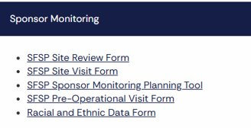
Monitoring Observations
Site Visit versus Site Review
The initial site operation observation is called a “visit.” The site visit within the first 2 weeks ensures that meal service operation is running smoothly and that any obvious errors are corrected immediately.
The 4-week observation is called a “review.” During the Site Review, the monitor will ensure that ALL areas of SFSP compliance are met. The Monitor must remain on site the entire length of service for the Site Review.
ATTENTION! Sponsors can find the 2026 monitoring forms on the SFSP webpage.

Slide 71
Monitor Job Responsibilities
Monitors are the link between the SFSP director and the site staff including Site Supervisor
Monitor all assigned sites within the required time frame
Pre-Operational Visits – Required for all new sites and sites with operating issues
Site Visits - Required within the first two weeks of site operations for all new sites and sites that had operational issues/findings previous year
4-week Site Reviews May complete at the same time as the Site Visits; must be completed for each site within the first 4 weeks, even if it lasts less than 4 weeks)
Conduct training as necessary for site staff
Ensure proper meal counting practices are followed and reconcile meal counts with the Site Supervisor
Conduct follow-up visits as needed

Slide 72
Monitor Job Responsibilities
Knowledge of meal pattern requirements in case site staff need to make changes to the planned menu or need menu planning assistance.
Understand meal counting requirements thoroughly enough to provide corrective technical assistance, as necessary.
Have a good understanding of food safety practices to be able to make suggestions when potential issues are noted.
Be able to provide Civil Rights training to site staff who may have missed training or who are newly hired.
BE ABLE TO NOTICE when meals are not eligible for reimbursement.

Slide 73
Monitor Reminder
Monitors need to ensure that any errors are noted on the review documentation and that corrective action or follow-up training has been conducted to ensure future compliance.
When the State agency reviewer observes that sites were monitored objectively with issues noted, it shows that problems are taken seriously, and errors corrected.
When monitoring reports completed by the sponsor’s monitor show that there were no errors, but State agency reviewer observes multiple errors, it shows that there may be a lack of objective monitoring and proper corrective action.

Slide 74
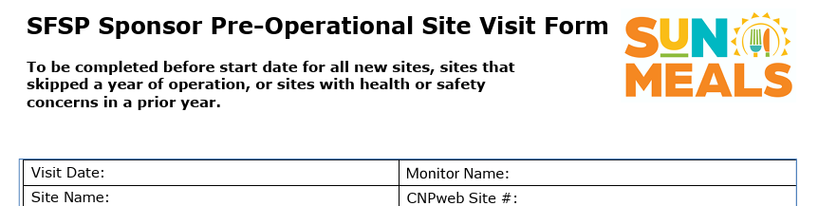
Pre-Operational Site Visit
Pre-operational visits are conducted for new sites and those that experienced operational problems the previous year before a site operates the summer program.
The visit should be conducted at the site to ensure accurate information is obtained through observation.
These visits are required to determine that the sites have the facilities to provide meal service
Sponsors: Please review the Pre-Operational Visit Form with Monitors to ensure understanding of how to complete the visit.

Slide 75
Site Visit – within the first 2 weeks
A Site Visit is required for all new sites, any returning site that skipped a year or sites that experienced operational problems in the prior year. (SFSP Policy 2023-1)
This visit is meant to look at the food service operation for general meal service compliance
There is some flexibility that monitors do not have to observe the entire length of meal service. However, best practice would be to stay the entire time to see all areas of compliance
Sponsors: Please review the Site Visit Form with Monitors to ensure understanding of form completion.

Slide 76
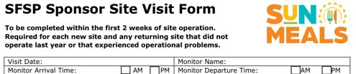
Site Visit – within the first 2 weeks
Critical items to check for accuracy and cross-check in CNPweb:
Site address & site supervisor’s name
Site type (open or closed) and operating dates
Meal types served & serving times. Field trips entered
Ensure sites are operating according to the site type. If the site is approved as open, site staff cannot prohibit public from entering the building. For example, if the program is a summer day camp but is listed as open site, any walk-in children must be welcomed and served a meal during the approved open service time.

Slide 77
Site Visit
Check to make sure the “And Justice for All” poster is visible to the public and the correct size
Inspect food safety practices
Observe meal counting procedures, making corrections if necessary
Determine if meals meet the meal pattern requirements for the type of meal served
Monitor if the site rules are enforced
Are children staying on site to eat their meals? Are adults aware they cannot eat off a child’s plate? Are Site Rules utilized or posted? Are share table items available only to children?

Slide 78
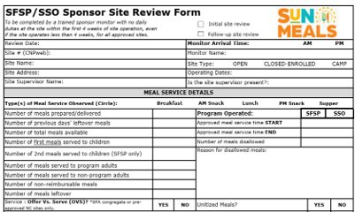
Site Review - within the first 4 weeks
The Site Review is to be conducted within the first four weeks of site operation.
The Site Review looks at all areas of SFSP compliance, not just meal service.
Note that the Site Review form is a multi-page document!!
Sponsors: Please review the Site Review form to ensure understanding of completion.

Slide 79
Site Review Reminders
Answer all question on the Site Review form completely.
Stay for the entire length of meal service for the meal observed.
Record all errors, including details to check if follow up is needed.
Describe corrective action to be applied and the implementation timeline.
Conduct a follow-up review as needed.

Slide 80
Completion of the Site Review Form
Complete all the requested information.
Monitor must remain on site for the entire meal service period.
Monitors are only required to observe one of the approved meal types offered at the site but can observe more as needed.
ADP can be determined by looking at the past 5 days of participation and then averaging the daily participation. Inquire more information if attendance is significantly lower during the day of review or if any other unusual attendance patterns are discovered.
Check if the ADP listed in the CNPweb accurately reflects the actual site attendance and make corrections as needed.

Slide 81
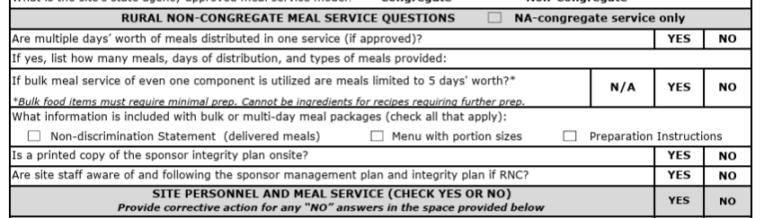
Completion of the Site Review Form
Complete each of the box on the form based on the type of meal service and meal observed.

Slide 82
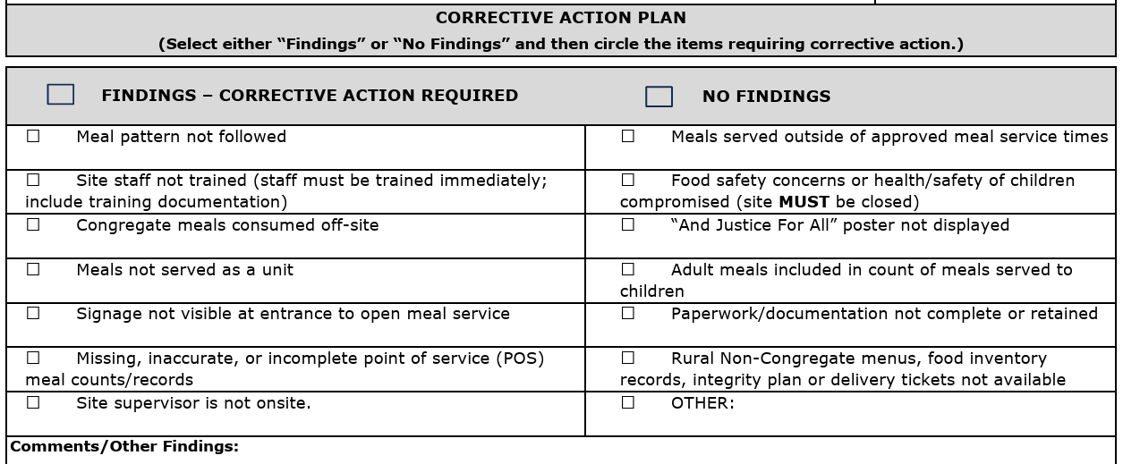
Completion of the Site Review Form
Answer the questions honestly.
Any discrepancies or non-compliance should be documented in writing with corrective action described.
Any questions where the answer may be “not applicable” write “n/a”. Explain any “no” answers as that will describe any errors in compliance.

Slide 83
Completion of the Site Review Form
Note that there are only a few short questions about food safety. However, it is important that Monitor ensures proper food safety practices are followed and report any discrepancies.
Proper food safety practices include:
Taking temperatures or checking the time prior to serving meals
Determination of either the time or temperature is reported on the proper log
Wearing hair coverings and gloves when needed
Keeping coolers and milk cases closed when not serving meals
If preparing meals on site, are dishes clean and sanitized properly?
Are cooler or hot holding unit temperatures taken?
If serving outside, is the food service area safe and free from debris?

Slide 84
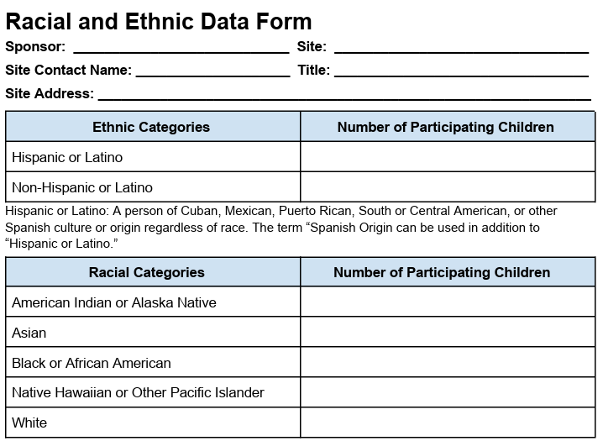
Complete Racial & Ethnic form with Site Review
The sponsor should complete this form for each site under its jurisdiction each year. Sponsors of residential camps must collect this information for each camp session. For all other sites, the sponsor must count the participating children at least once during the site’s operation.

Slide 85
Racial & Ethnic Data
The sponsor must retain racial and ethnic data as well as documentation for the data for 3 years plus the current program year.
Sponsor must safeguard this information to prevent its use for discriminatory purposes.
Access to Program records containing racial and ethnic data should be limited to authorized personnel.

Slide 86

Completion of the Site Review Form
If additional space is needed to list corrective action or issues noted, use additional sheet of paper to further explain.
List all areas of non-compliance and create a corrective action plan (CAP)
Conduct a follow-up review for all sites where non-compliance was observed.

Slide 87

Follow-up Review
Complete the Site Review form again.
Ensure all areas of non-compliance have been corrected and meal service is running smoothly.
Note on the review form how issues found in the last review have been corrected or if additional corrective action is needed.

Slide 88
Record Keeping
Sponsors: Insert on this slide the record keeping procedures for the program Monitors to follow:
Where are review forms submitted?
To whom are issues reported to?
How are follow-up reviews and corrective action planned?
Who will conduct follow-up reviews, if necessary?

Slide 89
Planning Your Reviews
It is important to schedule site visits & reviews in advance to ensure enough time to complete the reviews.
Helpful Hint: Put together a calendar (either paper or electronic) where all sites are listed, the site reviews required for each site, and due dates for completion during the summer.
First, list the operating dates of all the sites to visit and highlight all the new sites and sites with operational issues last year.
Helpful Hint: There is a report that your Director can attain from CNPweb that lists all sites under your sponsorship with operating information included! Also, the monitor can use this report to double check site operations for accuracy.

Slide 90
Planning Your Reviews
List all the Pre-Op and first 2- week visits that need to be conducted on the calendar. This will help to see if there is enough time to conduct all that is required.
Then, list all the Site Reviews (one for each site!) that need to be completed within the first 4 weeks of each site operation.
Plan pop-in site visits for sites throughout the program operation. Keep tabs on how sites are doing throughout the summer to ensure continued compliance.
Inform site staff of a possibility of unannounced site visit(s) by the USDA or State Agency reviewer(s).
Don’t forget when planning visits and reviews that multiple could possibly be completed in one day - visit a breakfast at one site & lunch at another. Remember to consider travel time to be able to observe the whole meal service!

Slide 91

Non-Congregate Meal Service
Each sponsor approved to operate rural non-congregate (NC) meal service, is required to train administrative and site personnel prior to the start of NC site operations.
Rural non-congregate meal service is a permanent addition to the federal program legislation called the SFSP Final Rule.

Slide 92
Meal Distribution Methods
The USDA has authorized the following NC meal distribution methods:
Parent/Guardian Meal Pick Up - Meals are picked up by parents or guardians. Meals are packaged and taken home for children to eat.
Home Delivery – Meals are packaged and delivered directly to homes. Written (digital, electronic or paper) household consent is required and must be available at the site/on the route.
Meal Delivery via Direct Shipment - Meals are shipped directly to the eligible households.

Slide 93
Non-Congregate Meal Service Requirements
The following requirements must be fulfilled when conducting NC meal service:
Food components for each reimbursable meal must meet meal pattern requirements
All food items that contribute to a reimbursable meal must be clearly identifiable
Menus, food storage and meal preparation instructions are included with each meal distribution
Food preparation is minimal
Reasonable modifications are made to accommodate participants with disabilities

Slide 94
Other NC Meal Service Reminders
Meal distribution times approved in CNPweb must be followed and any changes approved by the State agency prior to a change taking effect locally.
SFAs may only use OVS option and must be pre-approved by the State Agency. The OVS training must be completed unless following the NSLP/SBP meal pattern (see SFSP website for OVS Training PP).
Breakfast served at lunch or later during the day, is considered breakfast for the next morning.
Second meals are not allowed to be distributed at NC sites.

Slide 95
Non-Congregate Meal Service Integrity Plan
Along with menus, each sponsor operating NC meal service submits an Integrity Plan (Part A & B) to State agency to demonstrate compliance with federal regulations.
Integrity Plan purpose is to establish local policies and procedures that ensure program compliance and integrity.
State agency approved sponsor Integrity Plan must ensure there will be no duplication of meal benefits to the participants, including limiting meals to a maximum of 2 different meal types per day per participant.

Slide 96
Local Integrity Plan Overview
During the training, discuss with staff all aspects of Integrity Plan
Sponsors, you may list potential discussion topics below:
Suggested discussion points:
Implementation of the approved distribution method: It is critical that staff understands and follows the requirements associated with the specific meal distribution method.
Potential revisions to the Integrity Plan: If revisions are necessary, how is this communicated? Should staff contact program Director directly?
Maintain a copy of the Integrity Plan on site: Where will it be kept for easy staff access? A reviewer may ask for this during a site visit.

Slide 97
Integrity Plan Overview Continued:
Suggested discussion points continued:
Program integrity: What is the process for addressing integrity concerns that may surface after the start of site operations?
Civil Rights compliance: How is meal service announced and promoted in the community? How is equal treatment of everybody ensured?
Accurate meal counting: Consider questions such as: A procedure to be followed when a participant requests less meals than the typical number of meals being distributed?

Slide 98
Integrity Plan Overview Continued:
Suggested discussion points continued:
Inclement weather plan: Any changes when distribution occurs outdoors
Flow of traffic and participant safety: Consider all safety aspects while ensuring smooth distribution line; hold a practice pick-up run through
Meal distribution options: Discuss guidelines to be followed for the daily, multi-day, or bulk meal distribution
Attention! FSMC operated sponsors are not allowed to serve bulk meals as all meals served must be unitized.

Slide 99

Any lingering questions about meal service
this summer? Let’s discuss it now!

