Slide 1
HEA 1009 & HEA 1167 Frequently Asked Questions
Presented by:
Ryan Burke
Budget Field Representative
Phone: (317) 232-3777

Slide 2
Purpose of Today’s Presentation
Today we will clarify the following frequently asked questions:
How will the transition to the new funds work in Gateway?
Form 1 – Where are my line items?
How do I show transfers to be made in 2019?
Is the calculation for the Capital Projects Fund’s December Settlement changing?
Is it true that Excise, CVET, FIT, and LIT revenues can only be deposited in Operations?
Do I need to advertise anything in the newspaper?
Bus Replacement and Capital Projects plans – What is required?
What needs to be submitted?

Slide 3
FAQ #1: Transition in Gateway
How does the transition into the new Education and Operations funds work in Gateway?
The Budget application has replaced the previous funds with the funds to be used in 2019.
In place of the General fund, you will now see the Education fund.
The Operations fund in Gateway replaces the following funds: Capital Projects, Transportation, Bus Replacement, Art Association, Historical Society, Public Playground, and Racial Balance.

Slide 4
FAQ #1: Transition in Gateway
The General fund’s amounts will be entered in Gateway through the Education fund.
General Fund’s Amounts
Current Year Financial Worksheet
Form 2 Revenue Estimates Column A (Last half of 2018)
Entered into Gateway’s Education Fund
Current Year Financial Worksheet
Form 2 Revenue Estimates Column A (Last half of 2018)

Slide 5
FAQ #1: Transition in Gateway
The Operations fund’s fields will be a total of the funds being replaced by it in the following forms:
Current Year Financial Worksheet.
Form 2 revenues for the last 6 months of 2018.
Transportation
Bus Replacement
Capital Projects
Art Association
Historical Society
Public Playground
Racial Balance
Total all Funds’
CYFW fields
Form 2 Column A revenue estimates
Enter totals into the Operations Fund’s
CYFW & Form 2

Slide 6
FAQ #1: Transition in Gateway
An Excel worksheet will be released that assists schools in totaling their CYFW amounts.
The CYFW fields will be entered for each of the funds that are being replaced by the Operations fund and a summary column will provide the totaled amounts to be entered in Gateway.
Schools are to submit the completed worksheet along with their budget documents.

Slide 7
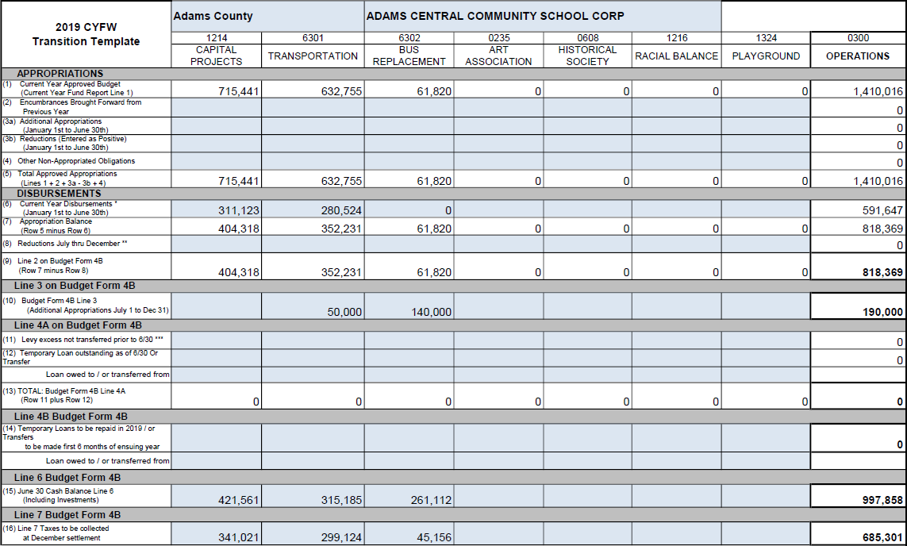
FAQ #1: Transition in Gateway

Slide 8
FAQ #2: Form 1 Line Items
My Form 1 line items didn’t rollover from last year to the Education and Operations funds. How can I restore these values?
Some expenditures will be paid from a different fund in 2019.
The DLGF issued a memo and waiver on June 6 that describes a possible rollover option. If desired, the waiver can be signed and returned.
By completing the form, the school acknowledges they are responsible for ensuring the line items are entered correctly pursuant to HEA 1009 and HEA 1167.

Slide 9
FAQ #2: Form 1 Line Items
Once submitted, all departments (program accounts) and unique line items from 2018 will be rolled over into Education and Operations funds.
Schools also have the option to manually enter their Form 1 or populate it with an upload from their software vendor.
All Departments and Lines Items will be combined for funds being replaced.
Excluding duplicates, these will all be populated into their respective new funds.
Schools are responsible for changing line items pursuant to HEA 1009 and HEA 1167.

Slide 10
FAQ #3: Transfers in 2019
How should I show anticipated transfers between funds in 2019?
Form 4B has had “Line 1A – School Transfer Out” added.
This will allow schools to show their ensuing year transfers between the Education and Operations fund in a dedicated field.
If planning for a transfer, please show the money leaving the fund on Line 1A and show the revenue coming into the fund as a Transfer In on Form 2.
Please provide a resolution approving the anticipated transfer to your Budget Field Rep when submitting your budget documents.

Slide 11
FAQ #3: Transfers in 2019
Example: $200,000 transfer from Operations to Educations
Form 4B: Financial Statement
Form 2: Estimates of Miscellaneous Revenues

Slide 12
FAQ #3 Transfers in 2019
New transfer revenue codes have been added to show more detailed transfers.
5201 – 5206 revenue codes don’t take effect until 2019, so Gateway only allows for data entry in column B of Form 2.
The 12/31/18 year-end transfers into the new funds are not to be included.
Revenue Codes | Revenue Descriptions
5200 | Transfers from One Fund to Another
5201 | Transfers from Operations to Education
5202 | Transfers from Operations to Rainy Day
5203 | Transfers from Educations to Operations
5204 | Transfers from Education to Rainy Day
5205 | Transfers from Rainy Day to Operations
5206 | Transfers from Rainy Day to Educations

Slide 13
FAQ #4: Capital Projects Line 7
Is the calculation for Capital Projects Fund’s Line 7: December property tax settlement changing?
Yes. Being a needs driven fund, it was previously calculated in the same manner as a Debt Service fund that does not take into account circuit breaker losses. The calculation can be seen below.
Certified Levy Method
Certified Levy
- June Settlement
= Estimated December Settlement

Slide 14
FAQ #4: Capital Projects Line 7
The December Settlement for 2018 will now be calculated in the same manner as all non-debt and non-exempt funds. The estimate to be used is the lesser of the two calculations below.
The levy and circuit breaker information can be found on the 2018 Circuit Breaker Reports that are available at: www.in.gov/dlgf/9644.
Certified Levy Method
Certified Levy
- June Settlement
= Estimated December Settlement
Post Circuit Breaker Abstract Levy Method
Abstract Levy
-Total Circuit Breaker loss
- June Settlement
= Estimated December Settlement

Slide 15
FAQ #4: Capital Projects Line 7
Below is an example of a school’s Circuit Breaker Report for CPF and the calculations that follow.
Fund Name | Certified Levy | Levy Based on Abstract AV | Over 65 Circuit Breaker | 1%/2%/3% Circuit Breaker | Total Circuit Breaker
Capital Projects | $1,650,000 | $1,600,000 | $2,000 | $148,000 | $150,000
Certified Levy Method
2018 Certified CPF Levy | $1,650,000
- June Settlement | $800,000
= Dec Estimate | $850,000
Post CB Abstract Levy Method
2018 Abstract CPF Levy | $1,600,000
- Total CB | $150,000
- June Settlement | $800,000
= Dec Estimate | $650,000
$650,000 is the lesser value and is to be entered on the school’s worksheet for Capital Project Fund’s December Settlement.

Slide 16
FAQ #5 : Miscellaneous Revenues
Is it true that according to IC 20-40-18-2(a)(2), Excise, FIT, CVET, and LIT revenues can only be deposited in the Operations fund starting in 2019?
No. The DLGF and SBoA have concluded that these revenues will still be deposited in other funds that will continue to have a certified levy:
Debt Service
Pension Debt
Referendum Operating
Referendum Debt

Slide 17
FAQ #6: Newspaper Advertisements
What is required to be advertised in the newspaper?
The Bus Replacement and Capital Projects Notice to Taxpayers are required to be advertised in the newspaper, but the format has changed.
The Form 3: Notice to Taxpayers must be advertised online.

Slide 18
FAQ #6: Newspaper Advertisements
Capital Projects and Bus Replacement Advertisements
An excerpt from IC 20-40-18-6 and IC 20-40-18-9 states:
“The governing body shall publish a notice of the hearing in accordance with IC 5-3-1-2(b). The notice must include the address of the school corporation's Internet web site.”
Requires the publishing of the public hearing information and the website address where the school has posted its purposed Bus Replacement and Capital Projects plans.

Slide 19
FAQ #6: Newspaper Advertisements
Capital Projects and Bus Replacement Advertisements
Statute no longer requires the publication of detailed plan information in the newspaper
The Capital Projects and Bus Replacement Notice to Taxpayers are to be published once, at least 10 days before the public hearing.
The Capital Projects’ Notice of Adoption is not required by IC 20-40-18-6.
Bus Replacement continues to not require a Notice of Adoption.

Slide 20
FAQ #6: Newspaper Advertisements
Form 3: Notice to Taxpayers
No change in procedure for Pay 2019.
The advertisement of the Form 3: Notice to Taxpayers (lists budgets and levies for all funds) in the newspaper remains optional.
Ensure that the Form 3 is submitted in Gateway at least 10 days before the public hearing to fulfill online advertising requirements.

Slide 21
FAQ #7: Bus Replacement Plan Changes
What changes have been made to the Bus Replacement Plan?
IC 20-40-18-9
The plan format is prescribed by the DLGF and has been posted on the Memos and Presentations page (www.in.gov/dlgf/2444).
The memo was issued on May 11, 2018 and outlines this year’s procedure along with providing templates for the Notice to Taxpayers and Bus Replacement Plan.

Slide 22
FAQ #7: Bus Replacement Plan Changes
The plan now applies to at least the 5 budget years (previously 12) immediately following the year the plan is adopted (2019-2023).
A plan must be adopted before a school can replace any buses using money from the Operations fund.
The plan shall be posted on the school’s website.

Slide 23
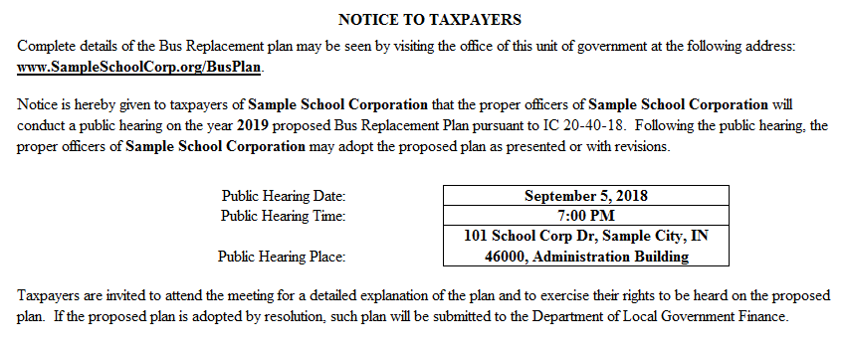
FAQ #7: Bus Replacement Plan Changes
The Notice to Taxpayers has a shortened version that can be used, but ensure that the website address is listed.
A detailed Notice to Taxpayers that largely resembles last year’s is also provided as an option, but it also must contain the website address.

Slide 24
FAQ #7: Capital Projects Plan Changes
What changes have been made to the Capital Projects Plan?
IC 20-40-18-6
New plan format prescribed by the DLGF and posted on Memos and Presentations page (www.in.gov/dlgf/2444)
The memo was issued on May 11, 2018 and outlines this year’s procedure along with providing templates for the Notice to Taxpayers and Capital Projects Plan.
The plan shall be posted on the school’s website.

Slide 25
FAQ #7: Capital Projects Plan Changes
The plan still applies to the 3 budget years immediately following the year the plan is adopted (2019-2021).
A plan must be adopted before a school can make any expenditures outlined in IC 20-40-18-7 from the Operations fund.

Slide 26
FAQ #7: Capital Projects Plan Changes
The plan is to include the amount of property taxes to be collected in the upcoming calendar year and retained in the fund for capital expenditures proposed for a later year.
Plans must contain a listing of all proposed expenditures that exceed $10,000 and are for:
Capital assets; or
Projects that are considered capital in nature including technology related projects.
The Capital Projects plan is only to include expenditures from the Operations fund.

Slide 27
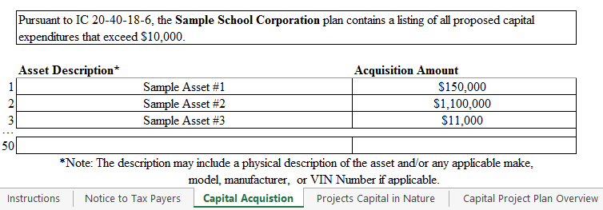
FAQ #7: Capital Projects Plan Changes
The Capital Projects Plan must contain the following tabs of the Department’s provided template:
Capital Acquisition
List of assets exceeding $10,000 to be purchased along with their estimated cost.

Slide 28
FAQ #7: Capital Projects Plan Changes
The Capital Projects Plan must contain the following tabs of the Department’s provided template:
Projects Capital in Nature
List of projects along with their estimated start date, end date and cost.

Slide 29
FAQ #7: Capital Projects Plan Changes
In order to help promote transparency and consistency, the Capital Projects Plan may also contain the following tabs of the template:
Capital Projects Plan Overview
Site 1 -5
Site Summary

Slide 30
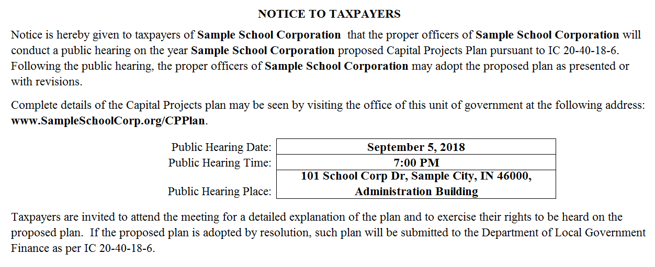
FAQ #7: Capital Projects Plan Changes
The Notice to Taxpayers is shortened compared to last year‘s and notifies the public of:
School’s website address where the plan is posted.
Date, time, and location of the public hearing.

Slide 31
Bus Replacement and Capital Projects Flow Chart
Post Plans on School’s Website
Advertise Notice (including website address) in the Newspaper
Hold the Public Hearing
Adopt the Plans
Submit Resolutions Approving the Plans

Slide 32
FAQ #8 : Should these be Submitted?
Please see the revised school checklist for the full list of required documents. This checklist will be released shortly.
Document | Required?
Signed resolutions approving the Bus Replacement and Capital Projects Plans | Yes
Signed resolution(s) approving transfers and/or anticipated transfers from July 1, 2018 – December 31, 2019 Not including the initial December 31 transfers into the newly established Education and Operations funds | Yes
Current Year Financial Worksheet Transition Template | Yes
Bus Replacement and Capital Projects Plans | No
Notice to Taxpayers: Proof of Publications | No
Pension Neutrality resolution | No

Slide 33
Contact the Department
Telephone: (317) 232-3777
Toll Free: (888) 739-9826
Gateway Support: gateway@dlgf.in.gov
Additional Appropriation email:
AdditionalAppropriationRequests@dlgf.in.gov
Website: www.in.gov/dlgf
“Contact Us”: www.in.gov/dlgf/2338.htm
Budget Field Representative Map: http://www.in.gov/dlgf/files/Field_Rep_Map_-_Budget.pdf

Slide 34
Budget Field Staff
County assignments can be found at: www.in.gov/dlgf/files/Field_Rep_Map_-_Budget.pdf.
Miranda Bucy
Ryan Burke
Kim Chattin
George Helton
Wayne Hudson
Vicky Neeley
Robert Norris
Kurt Ott
Dawn Ray
Judy Robertson
Michelle Rogers
Heather Witsman
(317) 650-6848
(317) 719-3546
(317) 650-6157
(317) 650-5254
(317) 650-4444
(317) 607-7524
(317) 650-3932
(317) 650-2497
(317) 677-2667
(317) 650-2508
(317) 447-2941
(317) 694-3017
mbucy@dlgf.in.gov
rburke@dlgf.in.gov
kchattin@dlgf.in.gov
ghelton@dlgf.in.gov
whudson@dlgf.in.gov
vneeley@dlgf.in.gov
robnorris@dlgf.IN.gov
kott@dlgf.in.gov
dray@dlgf.in.gov
jrobertson@dlgf.in.gov
mrogers@dlgf.in.gov
hwitsman@dlgf.in.gov

