Slide 1
Epinephrine Auto-Injector Training for Emergency Medical Responders
Developed by EMS Commission Technical Advisory Committee (TAC)

Slide 2
Objectives
After completing this training program, participants will be able to:
Identify the common causes of allergic reactions.
Identify signs and symptoms of severe allergic reactions (anaphylaxis), and their differences from other medical emergencies.
Identify the steps for administration of epinephrine by auto-injector.
Enumerate acceptable methods for safely storing, handling, and disposing of the auto-injector.
Verbalize an understanding of safety issues when using an Epi Pen including before and after administration issues.
Demonstrate knowledge of the conditions under which Certified Indiana EMR individuals’ services can possess and use the epinephrine auto injector.

Slide 3
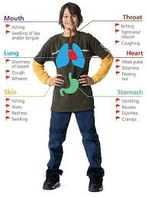
Signs and Symptoms
Presentation of symptoms
Notes:
Allergic reactions can present in many different forms, and can range from watery eyes and runny nose, to severe respiratory problems and hypotension.

Slide 4
Allergic Reactions
An allergic reaction is defined as an exaggerated response of the body to a foreign substance, known as an allergen, that is trying to neutralize or get rid of that substance.
Most allergic reactions are unpleasant, and relatively harmless, but others can be more serious, even life threatening. These more serious reactions are referred to as Anaphylaxis.
Allergic reactions can be unpredictable.
Notes:
An allergic reaction is defined as an exaggerated response of the body to a foreign substance, known as an allergen, that is trying to neutralize or get rid of that substance.
Most allergic reactions are unpleasant, and relatively harmless, but others can be more serious, even life threatening. These more serious reactions are referred to as Anaphylaxis.
Allergic reactions can be unpredictable.

Slide 5
Anaphylaxis
Anaphylaxis is a result of exposure to an allergen, which causes a rapid dilation of blood vessels, and can cause hypotension.
It will also swell respiratory tissues, causing constriction of airways and can even cause full airway obstruction.
Notes:
Anaphylaxis is a result of exposure to an allergen, which causes a rapid dilation of blood vessels, and can cause hypotension.
It will also swell respiratory tissues, causing constriction of airways and can even cause full airway obstruction.

Slide 6
Anaphylaxis
People do not have reactions the first time they are exposed to an allergen.
The body forms antibodies to fight the allergen.
After subsequent exposures, antibodies combine with the allergen to produce the allergic response.
Notes:
Antibodies are proteins that are produced by the body to fight the intrusion of foreign molecules, such as toxins or other poisons. The antibodies are designed to bind very tightly to their target molecules.

Slide 7
Anaphylactic Shock
Anaphylaxis or Anaphylactic Shock is a severe reaction to an allergen that can be fatal if not treated immediately.
Notes:
Anaphylaxis or Anaphylactic Shock is a severe reaction to an allergen that can be fatal if not treated immediately.

Slide 8
Some Causes of Allergic Reactions
Insects
Foods
Plants
Medications
Miscellaneous
Notes:
Insects
Foods
Plants
Medications
Miscellaneous

Slide 9
Insects
Most common reactions come from stings from bees, wasps, yellow jackets and hornets.
Reaction can be rapid and severe due to the sting being quickly absorbed into the bloodstream.
Notes:
Most common reactions come from stings from bees, wasps, yellow jackets and hornets.
Reaction can be rapid and severe due to the sting being quickly absorbed into the bloodstream.

Slide 10
Food
The most common food allergies include nuts, eggs, milk and shellfish.
Peanut allergies are commonly more rapid and severe than other food allergies.
Normal food allergic reactions are generally slower onset than insect stings.
Notes:
The most common food allergies include nuts, eggs, milk and shellfish.
Peanut allergies are commonly more rapid and severe than other food allergies.
Normal food allergic reactions are generally slower onset than insect stings.

Slide 11
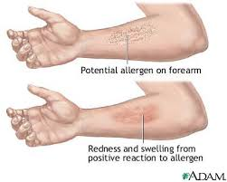
Plants
Probably the most common cause of allergy.
Contact with “poison” plants (ivy, oak, sumac), will cause allergic reactions, characterized by rashes.
Plant pollen is also a cause of allergies in many people.
Plant allergic reactions are rarely severe enough to be characterized as anaphylaxis.
Notes:
Contact with “poison” plants (ivy, oak, sumac), will cause allergic reactions, characterized by rashes.
Plant pollen is also a cause of allergies in many people.
Plant allergic reactions – while probably the most common form of allergy -- are rarely severe enough to be characterized as anaphylaxis.

Slide 12
Medications
Common medication allergies are to antibiotics, like penicillin or other meds like aspirin, ibuprofen, morphine, anticonvulsants, and chemotherapy to name a few.
People with penicillin allergies are usually allergic to related antibiotics as well.
Swelling or rash is the most usual reaction.
Swelling of the face, lips, gums or airway is most critical reaction.
Notes:
Common medication allergies are to antibiotics, like penicillin or other meds like aspirin, ibuprofen, morphine, anticonvulsants, and chemotherapy to name a few.
People with penicillin allergies are usually allergic to related antibiotics as well.
Swelling or rash is the most usual reaction.
Swelling of the face, lips, gums or airway is most critical reaction.

Slide 13
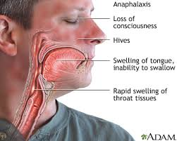
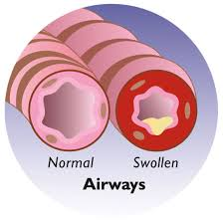
Medications
Medication allergies are usually not severe enough to be classified as anaphylaxis but there are some exceptions.
Allergies to medications can cause severe swelling of the tongue, lips and airway and pose potential breathing issues when they do.
Notes:
Medication allergies are usually not severe enough to be classified as anaphylaxis but there are some exceptions.
Allergies to medications can cause severe swelling of the tongue, lips and airway and pose potential breathing issues when they do.

Slide 14
Miscellaneous Allergens
There is a vast number of different substances to which people can potentially be allergic.
Dust, chemicals, make-up and soaps are common.
Many people, including EMS providers, are allergic to latex.
While these substances rarely cause anaphylaxis, it is still important to know when treating such patients.
Penicillin Reaction
Notes:
There is a vast number of different substances to which people can potentially be allergic.
Dust, chemicals, make-up and soaps are common.
Many people, including EMS providers, are allergic to latex.
While these substances rarely cause anaphylaxis, it is still important to know when treating such patients.

Slide 15
Physical Findings
HEENT Exam: Itchy and/or watery eyes, headache, runny nose dysphasia, larynx.
Skin: Swelling of face, lips, tongue, neck, or hands. Also itching, red, raised skin (hives), or cool, clammy skin and delayed cap refill (signs of hypoperfusion or shock).
Breathing: Coughing, rapid breathing, noisy breathing, change in voice, loss of voice, wheezing or stridor.
Breathing changes are sure signs of anaphylaxis.
Notes:
HEENT (which stands for Head, Eyes, Ears, Nose and Throat) Exam: Itchy and/or watery eyes, headache, runny nose dysphasia, larynx.
Skin: Swelling of face, lips, tongue, neck, or hands. Also itching, red, raised skin (hives), or cool, clammy skin and delayed cap refill (signs of hypoperfusion or shoock).
Breathing: Coughing, rapid breathing, noisy breathing, change in voice, loss of voice, wheezing or stridor.
Breathing changes are sure signs of anaphylaxis.

Slide 16
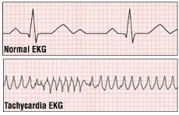
Physical Findings – Cont.
Heart: Tachycardia (rapid heart beat), hypotension,
Mentation: Altered Mental Status, either partial or full loss of consciousness.
Notes:
Heart: Tachycardia (rapid heart beat), hypotension,
Mentation: Altered Mental Status, either partial or full loss of consciousness.

Slide 17
The Epinephrine Auto-Injector
Definition: Liquid Medication administered by an automatically injecting needle and syringe system.
Medication Name
Generic: Epinephrine
Trade: Adrenalin ™
EpiPen® or EpiPen Jr. ® are brand names
Notes:
Definition: Liquid Medication administered by an automatically injecting needle and syringe system.
Medication Name
Generic: Epinephrine
Trade: Adrenalin ™
EpiPen® or EpiPen Jr. ® are brand names

Slide 18
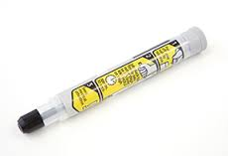
The Epinephrine Auto-Injector
Indications
Signs and symptoms of severe allergic reaction.
Epinephrine Auto-Injector is prescribed to patient by a doctor.
Medical Direction has been notified if the patient does not have a prescription for an auto injector.
Contraindications
None in a life threatening scenario.
Notes:
Indications
Signs and symptoms of severe allergic reaction.
Epinephrine Auto-Injector is prescribed to patient by a doctor.
Medical Direction has been notified if the patient does not have a prescription for an auto injector.
Contraindications
None in a life threatening scenario.

Slide 19
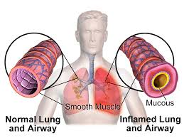
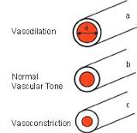
The Epinephrine Auto-Injector
An Auto-injection can reverse the reaction quickly
Action:
Bronchiodilation – Dilation of airways.
Vasoconstriction – constriction of blood vessels.
Notes:
An Auto-injection can reverse the reaction quickly
Action:
Bronchiodilation – Dilation of airways.
Vasoconstriction – constriction of blood vessels.

Slide 20
Epinephrine Auto-Injector Side Effects
Vomiting
Irregular or Fast Heart Beat
Breathing problems
Anxiety, Excitement
Sweating
Body tremors
Dizziness
Pallor
Nausea
Headache
Notes:
Some possible side effects of epinephrine are vomiting, irregular heartbeat, breathing problems, feeling anxious, sweating, body tremors, pale skin, dizziness and feeling extremely tired, as noted by Mayo Clinic. If these side effects get worse or there are signs of an overdose, it is important to get prompt medical attention.

Slide 21
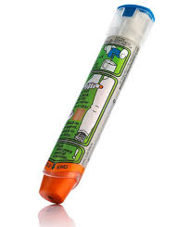
When to use the Epi-Pen
The auto-injector may be needed for a patient with a history of severe allergic reactions that comes in contact with substances that cause an allergic reaction. Also, it can be used for patients in severe respiratory distress, and have a prescribed auto-injector.
Notes:
The auto-injector may be needed for a patient with a history of severe allergic reactions that comes in contact with substances that cause an allergic reaction. Also, it can be used for patients in severe respiratory distress, and have a prescribed auto-injector.

Slide 22
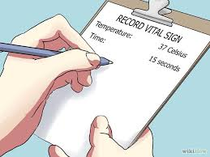
Administration of the Auto Injector
1st -- Ensure your safety from the allergen.
Do not expose yourself to the environment, especially if it could pose a threat to crew safety.
Ensure that ALS is in route
Sit the patient down, or ask them to lay down. If the patient is demonstrating signs of anaphylactic shock, elevate the patient’s feet.
Check the patient’s vital signs
Administer a high concentration of oxygen.
Notes:
1st -- Ensure your safety from the allergen.
Do not expose yourself to the environment, especially if it could pose a threat to crew safety.
Ensure that ALS is in route
Sit the patient down, or ask them to lay down. If the patient is demonstrating signs of anaphylactic shock, elevate the patient’s feet.
Check the patient’s vital signs
Administer a high concentration of oxygen.

Slide 23
Administration of the Auto Injector
If BOTH cardiac and respiratory status are normal, you will not need to administer.
Reassess the patient’s status at least every five minutes.
If EITHER the cardiac or respiratory status of the patient is or becomes abnormal, then you will need to administer the auto-injector.
Notes:
If BOTH cardiac and respiratory status are normal, you will not need to administer.
Reassess the patient’s status at least every five minutes.
If EITHER the cardiac or respiratory status of the patient is or becomes abnormal, then you will need to administer the auto-injector.

Slide 24
Administration of the Auto Injector
If the patient has their own auto-injector, assist them in using it.
If the patient’s auto-injector is not available, or has expired, and your agency is authorized to carry the auto-injector, has been authorized by their Medical Director and trained in its use, then administer the auto-injector.
If there is a question in your mind about administration, call medical control.
If medical control cannot be reached, and the patient is under 35 years of age, administer the auto-injector as indicated, and report the incident to Medical Control and the your agency Medical Director as soon as possible.
Notes:
If the patient has their own auto-injector, assist them in using it.
If the patient’s auto-injector is not available, or has expired, and your agency is authorized to carry the auto-injector, has been authorized by their Medical Director and trained in its use, then administer the auto-injector.
If there is a question in your mind about administration, call medical control.
If medical control cannot be reached, and the patient is under 35 years of age, administer the auto-injector as indicated, and report the incident to Medical Control and the your agency Medical Director as soon as possible

Slide 25
Administration of the Auto Injector
Remove the safety cap from the injector, and check fluid for color and clarity. Fluid should be clear, and colorless.
Do not put fingers over the black tip when removing the safety cap, or after safety cap has been removed.
Notes:
Remove the safety cap from the injector, and check fluid for color and clarity. Fluid should be clear, and colorless.
Do not put fingers over the black tip when removing the safety cap, or after safety cap has been removed.

Slide 26
Administration of the Auto Injector
Place the tip of the auto-injector against the patient’s thigh (preferably bare), halfway between their waist, and knee.
With a rapid motion, push the auto-injector firmly against the thigh until the spring loaded needle is activated. Hold the auto-injector in place for ten (10) seconds.
Notes:
Place the tip of the auto-injector against the patient’s thigh (preferably bare), halfway between their waist, and knee.
With a rapid motion, push the auto-injector firmly against the thigh until the spring loaded needle is activated. Hold the auto-injector in place for ten (10) seconds.

Slide 27
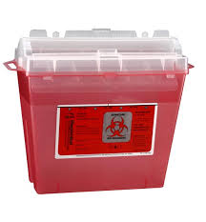
After Administration
Remove the auto-injector from the thigh, and record the time of the injection.
Dispose of injector in biohazard container.
Document patient response to injection.
Notes:
Remove the auto-injector from the thigh, and record the time of the injection.
Dispose of injector in biohazard container.
Document patient response to injection.

Slide 28
After Administration
After administration, continue to reassess the patient. Focus on ABC’s.
Transport patient, if not already enroute to hospital.
Notes:
After administration, continue to reassess the patient. Focus on ABC’s.
Transport patient, if not already enroute to hospital.

Slide 29
After Administration
If needed, contact medical control for a second dose of epinephrine via auto-injector.
In the event of cardiac arrest, perform CPR as per ARC/AHA guidelines.
Notes:
If needed, contact medical control for a second dose of epinephrine via auto-injector.
In the event of cardiac arrest, perform CPR as per ARC/AHA guidelines.

Slide 30
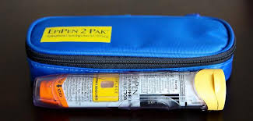
Storage of the Auto-Injector
Store where it can be accessed quickly
Keep in the plastic tube that it comes in.
Kept at room temperature at all times.
Not refrigerated, or exposed to extreme heat.
Exposure to light and heat can cause the epinephrine to turn brown, and lose its effectiveness.
Notes:
The Epinephrine Auto-Injector should be stored in an area where it can be accessed quickly in an emergency, and should be kept in the plastic tube that it comes in.
The auto-injector should be kept at room temperature at all times. It should not be refrigerated, or exposed to extreme heat. Do not expose the auto-injector to direct sunlight. Light and heat can cause the epinephrine to turn brown, and lose its effectiveness.

Slide 31
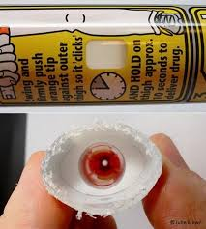
Replacing the Auto-Injector
Expiration date.
Check the date on a regular basis.
Replace the unit before it expires.
Regularly inspect for color and clarity, and replace if the liquid is discolored or cloudy.
Notes:
As with any medication, the epinephrine auto-injector has an expiration date. It is very important to check the date on a regular basis, and replace the unit before it expires.
Also regularly inspect for color and clarity, and replace if the liquid is discolored or cloudy.

Slide 32
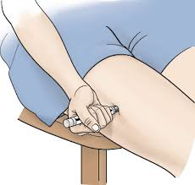
Who can use the Auto-Injector?
People who have been prescribed and trained in self administration.
EMR’s may assist in this self administration process.
The EMR’s agency can carry and administer the auto-injector:
if they have been trained; and
their Medical Director allows it.
Notes:
Physicians prescribe the epinephrine auto-injector to many people who suffer from allergic reactions to different allergens, these people have been trained in self administration. EMR’s may assist in this self administration process.
The Indiana EMS Commission has adopted a policy that says EMR’s can carry and administer the auto-injector f they have been trained and their Medical Director allows it.

Slide 33
If you have questions, please ask prior to the quiz.

