Slide 1

INDIANA DEPARTMENT OF HOMELAND SECURITY New ema training orientation
{{
OCTOBER 2021

Slide 2

Welcome
On behalf of Stephen Cox, Executive Director of the Indiana Department of Homeland Security, welcome to the new EMA Orientation Seminar!

Slide 3
Unit 1: Introduction

Slide 4

Indiana Department of Homeland Security
317-232-2222
https://www.in.gov/dhs

Slide 5
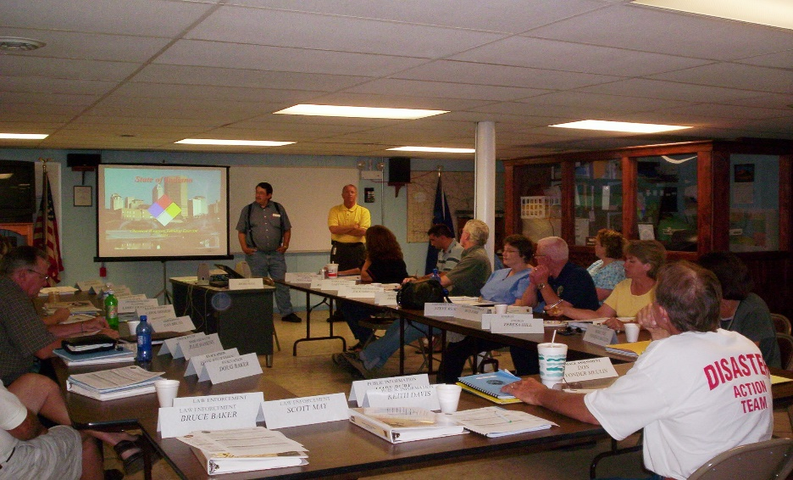
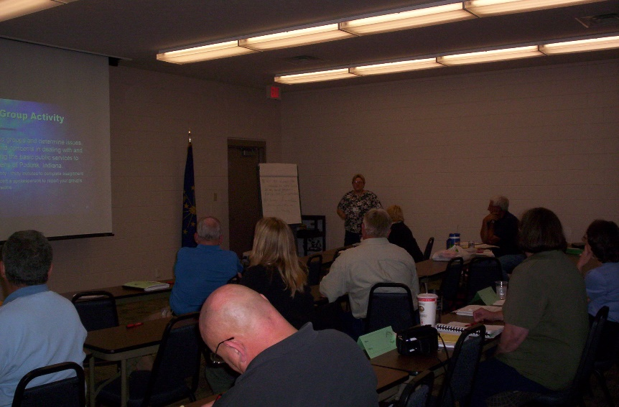
Unit 1: Introduction
To provide individuals who are new to emergency management with the appropriate information and tools necessary to establish and function within a comprehensive emergency management system.

Slide 6
Course Objectives
At the end of this course, participants should be able to:
Define emergency management and recognize the authorities and methods used to shape EM programs.
Understand the importance of emergency planning, recognize resource management issues, and consider other planning concepts.

Slide 7
Course Objectives
At the end of this course, participants should be able to:
Recognize response operations and key actions during an emergency or disaster situation.
Understand the concepts related to declaring emergencies and disasters.

Slide 8
Course Background
This one-day program was designed to orient personnel to their roles and responsibilities in:
Coordinating emergency preparedness and response activities within local jurisdictions
Understanding both natural and human-caused hazards
Exercising the ability to respond and recover
Recognizing the changes in both federal and state disaster laws that incorporate emergency management and homeland security

Slide 9
Intended Audience
Primary Audience
New EMA Directors
New Deputy Directors
New EMA Admin Staff
Also Useful For
Fire Service
EMS Personnel
Law Enforcement
Public Works
Public Health
Elected/Appointed Officials
Other Appropriate Personnel

Slide 10
Course Overview
Module 1: Overview of IDHS
Module 2: Emergency Management Role, EM Cycle, IA/PA, and Legal Authorities
Module 3: Grants, HSEEP/Exercise, Training
Module 4: Planning, WebEOC, and LEPC

Slide 11

Course Materials
EMA Checklist
New EMA Packet
Evaluation Form
Copy of Slides

Slide 12



Slide 13


Slide 14
END
{{

