Slide 1
EMA Orientation Seminar Module 3 Grants, HSEEP, & Training
{{
October 2021

Slide 2
Module 3
In this module we will go over:
Grants
Presented by: Stormy Friday
HSEEP/Exercise
Presented by: Ashley Baldwin
Training
Presented by: Cassie Parker

Slide 3
{{
IDHS Funding streams and
General information
In this portion “presenter” will go over different types of grants available through IDHS.

Slide 4
IDHS FEDERAL FUNDING STREAMS
State Homeland Security Program (SHSP)
Nonprofit Security Grant Program (NSGP)
Assist local preparedness activities that address high-priority preparedness gaps across all core capabilities that support terrorism preparedness
Risk-driven and capability/high-priority based relating to terrorism preparedness
Assist local preparedness activities that address high-priority preparedness gaps across all core capabilities that support terrorism preparedness
Specifically for 501(c)(3) nonprofits
Templates are available for organizations to begin preparing for next year

Slide 5
IDHS FEDERAL FUNDING STREAMS
Hazardous Materials Emergency Preparedness Grant Program (HMEP)
Emergency Management Performance Grant (EMPG)
Assist local preparedness activities in preparing for all hazards
Supports a comprehensive, all-hazards emergency preparedness system by building and sustaining core capabilities
Assist states, territories and Native American Tribes to develop, improve and carry out emergency plans within hazardous transportation

Slide 6
IDHS STATE FUNDING STREAMS
Homeland Security Foundation Grant Program (Foundation)
Homeland Security Foundation Grant Program (Scholarships)
Supports public safety projects with a focus on ensuring citizen safety
Supported by the Secure Indiana license plate
Priority areas include:
Lifesaving activities
Day-to-day operational requirements
Improvements to existing capabilities
Supports students enrolled in higher education programs with a public safety concentration
Full-time students can apply for $2,000
Part-time students can apply for $1,000

Slide 7
IDHS STATE FUNDING STREAMS
Secured School Safety Grant (SSSG)
The SSSG program is an allocated state fund that provides matching grants to school corporations, accredited non-public (i.e., private) schools, charter schools and coalitions of school corporations. SSSG funds may be used to:
Employ a school resource officer (SRO); employ a law enforcement officer (LEO); provide school resource officer training described in IC 20-26-18.2(b)(2);
Purchase equipment and technology to
Restrict access to school property; or
Expedite notifications to local law enforcement and first responders;
Conduct a threat assessment
Provide firearm and self-defense trainings
Cover initial set up costs for an active event warning system with the County’s Sheriff Department. (No match requirement)
Implement a student and parent support services plan.

Slide 8
FEDERAL FUNDING
Congress
Office of the President
Federal Agency (U.S. DHS)
Awarding Division of U.S. DHS (FEMA)
State Administrating Agency (IDHS)
Local Sub-grants
Office of the Governor

Slide 9
IDHS GRANT CYCLE
Pre-Application
State application submitted
State NOFO released to applicants
Funding strategy determined
Award Received
Local award letters & grant agreements sent out
Sub-recipients sign & return grant agreements
Grant Agreements Processed
Grant agreements fully executed
State reviews applications
Local Applications
Federal NOFO released
Local applications submitted
Clearance checks

Slide 10
DUNS NUMBER
Data Universal Numbering System (DUNS) number which is a unique numeric identifier regulated by Dun and Bradstreet
Federal requirement to receive grant funds
DUNS number request line at (844) 230-8762
If applicants believe they possess an active DUNS number, they should call the request line to verify their DUNS number
Applicants must register their DUNS number in the System for Awards Management (SAM) at the following link: www.sam.gov/content/home using a browser such as Chrome, Firefox or Safari

Slide 11
SUPPLANTING
Grant funds must be used to supplement existing funds for program activities and cannot replace or supplant non-grant funds that have been appropriated for the same purpose

Slide 12
UNALLOWABLE ITEMS
Food and beverage costs
Equipment sustainment
Oil changes
Routine maintenance

Slide 13
Authorized equipment list (AEL)
The Authorized Equipment List (AEL) is a list of approved equipment types allowed under FEMA’s preparedness grant programs.
Specifically for NSGP, EMPG and SHSP. Always verify against the NOFO
If project includes equipment, confirm the allowability through FEMA’s authorized equipment list (AEL) website prior to submitting proposal
https://www.fema.gov/authorized-equipment-list

Slide 14
EHP Form
Environmental and Historic Preservation (EHP) Screening Form
Review process begins with submission of an EHP Screening Form
Screening Form requires a detailed project description that explains the objectives of the proposed project, along with supporting documentation including photos
FEMA uses this information to determine if the proposed project has the potential to affect the environmental and/or historic properties
Projects will be sent for final review to the U.S. DHS/FEMA Headquarters
Projects should NOT start until FEMA has approved the EHP
Once an EHP is approved, no changes can be made

Slide 15
Projects that require EHP
Ground disturbances
Anything that breaks ground or changes the condition of the grounds surface
Construction, additions, modifications, renovations of new facilities or existing structures
Cameras, generators, access controls, etc.
Physical security enhancements
Interior/exterior
Grounds
Doors, lights, fences, bollards, etc.

Slide 16
Projects that require EHP
Construction/modification of communication towers
Addition of antennas, mounting equipment or shelters
Training/exercises
Involve ground disturbance
Not conducted at a designated training facility
Mobile equipment
Involve radar/sonar technology

Slide 17
Projects that DO NOT require EHP
Preparation of Planning Documents
Classroom-based training/table-top exercises only
Training or exercises at designated training facilities using established procedures for a specific training/exercise
Hand-held mobile equipment and supplies
Motorized vehicles, watercraft or trailers that will use existing staging or storage areas
Personal protective equipment (PPE)
Plug-in equipment; requires no wiring or installation onto walls, ceilings or floors

Slide 18
Application Tips
Make a strong link to the assessment/THIRA/SPR that found gaps
Explain how project will close gaps
Make a strong tie to terrorism or prioritized core capabilities
Make sure project and descriptions fit the national priority description and sample projects in the federal NOFO
If project will enhance collaboration with other entities, please explain who and how
Explain the urgency of need for this project – why is it important this project be funded now versus in a year or two
Recommend proofreading and a final review to make sure the questions asked are answered before submission

Slide 19
Intelligrants Registration
Please take the next 10-15 minutes to register for an IntelliGrants account
https://intelligrants.in.gov/Registration2.aspx

Slide 20
THANK YOU!
{{

Slide 21
{{
HSEEP what you need to know
In this portion “presenter” will go over HSEEP awareness.

Slide 22
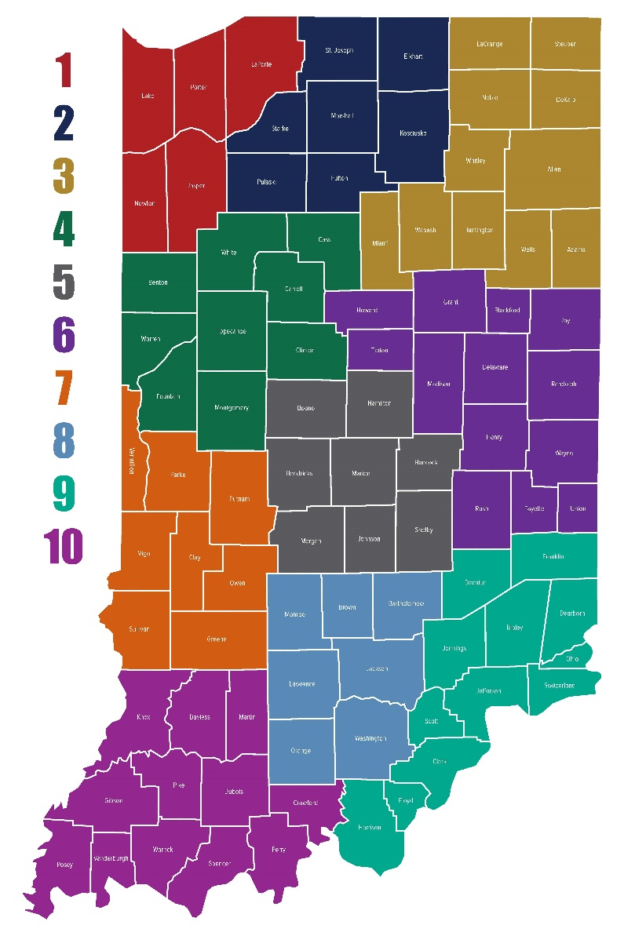
IDHS EXERCISE STAFF
Division of Response and Recovery Director- Mary Moran
State Exercise Director- Ashley Baldwin
North Exercise Program Manager – Jason Chapman
Central Exercise Program Manager - Jess Kindig
South Exercise Program Manager – Casey Fizer

Slide 23
EXERCISE

Slide 24
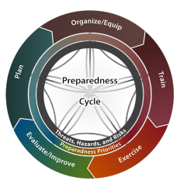
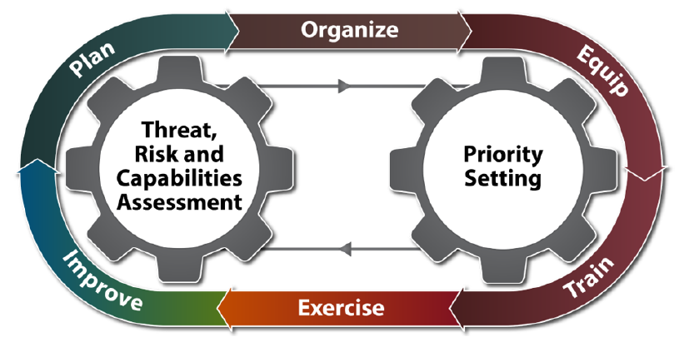

Slide 25
WHAT IS EXERCISE?
Enables whole community stakeholders to test and validate plans and capabilities
Corresponds with the core capabilities and identified high priority hazards
Key component of national preparedness
Low-risk, no fault environment
Familiarizes personnel with roles and responsibilities
Addresses areas of improvement and identifies capability gaps
Notes:
An exercise is an event or activity, delivered through discussion or action, to develop, assess, or validate plans, policies, procedures, and capabilities that jurisdictions/organizations can use to achieve planned objectives. It is an opportunity to provide first responders and stakeholders a chance to implement their skills during a simulated catastrophic event. Exercise design emphasizes the importance of prevention, protection, response, recovery. Exercises help build preparedness for threats and hazards by providing a low-risk environment to test and validate plans, policies, procedures and capabilities. As well as identify resource requirements, capability gaps, strengths, areas for improvement, and potential best practices.

Slide 26
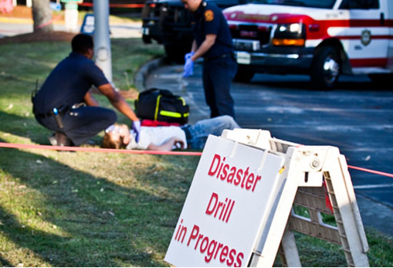
TYPES OF EXERCISES
Discussion-based
Seminar
Workshop
Tabletop (TTX)
Games
Operations-based
Drill
Functional (FE)
Full Scale (FSE)
Notes:
Discussion- Based Exercises include Seminar, Workshop, Tabletop, Games
Operations- Based- Drill, Functional, Full Scale
Discussion-based exercises focus on strategic, policy-oriented issues.
Operations-based exercises are used to validate plans, policies, agreements and procedures. Operations-based exercises are more complex than discussion-based exercises.

Slide 27
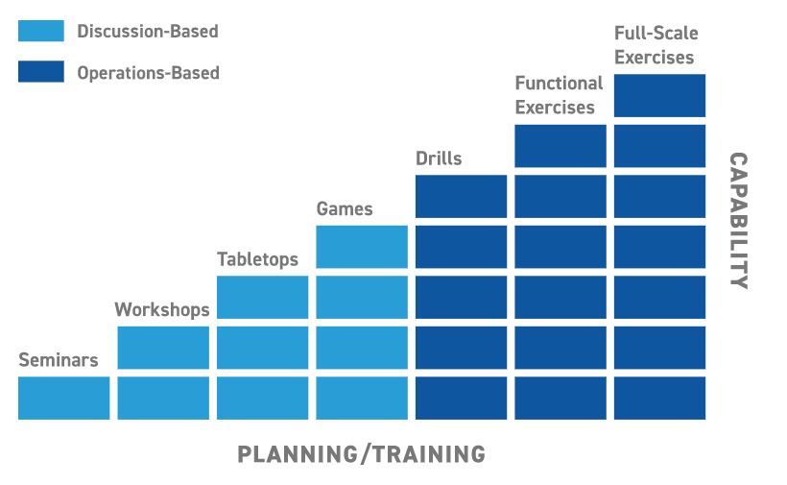
PROGRESSIVE PLANNING APPROACH
Notes:
What came first the chicken or the egg? The seminar or the workshop?
What is a Progressive Planning Approach – It is a common set of objectives, built toward an increasing level of complexity over time, and involves the participation of multiple entities. Developing an Integrated Preparedness Schedule.
More planning, time and resources- Drills, functional or full scale exercise.
Brief explanation of IDHS exercise program

Slide 28
Discussion-Based Exercises
Discussion-based exercises focus on strategic, policy-oriented issues
Seminar
Workshop
Tabletop (TTX)
Games
Notes:
Familiarize players with agreements, policies, or develop plans. Facilitators/presenters will typically lead the discussion and keep everyone on task to meet their objectives.

Slide 29
SEMINAR EXERCISE
Discussion-based
Not to be confused with training
Orients participants to a plan, policy or procedure
Notes:
Seminars typically orient participants to or provide an overview of concepts, ideas, resources, strategies, plans.
Can be valuable for people that are developing or making major changes to an existing plan or procedure.
Example of a Seminar- SLAP/ Madison County LSA plan review
Review a plan, policy or procedure.

Slide 30
WORKSHOP EXERCISE
Discussion-based
Commonly misused and not to be confused with training
Development of a plan, policy or procedure by the attendees
Example – Integrated Preparedness Planning Workshop (IPPW)
Produces the Integrated Preparedness Plan (IPP) and Integrated Preparedness Schedule (IPS)
Notes:
Develop a plan- TEPW
Misused and most confused with Seminars, but they differ in two aspects: Participant interaction is increased, and the focus is of it is building a product (SOPS, COOP, Mutual aid agreements, etc.)
If needing to develop a plan you host a workshop. Once you have a plan you can host a seminar to review the plan

Slide 31
TABLETOP EXERCISE (TTX)
Discussion-based
Facilitation heavy to keep discussion on track with objectives
Assesses plans, policies and procedures regarding a hypothetical, simulated emergency
Outcome - obtaining recommended revisions to current plans, policies or procedures
Basic V. Advanced
Notes:
Intended to generate discussion of various issues regarding a hypothetical, simulated emergency.
TTX: facilitator asking questions and participants discuss how they would respond based off of plans, policies and procedures
Basic: Example-Facilitated discussion-the scenario is presented and remains constant-describes the emergency and brings discussion participants up to the simulated present time.
Advanced: play advances as players receive pre-scripted messages that alter the scenario. For example, a facilitator introduces problems one at a time by a written message, telephone call, webeoc message, etc. then players discuss issues raised by each problem references those policies, plans or procedures that they have developed.

Slide 32
GAMES EXERCISE
Discussion-based
Rare
Models and simulations that increase in complexity as game progresses
Often involves two or more teams with competitive environment
Uses rules, data and procedures to depict a situation
Critical decision-making points determine success of game
Notes:
Games: Simulation of operations in a competitive Family Feud style Game- FEMA has done a study and suggested that GAMES are one of the most beneficial types of exercises. This gets participants reading the plan in a low stress environment.
Ask the audience if they have attended a game

Slide 33
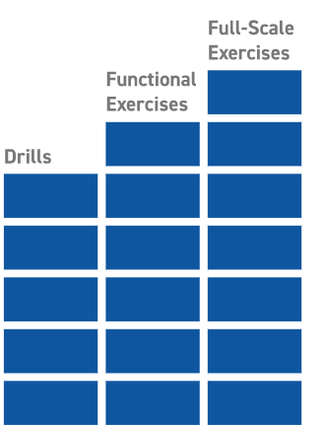
Operations-Based Exercises
Operations-based exercises are used to validate plans, policies, agreements and procedures. Operations-based exercises are more complex than discussion-based exercises.
Drill
Functional (FE)
Full-Scale (FSE)
Notes:
“Actions”, moving
Operation Based Exercises require action and or equipment. The difference between Operation based exercise vs Discussion Based exercises- is that in Discussion Based Exercises you talk, update and review actions and processes
Operation based exercises are not to teach others how to respond. Participants should know their responsibilities when responding to the scenario.

Slide 34
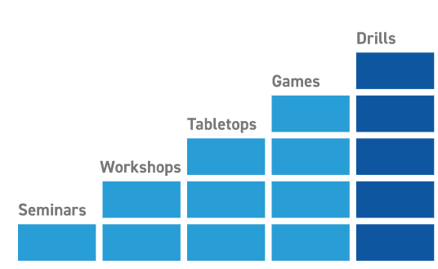
DRILL EXERCISE
Operations-based
Commonly misused
Tests single operation of function in a single agency or organization
Notes:
Coordinated, supervised activity to validate a specific function or capability in a single organization.
Example- Fire Drill
The most common type of drill that you can conduct, is a school fire drill. The participants will test a single response agency . In a school fire drill you are testing the response time of the fd to get from the station to the school. OR in a school drill, with NO fd involvement, you are testing your evacuation plan.
Example – set up of State IMAT’s Base-X Tent

Slide 35
FUNCTIONAL EXERCISE (FE)
Operations-based
Validates multiple functions
Movement of personnel and equipment is usually simulated
Example – Emergency Operation Center activation exercise
Notes:
Designed to validate and evaluate capabilities, multiple functions, or interdependent groups of functions. Typically focus on exercising plans, policies, or procedures, and staff members involved in management, command, and control functions. Movement of personnel and equipment is simulated.
LEPC exercise-based on a hazard they simulate.
Can hybrid this form of exercise with a TTX for advance exercise play

Slide 36
FULL-SCALE EXERCISE (FSE)
Operations-based
High stress, multi-agency, multi-jurisdictional activities
Most complex
Resource-intensive and possibly expensive
Many moving parts
Notes:
Involves multiple agencies and validate many areas of preparedness. Often include many players operating under a unified command or Incident management system. For those in the room at the state level, you typically see a full scale exercise being conducted at MUTC and or Atterbury. During the Full Scale Exercise you see multiple agencies testing multiple parts.

Slide 37
HSEEP
Notes:
Does anyone know what HSEEP Stands for?
Homeland Security Exercise Evaluation Program

Slide 38
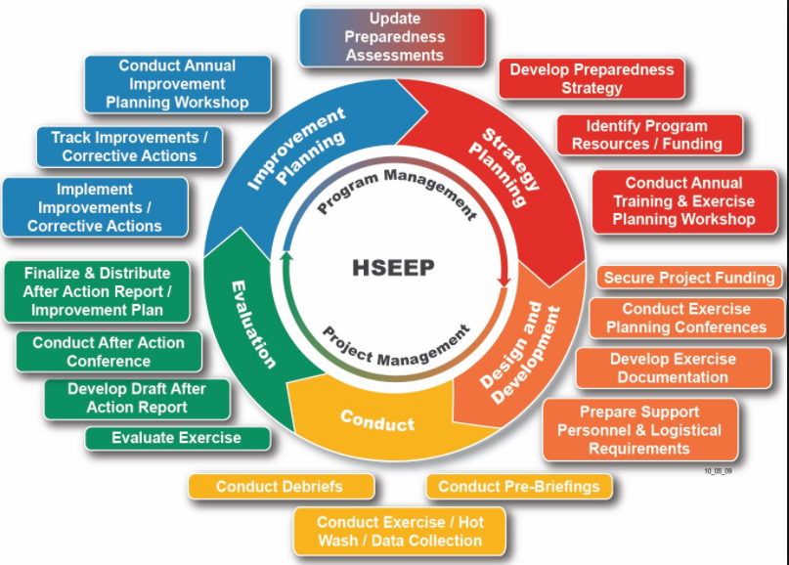
WHAT IS HSEEP?
Homeland Security Exercise and Evaluation Program
Set of guiding principles, common approaches and common methodology for planning and conducting exercises
Flexible
Improves preparedness
Notes:
Uses a common methodology for planning and conducting individual exercises. What that means is that it makes sure each exercise has a consistent approach to the design, development, execution, and improvement planning.

Slide 39
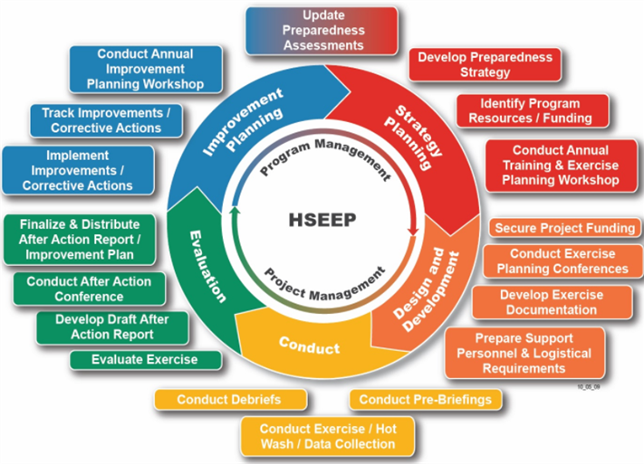
Notes:
The Homeland Security Exercise and Evaluation Program (HSEEP) provides a set of fundamental principles for exercise programs, as well as a common approach to program management, design and development, conduct, evaluation, and improvement planning. Through the use of HSEEP, the whole community can develop, execute, and evaluate exercises that address preparedness priorities established by a jurisdiction’s senior leaders. These priorities are selected by risk and capability assessments, findings, corrective actions from previous events, and external requirements. These priorities guide the overall direction of an exercise program where individual exercises anchor to a common set of priorities or objectives, which increase in complexity over time. T

Slide 40
IDHS POLICY
All exercises conducted by IDHS must be HSEEP compliant
IDHS Exercise staff must approve/deny and track exercises as HSEEP compliant
EMPG funded individuals must participate in three HSEEP compliant exercises in year
EMPG funded exercises must be HSEEP compliant
Notes:
Audit

Slide 41
EXERCISE DOCUMENTATION – Seminar, Workshop and Game
Pre-planning meetings sign-in sheets and agendas
Initial Planning Meeting (IPM)
Final Planning Meeting (FPM)
Documentation
Budget
Pre-planning meeting sign-in sheets and agendas
Presentations – if applicable
Agenda for exercise event
Exercise participant rosters/sign-in sheet
Executive summary
Notes:
Organized documentation is important when we have exercises. We want to have an accurate account of the exercise not only because we must capture any lessons learned, but also any critical issues as well to support future exercises.

Slide 42
EXERCISE DOCUMENTATION – Tabletop
Pre-planning meetings sign-in sheets and agendas
Initial Planning Meeting (IPM)
Final Planning Meeting (FPM)
Documentation
Budget
Pre-planning meeting sign-in sheets and agendas
Agenda for exercise event
Situation manual
Exercise evaluation guides
Exercise participant rosters/sign-in sheet
After Action/Improvement Plan
Notes:
Situation manual-core documentation that provides the background to your exercise.
EEGS-designed to help evaluators collect exercise observations

Slide 43
EXERCISE DOCUMENTATION – Drill, Functional and Full Scale
Documentation
Budget
Pre-planning meeting sign-in sheets and agendas
Agenda for exercise event
Exercise Plan
Master Scenario Events List
Controller/Evaluator Handbook
Exercise Evaluation Guides
Exercise participant rosters/sign-in sheet
After Action/Improvement Plan
Pre-planning meetings
Sign-in sheets and agendas
Concept and Objectives Meeting (C&O Meeting)
Initial Planning Meeting (IPM)
Midterm Planning Meeting (MPM)
Master Scenario Events List Meeting (MSEL Meeting)
Final Planning Meeting (FPM)

Slide 44
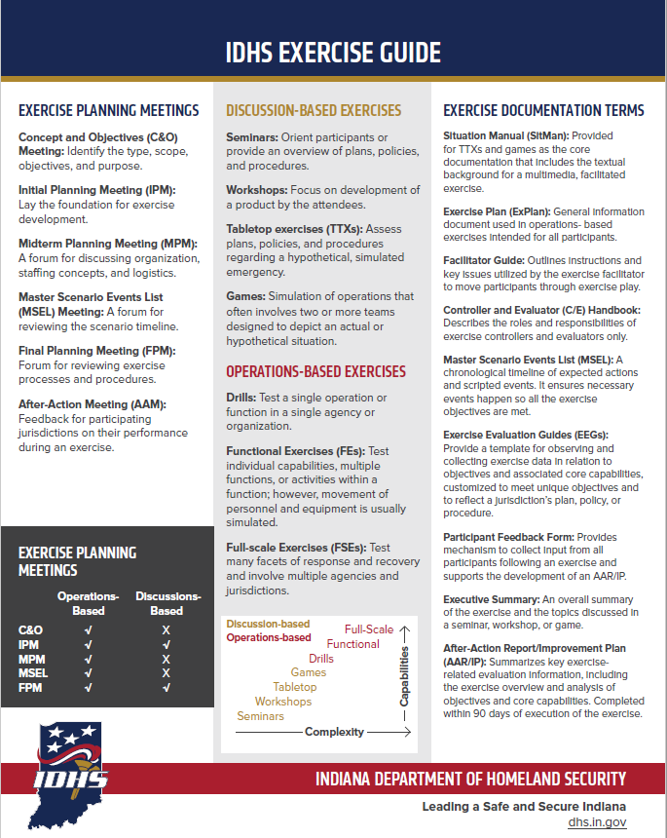
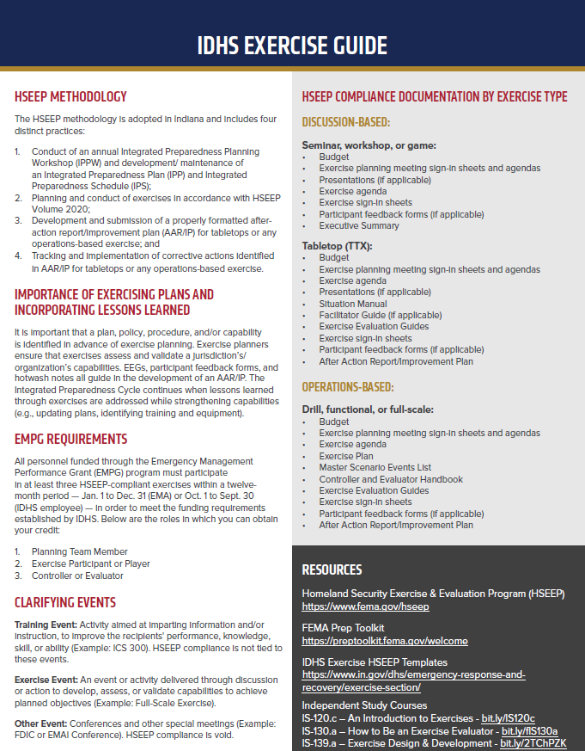

Slide 45
IDHS HELPFUL TIPS
Use the templates (not required, but recommended)
If using your own version, documentation should still include the key components necessary, i.e. objectives and areas of improvement
Ask for assistance if you are planning an exercise with a hazard you have never exercised before – we can help
Use core capabilities; no longer using target capabilities/mission areas
SMART objectives
Notes:
FEMA and IDHS have published templates for agencies to use when developing HSEEP.
The HSEEP templates are flexible and adaptable. You can delete/ remove information that does or does not apply to your exercise. In order to receive compliance, agencies must submit paperwork.
Simple, Measurable, Achievable, Realistic, Task-Oriented

Slide 46
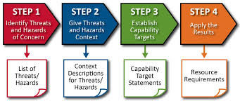
IDHS HELPFUL TIPS CONT.
Progressive Planning and THIRA/SPR data driven exercises
Small exercise? HSEEP is flexible. Combine a planning meeting if necessary. Use a conference call or webinar for a planning meeting if you must. Just make sure you create an agenda and document who participated on the call
Well-written After-Action Reports, to include Corrective Action Plans, are important to the improvement process and can be a valuable tool to inform organization and community leaders
Notes:
Exercise evaluation assesses the ability to meet exercise objectives and capabilities by documenting strengths, areas for improvement, capability performance, and corrective actions in an After-Action Report/Improvement Plan (AAR/IP). Through improvement planning, organizations take the corrective actions needed to improve plans, build and sustain capabilities, and maintain readiness.

Slide 47
REFERENCE MATERIAL
HSEEP
https://www.fema.gov/sites/default/files/2020-04/Homeland-Security-Exercise-and-Evaluation-Program-Doctrine-2020-Revision-2-2-25.pdf
Exercise Templates
https://www.in.gov/dhs/2426.htm
FEMA Independent Study: IS-0120.c – An Introduction to Exercises
IDHS Exercise Guide
https://www.in.gov/dhs/files/IDHS-Exercise-Guide.pdf
FEMA Core Capabilities
https://www.fema.gov/core-capabilities

Slide 48
QUESTIONS?
{{
Ashley Baldwin
State Exercise Officer
Abaldwin@dhs.IN.gov
317-501-6244

Slide 49
{{
Training
In this portion “presenter” will go over different aspects of IDHS Training section.

Slide 50
emergency management training
Introduction
The Indiana Department of Homeland Security (IDHS) is responsible for providing a comprehensive training program based on the needs of the state in the areas of mitigation (preventing or lessening the effects of a hazard), preparedness (planning, training and exercising), response (responding to hazards to prevent further injury or damage) and recovery (restoring community functions, both short and long term).

Slide 51
Training resources
National Incident Management System (NIMS) and Incident Command System (ICS) training:
ACADIS-https://acadisportal.in.gov/
Federal Emergency Management Agency’s Emergency Management Institute and Independent Study (IS) courses
https://training.fema.gov/is/crslist.aspx
Other organizations
Texas A&M Engineering Extension Service (TEEX)
Center for Domestic Preparedness (CDP)
National Disaster Preparedness Training Center (NDPTC)

Slide 52
emergency management training
How to request a training in your area?
PORTAL

Slide 53
emergency management training
Professional Emergency Manager (PEM) Program
The Professional Emergency Manager (PEM) Program is Indiana’s program to help raise and maintain professional standards in emergency management and recognize individuals who have demonstrated basic competencies in the field. Interested individuals complete a series of courses, exercises and professional contributions, and they meet work experience requirements in the emergency management discipline or related public safety fields and submit an application to apply.
PDF

Slide 54
Acadis/PSID
Please take the next 10-15 minutes to apply for a PSID number if you do not yet have one.
https://www.in.gov/dhs/fire-and-building-safety/public-safety-identification-psid-information/

Slide 55
QUESTIONS?
{{

Slide 56
This completes Module 3

Slide 57
END
{{

