Slide 1
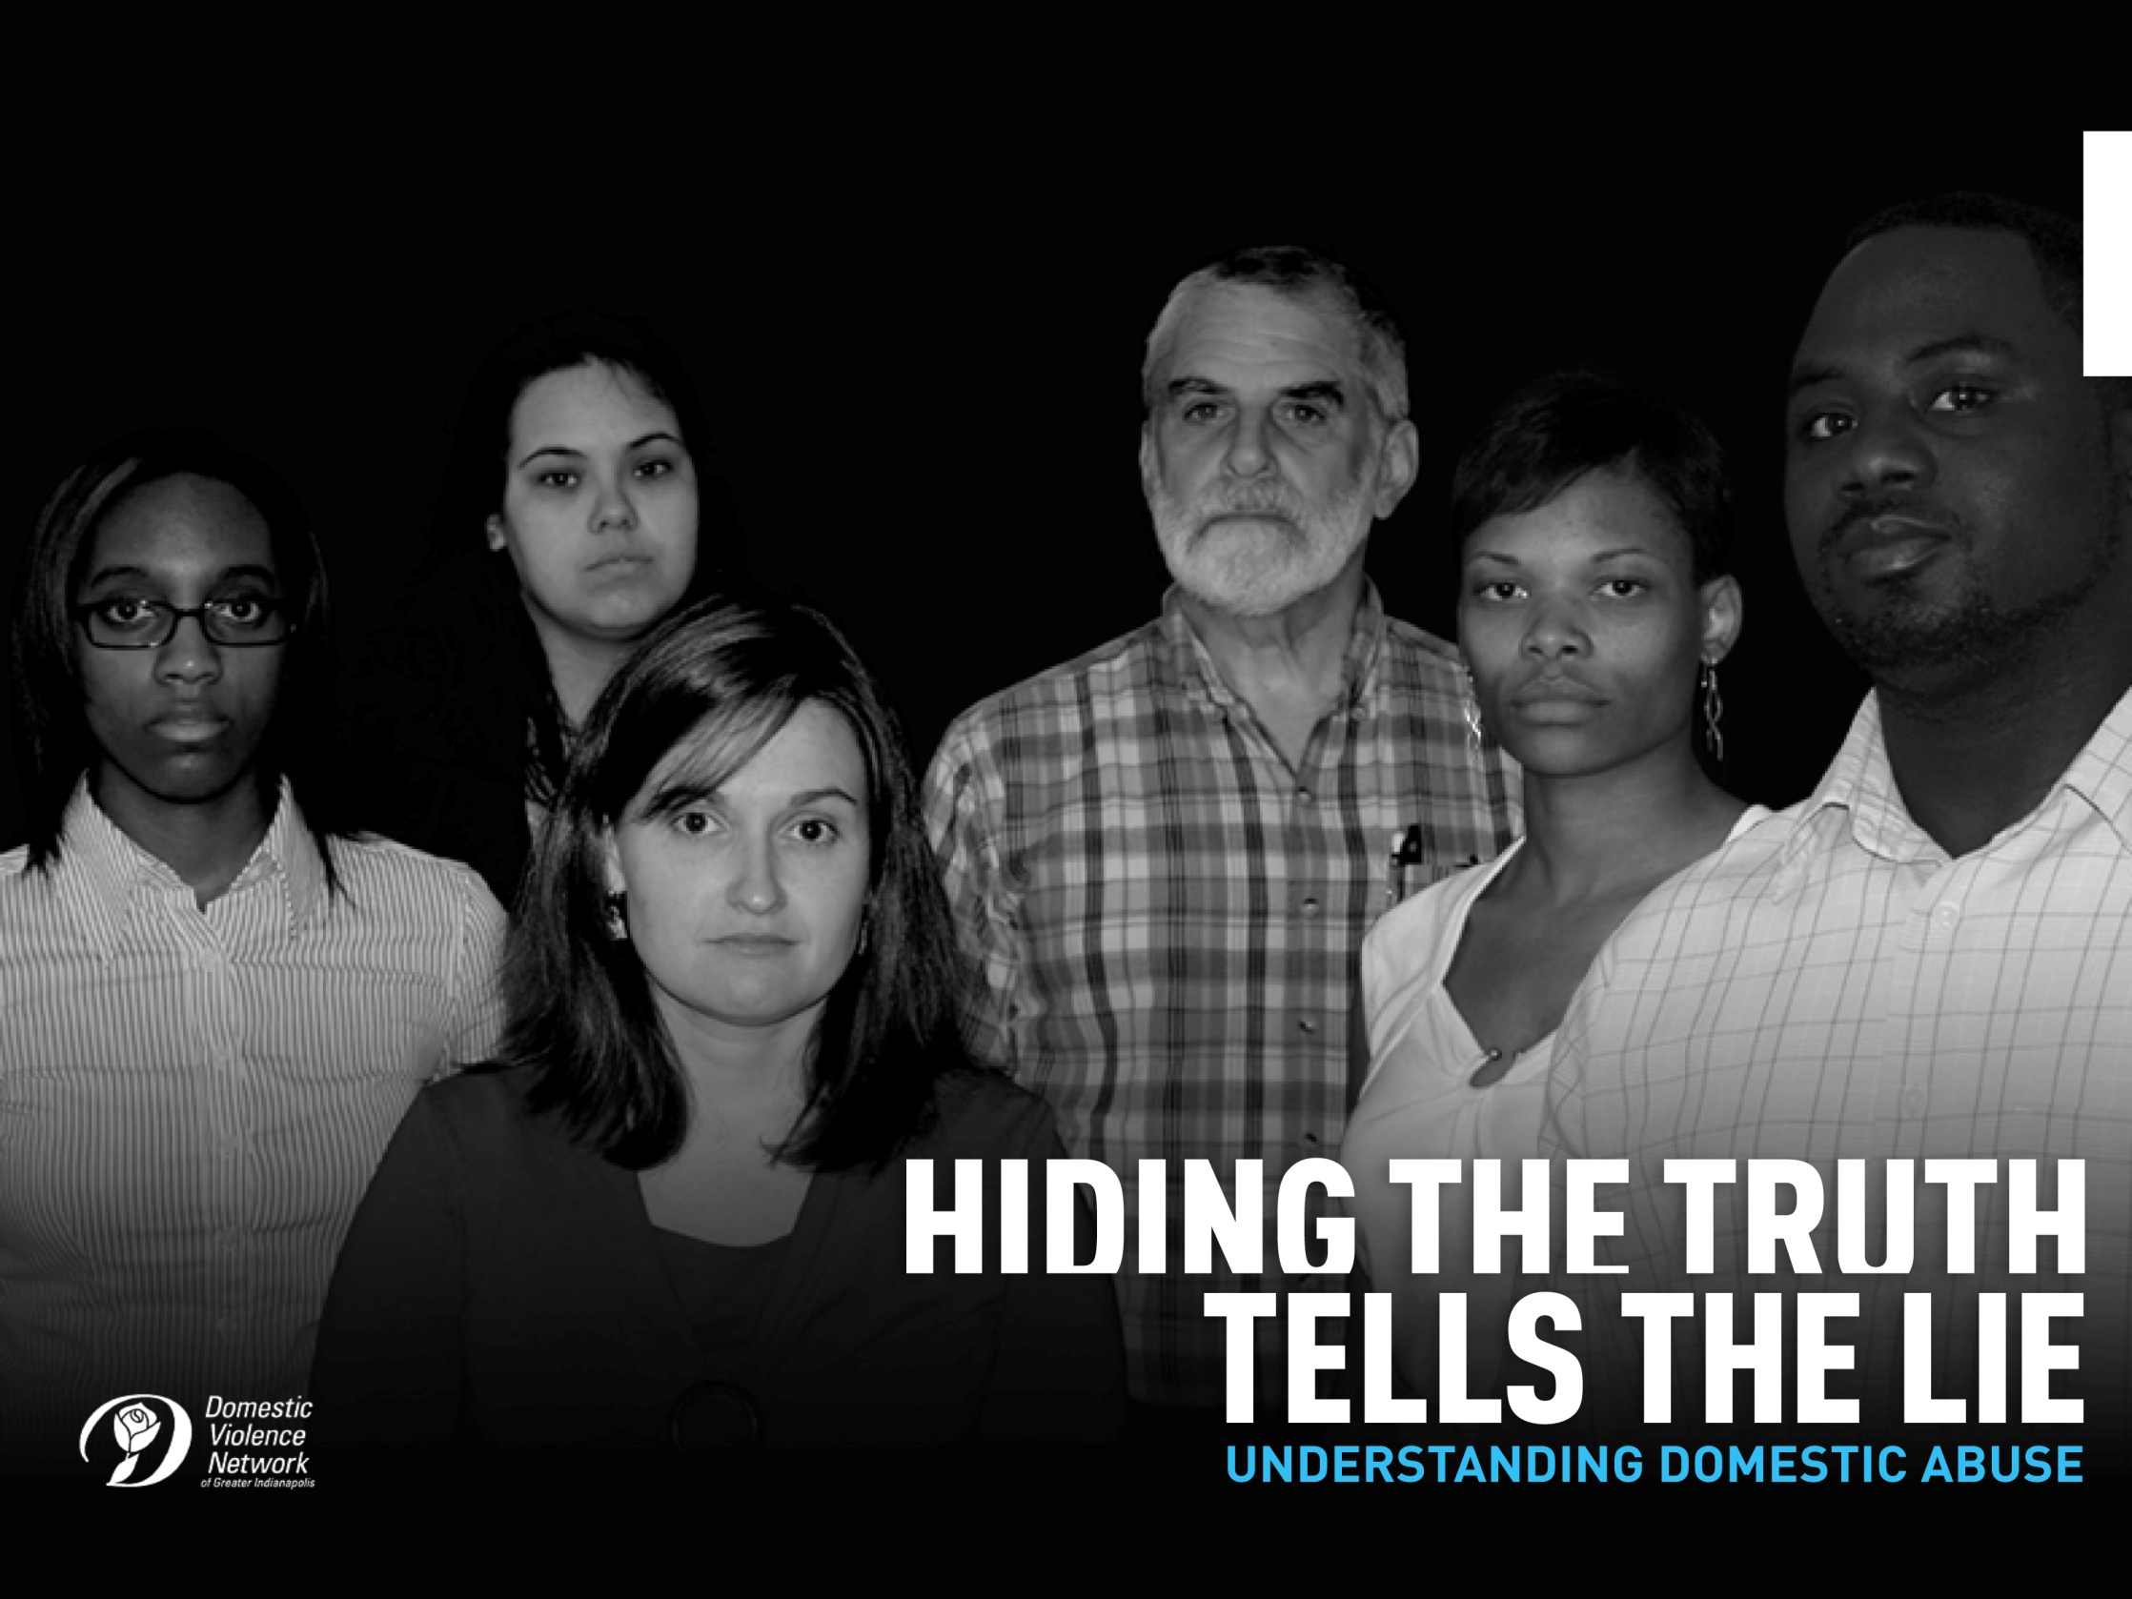


Slide 2

Intimate partner abuse is a pattern of behavior using power and control within an intimate relationship that threatens a person's well–being.
Abuse can take many forms, such as physical, emotional, financial,
sexual, or psychological abuse.
Intimate partner abuse is committed by an intimate partner, including a spouse or former spouse, or a current or former dating partner.
Intimate partner abuse is sometimes also called partner abuse, domestic abuse, domestic violence, family violence, or battering.

Slide 3
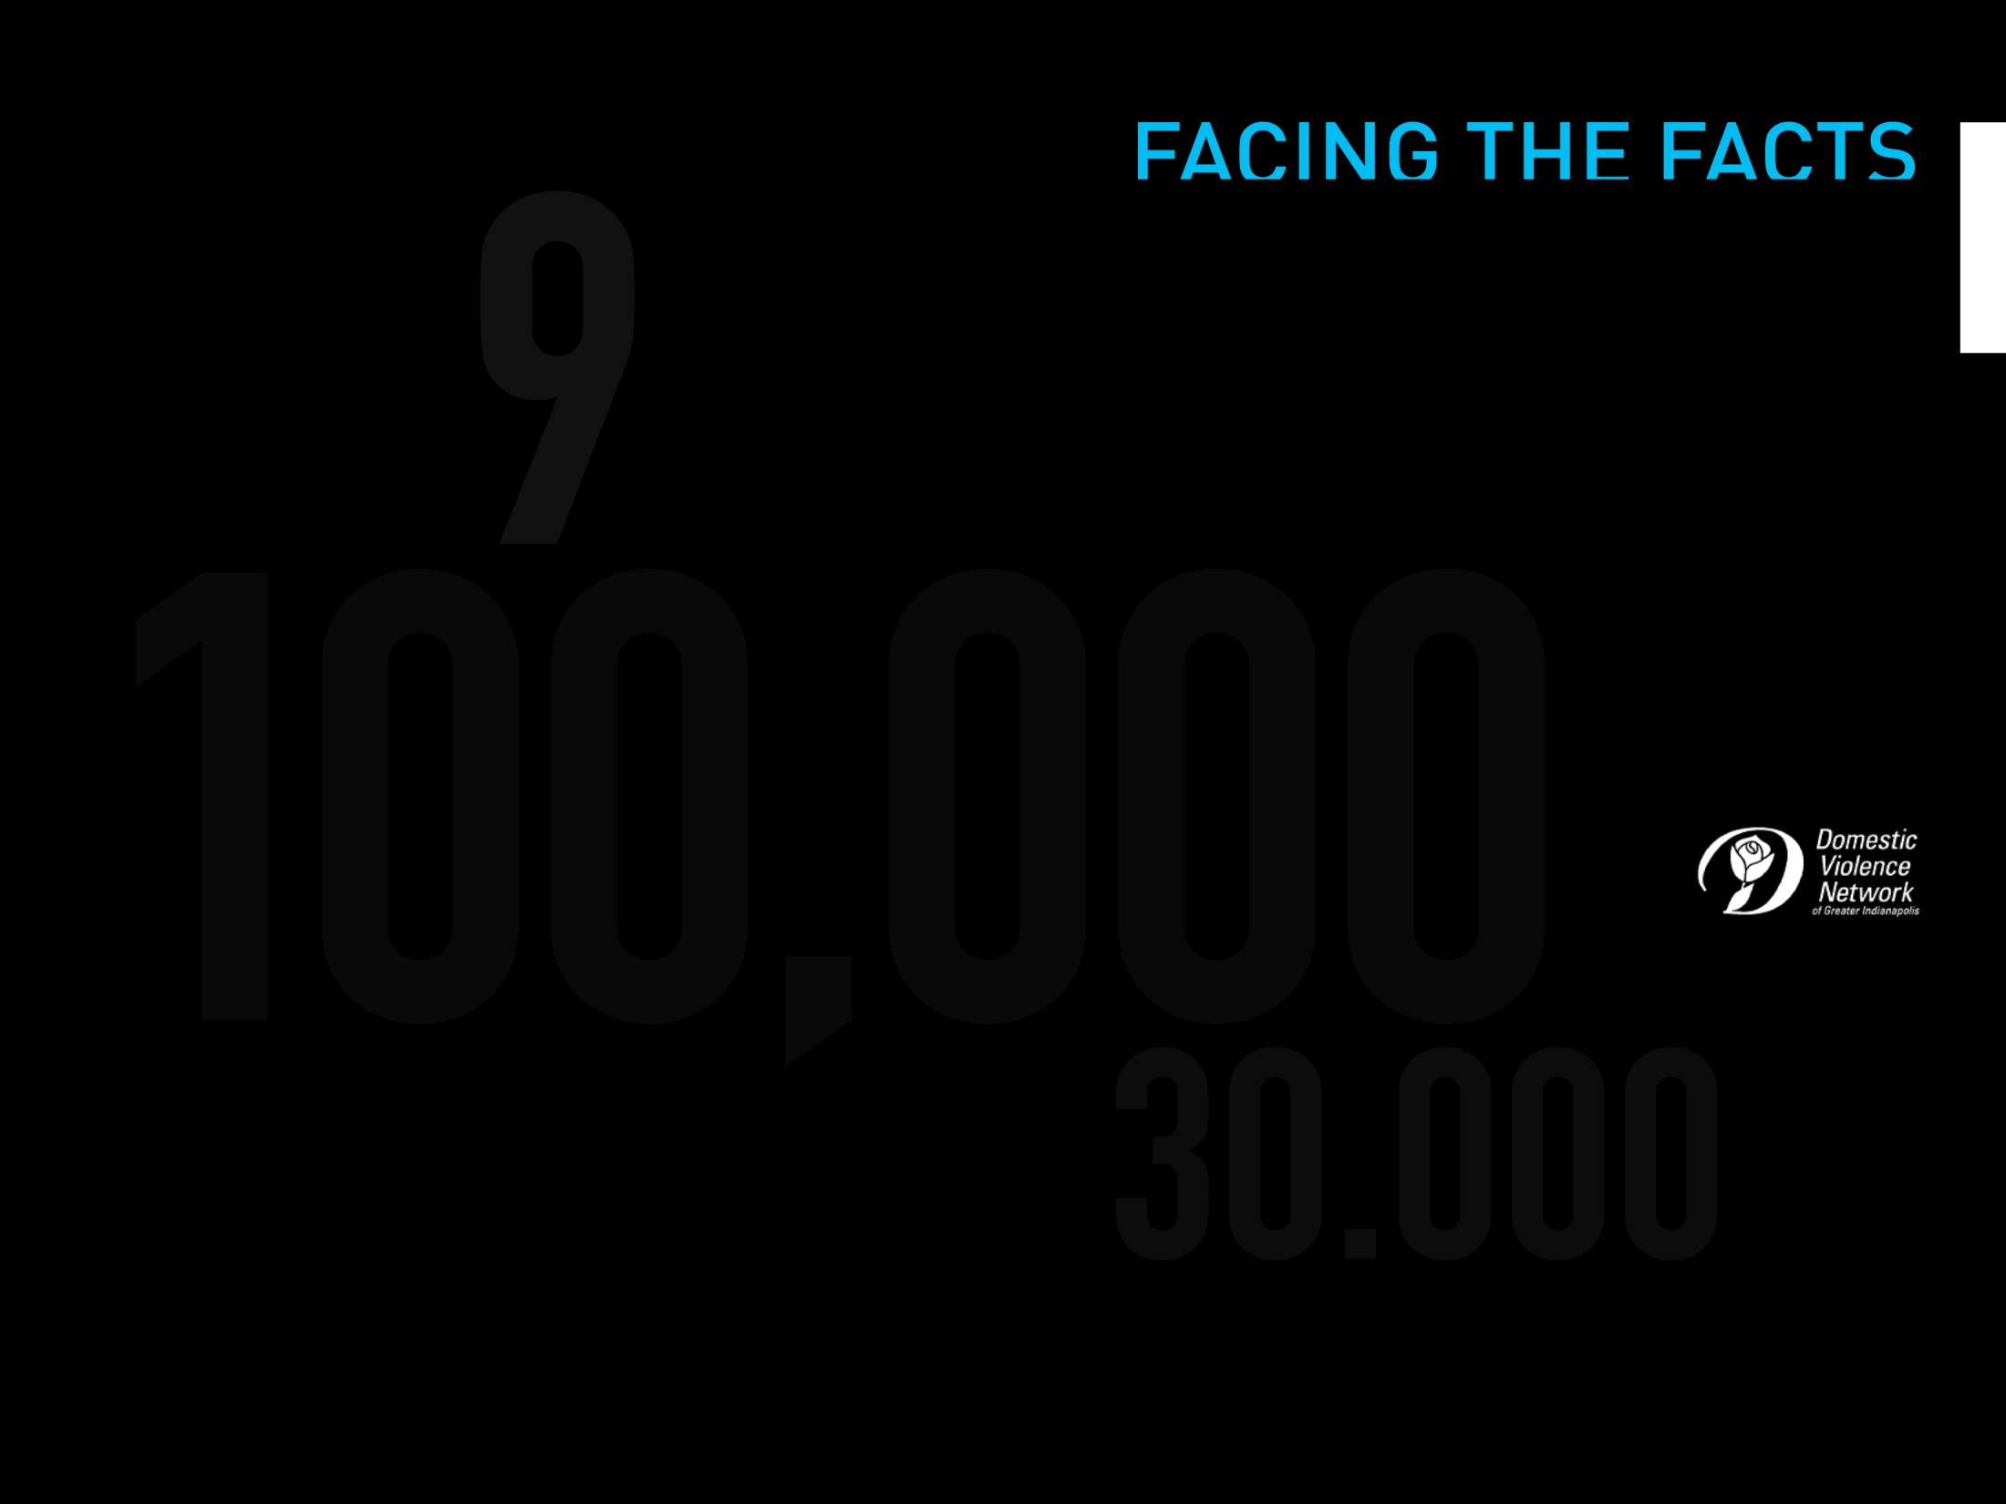
In the U.S., every 9 seconds a person is physically abused by a current or former intimate partner.
25% of women and 8% of men in the U.S. report being physically or
sexually assaulted by a partner at some point in their lives.
This means that in Marion County, more than 100,000 women and 30,000 men will be abused in their lifetime.

Slide 4
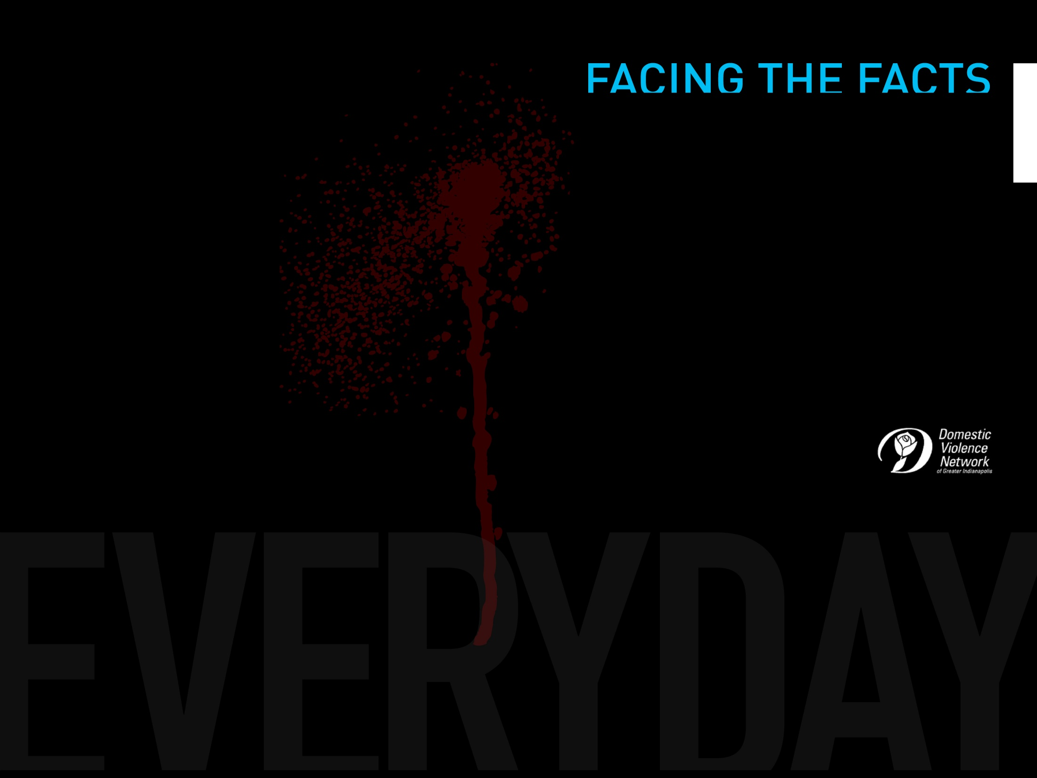
On average, more than 3 women are murdered by their husbands or boyfriends in the U.S. everyday.

Slide 5
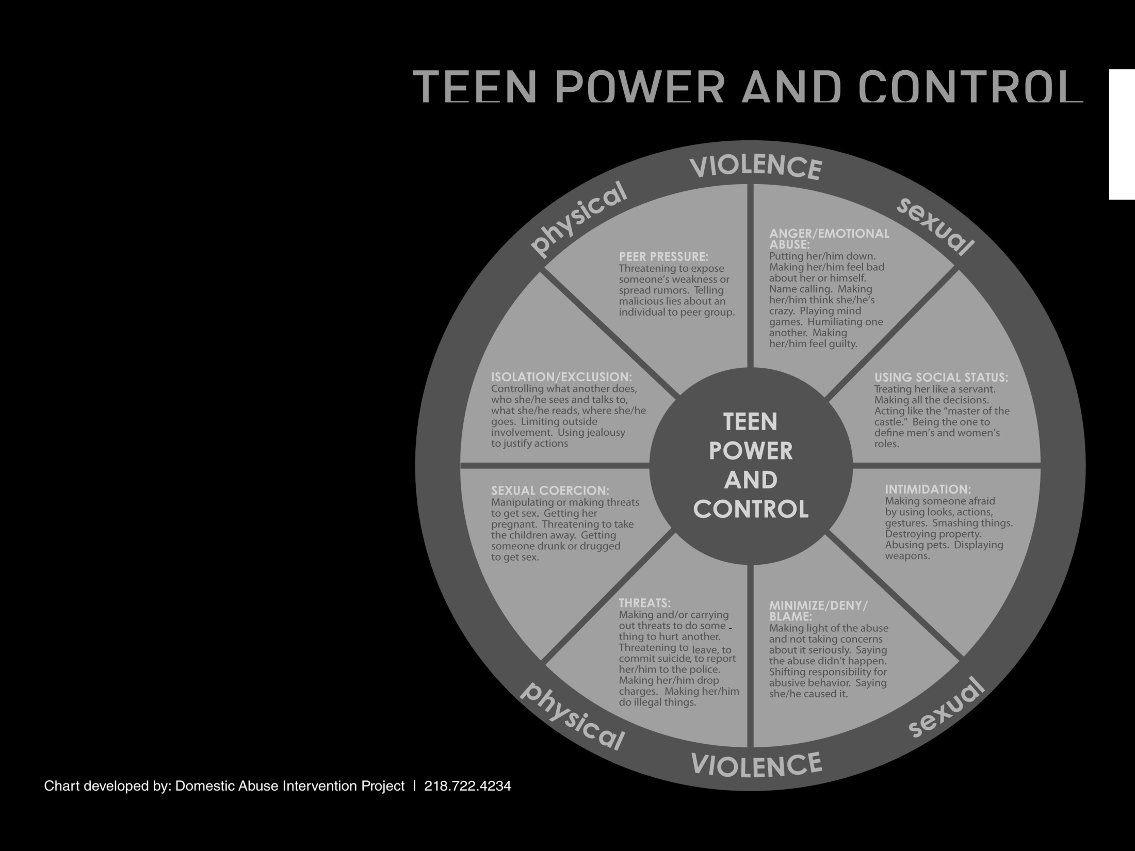
Emotional Abuse
Using Social Status
Intimidation
Minimize/Deny/Blame
Threats
Sexual Coercion
Isolation/Exclusion

Slide 6
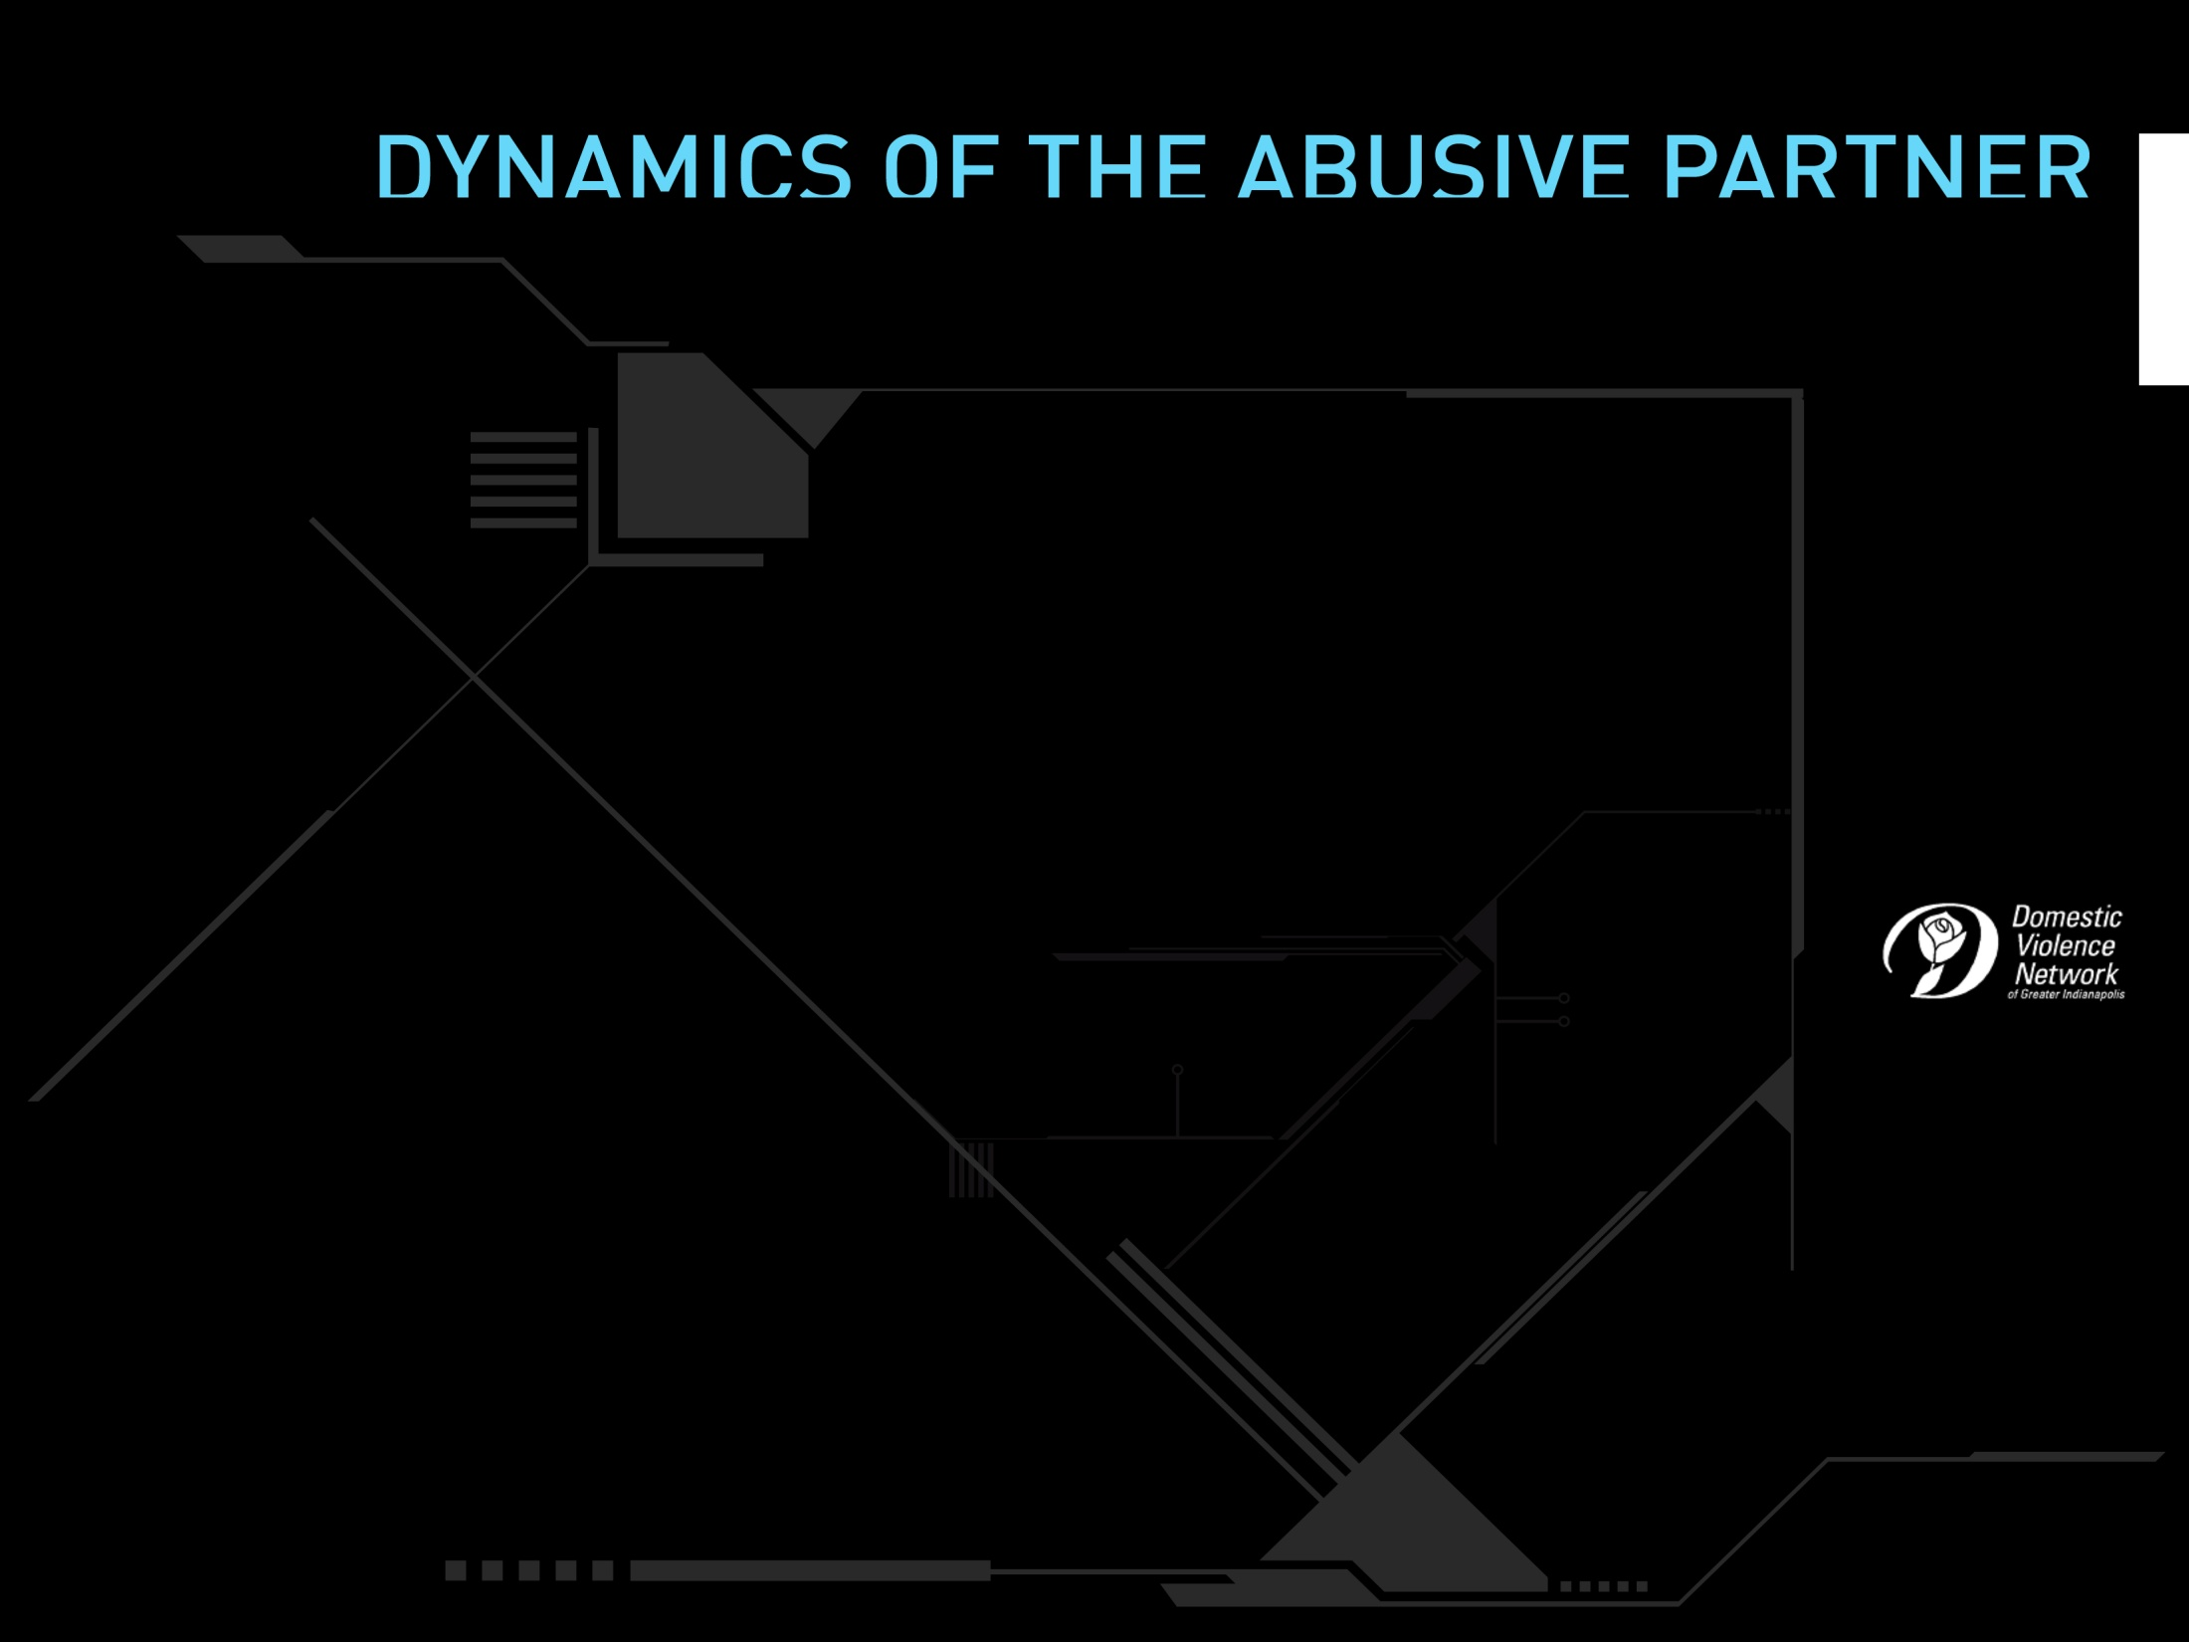
Escalation
Increased tension,
anger, blaming, name
calling, etc.
Explosion
Incident of abuse, violence, sexual assault, etc.
Cycles of abuse
Honeymoon
Apologies, increased romance, or possible denial.
Calm
Seems like an ordinary relationship.

Slide 7
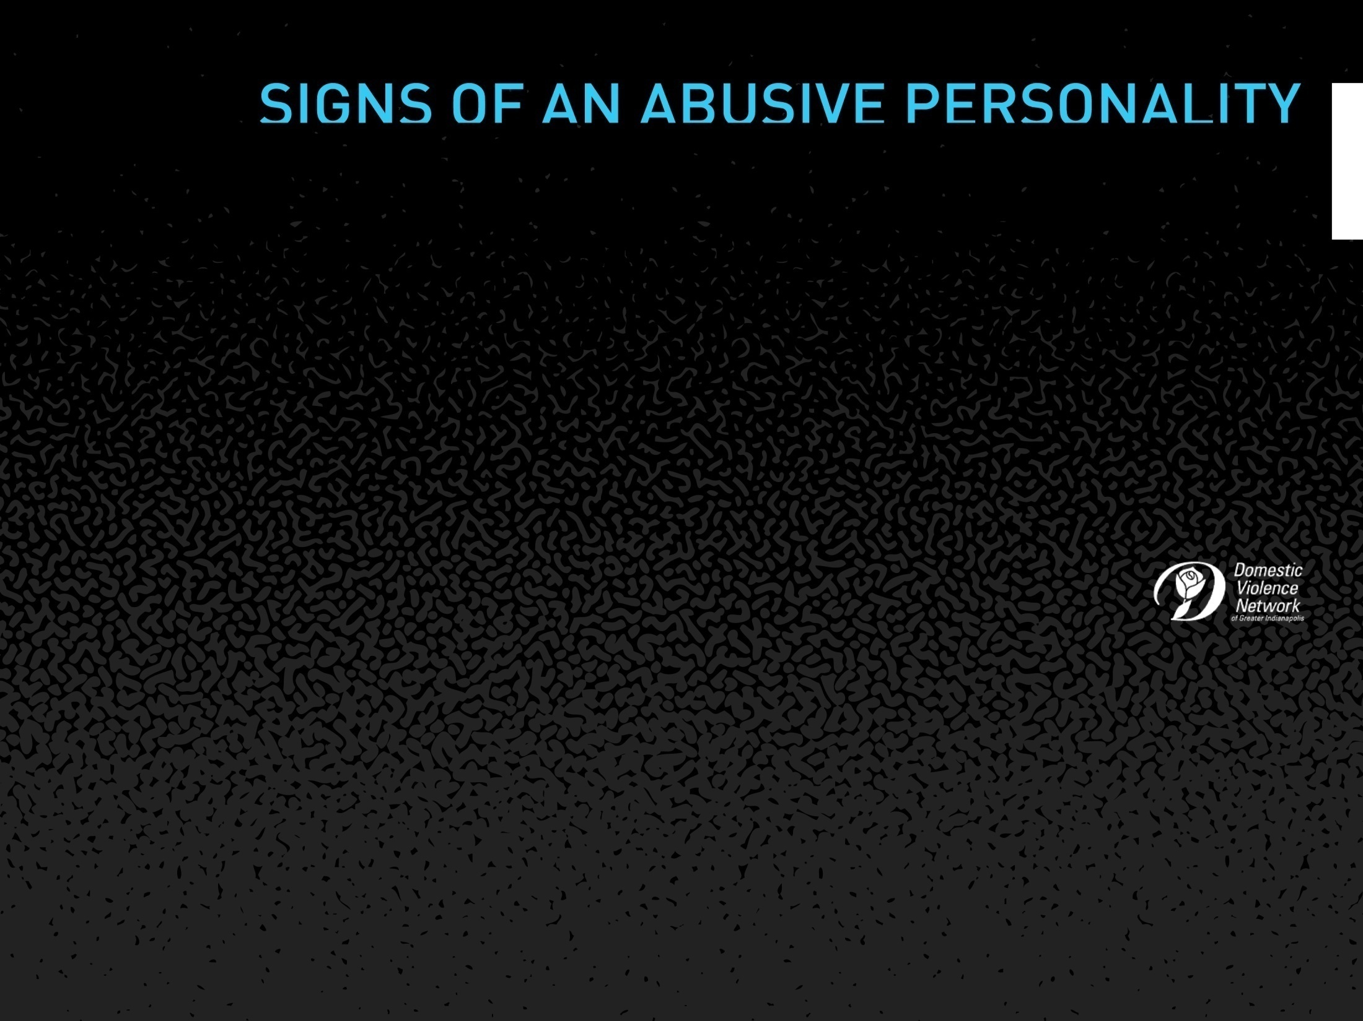
Controlling behavior
Unrealistic expectations
Blaming others for problems or feelings
Sexual violence
Verbally abusive
Jealousy
Intimidating personality
Dr. Jekyll / Mr. Hyde
Sexually aggressive
History of abusing other partners
Rigid gender roles
Hypersensitivity
Cruelty to animals and children
Possessive behavior
Pushes for immediate commitment
Lack of empathy

Slide 8
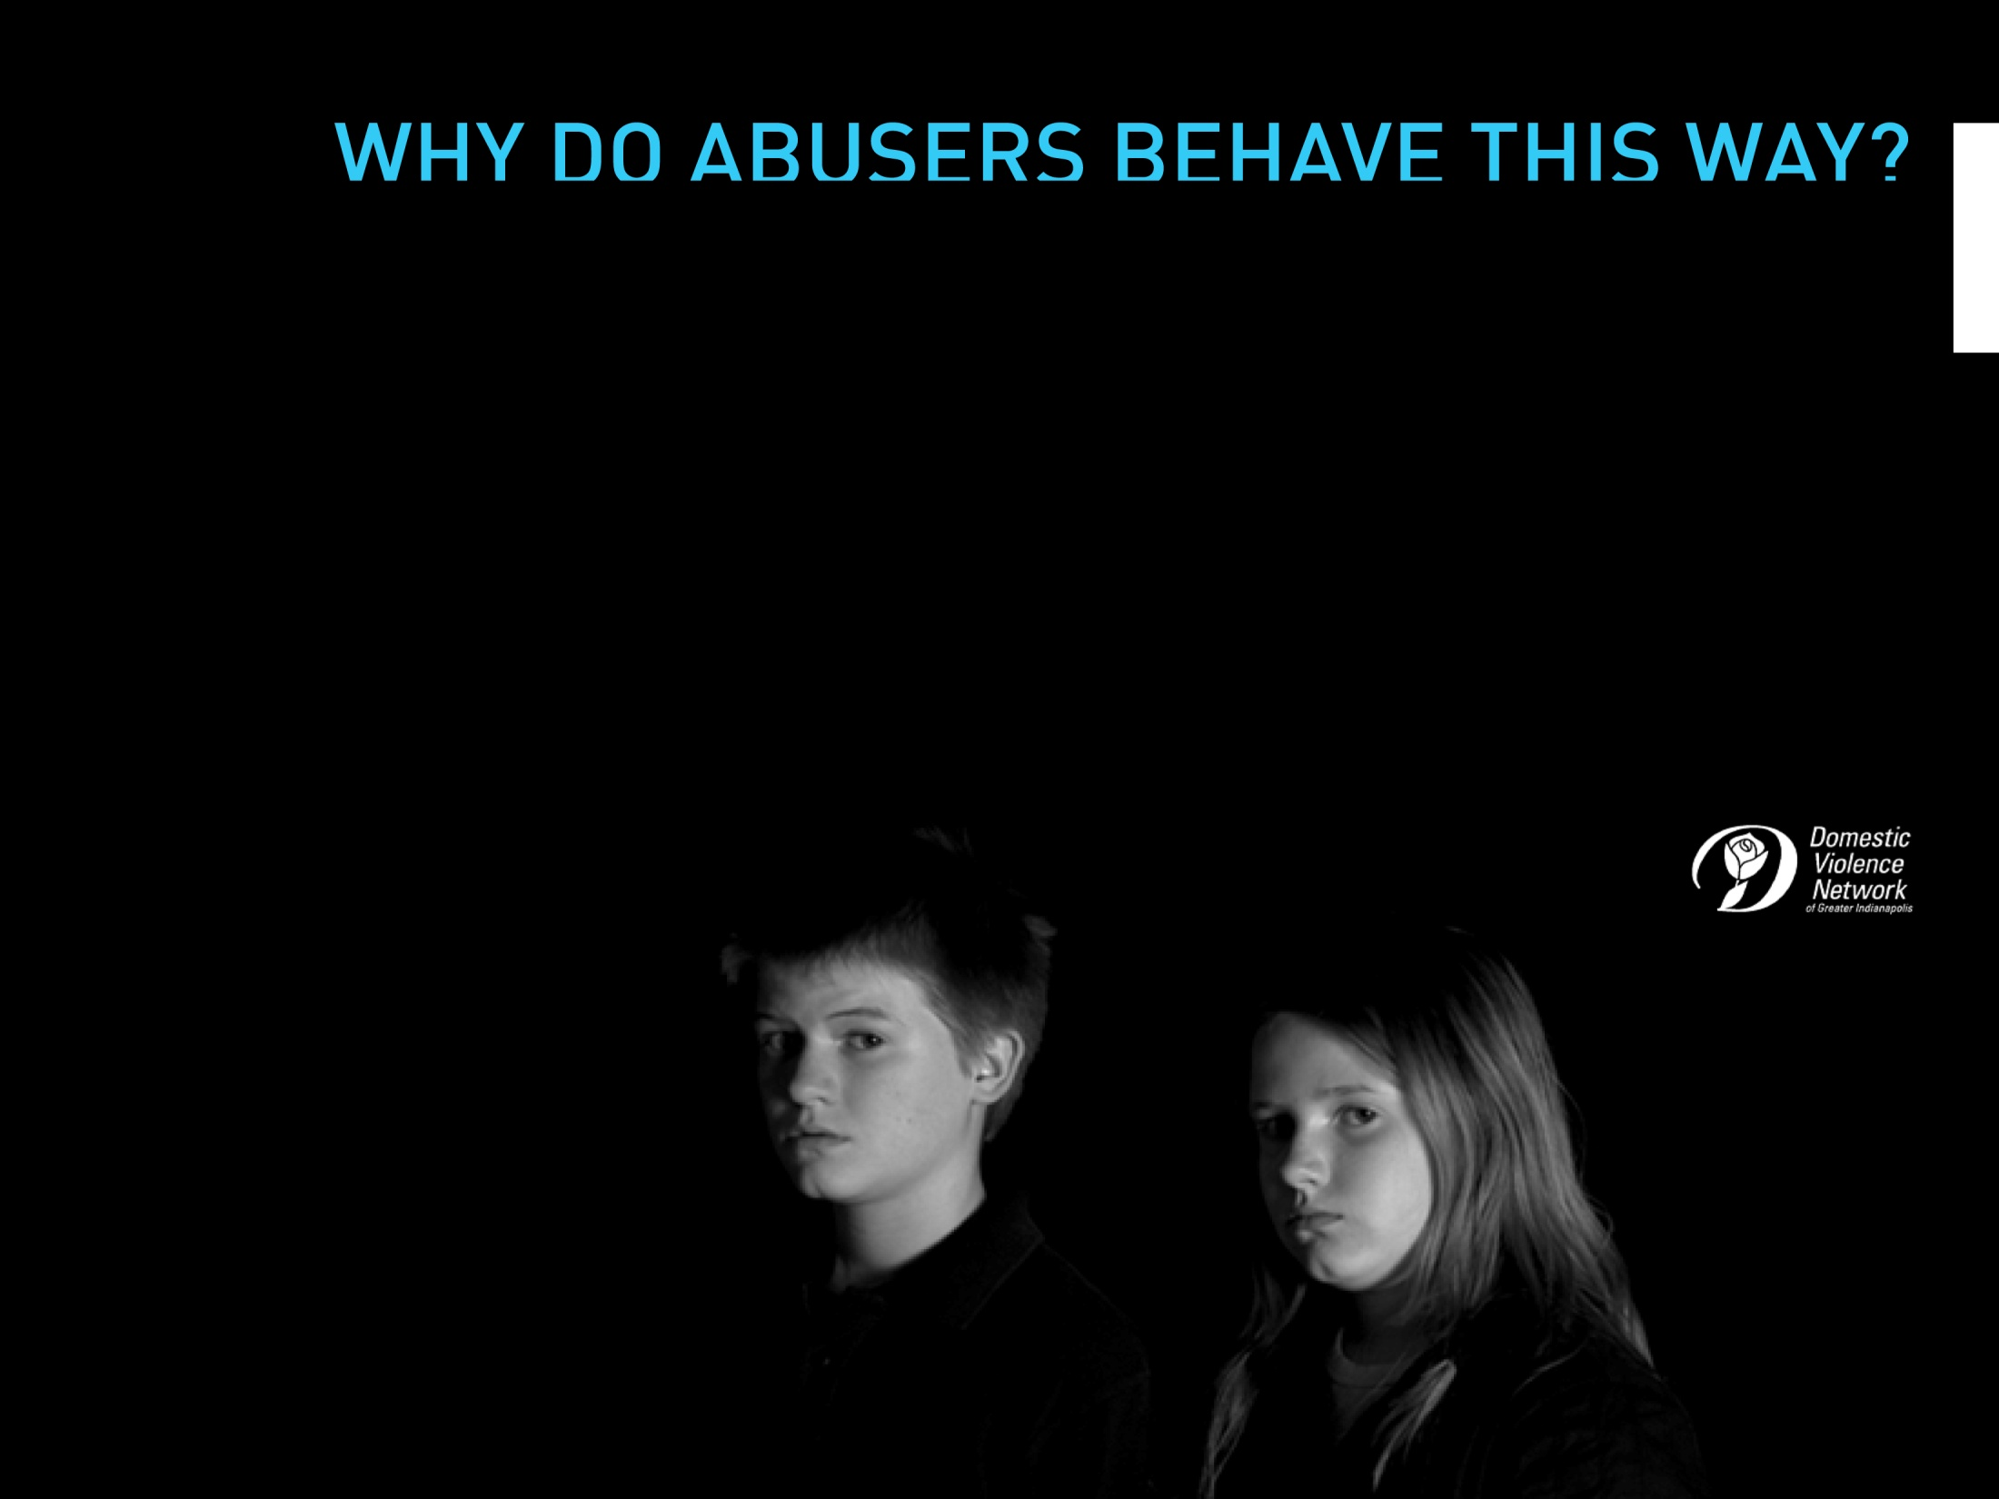
Abusive behavior is NOT caused by the use of alcohol or other drugs,
stress, poverty, disagreements, jealousy or mental illness.
The person behaving abusively is the only person who is responsible for the
abuse. It is not caused by anything said or done by the person who is abused.
Partner abuse is driven by a “need” to dominate those close to them.
excuses, excuses…

Slide 9
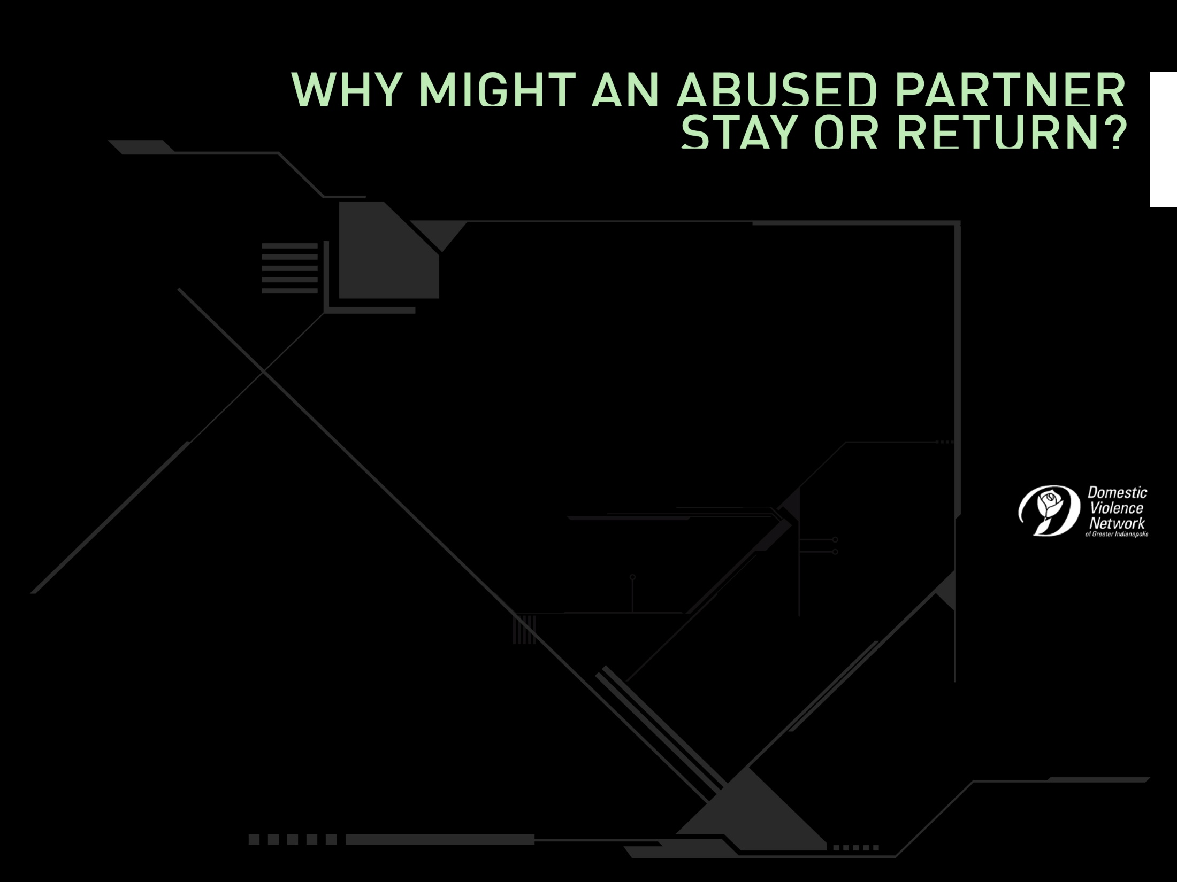
Financial dependence on abuser
Health problems or disability
Nowhere to go
Fear for life or safety based on threats
Hope that violent or abuse will stop
Religious beliefs
Too exhausted by the abuse
Belief that the abuser will change
Belief that the abuser has changed
A lack of supportive relationships
Children’s love and attachment to the abuser
One’s own love for the abuser
Belief in an obligation to the relationship
Family disapproval or lack of emotional support
Not wanting to be alone
Fear of losing custody of the children
Abuser is not always abusive

Slide 10

Leaving the relationship might not end the abuse…
Most abused partners report increased harassment or even violence after they break off the relationship.
75% of women who die due to domestic violence are killed after
leaving the relationship.
Only the survivor can determine when it is safe to leave.

Slide 11
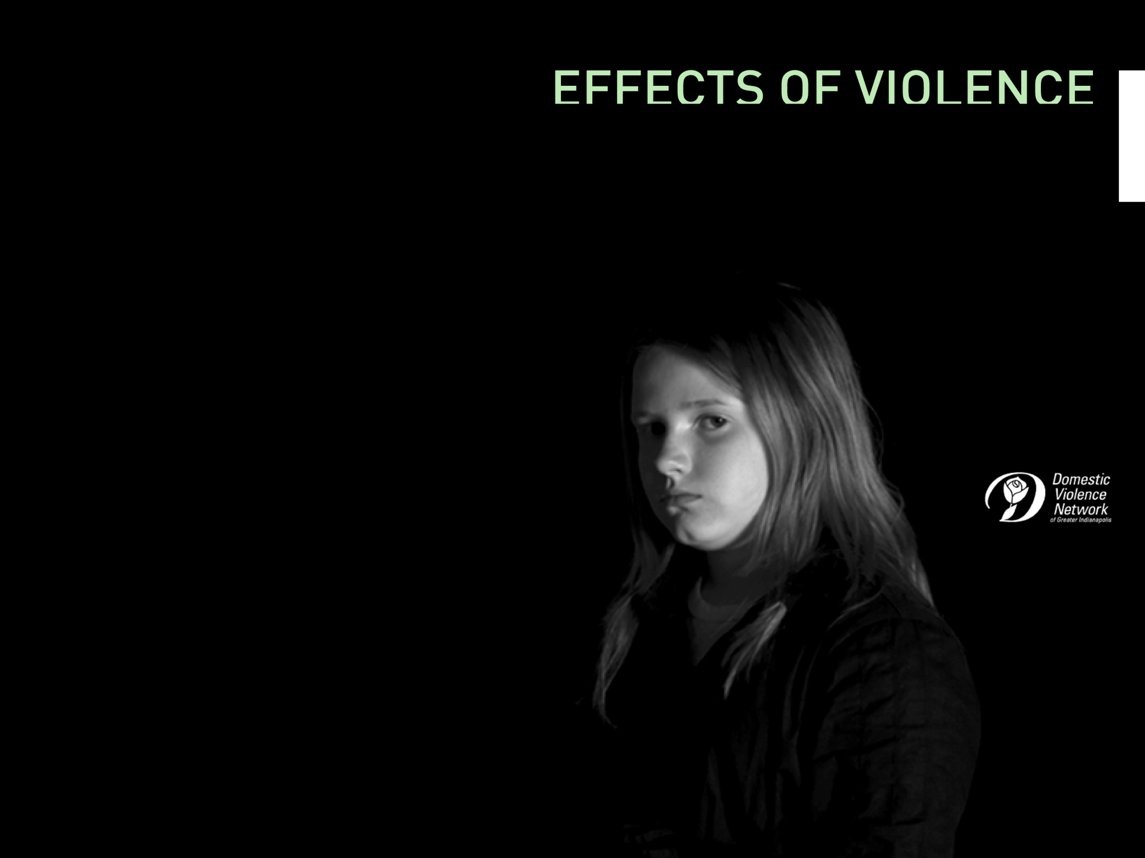
Up to 10 million children are exposed to partner abuse in their homes each year.
As many as 324,000 pregnant women are battered each year.
The U.S Advisory Board on Child Abuse suggests that partner abuse may be the single major precursor to child abuse and neglect fatalities.
cycles of abuse

Slide 12
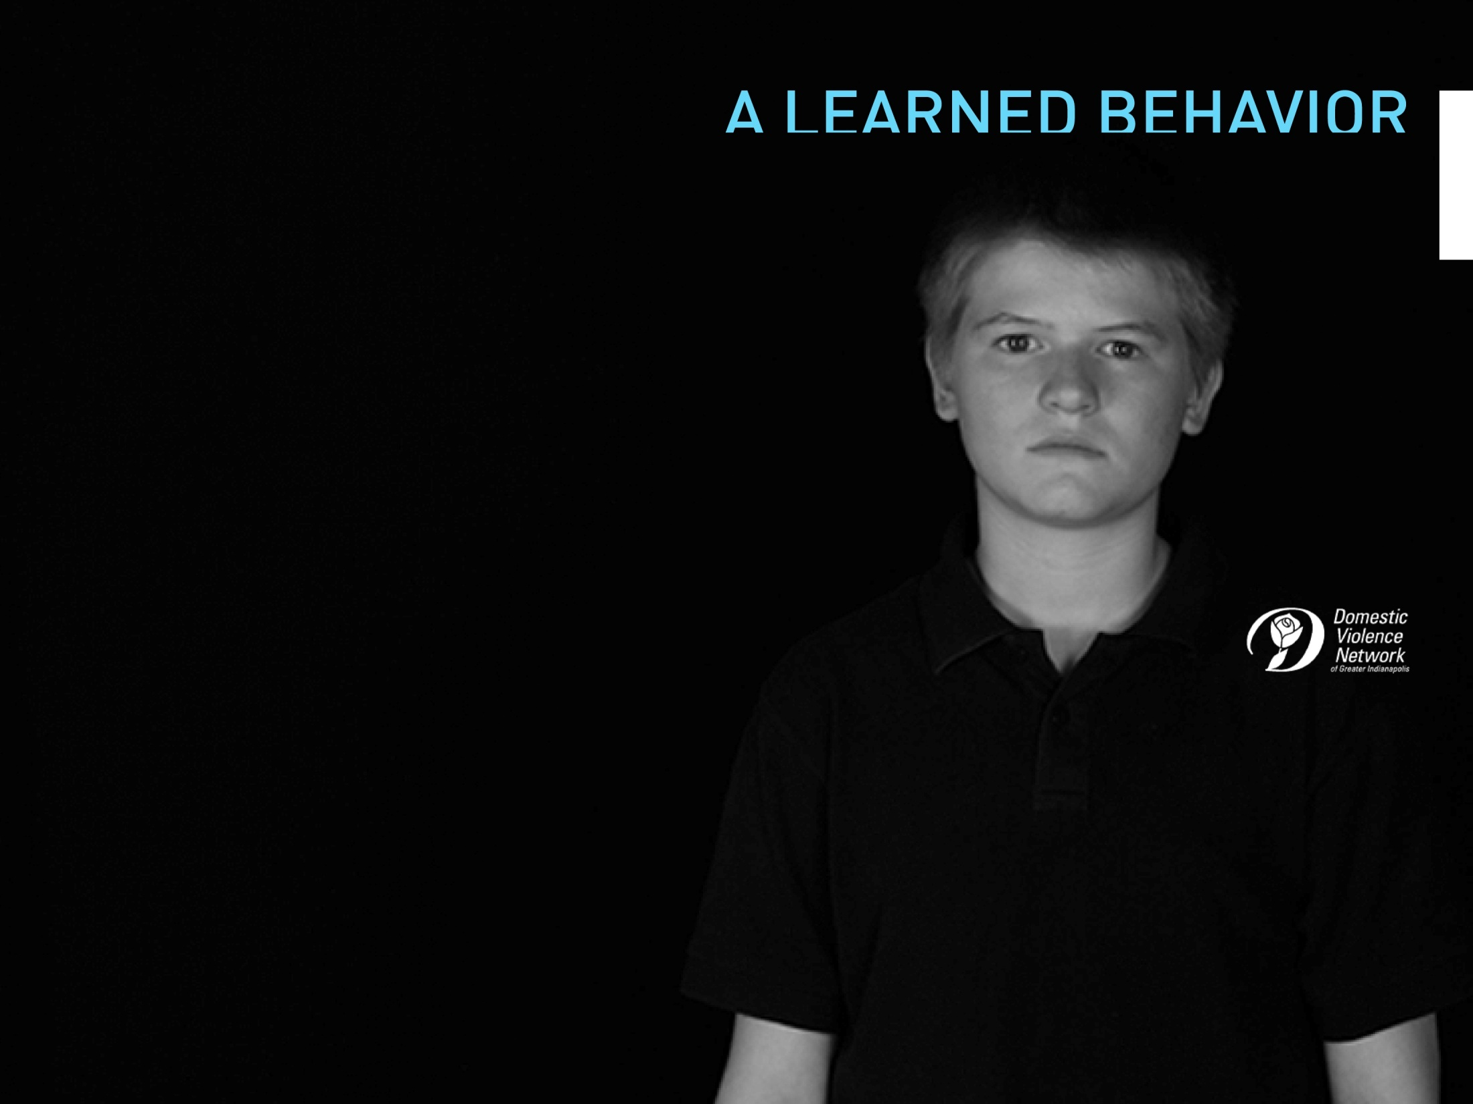

cycles of abuse
Children who grow up in violent homes have a 74% higher likelihood
of committing criminal assaults.
(Survey of Massachusetts Department of Youth Services, Self Magazine, May 1992)
79% of violent children have witnessed violence between their parents.
(Family Violence Prevention Fun, 1991 “The Invisible Victim: Children of the War At Home.”
Source quoted as Lewis, et al. 1983)

Slide 13
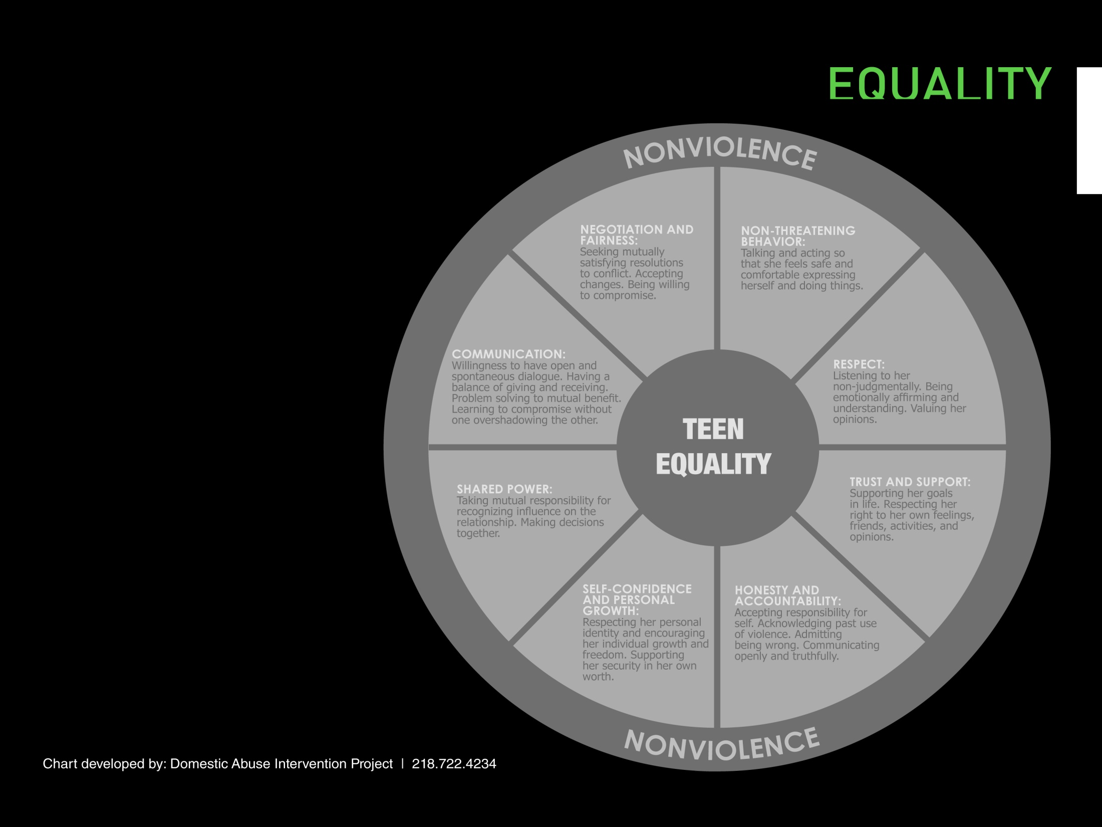
Non-Threatening Behavior
Respect
Trust and Support
Honesty and Accountability
Self-Confidence
Shared Power
Communication
Negotiation and Fairness

Slide 14
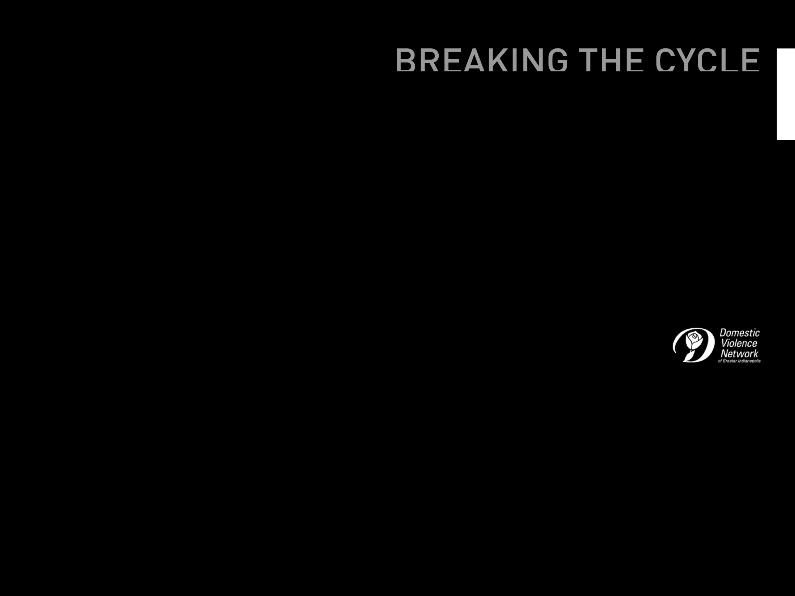
helping a friend in need
Validation
Focus on safety
Confidentiality
Respect autonomy
Connect to resources
Patience
Compassion
As simple as it is, just saying “I believe you” goes a long, long way.
Address immediate needs. Contact a local advocacy group for help.
It is important not to gossip or tell anyone else about the disclosed abuse without the survivors permission.
A survivor is taking a great risk talking to you about the abuse… taking action without his or her permission could only put them at further risk.
A key supportive role is to help the survivor locate and navigate the systems that may help him/her.
On average, it takes 7 to 10 times for an abused person to leave their abuser.
Even if you don’t always know what to do, or what to say, don’t underestimate how powerful your concern is to survivors of abuse.

Slide 15
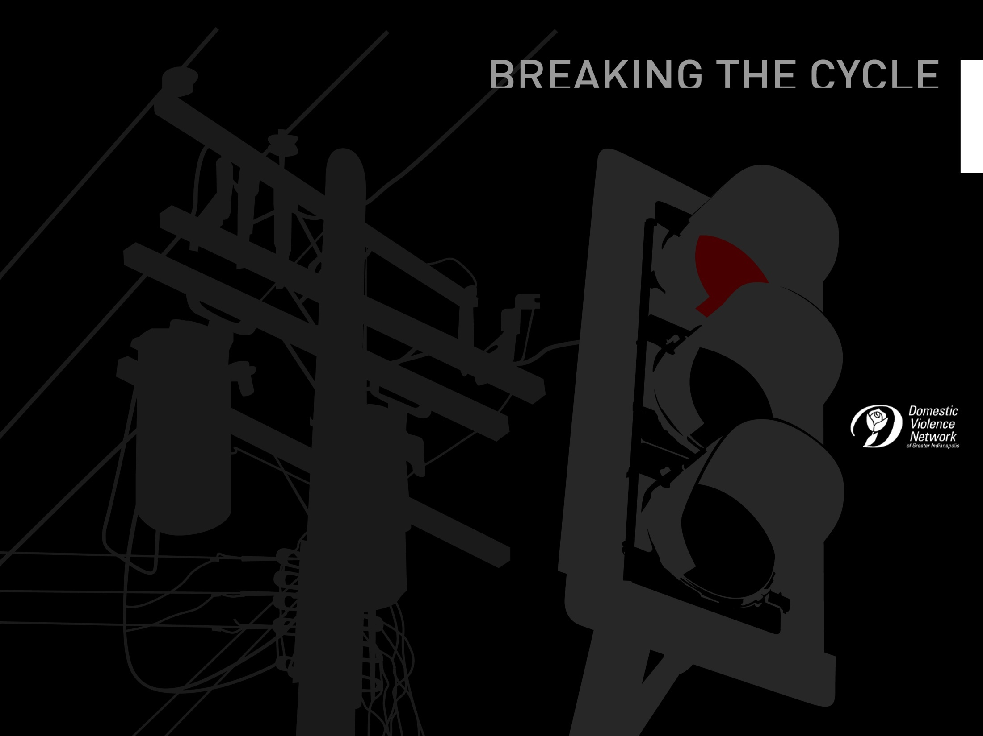
what if someone you know is acting abusively?
Don’t turn the other cheek
Address their behavior
Accountability
Discuss abuse
Connect to resources
Don’t allow justifications
Stay in touch
Speak out
Don’t ignore abusive behavior. Your silence helps the abuser pretend there is nothing wrong with their behavior.
Focus on their abusive actions, not their whole person.
Be firm: Tell the abuser that he or she is the only person responsible for their behavior, and that they CAN control their actions.
Help the abuser identify and understand what abuse is. Focus on the serious harm to the victim and the possible consequences for the abuser.
Encourage the abuser to seek professional help. Help the abuser locate a certified batterers program.
Do not participate in, or allow, justifications of abusive behavior. The only person responsible for the abuse is the abuser.
This isn’t a one time conversation, and an abuser will not change over night. Keep supporting non violent behavior by staying in touch, offering encouragement, and keeping the topic alive.
Set an example of compassion and non violence. Speak out against abuse.

Slide 16

breaking free from abuse
Safety plan
Tell someone you trust
Research your options, make a plan
Seek help – Help is available know matter what type of abuse you are experience.
Trust yourself, trust your instincts

