Slide 1




“Indiana children will live in safe, healthy and supportive families and communities.”

Slide 2

DCS CARES Act RFF - Informational Conference

Slide 3


Coronavirus Aid, Relief, and Economic Security (CARES) Act Request for Funding (RFF)
RFF Informational Conference
October 15, 2020
3:00 PM ET
www.in.gov/dcs

Slide 4

General Information
All information supplied in this webinar can be found in the RFF.
This webinar is not intended to be a comprehensive summary of the RFF. Applicants must read the DCS CARES Act RFF for details.
This webinar PowerPoint will be posted on DCS’ grant website.
Please hold questions until the end of the webinar.
  Any verbal response is not considered binding; respondents are encouraged to submit any questions formally, in writing, if it affects the proposal that will be submitted to the state.
www.in.gov/dcs
Notes:
In RFF, it is mentioned that the webinar can be accessed through a link on the RFF webpage.

Slide 5

Agenda
Grant Overview
  RFF Objectives
  Eligible Applicants
  Grant Funding
  Eligible and Ineligible Expenses
  Key Dates
Grant Application Components
  DCS CARES Act Webpage
  RFF Outline
  General Applicant Information
  Grant Budget Proposal
  Supporting Budget Documentation
  Provider Attestation
  Risk Assessment Form
  Sample Grant Agreement
  Intent to Respond Form
  KidTraks Provider User Guide
Question and Answer Session
  Written Questions
  Verbal Questions
www.in.gov/dcs

Slide 6
Grant Overview

Slide 7

RFF Objectives
This RFF is being issued by the Indiana Department of Child Services (DCS) to provide economic assistance to eligible providers impacted by COVID-19.
The goal of this RFF is to provide funding to eligible providers to reimburse expenditures that have incurred due to COVID-19 while delivering high quality child welfare services in the state of Indiana.
This RFF requests responses from eligible providers that have experienced expenditures incurred due to COVID-19 to meet the needs of children receiving their services.
www.in.gov/dcs

Slide 8

Eligible Applicants
To receive funding under this grant, an eligible provider must be a current DCS contractor (with an active contract) who provided services during the grant period (March 6, 2020 through June 30, 2020). Eligible provider types include the following:
  Licensed Child Placement Agencies (LCPA)
  Community-Based Providers
  Residential Providers
If an agency provides services in more than one of the eligible provider categories (LCPA, Community-Based, and/or Residential) the agency shall submit one application with a separate reimbursement request for each provider category.
www.in.gov/dcs

Slide 9

Grant Funding
The State of Indiana has set aside $10.8 million for eligible applicants to this RFF.
Applicants will apply for available funds per the guidelines in this RFF. If awarded, the applicant will receive funds to reimburse the items approved in the applicant’s request.
DCS reserves the right to make all final award decisions and to award grants based on applications received and available funding. The amount of grant funding available for each provider may differ depending on the provider type and need.
DCS has set a maximum amount of funds available to eligible applicants. Each applicant may apply for a funding amount no greater than ten (10) percent of DCS payments for provider services made over the grant period (March 6, 2020 to June 30, 2020).
www.in.gov/dcs

Slide 10
Eligible Expenses
The CARES Act provides that payments may only be used to cover costs that:
  Are necessary expenditures incurred due to the public health emergency with respect to the Coronavirus Disease 2019 (COVID–19);
  Either represent increase costs that would not have been incurred but for COVID-19 (private entity) or were not accounted for in the budget most recently approved as of March 27, 2020 for the government (public entity);
  Were not covered by any other Federal, State, other governmental, or non-governmental program; and
  Were incurred during the period that begins on March 6, 2020 and ends on June 30, 2020.
www.in.gov/dcs

Slide 11
Eligible Expense Categories (CARES)
Expenses must fall within the following categories, as mandated by the CARES Act, and Respondents shall classify each line item expense in their Budget Proposal into these categories:
  Medical Expenses
  Public Health Expenses
  Payroll Expenses
  Public Health Compliance Expenses
  Economic Support Expenses
  Other Reasonably Necessary Expenses
In addition to ensuring all expenses fall within these CARES Budget Categories, providers must also organize their expenses into DCS expense categories based on the provider type (LCPA, Community-Based, and/or Residential).
www.in.gov/dcs

Slide 12
Eligible Expense Categories (DCS)
LCPA’s eligible expenses will also need to be classified in the eight categories listed below:
  Administrative
  Adoption
  Case Management
  Time Study
  Non IV-E (IL & Recreation)
  Behavioral Health
  Medical
  Education
Community-based providers’ eligible expenses only need to be classified in the six categories mandated by the CARES Act listed on the previous slide
Residential providers eligible expenses will also need to be classified in the eight categories listed below:
  Administrative
  Maintenance
  Case Management
  Time Study
  Non IV-E (IL & Recreation)
  Behavioral Health
  Medical
  Education
www.in.gov/dcs

Slide 13
Ineligible Expenses
The following is a non-exclusive list of costs that would not be eligible:
  Expenses for the State share of Medicaid.
  Damages covered by insurance.
  Payroll or benefits expenses for employees whose work duties are not substantially dedicated to mitigating or responding to the COVID-19 public health emergency.
  Expenses that have been or will be reimbursed under any federal program, such as the reimbursement by the federal government pursuant to the CARES Act of contributions by States to State unemployment funds.
  Reimbursement to donors for donated items or services.
  Workforce bonuses other than hazard pay or overtime.
  Severance pay.
  Legal settlements.
www.in.gov/dcs

Slide 14
Key Dates
Activity | Date
RFF sent to potential applicants and posted online | October 9, 2020
RFF Informational Conference | October 15, 2020
Application questions due to State by 3 PM ET | October 16, 2020
Answers to questions posted (subject to change based on volume) | October 23, 2020
RFF applications due at 3 PM ET | November 5, 2020
Approximate award decisions release date* | December 8, 2020
*Depending on how many applications DCS receives, the award date may change to allow for adequate time for review.
www.in.gov/dcs

Slide 15
Grant Application Components

Slide 16
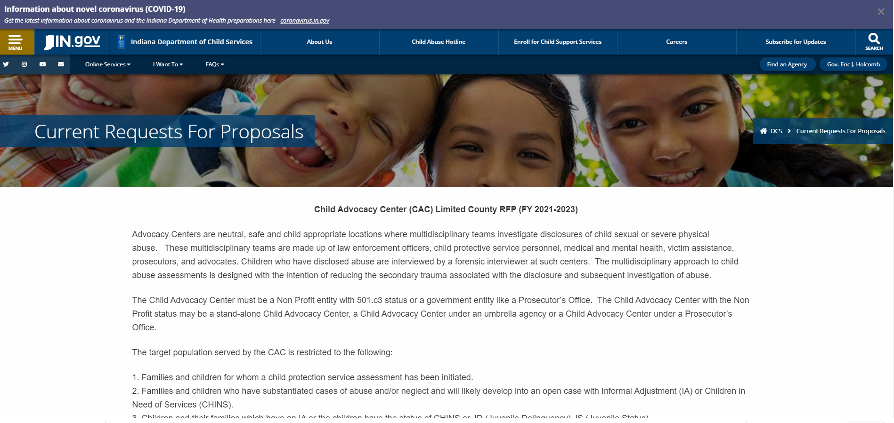
DCS CARES Act RFF Webpage
https://www.in.gov/dcs/3151.htm
www.in.gov/dcs

Slide 17
RFF Outline
Section | Description
Section 1 – Introduction | This section provides an overview and outline of the RFF.
Section 2 – Grant Application Details | This section provides additional details including eligible applicants, eligible expenses, and a general timeline of RFF events.
Section 3 – Grant Application Components | This section includes a description of required application components.
Section 4 – Application Review | This section discusses the criteria to be used to review applicants’ proposals.
Attachment A | Risk Assessment Form
Attachment B | Question and Answer Response Template
Attachment C | Provider Attestation
Attachment D | Grant Budget Proposal
Attachment E | Sample Grant Agreement
Attachment F | Intent to Respond Form (Optional)
Attachment G | KidTraks Provider User Guide
www.in.gov/dcs

Slide 18
General Applicant Information
Any interested applicant must submit a complete grant application no later than 3 PM ET on November 5, 2020, to be eligible for award. Any applicant that does not submit a complete application on time may not be considered for award.
All components of the grant application should be submitted through KidTraks (see Attachment G).
Each applicant is required to provide general information regarding their organization according to the instructions on KidTraks (see Attachment G), separate from any grant application component.
www.in.gov/dcs

Slide 19
Grant Budget Proposal
The Grant Budget Proposal is available in an Excel document file (Attachment D) and is broken out into three tabs for each provider category.
Complete a detailed budget for the total funding amount that you are requesting for each provider category (LCPA, Community-Based, and/or Residential) by submitting the Grant Budget Proposal (Attachment D) with associated tab(s) completed.
Applicants who do not submit their budget using Attachment D may be disqualified. Applicants shall not unlock the form and shall not make modifications to the locked template.
If an agency provides services in more than one of the eligible provider categories (LCPA, Community-Based, and/or Residential) the agency shall submit one application with a separate reimbursement request for each provider category.
www.in.gov/dcs

Slide 20
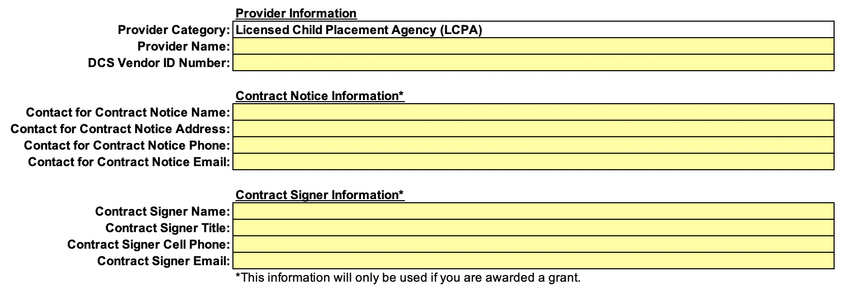
Grant Budget Proposal (continued)
Applicant Information: Applicants shall enter provider name, DCS vendor ID number, information for the contact for contract notice, and information for the contract signer.
www.in.gov/dcs

Slide 21
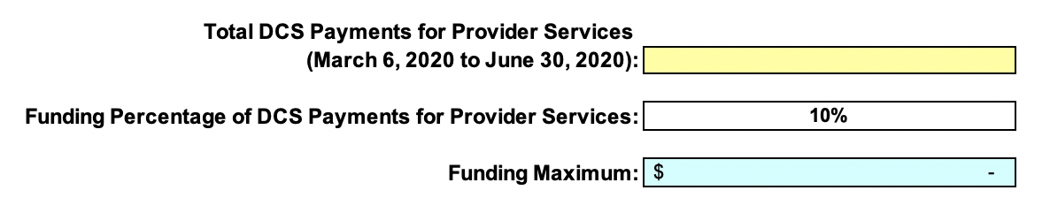
Grant Budget Proposal (continued)
Request Maximum: Applicants shall enter the dollar amount of the total DCS payments made for the provider category's services over the grant period (March 6, 2020 to June 30, 2020).
www.in.gov/dcs

Slide 22
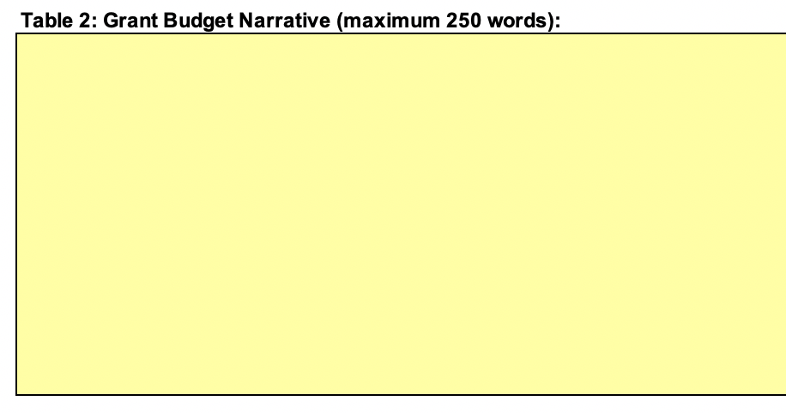
Grant Budget Proposal (continued)
Grant Budget Narrative: Applicants shall provide a narrative explaining how they created their budget and why the items in their budget meet the requirements of the RFF.
www.in.gov/dcs

Slide 23
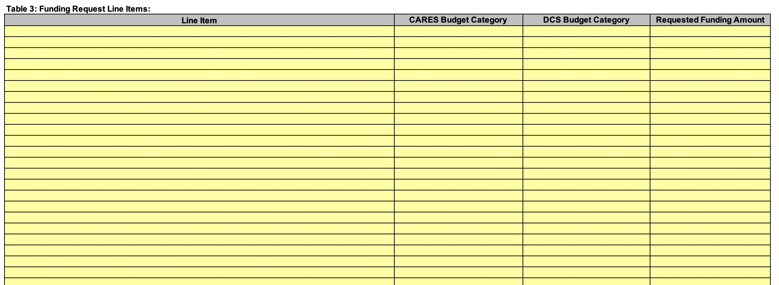
Grant Budget Proposal (continued)
Funding Request Line Items: Applicants shall enter all line items requested as part of the RFF, including appropriate DCS Budget Categories, CARES Budget Categories, and requested funding amount for each line item.
Note: Community-Based Providers need only select a joint DCS/CARES Budget Category
www.in.gov/dcs

Slide 24
Grant Budget Proposal (continued)
Applicants shall repeat this process on the Excel tab for other provider categories (LCPA, Community-Based, and/or Residential) as necessary.
Please note that the Total Funding Request (the sum of all Funding Request Line Items) cannot exceed the Funding Maximum, calculated as 10% of the Total DCS Payments for Provider Services over the Grant Period.
www.in.gov/dcs

Slide 25
Supporting Budget Documentation
Each applicant is required to submit supporting documentation for all line items included in their Grant Budget Proposal.
Examples of supporting documentation include, but are not limited to, receipts, pay stubs, and timesheets.
Any line items that are submitted without supporting documentation may be excluded from the applicant’s budget request.
www.in.gov/dcs

Slide 26
Provider Attestation
Each applicant is required to submit a signed letter of attestation (Attachment C) stating that all submitted expenses are eligible according to the guidelines of the RFF, the CARES Act, and State and Federal laws and regulations.
The signed letter also confirms the applicant acknowledges that the State reserves the right to:
  Verify and/or audit all submitted expenses.
  Recoup any and all funds that violate the guidelines of this RFF, the CARES Act, or State and Federal laws and regulations.
  Recoup funding for expenses covered by other federal, state, local governmental, or non-governmental programs.
www.in.gov/dcs

Slide 27
Risk Assessment Form
Each applicant is required to submit a completed Risk Assessment Form (Attachment A).
A completed Risk Assessment Form is requirement for a completed response.
www.in.gov/dcs

Slide 28
Sample Grant Agreement
Each applicant is required to review, agree, and adhere to the Sample Grant Agreement (Attachment E).
Signing the Provider Attestation (Attachment C) completes this requirement.
www.in.gov/dcs

Slide 29
Intent to Respond Form
Each applicant is requested to provide an optional letter of intent indicating their intention to submit a request for this RFF.
If the applicant subsequently decides not to respond after submitting this letter of intent, there are no ramifications.
Please submit the letter using the Intent to Respond Form (Attachment F).
The letter may be emailed to Michael.Sturm@dcs.IN.gov by October 16, 2020 at 3 PM ET.
www.in.gov/dcs

Slide 30
Question & Answer Session

Slide 31
Written Questions
Any verbal response is not considered binding; respondents are encouraged to submit any questions formally, in writing, if it affects the proposal that will be submitted to the state.
Written questions regarding the content of this RFF must be submitted to Michael.Sturm@dcs.IN.gov by October 16, 2020 at 3 PM ET. Please use Question and Answer Response Template (Attachment B) to submit your questions. The State reserves the right not to address questions about the RFF submitted after the deadline.
The State will post a document with answers to applicant questions on the RFF website on or around October 23, 2020. Applicants are encouraged to check the website for amendments to the RFF when answers to applicants’ questions are posted.
www.in.gov/dcs

Slide 32
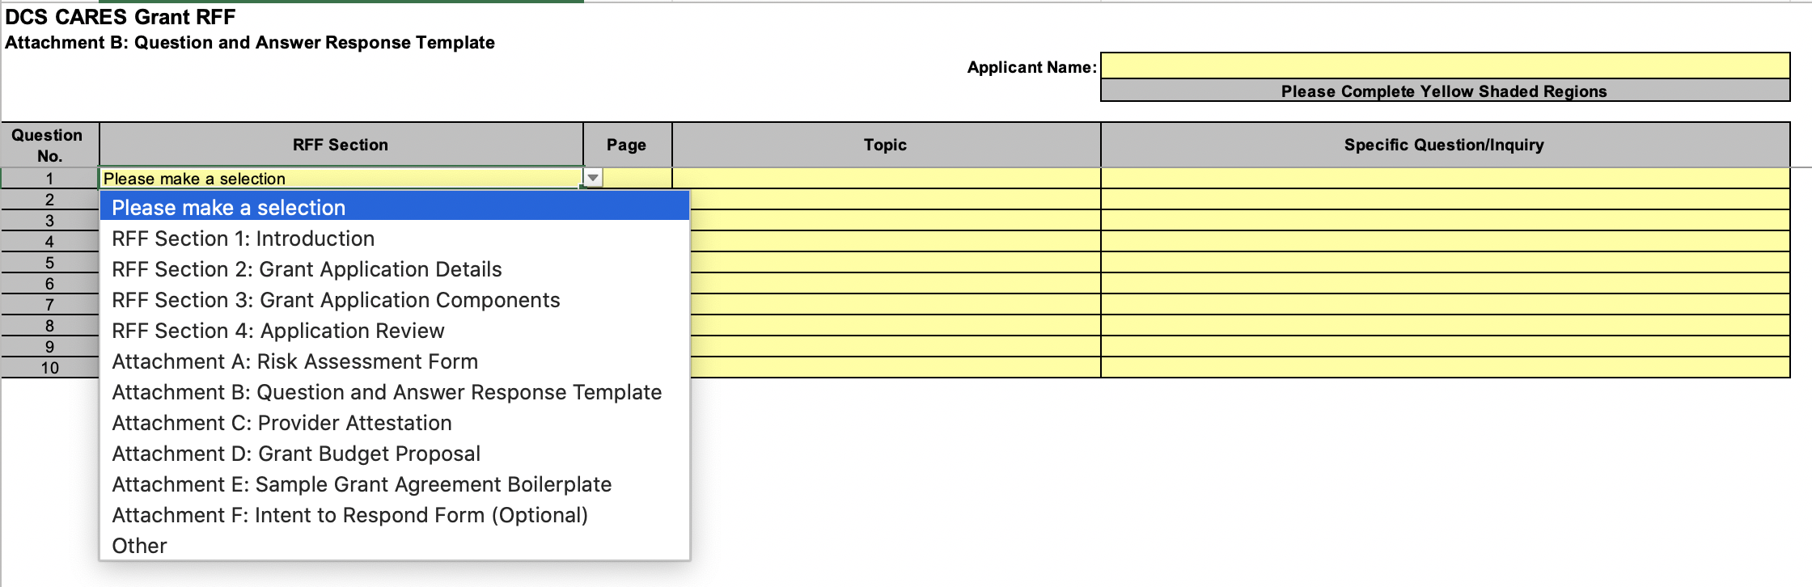
Written Questions (Continued)
www.in.gov/dcs

Slide 33
Verbal Questions
Any questions or comments?
As a reminder, any verbal response is not considered binding; Respondents are encouraged to submit any question formally in writing if it effects the proposal that will be submitted to the State.
Grant application are due no later than 3 PM ET on November 5, 2020 through KidTraks (see Attachment G), to be eligible for award.
Thank You!
www.in.gov/dcs

Slide 34

“Indiana children will live in safe, healthy and supportive families and communities.”

