Slide 1

Community Mental Health Center Request for Proposal
Department of Child Services, Services and Outcomes 1/19/15

Slide 2
Purpose of Webinar
Inform CMHC’s of RFP
Walk through requirements of RFP
Review milestones

Slide 3
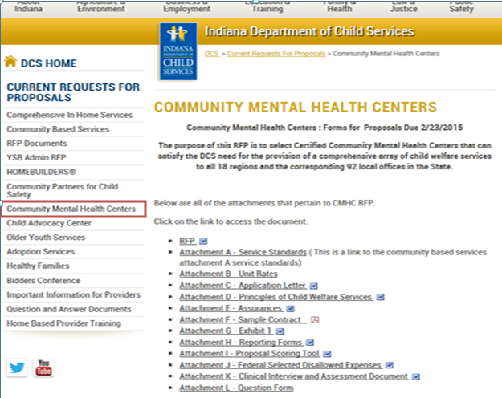
RFP Documents
http://www.in.gov/dcs/3155.htm

Slide 4
Purpose of RFP and Services
  The purpose of this RFP is to select Certified Community Mental Health Centers that can satisfy the DCS need for the provision of a comprehensive array of child welfare services to all 18 regions and the corresponding 92 local offices in the State.
  Contract period: 7/1/15-6/30/17
Homebased Family Centered Casework
Homebased Family Centered Therapy
Homemaker/Parent Aid
CHINS Parent Support
Clinic based Counseling
Diagnostic and Evaluation Services
Parent Education
Parenting family Functional Assessments
Sex Offender Treatment
Tutoring/Literacy Classes
Visitation Facilitation
Detoxification
Residential Substance Use Treatment
Substance Use Disorder Assessment
Substance Use Outpatient Treatment
Children’s Mental Health Initiative
SOBRIETY TREATMENT AND RECOVERY TEAMS (START)-Pilot in limited areas

Slide 5
Regarding Access to Services
Methods of payment: Medicaid Clinic Option (MCO), Medicaid Rehabilitation Option (MRO) and Department of Child Services (DCS).
It is the responsibility of the service provider to utilize Medicaid for Medicaid eligible services prior to seeking DCS funding. It is expected that clients and families will receive services that are medically necessary as well as services to fully address child safety and family functioning regardless of the funding source.
The CMHC should assist clients in their application to enroll in Medicaid. It is expected that the CMHC utilize Medicaid funding for all eligible services, and to know which services are billable to Medicaid. DCS will make payment for authorized services that cannot be billed to Medicaid.
It is the CMHC’s responsibility to ensure their staff meet the minimum qualifications of the DCS service standards.

Slide 6
CMHI
  The Children’s Mental Health Initiative (CMHI) is an initiative to provide services to children who do not have formal involvement with the child welfare system, but due to their behavioral health needs, require services to maintain safely in their home and community.
  Assessment for eligibility
  Wraparound Facilitation
  Habilitation
  Respite
  Family Support and Training for the Unpaid Caregiver
  Behavioral health services as defined under Medicaid Rehabilitation Option
  Behavioral health services as defined under Medicaid Clinic Option
  Other necessary client specific services

Slide 7
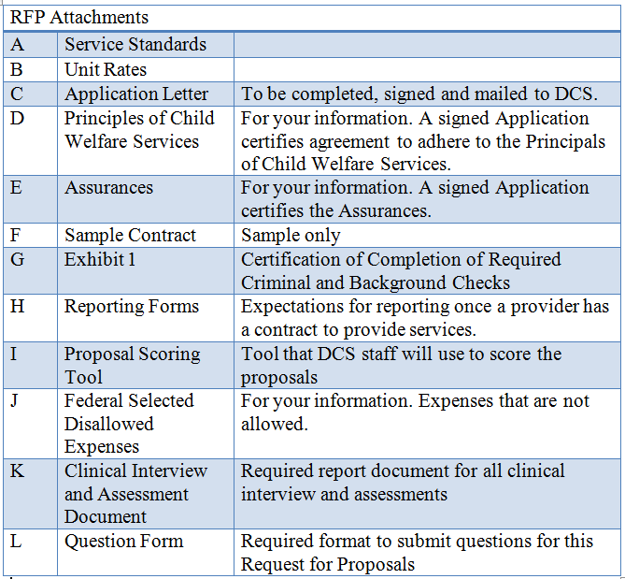
RFP Attachments

Slide 8
RFP Milestones
Key RFP Dates
Issue of RFP: January 13, 2015
Questions due to DCS: January 26, 2015 10am EST
Responses to questions posted to website: February 9, 2015
Submission of Proposals: Original signed hard copy postmarked by February 23, 2015
The following timeline is only an illustration of the RFP process. The dates associated with each step are not to be considered binding. Due to the unpredictable nature of the evaluation period, these dates are commonly subject to change.
Notification of Awards: May 1, 2015
Contract Start Date: July 1, 2015
Contract End Date: June 30, 2017

Slide 9
Application Letter
The provider agrees to comply with the assurances
The provider agrees to comply with the sample contract
The provider agrees to comply with the Child Welfare Principles
The provider agrees to comply with the service standards
The provider agrees to provide Home Based Family Centered Casework Services, Home Based Family Centered Therapy, Counseling, Diagnostic and Evaluation Services, Substance Use Disorder Assessment and Substance Use Outpatient Treatment within the provider’s service area.

Slide 10
Thank you!

