Slide 1
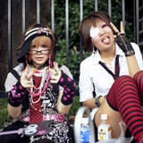
Teen Development 13-18
Presented by: Erika McCuiston
SCAN Training Technician

Slide 2

13 to 18 Years
Task: Identity, Sexuality, Separation
Child’s Responsibility
  Emotional Separation
  Sexual Identity
  Develop own moral thinking
  Physical Separation (possibly)
Notes:
Discuss that initial topics ill be discussed as activities that happen during this age range. Since development happens at differnet periods for different individuals it is difficult to pin point a specific age. More specific development related to specific age will be discussed following general development.
Major tasks during these years:
WHO AM I??
Discovering how to become comfortable in own skin
Spreading wings and experiencing joy and fears of independence

Slide 3

Parents Responsibility
Be clear on rules, negotiate rules
Encourage moral behaviors
Encourage being responsible
Behavior and thinking-allow consequences
Be the grown-up!
Notes:
Parents are growing and developing to understand and hopefully meet the needs of their teens. Parents need to follow through on their “end of the deal” in order to assist in building a solid foundation for teens to build from. The “real world” will teach if parents do not. Much easier to learn from those who love, comfort, and support then others
May be challenging for parents to allow consequences “tough love” needed experience!
Parent not friend role-does not mean that communication is sacrificed!

Slide 4

Parents Responsibility
RUN THE FAMILY!
Accept that you
cannot change your
teens behavior.. You
can only change the way you react
Change the way you react to the behavior

Slide 5
“Backing Off”
State your feelings and thoughts
Recognize your teens feelings
Turn over the responsibility
Show Trust
Address your part of the problem
Notes:
Allow room for error = learning experience

Slide 6
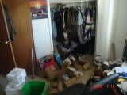
“Taking a Stand”
Negotiate a Fair Deal
Insist with persistence
TAKE ACTION
Arrange a Limited Strike
Notes:
The results of the “strike” may be less than desirable but eventually they come around (we hope!)

Slide 7
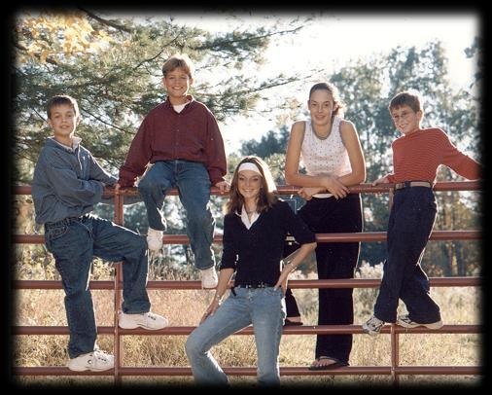
13 and 14 year olds

Slide 8

Language Skills
Sees connections between novels they read and their own lives.
Add new and more complex words to their vocabulary.
Be able to determine whether
or not something is fact
or opinion.
Begin using a variety of literary
techniques-including suspense, dialogue, episodes, and flashbacks.

Slide 9
Math Skills
Be able to do complex inversions between different mathematical functions.
Be familiar with geometry terms.
Familiar with representing different algebraic functions.
Figure out rules of chance.

Slide 10

Social Skills
Will want to be involved with a peer group.
Will assume
that their peers
are watching,
and evaluating,
their every move
Will usually
“date” in groups.
Notes:
Opposite sex tolerable- may even be cool in some settings
Want to “hangout” at mall, pool, sports event with same sex friends and then interact with opposite sex

Slide 11
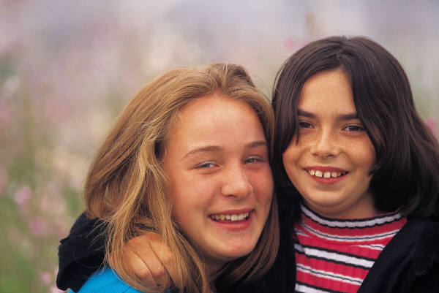
Emotional Changes
May form a strong opinion of what is right and what is wrong. Beliefs may seem rigid and very “black and white.”
Wanting to assert their
independence. Begin
seeing themselves as
an individual and member
of a peer group.
Shifting between wanting to be responsible and being “babied.”
Notes:
Teen will let parent know when appropriate to “baby” teen and when independence is desired. If parent gets the wrong signal and acts inappropriatley then teen will most likely set the parent “straight”

Slide 12
Physical Changes
First period has occurred and
breasts are developing.
Boys are in the midst of a growth spurt and may go from chubby to
thin as grow taller.
See HANDOUTS
Notes:
Handouts offer more specific details

Slide 13


Challenges
Sex begins to be a point
of peer pressure
See Handout

Slide 14
Challenges
May begin to be more openly rebellious and rude to parents. This may be more of a relatively immature rebellion.
Their moral rigor will cause your teenager to test every belief you hold sacred.
Critical time in whether or not a child tries to do well in school or not.
Notes:
Teen will choose to adapt to social and academic requirements or not

Slide 15

How to Help
Encourage reading.
Encourage a part-time job or summer internship...possibly volunteer.
Give choices regarding
family occasions for them
to attend.
Possibly give an allowance
for personal hygiene
products.
Notes:
Any additional input from group?

Slide 16

15 year olds

Slide 17
Social Skills
Will become more tolerant and even-tempered, able to compromise, and stay composed when they’re in disagreement with someone.
View of the world will settle first on the friends they have around them.
Will spend more time in mixed-sex groups.

Slide 18

Emotional Changes
Concerned about their physical appearance, as well as how they are developing.
Some teens who are having sex may have a shakier image of themselves.
This is when the time of
greatest rebellion usually
begins
See Handouts

Slide 19

Intellectual Skills
More class work, homework,
projects, and research reports.
Greater awareness and
curiosity of the world
around them.

Slide 20
Physical Changes
You should not begin worrying about you child not menstruating until 16.
Boys may begin to be able to grow a mustache. Voice is changing.
Notes:
Some young men may have developed facial hair prior to this age-again dependent on individual child development

Slide 21
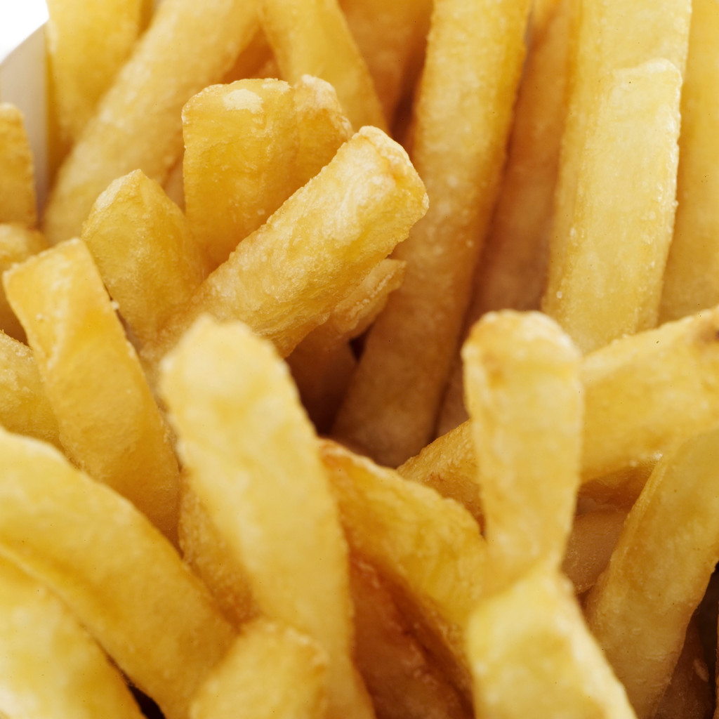
Challenges
Teenage sex. Like it or not, your teen probably knows people who are having sex. They might be, too.
Academic failure.
Not eating enough
or too much.

Slide 22
Eating Disorders
8,000,000 or more people in the US have an eating disorder
90% are women
Victims may be poor or rich
Eating disorders usually start in the teens but may begin as early as age 8.
See Handout

Slide 23
Overweight
Can lead to bone deformity
Arthritis
Painful hip problems
Asthma
Sleep apnea
High Blood Pressure
High Cholesterol Gallstones
Fatty Liver
Severe Headaches
Females may have elevated levels of Testosterone due to infrequent or missed periods
Insulin resistance and Diabetes
Depression
See Handout

Slide 24

How to Help
Acquaint yourself with your teenagers environment.
Encourage spirited dinner discussions. Don’t turn this into a shouting match. They will push your buttons on purpose.
Notes:
Remember! INTEGRATED EXPERIENCE!
Any additional input from group?

Slide 25

16 Year Olds

Slide 26
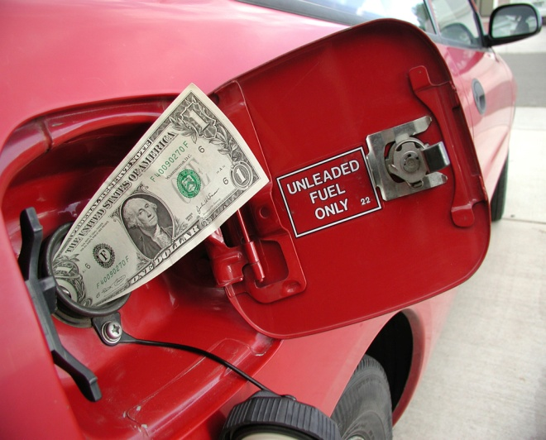
Social Skills
Will become more socially and physically adventurous.
Ability to get driver’s
license.
Allowance and
managing money.
Will want to talk about
“issues” such as the paranormal, life after death, abortion, war, capital punishment, etc.
Greater possibility your teen is having sex.
See Handout

Slide 27
Emotional Changes
Things in the home are probably quieter, but they may regress at any point in time.
Silence may not be boredom or lack of interest in surroundings.
Your teen may be
contemplating something
very important.
Lack of belief in their own morality.

Slide 28
Intellectual Skills
May begin to show or develop specific interests in one particular subjects
Becoming more independent
in their thinking and
is able to
come to reasonable
conclusions on their own.
(see handout)

Slide 29

Physical Changes
Breasts and other genitalia are probably mature.
Boys development may still be delayed at this point.

Slide 30

Challenges
Drugs (see handout)
Injury
Being Overworked
Arguing with Mom and Dad

Slide 31
How to Help
Encourage abilities in whatever they show interest in.
Encourage diverse experiences.
Ask questions that show you are there and willing to talk.
Be very clear about your concerns with their driving.
Notes:
Any additional input from group?

Slide 32

17 Year Olds

Slide 33
Social Skills
Friendships are still just as important to your teenager, but you may find that their group of friends is shifting.
Some will devote themselves to one boyfriend or girlfriend, while others may date around with less serious intentions.
If your child is held in reserve when they get home from school, you may not be asking questions about their day in a way that will elicit the best response.
Notes:
Ask about what is going on in their world. Remember.. It is much different than what is going on in yours.
How are “Betty Sue” and “Trixy” doing?
Are “Trixy” and her mother getting along better?
Is everyone still having a hard time with that Science Substitute?

Slide 34
Emotional Changes
There will be less melodrama, but they will still need your support and words of encouragement.
Your teen will have a growing desire for personal space.
Less shocked by
the realities of his
and your world.

Slide 35
Intellectual Skills
Use of logic will be expected in all courses.
Will be able to think logically by combining knowledge they already possess and new knowledge.
Writing should be grammatically correct and coherent to the average reader.

Slide 36


Physical Changes
All basic development work is done in girls.
Acne can continue to be an issue.

Slide 37

Challenges
Drugs
Sex
Curfews
Lack of academic achievement

Slide 38
How to Help
Provide fun study breaks.
Most time spent with members of the opposite sex is platonic. Don’t make assumptions.
Freedom to decorate their room
Keep your sense of humor.
Live your values.
Notes:
Any ideas from group?

Slide 39
18 Year Olds

Slide 40

Social Skills
Many at this stage will choose to spend time with a boyfriend or girlfriend, rather than a peer group.
Will probably be in and out of the house so much that your home will be more like a motel.

Slide 41
Emotional Changes
Your teen will become more tolerant of your opinions and may even start to return your values.
May begin the process of “finding themselves” if unsure of what to do with adult life.
Notes:
What do I want to do when I grow up? Next month.. Not ten years from now. SCAREY!

Slide 42
Physical Changes
No big changes this year.
May show more interest in taking care of their body.

Slide 43
Intellectual Skills
Focus on reaching university-level standards.
Teachers can become very important.
Will probably be an effective problem-solver who can think critically individually in groups. Their thought processes will be sharper than ever. They see the complexities of everyday life and the reasons behind political, social, and other global problems.

Slide 44

Challenges
Marijuana
Date Rape and
Dating Violence
See Handout
Depression and anxiety
See Handout

Slide 45

How to Help
Help the experience careers they are interested in to encourage them that they can achieve their goals.
Include their girlfriend or boyfriend in some family events.
Avoid “I told you so.”
Help when they are
ready to leave home.
Notes:
Input from group?

Slide 46



Empty Nest

Slide 47


Other Teen Issues

Slide 48
Teen Suicide/Identifying High Risk
Recent major loss
Break-up with girlfriend/boyfriend
Failure in school
Change in body part/function
Loners
Those who lack social skills
Over-achievers
Learning disabled and under achievers
Those under pressure
New students
Inadequate family bonding (adopted children or blended families)
SEE HANDOUT
Notes:
Warning involving next slide

Slide 49

Cutting
Notes:
Many times associated with sexual abuse

Slide 50
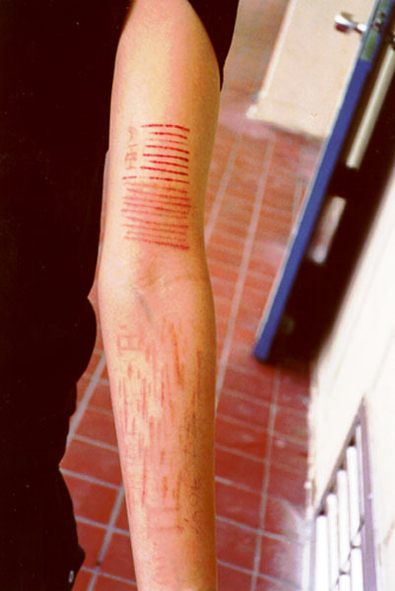
Cutting
Notes:
Cutters have explained the feeling of “letting the pain out” when discussing why they cut

Slide 51


Slide 52
Cutting/From a teenager’s perspective
Abandoned
Afraid
Threatened
Alone; Isolated
Misunderstood
Judged
Unaccepted
Rejected
Controlled
Overwhelmed
Unloved
Punished
Powerless
Untrusted
Unsafe
Trapped
Imprisoned
Not listened to
Abnormal
Confused
Guilty
Responsible
Hated
SEE HANDOUT

Slide 53




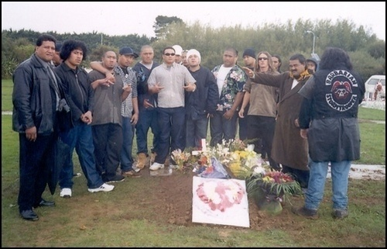

Gangs/Cliques
Notes:
On Photobucket.. Thousands of people willingly identified under “gang” search. Look at how young training/identification begins

Slide 54
A Street Gang is..
Three or more people
Share a unique name or have an identifiable mark or symbol
Associate together and sometimes claim a location or territory
Have an organization or hierarchy
Engage in antisocial, unlawful, or criminal activity to further the gangs social or economic status.
Notes:
More details in Gang Training covered in Foundations but a teen issue that needs discussed

Slide 55
Gangs
Youth may participate for a “sense of belonging”
Youth often show signs of deviance prior to joining a gang.
Some may work or attend school full time and live a “double lifestyle”
The double lifestyle may make it difficult to identify youth involved in gang activity

Slide 56

Teen Internet Safety
Teenagers ages 12-19, especially girls are the most victimized on the Internet
One in four teen girls reported that they met strangers off the Internet
64% of teens report that they
do things on the Internet
that they would not want
their parents to know about!

Slide 57
Protection on Internet
Keep passwords safe
Don’t respond to E-mails/messages from those that you do not know
Block anyone who is attempting contact
DO NOT EVER DISCLOSE PERSONAL INFORMATION/DEMOGRAPHICS!
DO NOT EVER MEET ANYONE FROM ONLINE WITHOUT A PARENT!
SEE HANDOUT

