Slide 1
Verbal De-Escalation
For DCS Contracted Service Providers

Slide 2

Course Competencies
At the end of this course, participants will be able to:
1. Acknowledge one’s own Conflict Management Style
2. Recognize the Stages of Escalation, and common triggers of agitation and aggression
3. Intervene with escalating clients using verbal de-escalation techniques.

Slide 3

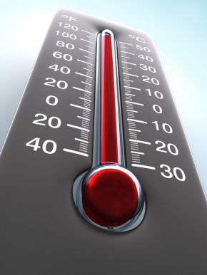
Crossing the Line into Crisis Situations
It is important to develop strategies for ensuring personal safety in potentially problematic situations.
In any conflict, you have a choice
Escalate the incident further
De-escalate the situation.

Slide 4
How do you manage conflict?
Personal strategy for managing conflict:
Is learned in childhood
Functions automatically
Defaults to doing what comes naturally
Your safety may depend on your
conflict management style.

Slide 5

Your Personal Conflict Management Style Activity
Access the University of Minnesota’s Department of Family Social Science website:
http://www.cehd.umn.edu/fsos/projects/ruralmnlife/conflict.asp
2. Take the Conflict Management Styles Assessment
3. Watch the Interpreting Conflict Management Styles Assessment video
*The next slide shows which links to click on for the assessment and video

Slide 6
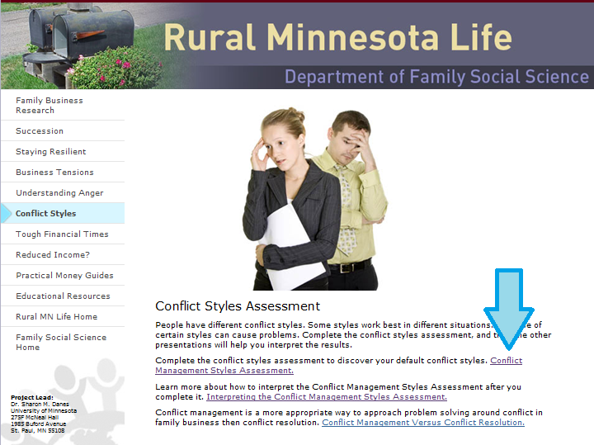
Conflict Management Styles Assessment

Slide 7
What did you learn about your default management style?
Conflict Management Style
Avoiding
Accommodating
Collaborating
Competing

Slide 8

Reflection Question
What efforts might you need to make to adjust your default Conflict Management style in order to engage clients?

Slide 9
7 Stages of Behavior Escalation
1. Calm – Person relatively calm / cooperative.
2. Trigger - Person experiences unresolved conflicts . This triggers the
person’s behavior to escalate.
3. Agitation – Person increasingly unfocused / upset.
4. Acceleration - Conflict remains unresolved. Person FOCUSES on the conflict.
5. Peak - Person out of control / exhibits severe behavior.
6. De-escalation – Vents in the peak stage, person displays confusion. Severity of peak behavior subsides.
7. Recovery - Person displays willingness to participate in activities.
Colvin, G., & Sugai, G. (1989). Understanding and Managing Escalating Behavior (ppt). Retrieved 22 January 2012 from http://www.pbis.org/common/pbisresources.

Slide 10
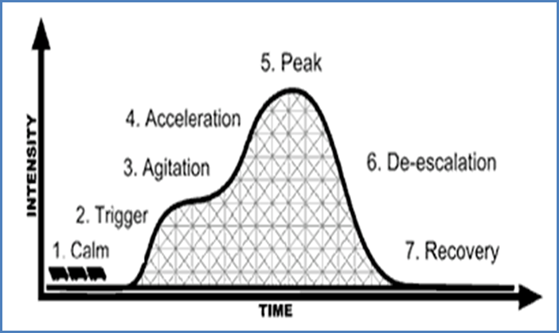
Stages of Escalation

Slide 11
Traits and Factors That May Trigger Aggression
Psychiatric illness
Substance abuse
Prior history of violence
Highly stressful situations
Removal of children
Involvement with DCS
Court proceedings
Compliance with services
Termination of parental rights
Ages 15-40, esp. males
Certain feelings
Powerlessness
Fear
Grief
Feeling of injustice
Boredom
Humiliation
Access to weapons
Physical disability or chronic pain
Personal history of child abuse

Slide 12

Common Signs of Agitation
Raised Voice
High-pitched voice
Rapid Speech
Pacing
Excessive Sweating
Excessive Hand-Gestures
Fidgeting
Shaking
Balled Fists
Erratic Movements
Aggressive Posture
Verbally Abusive

Slide 13

What is Verbal De-escalation?
Verbal De-Escalation is an intervention for use with people who are at risk for aggression.
It is basically using calm language, along with other communication techniques, to diffuse, re-direct, or de-escalate a conflicting situation.
Mary M. Kerr & C.M. Nelson: Strategies for Addressing Behavior Problems in the Classroom, 2010.

Slide 14

Physical Force in De-Escalation
Never consider the use of physical force as your first response.
Physical force is a last resort to prevent injury to yourself or to another person.
Use of physical force usually results in someone (you?) getting hurt.

Slide 15
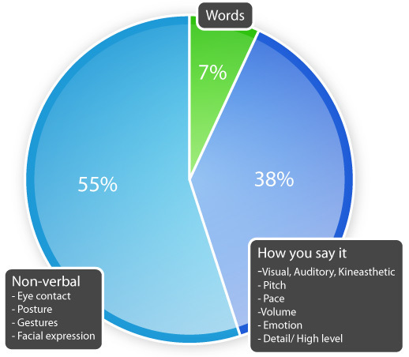
3 Aspects of Communication
Body Language
Tone
Word choice
Which has the
most influence?

Slide 16

Non-Verbal Communication
What is her body language saying?

Slide 17

BODY LANGUAGE CAN ESCALATE TENSION
Match the body language to its message.
Click anywhere on the screen for answers.
Shoulder shrugging
Jaw set with clenched teeth
Finger pointing
A fake smile
Excessive gesturing, pacing,
fidgeting, or weight shifting
Touching, even when culturally appropriate
Mocking or uncaring
Accusing or threatening
Anxiety
Hostility or threatening
Not open- minded or listening
Uncaring or unknowing

Slide 18
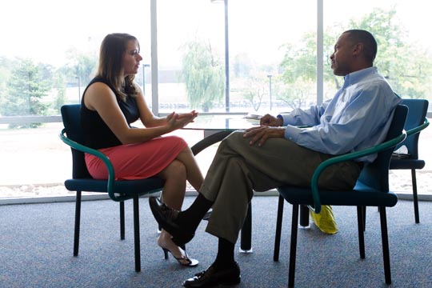
Try to look as non-threatening as possible.
Appear calm and self-assured even if you don’t feel it.
Maintain limited eye contact.
Maintain a neutral facial expression.
Place your hands in front of your body in an open and relaxed position.
Be at the same eye level. Encourage the client to be seated, but if he/she needs to stand, stand up also.

Slide 19
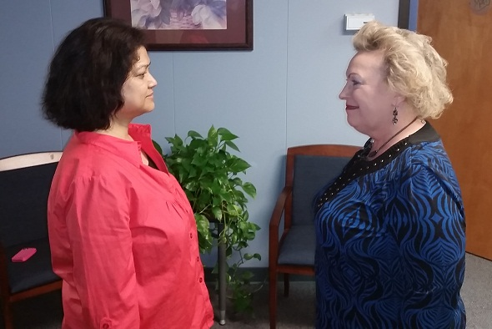
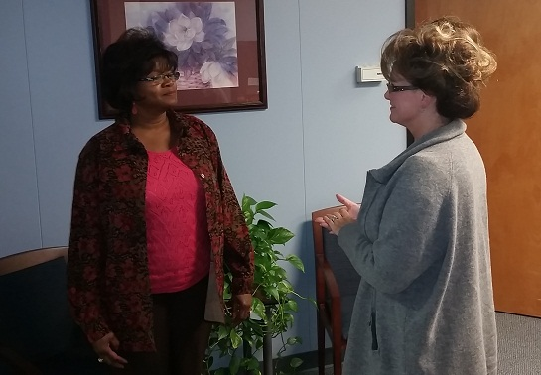
Which position…
…is less aggressive? Why?

Slide 20
Which position is less aggressive? Why?
Stand at an angle of about 45 degrees, feet hips width apart, one foot in front
Greater balance and mobility
Exposes less of the body as a target
Stay far enough away that the other person cannot hit, kick or grab you.
Never turn your back
Maintain at least two arms-length distance from a hostile person
Casually position yourself behind a barrier such as a sofa, table, or chair
University of Iowa School of Social Work: Committed to Excellence Through Supervision, 2009.

Slide 21
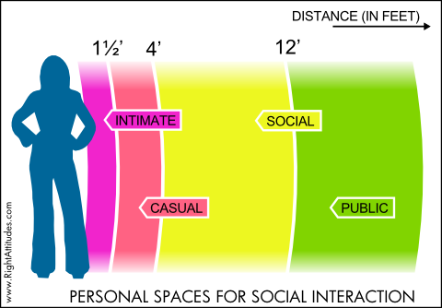
‘Stand by Me’ or ‘Stand Back’?
Four Personal Spaces
Edward Hall, American anthropologist
Hidden Dimension, 1966.
Intimate space - interacting with friends, significant people / hand-shaking, whispering, etc. -- touch to 1.5 feet
Casual space - interacting with close friends—1.5 feet to 4 feet
Social space - interacting with acquaintances—4 feet to 12 feet
Public space - interacting with anonymous people—further than 12 feet
CBS video - The Personal Space Experiment
http://www.youtube.com/watch?v=eWl5EA6xfgI

Slide 22
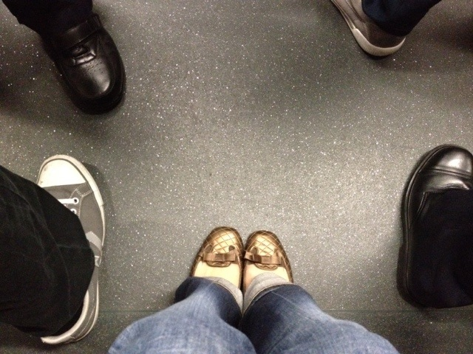

Don’t Fence Me In!
Violence-prone individuals perceive the need for a wider territorial space in order to feel comfortable – 5 times the normal physical space.

Slide 23
Reflection Question
How might you feel when another person (client, family member, etc.) has different spatial boundaries than you do? How will you address your own spatial boundaries?

Slide 24
It’s not what you say, but how you say it.
Tone expresses speaker’s feelings or attitudes.
Listener interprets speaker’s message through tone.
38% of communication depends on tone
Try it! Say the following sentence with different tones.
1. in a suspicious tone
2. in a happy tone
3. in a patronizing tone
4. in an irritable tone
“You made it here on time!”

Slide 25
It’s not just what you say, but how you say it.
Tone
Stern = confidence, possibly aggression.
Timid/wavering = fear, lack of self-assurance
Lowered = uncertainty
Raised = anger, agitation
Volume
-- Loud, overpowering = authority, unwillingness to hear others
Soft, unassuming = docility, possibly fear
Rate of speech
Slow but rhythmic rate = soothing
Controlled - both calm and firm promote confidence
Politeness
Be respectful. No name calling.
“Please” and “thank-you” -- “Mr.” or “Ms.” indicate respect.

Slide 26

“Handle them carefully, for words have more power than atom bombs.” Pearl Strachan, British politician, 1930.
Do not get loud or yell over a screaming person. Wait until he/she takes a breath, speaking calmly at normal volume.
Respond simply. Repeat if necessary. Answer informational questions, no matter how rudely asked.
“Why do I fill out these <expletive> forms?”
This is a real information-seeking question.
Do not answer abusive questions.
“Why are all DCS employees such <expletives>?”
Help client talk out angry feelings rather than act on them.

Slide 27
Verbal De-Escalation Tips
Do Not Be Defensive
Be Honest
Explain Limits and Rules
Be Respectful
Empathize with Feelings, Not Behaviors
Suggest Alternatives

Slide 28

The First and Only De-Escalation Objective
Reduce the level of anxiety to encourage the possibility for discussion.
Reasoning with an enraged person is not possible.

Slide 29

Use Minimal Encouragers
Brief nonverbal statements (positive head nodding)
Simple verbal responses
- Okay
- Uh-huh
- I see
- I am listening
Minimal encouragers demonstrate to the person that you are listening and paying attention, without stalling the dialogue or creating an undue interruption.
Asheville, NC Law Enforcement Academy: Crisis Intervention Team Training ppt, 2010. Retrieved 28 February 2012 from http://naminc.org/nn/blet/bunc-de-escalation.ppt

Slide 30
Demonstrate Reflecting
Show evidence of active listening by repeating what the person has said.
These statements should be brief. Do not interrupt the agitated person.

Slide 31
Open-Ended Questions
Use phrases like ‘Tell me about’ or ‘What do you think’
Allow you to get more information
Allow you to assess whether the situation is potentially dangerous to you
Allow you to assess whether the person is rational

Slide 32
Reflection Question
Can you think of a time when someone supported you by asking these types of questions?

Slide 33
Verbal De-Escalation
Thank you for participating!

