Slide 1
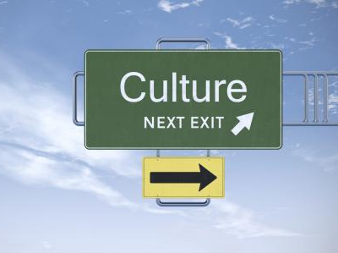
Cultural Competency
Building a Culturally Competent Practice

Slide 2
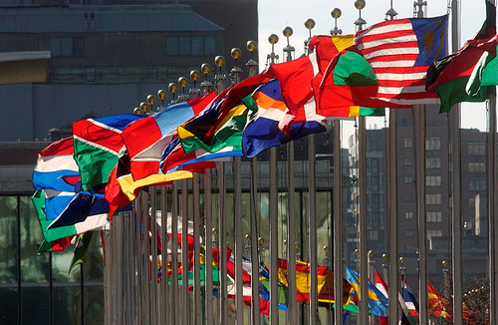
“Tolerance, inter-cultural dialogue and respect for diversity are more essential than ever in a world where people are becoming more and more closely interconnected.”
Kofi Annan, Former Secretary-General of the United Nations

Slide 3
Course description
Cultural Competence: Building a Culturally Competent Practice is a one day training that reviews the knowledge, awareness, and skills needed to work with today’s diverse cultures.
Participants will reflect on how one’s personal cultural lens impacts child welfare outcomes.
Participants will identify best practice guidelines for culturally-responsive communication skills and interactions in child welfare.

Slide 4
Learning Objectives
To examine what is meant by culture, cultural sensitivity, awareness, and competence.
To be aware of one’s personal cultural lens and recognize its impact when working with diverse groups in child welfare.
To be familiar with practice recommendations to incorporate cultural understanding into child welfare work.
To utilize resources to deliver information, referrals, and services in the language appropriate to the client which may include use of interpreters.
To explore concepts related to human diversity including bias, stereotyping, prejudice, and cycle of oppression

Slide 5
Acknowledge Sensitivity
“Ouch.”
“I have a challenge.”
“Oh!”

Slide 6
What is culture? Why important?
"You never really understand a person until you consider things from his point of view - until you climb into his skin and walk around in it."- Atticus Finch to his young daughter Scout.
Harper Lee’s To Kill a Mockingbird
ba

Slide 7
Culture – “the integrated pattern of human behavior that includes thoughts, communications, actions, customs, beliefs, values, and institutions of a racial, ethnic, religious, or social group. Often passed from generation to generation. ”
Nation Association of Social Workers, 2000
Cultural competence - “. . . process by which individuals and systems respond respectfully and effectively to people of all cultures, languages, races, ethnic backgrounds, religions, and other diversity factors in a manner that recognizes, affirms, and values the worth of individuals, families, and communities and protects and preserves the dignity of each."
National Association of Social Workers, 2007

Slide 8
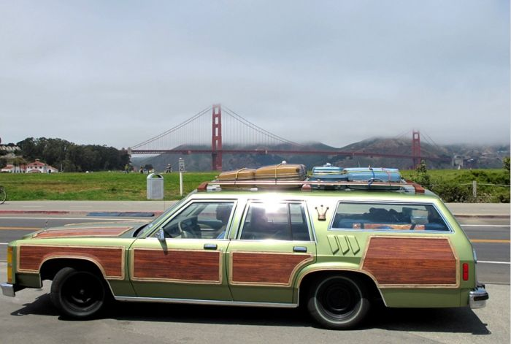
How is culture like a car?
What can you learn by just looking at the surface?

Slide 9
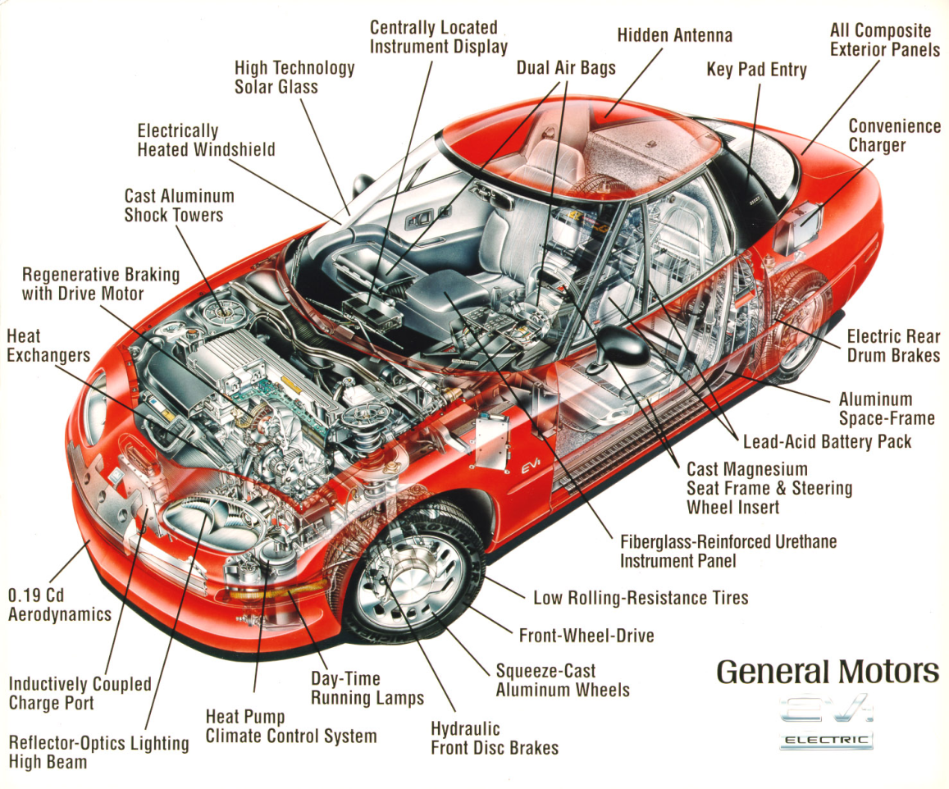
Car parts below-the-surface are more complicated than visible ones.

Slide 10
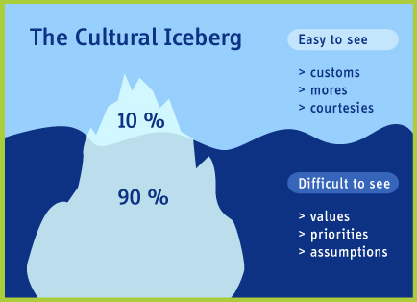
Our cultures have some parts that are very visible and obvious to ourselves and others.
Tolerance toward physical pain
Attitude toward conflict
Attitudes toward elders
Ideas of child-rearing
Tempo of work
Decision-making
Communication styles
Preference for competition
Concept of beauty
Roles in relation to age, sex, gender, class
Definition of obscenity
What parts of culture are less visible?
More complex & subtle?

Slide 11
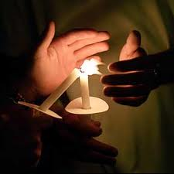
Cultural Awareness
“Recognition of one’s own cultural influences upon values, beliefs and judgments, as well as the influences derived from the professional’s work culture.”
National Center for Cultural Competence, Georgetown University Center for Child and Human Development, Washington, D.C.

Slide 12
Building a Culturally Competent Practice
People with colored discussion cards will move
chairs each time. Everyone else - stay seated.
Each new pair discusses the colored card topic’s impact on the work of Family Case Managers.
2 minute rounds
Before anyone moves, ask each card holder to pass his/her colored discussion topic card down TWICE. (This prevents topic repeats.)
Each card holder moves seats to a new discussion partner.

Slide 13
Disproportionality | In most states, there are higher proportions of children of color in the child welfare system than in the general child population.
2010 Disproportionality Index: Indiana Foster Care
African American/Black children 2.4
Caucasian/White children 0.8
Hispanic/Latino 0.6
Native American/Alaska Native 0.2
Asian/Pacific Islander 0.2
Data provided by Adoption & Foster Care Analysis & Reporting System (AFCARS) Indiana’s African American disproportionality rate has decreased 41% (2000-2010), dropping from 4.1 to 2.4

Slide 14
“Be the change you want to see in the world.” Mahatma Gandhi
Stereotype
Prejudice
Internalized
Oppression
Bias / Bias Confirmation
Discrimination
Institutionalized Discrimination
Oppression
Interrupt the cycle of oppression

Slide 15
Stereotypes
“Once you label me you negate me.”
Søren Kierkegaard,
philosopher & theologian

Slide 16
Are generalizations good or bad?
Where do stereotypes originate?
How are stereotypes reinforced?
What are the most common stereotypes non-Americans have of us?
How many of these American stereotypes are true?
How many are positive and how many are negative images of Americans?
Outgoing, friendly, informal
Loud, rude, immature
Hardworking
Extravagant, wasteful, wealthy
Not class conscious
Always in a hurry
Disrespectful of authority
Racially prejudiced
Overweight
Know little about other countries
Generous
Promiscuous women
Disregard the elderly
Think they have all the answers.
[Referenced from Robert Kohls and John Knight ‘s 1994 study]

Slide 17
The Impact of Bias
“Boys can’t play house.”
“Girls aren’t strong.”
Research shows that children between ages 2 and 5 become aware of
Gender
Race
Ethnicity
Disabilities
Children become sensitive to both the positive attitudes and negative biases attached to these four key aspects of identity by their family and by society.
“People with glasses are mean.”

Slide 18
Put yourself to the test.

Slide 19
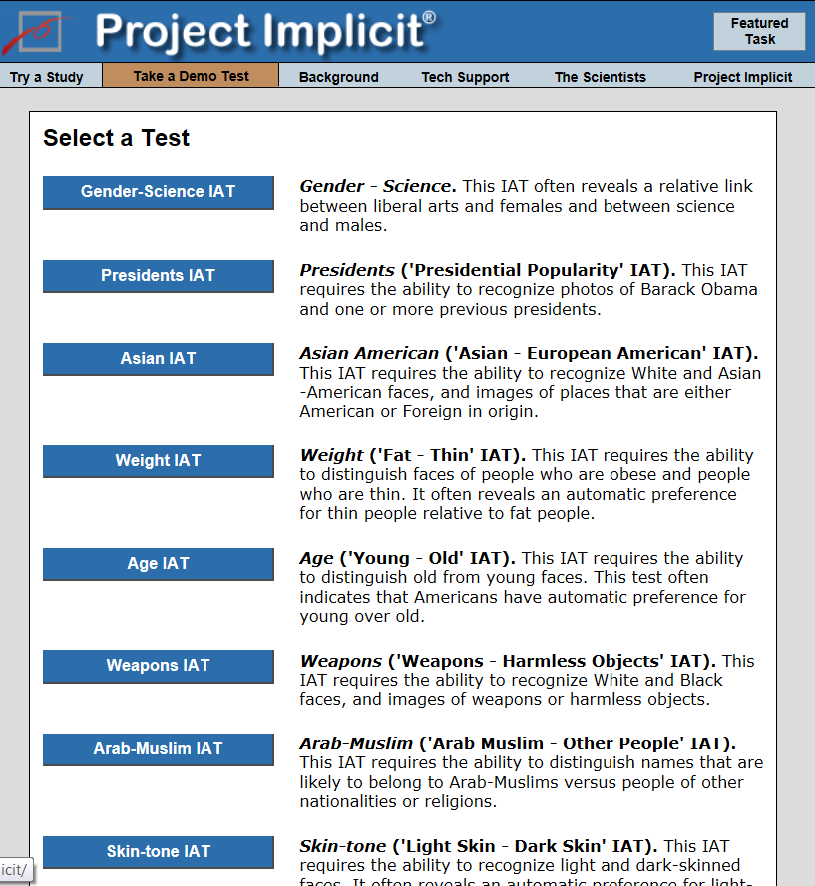
Put yourself to the test – Project Implicit
Please log on to the Project Implicit website. https://implicit.harvard.edu/implicit/demo/takeatest.html
Read through the preliminary info screen and click “I wish to proceed.”
Choose which test to take.
Review your results.

Slide 20
Cultural competence is a life’s journey . . . not a destination

