Slide 1
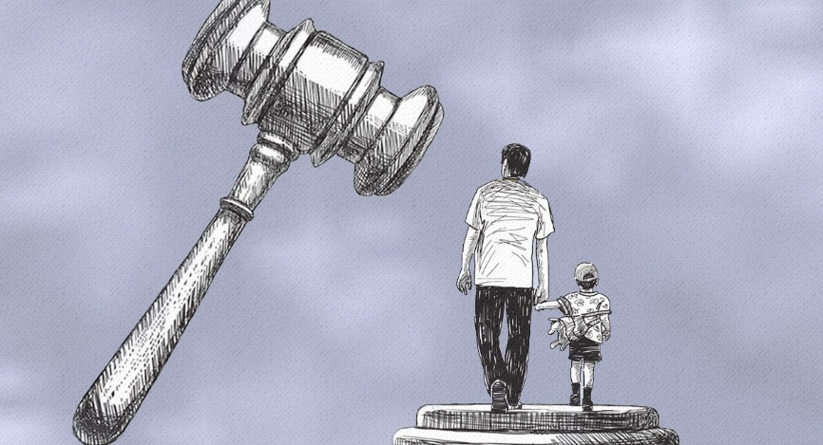
DCS Service Provider Training: Legal and Testifying
For use by DCS Contracted Service Providers

Slide 2
Course Competencies
Upon completion of this course, participants will be able to:
Recognize different types of law
Describe each of the CHINS statutes
Differentiate between Standards of Proof
Identify Types of Evidence
Understand Rights and Due Process
2

Slide 3
Before We Begin
What you need:
Paper and writing utensil – you may want to take some notes
Quiet Space – you’ll need to focus your attention on the information presented
30-45 Minutes – set aside plenty of time to review this training in one setting if possible
3

Slide 4
DCS Service Provider Training: Legal and Testifying
TYPES OF LAW

Slide 5
State Statutory Law
State Statutory Laws are passed by a legislature at the state level. Statutes set forth general propositions of law that courts apply to specific situations.
5

Slide 6
State Statutory Law (continued)
CHINS statutes are one form of statutory law. In Indiana, our state law is written into statutes, known as the Indiana Code. In terms of child welfare work, we deal primarily with the Indiana Code Title 31, found here:
https://iga.in.gov/legislative/laws/2017/ic/
*You may need to update the year (2017)
to the current year in the URL box
6

Slide 7
Case Law
Case Law defines statutory law in specific situations. Case law is created by decisions of appeals courts which make new interpretations of the law and, therefore, can be cited as precedents.
7

Slide 8
Case Law (continued)
For example, CHINS statute does not specifically define the standards of physical abuse. The appeals courts consider a specific case and make a decision on whether or not a case involves physical abuse based on evidence. This decision becomes precedent. Now other courts can look at that precedent for guidance.
8

Slide 9
Making Connections
Case law is created in the appeals courts.
Statutory law is written by legislative bodies.
Case law is a dynamic and constantly developing body of law.
9

Slide 10
Administrative Law
Administrative Law is the kind of law that governs the administrative agencies of the state. Those laws are known as the administrative code.
10

Slide 11
Administrative Law (continued)
Foster care licensing and daycare licensing laws are examples of Administrative law. Substantiations are appealed via administrative law.
11

Slide 12
Administrative Law (continued)
Administrative Laws that govern Child Welfare work:
Indiana Administrative Code – found at http://www.in.gov/legislative/iac/iac_title
Title 465 Article 2 – Child Welfare Services – outlines requirements for foster care homes, group homes, licensing related to taking care of children placed in care, CAPTA, adoption subsidies.
12

Slide 13
Policy and Local Practice
Policy is an agency’s interpretation of the law. It is how the agency comes into compliance; but policy is not law. Policy is supported by the law.
DCS policy can be found on the DCS website: http://www.in.gov/dcs/
13

Slide 14
Policy and Local Practice (continued)
Laws are developed to provide regulation to state agencies
DCS develops policy based on law
Your agency develops its own policy/procedure based on law and DCS policy
14

Slide 15
Policy and Local Practice (continued)
Local Practice refers to how policy is handled in a particular county.
Example: The law states that a child can be removed without a court order in certain circumstances. However, in some counties judges have determined that children in their counties cannot be removed without their approval. In some cases, the judge expects to be called in the middle of the night.
15

Slide 16
Activity:
Which is it?
On the following slides, you will see the law, code, or policy at the top of the slide. You then click on the category you think is correct to find more information.
16

Slide 17
Indiana Administrative Code, Title 465, Article 2
State Statute
Case Law
Administrative Law
Policy
17

Slide 18
Indiana Administrative Code, Title 465, Article 2
That is not correct.
The clue in the title is ‘Administrative Code’
BACK
18

Slide 19
Indiana Administrative Code, Title 465, Article 2
That is correct!
This Administrative Law pertains to Foster Care Licensing. The name indicates this is an administrative code, which is the type of law that governs administrative agencies.
NEXT
19

Slide 20
Indiana Code (IC) 31-34-1-8 Missing Child
State Statute
Case Law
Administrative Law
Policy
20

Slide 21
Indiana Code (IC) 31-34-1-8 Missing Child
That is not correct.
The clue in the title is ‘Indiana Code’
BACK
21

Slide 22
Indiana Code (IC) 31-34-1-8 Missing Child
That is correct!
This is a State Statute pertaining to CHINS (Child in Need of Services) which will be covered later in this training.
NEXT
22

Slide 23
B.H. & B.H. (Minor Children), and T.H. (Mother), Appellant–Respondent, v. The INDIANA DEPARTMENT OF CHILD SERVICES, Appellee–Petitioner. No. 52A02–1210–JT–849.|May 30, 2013.
State Statute
Case Law
Administrative Law
Policy
23

Slide 24
B.H. & B.H. (Minor Children), and T.H. (Mother), Appellant–Respondent, v. The INDIANA DEPARTMENT OF CHILD SERVICES, Appellee–Petitioner. No. 52A02–1210–JT–849.|May 30, 2013.
That is not correct.
The clue in the title is in the ‘v.’, as that indicates a court case.
BACK
24

Slide 25
B.H. & B.H. (Minor Children), and T.H. (Mother), Appellant–Respondent, v. The INDIANA DEPARTMENT OF CHILD SERVICES, Appellee–Petitioner. No. 52A02–1210–JT–849.|May 30, 2013.
That is correct!
This was an Indiana Supreme Court decision that declared a family may sue the state’s child protection agency for negligence. For more information about this case see the following link: https://www.in.gov/judiciary/opinions/pdf/05301302nhv.pdf
NEXT
25

Slide 26
DCS Service Provider Training: Legal and Testifying
CHINS Child in Need of Services

Slide 27
CHINS Statutes
CHINS stands for Child in Need of Service. CHINS statutes are State Law. It is not necessary for service providers to memorize the CHINS specific incidents, however, it may be helpful to be familiar with them as you work with families and hear/discuss CHINS references in court.
This section will serve as an overview of CHINS. For more information, refer to Indiana Code title 31 (link on Slide 6).
27

Slide 28
Statute Specific Incidents
CHINS 1: Neglect
CHINS 2: Physical/Mental Abuse
CHINS 3: Sexual Abuse
CHINS 3.5: Human or Sexual Trafficking Victim
CHINS 1-3 are the most commonly used CHINS
28

Slide 29
Statute Specific Incidents (continued)
CHINS 4: Obscene Performance
CHINS 5: Parent Allows Child to Commit Sex Offense
CHINS 6: Child Endangers Self or Other Child
CHINS 7: School Disciplinary Proceeding
CHINS 8: Missing Child
29

Slide 30
Statute Specific Incidents (continued)
CHINS 9: Disabled Child Denied Medical Care
CHINS 10: Child born with fetal alcohol syndrome, neonatal abstinence syndrome, controlled substance, legend drug*
CHINS 11: Injury, abnormal physical or psychological development, symptoms of neonatal intoxication or withdrawal due to drug use during pregnancy
*Legend drug refers to drugs that are approved by the U.S. Food and Drug Administration (FDA) and that are required by federal or state law to be dispensed to the public only on prescription of a licensed physician or other licensed provider.
30

Slide 31
A Child is Considered CHINS if:
The Child is under age 18
A statute specific incident occurs (CHINS 1-11)
The child needs care, treatment, or rehabilitation
The child is not receiving care, treatment, or rehabilitation
Care, treatment, or rehabilitation is unlikely to be provided or accepted without the coercive intervention of the court
31

Slide 32
Court Appearance
Service Providers may be requested to testify in court
Requests my come via subpoena or written request form the DCS office (email or letter)
A Court Appearance is defined as appearing for a court hearing after receiving a written request or subpoena from DCS to appear in court, and can be billed per appearance
Therefore, if the provider appeared in court two different days, they could bill for 2 court appearances
Maximum of 1 court appearance per day
The Rate of the Court Appearance includes all costs associated with the court appearance
Additional costs associated with the appearance cannot be billed separately
32

Slide 33
Types of Hearings
Detention
First Appearance
Service Provider unlikely to attend; unless services were previously offered
Initial
Initiate CHINS
Service Provider unlikely to attend; unless services were previously offered
Fact Finding
Court rules on CHINS
SOME Service Providers may appear if services are provided during assessment
Disposition
Periodic Review
Permanency
Termination of Parental Rights
Hearing in which services are ordered
Service Providers are unlikely to appear, unless they have been providing other services
Update to the court regarding case progress
Service Providers may appear as needed
Update to the court regarding permanency
DCS can request change in permanency plan
Service Providers often appear
DCS argues in favor of terminating parental rights
Service Providers almost always appear
Service Providers will receive a request to appear if and when their presence is required for any of the identified hearings. Requests provided via subpoena or email/letter from the local DCS office.
33

Slide 34
DCS Service Provider Training: Legal and Testifying
Standards of Proof

Slide 35
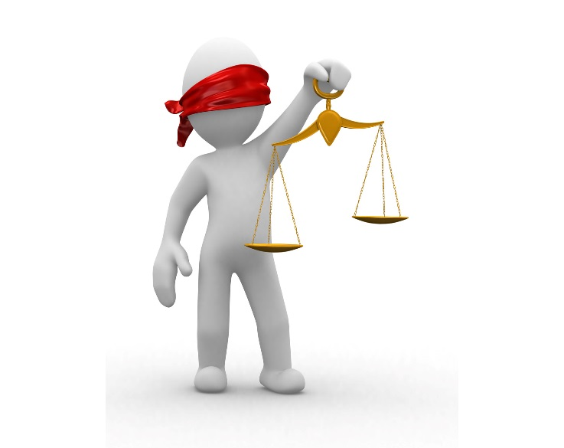
Standards of Proof
A standard of proof is the level of proof demanded or required in a specific case. Different circumstances and courts require different standards of proof. We will address the different standards of proof, what they mean, and when and where you will apply them.
35

Slide 36
Reasonable Suspicion
(Low Standard of Proof)
A quantum of proof less demanding than probable cause, but more than a hunch. There must be some minimal level of objective justification for the suspicion and there must be specific and articulable facts which, based on the totality of the circumstances, are sufficient to warrant reasonable suspicion.
Standard for making a report to the Child Abuse Hotline
A service provider may use this standard if you observe a concerning incident or if a client you are already working with tells you something not related to the current DCS involvement
For example, if you are completing Home Based Services with a family and arrive at the home to find a preschool age child home alone – this would be reasonable suspicion and prompt a call to the Hotline
36

Slide 37
Probable Cause
(25% Standard of Proof)
A person has knowledge of facts and circumstances which warrant a person of reasonable caution to believe that the facts are correct. Involves reasonably trustworthy information.
Standard for taking a child into DCS custody
Visible evidence and fact based information is expected; hearsay is allowed
This standard is used at a Detention Hearing or filing CHINS – service providers are often not involved with families at this point
37

Slide 38
Preponderance of the Evidence
(51% Standard of Proof)
Means the greater weight of the evidence. It is sometimes called ‘more likely than not’. The evidence given upon any fact that convinces you most strongly of its truthfulness is of the greater weight.
Standard required to determine CHINS
Enough evidence to lead a reasonable person to believe abuse/neglect has occurred
This standard is used at a Fact Finding Hearing – in some areas, services are in place at this point and service providers MIGHT be asked to testify
38

Slide 39
Clear and Convincing Evidence
(75% Standard of Proof)
Requires the existence of a fact to be highly probable.
Standard required for Termination of Parental Rights
Increased formality in the courtroom due to the higher burden of proof
Service providers are often asked to testify in these hearings, as they will have valuable information regarding the people/families they have been working with
39

Slide 40
Activity:
How Much Proof is Necessary?
On the following slides, read the scenario then select the correct Standard of Proof.
Once you complete the activity, you can choose to try again if you did not answer each one correctly, or proceed to the next section.
40

Slide 41
Scenario One
You are a Forensic Interviewer for a child advocacy center. You have been asked to testify at a Fact-Finding Hearing regarding an interview you facilitated with a DCS client. Click on the correct Standard of Proof.
Probable Cause
Preponderance of the Evidence
41

Slide 42
Scenario One
That is incorrect.
Fact Finding Hearings require a PROPONDERANCE OF THE EVIDENCE.
This shows that Child Abuse or Neglect is or was more likely to occur than not.
It is the responsibility of DCS to prove to the court that abuse or neglect occurred, and may use service provider testimony.
Next
42

Slide 43
Scenario One
Fact Finding Hearings require a PROPONDERANCE OF THE EVIDENCE.
This shows that Child Abuse or Neglect is or was more likely to occur than not.
It is the responsibility of DCS to prove to the court that a child is in need of services due to the act or omission of a parent, caregiver, or guardian, and may use service provider testimony.
Next
43

Slide 44
Scenario Two
You are a Counselor, providing individual counseling to a six year old child in foster care. During a counseling session, the child indicates that he doesn’t like the foster home because he has to babysit his 3 year old sister and another child in the home while his foster parents are at work on Saturday mornings. The child provides a detailed description of what he has to do with the younger sibling while babysitting (get breakfast, provide medicine, watch TV). You are confident this child is being truthful with you.
Reasonable Suspicion
Clear and Convincing Evidence
44

Slide 45
Scenario Two
That is incorrect.
You have Reasonable Suspicion to contact the Child Abuse and Neglect Hotline.
Your client provided information that leads you to ‘more than a hunch’ that supervision in the foster home is not adequate.
Remember, you can also call the FCM, but you are required to make a report to the Hotline if you suspect abuse or neglect has occurred.
Next
45

Slide 46
Scenario Two
You have Reasonable Suspicion to contact the Child Abuse and Neglect Hotline.
Your client provided information that leads you to ‘more than a hunch’ that supervision in the foster home is not adequate.
Remember, you can also call the FCM, but you are required to make a report to the Hotline if you suspect abuse or neglect has occurred.
Next
46

Slide 47
Scenario Three
You have provided therapy to a sibling group for the last two years. The siblings are in pre-adoptive placement with a relative, and you are asked to testify at the Termination of Parental Rights Hearing. You have information to provide the court regarding trauma the children have experienced, as well as the effects their parents’ continued drug use has on their well-being.
Clear and Convincing Evidence
Probable Cause
47

Slide 48
Scenario Three
TPR Hearings require
Clear and Convincing Evidence.
The burden of proof is increased in this case because the stakes are high. A judge will be deciding whether or not to permanently revoke a parent of his or her rights to their child. This is the highest burden of proof required for any DCS related court hearing.
Next
48

Slide 49
Scenario Three
That is incorrect.
TPR Hearings require
Clear and Convincing Evidence.
The burden of proof is increased in this case because the stakes are high. A judge will be deciding whether or not to permanently revoke a parent of his or her rights to their child. This is the highest burden of proof required for any DCS related court hearing.
Next
49

Slide 50
How Well Did You Do?
Are you satisfied with your performance in this activity?
Continue
Would you like to review the standards and try again?
Review
50

Slide 51
DCS Service Provider Training: Legal and Testifying
Types of Evidence

Slide 52
Types of Evidence
In order to meet each standard of proof, DCS and Service Providers will need to provide evidence to the court. There are different types of evidence that you will encounter and even gather yourself in the course of working with clients.
52

Slide 53
Types of Evidence (continued)
Direct evidence proves a fact directly. Eyewitness testimony to an event and client admission are both examples of direct evidence.
Testimony
Hearsay
53

Slide 54
Testimony
Testimony can be provided by a party to the case, witness, or expert, and may include:
Statements of clients made to DCS, law enforcement, or service providers (party to the case)
Statements of Child (party to the case)
Statements of physician who examined or treated the child, some service providers (expert)
Statements of relatives or others in the home who observed mistreatment of child or poor condition of the home or injuries to the child (witness)
54

Slide 55
Hearsay
Hearsay is a statement made out of court by a third party to prove a fact. Hearsay is a complicated legal concept and is interpreted differently in various courtrooms.
Hearsay is generally not admissible, but it is only objectionable if someone objects to it
Each court approaches hearsay differently
As a service provider, you may receive a subpoena
to appear in court to provide testimony in order
to avoid hearsay
55

Slide 56
Indirect or Circumstantial Evidence
Indirect or Circumstantial Evidence consists of a fact that can be used to infer another fact. Examples include bodily fluids, fibers, and expert witness.
Physical
Evidence
Documentary
Evidence
56

Slide 57
Physical Evidence
Physical Evidence includes:
Old food, moldy bathroom facilities (Neglect)
Belts, hangers, or other items (Physical abuse)
Findings from a medical examination (Sexual abuse)
“Dress up” clothes or costumes, sexual aids (Obscene performance, Sex offense)
Illegal or controlled substances (Neglect; Drug exposed infant)
57

Slide 58
Documentary Evidence
Documentary Evidence includes:
Photographs of child injuries, home condition
Medical records for treatment of injuries, drug positive birth (child) or delivery (mother) records
Service Provider treatment records
Service Provider monthly reports
58

Slide 59
What Does the Service Provider Do?
What do you do if you find something concerning in a home or in working with a family?
Be familiar with your agency policy BEFORE you find yourself in this situation
If acceptable per agency policy, you MUST ask the family before taking any photographs
ALWAYS immediately notify the FCM of concerning or questionable information
Provide clear and detailed recollection (what you see, smell, hear, etc.) in an incident report or case note to the FCM
59

Slide 60
Monthly Reports
Monthly reports may be included in reports to the court and/or referenced during court hearings. Monthly reports are provided to judges to provide guidance regarding case decisions. You may be subpoenaed to court to discuss reports you have provided. As the service provider, it is important to:
Ensure information is accurate and detailed
Report on current progress – DO NOT copy/paste from previous reports
60

Slide 61
Preparing for Court
If you are subpoenaed to court, there are some things you can do to prepare:
The DCS Attorney may call you to prep - schedule time to meet with them in person or on the phone
Practice with a peer in your agency who has experience in court testimony
Review reports you have prepared for this case
Provide the same information in the courtroom as you did in prep
61

Slide 62
Service Provider in the Courtroom
You are asked to appear in court to provide information regarding services provided
You are NOT representing DCS or the family – you are representing your agency and the services provided
Only provide information you know to be true – things you have seen or done in your meetings with the family
62

Slide 63
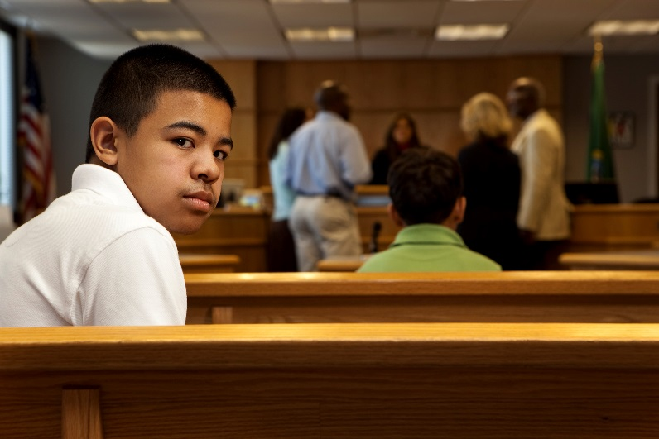
The Courtroom
DCS cases are heard in trial courts. Trial courts have general jurisdiction.
Judges make the ultimate decisions
There is NO JURY
DCS is not the prosecution
Be prepared to testify with your client (DCS family) in the room
This can be intimidating – it is important to be truthful
63

Slide 64
Day of Court Proceeding
Arrive Early
Dress professionally
Behave conservatively (language, conversation, etc.)
Usually, you may take one page of notes to the stand with you – this can be confirmed in prep
Notes might be added to evidence
64

Slide 65
During Testimony
Testimony can be intimidating - Use these skills to ensure accurate testimony:
Provide only facts about what you know
Do not elaborate to fill time
Pause before answering – take your time
Enunciate words so judge and attorneys can hear you clearly
Cross examination can be difficult – listen to the question carefully and respond directly
65

Slide 66
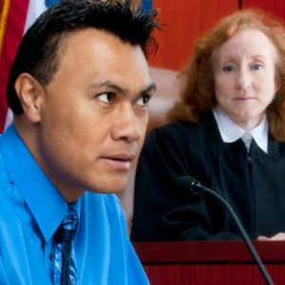
Cross Examination
You will first provide testimony by answering questions from the DCS Attorney. After that, the Defense Attorney will ask you questions:
Do not be intimidated
The cross-examiner may refer to documents or statements you have previously made – be consistent
Answer as simply as possible
Pause before answering to collect your thoughts
You can ask for the question to be repeated
DO NOT find yourself arguing with the questioner, just answer simply and honestly
66

Slide 67
DCS Service Provider Training: Legal and Testifying
Rights and Due Process

Slide 68
Absolute vs. Contingent Rights
Absolute
Cannot be Limited under any circumstance
Children’s rights are absolute
Contingent
Dependent upon current events or performance
Parent’s rights are contingent
68

Slide 69
A Child’s Absolute Rights
An environment…
Free from Abuse
Free from Neglect
Free from Exploitation
Provided Food
Provided Shelter
Provided Medical Care
69

Slide 70
Examples of Absolute Rights
Click your mouse or keypad for each example and consider whether or not it violates a child’s Absolute Rights. Think about or write down a justification for each. Click again to view the correct answer and compare it to your own thoughts.
70

Slide 71
Examples of Absolute Rights (continued)
French Fries with Every Meal
Acceptable in most cases, as it meets minimum standard
Exception may be if a medical condition develops as a direct result of poor diet
Untreated Diabetes
This is acceptable, as it meets minimum standard
2nd Hand Clothes
This violates the child’s absolute rights to medical care
Each child should have their own bedding
3 Children Sharing a Bedroom
This is acceptable, as it meets minimum standard
Clothes should fit properly and be appropriate for the season
71

Slide 72
Children and Negative Rights
The legal rights of children have been described as Negative Rights
The right NOT to be harmed, abused, or exploited
Law does not clearly define a level of standard
No guarantee of the standard of care
above basic rights
72

Slide 73
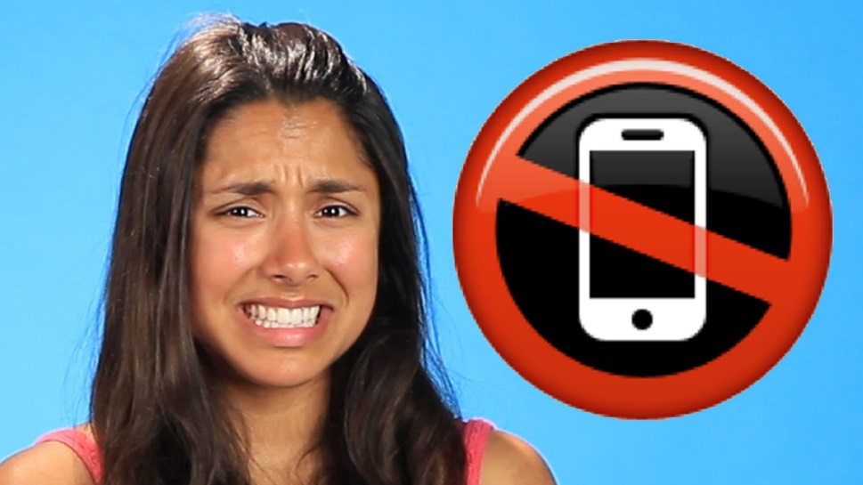
Children and Negative Rights
(continued)
For example, children DO NOT have the right to own a cell phone!
73

Slide 74
A Parent’s Contingent Rights
Set of Conditions…
Minimum Level of Care
Minimum Level of Nurturing
Environment Free From Harm
Environment Free From Neglect
74

Slide 75
Examples of Contingent Rights
Click your mouse or keypad for example and consider whether or not it violates the conditions in which a parent’s Contingent Rights are based. Think about or write down a justification for each. Click again to view the correct answer and compare it to your thoughts.
75

Slide 76
Examples of Contingent Rights
(continued)
No Furniture in Living or Dining Room
Furniture (other than bedding) is not necessary to keep a child safe
Parents do not allow Television
Canned, frozen, and prepared meals meet the minimum level of sufficiency
Refusing Food as a Form of Discipline
This is acceptable
Exception may be if a negative medical condition results from a poor diet
Parents Do Not Know How to Cook
This is NOT acceptable
The child’s absolute right to food supersedes the parental decision to discipline in this manner
This is acceptable
Children do not need television in order to remain safe
76

Slide 77
Parental vs. State Rights
The depth and breadth of parental rights are considerable. Our society has clearly determined that in the vast majority of circumstances, parents should have the authority and responsibility to make decisions in their children’s best interests.
When there is clear evidence that parents are not able to keep their children safe, the state, under the doctrine of parens patriae, (Latin for “father of his country”), can intervene to protect the children’s rights. To do this, the state must be able to show probable cause of an immediate and pressing danger to the child.
77

Slide 78
Parental vs. State Rights
(continued)
When parents violate the set of conditions upon which their CONTINGENT RIGHTS are based, the state intervenes to protect children’s ABSOLUTE RIGHTS.
78

Slide 79
Parental vs. State Rights
(continued)
Since you have completed this course, you should now be able to:
Recognize different types of law
Describe each of the CHINS statutes
Differentiate between Standards of Proof
Identify Types of Evidence
Understand Rights and Due Process
79

Slide 80
DCS Service Provider Training: Legal and Testifying
Thank you for participating!

