Slide 1
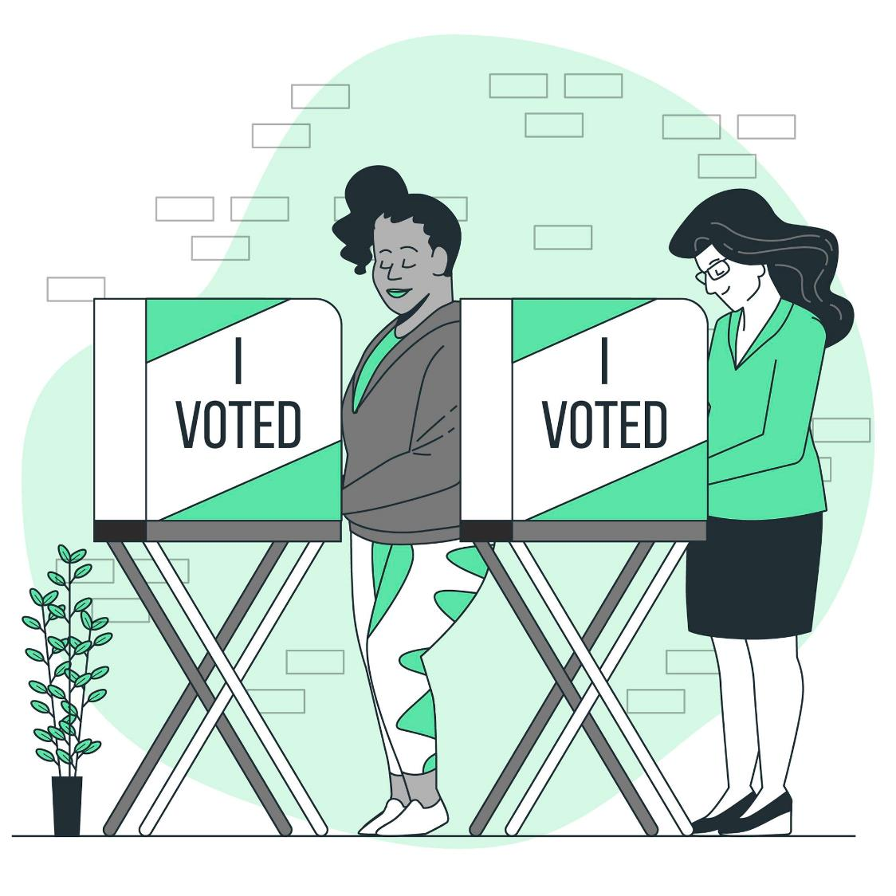
Managing ABS Workflows:
Onboarding ABS Voter Boards
Reviewing ABS procedures
Learning more about Democracy Live
Presented by:
Angie Nussmeyer, IED Co-Director
Spring 2024 Clerk’s Association Meetings
Image by storyset on Freepik

Slide 2

Acronyms
ABS = absentee
  ABS-Mail: vote by mail
  Travel Board: bi-partisan team sent to assist voters who qualify
  Early Voting: 28-days of in-person ABS voting
CEB = county election board
D or R = Democratic or Republican Party
DL = Democracy Live
FPCA = Federal Post Card Application
VPD = voter with print disabilities
Image by pikisuperstar on Freepik

Slide 3
ABS Voter Board Duties
Bi-Partisan teams providing ABS support BEFORE election day
ABS-Mail
  Approve application
  Initial ballots
  Mail ballots
  Receive ballots & organize by precinct for storage
ABS-Travel Board
  Approve application
  Initial ballot
  Provide assistance to voter, if requested
    No PRE-3 form needed
  Return ballot to CEB
  Organize by precinct for storage
Unlike CEB, decisions made by ABS Board do not
need to be made during a public meeting.
Not an exhaustive list of duties, responsibilities, or procedures; see 2024 Election Administrator’s Manual for more details

Slide 4
ABS Voter Board Duties
Early Voting (In-Person ABS Voting)
  “…As an alternative to voting by mail, a voter is entitled to cast an absentee ballot before an absentee voter board…”
    This applies to:
      ALL counties!
      All locations! One clerk’s office location and any additional satellite voting locations approved by the CEB
    ALL ABS voter boards MUST have one D & one R member
      NO Inspector or equivalent
      CEB decides how many total boards are needed to run early voting
    May have other staff supporting early voting, but ABS voter board members are:
      checking ID
      initialing ballots
      assisting voters, when necessary
ABS Voter Board teams can perform the first signature review on
ALL ABS methods to identify missing or mismatched signatures

Slide 5

ABS Voter Board* Qualifications
Registered voter of the county
Read, write & speak English language
No property bet or wagered on outcome of election
May not be a candidate, unless unopposed for PC/delegate or a city, town, township or school board office
May not be related to an opposed candidate on the ballot
Possible for an opposed candidate or relative of opposed candidate for a non-countywide office to serve on ABS voter board but CANNOT handle
ABS ballots in precincts where candidate’s name appears on the ballot
Image by Freepik
IC 3-11.5-4-22 | * Also applies to central count and courier team members

Slide 6
ABS Voter Board* Qualifications
Students serving on ABS Board*
  Possible for “underage” 16- or 17-year-old to serve on ABS Board, EXCEPT to be on travel board team, or serve as counter or courier
  Required to meet qualifications under IC 3-6-6-39 (student poll worker program)
    Be a US citizen
    Resident of the county
    GPA of 3.0 on 4.0 scale
    Has written approval of principal, if school is in session (not required if school is not in session) If educated in the home, then the individual responsible for the education of the student.
    Has approval of parent or guardian
    Otherwise meets the criteria to serve on ABS voter board, central count or courier team (or if an Election Day poll worker, then those requirements)
  CEB must unanimously agree to permit student poll workers or ABS voter board members
IC 3-11.5-4-23 |
* Also applies to central count and courier team members

Slide 7


Can she serve on Cardinal County ABS Board?
Can he work the central count for Cardinal CEB?
Registered voter of Cardinal County
Husband to an opposed candidate for countywide office
16-years old
Lives in Cardinal County
GPA: 3.5/4.0
Permission granted from school & parent
MAYBE! Did CEB unanimously agree to allow underage students to work? If so, YES! If not, NO!
NO! Since his spouse is running for a countywide office AND is opposed, then he is unable to serve.

Slide 8
ABS “Hiring” Workflow
Not later than 50-days before each election:
  CEB must inform D & R chairs the number of people needed to serve on:
    Absentee Voter Board, Central Count Team & Courier Team, if applicable
      NOTE: March 18, 2024, deadline before May 2024 primary
Not later than NOON, 46-days before each election:
  D & R chairs nominate, in writing, qualified individuals to serve
    NOTE: NOON, March 22, 2024, deadline before May 2024 primary
CEB must then APPOINT nominees & find individuals to backfill open positions
  Final decisions on appointment, filling vacancies
  should be made at an election board meeting
IC 3-11.5-4-23

Slide 9
ABS Management: CEB Members
Fills ABS voter board/central count positions
Approves or reject all ABS apps, except for ABS-In Person, which is approved by ABS board in clerk’s office. If ABS board is unable to agree, matter gets referred to CEB.
Initials ABS ballots
  Limits on how early this may be started. Not until application approved or more than 24 hours before ABS ballot mailed to voter.
Perform FIRST signature review
Challenges ABS ballot before it is processed at central count, if voter is alleged to not be a qualified voter in the election district
Settles disputes if raised by an ABS voter
board or central count team member
Remember, CEB MUST conduct public meeting to
perform these functions final decisions are being made!
Not an exhaustive list of duties, responsibilities, or procedures; see 2024 Election Administrator’s Manual for more details
IC 3-11-4-19(c)| IC 3-11.5-4-23 | IC 3-11-4-17.5| IC 3-11.5-4-5

Slide 10
ABS Management: Clerk/Deputies
Enters information about ABS app & status into SVRS
  If CEB has passed resolution by majority vote to delegate the county election board duty of reviewing ABS application, then clerk and clerk employees may review and approve ABS apps except those at early voting locations
IC 3-11-4-17 | IC 3-6-5-19

Slide 11
Central Count Teams
Provide ABS support ON election day
NOTE: If CEB adopts resolution under IC 3-11.5-4-11.5, then central count teams can start up to three days before election day
Perform SECOND signature review on ALL ABS materials
  CEB may adopt a resolution by unanimous vote permitting counters to skip this SECOND signature review
Review ALL ABS materials, as organized by precinct, to determine if ABS can be counted or rejected but if unable to agree, CEB makes determination
Prepare & process ABS ballots to begin tabulation ON election day
Not an exhaustive list of duties, responsibilities, or procedures; see 2024 Election Administrator’s Manual for more details
IC 3-11.5-4-11 | IC 3-11.5-4-12 | IC 3-11.5-4-13 | IC 3-11.5-6

Slide 12
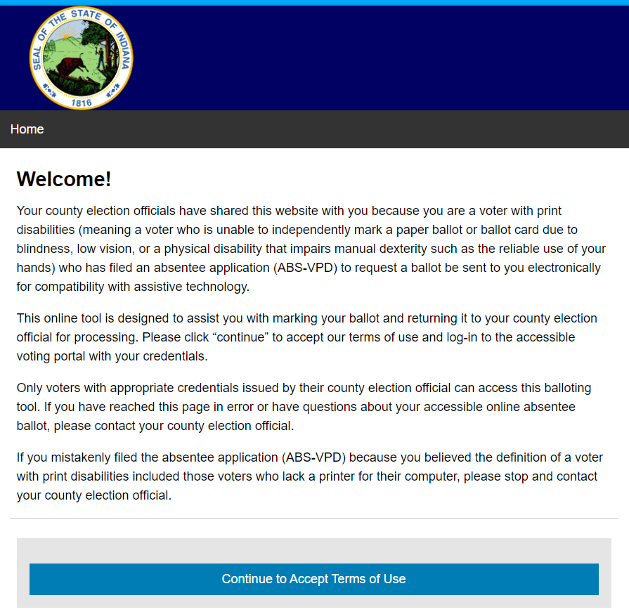
Democracy Live
OmniBallot Portal
Felicia Erlich
Chief Operations Officer & Corporate Counsel
IN Democracy Live Point of Contact
felicia@democracylive.com
Used by ABS-VPD voters requesting an ABS ballot by email
Counties will send static website link to voter along with their PIN*
DL receives VPD voter info from Civix at 9A & 3P (Eastern Time)
Voter’s ballot packet (marked ballot & ABS-25) sent to DL portal
Indiana DEMO site:
https://in.omniballot.us/sites/18/demo/app/home

Slide 13
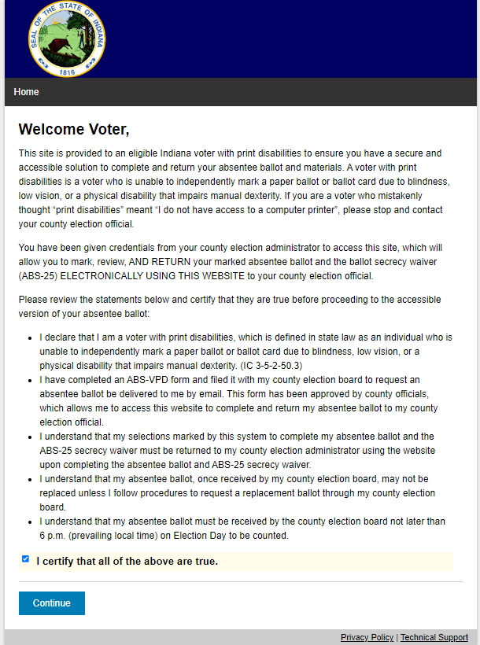
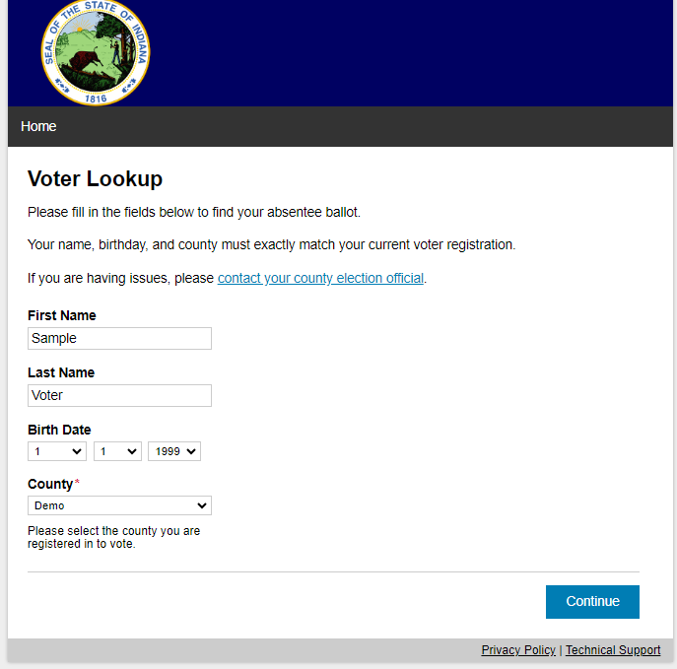
Certification Screen
Voter Entry Screen
Screen shows the credentials to use to access the demo site. “Dummy” log-in information to access the test site is found on indianavoters.com, too.
- “Demo” county is at the END of the county list

Slide 14
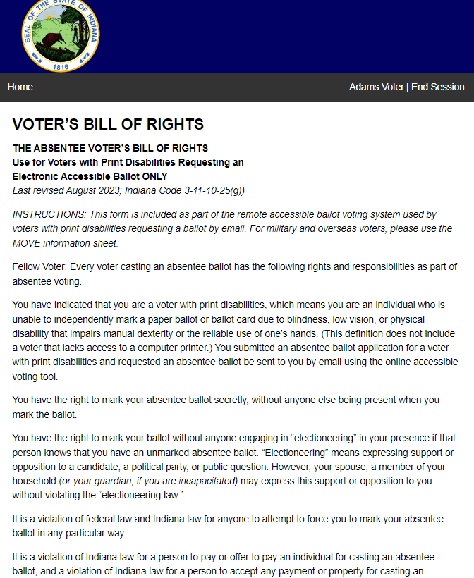
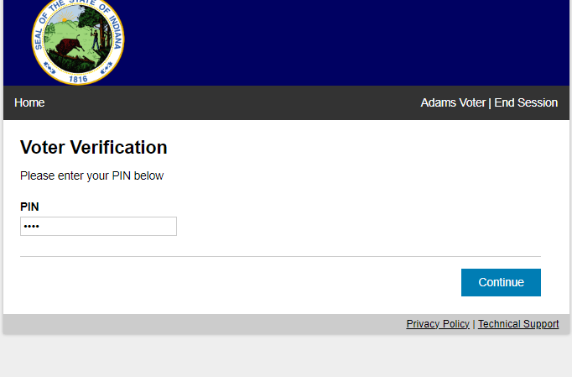
ABS Voter’s Bill of Rights
PIN Screen
County must include PIN in the email sent to a VPD who requests an emailed ABS ballot
  For demo site ONLY the PIN is 1234
PIN is pulled from the reports in the INSVRS Reports Library: DemLive VPD Email Details
  This specific report is NOT public record, as it contains information that would jeopardize the registration system under IC 5-14-3-4(b)(10)
Voter MUST enter PIN number that matches the PIN in the report to access information.
Randomized digits change in each election
Bottom of screen includes county contact information.

Slide 15
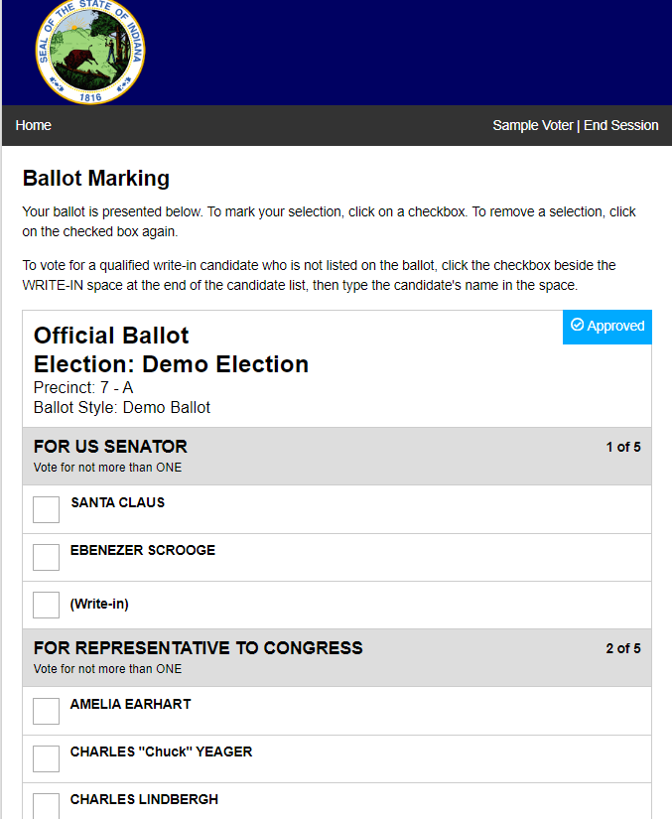
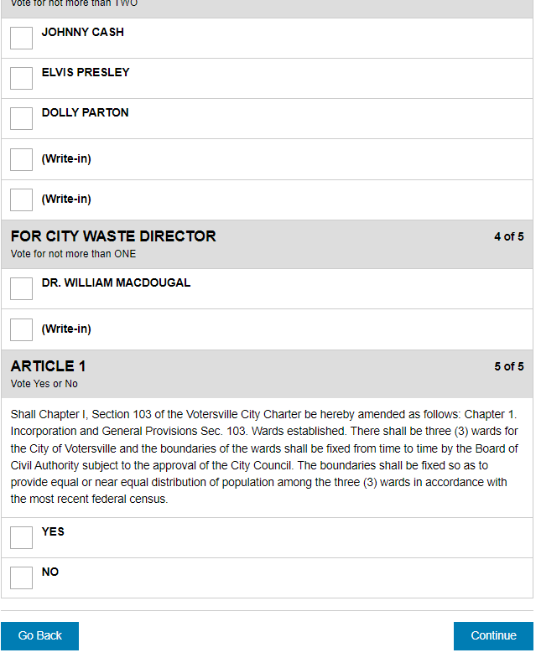
Ballot Marking Screen

Slide 16
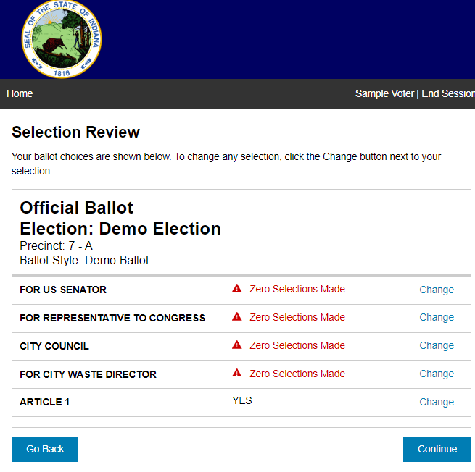
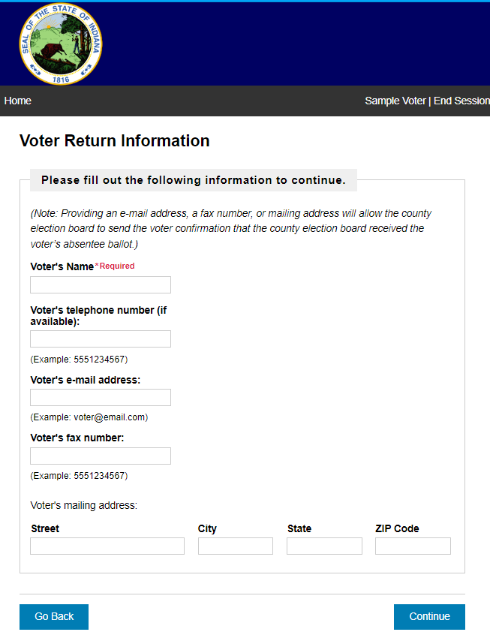
Selection Review Screen
Voter Return Info Screen

Slide 17
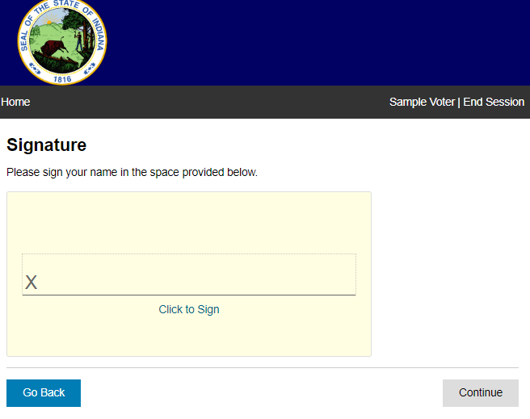
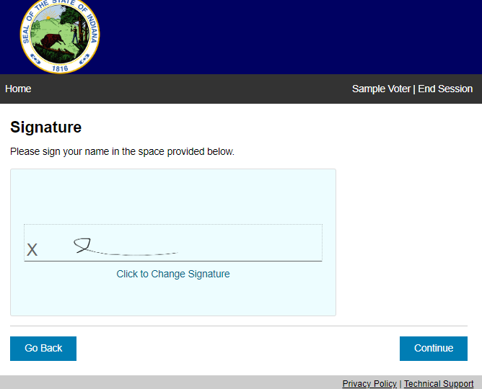
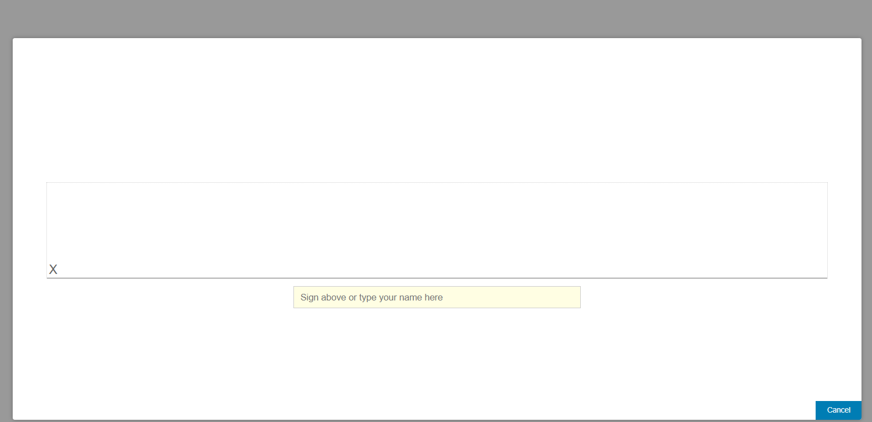
Signature Screen

Slide 18
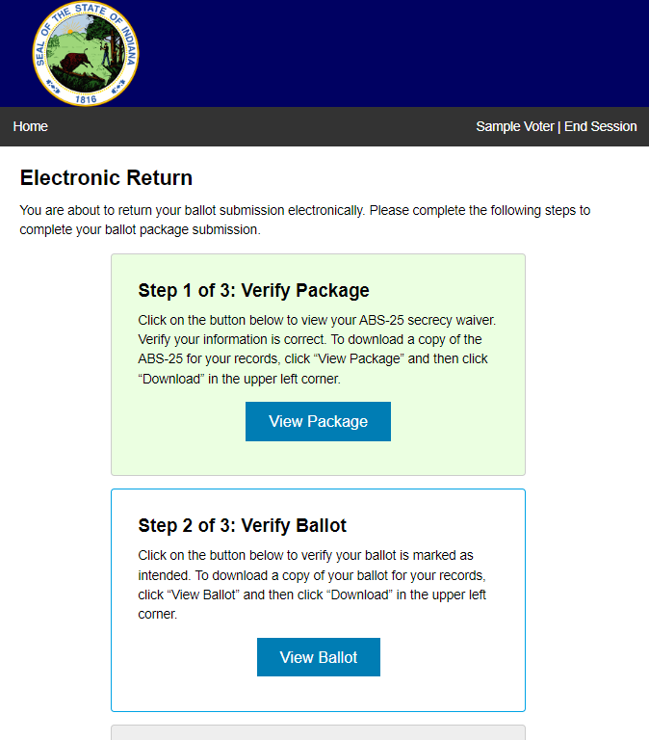
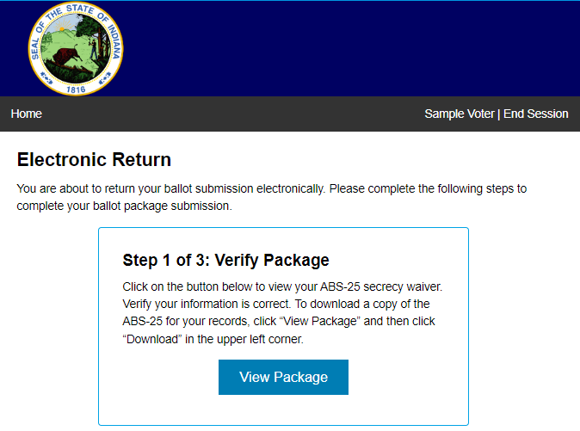
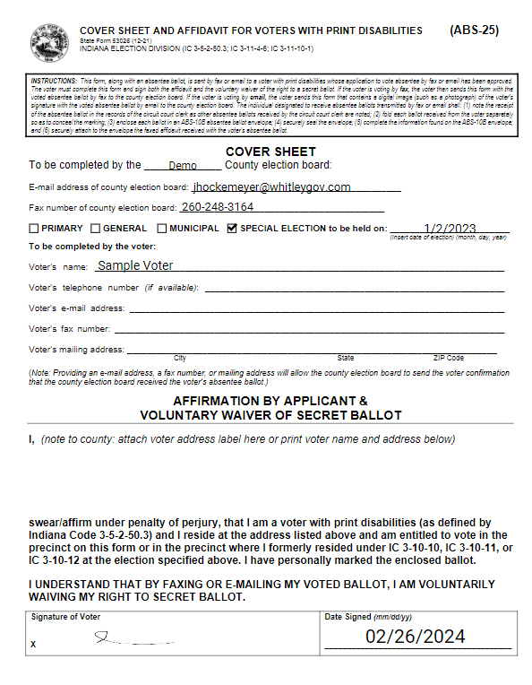
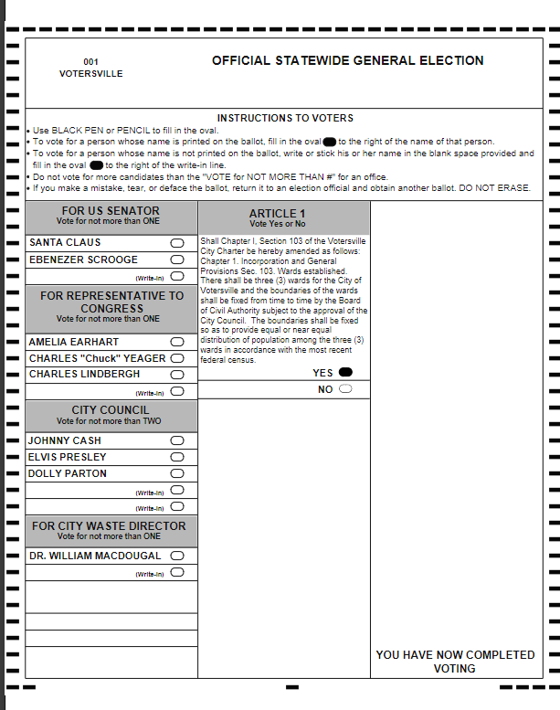
Electronic Return Screen

Slide 19
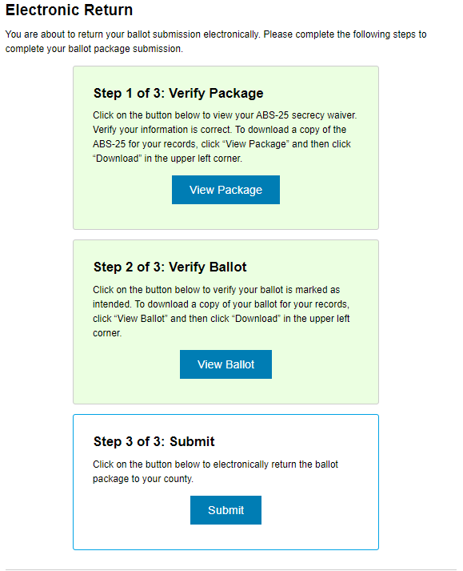
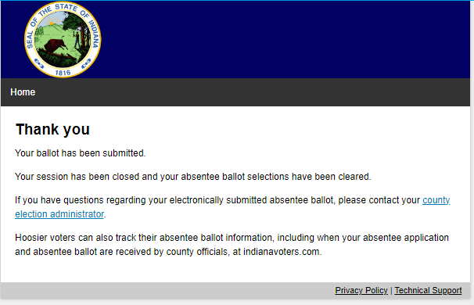
Electronic Return Screen
Thank You Screen
Voter’s marked ballot image & ABS-25 is sent to OmniBallot Portal.
Democracy Live will provide training on how to download and print the absentee ballot & secrecy waiver.
Once printed, absentee ballot is sealed in ABS-10B & voter’s ABS application and ABS-25 waiver is attached to envelope.
On Election Day, if approved by the Central Count team, printed ballot is remade on an official ballot card by bi-partisan remake team. Note: Don’t forget to use same serial number on printed AND remade ballot!

Slide 20
ABS-VPD (Email) Next Steps
SVRS (Civix)
  Watch training session to learn more about:
    Entering ABS-VPD into SVRS;
    Making sure ABS-VPD application is “approved” and ballot is in “issued” status before running DL report
      SVRS Reports Library: DemLive VPD Email Details
    Running proper report to find PIN for voter to use to access site
  Contact Civix for questions about SVRS-side issues
Democracy Live
  Look for an email from Felicia Erlich
  Work with her to set up training on OmniBallot Portal
  Provide her with ballot images & precinct/ballot
  style matrix so DL can set up the site for your voters
  to use

Slide 21

Last Minute ABS Reminders:
Don’t forget to send notice to D&R chairs request ABS boards/counters by March 18
Not later than March 23, 2024, you MUST send all ABS ballots out, if app has been approved
  Applies to ABS-Mail, ABS-VPD, FPCA
  Be sure SVRS ballot ready date is updated
MUST send ABS out the same day app is approved, once initial batch of ABS are sent
If FPCA is filed, a US Citizen who marks their “return is uncertain” must be sent a federal only ballot
  In May 2024 primary, this would include candidates in presidential primary, U.S. Senate, and U.S. Representative
Image by pvproductions on Freepik

Slide 22
Questions?
Angie Nussmeyer, IED Co-Director
317-232-3940 | anussmeyer@iec.in.gov
Matthew Kochevar, IED Co-General Counsel
317-232-3942 | mkochevar@iec.in.gov
Image by storyset on Freepik

