Slide 1
COMMON ERRORS and ISSUES For Culvert Rehabilitation and Culvert Replacements
Anthony Cox
INDOT Hydraulics Team Leader
tcox@indot.in.gov
(317) 232-5355
Notes:
This presentation is going over some common errors that we encounter during Hydraulics reviews, whether it be Liners, replacements and General Submittal Issues

Slide 2
Why THIS Presentation??? – 2 MAIN Reasons
Both Reasons Are Mutually Beneficial
  Reduce Total Number of Re-submittals
  Reduce Time to Review Consultant submittals
Notes:
Why this presentation in particular? There are two main reasons and they are both mutually beneficial to INDOT and Consultants. We want to reduce the total number of resubmittals and we also want to reduce the amount of time it takes to review each submittal.

Slide 3
Common Errors and Issues
General
  HY-8 Related
  Submitting for Hydraulics
Culvert Rehabilitation
  Liners
  Bored Pipes
  Paved Inverts
Culvert Replacements
Notes:
The Outline is broken into 3 main categories of General which includes Hy-8 related items and submitting for hydraulic review, Culvert Rehabilitation which includes Liners, bored pipes and Paved Inverts, and finally culvert Replacements

Slide 4
Common Errors and Issues
(website) = INDOT Hydraulics Website
Std. Dwg = INDOT Standard Drawings
IDM = Indiana Design Manual
Web Addresses Provided at the End
Notes:
For Reference throughout the presentation, (website) is referring the INDOT Hydraulics Website. Std. Dwg. Is referring to INDOT Standard Drawings, and IDM is referring to the Indiana Design Manual. Web addresses for each of these will be provided at the end of this presentation.

Slide 5

General Errors/Issues – HY-8
1. When to use Outlet Depth vs Tailwater depth?
  Sooo….
  If the Existing Q100 Outlet Depth > Q100 Tailwater Depth → Use The EXISTING Q100 Outlet Depth in your backwater computations in lieu of tailwater depth.
Notes:
This is some guidance about when to use Outlet Depth versus Tailwater depth for your backwater computation. The IDM has some language: “The existing outlet depth may be used in lieu of the tailwater depth if the culvert outlet is operating with a low tailwater depth or a free outfall.” A free outfall is a little more obvious, like if there is a drop at the outlet, you can model that drop and use outlet depth in that situation. “Low tailwater,” is a little ambiguous. We’ve talked about this language internally, and the intention is: If for your EXISTING analysis, if your EXISTING OUTLET DEPTH is greater than your tailwater depth, then we will allow you to use your EXISTING Outlet Depth in lieu of tailwater depth for your backwater computation. Remember that it is Only the Existing Outlet Depth and not the proposed outlet depth, so if you are computing backwater for a proposed run, you wouldn’t want to use your Proposed Outlet depth, but you would refer back and use your EXISTING Outlet Depth.

Slide 6
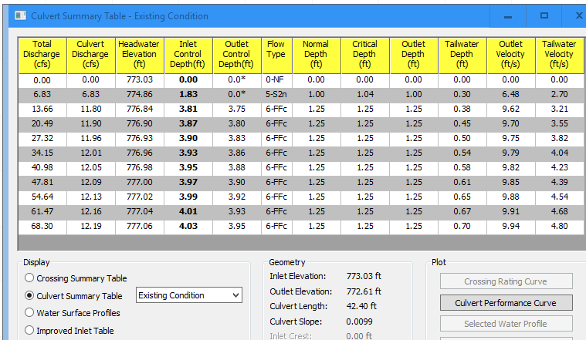
General Errors/Issues – HY-8
Notes:
The outlet depth can be found on your HY-8 Culvert Summary Table right next to the tailwater column. If this table was your Existing run, the outlet depth is 1.25 which is greater than 0.70, so you could use The outlet depth for your backwater computation.

Slide 7
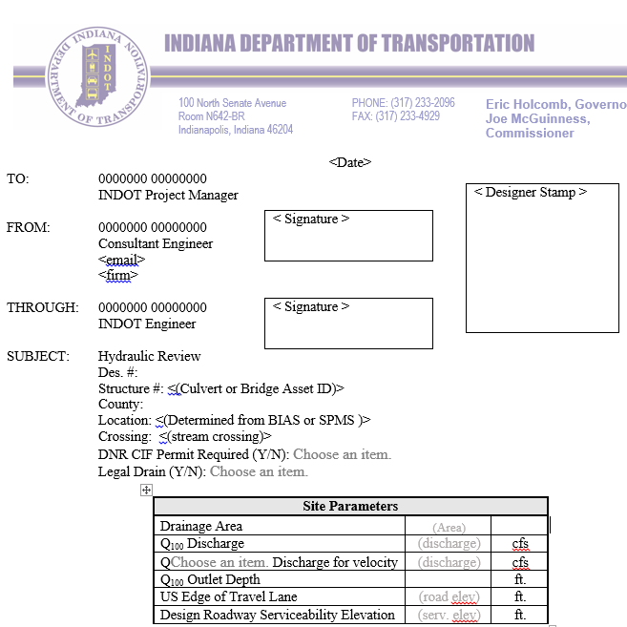
General Errors/Issues – HY-8
Notes:
And of course, you want to make sure to note in the Memo accordingly if you’re using tailwater or outlet depth

Slide 8
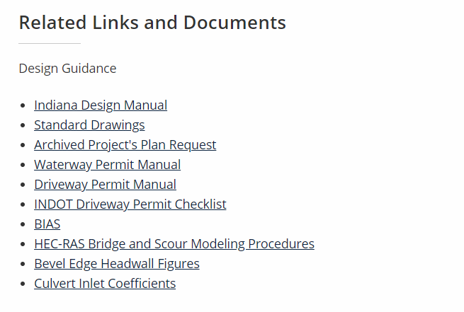
General Errors/Issues – HY-8
2. How to model a flared metal end section (or other type) in HY-8?
  INDOT Hydraulics Website - https://www.in.gov/indot/3595.htm (Website)
Notes:
How are you supposed to model a flared metal end section or other type of end treatment that isn’t available in the drop down menu for HY-8? On the Hydraulics Website, we have provided a PDF created by Jim Emerick displaying End Treatments and equivalents to the options available in HY-8

Slide 9
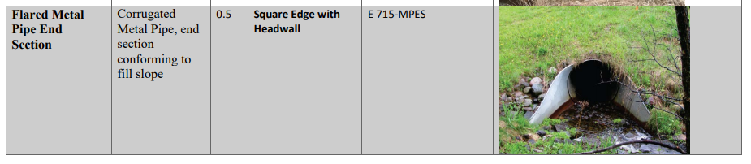
General Errors/Issues – HY-8
Notes:
Jim’s PDF has a table that lists the types of end treatments that are typical for most INDOT projects, along with a photo. The table also provides the associated description, Inlet Loss Coefficient, HY-8 inlet Edge Condition Equivalent, and Standard Drawing Reference (if applicable)

Slide 10
General Errors/Issues – HY-8
3. What to do if a pipe has an adverse or reverse slope (sloped the wrong way)?
  HY-8 Version 7.2 (Currently accepted version) will not allow for adverse slopes.
(INDOT Hydraulics Website FAQ)
If the existing pipe has a reverse slope, we recommend bringing the inlet invert to the elevation of the outlet creating a flat pipe.
Notes:
What do you do if your pipe has an adverse slope where the inlet is at a lower elevation than your outlet? Currently version Hy-8 version 7.2, which is the only version that we accept right now, does not allow you to model adverse slopes. Our website provides some guidance on this, which is to model it as level, and to use the outlet elevation.

Slide 11
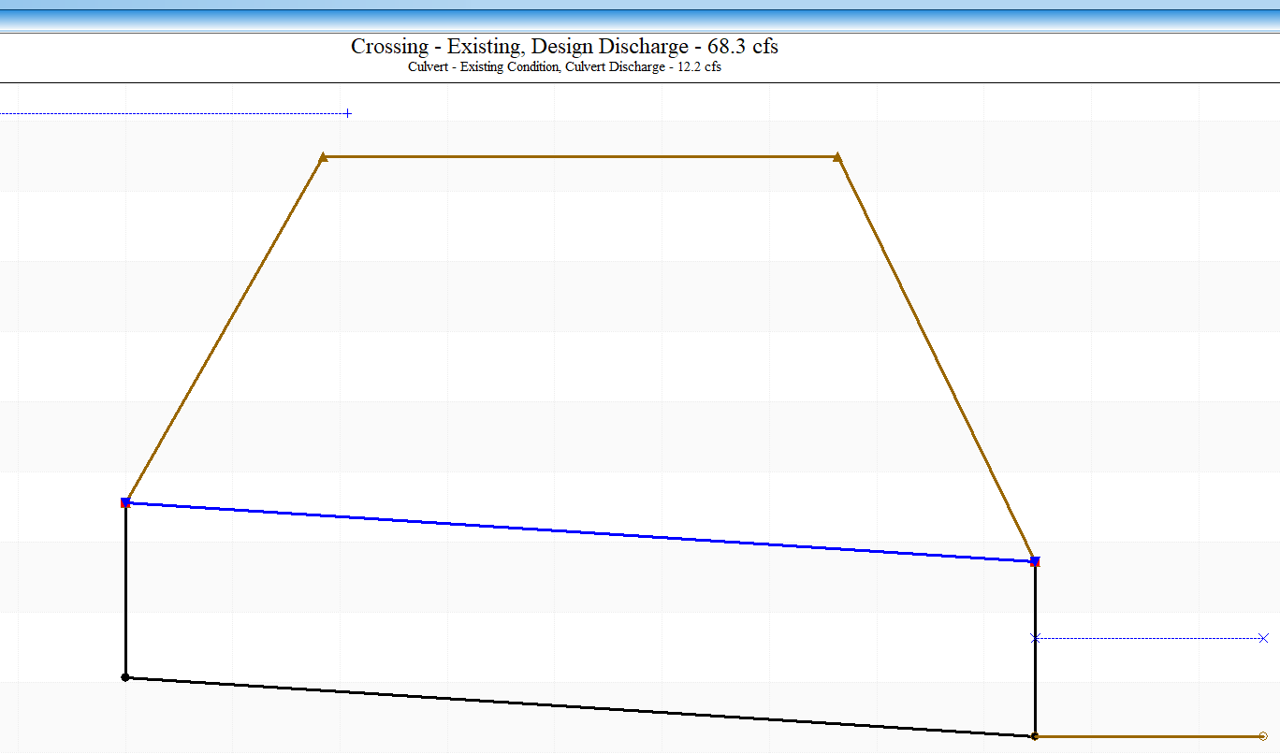
General Errors/Issues – HY-8
4. Where do I survey the downstream cross section for HY-8
Sedimentation
Natural
Channel
PROFILE VIEW
Scour Hole
Notes:
An issue that we have encountered several times during reviews is where exactly the downstream cross section should be surveyed for an HY-8 model. Ideally, if we go to the site of the culvert, at the downstream end, the ditch profile would look like the dashed green line, a nice even taper away from the outlet. What is not uncommon for us to see at a typical culvert outlet is more like the blue line shown above where there is a scour hole immediately beyond the outlet, and a short distance beyond that will have sedimentation. Also, typically near the outlet, you can have roadway side ditches draining towards the outlet of the culvert. We don’t want to see the cross section cut in the scour hole or within the road side ditch or in the sedimentation portion of the ditch profile, but rather just beyond where the ditch profile returns to the natural condition, which is typically a constant slope.

Slide 12
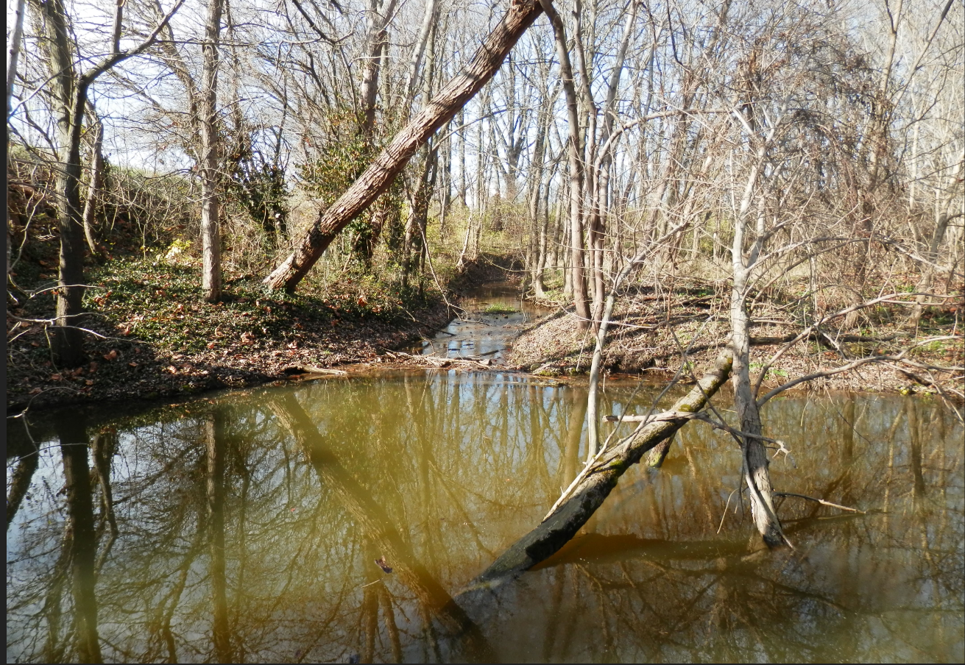
General Errors/Issues – HY-8
Scour
Holes
Sedimentation
SCOUR HOLE
Notes:
This is a good site photo at the outlet looking downstream, where you can see a noticeable scour hole and just beyond there is sedimentation. We would want you to survey the downstream cross section just beyond the sedimentation where the channel reverts back to a more natural condition.

Slide 13
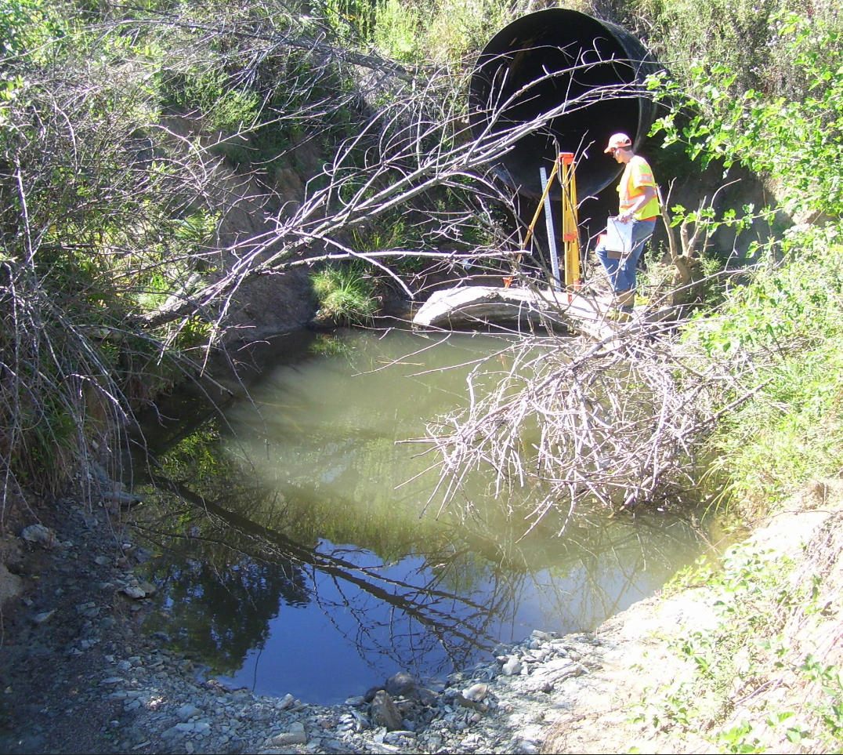
General Errors/Issues – HY-8
Scour
Hole
And
A
Free
Outfall
Notes:
This is another photo showing a scour hole. You can see that they are typically oval in shape. This one is unique also in that it also has a drop at the outlet and you can actually see the pipe anchor has fallen of into the channel. Due to the drop at the outlet, this is a situation where you could use the Existing Outlet Depth for your backwater computation.

Slide 14
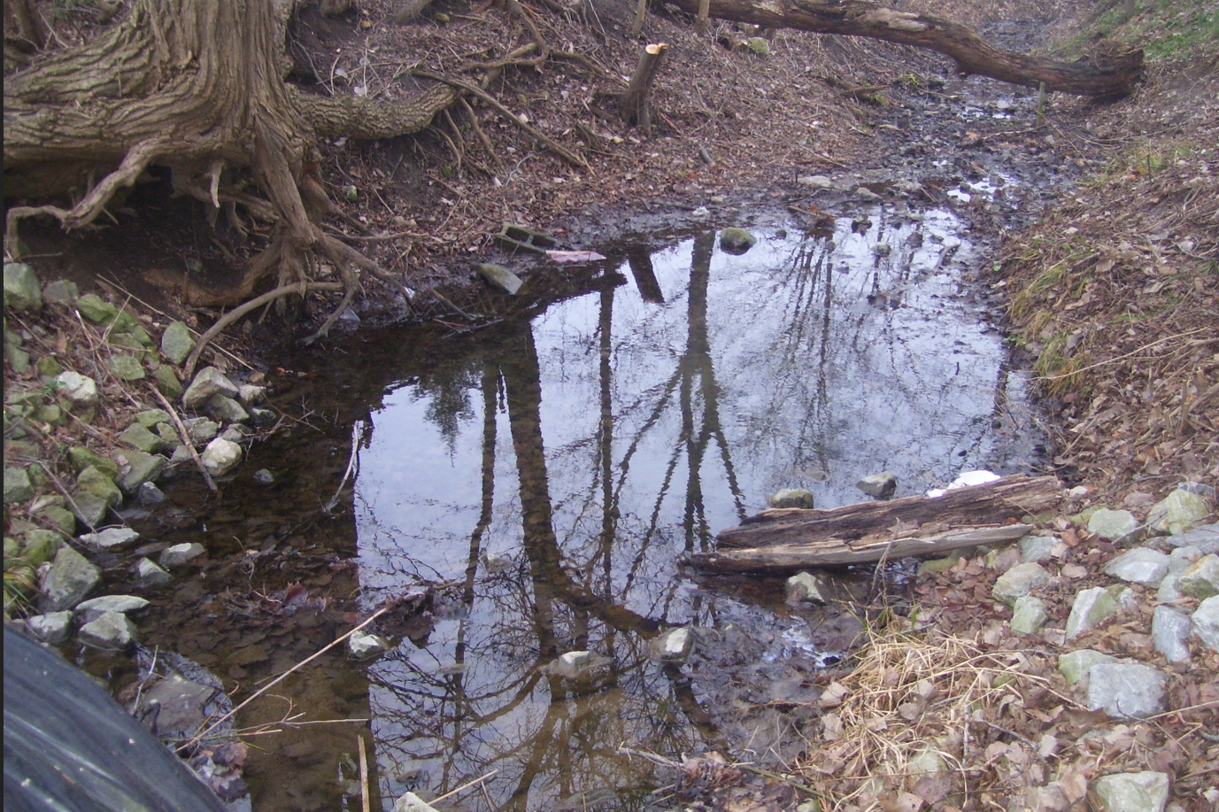
General Errors/Issues – HY-8
Notes:
This is just another photo of a typical scour hole.

Slide 15
General Errors/Issues – HY-8
5. Inverts/Flowlines and quick visual Checks (For most projects)
Downstream channel Flowline and Cross section should be adjusted so that the flowline elevation matches the Existing Outlet pipe invert
Notes:
The following few slides are intended to provide some quick visual checks for most projects, not every single situation, from the HY-8 model to identify common errors. Typically, as a reviewer, I am going to be looking for these quick visual checks and if they don’t pass the quick visual check, as a reviewer, I will have to look closer to see if there is a good reason. When you survey the cross section downstream, we want you to adjust the elevations of that cross section so that the ditch flowline elevation matches the outlet pipe invert. One way that we can verify that with your HY-8 model is to look at the crossing view and we want to see that the ditch flowline, the brown line, matches the pipe outlet invert.

Slide 16
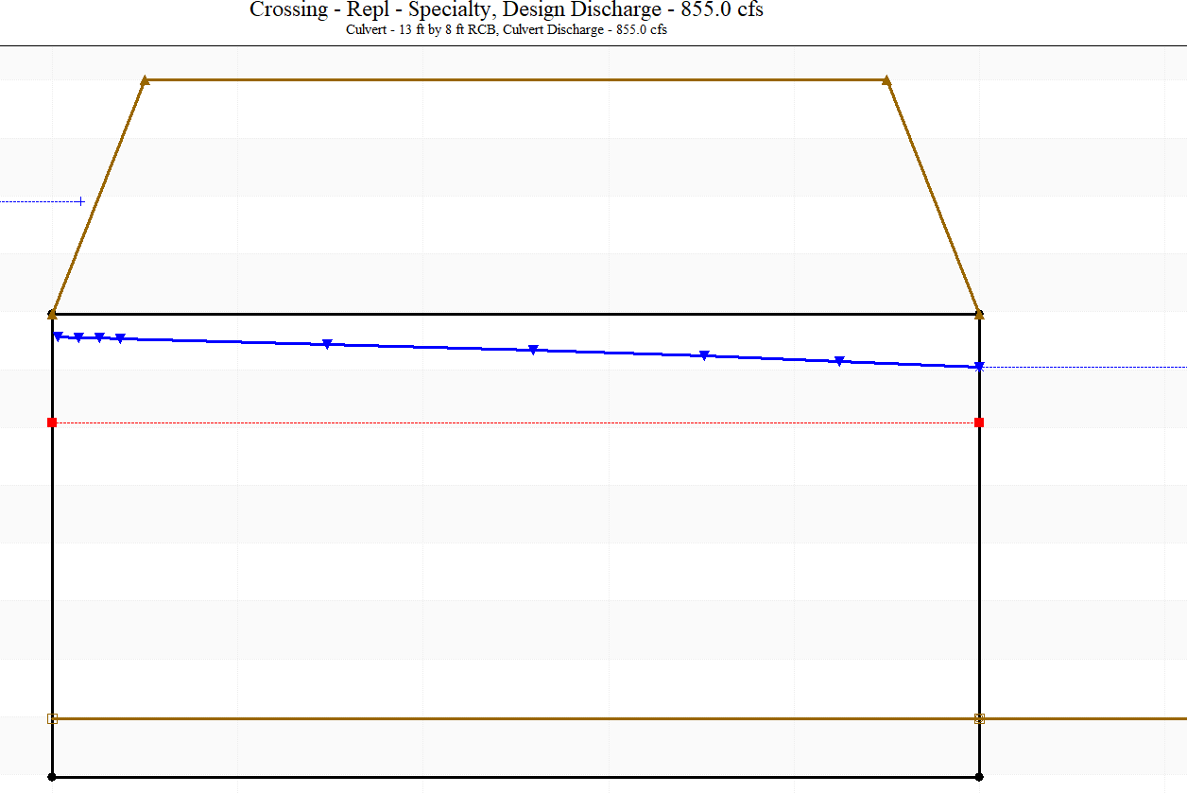
General Errors/Issues – HY-8
5. Inverts/Flowlines and quick visual Checks (For most projects) – (Cont.)
Proposed Sumped Flowline Should Match Existing Flowline
Notes:
For most replacement projects, your options will typically provide a sump. You can see in the slide the brown line directly above the bottom of the pipe is showing how much the pipe is sumped. A quick visual check should show the sump line in the culvert should tie directly into the ditch flowline elevation. So the outlet pipe invert should be set so that it is below the ditch flowline by the sump depth.

Slide 17
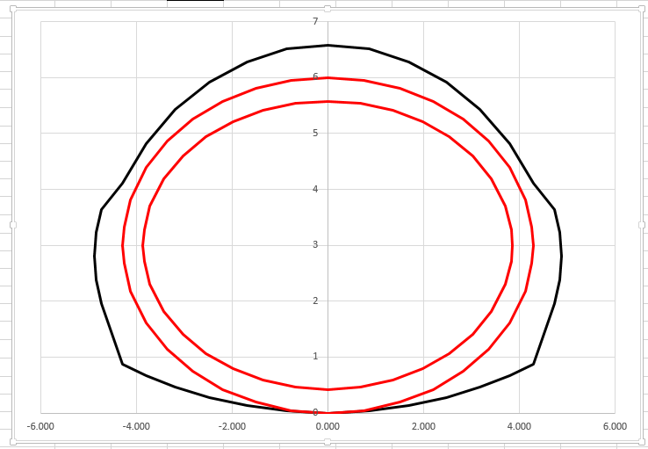
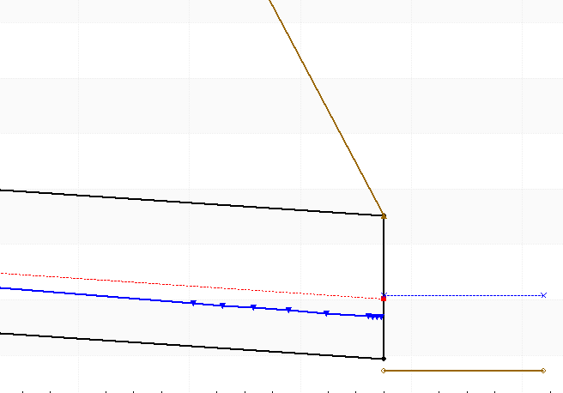
General Errors/Issues – HY-8
5. Inverts/Flowlines and quick visual Checks (For most projects) – (Cont.)
Proposed Liner invert should be slightly above Existing flowline
Notes:
For proposed pipe liners, your liner will sit in the bottom of the host pipe as can be seen in the section view on the left, so we are going to want to see in a quick visual check in the HY-8 Crossing View that the pipe invert should be higher than the downstream flowline by a depth equal to the thickness of the liner. We want to model liners with the actual invert elevations, because the invert increase, although slight, can result in an increased headwater condition.

Slide 18
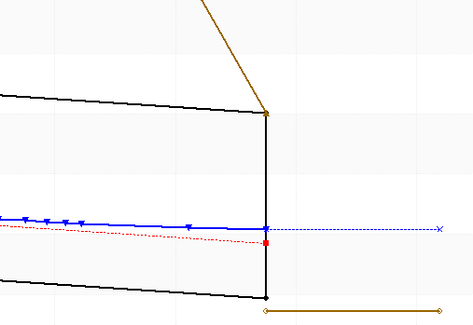
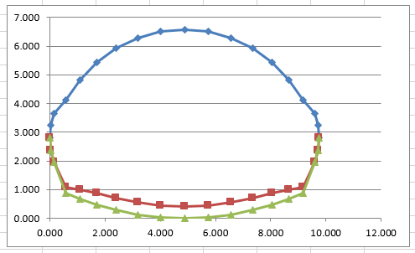
General Errors/Issues – HY-8
5. Inverts/Flowlines and quick visual Checks (For most projects) – (Cont.)
Proposed Paved Invert should be 5” above Existing flowline
Notes:
For Hydraulics, we call for 5” Paved Inverts as another rehabilitation option. As can be seen in the left section view, the bottom of the host pipe is the Green Line, and the top of the 5” paved invert is the Red Line. As a quick visual check in the HY-8 Crossing View (on the right), the invert should be raised accordingly above the ditch flowline at the outlet.

Slide 19
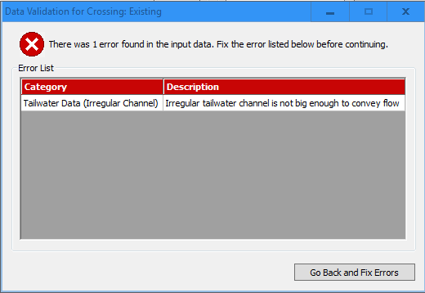
General Errors/Issues – HY-8
6. Most of us have gotten this error in HY-8
Notes:
If you have used HY-8 very much, you have probably gotten this error. This Error basically means that your cross section is too small for the flow you’ve entered. So you need to make it bigger.

Slide 20
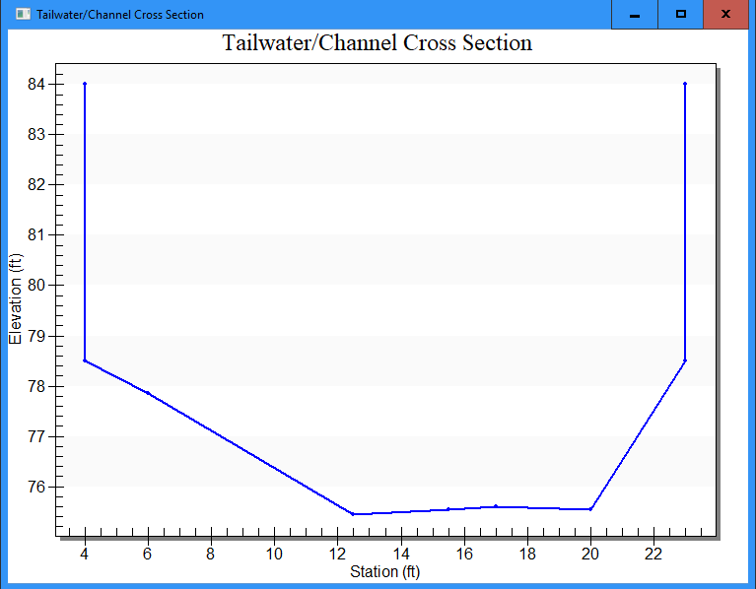
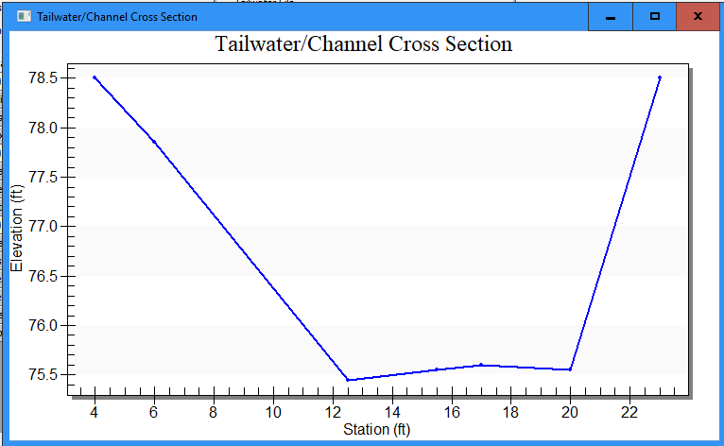
General Errors/Issues – HY-8
6. Your initial field surveyed section may look like this?
Some people like to try this →
Notes:
When we survey a ditch cross section, it isn’t unusual for it to look something like the image on the left. But often times, this cross section is inadequate to handle the design flow and you will subsequently get the error shown on the previous page/slide. So what some people tend to do is just artificially create walls to the existing section similar to what is shown on the right. This is not acceptable as it doesn’t represent reality. We may have accepted this at one time, but with the advent of LIDAR, we should be able to do better.

Slide 21
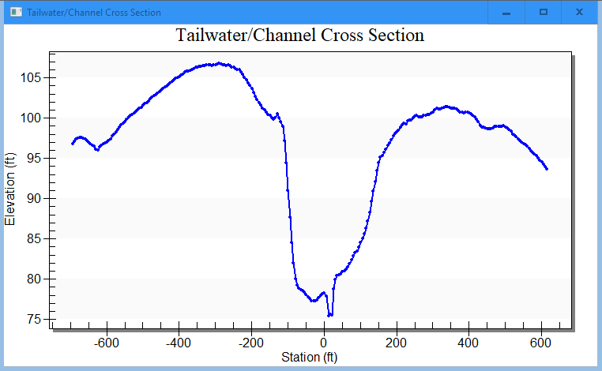
General Errors/Issues – HY-8
6. Supplement the cross section data with more realistic site conditions (LIDAR or Survey)
Actual Survey
LIDAR
LIDAR
Notes:
(Continued from Previous slide) We will want to see something more like this slide shows where you still use the survey data for the actual channel, but the overbanks can be more realistic with the use of LIDAR. You will have to combine the data from your survey with that of LIDAR. LIDAR is adequate for the overbanks typically but in general, we want to see actual survey data for the channel itself.

Slide 22
Questions
Where should the downstream cross section for a culvert be surveyed?
  Within 2 to 3 feet of the outlet
  At the face of the outlet
  Beyond any scour hole or sedimentation, where there is a natural channel shape
  At the centerline of the Road Side Ditches
2. When is it okay to use outlet depth for your backwater computation?
a. If the downstream channel is very deep
b. If your existing tailwater elevation is greater than the outlet depth
c. If your existing outlet depth is greater than your tailwater depth

Slide 23
Questions
3. How do you model a culvert with an adverse slope in HY-8 version 7.2?
  Model it with a slope that you’ve used on other projects
  Swap the inlet and outlet inverts
  Model it as flat using the outlet invert
4. What should you do if your channel section in HY-8 if it is too small for the flow?
a. Reduce your flow rate until it runs
b. Supplement the surveyed section with LIDAR elevation data
c. Make artificial vertical walls so that it is contained
d. Use a trapezoidal section
e. Lower your channel n-value

Slide 24
General Errors/Issues -
SUBMITTALS
Notes:
The following will address general submittal issues that we see and would like to address.

Slide 25
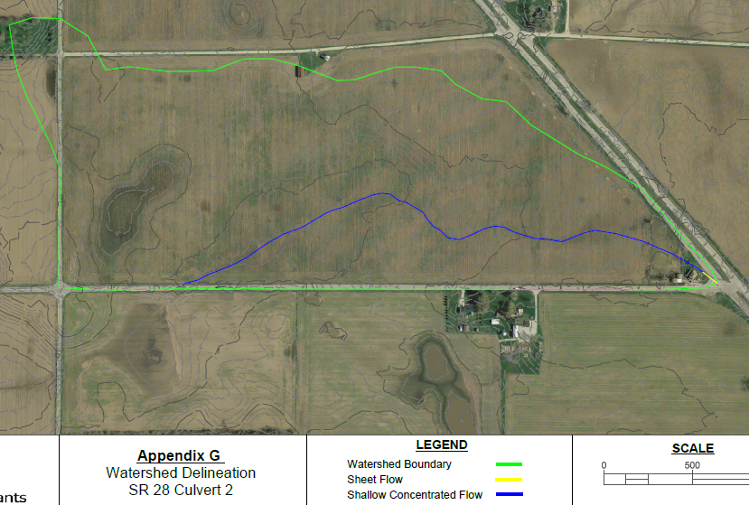
General Errors and Issues - Submittals
1. Show Drainage Area Delineation with Contours and TC Path for EACH Culvert
Notes:
For each culvert in a submittal, we are going to want to see a watershed boundary delineation with contours. Preferably the contours would be labeled with actual elevations unlike the one shown above. We also need to see that actual Time of Concentration Path that you used in your computations. One exception to showing the TC Path might be if you obtained a DNR provided Q, Then no TC Path would need to be shown, but we will still need to see the watershed delineation.

Slide 26
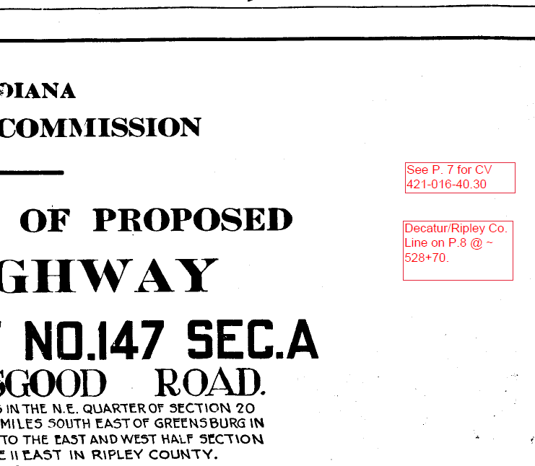
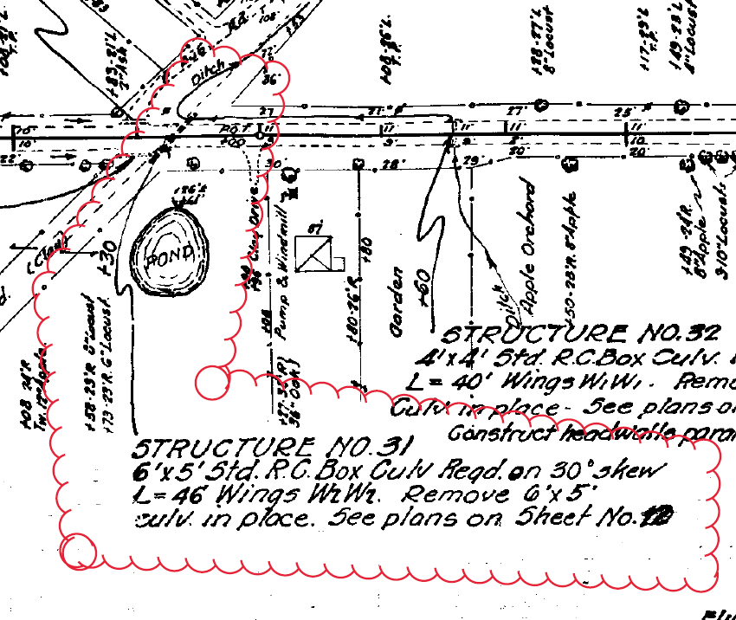
General Errors and Issues - Submittals
2. Provide Historical Road Plans for Each Culvert (if Available)
  Historical Plans Request Website: https://entapps.indot.in.gov/OPSM/Dashboard/UserRequest
Notes:
If possible, it is usually helpful to include historical road or bridge plans. These can be requested from the INDOT Records group. See the hyperlink above.
If you decide to include the entire Road Plan set rather than only the applicable sheets, It is recommended to add text Box on Title sheet listing the pages that have the pertinent information for your project. This will make it much easier for the reviewer to confirm. On the page or pages that show your actual culvert or bridge, it is always helpful to identify or draw a cloud around your specific culvert or bridge.

Slide 27
General Errors and Issues - Submittals
3. Submit your HY-8 , HEC-RAS, and HEC-HMS, models with your submittals – Not just screen shots of the output.
FOR HY-8
  Existing and Proposed Runs should be in together in 1 HY-8 file
  You should have 1 HY-8 files for Each Individual Culvert
Notes:
Any time you make a submittal that has output from HY-8, HEC-RAS, HEC-HMS, or TR-20, please include your model(s) along with the hydraulic report and associated files. You can zip these if you have multiple files such as HEC-RAS or HEC-HMS. For HY-8 in particular, Existing and Proposed runs for the same culvert location should be together in 1 file. And you should have a separate File for each location.

Slide 28
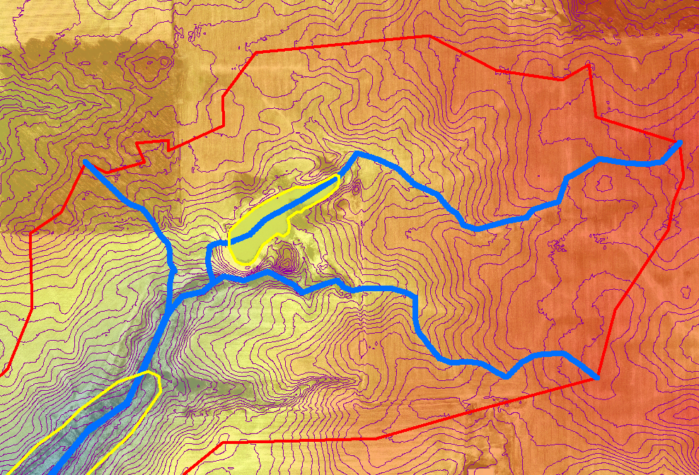
General Errors and Issues - Submittals
4. For Time of Concentration computations, any part of the Path through a pond should be excluded from the time. So it will take no time from when the water enters a pond, to where it exits the pond.
Notes:
It may not be intuitive, but for calculation of Time of Concentration through a pond, the time it takes for the water to travel through the pond should be assumed to be zero. So essentially one drop in – one drop out. The portion of the TC path through a pond or lake should be ignored.

Slide 29
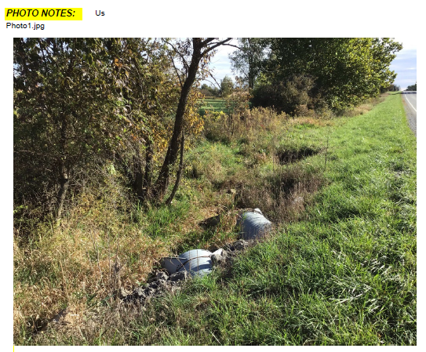
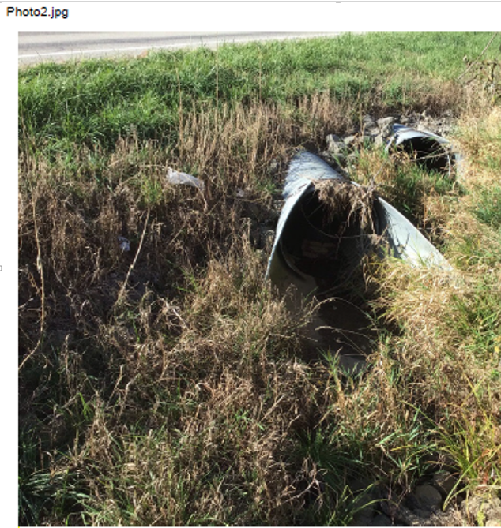
General Errors and Issues - Submittals
5. Structure Size and Type in the Model should match the Hydraulic Memo
6. Provide Inlet, Outlet, and downstream channel photos (minimum)
= Upstream
Downstream
Notes:
Make sure to double check that your Final Hydraulic memo matches what is in your model. Also, at a minimum, we are going to want see photos of your inlet, your outlet, and a photo of the downstream channel. Additionally, it is very important to label which photo is upstream and which photo is downstream. Additional photos can be helpful as well that can provide useful information such as limited cover, nearby building, road side ditches, limits of scour, or bank erosion.

Slide 30
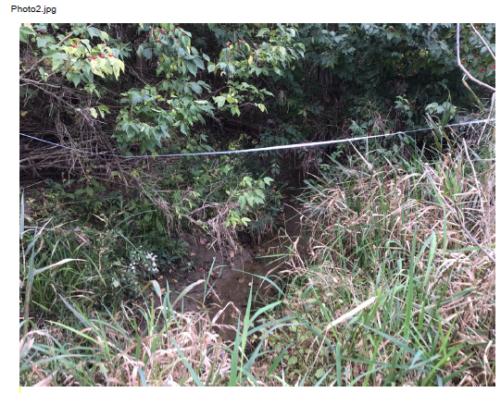
General Errors and Issues - Submittals
6. Provide Inlet, Outlet, and downstream channel photos (Cont.)
Downstream
Notes:
Also, for your channel photo, it is important to note Upstream and Downstream.

Slide 31
General Errors and Issues - Submittals
7. HY-8 7.2 is the only currently accepted version. (Website)
8. Due to a recent Windows 10 update, if you try to install HY-8, there is a necessary file that is now missing. (Website)
So if you already have HY-8 7.2 installed
If you haven’t? : Visit INDOT Hydraulics Website
Notes:
Currently, we only accept HY-8 version 7.2 and Federal Highway no longer provides a link to download version 7.2. The INDOT Hydraulics website will direct you to a location where you can download a copy of version 7.2. It should be noted, that due to a recent Windows 10 update, a file has been removed that you need in order to install HY-8 version 7.2. So if you already have HY-8 7.2 installed, you don’t need to do anything, but if you haven’t installed it and would like to, you also need to install an additional file that you can get directly from the INDOT Hydraulics Website.

Slide 32
General Errors and Issues - Submittals
Large Design Submittals …
Break Them up – Separate Reports and Submittals
Culverts (~10 culverts per submittal)
-Break up by watershed
Detention Separate Submittal
Median Drains Separate Submittal
Storm Drains Separate Submittal
Notes:
Recently we’ve been getting a lot of large submittals that include a combination of storm drains, culverts, median drains, and detention all combined into one massive submittal. We would like to ask consultants to break up these large submittals and also the reports. Some of these reports can have hundreds or thousands of pages. We would like to see a separate SUBMITTAL and REPORT for culverts, Detention, Median Drains, and Storm Drains. Also, if you have a large quantity of culverts, we would like you to try break those into separate submittals as well. Ideally the culverts in each submittal would be in close proximity to each other and possibly within the same watershed. Also we would like to see culvert submittals to have a max of around 10 culverts per submittal/report. So if you had 27 culverts in one watershed, we would prefer you break them into 3 submittals of 9. Or if you had 33 culverts, you could break them into 3 submittals of 11.

Slide 33
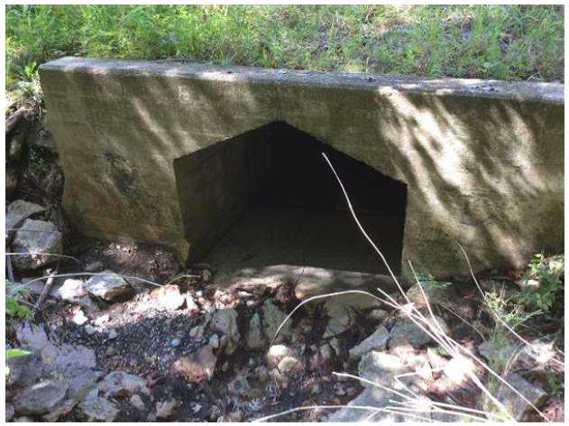
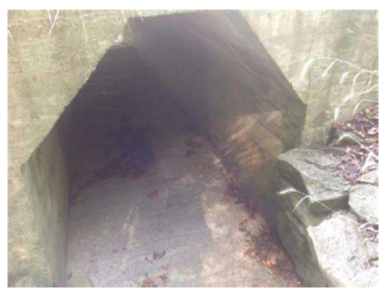
General Errors and Issues - Submittals
  10. Situations it would be prudent to have a PRE-Submittal Meeting with INDOT Hydraulics or a phone call at a minimum.
    There is no defined channel downstream (Farm fields on both sides) – may consider matching existing rather than upsizing to meet current IDM.
    Planning requires altering the existing drainage pattern.
    The model shows roadway overtopping, but in order to eliminate it, will require a significant change to the scope of the project. (Grade raise required or Pipe size increases from 4’ Diameter to 20’ RCB)
    Anything you haven’t encountered or seen before
Notes:
There are situations that it would be good to coordinate with INDOT Hydraulics BEFORE you make your submittal. The following are a few examples of situations it would be a good idea to talk to us before making a submittal. Sometimes there are sites that have no defined channel downstream, like where there are farm fields on both sides. It may be more desirable to match the existing rather than upsizing to meet INDOT Replacement Criteria. If you are proposing to alter the existing drainage pattern, this is always a big deal and can create unintended consequences. If your model shows overtopping, but in order to eliminate it, it would require a significant change to the scope such as a grade raise or significant structure size increase from that of the existing. If there is anything that you haven’t seen before and just aren’t sure how it should be modeled or how to address it.

Slide 34
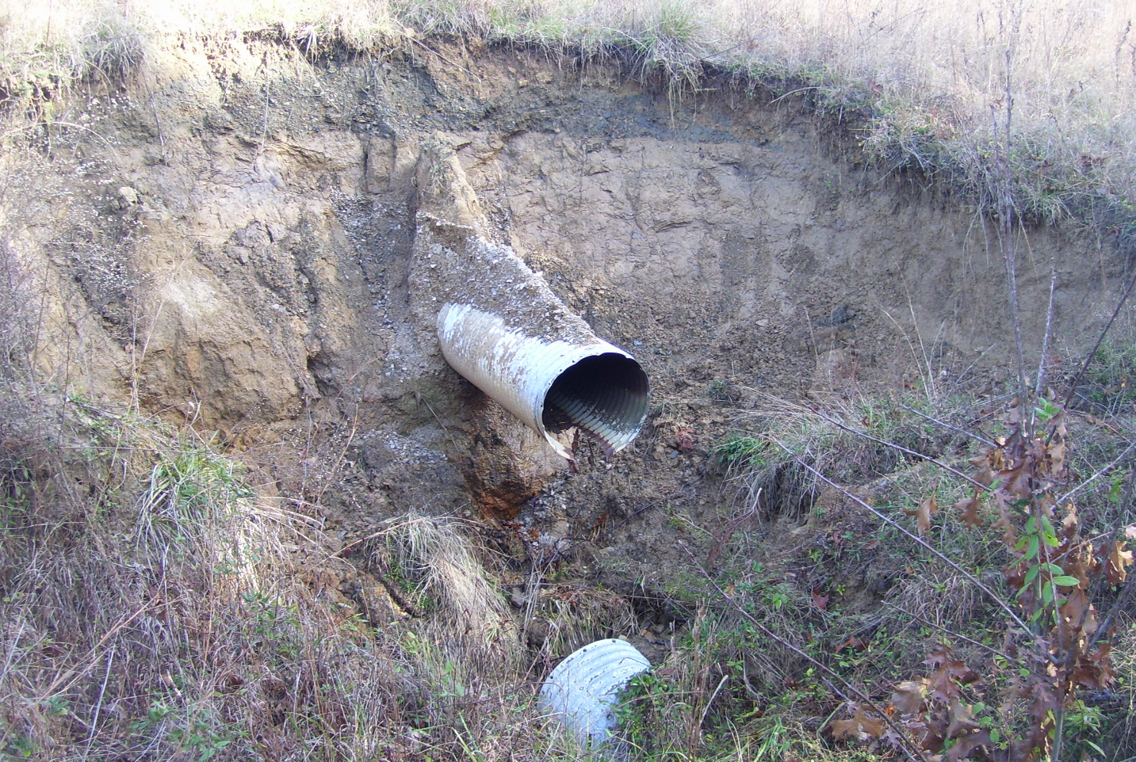
General Errors and Issues - Submittals
Notes:
Just another example of a unique condition that it may be prudent to bring INDOT Hydraulics in on before making a Hydraulics submittal.

Slide 35
Culvert Rehabilitation
Culvert Rehabilitation
(Liners, Paved Inverts, Bored Pipes)
Notes:
In the following section we will review issues specific to Culvert Rehabilitation such as Liners, paved inverts and bored pipes.

Slide 36
Culvert Rehabilitation (Liners, Paved Inverts, Bored Pipes)
1. When analyzing an existing structure that has been lined, or extended with a different size/type, you should use the ORIGINAL Structure Size and Type for modeling the existing condition.
So if a 4’x4’ RCB has been extended on both ends with a 4’ diameter CMP, you would analyze the existing as if it were a 4’x4’ RCB
And
If you are looking to replace a 48” CMP that has been lined with a 36” HDPE, you should analyze the existing as if it were the 48” CMP
Notes:
If you are looking at an existing site that has a culvert that has been previously lined or extended with a different size or type of culvert, you should use the ORIGINAL Structure size and Type for modeling the existing condition. So for example, if the original structure was a 4’x4’ RCB and over the years, they may have widened the road and as a result, it has been extended on both ends with a 4’ diameter CMP, you would analyze the entire existing as if it were a 4’x4’ RCB in HY-8. Another example might be If you are looking to replace a 48” CMP that has been lined with a 36” HDPE, you should analyze the existing as if it were the 48” CMP.

Slide 37
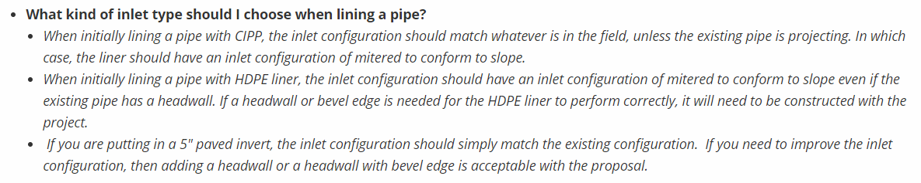
Culvert Rehabilitation (Liners, Paved Inverts, Bored Pipes)
2. What inlet condition do I use in HY-8 for a liner/Paved Invert? (Website)
Notes:
How to model inlet conditions in general for HDPE and CIPP Liners and Paved inverts. The INDOT Hydraulics website covers in pretty good detail how each liner inlet condition should be modeled. For example, a CIPP Liner should be modeled with the same inlet condition as the existing, the existing is projecting from the fill. In that case, the inlet condition for a CIPP liner would be “Mitered to conform to slope”. When modeling an HDPE liner, regardless of the inlet condition of the existing pipe, you should start off modeling the HDPE liner as “Mitered to conform to slope”. And Finally for paved inverts, the inlet condition should match the existing unless an improved inlet is needed to be constructed. If any of the pipe rehabilitation options doesn’t meet design criteria for liners, you can then consider an improved inlet condition such as a “Square Edge Headwall” or “Beveled Headwall.” It should be noted that if any pipe rehabilitations are needed, you will need to state this clearly in the Hydraulic Memo so that it is clear that it needs to be constructed as part of the project.

Slide 38
Culvert Rehabilitation (Liners, Paved Inverts, Bored Pipes)
3. For Liners, if your liner increases the headwater > Existing Headwater:
IDM (203-2.02(13))→
Provide Justification IN THE MEMO (i.e. contained in the ditch, contained on INDOT R/W, Flood Easements)
Provide visual evidence (Contour boundary of Headwater or section showing headwater in the ditch)
Notes:
When we are looking at liner options, we are looking at reducing the opening size of the original host pipe. So one of the common issues that we run into is that the headwater elevation goes up. Sometimes it does and sometimes it doesn’t. Currently the IDM states that an increase in backwater over the existing condition is not allowed and any exception to that will require justification and approval by INDOT Hydraulics. If your design shows that there is an increase in headwater from the existing condition, then we are going to want to see JUSTIFICATION for that headwater increase IN THE MEMO. Typical justification for this might be that the increased headwater is contained in the upstream channel, or the increased headwater remains entirely on INDOT Right of Way with no negative impacts or if you plan to buy flood easements.

Slide 39
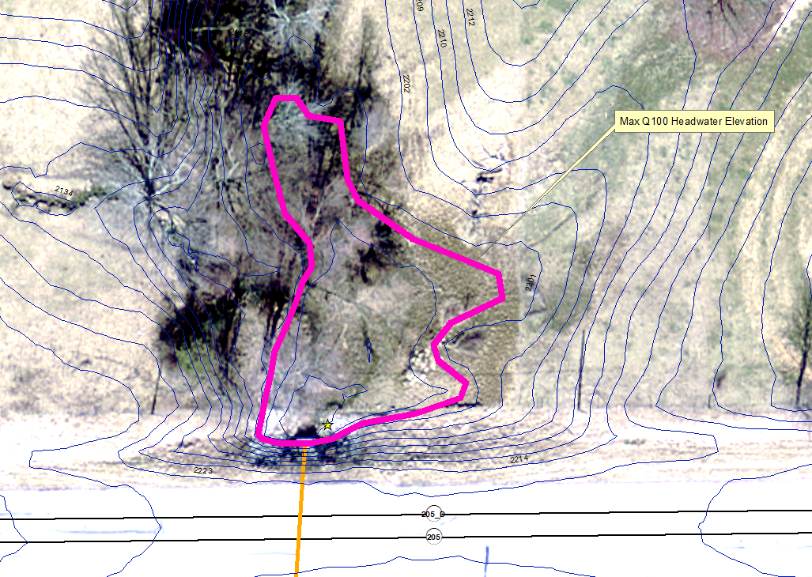
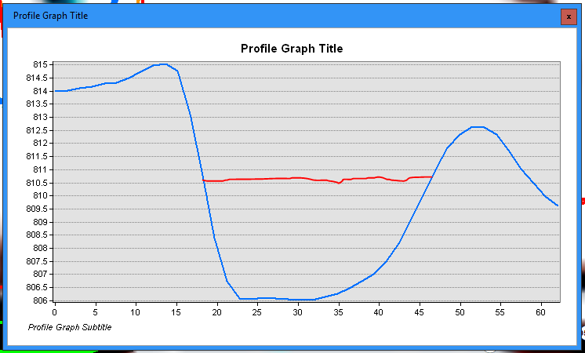
Culvert Rehabilitation (Liners, Paved Inverts, Bored Pipes)
3 (Cont.) – Headwater – Show it.
Max Q100 Headwater
Max Q100 Headwater
Notes:
If your liner does increase the headwater and your justification is that the headwater stays contained in the upstream channel, please provide visual evidence similar to the one on the left above showing the ditch section with the proposed headwater or like on the aerial view on the right, you can show contours and identify the contour of the proposed headwater elevation.

Slide 40
Culvert Rehabilitation (Liners, Paved Inverts, Bored Pipes)
4.When installing a Bored Pipe adjacent to a lined pipe, what elevation should I set the inverts? (Website)
For Low Q100 Elevations, we will typically allow the bored pipe to be set 6” above the existing.
5. What is the minimum internal diameter of a bored pipe?
(Website)
Notes:
Occasionally we have the situation when a liner, even with improved inlet conditions such as a beveled headwall, increases the headwater above the existing. In this situation, in addition to the liner, we will typically include a new Bored pipe that will be placed adjacent to the existing pipe. One of the common questions that comes up regarding bored pipes is what elevation to set the inverts. Our website provides some guidance. We want that existing pipe that is getting lined to remain as the primary conduit for flow and the bored pipe should act as more of an overflow or additional capacity in higher flow conditions. When modeling and eventually constructing these bored pipes, we want the inverts to be set 1 foot above the existing pipe inverts. However, there are situations that the Q100 headwater elevation is relatively low and setting the bored pipe inverts 1 foot above doesn’t help reduce the headwater enough. In those situations, we would allow the bored pipes to be set 6 inches above the existing inverts, but you should state in the hydraulic report that you tried to set it at 1 foot and needed to lower the bored pipe inverts to 6 inches accordingly. Also, what is the minimum internal diameter of a bored pipe? This is also on our website, and as you can see, the minimum bored pipe size is 18”.

Slide 41
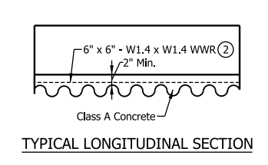
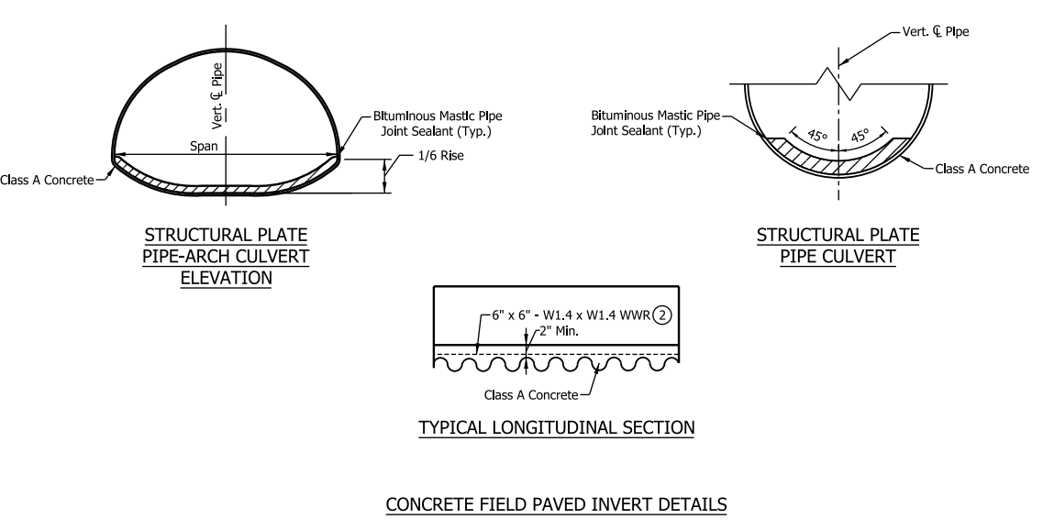
Culvert Rehabilitation (Liners, Paved Inverts, Bored Pipes)
6. When providing Liner Options, we typically would also like to see a 5” paved invert option if it meets Liner design Criteria.
  Standard Drawing → Std Dwg. E 715-Pipe-02
Notes:
When the district asks for liner options, they will typically want to see a paved invert as well. It is good to provide the paved invert alternative as long as it meets the design criteria for liners. There is one standard drawing that we are aware of for paved inverts as shown in the slide. It should be noted that the standard drawing calls out a thickness of 2 inches minimum. When we call for paved inverts for hydraulics, we want to see 5” paved inverts.

Slide 42
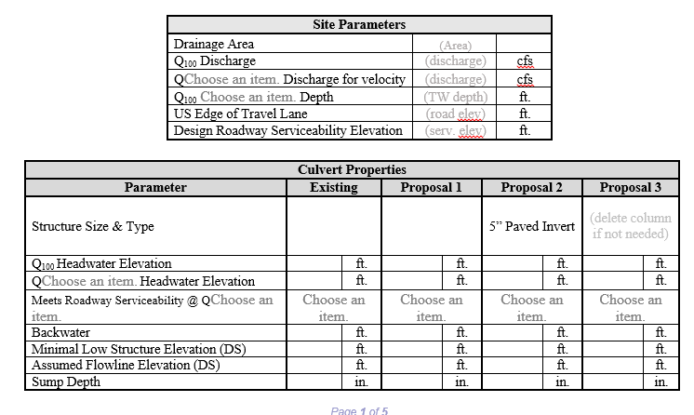
Culvert Rehabilitation (Liners, Paved Inverts, Bored Pipes)
6. Must State the Thickness of the Paved Invert in the Memo
Notes:
Therefore, in your hydraulic memo, it is really important to Note the THICKNESS of the paved invert.

Slide 43
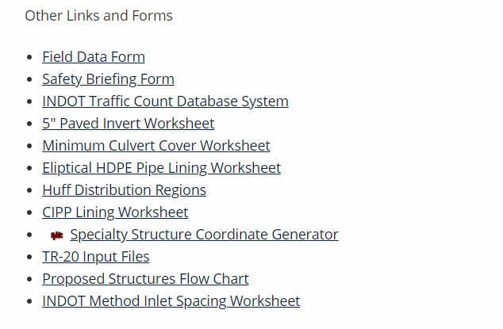
Culvert Rehabilitation (Liners, Paved Inverts, Bored Pipes)
6. Spreadsheet for Coordinates in HY-8: (Website)
Notes:
On the INDOT Hydraulics website we provide a spreadsheet that will provide coordinates for paved inverts in circular or Pipe arch shapes

Slide 44
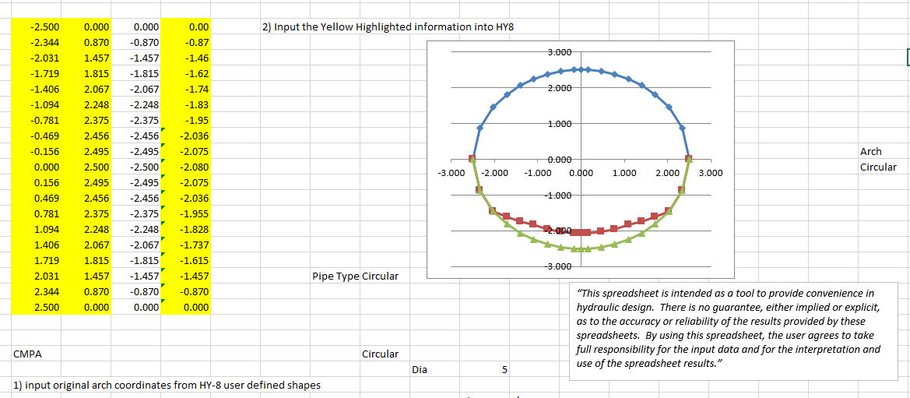
Culvert Rehabilitation (Liners, Paved Inverts, Bored Pipes)
6. Paved Invert (Cont.)
Notes:
This is a screen shot of the paved invert spreadsheet for a round pipe which will provide you with the user-defined coordinates for HY-8. You can see the green is the bottom of the host pipe and the red is the top of the paved invert. Remember the n-value of the paved invert should be 0.012.

Slide 45
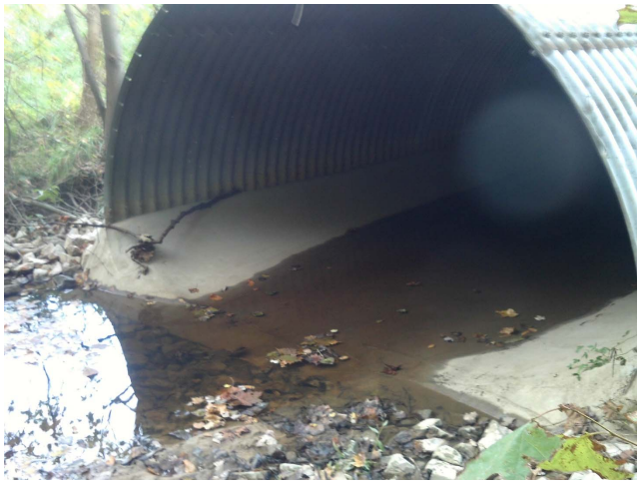
Culvert Rehabilitation (Liners, Paved Inverts, Bored Pipes)
6. Paved Invert (Cont.)
Notes:
This is a corrugated metal pipe arch with a paved invert.

Slide 46
Culvert Rehabilitation (Liners, Paved Inverts, Bored Pipes)
6. What is the minimum Pipe Size for a Paved Invert (Constructability)?
(Website)
Notes:
So what is the minimum pipe size that we want to consider paved inverts for. Constructability can be an issue for smaller longer pipes. We got some feedback from INDOT Construction and the smallest size we will consider for paved inverts is 4 foot span and 4 foot rise.

Slide 47
Culvert Replacement
Culvert Replacement
Notes:
The following will address some common issue that we encounter for Culvert Replacements

Slide 48
Culvert Replacement
1. RCB’s and 3-Sided Structures will require riprap placed at the INLET and OUTLET According to their standard drawings.
RCB → E 714-BCSP-01
Notes:
Per INDOT Standard Drawings, 4-sided reinforced concrete boxes and 3-sided reinforced concrete structures will require riprap at the inlet and outlet. We have seen several memos where it is only called for at the outlet for these structure types.

Slide 49
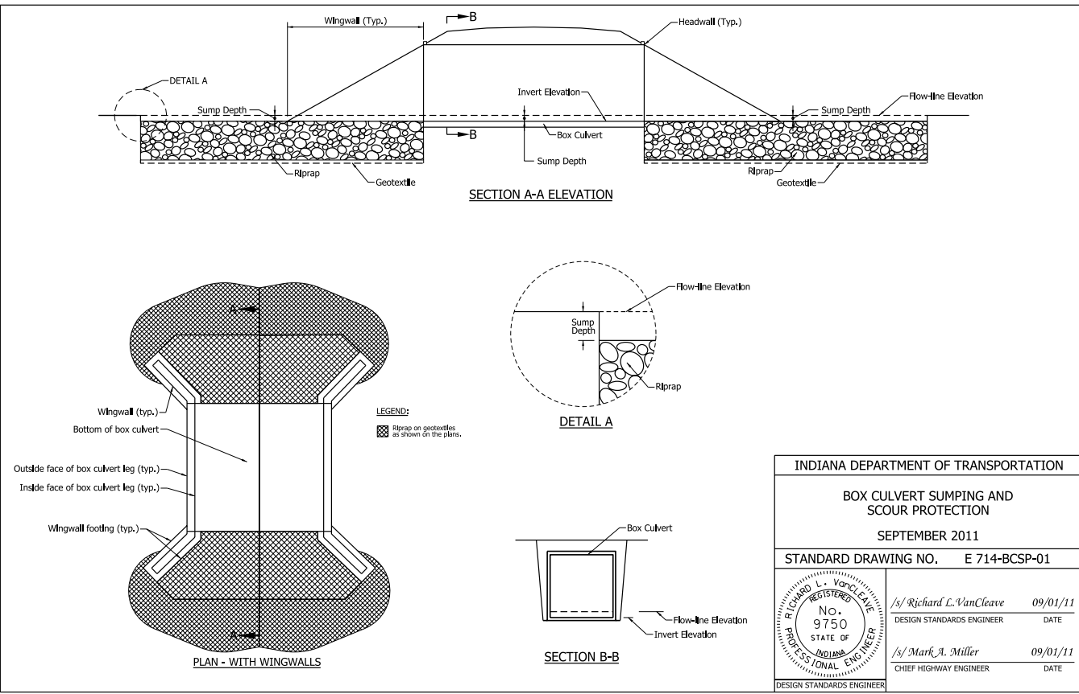
Culvert Replacement
Notes:
The image is from the current 4-sided Reinforced concrete box standard drawing for scour protection and you can clearly see that it is calling for riprap at the inlet and outlet.

Slide 50
Culvert Replacement
1. RCB’s and 3-Sided Structures will require riprap placed at the INLET and OUTLET According to their standard drawings.
3-Sided Structures → E 723 CCSP (series)
Notes:
For 3-sided structures, the standard drawings are the E 723 CCSP series.

Slide 51
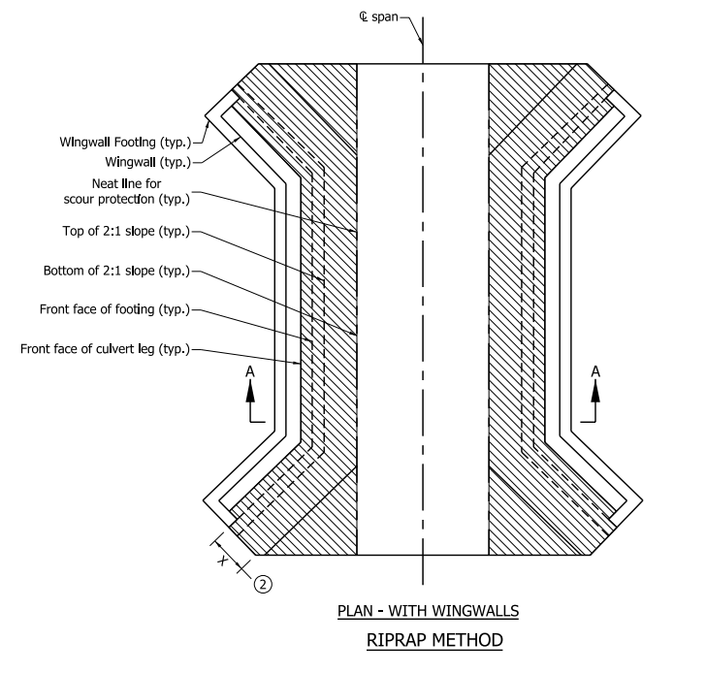
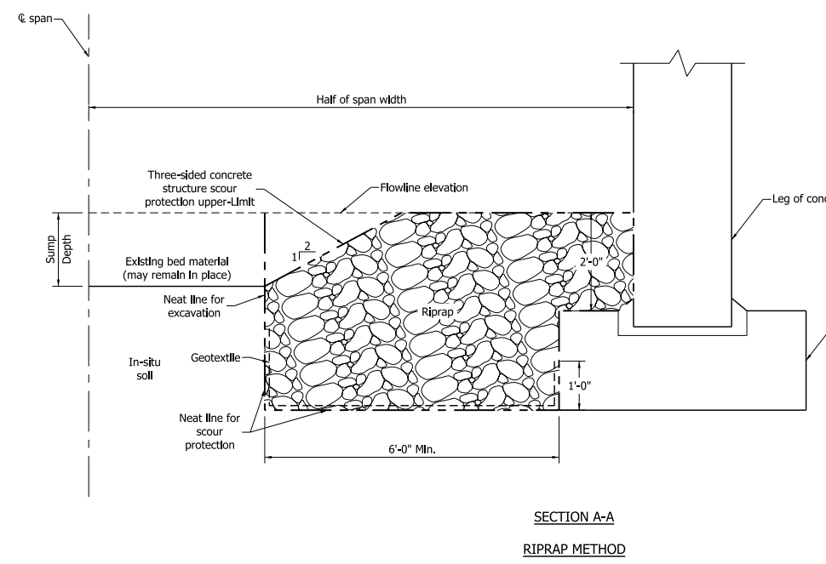
Culvert Replacement
Notes:
You can see that riprap is shown at the inlet, outlet and along the inside of the structure along the footings as well.

Slide 52
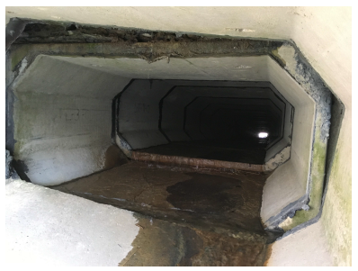
Culvert Replacement
2. Haunches for RCB’s and 3-Sided Flat-Top Structures:
Notes:
Haunches as identified by the red arrows in the slide. If you select Concrete Box in HY-8, it is going to model a rectangle. We have determined that these haunches can create a significant affect on increasing backwater.

Slide 53
Culvert Replacement
2. Haunches for RCB’s and 3-Sided Flat-Top Structures:
Spans < 18’, Haunches should be modeled (Website)
Spreadsheet providing Coordinates is available on Website
Notes:
So we started requiring that 3-sided Flat Top and 4-sided RCB’s be modeled with Haunches if the Span <18’. It should be noted that you CAN model haunches for larger structures, you’re just not required to.

Slide 54
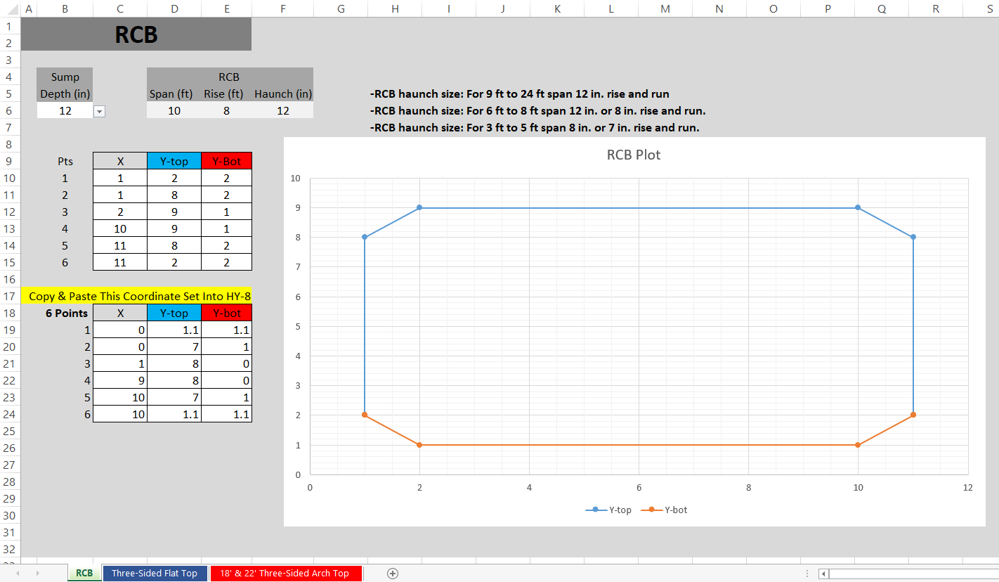
Culvert Replacement
2. Haunches - (Cont.)
Use largest Haunch
For size listed
So, for a 4’x4’ RCB, you would
Conservatively use an 8” Haunch
Notes:
James Boehm created this spreadsheet to allow for easy input as User-Defined into HY-8. This spreadsheet is available to download from our INDOT Hydraulics Website. Some common haunch sizes were investigated with manufacturers and listed at the top. You should select the larger (more conservative) haunch dimension since we don’t know which manufacturer will provide the RCB. So for Example, if you are proposing a 4 foot by 4 foot reinforced concrete box, you would conservatively use an 8 inch haunch.

Slide 55
Culvert Replacement
3. A Sump is no longer required for 3-Sided Structures
Unless it is a County Regulated Drain and the County Surveyor/Drainage Board has requested a sump.
Notes:
Sumping is no longer required for 3-sided structures. We have had agreement among multiple agencies that sumps are no longer required for 3-sided structures. One exception to that might be if the structure is located in a County Regulated Drain and the County Surveyor requests that a sump be provided.

Slide 56
Questions
For hydraulics, what is the thickness for a paved invert?
  2 inches
  1/10th of the structure rise
  5 inches
  Just enough to cover the bottom
2. Haunches should be modeled for reinforced concrete structures with spans less than?
a. 10 feet
b. 12 feet
c. 18 feet
d. 20 feet

Slide 57
Questions
3. Which is NOT an acceptable justification for allowing increased headwater over existing for a liner
  The headwater elevation stays contained in the upstream channel
  The headwater only floods a farm field
  Purchase flood easements
  The headwater stays on INDOT R/W
2. What version of HY-8 is currently accepted by INDOT Hydraulics?
a. 7.1
b. 7.2
c. 7.3
d. The newest version

Slide 58
The End.
Questions???
Links:
INDOT Hydraulics:
https://www.in.gov/indot/3595.htm
INDOT IDM: https://www.in.gov/indot/design_manual/design_manual_2013.htm
INDOT Standard Drawings:
https://www.in.gov/dot/div/contracts/standards/drawings/sep19/sep.htm
Historical Plans Request Website: https://entapps.indot.in.gov/OPSM/Dashboard/UserRequest
Notes:
Hyperlinks to referenced sources are provided

