Slide 1
E. coli Training
Hoosier Riverwatch
Office of Water Quality
Dylan Allison
Hoosier Riverwatch Coordinator

Slide 2


Overview/Agenda
History
Bacteria & Pathogens
Sources
State Standards
Prevention/BMPs
HRW Methods
Practice

Slide 3

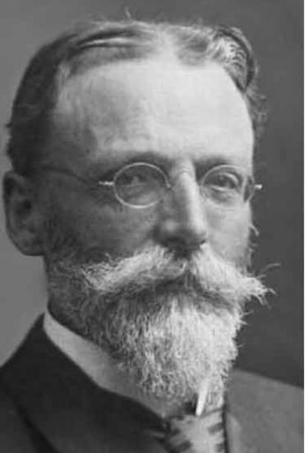
History
First discovered in 1885 by German pediatrician,
Theodor von Escherich
  Bacterium coli – ‘coli’ refers to its presence in the colon
  Renamed Escherichia coli in 1919 in memory of Theodor
Many strains of E. coli exist, one particular (K-12) isolated
from diphtheria patient
  In 1925, added to the collection at the Department of Bacteriology
  and Experimental Pathology at Stanford University
  Professor Charles E. Clifton conducted studies through the 1930’s
  that linked bacterial metabolism and the availability of nutrients
Opened a new world of bacterial genetics and molecular biology
  Luria-Delbrück experiment in 1943 showed that Darwin’s theory of
  natural selection applied to bacteria as well
Notes:
Did you know? Professor Richard Lenski, at Michigan State University, has been studying the genetic changes in twelve (originally) identical populations of E. coli since 1988. The experiment has now reached more than 65,000 generations, making it the longest running study in experimental evolution in the world. The goal is to study the dynamics of evolution, particularly the rate of evolutionary change.
https://whatsinaname.hmnh.harvard.edu/ecoli
https://www.ncbi.nlm.nih.gov/pmc/articles/PMC9487582/

Slide 4
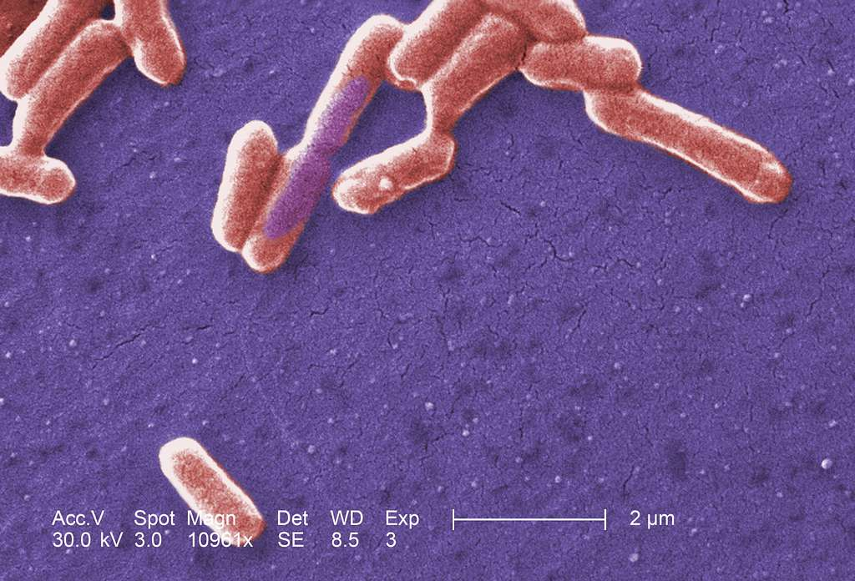
Watch Your Bacteria!
Bacteria are…
Single cell organism without nucleus or
organelles (prokaryotes)
Shapes include rods, spirals, spheres, etc.
Typically, a few micrometers in length
(1 mm = 1,000 micrometers)
Found in every environment on Earth
  1 teaspoon topsoil holds more than 1 billion bacteria
Play a vital role in decomposition, digestion, the
creation of products like antibiotics and cheese
Most are NOT pathogenic

Slide 5
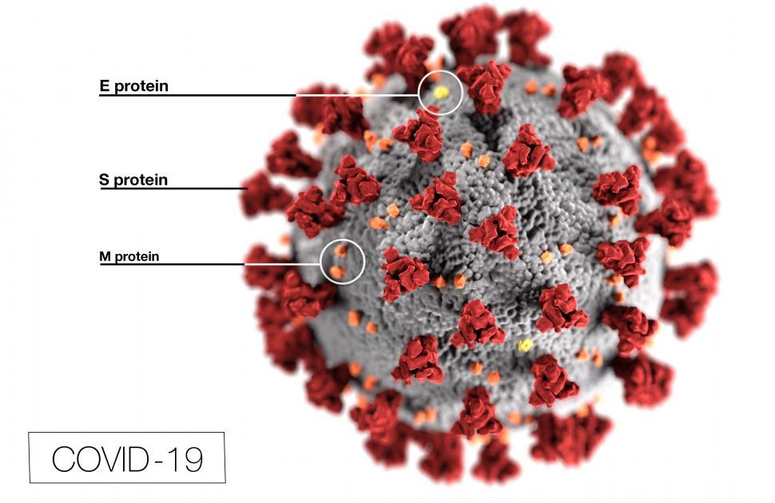
Pathogen
Greek: ‘pathos’ = disease, ‘genos’ = birth
Any microorganism capable of producing disease or illness
  Symptoms can be widespread – nausea, diarrhea, fever,
  sore throats, cough, abdominal cramps, rash, etc.
Virus, Protozoa/Parasite, Bacteria
Enteric pathogens primarily infect
gastrointestinal tract
  May spread to other systems
Treatment includes vaccines, antibiotics/
medications, hydration & rest
  Prevention is the best protection!

Slide 6
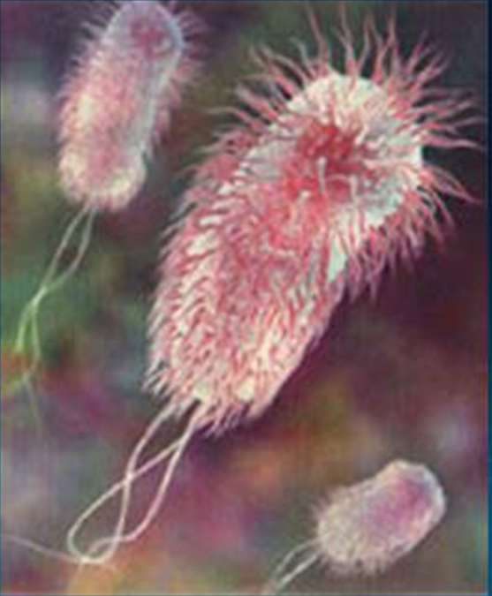
What is E. coli?
Member of the Enterobacteriaceae family
(>100 species)
Gram-negative – stains pink
  Protective capsule prevents white blood cells
  and antibiotics from being effective
Rod-shaped, 2-micrometers long
Indicator species

Slide 7
Total Bacteria
Family Enterobacteriaceae
Total Coliforms
Fecal Coliforms
E. coli
Pathogenic E.coli
Notes:
E. Coli are a subset of family of bacteria called Enterobacteriaceae. This family represents a group of organisms that includes nearly a dozen sperate genus groups and more than 40 species.
For bacterial monitoring, total coliforms – many species and strains for a variety of sources (fecal and non-fecal) including plants and animals.
Fecal Coliform – Includes bacteria from fecal matter (animal or human).
E. Coli – one type of bacteria within the fecal group, hundreds of different strains, most harmless, useful indicator organism.

Slide 8
Why not sample for pathogens?
Few laboratories have the capacity
It’s expensive
Takes a long time for analysis
Requires a large volume of water
Most tests identify only one pathogen
Notes:
Because of the challenges with direct detection, traditionally scientists have focused on the use of “indicators” that help predict the presence of pathogens in the environment.

Slide 9
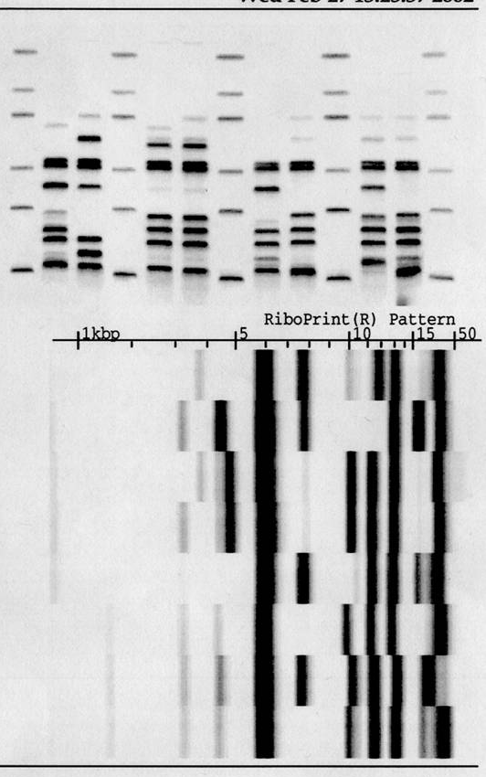
Indicator Bacteria …
Suggest the presence of pathogens
Are easy to collect and analyze
Are relatively safe to handle and generally harmless
Coliform, fecal, E. coli, and Enterococci are used
as indicators
Do NOT “indicate” the source of the fecal matter
Notes:
Expensive tests to indicate source.
~$1000 antibiotic resistance analysis – on website under BST project (sjrwi.org)
Ribotyping is more expensive – send to lab to find source

Slide 10
E. coli?
NOT pathogenic
  Symbiotic – aids in digestion, vitamin uptake, prevention of other
  bacterial infection
Pathogenic
  Shiga toxin-producing E. coli (STEC), Strain O157:H7 is the “bad guy”
  Gastrointestinal symptoms after 2 - 4 day incubation
  Spread by ingesting contaminated food, water, or contact with feces
  Only 20% are recognized outbreak
  Estimated 265,000 STEC infections in US annually

Slide 11
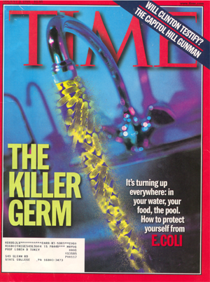

Slide 12
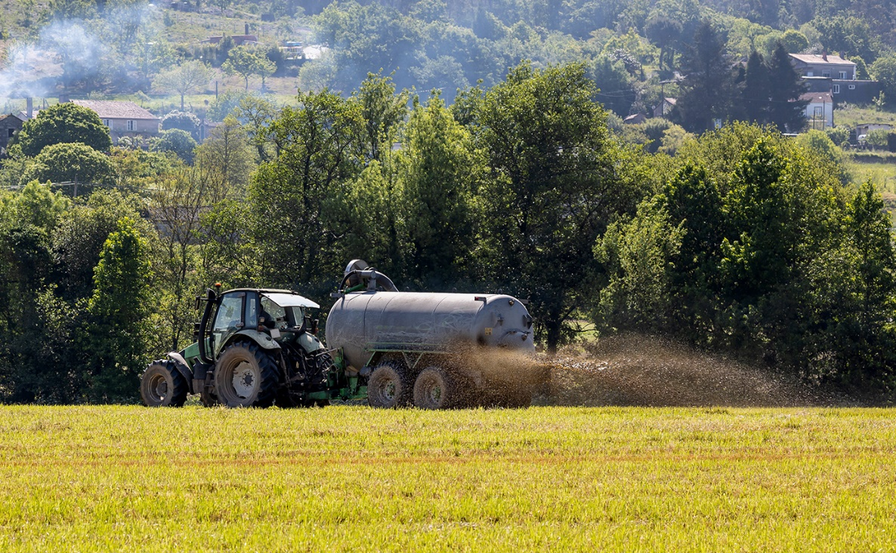
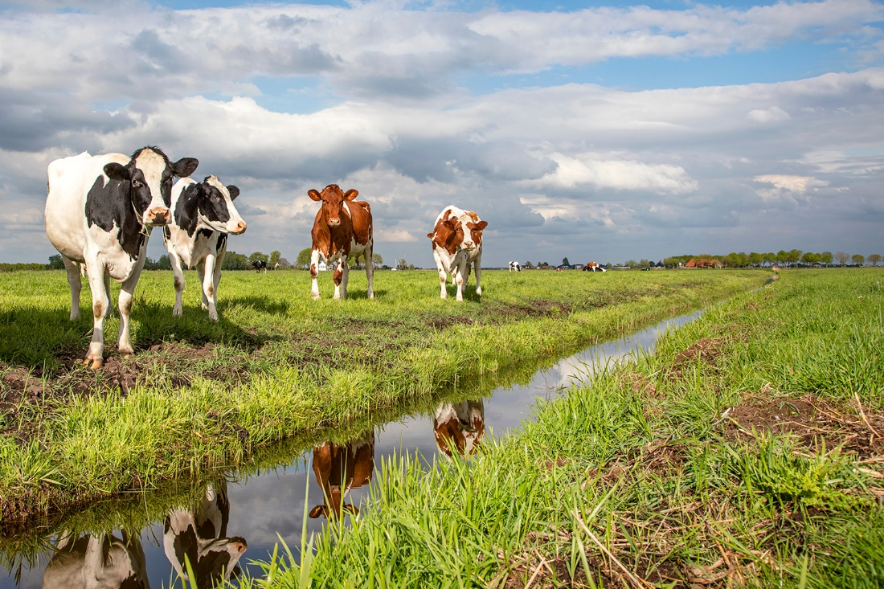
Sources
Notes:
Anything that adds fecal material to water can add pathogens
Human – dirty diapers, swimming “accidents,” inadequate septic systems, sewage treatment plant discharges, leaking sewage lagoons
Animals – direct contribution, overflowing lagoons, runoff from fields after manure application, manure spills, storm water runoff from lands with wildlife or pet droppings

Slide 13
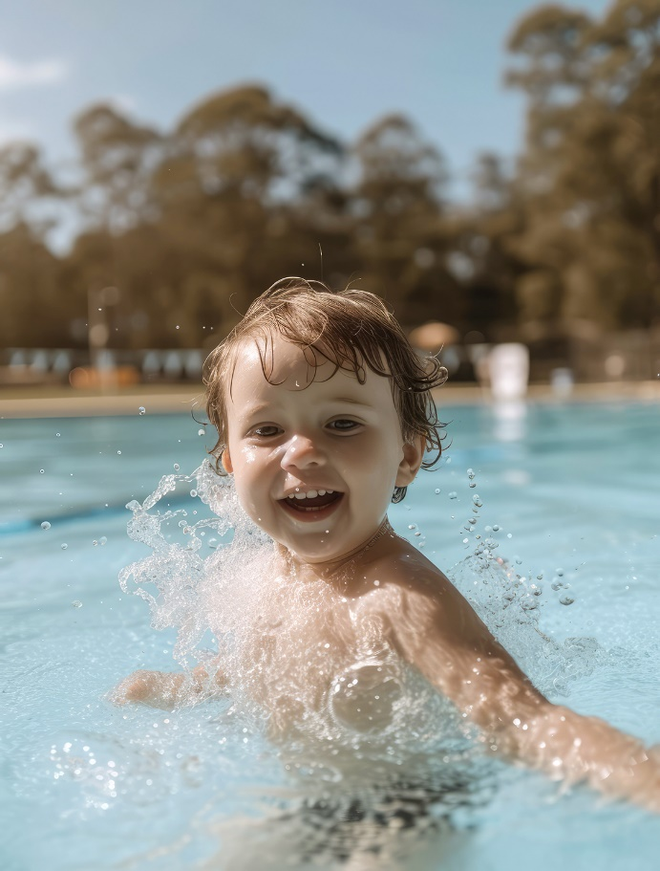
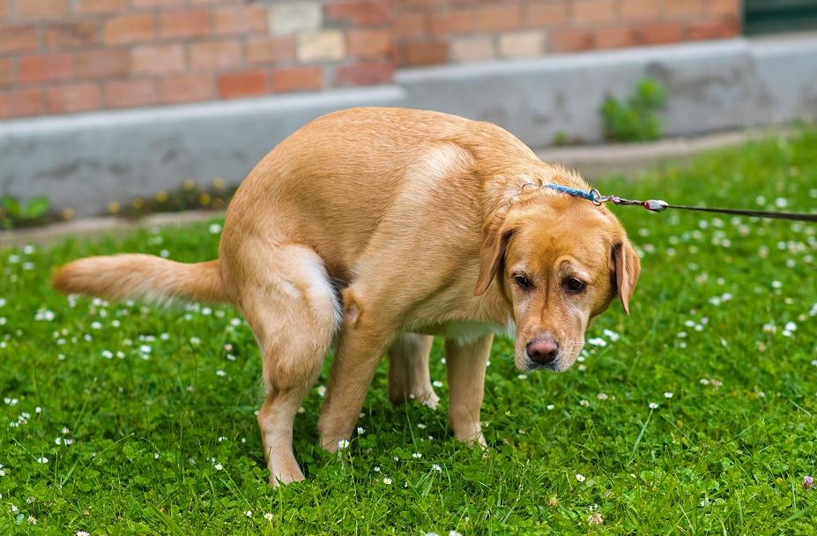
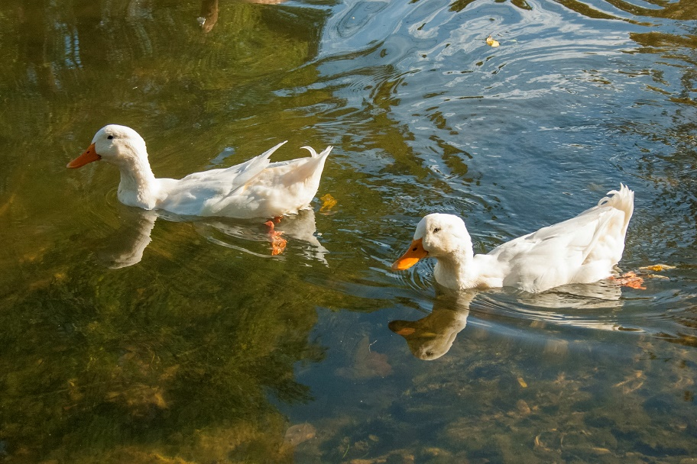
Sources

Slide 14
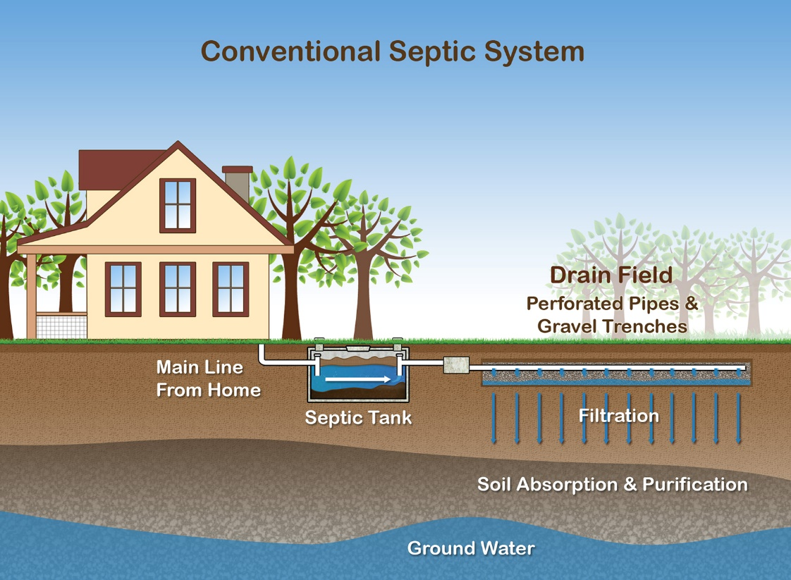
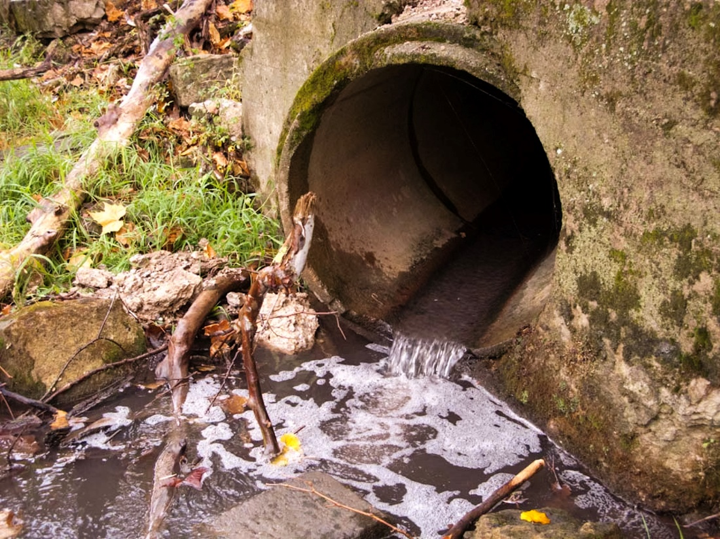
Sources

Slide 15
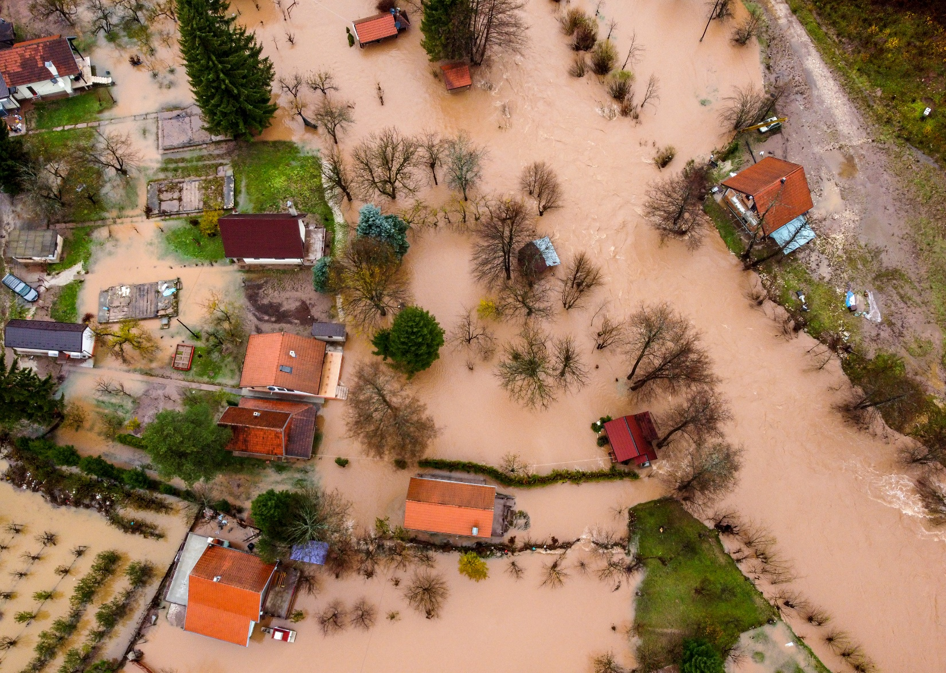

Slide 16
Bacteria levels can be related to flow:
More runoff = Higher bacteria counts

Slide 17
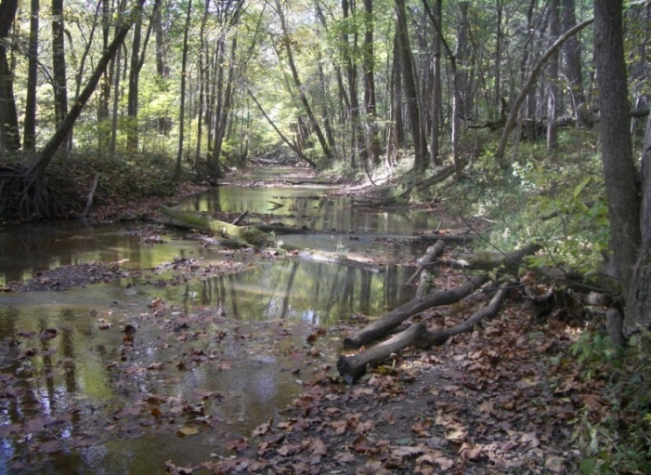
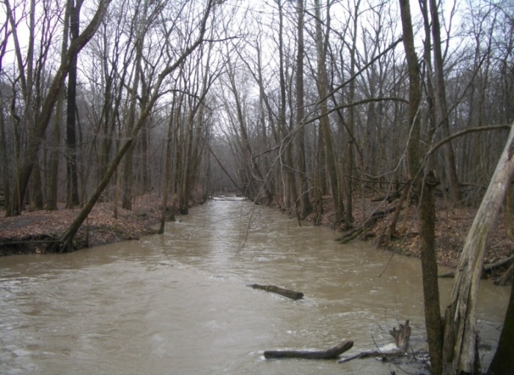
Willow Creek – Huntertown (Allen County)
Date | Weather (Past 48 hrs) | E.Coli (cfu/100 mL)
10/16/05 | Clear and Sunny | 280
3/1/06 | Overcast | 400
3/12/06 | Showers and Storms | 2500
Notes:
Illustrates the point that weather has a dramatic influence on test levels with real, local data. This is usually true of other parameters as well.
Also may be indicative of excessive runoff caused by lack of riparian vegetation, poor conservation practices, etc.

Slide 18
Indiana E. coli Standards
Measured in colony forming units (CFU) per 100-mL of water
Different standards for drinking water and body contact
  Drinking = < 1 CFU/100mL
  Body Contact = < 235 CFU/100mL (one-time sample) or < 125 CFU/100mL (geometric mean of 5 samples over 30 days)
39% of Indiana streams do not support primary contact recreation due to high E. coli bacteria levels (2022)

Slide 19
Geometric Mean
Method recommended by EPA
Minimizes influence of one-time high result
Example: Sunshine Lake E. coli readings of 5, 10, 120, 20, 2700 CFU/100mL

Slide 20
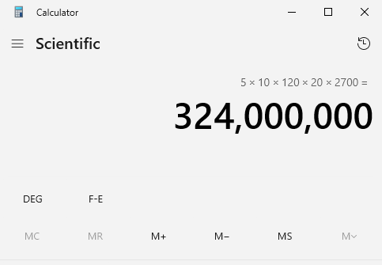
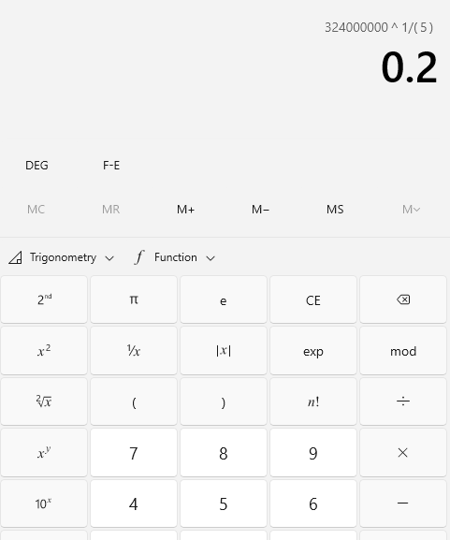
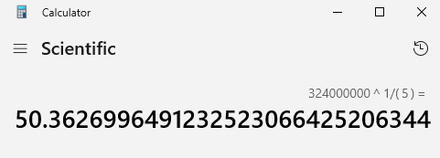
3
1
2

Slide 21
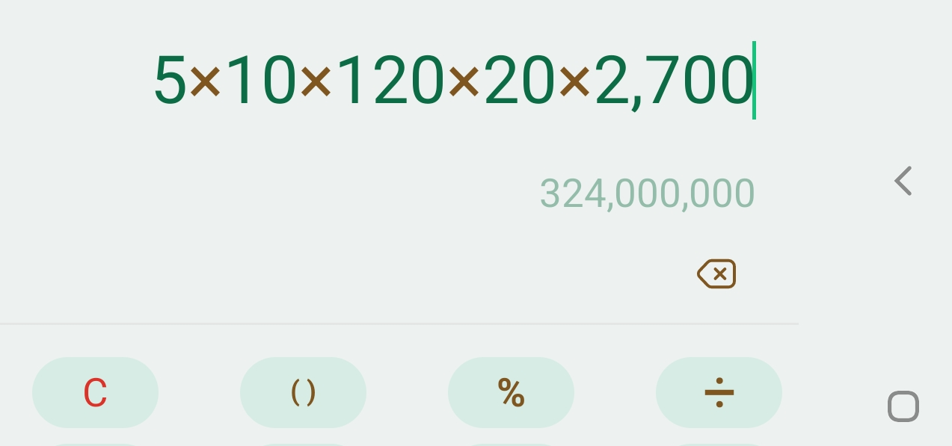
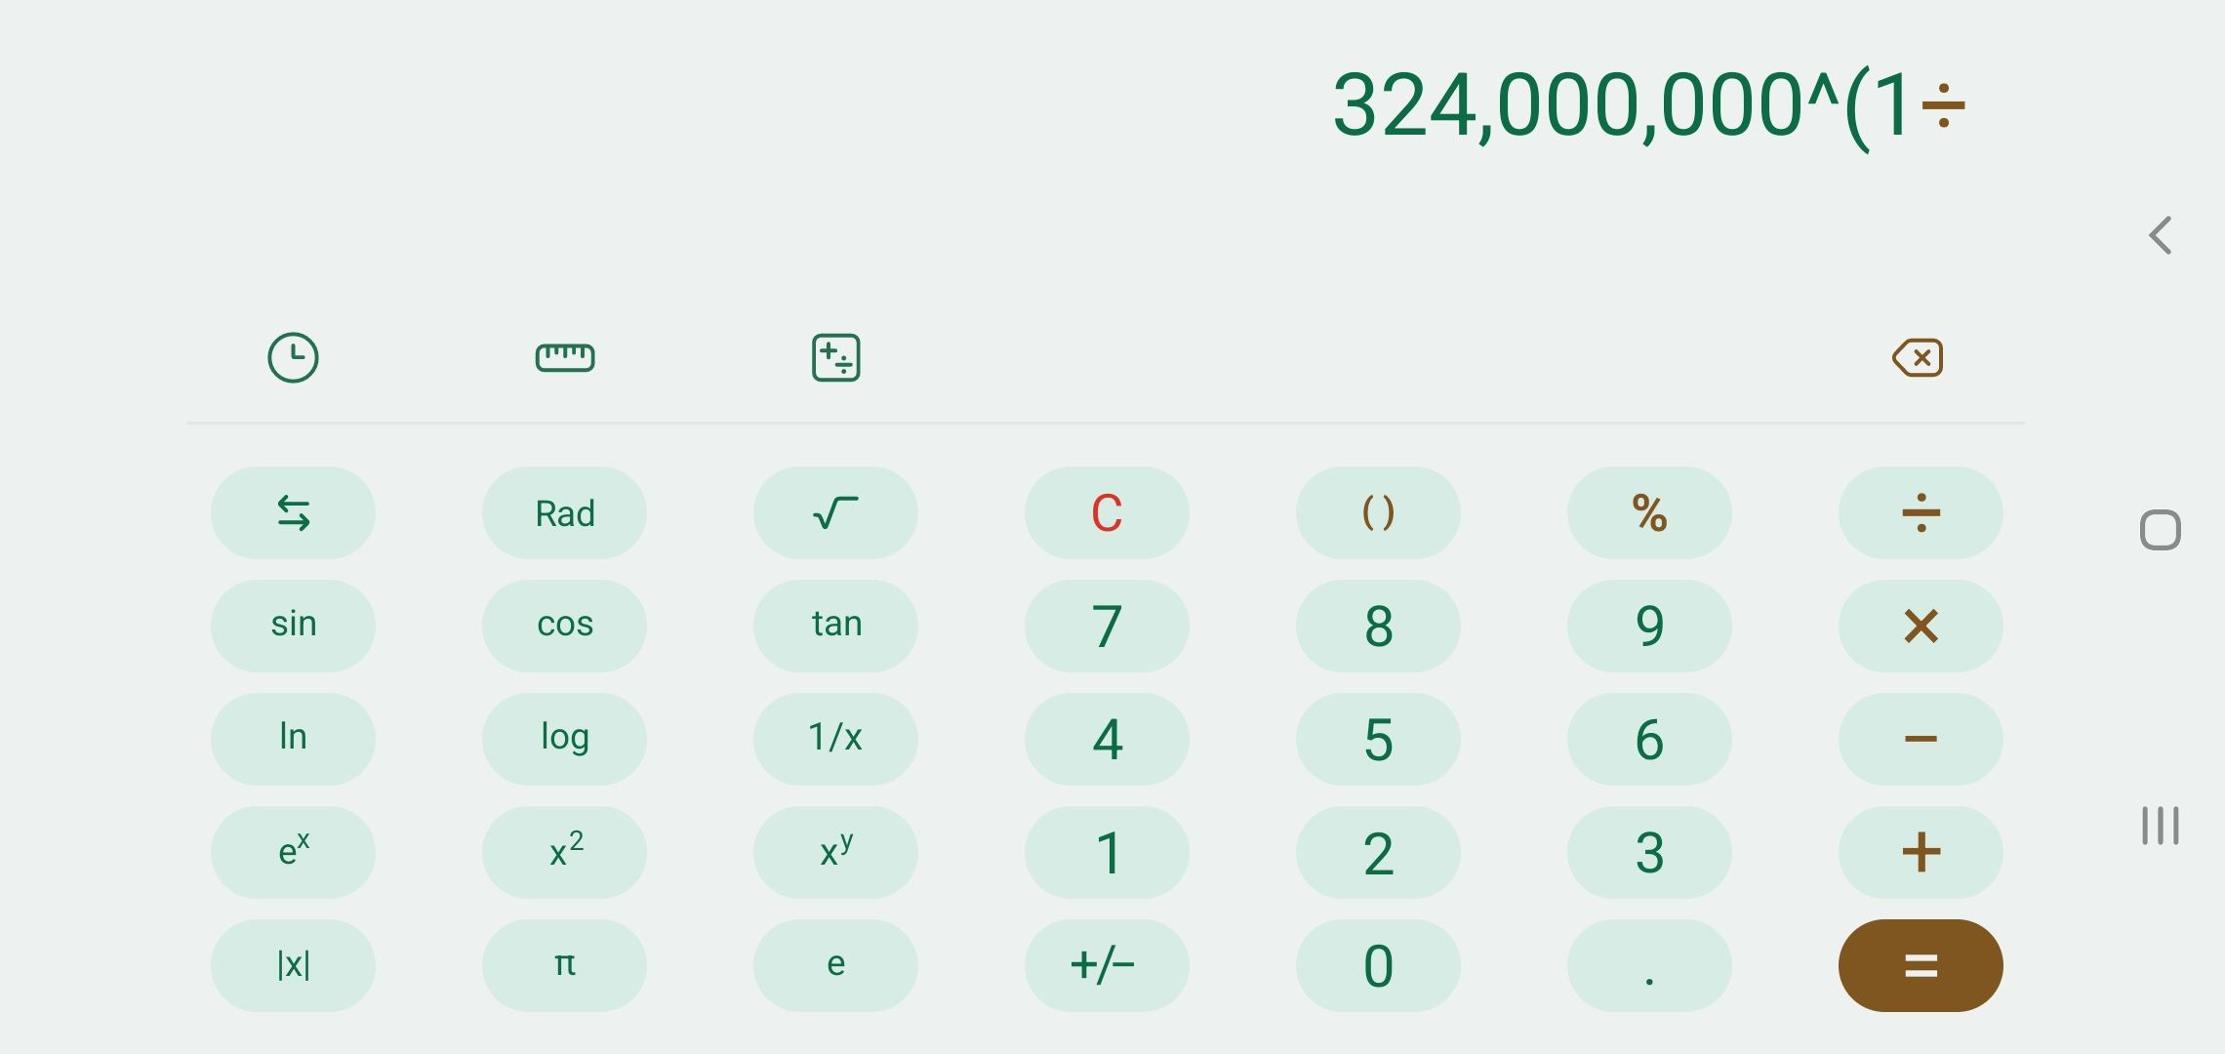
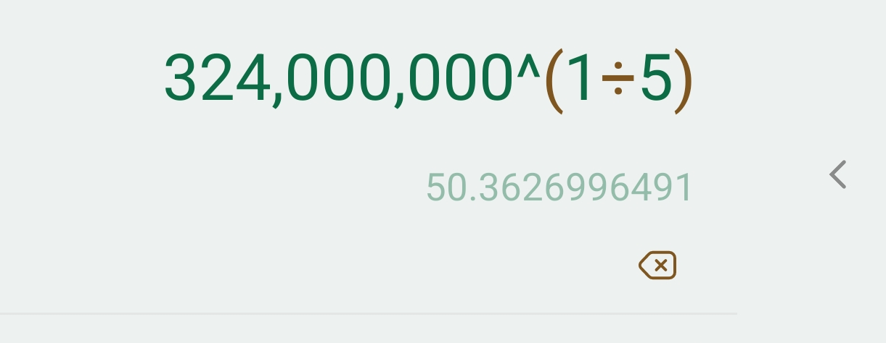
2
3
1

Slide 22
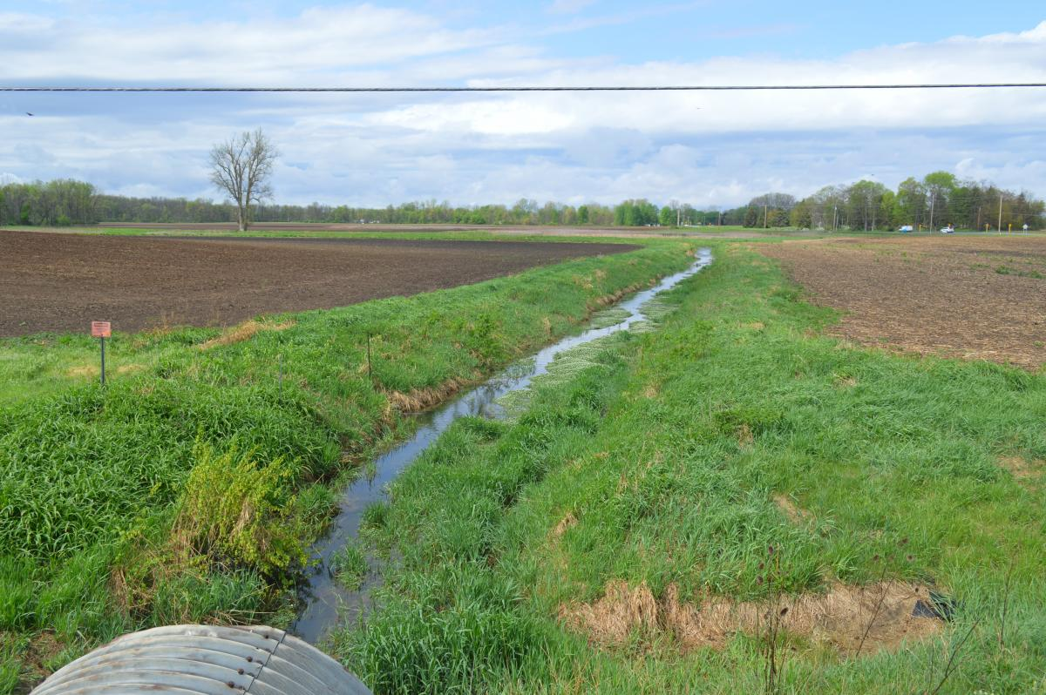
Prevention/BMPs
Slow down or eliminate runoff
  Retention Ponds
  Buffers/Filter Strips
  Wider Riparian Zones
Livestock Access Control, i.e. fencing
Manure Management
  Covered Storage
  Sub-surface Application
Regular Maintenance of Septic System
Education & PSA for Picking Up Pet Waste
Wildlife Management

Slide 23
HRW E. Coli Sampling
Preparation
Collection
Plating
Incubation
Reading and Interpreting Results
Clean-up

Slide 24
Preparing to plate samples
Disinfect workspace and collect supplies
Check incubator temp, adjust to 35ºC (95ºF)
Make sure Easygel media and Petrifilm plates
are at room temperature

Slide 25
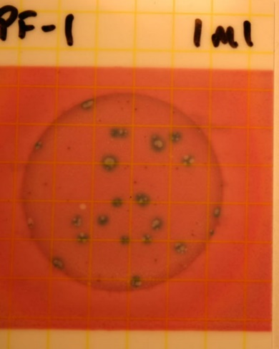
Preparation Continued
Coliscan
  Label the bottom of the petri dishes along
  the edge and at the front top of Petrifilm
Petrifilm
  Label the front top of film
Label should include:
  site name
  date of collection
  volume of water plated (mL)
Site, collection date, mL
-
-
-

Slide 26
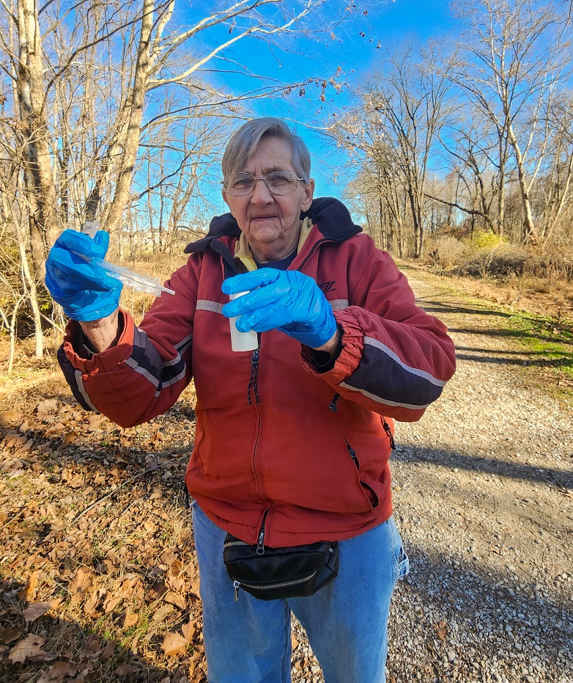
Sample Collection
You can take your E.coli sample directly
in the stream and add it to the bottle of Easygel medium.
Remember to put the bottle of Easygel
in a cooler (on ice) until you can plate
the sample!
Notes:
Lab cleaned pipettes alternative to sterile pipettes

Slide 27
Coliscan Easygel Plating
Carefully remove pipette from sterile paper
(keep sterile)
Transfer 0.25 mL to 5 mL of water from sample
to Easygel media bottle
  Label your media bottle with # of mL used
Pour media into labeled petri dish

Slide 28
Coliscan Continued
Swirl the dish (figure-8 mode) gently to evenly distribute the media
  be careful not to splash over the side or get any on the lid
Let plates sit undisturbed at room temperature (out of direct
sunlight) for 45 minutes or until solid
After media gels, add to incubator, upside down (to reduce condensation on plate bottom)
  They can be stacked on top of one another

Slide 29
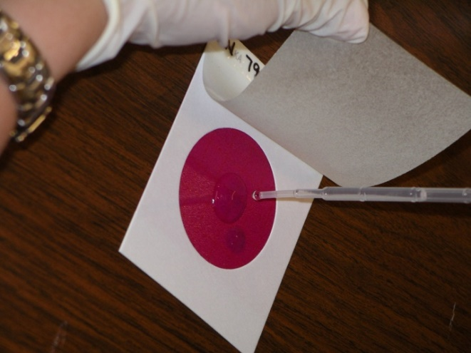
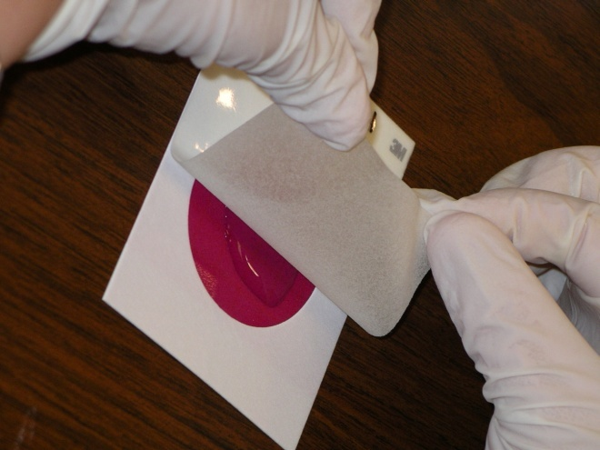
3M Petrifilm Plating
Pipette water sample 1 mL only
Lift film and dispense sample onto
pink circle
Carefully roll down film
Let sit 1 minute
Put in incubator right side up
(can be stacked)

Slide 30
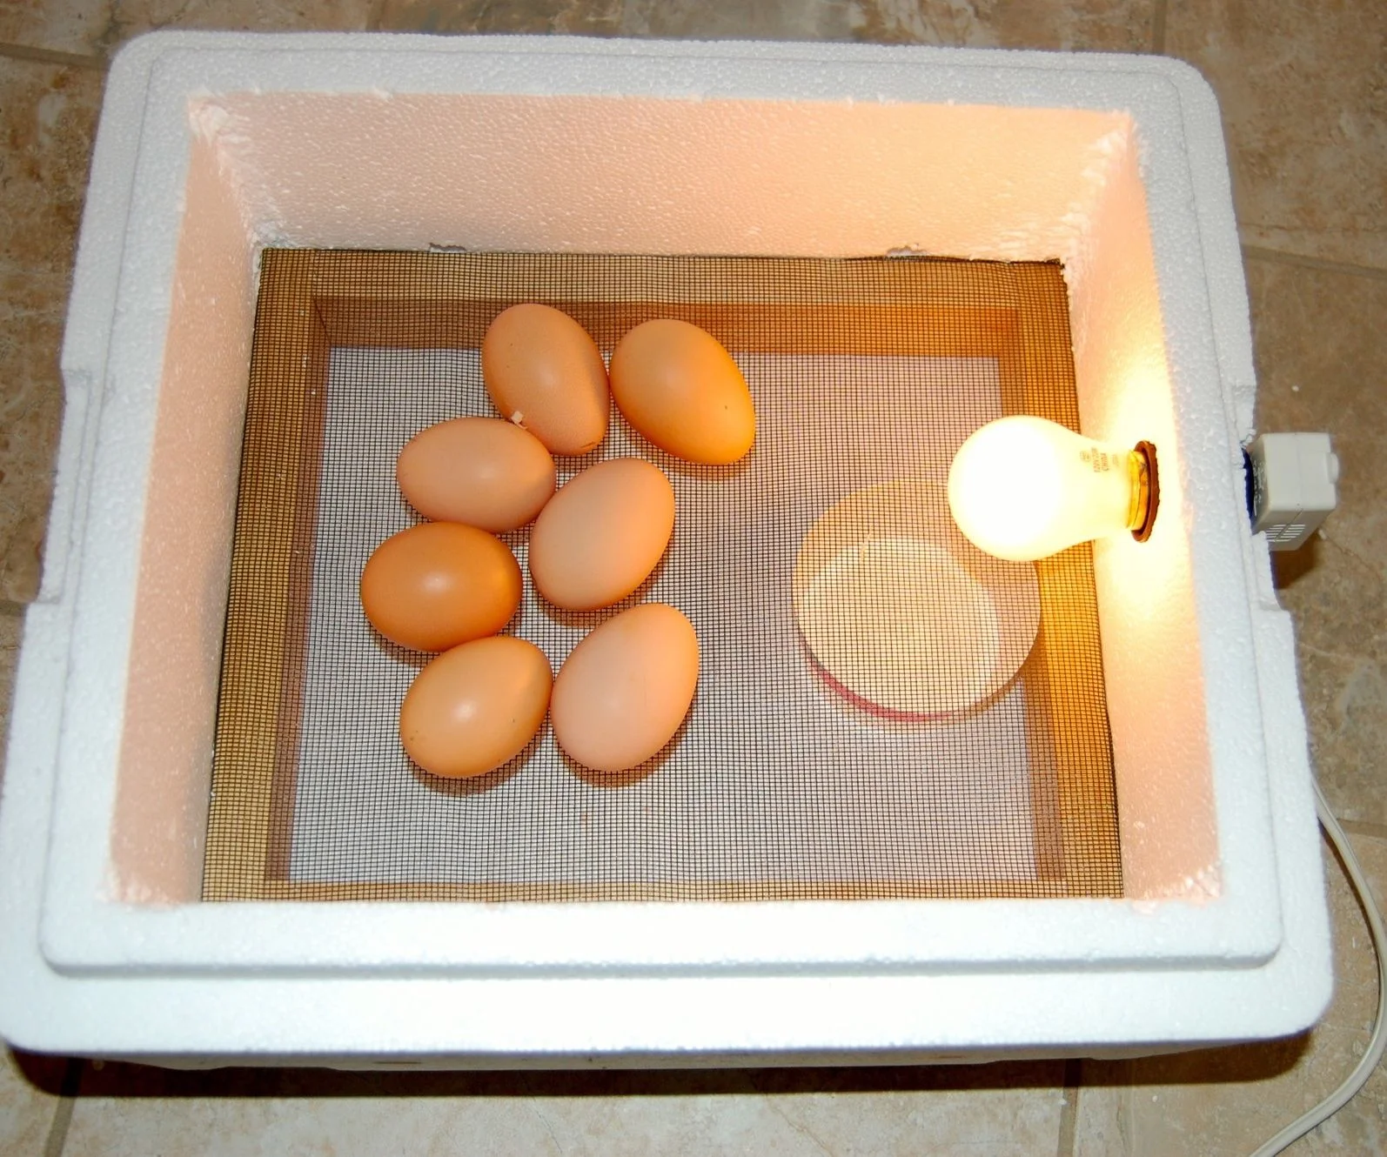
Incubation
Samples should be incubated for
24 hours at 35ºC
  Petrifilm needs humidity

Slide 31
Reading & Interpreting
Coliscan Easygel Plates
Count after 24 hours of incubation
Count dark blue or deep purple colonies
Teal and pink colonies are not E. coli
Helpful Hint:
  Use a magnifier
  Bright light is best (full spectrum bulb)

Slide 32
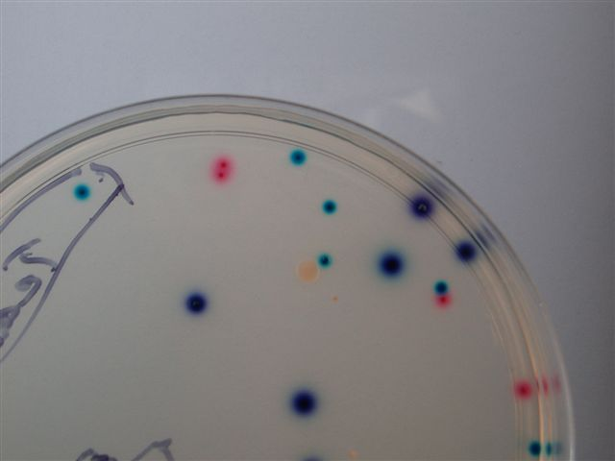
Coliscan Easygel
Contains 2 enzyme specific chemicals (chromogens)
“Red Gal” (galactosidase)
  Red or pink color produced
“X-Gluc” (glucuronidase)
  Teal color produced
Only E. coli produces both enzymes
E.coli shows up first
Red + Teal = Dark Blue/Purple

Slide 33
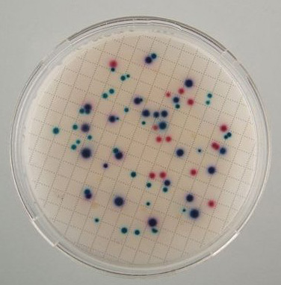
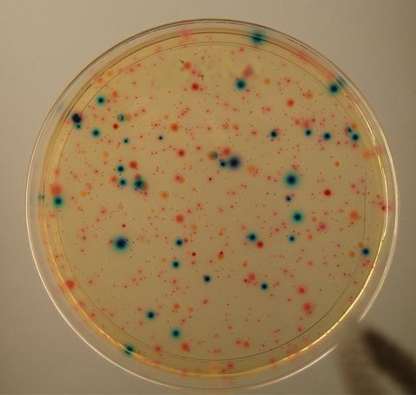
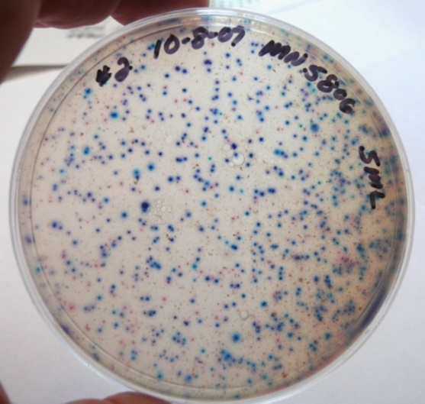
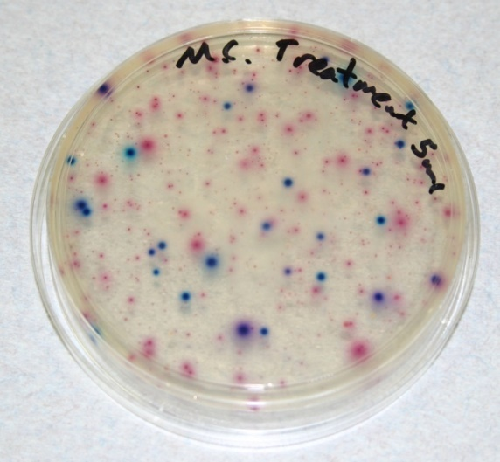
Coliscan Easygel
>300 = TNTC
Notes:
>400 in a big plate is not accurate information, Too Numerous To Count (TNTC)
Count quadrants – acceptable lab procedure
Graph paper under plate, use sharpie

Slide 34
Reading & Interpreting PetrifilmTM Plates
Count after 24 hours incubation
Count BLUE colonies WITH gas bubbles
Don’t count blue colonies without gas bubbles
Don’t count pink or white colonies with or without gas bubbles

Slide 35
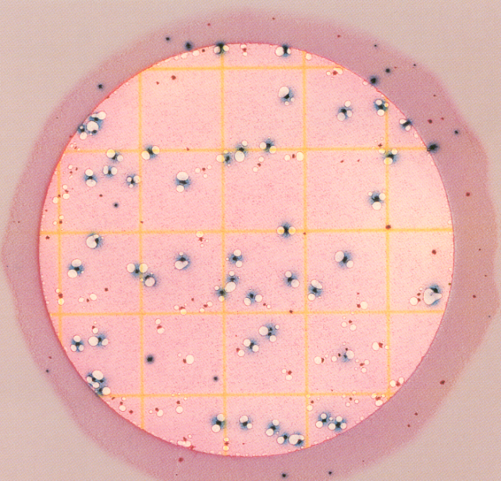
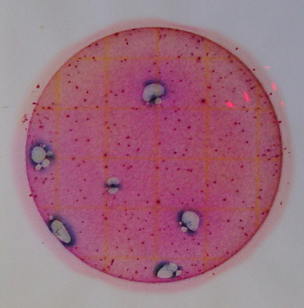
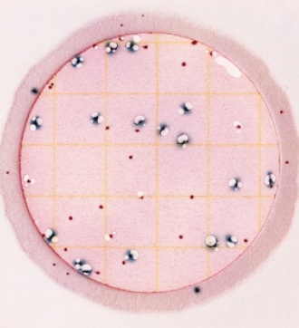
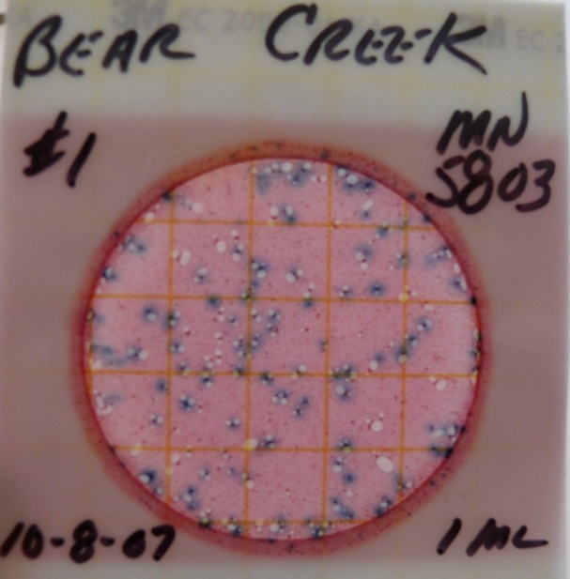
3M PetrifilmTM Sample

Slide 36
Accuracy and Variability
Results may not be accurate when:
  Samples aren’t kept cold prior to plating
  Workspace or equipment isn’t sterile
  Bottles, lids, pipettes are contaminated
  Sample wasn’t incubated properly

Slide 37

Disposing of plates
Add a teaspoon of bleach to each Easygel Petri dish
Cover and place in a Ziplock bag
Put Petrifilms in the same Ziplock bag
Zip tightly and throw in trash
Dump remaining water sample and throw
sample bottle in trash

Slide 38
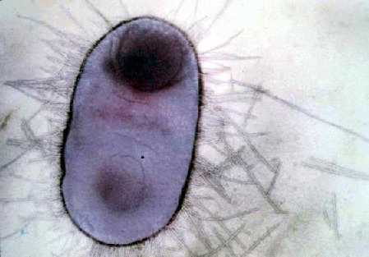
Let’s Practice
Notes:
Stop Here
Practice plating samples.
Take time to read pre-made samples.

Slide 39
Resources
Harvard Museum of Natural History. (2024) What’s In A Name?. Available from https://whatsinaname.hmnh.harvard.edu/ecoli (accessed 3/8/2024)
Centers for Disease Control & Prevention. (2024) E. coli (Escherichia coli). Available from https://www.cdc.gov/ecoli/index.html (accessed 3/8/2024)
Purdue University. (2024) E. Coli and Indiana Lakes and Streams. Available from https://engineering.purdue.edu/SafeWater/
watershed/ecoli.html (accessed 3/8/2024)

Slide 40
Resources Continued
World Health Organization. (2024) E. coli. Available from https://www.who.int/news-room/fact-sheets/detail/e-coli
(accessed 3/8/2024)
National Library of Medicine. Mueller, Matthew. Tainter,
Christopher R. (2023) Escherichia coli Infection. Available
at https://www.ncbi.nlm.nih.gov/books/NBK564298/
(accessed 3/8/2024)

Slide 41
Thank You!
Dylan Allison
Riverwatch@IDEM.IN.gov
(317) 308-3392

