Slide 1

Detention Do’s Don’ts and Maybes
James Emerick, PE
Eric Harned, EI

Slide 2
Agenda
Introduction
INDOT Detention History
Current INDOT Requirements
Analysis
Reporting
Design Considerations
Project Examples
Common Errors Seen
Q/A

Slide 3
INDOT Detention History
1988 – Detention Requirements
  Private developments draining to the right-of-way Q_{50 Post-construction →} Q_{10 Pre-const.}
  INDOT projects only provided detention if legal drain required or known drainage issue
  At this time any method of detention calculation was allowed.
1993 – Detention Requirements
  Started requiring hydrographs for the large developments (>5 acres).
  INDOT also included detention for new maintenance facilities.
1999 – Design Manual is published.
  Inflow and outflow hydrographs required (no constant discharge)
  Huff Distribution Required (no longer allowed Type II distribution)
2011 – Design Manual rewrite requires
  Detention required on all new projects
  INDOT Projects to mitigate Q_{100 Post-construction →} Q_{10 Pre-const}

Slide 4
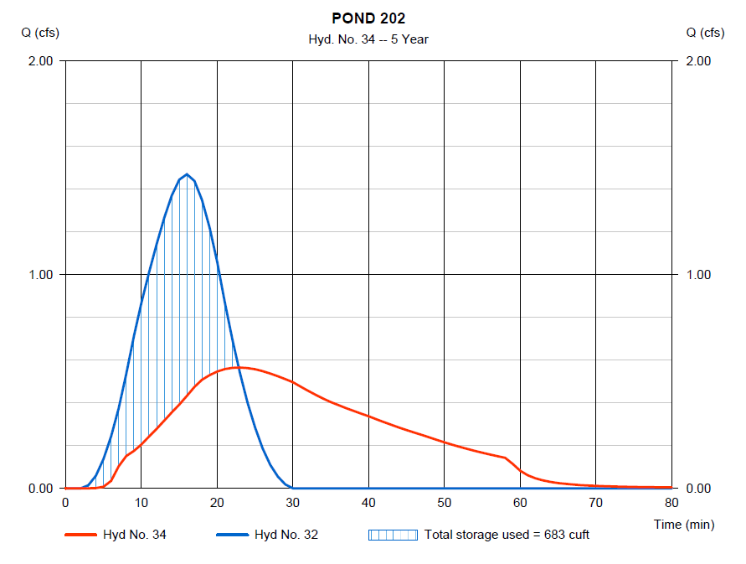
Where does INDOT Currently Require Detention?
  Private or local development that drains to INDOT right-of-way
  New road alignment
  Road widening/added travel lanes
  Intersection and interchange improvements
  Redirection of runoff or changes to conveyance
  Mitigation of existing flooding issues

Slide 5
INDOT Current Requirements
INDOT Projects
  Q₁₀₀ Post-construction → Q₁₀ Pre-const
Local Stormwater Requirements
  INDOT is not required to meet local ordinances
  Discuss requirements with INDOT Hydraulics before project design
  Still must show design meets INDOT requirements
    Show Huff Distribution works even if local communities are using a Type II Distribution
Legal Drains
  Coordination with County Surveyor may be required
Driveway permits
  Private developments that drain to the INDOT right-of-way require
    Q_{50 Post-construction →} Q_{10 Pre-const}
  Required to meet local ordinance

Slide 6
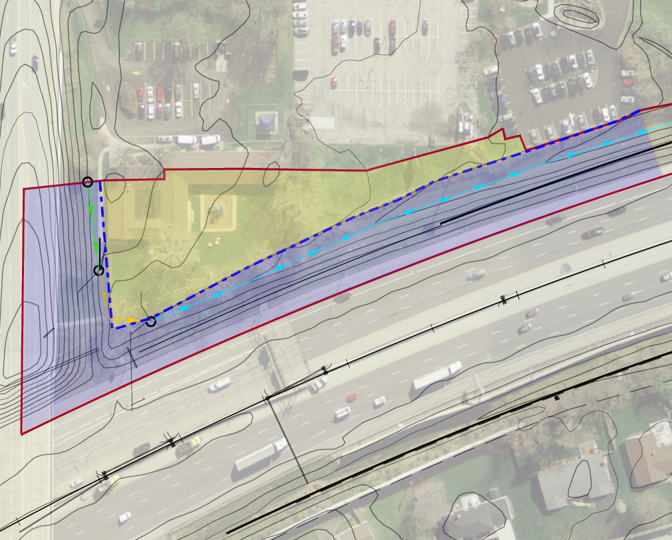
Special Considerations for Detention
  Offsite Runoff Passthrough
    Onsite area is within the right-of-way Q₁₀₀ Post →Q₁₀ Pre
    Offsite is the area outside the right-of-way tributary to the detention area Q₁₀₀ Post →Q₁₀₀ Pre
    Q₁₀₀ Allowable release rate
      Q₁₀₀ Pre offsite + Q₁₀ Pre onsite
    Outlet Design
      Overflow Berm
      Outlet Pipe
Proposed Ditch Detention
Offsite
Onsite
right-of-way

Slide 7
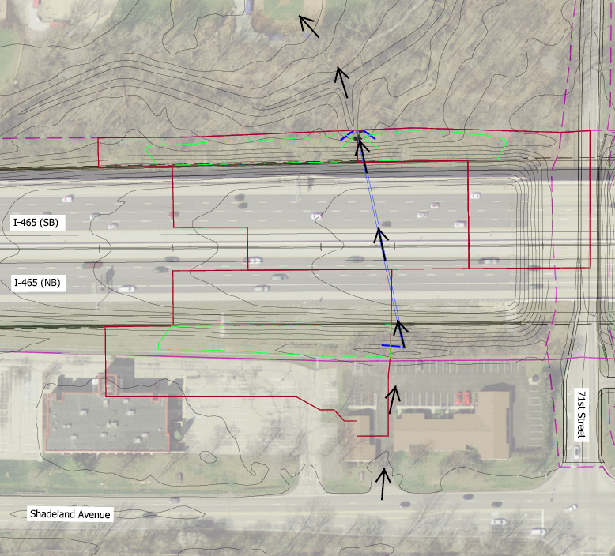
Special Considerations for Detention
Over-detaining
  Providing excess detention in one location to make up for lack of detention in another
  Only considered with a direct common point of discharge within or at the right-of-way boundary
    Typically at stream or culvert crossings
Over-detain here
Over-detain here
Can’t detain here

Slide 8
Special Considerations for Detention
Exception from Q₁₀₀ _{Post} →Q₁₀ _{Pre} requirement to Q₁₀₀ _{Post} → Q₁₀₀ _{Pre}
  IDM detention criteria
    Would require purchase of additional right-of-way
    Excessive additional project cost
  No known flooding concerns
  Sufficient capacity in downstream facilities

Slide 9
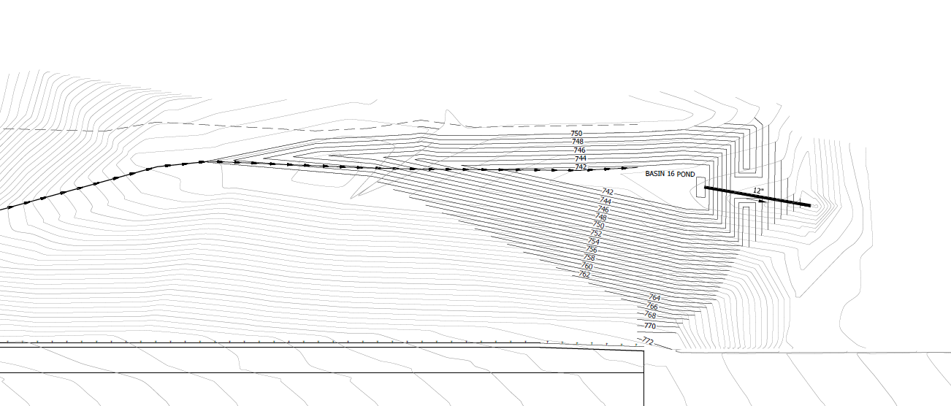
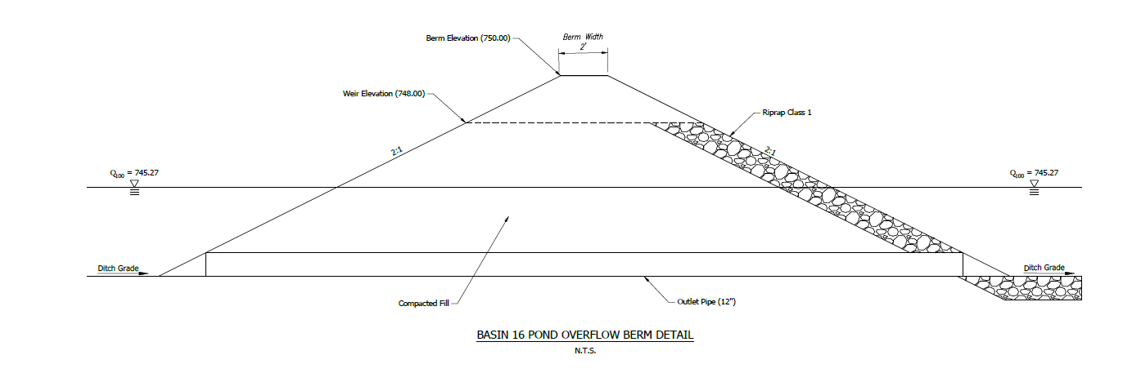
INDOT Current Requirements
Types of Detention
Ditch Detention
  Used on a lot of recent projects
  Inexpensive mostly grading and construction of berm
  Constructed in the roadside ditch within right-of-way
  Check Berm with pipe used for controlling discharge rates
  May require multiple check dams along a ditch to reach allowable release rates

Slide 10
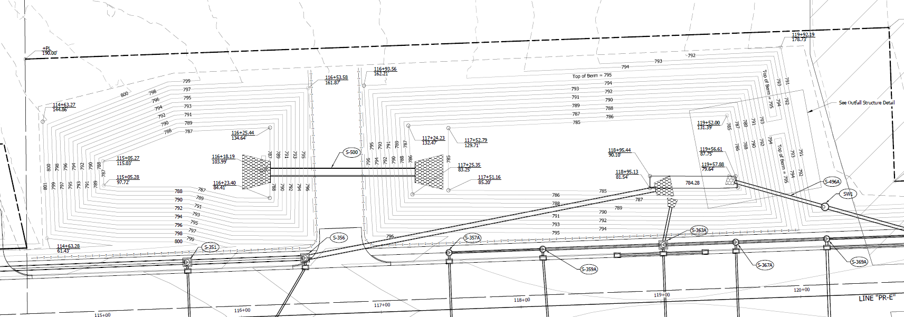
INDOT Current Requirements
Types of Detention
Dry Detention
  Within the specially purchased right-of-way or infield
  should consider serviceability and impact to median drains and storm sewer
  Should have appropriate overflow incase primary outlet clogs

Slide 11
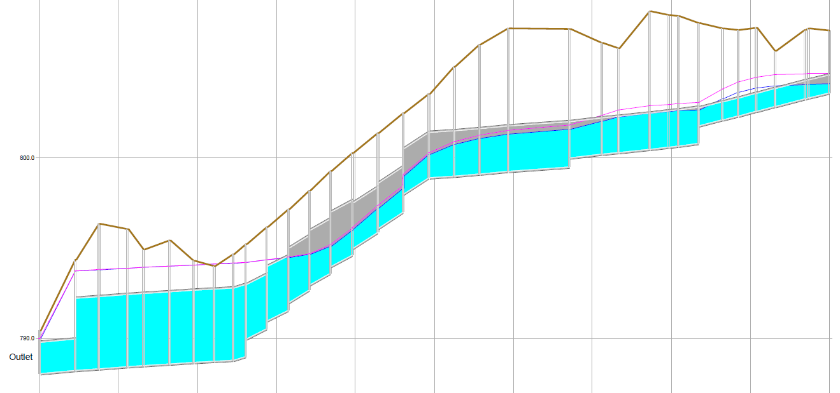
INDOT Current Requirements
Types of Detention
Oversized Storm Sewer
  Increased storm pipes with smaller outlet pipe
  Costs varies based on the upsizing of storm sewer pipes
  Should consider upstream impacts so that HGL does not exceed rim elevations

Slide 12
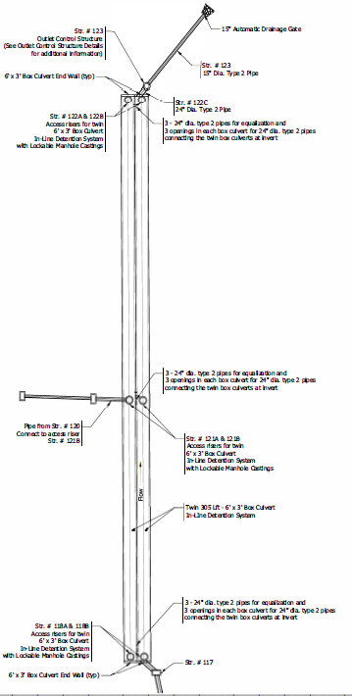
INDOT Current Requirements
Types of Detention
Underground Detention
  Use of chambers or pipe system
  Typically very expensive
  Not under drive lanes
  Maintenance and Access Concerns

Slide 13
INDOT Current Requirements
Types of Detention
Infiltration
  Only would consider infiltration when no positive outlet is available
  Should provide overflow routing incase infiltration fails
  Should be sized for the storage of 1.5 times the total 100 year storm volume plus 1 ft of freeboard
  INDOT’s Geotechnical Group has developed standardized testing
  Protection during construction over compaction and sedimentation
Wet Detention
  Requires special right-of-way
  Typically not preferred due to safety concerns
No Median Detention
  Too much risk to the roadway
  No available emergency overflow path

Slide 14
INDOT Current Requirements
General Detention Basin Design Requirements
  2 ft elevation from edge of lane to Q₁₀₀ Water Surface Elevation (WSE)
  1 ft of freeboard is required
  Overflow weir designed to pass Q₁₀₀
  Maximum 72 hour drain time
  Maximum of 5 ft operating-pool depth
  Minimum of 0.5% running slope

Slide 15
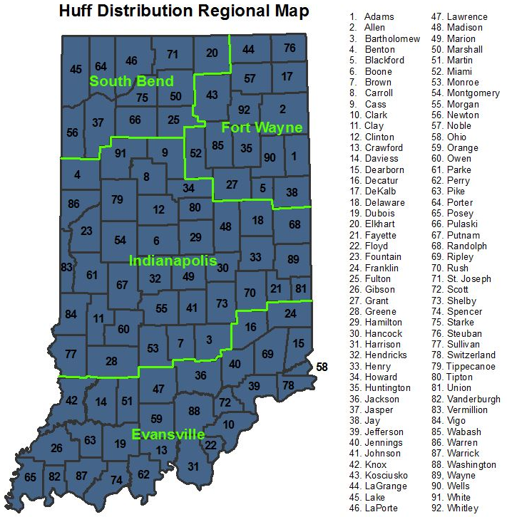
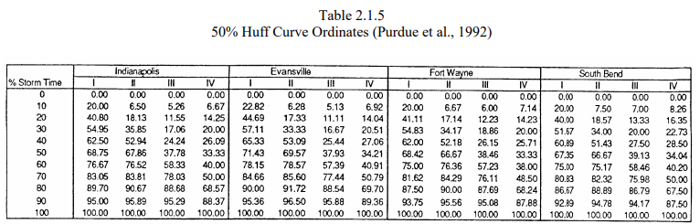
Detention Analysis
<5 ac. can use Rational Method
5 ac. or more TR-20 methodology using Huff Distribution
  Critical storm analysis running multiple duration storms 15 min to 24 hour
  Use appropriate quartile
  Use appropriate Region
Allowable Programs
  AutoCAD Hydrographs Extension
  Autodesk Storm and Sanitary Analysis (SSA)
  Bentley PondPack
  HydroCAD
  XPSWMM

Slide 16
Reporting
Narrative
  Project Description
  Design assumptions, criteria used, special exemptions
  Detention Summary Table
    Existing Peak Flow Rates
    Proposed Peak Flow Rates No Detention
    Proposed Peak Discharge Rates with Detention
    Q₁₀₀ water surface elevation/Max Storage volume
    Edge of Lane/Serviceability Freeboard
    Overflow Weir Elevation/ Detention Basin Freeboard
Drainage Area Maps
  Existing and proposed
  Include offsite areas
  Existing and proposed contours
  Time of concentration (Tc) path
Tc calculations
CN or Rational C calculations
Model Input and Output –Hydrologic Parameters, Stage-Storage, and Stage-Discharge

Slide 17
Design Considerations
Outlet Structure
  Type
  Size
  Locations
Overflow Weir
  Location
  Routing
Impacts to and from median drainage, storm sewer system, and culverts
Up and Downstream Impacts
Maintenance

Slide 18
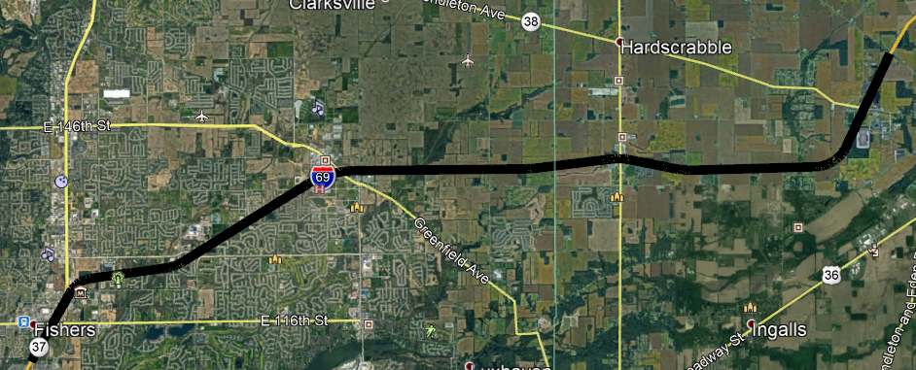
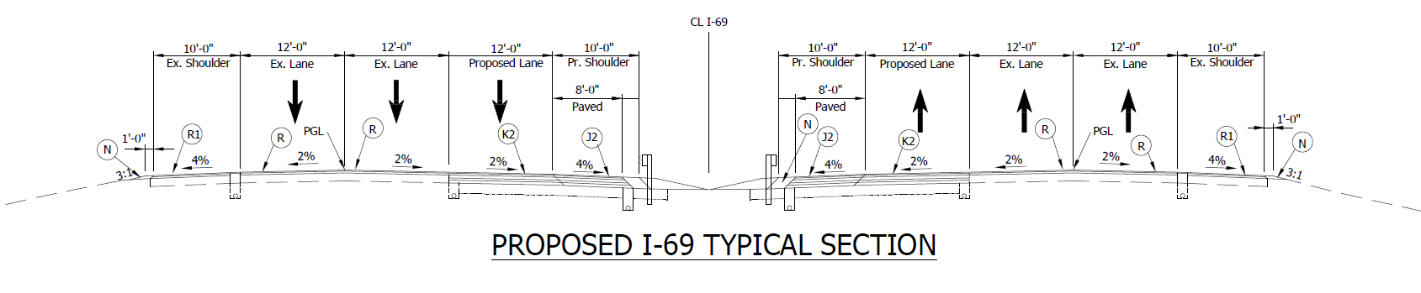
Project Examples
I-69 Major Moves 2020

Slide 19
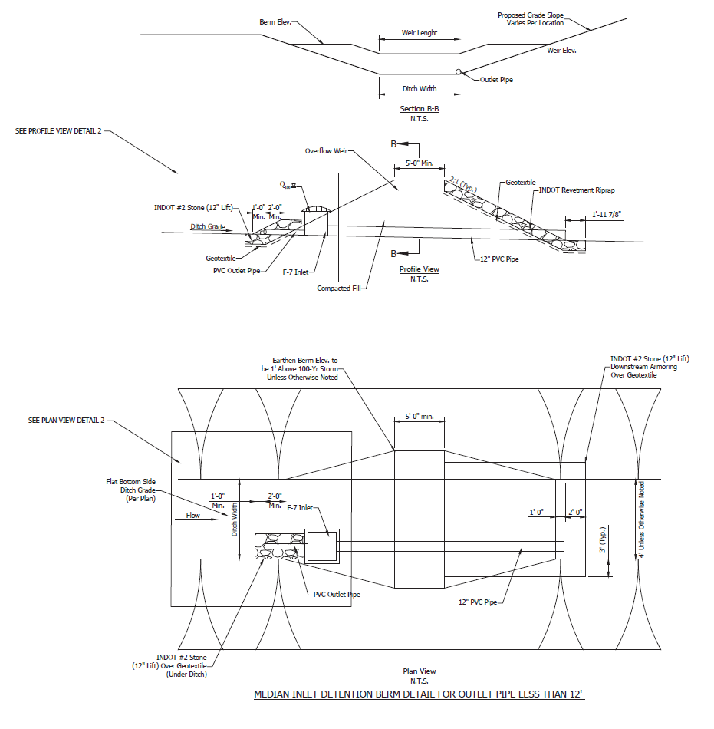
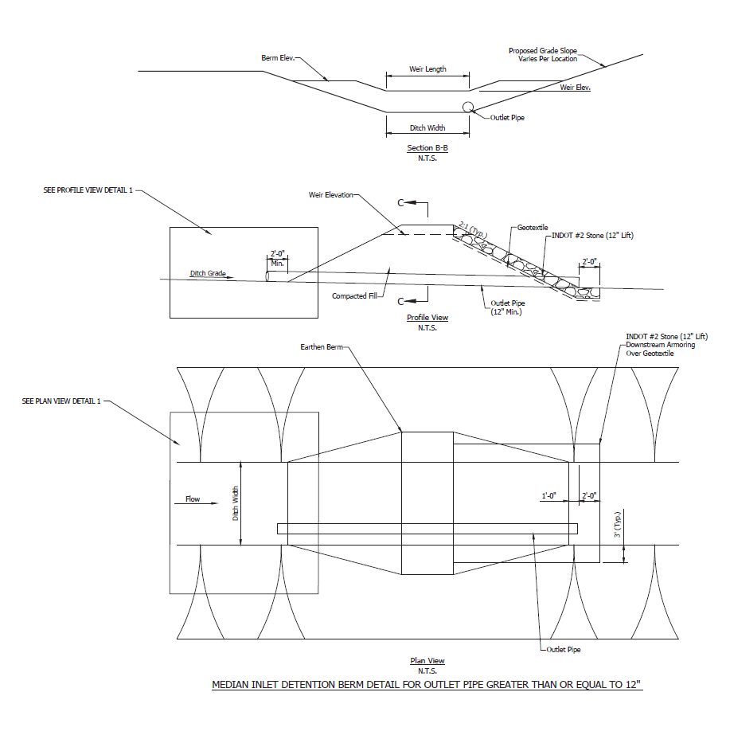
Project Examples
I-69 Major Moves 2020

Slide 20
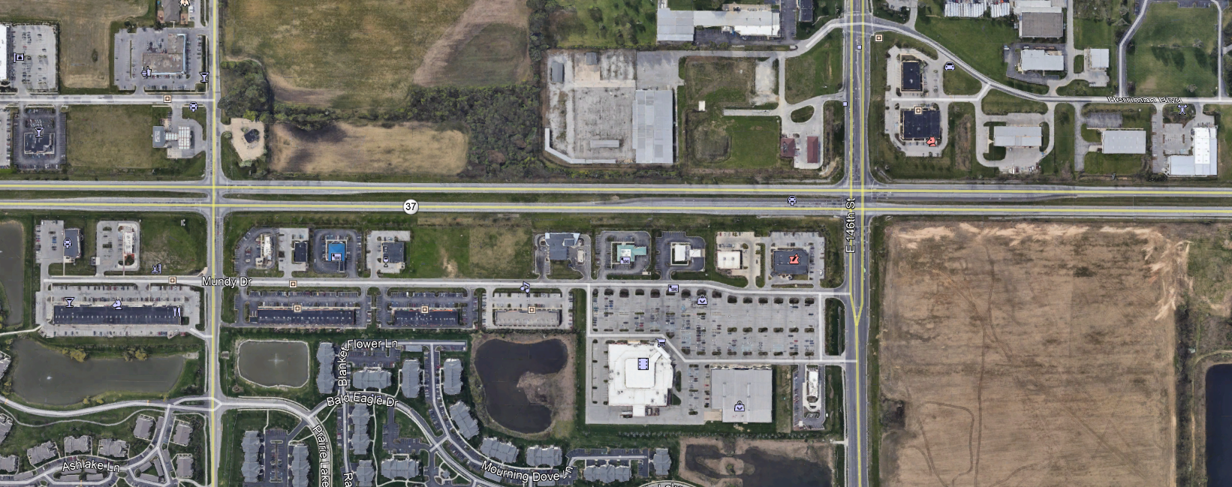
Project Examples
SR37 Interchanges at 141st and 146th Streets

Slide 21
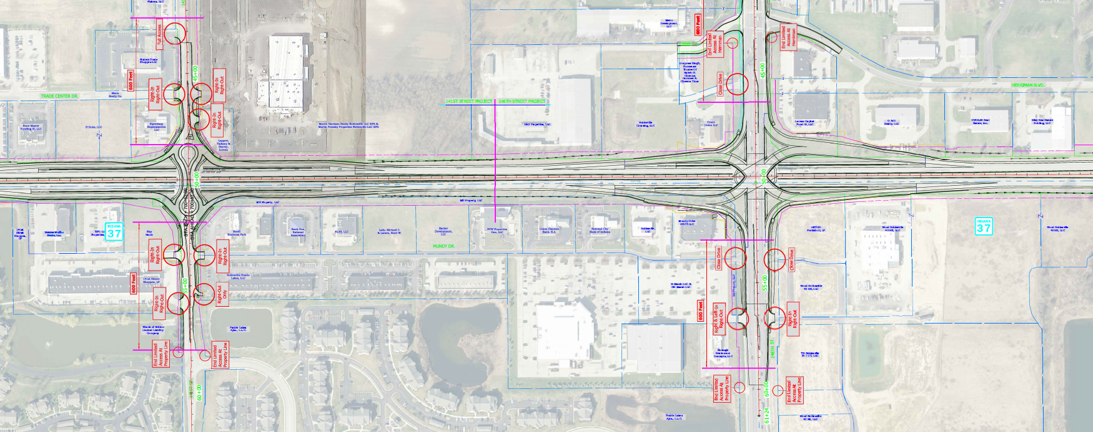
Project Examples
SR37 Interchanges at 141st and 146th Streets

Slide 22
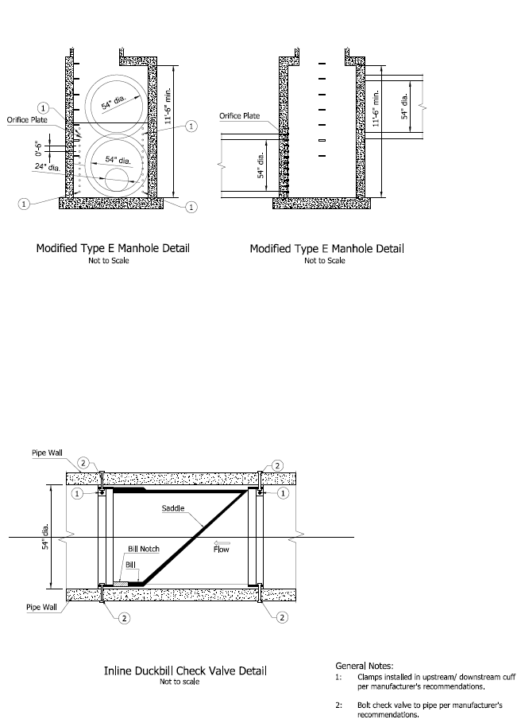
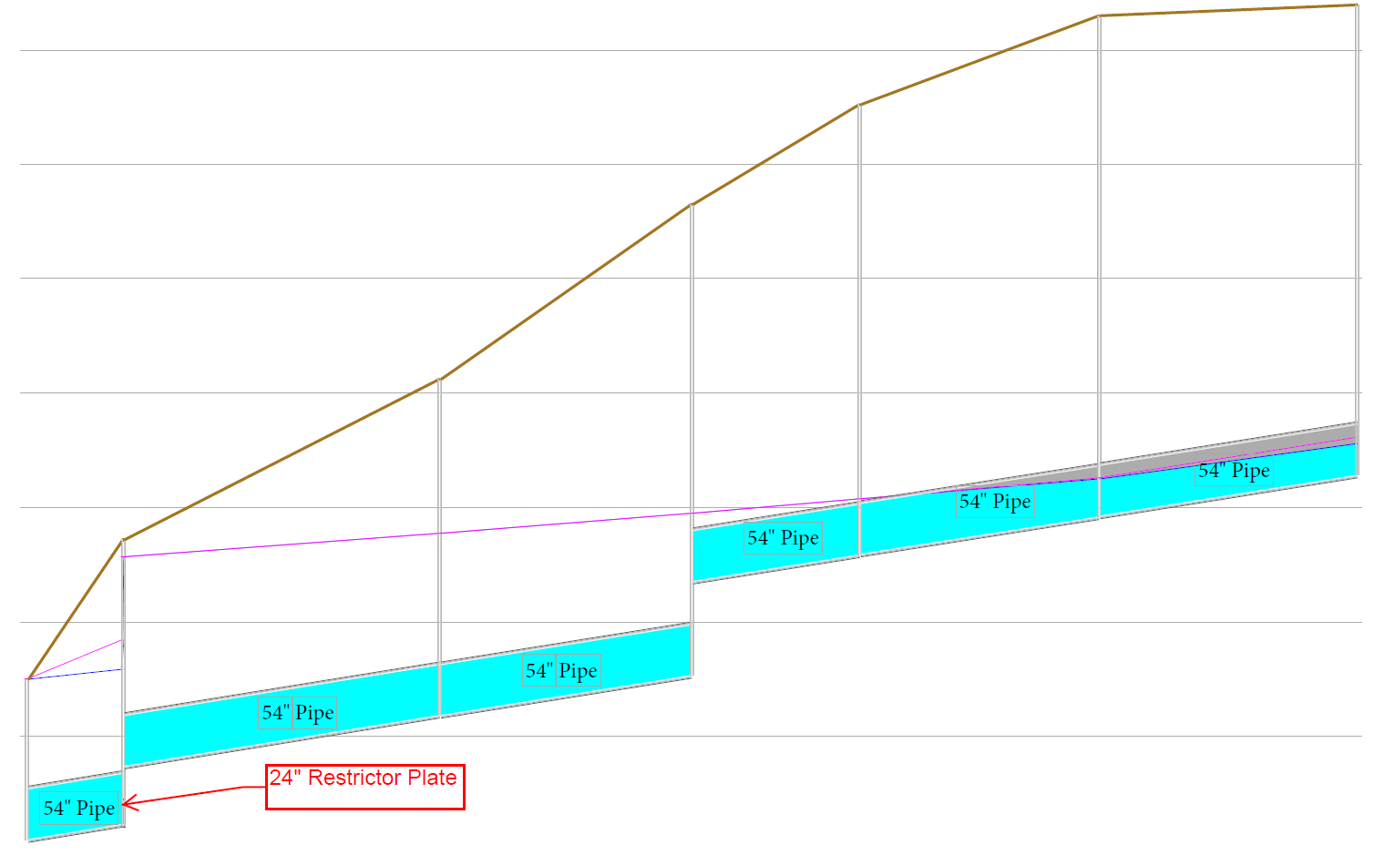
Project Examples
SR37 Interchanges at 141st and 146th Streets

Slide 23
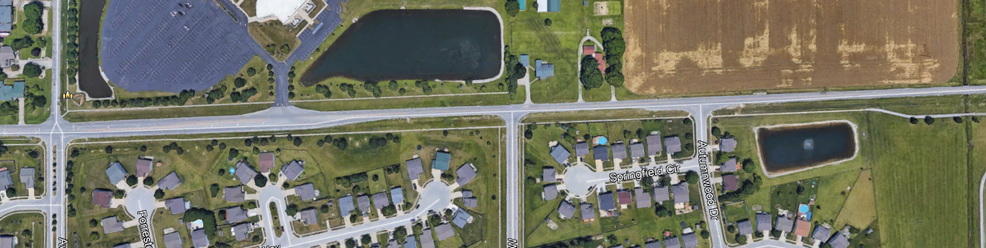
Project Examples
Worthsville Road
Tracy Ditch

Slide 24
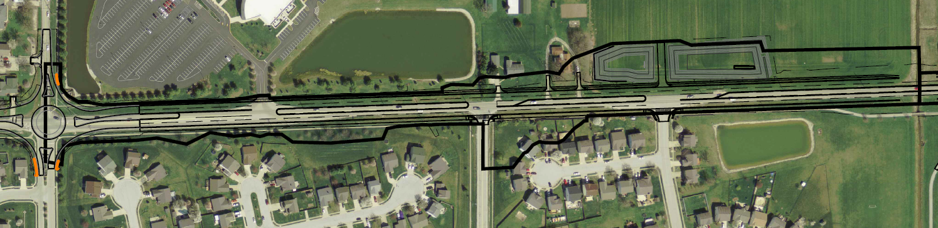
Project Examples
Worthsville Road
Tracy Ditch

Slide 25
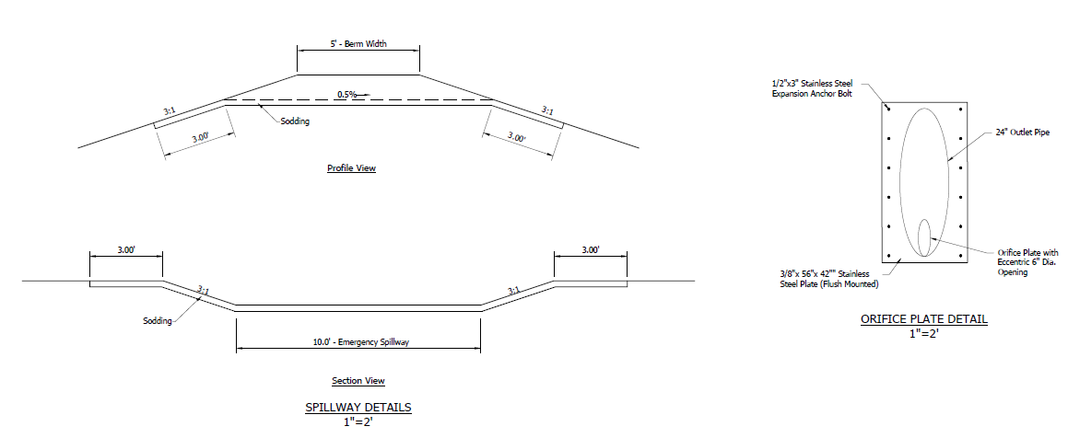
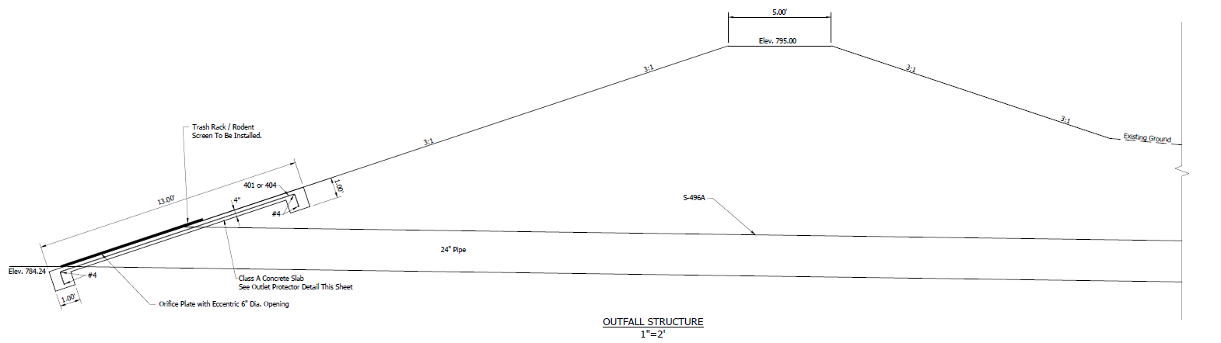
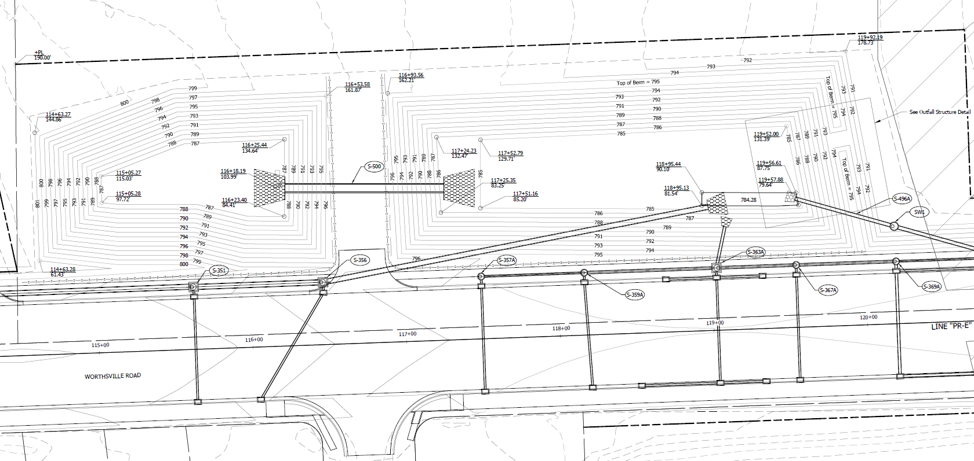
Project Examples
Worthsville Road

Slide 26
Issues Seen on Projects
Median Drains and Storm Sewer Outlets
  should be daylighted above the Q₁₀₀ water surface or
  analyzed with tailwater at the detention basin Q₁₀₀ water surface elevation
Adjacent properties
  consider overtopping top of berm
  pipes that may drain to the ditch
Freeboard and Roadway Serviceability
Overflow berm used to control design storms
Multiple outlet pipes
  Prefer single pipe
  Staged outlet
Pipe size less than minimum required by IDM for under road or drive
The IDM requires a minimum orifice size of 6 inches to prevent clogging
  Prefer to have a small orifice with standpipe to allow passage of larger storms
Consider Impacts of Detention on overall DA
  Small onsite with a larger offsite DA with long Tc detention may line up peak and make increase worse than undetained
Consider existing detention in the existing analysis
Consider tailwater conditions for the detention basin outlet pipe

Slide 27
Questions
  Additional Resources:
  INDOT Hydraulics Website - https://www.in.gov/indot/3595.htm
  Infiltration Testing Guidelines - https://www.in.gov/indot/files/percolation-Infiltration-guidelines.pdf

