Slide 1
INDOT Hydraulics: Design Guidance
Mark Bailey, PE
Alex Schwinghamer, PE
Jim Emerick, PE

Slide 2
Overview
Mark
  Replacement in-kind aka when do I need to do calculations?
  Expectations for 2023
Alex
  Website Updates
  HRA Design –vs- Review Requests
  Median Drains
  Spread
Jim
  Common Design Exceptions
  Infiltration
  Cutoff Walls

Slide 3
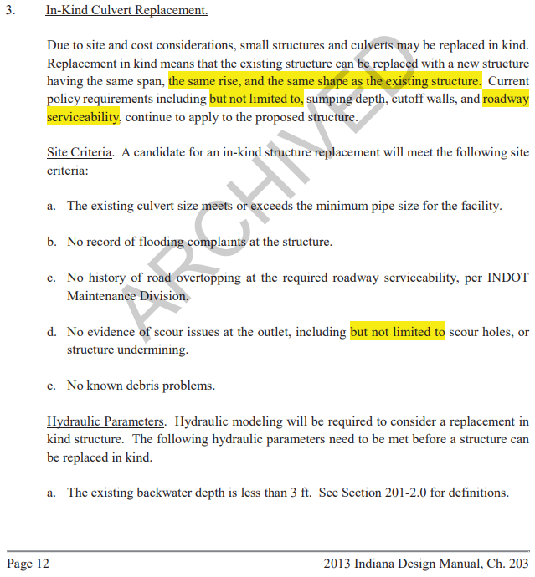
“Replacement in-kind”
Eliminated in 2013

Slide 4
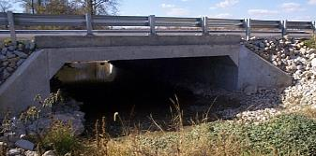
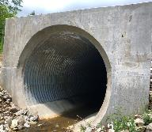
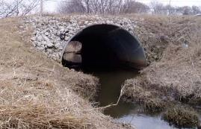
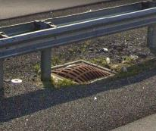
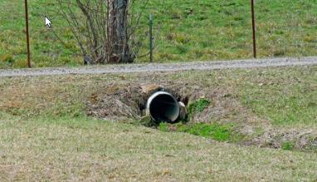
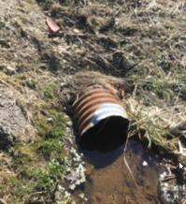
“Replacement in-kind”
Each culvert should be hydraulically designed. – IDM 203-2.02
What to do with the calculations?
Proposed span 36” or greater, all median drainage – INDOT Hydraulics Review
Proposed span < 36”, include all calculations with roadway submittal packages

Slide 5
Expectations for 2023
Design manual update finalized and rolled out.
Online training courses updated.
Annual hybrid conference planning for 2024
New Director of Hydraulics (Highway Engineer Supv) – requisition ID 421947
  Also have two hydraulic engineer positions open
    Highway Engineer 3 – requisition ID 422270 & 422242

Slide 6
Content
Website Updates
Riprap – IDM Figure 203-2D
Median Drains
Spread Updates

Slide 7
Website Update
Developing Design Guidance:
  Steel Liners
  Median Drain
  Infiltration Ponds
Coordinate Generator for Corrugated Metal Pipe Arches (CMPA) Liners
Minimum pipe size that can be lined
  If structure is already at the minimum size, then only a CIPP liner can be used.
  If structure is under minimum size, it cannot be lined.
Keep Memo Templates Up to Date
  Check version numbers
Submitting requests to the HRA
  HRA Project Type Flow Chart

Slide 8
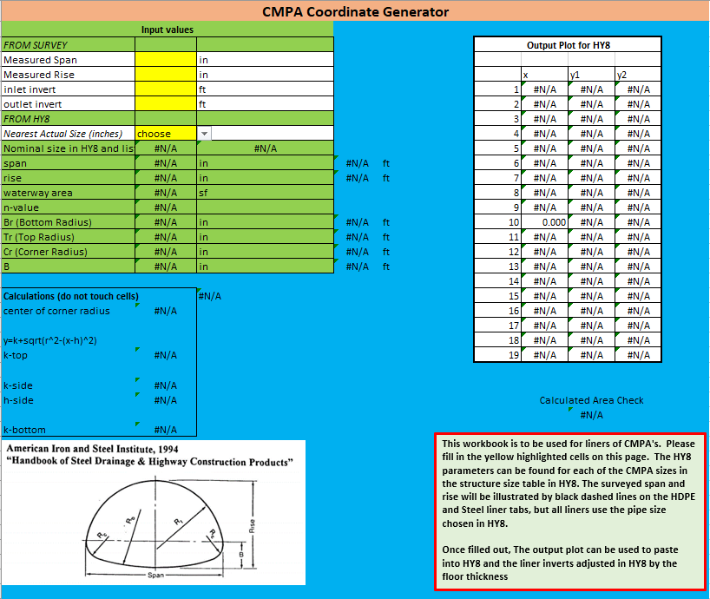
CMPA Coordinate Generator
Fill in yellow highlighted Cells
HY8 error in structure sizes
  Current 18” Corner Radii
  Spreadsheet corrects this error

Slide 9
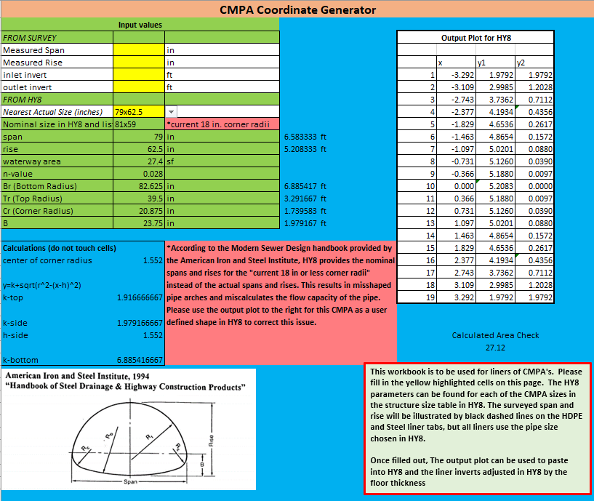
CMPA Coordinate Generator
Fill in yellow highlighted Cells
HY8 error in structure sizes
  Current 18” Corner Radii
  Copy cells for existing and place into user defined coordinates in HY8

Slide 10
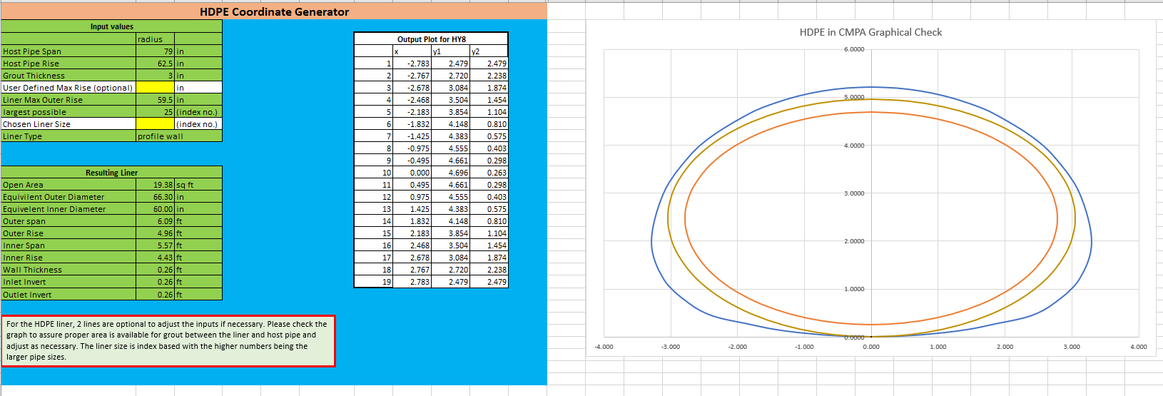
CMPA Coordinate Generator
Liners
  HDPE (High Density Polyethylene)
  CIPP
  Paved Invert
  Steel
Includes solid wall and profile wall liners
Updated periodically per supplier information

Slide 11
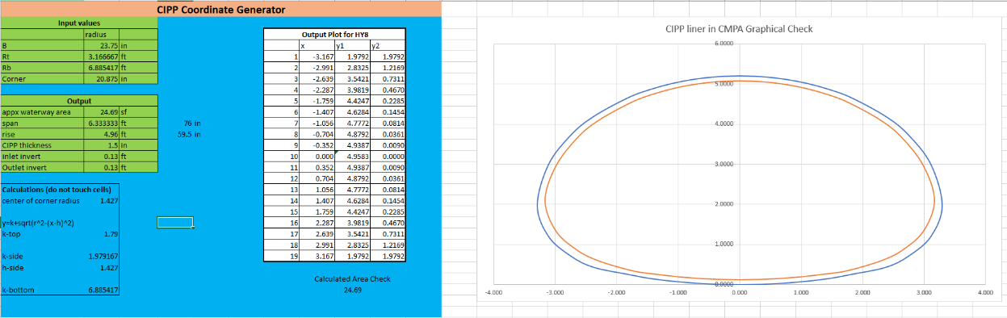
CMPA Coordinate Generator
Liners
  HDPE
  CIPP (Cured in place pipe)
  Paved Invert
  Steel
Error will occur if structure is too big for a CIPP
  It will not draw the liner

Slide 12
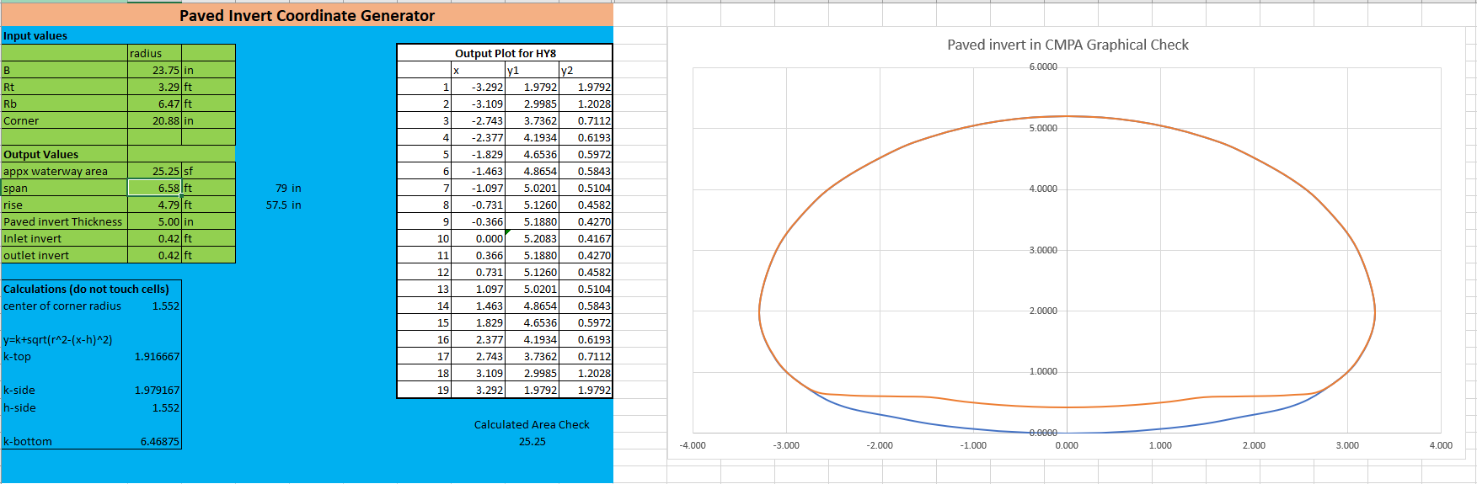
CMPA Coordinate Generator
Liners
  HDPE
  CIPP
  Paved Invert
  Steel
Error will occur if structure is too small for a Paved Invert
  It will not draw the liner

Slide 13
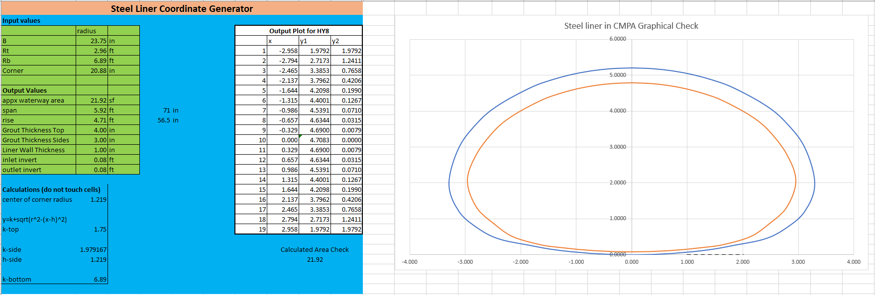
CMPA Coordinate Generator
Liners
  HDPE
  CIPP
  Paved Invert
  Steel
Error will occur if structure is too small for a steel liner
  It will draw but will recommend points to be fixed
  Note states that liner size is not available

Slide 14
Website Update
Developing Design Guidance:
  Steel Liners
  Median Drain
  Infiltration Ponds
Coordinate Generator for CMPA Liners
Minimum pipe size that can be lined
  If structure is already at the minimum size, then only a CIPP liner can be used.
  If structure is under minimum size, it cannot be lined.
Keep Memo Templates Up to Date
  Check version numbers
Submitting requests to the HRA
  HRA Project Type Flow Chart

Slide 15
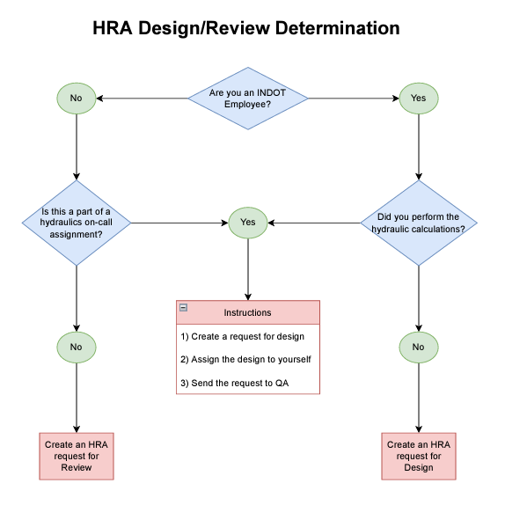
HRA Design-vs-Review
  Design projects include:
    District requests that are designed by INDOT Hydraulics
    A person from another INDOT department designs and we QA
    An on-call designs and INDOT Hydraulics QA’s
  Review projects include:
    Consultant performed calculations
  The Website Flow Chart provides instruction on which item to choose and how far the requester should continue into the request process.

Slide 16
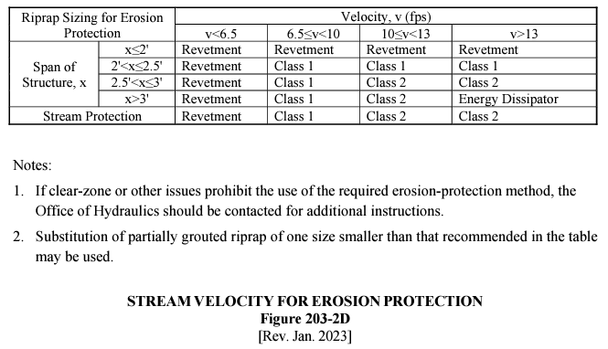
Riprap – IDM Figure 203-2D

Slide 17
INDOT Median Drain Policy
  GUIDANCE
  INDOT has limited hydraulic guidance for median drains in the Indiana Design Manual (IDM)
  Developing Design Guidance is given on median drains on the Hydraulics Website
    https://www.in.gov/indot/engineering/hydraulic-engineering/
  IDM to be updated with median drain policy in the near future

Slide 18
Median Drain Risks
  Lack of Redundancy
    Water will go on or over the roadway if drainage fails
    The road is the emergency spillway
    Medians are typically on major corridors and/or divided highways
      High Traffic Volume (traffic delays, commute times increase)
      High Travel Speeds (safety)
      Economy (commerce affected)
  All median drains are always subject to INDOT Hydraulics Review

Slide 19
Tailwater Conditions
Downstream Ditch Normal Depth
  New median and storm sewer outlets shall be a minimum of 12” above the downstream ditch flow line
  6" may be used but the ditch hydraulic grade line (HGL) shall be checked for impact to the median
Detention Hydraulic Grade Line (HGL)
  Q100 for ditches
  Q50 for storm sewers
Receiving Water -Joint Probability
  IDM Fig. 203-2G
Existing storm sewer
  Assume full flow of downstream system if not an INDOT asset
  Check with owner of downstream system if they are good with higher flows (if necessary)

Slide 20
Medians: Interstate ATL vs. Non-Interstate
Interstate Added Travel Lanes (ATL)
  AEP1% (Q100) Serviceability
Non-Interstate
  AEP2% (Q50) Serviceability

Slide 21
Median Drain Design Factors
Minimum pipe size 12” Inner Diameter (ID)
Minimal rational C for pavement – 0.90
No detention is allowed in the median or under pavement
Slotted drains shall not be used in the drainage calcs but a trench drain may as long as it has a minimum width of 12”
1’ contour map for drainage areas
No drainage from an outside ditch should be brought into median drainage system

Slide 22
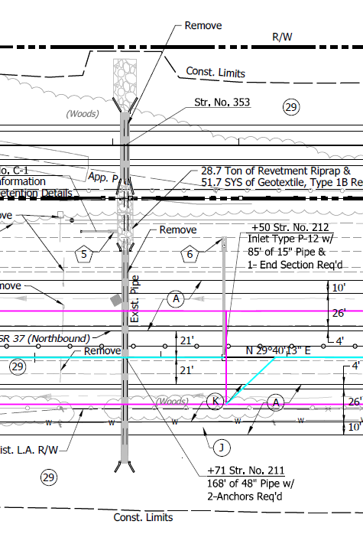
Median Drain Design Factors
Flanking Inlets required at all Sag inlet locations
  Required on both sides if flow comes from both directions
  If flow comes from only 1 direction, then only one flanking inlet is needed
When possible, median drains shall have a separate pipe to the outside.
  Exception: Flanking inlets may be connected to the primary inlet
  Exception: inlets on other side of barrier wall may be connected

Slide 23
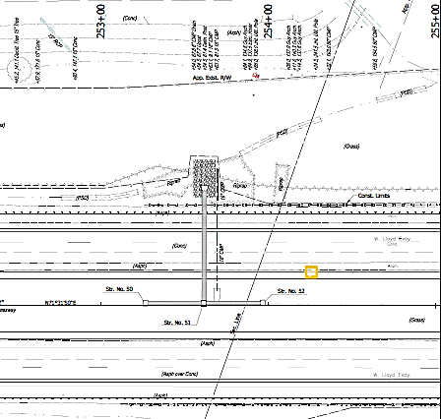
Median Drain Design Factors
Flanking Inlets required at all Sag inlet locations
  Required on both sides if flow comes from both directions
  If flow comes from only 1 direction, then only one flanking inlet is needed
When possible, median drains shall have a separate pipe to the outside.
  Exception: Flanking inlets may be connected to the primary inlet
  Exception: inlets on other side of barrier wall may be connected

Slide 24
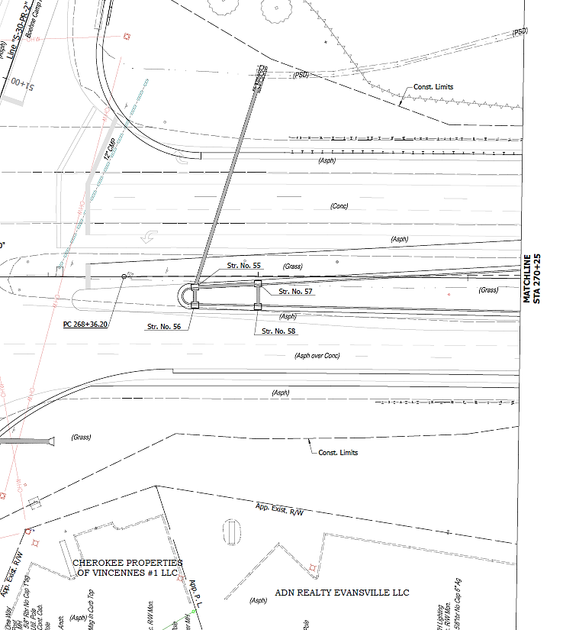
Median Drain Design Factors
Flanking Inlets required at all Sag inlet locations
  Required on both sides if flow comes from both directions
  If flow comes from only 1 direction, then only one flanking inlet is needed
When possible, median drains shall have a separate pipe to the outside.
  Exception: Flanking inlets may be connected to the primary inlet
  Exception: inlets on other side of barrier wall may be connected

Slide 25
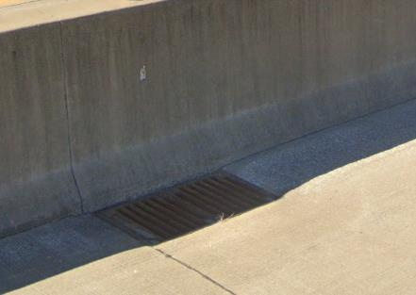
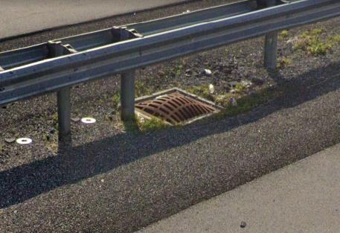
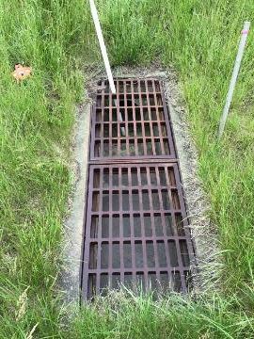
Inlet Types
Preferred
  Non-Paved Medians: Type N-12 inlets
    P-12 inlets if N-12 cannot geometrically fit
  Paved Medians: Type 5 inlets
Not recommended
  Type E7 inlets
N-12 Inlet
Type 5 Inlet
E7 Inlet

Slide 26
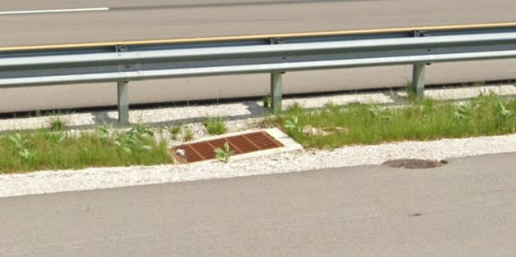
Inlet Types
Preferred
  Non-Paved Medians: Type N-12 inlets
    P-12 inlets if N-12 cannot geometrically fit
  Paved Medians: Type 5 inlets
Not recommended
  Type E7 inlets
N-12 Inlet
Type 5 Inlet
P-12 Inlet

Slide 27
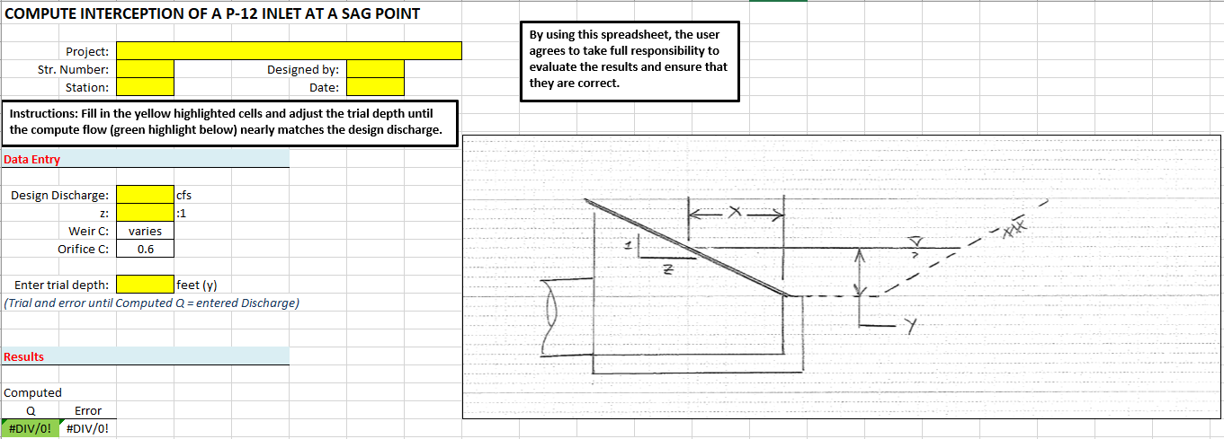
P-Inlet Spread Calculations – At a Sag

Slide 28
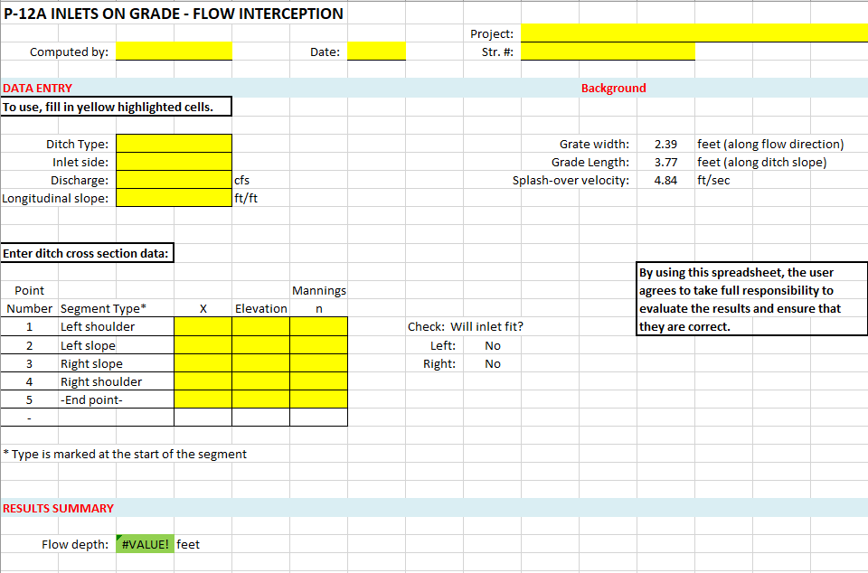
P-Inlet Spread Calculations – On Grade

Slide 29
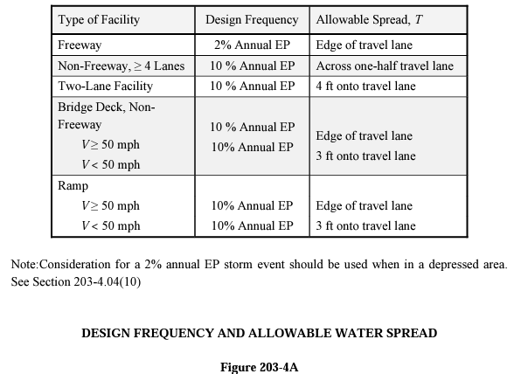
Typical Spread Standards

Slide 30
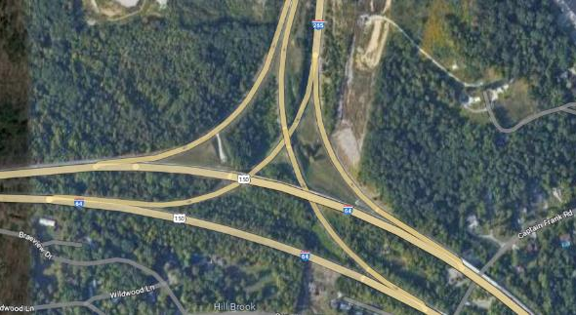
Interstate to Interstate Ramps
Ramps at interstate to interstate interchanges shall have matching serviceability requirements to normal interstate lanes.

Slide 31
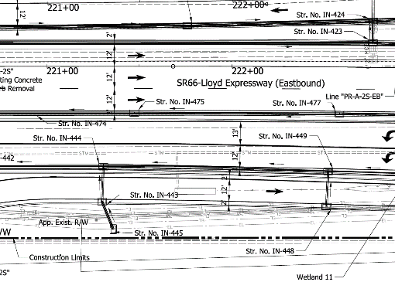
Curb Confined Lanes
Single lanes confined by curbs on each side have a maximum spread of 4 ft into travel lane.
  This includes facilities that are over 4 lanes total
  Displaced left intersections
curb
curb

Slide 32
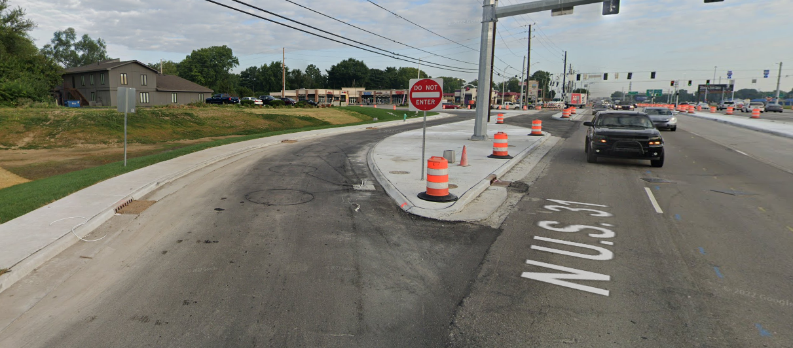
Curb Confined Lanes

Slide 33
Hydraulics Design Exemptions
Exemptions are Sometimes Allowed
Can provide significant cost savings without incurring unreasonable risk
Often requires coordination with Hydraulics before submittal
Provide supporting documentation

Slide 34
Hydraulics Design Exemptions
Pipe Liner – Allowing an Increase in Headwater (HW)
No road overtopping
Proposed headwater is contained
  In the upstream channel or
  Contained in ROW or
  Contained in a deep wooded ravine
Does not negatively affect upstream properties or structures

Slide 35
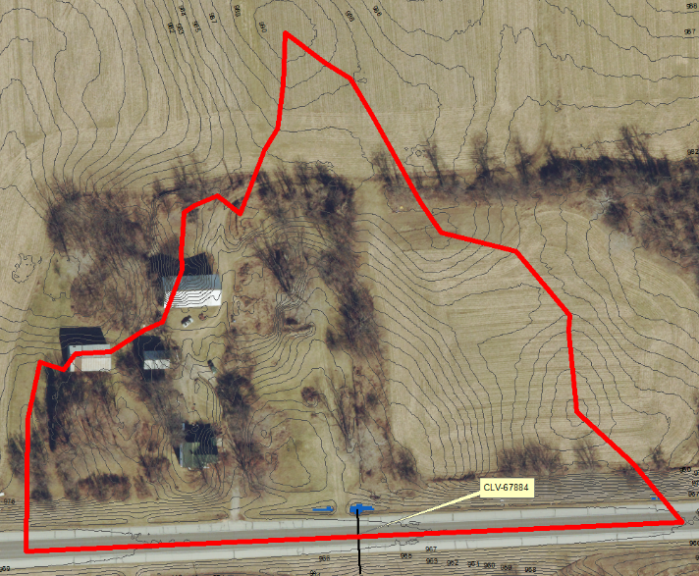
Hydraulics Exemption Considerations
Pipe Liner – Allowing an Increase in Headwater (HW)
To the right is an example of when we would allow an increase in the headwater.
Liner HW

Slide 36
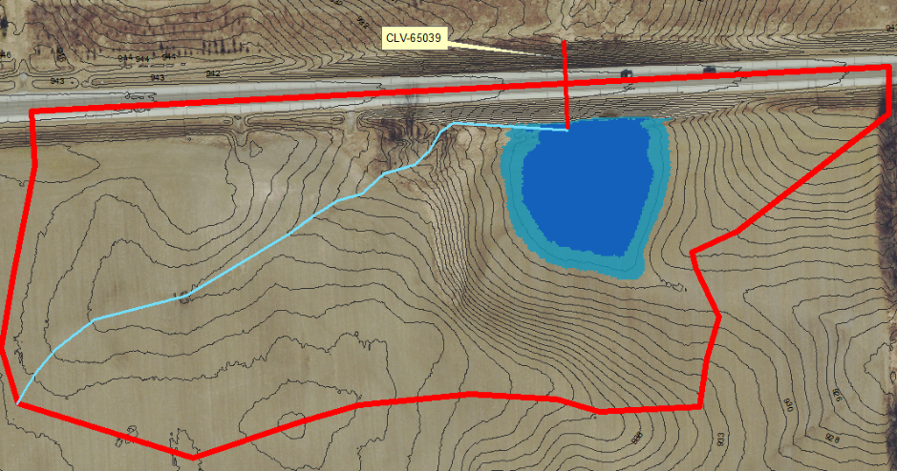
Hydraulics Exemption Considerations
Pipe Liner – Allowing an Increase in Headwater (HW)
This is an example where we would not allow an increase. ​
Existing HW
Liner HW

Slide 37
Hydraulics Exemption Considerations
Structure Replacement - Match Existing Performance
Model shows overtopping during a small Q (say 10% of Q₁₀₀)
Checked with district maintenance and County Surveyor no known flood history
The topography shows the water jumps to another drainage area
That there is significant natural storage
Concerns with downstream restrictions

Slide 38
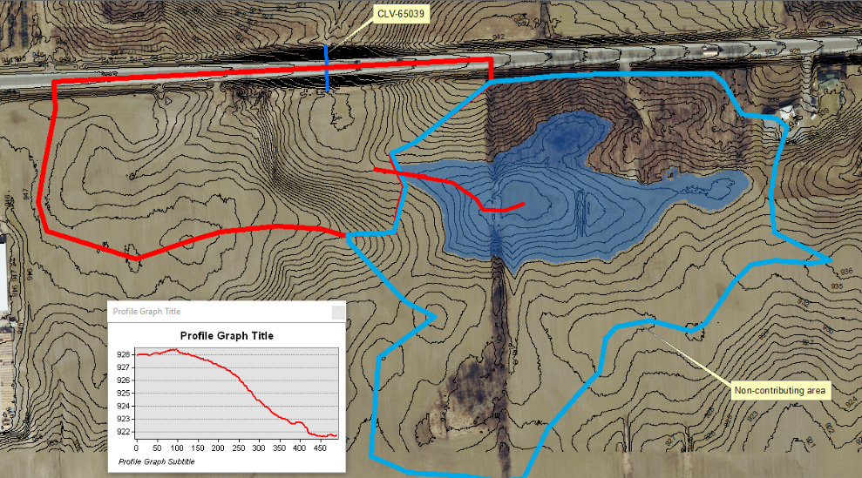
Hydraulics Exemption Considerations
Non-contributing Drainage Areas
Areas that have natural storage that is greater than the potential runoff generated by the drainage area.

Slide 39
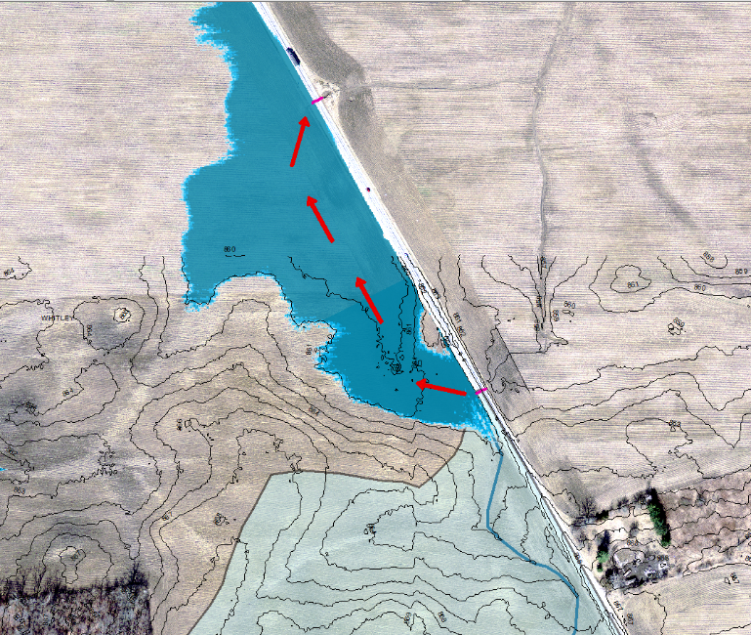
Hydraulics Exemption Considerations
Structure Replacement - Match Existing Performance
Water leaves the drainage area before it can reach the road elevation.

Slide 40
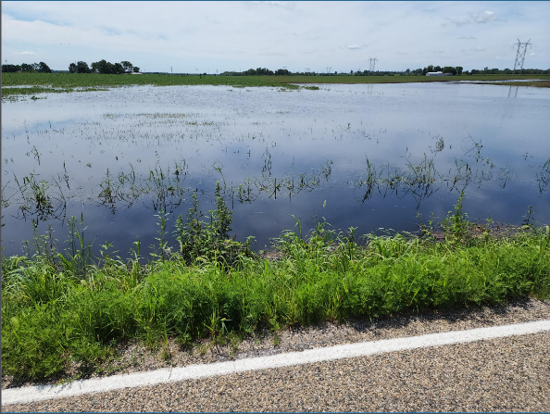
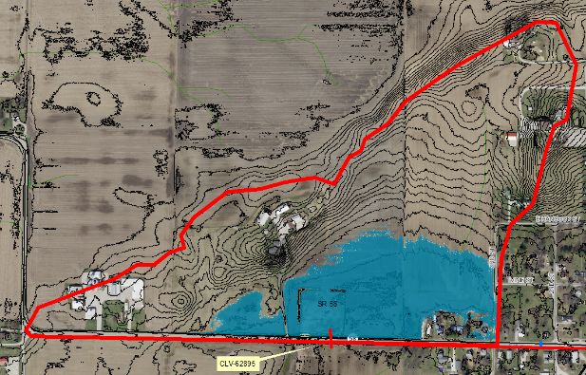
Hydraulics Exemption Considerations
Structure Replacement - Match Existing Performance
Significant natural storage in the drainage area

Slide 41
Hydraulics Exemption Considerations
Using the Existing Outlet Depth to Calculate the Backwater (BW)
Culvert with no downstream channel
Outlet depth is greater than the natural TW
Existing outlet depth can be used for calculating the existing and proposed BW

Slide 42
Infiltration Basins
Infiltration should only used after all other designs have been considered
Cannot provide positive slope for ditching
Storm sewer system not feasible
Check Natural Resources Conservation Service (NRCS) soil data
Soils should be classified as sand
Check seasonable high ground water should be at least 2 feet below the proposed bottom elevation of the basin

Slide 43
Infiltration Basins
Infiltration Basin Testing – INDOT Geotechnical Guidelines
https://www.in.gov/indot/engineering/files/percolation-Infiltration-guidelines.pdf
Provide infiltration tests at the bottom of basin elevation
Measure depth to groundwater measurements table during testing
Presoaking required prior to testing
Testing should be done during the wet season if possible

Slide 44
Infiltration Basins
Consider Redundancy
Consider the overflow routing if infiltration fails
Even if the basin can’t be completely drained due to elevation, provide overflow ditching or piping so that the road or adjacent properties are not impacted
Connect multiple basins if possible
Notes:
Soils can be compromised during construction.

Slide 45
Infiltration Basins
Consider Construction Impacts
Construction in cut only (not fill areas)
Erosion and Sediment Control
  Should not be used as a sediment basin
  Runoff from disturbed areas should be diverted until stabilized
  The surface and side slopes of the infiltration basin should be stabilized immediately after grading
Prevent Compaction of Soils
  Should not be used for equipment storage or material staging
  Other than grading the infiltration area should not be driven on
Notes:
Soils can be compromised during construction.

Slide 46
Cutoff Walls
Design Memo 22-24 Revised
Cutoff walls are now required for all box structures with a concrete bottom.
Used to prevent piping along the culvert barrel and undermining at the culvert end.
If bedding material (i.e. crushed stone, b borrow, etc.) is present, the cutoff wall should extend 6 inches below the bedding material.
If bedding material is not present, the depth of the cutoff wall should be a minimum of 20 inches below the bottom of the culvert.

Slide 47

Q & A

Slide 48
Stay up to Date Contact Info
INDOT Hydraulic Listserv
  INDOT Hydraulics Email List
INDOT Hydraulics email
  Hydraulics@indot.IN.gov
INDOT Hydraulics Website
  https://www.in.gov/indot/engineering/hydraulic-engineering/
Design Questions: hydraulics@indot.in.gov
Mark Bailey (317) 233-2096 mbailey1@indot.in.gov
Alex Schwinghamer
(317) 233-6951
aschwinghamer@indot.in.gov
Jim Emerick
(317) 232-2770
jemerick@indot.in.gov

