Slide 1

Hydraulics Boot Camp
Mark Bailey, PE, INDOT
Robert Page, PE, HNTB

Slide 2

Boot Camp
https://www.goarmy.com/army-life/basic-training.html
Notes:
The idea behind this presentation is to give you a strong foundation for hydraulic design and to emphasize that design guidance changes as technology improves so try to keep an open mind and embrace the change.

Slide 3
Agenda
Background Information
  Indiana Design Manual (IDM)
  INDOT Hydraulics Website
  Hydraulics Links
Hydrology and Hydraulics (H&H) Basics
Tips and Tricks
Question and Answer

Slide 4
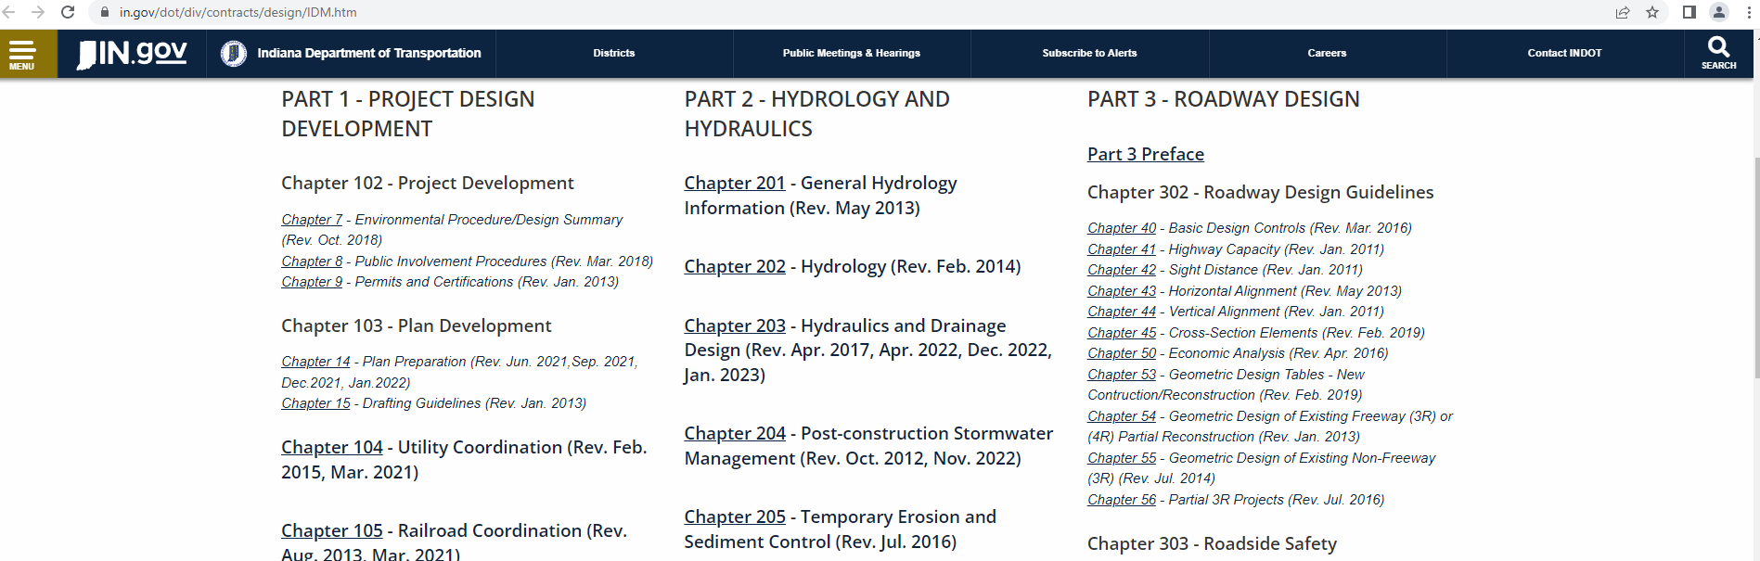
Design Manual
https://www.in.gov/dot/div/contracts/design/IDM.htm

Slide 5
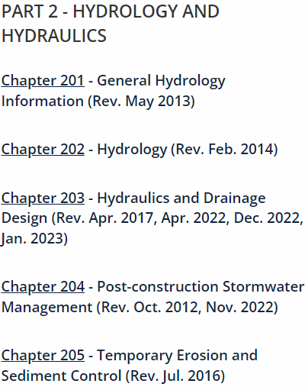
Design Manual
…...............................
…...............................
…...............................
…...............................
…...............................

Slide 6
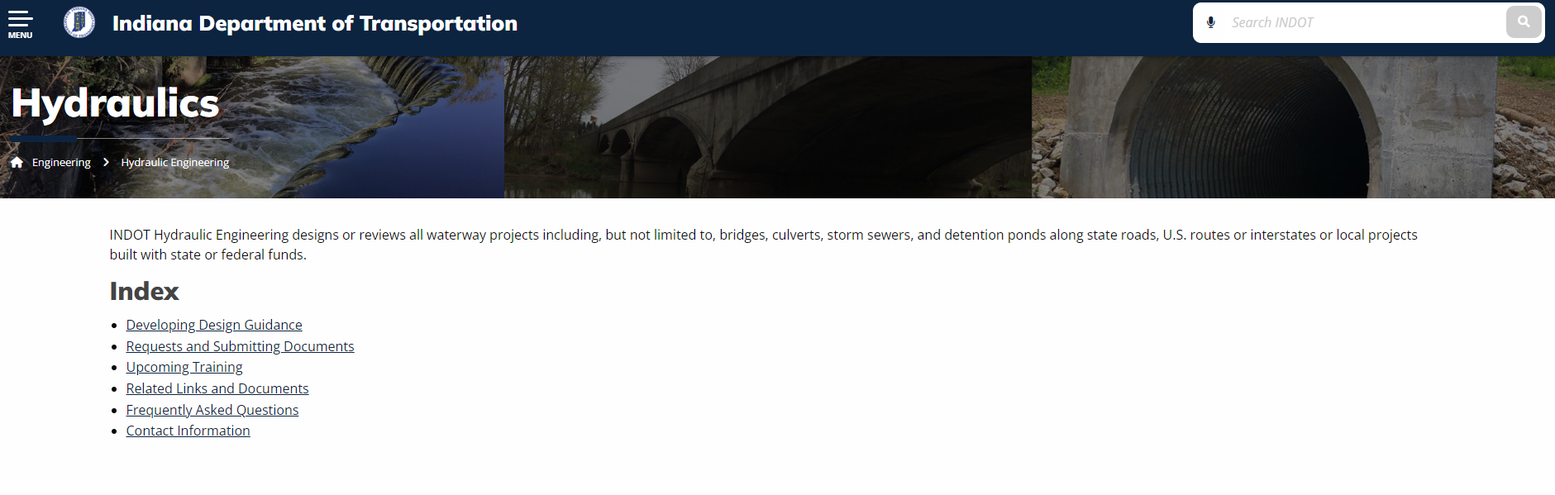
INDOT Hydraulics Website
https://www.in.gov/indot/engineering/hydraulic-engineering/
Notes:
The hydraulics website is loaded with great information including example reports and calculations, developing design guidance and how to submit your plans and calculations for a hydraulics review.

Slide 7
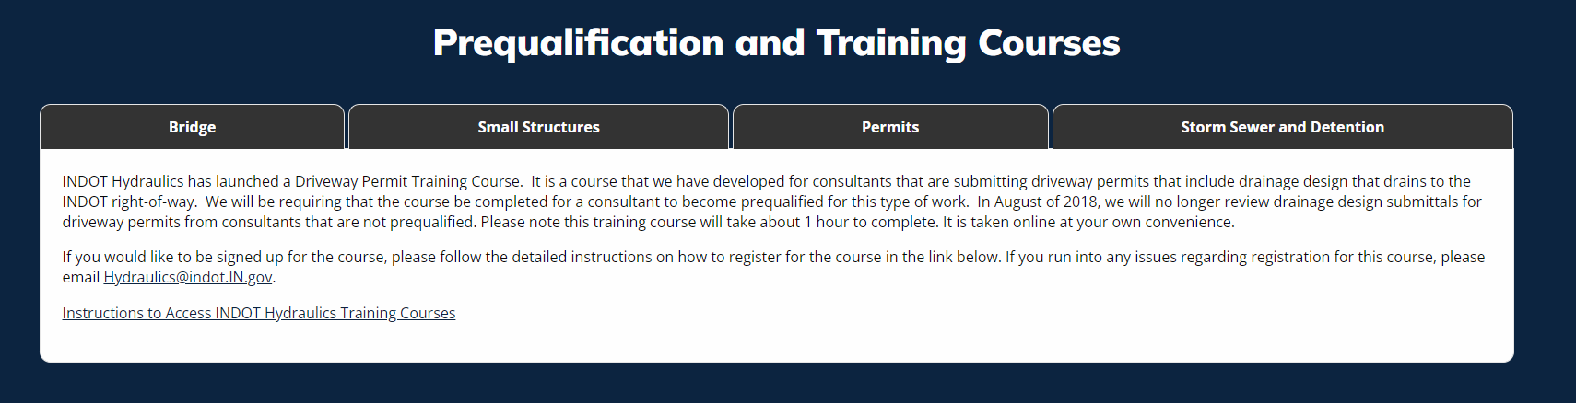
Online Training Courses
Notes:
Once you have read through the design manual and website, it is a great idea to complete the training courses to give you an opportunity to put your newly acquired knowledge to use.

Slide 8
Keep in Touch
Hydraulics@indot.IN.gov
Stay current on INDOT Hydraulics design guidance and policy changes by subscribing to the INDOT Hydraulics Email List.
Notes:
Once you have read through the design manual and website, it is a great idea to complete the training courses to give you an opportunity to put your newly acquired knowledge to use.

Slide 9
Hydraulics Links
DNR Sites
https://indnr.maps.arcgis.com/apps/webappviewer/index.html?id=05026dabc2e8461983e196d56a213c1e
https://indnr.maps.arcgis.com/apps/webappviewer/index.html?id=6619094e25a64c6b865aacb625d7aba1
https://dnrmaps.dnr.in.gov/appsphp/dischargecalc/
https://www.in.gov/dnr/water/publications/coordinated-discharges-of-selected-streams-in-indiana/
https://dnrmaps.dnr.in.gov/appsphp/model/index.php

Slide 10
Hydraulics Links
INDOT Sites
Traffic Counts https://indot.public.ms2soft.com/tcds/tsearch.asp?loc=Indot&mod
Hydraulics Website https://www.in.gov/indot/engineering/hydraulic-engineering/
IDM https://www.in.gov/dot/div/contracts/design/IDM.htm
Standard Drawings https://www.in.gov/dot/div/contracts/standards/drawings/sep22/sep.htm
Asset Viewer https://indot.maps.arcgis.com/apps/webappviewer/index.html?id=2566be6a717042e895e511aeac5a09e7
Plan Request https://entapps.indot.in.gov/opsm/Dashboard/UserRequest
Hydraulics Request Application (HRA) https://hra.indot.in.gov/Dashboard
Federal Sites
Rainfall Depths https://hdsc.nws.noaa.gov/hdsc/pfds/pfds_map_cont.html?bkmrk=in
FIS Studies https://msc.fema.gov/portal/advanceSearch

Slide 11
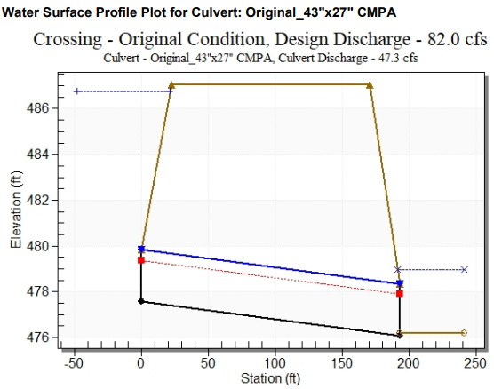

H&H Basics
What is H&H?
  Hydrology – How much water gets to a particular point.
  Hydraulics – What happens to the water at that point.

Slide 12
H&H Basics
Calculating Flows - Hydrology
  Chapter 202 of Design Manual
  Depends on location and drainage area (DA)
    Rational Method: DA < 100 ac (urban), DA < 200 ac (rural)
    NRCS (TR-20): DA > 100 ac (urban), DA > 200 ac (rural)
    HEC-HMS: Similar to TR – 20 but less desirable
    IDNR: Required if CIF needed
    IDNR Coordinated Discharge: Preferred if available (https://www.in.gov/dnr/water/publications/coordinated-discharges-of-selected-streams-in-indiana/)
    StreamStats: Used in conjunction with other methods. Usually for setting parameters and justification

Slide 13
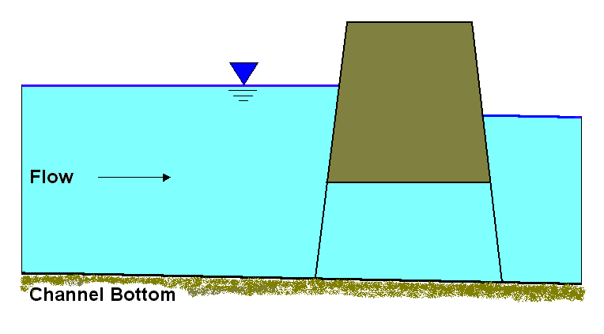
H&H Basics
Terminology
Notes:
Headwater, tailwater, backwater

Slide 14
H&H Basics
Software Versions
  HY-8, use 7.2
    Need to download an application first.
    Then the software from INDOT Hydraulics website.
  HEC-RAS, the most current version allowed by IDNR (may be 6.1.0)
Notes:
Headwater, tailwater, backwater

Slide 15
H&H Basics
Modeling Approaches
  HY-8 – Used for smaller spans, typically culverts under 20 feet
  HEC-RAS – Can be used for nearly all applications
    1-D, steady flow is generally sufficient in Indiana.
    If other means/methods are needed, reach out to INDOT Hydraulics before starting.
Notes:
HY-8 can be used on spans up to 30' if neither the existing or any of the proposed alternatives contain a spill through structure.

Slide 16
H&H Basics
HY-8 Culvert Data
  Size, length, invert elevations, inlet configuration, Channel cross section and slope
  Inlet MUST be above the outlet!
Notes:
Headwater, tailwater, backwater

Slide 17
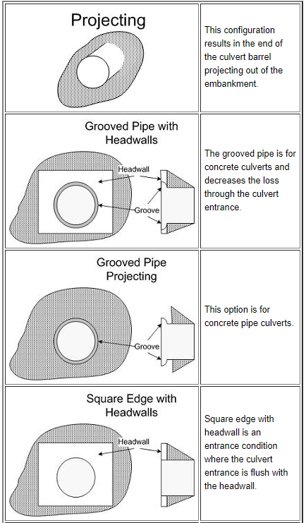
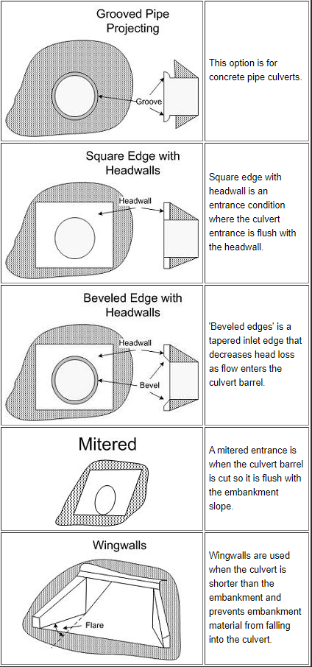
H&H Basics
HY-8
  Remember to modify tailwater if culverts in series
  Know your end treatments!

Slide 18
H&H Basics
HEC-RAS
  Map out ineffective flow
    Helps understand where to place in cross-sections for bridges/culverts
    Demonstrates thought process for reviewers
  Monitor contraction/expansion coefficients
    Modify at bridges/culverts to reflect restrictions
    Understand what is happening at natural restrictions
  Bridge Modeling
    Understand the different types of flow
      Weir
      Energy
      Pressure – Flow

Slide 19
Detention
Need to evaluate any time potential exists to increase flow off-site
  Generally added pavement over an acre = detention required
  Depends on project size and location, along with flooding history

Slide 20
Reporting Results
Examples on INDOT Hydraulics website
Document your assumptions and thought process
  Reviewers do not know what you are thinking.
  Be thorough in your documentation.
  Do not assume a reviewer will know what your thought process was!

Slide 21
Reporting Results
When your plans, calculations and report are ready, submit them using the HRA for review and approval.
The HRA is covered under “Past Presentations” on the INDOT Hydraulics website.

Slide 22
Tips and Tricks
Do not change drainage patterns.
Use a rational C-value of 0.90 or higher for pavement.
Provide your calculation documents.
Do not drain outside ditches into median drains.
Include HGL profiles with storm sewer calculations.
Outlet median drains and storm sewers 12 inches above the flowline of outlet ditch and above the water surface elevation of a detention basin or receiving water.
Do not detain in the median.
Coordinate with INDOT Hydraulics when unusual conditions are found.

Slide 23

Q & A

Slide 24
Contact Information
Design Questions: hydraulics@indot.in.gov
Mark Bailey
(317) 233-2096
mbailey1@indot.in.gov
Bob Page
(317) 767-4586
rtpage@HNTB.com

