Slide 1
Injury prevention advisory council (IPAC) & Indiana violent death reporting system (INVDRS) Meeting
05/19/2023

Slide 2
OUR MISSION:
To develop, implement and provide oversight of a statewide comprehensive trauma care system that:
Prevents injuries.
Saves lives.
Improves the care and outcomes of trauma patients
OUR VISION:
Prevent injuries in Indiana.

Slide 3
Round Robin and Introductions (in chat)
Name
Position
Organization/ Association
Updates
Current Projects and Programs
Upcoming events

Slide 4
Program Updates
  Indiana Violent Death Reporting System (INVDRS)
    2022 data abstraction complete on May 25. 2022 NVDRS/SUDORS data can be requested after this date.
  Midwest Injury Prevention Alliance (MIPA) Conference
    Indiana will be hosting the 2023 MIPA Conference.
    Save the Date: November 30
    Theme: All Systems Go! Injury and Violence Prevention through Innovative Discovery and Practice

Slide 5
Upcoming Events
May
Child Passenger Safety Technician Month
Electrical Safety Month
Older Americans Month
Mental Health Awareness Month
Motorcycle Safety Month
Water Safety Month
June
National Safety Month
National Trailer Safety Month
July
National Fireworks Safety Month

Slide 6
Unintentional Injury Presentation:
Statewide TBI Support
Wendy Waldman, BSW, CBIST
NeuroResource Facilitator
The Indiana NeauroResource Facilitation Program

Slide 7
Indiana criminal justice institute (ICJI)

Slide 8

Child
Passenger Safety
Janine Walter
ICJI Occupant Protection & Child Passenger Safety Program Manager
jwalter@cji.in.gov

Slide 9
Child Restraint Inspection Stations | Child Passenger Safety Specialists (CPSS) | Child Restraint Distribution Grant (CRDG) | Automotive Safety Training Program (ASP)

Slide 10
Child Restraint Inspection Stations
100+ Permanent Fitting Stations (PFS)
    1,260 Active CPSTs
6,734 Entries into NDCF FFY22
    3,928 Seats Distributed
3,588 Entries into NDCF YTD
    2,101 Seats Distributed

Slide 11
National Digital Check Form Data
125,379 Checks have been performed from July 1, 2018 to March 31, 2023 across the United States
  65% Misuse Rate
Indiana Represents 30,156 of these total checks
  62% Misuse Rate

Slide 12
Child Passenger Safety Specialists (CPSS)
  Region 1: Kathleen Vasilopulos
  Region 2: Jennifer Homan
  Region 3: Hannah LaPradd
  Region 4: Keisha Nickolson
  Region 5: Tiffani Sinn-Trulock
  Region 6: Jennifer Hacker

Slide 13
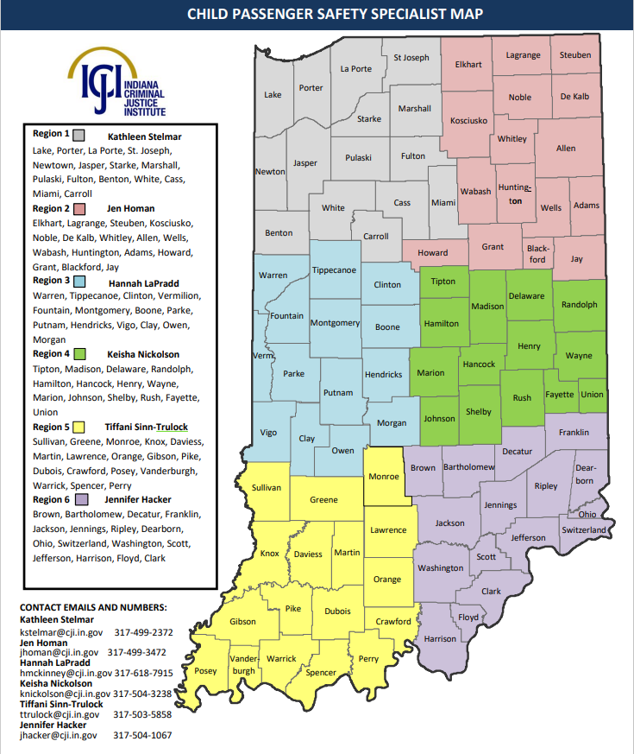

Slide 14
Region 1
Checks Rank | Agency Name | Count
1 | Crown Point Fire Rescue, City of Crown Point, Indiana (Crown Point, Indiana) | 365
2 | Dukes Memorial Hospital (Peru, Indiana) | 234
3 | Valparaiso Fire Dept (Valparaiso, Indiana) | 183
4 | Beacon Health System (South Bend, Indiana) | 152
5 | Franciscan Health Crown Point (Crown Point , Indiana) | 96

Slide 15
Region 2
Checks Rank | Agency Name | Count
1 | Lutheran Children's Hospital Safe Kids Allen County (Fort Wayne, Indiana) | 544
2 | DuPont Hospital Safe Kids Allen County (Fort Wayne , Indiana) | 359
3 | Lutheran EMS - Kosciusko Community Hospital (Leesburg, Indiana) | 226
4 | Parkview Whitley Hospital (Columbia City, Indiana) | 199
5 | Marion General Hospital (Marion, Indiana) | 84

Slide 16
Region 3
Checks Rank | Agency Name | Count
1 | Indiana University Health Arnett (Lafayette, Indiana) | 1047
2 | Chances And Services for Youth, Inc. (Terre Haute, Indiana) | 166
3 | Women's Resource Center of Montgomery & Fountain Counties (Crawfordsville, Indiana) | 45
4 | Healthy Communities (Frankfort , Indiana) | 35
5 | Franciscan Health Mooresville (Mooresville, Indiana) | 31

Slide 17
Region 4
Checks Rank | Agency Name | Count
1 | Franciscan Health Indianapolis (Indiana, Indiana) | 832
2 | Automotive Safety Program (Indianapolis, Indiana) | 590
3 | Safe Kids Greater Lafayette (Lafayette, Indiana) | 377
4 | White River Twp Fire Department (Greenwood, Indiana) | 377
5 | Riley Hospital for Children at IU Health (Indianapolis, Indiana) | 269

Slide 18
Region 5
Checks Rank | Agency Name | Count
1 | St. Vincent Hospital for Women and Children (Evansville, Indiana) | 1905
2 | Daviess Community Hospital (Washington, Indiana) | 1039
3 | Little Lambs of Evansville (Evansville, Indiana) | 266
4 | The Women's Hospital (Newburgh, Indiana) | 136
5 | IU Health Southern Indiana Physicians (Bloomington, Indiana) | 125

Slide 19
Region 6
Checks Rank | Agency Name | Count
1 | Goodwill Nurse-Family Partnership (Clarksville, Indiana) | 69
2 | Margaret Mary Health (Batesville, Indiana) | 53
3 | Dorel Juvenile (Columbus, Indiana) | 34
4 | Lafayette Township Fire Protection District (Floyd Knobs , Indiana) | 32
5 | New Hope Services (Jeffersonville, Indiana) | 19

Slide 20
Child Restraint Distribution Grant (CRDG)
  ICJI partners with IDOH to support Trauma Hospitals with Child Restraints with Title V Funds.

Slide 21
Child Restraint Distribution Grant (CRDG)
Memorial Hospital and Health Care Center
St. Vincent Evansville
Franciscan Health (Location 1)
Franciscan Health (Location 2)
Franciscan Health (Location 3)
St Vincent Hospital and Health Care Center
Indiana University Health Bloomington
Riley Hospital For Children
IU Health Ball Memorial

Slide 22
Automotive Safety Training Program (ASP)
  ICJI Partners with ASP to provide training resources such as Certification Courses, Refresher Courses, CEUs and Community Events.
    Permanent Fitting Station
    Annual Conference & Clinic
    Safe Kid’s Coalition
      Belts About Program (ages 8-12)

Slide 23
Automotive Safety Training Program (ASP)
  FFY22:
  Supported 17 National Child Passenger Safety Certification Training Courses
  196 New CPSTs
  100 CPST Car Seat Check-Offs

Slide 24
Region | Count
1 | 738
2 | 438
3 | 217
4 | 653
5 | 193
6 | 131
Unknown | 18
Total | 2388
Project LOVE Law Officer Voucher & Enforcement

Slide 25
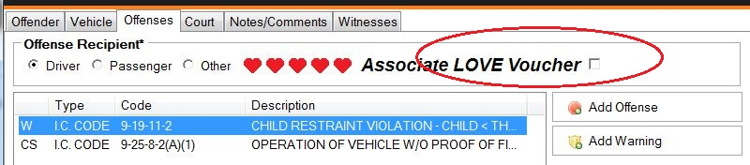
Project LOVE
LOVE Voucher for Child Restraint-E Ticket
    9-19-11-2
    9-19-11-3.6

Slide 26
Project LOVE
A family receives an E-Voucher or Paper ticket via officer either at the scene of a crash or when a ticket is issued.
1
Family is only eligible for seat if it is the incorrect or unsafe seat and receives public assistance.
2
Family must have voucher to have it redeemed.
3
Fill out car seat check up form either via paper or the online NDCF
4
Collect any additional information for Liability Release Form (please see example)
5
Scan in liability release and project love voucher to cps@cji.in.gov
6

Slide 27
Questions?

Slide 28
National alliance on mental illness (nami) - Indiana
Caroline Chastain
Communications Coordinator

Slide 29

Notes:
Good afternoon, my name is Linda Williams. I am the Program Director for NAMI Indiana.
NAMI, the National Alliance on Mental Illness, is the nation’s largest grassroots mental health organization dedicated to building better lives for the millions of Americans affected by mental illness.
What started as a small group of families gathered around a kitchen table in 1979 has blossomed into the nation's leading voice on mental health. Today, we are an association of more than 600 local affiliates and 48 NAMI State Organizations who work in your community to raise awareness and provide support and education that was not previously available to those in need.

Slide 30

NAMI Indiana’s mission
To improve the quality of life for persons who are affected by severe and persistent mental illness by providing education, support, advocacy and promoting research.
The state organization supports and develops local affiliates and represents the needs of
the members.
Notes:
Our Vision
We want to be the foremost advocate at the state level for persons affected by severe and persistent mental illness, and the leading proponent on consumer and family involvement in care, treatment, and recovery. We do this by strengthening and empowering local affiliates through advocacy, education, and support to their communities. We link national resources with local affiliate passion and action. We coordinate family and consumer involvement in public policy at the state level.
Our Mission
We improve the quality of life for persons who are affected by severe and persistent mental illness by providing education, support, advocacy and research. The state organization supports and develops local affiliates and represents the needs of the membership.

Slide 31
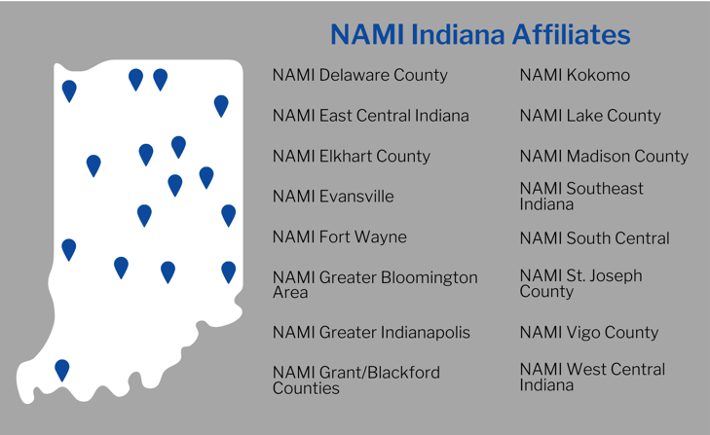

Notes:
As the state chapter of this national organization, NAMI Indiana is tasked with bringing our programming and advocacy to the grass roots.
The state office provides training to the volunteer leaders across Indiana to provide the NAMI programs.
The latest new affiliates to be added/restored are Lake County and Vigo County.
NAMI East Central Indiana in the Richmond area is rebuilding and we hope to have their official affiliate status soon. Years ago, there was affiliate at Richmond State Hospital.
We also have NAMI On Campus Clubs established at Ball State, Indiana University Bloomington, and Purdue University in West Lafayette.

Slide 32





Education Classes
Support Groups
Notes:
NAMI National programs and presentations are developed by experienced professionals using the best available scientific and clinical information and teaching models. Many of our programs and presentations have been offered for decades in communities across the country. NAMI actively works with researchers to conduct studies on our programs and presentations to measure their effectiveness. Based on the results of these studies, we can designate a program as an Evidence-Based Practice (EBP). NAMI currently has four programs designated as evidence based, three of which we are able to provide around the state of Indiana. (NAMI Family-to-Family, NAMI Basics, NAMI Ending the Silence)
NAMI Family-to-Family is a free, 8-session educational program for family, significant others and friends of people living with mental illness. It is a designated evidenced-based program. Research shows that the program significantly improves the coping and problem-solving abilities of the people closest to an individual living with a mental health condition.
NAMI Family-to-Family is taught by NAMI-trained family members who have been there, and includes presentations, discussion, interactive exercises videos and Powerpoint.
NAMI Peer-to-Peer is a free, 8-session educational program for adults with mental illness who are looking to better understand their condition and journey toward recovery.
Free and confidential
Held weekly for two hours
Led by peers with mental health conditions
A great resource for information on mental health and recovery
Offers respect, understanding, encouragement and hope
Builds on the strength and resilience of participants
NAMI Basics is a 6-session education program for parents, caregivers and other family who provide care for youth (ages 22 and younger) who are experiencing mental health symptoms. This program is free to participants, 99% of whom say they would recommend the program to others. NAMI Basics is available both in person and online through NAMI Basics OnDemand.
NAMI Family Support Group is a peer-led support group for family members, caregivers and loved ones of individuals living with mental illness. Gain insight from the challenges and successes of others facing similar circumstances.
Individuals helping one another by utilizing their collective lived experiences and learned wisdom
Family member can achieve a renewed sense of hope for their loved one living with mental health challenges
NAMI Connection Recovery Support Group is a free, peer-led support group for adults living with mental illness. You will gain insight from hearing the challenges and successes of others, and the groups are led by NAMI-trained facilitators who've been there.
Free and confidential
Held weekly for 90 minutes
Designed to connect, encourage, and support participants using a structured support group model
Led by trained facilitators living in recovery themselves
Not a therapy group

Slide 33





Free Presentations
Notes:
NAMI In Our Own Voice presentations change attitudes, assumptions and stereotypes about people with mental health conditions. These free, 40-, 60- or 90-minute presentations provide a personal perspective of mental illness, as presenters with lived experience talk openly about what it's like to live with a mental health condition.
Our trained presenters humanize the misunderstood, highly stigmatized topic of mental illness by showing that it's possible—and common—to live well with a mental health condition.
This presentation also provides:
A chance to ask presenters questions, allowing for a deeper understanding of mental health conditions and dispelling of stereotypes and misconceptions.
The understanding that every person with a mental health condition can hope for a brighter future.
Information on how to learn more about mental health and get involved with the mental health community.
There are 3 versions of ETS - NAMI Ending the Silence for Students: 50-minute presentation designed for middle and high school students that includes warning signs, facts and statistics and how to get help for themselves or a friend. Research has shown that NAMI Ending the Silence for Students is effective in changing middle and high school students’ knowledge and attitudes toward mental health conditions and toward seeking help
NAMI Ending the Silence for School Staff: 1-hour presentation for school staff members that includes information about warning signs, facts and statistics, how to approach students and how to work with families
NAMI Ending the Silence for Families: 1-hour presentation for parents and primary caregivers that includes warning signs, facts and statistics, how to talk with your child and how to work with school staff
ETS is now available in a virtual format for those areas that do not have the program available yet.
SYSLE NAMI Sharing Your Story with Law Enforcement (SYSLE) is a presentation program that trains peers and families to share their stories of mental illness and recovery during law enforcement training, such as Crisis Intervention Team (CIT) training. Officers that hear these stories report greater empathy and understanding, and an increased desire to adapt their response to people experiencing a mental health crisis.
NAMI Family & Friends is a seminar (available in 4-hour or 90-minute format) that informs and supports people who have loved ones with a mental health condition. Participants learn about diagnoses, treatment, recovery, communication strategies, crisis preparation and NAMI resources. Seminar leaders have personal experience with mental health conditions in their families.

Slide 34

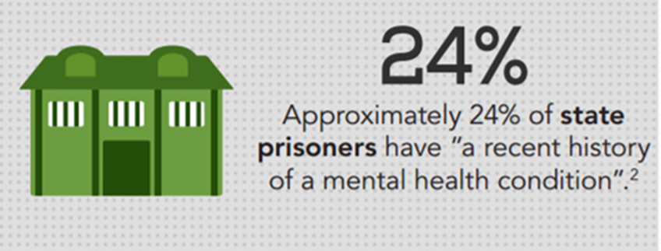
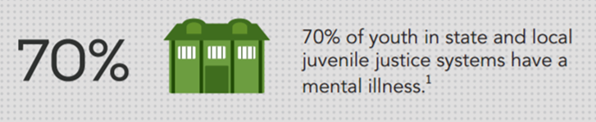
Notes:
NAMI Indiana maintains a special program focus on mental health and the criminal justice system because a broken mental health system is leading people to fall into the criminal justice system. One study found there are 10x more people living with a mental illness in prison than there are in state mental health hospitals.
Each year, NAMI Indiana pulls together a diverse group of leaders from the criminal justice field to provide in-depth education, novel tools, and networking opportunities for professionals. Our annual Mental Health and Criminal Justice Summit becomes a powerful tool for building bridges between systems and entering into beneficial collaborations and partnership, causing a strong desire for substantial changes.

Slide 35
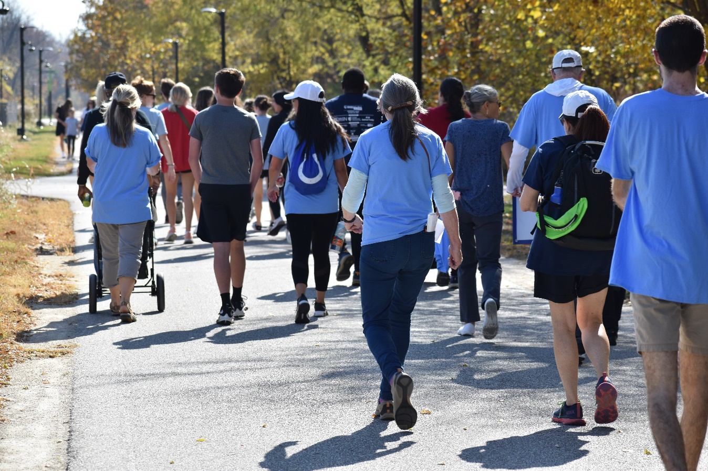
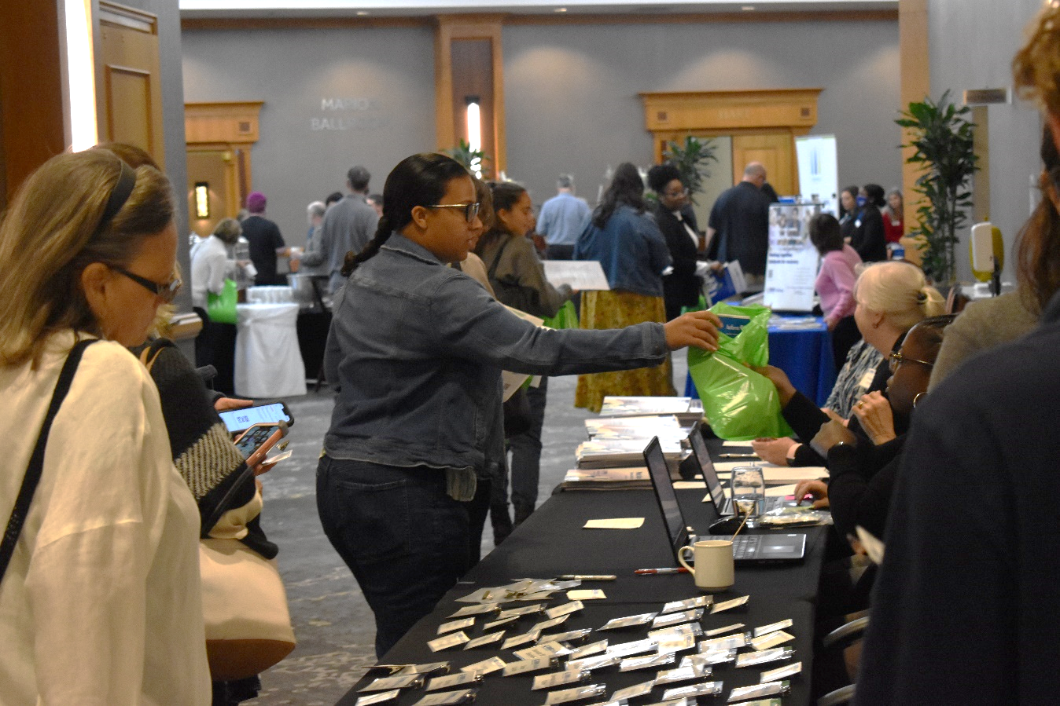
Notes:
Since 1988, NAMI and our national network of local and state organizations have partnered with law enforcement agencies on Crisis Intervention Team (CIT) programs. CIT is a community-based program designed to improve the response to mental health crisis. It focuses on developing collaborative relationships between law enforcement, mental health providers, and individuals impacted by mental illness. As a pre-arrest diversion program, the goals of CIT include increasing safety, decreasing the number of individuals with mental illness entering the criminal justice system, and increasing referrals to mental health services.

Slide 36
NAMI Indiana
921 E. 86th St., Suite 130
Indianapolis, IN 46240
317-925-9399 or 800-677-6442
Caroline Chastain
Communications Coordinator cchastain@namiindiana.org www.namiindiana.org
Notes:
Here is our contact information.
NAMI Indiana answers the phone for helpline calls M-F 9-5.

Slide 37
intentional injury presentation:
Mental health problem in invdrs
Morgan Sprecher, MPH
Indiana Violent Death Reporting System (INVDRS) Epidemiologist

Slide 39
Demographics for Suicide Deaths & Mental Health Problem Circumstance
Count
Rate per 100,000
Gender
Age Female Male
19 and Under 30 66
20-34 79 255
30-44 54 132
45-54 68 121
55-64 56 115
65-74 15 77
75 and Older 8 50
Gender
Age Female Male
19 and Under 0.70 1.47
20-34 2.36 7.40
30-44 1.72 4.19
45-54 3.27 5.85
55-64 2.51 5.40
65-74 0.89 5.13
75 and Older 0.61 5.60

Slide 40
Demographics for Unintentional Overdose Deaths & Mental Health Problem Circumstance
Count
Rate per 100,000
Gender
Age Female Male
19 and Under 9 6
20-34 65 153
30-44 69 105
45-54 77 78
55-64 41 47
65-74 6 9
75 and Older 2 0
Gender
Age Female Male
19 and Under 0.21 0.13
20-34 1.94 4.44
30-44 2.19 3.33
45-54 3.70 3.77
55-64 1.83 2.21
65-74 0.35 0.60
75 and Older 0.15 0.00

Slide 41
Race by Manner of Death for Mental Health Problem Circumstance
Suicide
Unintentional Overdose

Slide 42
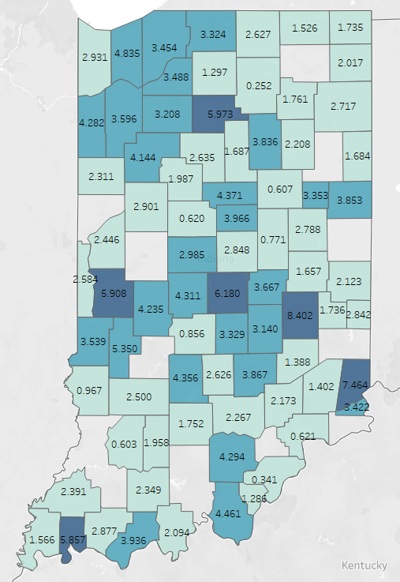
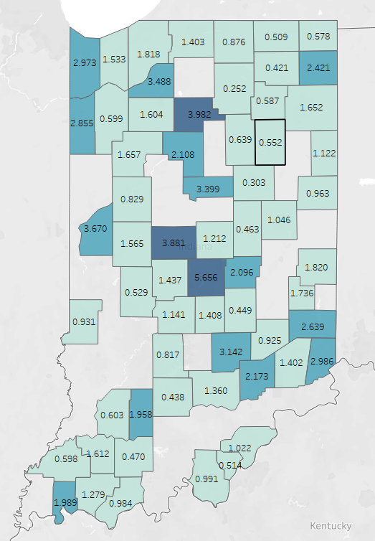
Suicide Deaths with Mental Health Problem
Overdose Deaths with Mental Health Problem

Slide 43
Discussion
What do we, in Indiana, do well when it comes to the topics from today?
How can / where can we improve this?

Slide 44
Discussion – Part II
Please comment your email in the chat if you would like to receive access to the IPAC/INVDRS SharePoint folder.
Sign-ups for Q3/Q4 2023 presentations

Slide 45
2023 Meeting Dates
February 17
May 19
August 18
November 17

Slide 46
THANKS!
Presenter | Phone | Email
Morgan Sprecher | 317-234-9825 | msprecher@isdh.in.gov
Maria Cariaso | 317-234-4943 | mcariaso@health.in.gov
Wendy Waldman | 317-329-2235 | wenwaldm@iu.edu
Caroline Chastain | 317-925-9399 | cchastain@namiindiana.org

