Slide 1


Getting a Great Start on Early Learning
Courtney Penn
Director of the Office of Early Childhood and Out-of-School Learning
Indiana Family and Social Services Administration
Hoosier Huddle
June 2024

Slide 2

The opportunity
Hoosier families often face barriers in accessing child care due to local access gaps, affordability challenges or misalignments between program offerings and needs.
This dynamic leaves families in difficult positions as they manage child care coverage, make trade-offs about care decisions or leave the workforce.
These adverse effects ripple across Hoosier communities, with children arriving unprepared for school and employers facing critical workforce challenges.

Slide 3








Indiana’s Early Learning System
Goals:
Ensure Hoosier children – especially vulnerable children – have access to early learning opportunities capable of preparing them with the foundational skills required to thrive in kindergarten and beyond.
Ensure Hoosier families have convenient access to reliable and effective early learning opportunities that facilitate participation in the labor force.
Priorities:
Improve learning and readiness for kindergarten | Increase the supply and sustainability of high-quality providers | Increase affordability, particularly for vulnerable families | Improve and increase system capacity
Notes:
State-led, multi-year planning process that convenes cross-sector stakeholders
Indiana was past of one of the first cohorts of states to begin developing this strategic plan
A collaborative effort to address the needs of an aging population, including older adults and people with disabilities, as the aging population increases significantly by 2030- how do we plan today for this, embrace this change and the opportunities that can come with it
Guides the restructuring of state and local policy and programs
Creates systems-based solutions in healthcare, human services, housing, transportation, consumer affairs, employment and income security across the life continuum
This is a movement that is growing across the country- and last week, the U.S. Department of Health and Human Services, through its Administration for Community Living, released “Aging in the United States: A Strategic Framework for a National Plan on Aging.”: Per the ACL announcement, “The report lays the groundwork for a coordinated effort – across the private and public sectors and in partnership with older adults, family caregivers, the aging services network, and other stakeholders – to create a national set of recommendations for advancing healthy aging and age-friendly communities that value and truly include older adults. The national plan on aging will advance best practices for service delivery, support development and strengthening of partnerships within and across sectors, identify solutions for removing barriers to health and independence for older adults, and more.”

Slide 4


Building the supply and sustainability of high-quality providers

Slide 5

Regulatory improvements
Earlier this year, Indiana commissioned a third-party evaluation to assess its child care regulations and provide recommendations for standardizing and streamlining requirements across provider types.
OECOSL is reviewing resulting recommendations and will work on implementation plans in the coming year:
  Create one set of regulations that apply to all settings
  Streamline regulations by focusing on health and safety
  Maintain current ratios and group sizes, with some modifications to create consistency and offer flexibility
  Establish a more direct measure of staff qualifications
  Provide more flexibility in facilities
Notes:
Through our recent Kick-off event, have already started engaging with organizations and representatives across sectors, including:
Indiana state government agencies (FSSA, Arts Commission, Department of Health, Housing and Community Development Authority, Economic Development Corporation, Department of Workforce Development, Indiana Office of Court Services Adult Guardianship)
AARP Indiana
Local government (Indianapolis City-County Council & other local municipalities across the state)
Higher Education (Indiana University, University of Indianapolis)
Industry Associations (Indiana Association of Area Agencies on Aging, Alzheimers Association, Indiana Farm Bureau, Indiana Chamber of Commerce)
Health and Social Services Providers (Ascension St Vincent, Gentiva Hospice, Joy’s House)
Community Based Organizations (Area Agencies on Aging, NeighborLink Indianapolis, United Way of St. Joseph County)
Private/Philanthropic Entities (Grantmakers in Aging)

Slide 6
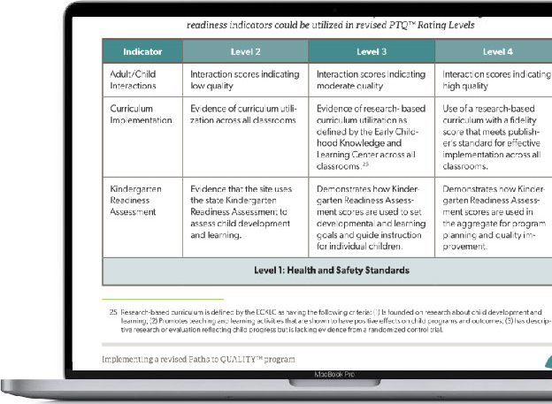
Paths to QUALITY™ refresh
Paths to QUALITY™ is Indiana’s Quality Rating and Improvement System, implemented in 2007.
To support families in navigating the child care
system and finding child care that works best
for them, Indiana is making updates to PTQ.
Proposed key changes include:
  Increased focus on adult-child interactions and the implementation of developmentally appropriate, research-based curriculum
  Effective use of an observation-based child assessment
  Integration of regulatory and quality systems, allowing licensed providers to qualify as Level 1 providers
Notes:
54 attendees at the May 15 kick-off event representing a diverse cross-section of people and organizations with expertise and passion for this work. Ambitious timeline to keep momentum on this strategic plan

Slide 7

Subsidy reimbursement policy changes
Over the past year, Indiana has made key policy changes to better support providers serving children and families in the state’s subsidy system.
Cost-based reimbursement model: In July 2023, OECOSL introduced new CCDF reimbursement rates to align with the current cost of providing care across provider settings and quality levels. New rates offered a minimum 20% increase
to all payments.
Paying based on enrollment: Beginning in July, the state will reimburse providers based on children’s enrollment versus attendance. This change provides more stability for subsidy providers and creates a better service experience for families.
Notes:
The Indiana PathWays for Aging program is a statewide managed care initiative that offers Medicaid services for eligible individuals aged 60 years and older. The objectives of the program are to support eligible Hoosiers in navigating the various options and care transitions associated with long-term care services and supports
This program intends to address the current opportunities to improve the care coordination between Medicaid and Medicare, provide additional caregiver support, offer enhanced benefits and increased access to services at home or within the community, and improve the overall quality of care.
There are 3 over arching program goals -
1) Person-Centered Services and Supports - Develop service plans and deliver services in a manner that is person-centered, member-driven, holistic, involves caregivers, and addresses social determinants of health (SDOH).
2) Ensuring Smooth Transitions - Ensure continuity of care and seamless experiences for members as they transition into the Indiana PathWays for Aging program and ongoing as transitions occur between providers, settings, or coverage types.
3) Access to Services (Member Choice) - Assure timely access to appropriate services and supports to enable members to live in their setting of choice and promote their well-being and quality of life.
The FSSA, through a procurement process, has contracted with three Managed Care Organizations (MCOs) to implement this program. Individuals can choose one of these healthplans to provider their Medicaid benefits:
Anthem Blue Cross and Blue Shield
Humana Healthy Horizons
United Healthcare Community Plan

Slide 8

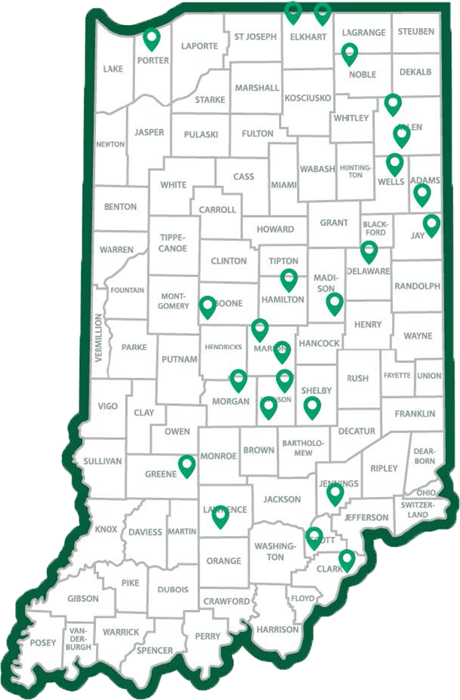
Addressing access challenges
In 2023, we offered Child Care Expansion Grants to encourage child care providers to build or expand their capacity to meet growing child care demands.
Grants awarded: 24
Counties reached: 20
Total funding: $9.91M
Projected seats to be created: 1,809

Slide 9

Strengthening the workforce

Slide 10

Expand assistance for child care workers
New legislation passed in March 2024 expands On My Way Pre-K and Child Care Development Fund eligibility for employees of regulated child care programs to 85% of the state median income.
For example, 85% of Indiana's SMI for a four-person household is approximately $75,814, or 243% of Federal Poverty Level.
Previously, child care workers were held to the same 150% of FPL income eligibility threshold.
Notes:
PathWays provides the standard Medicaid benefits including:
Coverage for medical expenses such as doctor visits, hospital care, therapies, medications, prescriptions, and medical equipment
Preventive care, such as regular check-ups, and mental health and substance abuse treatment
Care coordination services are available to every PathWays member. Members who meet the functional eligibility requirements have access to service coordination and MCEs offer different enhanced benefits.
Part D pays for prescription drugs. Members eligible for Medicare are required to have Part D coverage. If a member opts-out of Part D coverage, Medicaid does not pay for the member’s prescription drugs.

Slide 11

Recent legislative updates
Early learning received increased focus during the 2024 legislative session with two significant child care-related bills (Senate Enrolled Act 2 and House Enrolled Act 1102). Workforce-related legislative changes include:
Allows contracted support staff in schools to access child care at that school.
Reduces minimum caregiver ages for licensed child care centers and allows providers to recruit younger workers.
Permits qualified individuals, such as K-12 teachers, to register as substitute educators.
Commissions an early learning compensation study.

Slide 12

Increase affordability for families

Slide 13
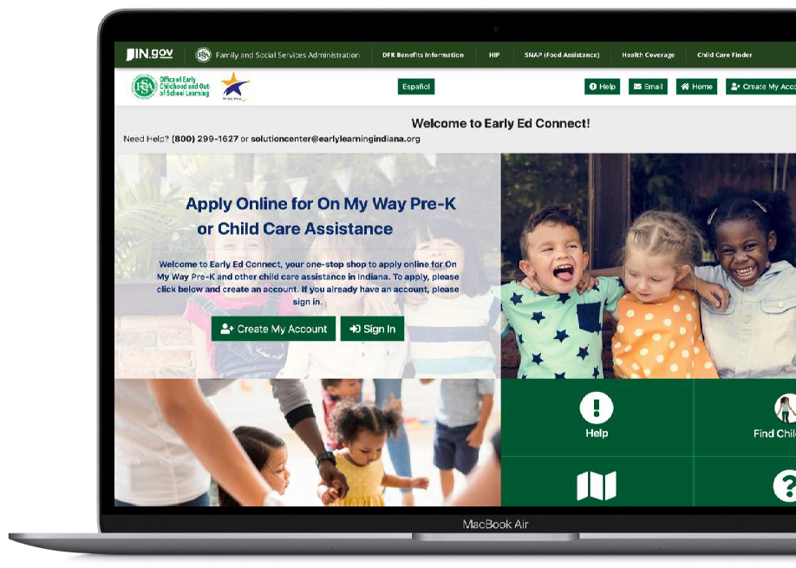

Increase affordability for families
Effective July 2023, initial income eligibility for CCDF and On My Way Pre-K increased from 127% of the federal poverty level to 150%—about $45,000 for a family of four.
This expansion creates access for approximately 11,000 more Hoosier children and families.
As of May 2024, more than 37,626 families have qualified under this new threshold.
Families can apply for child care assistance at earlyedconnect.fssa.in.gov/onlineApp/home

Slide 14
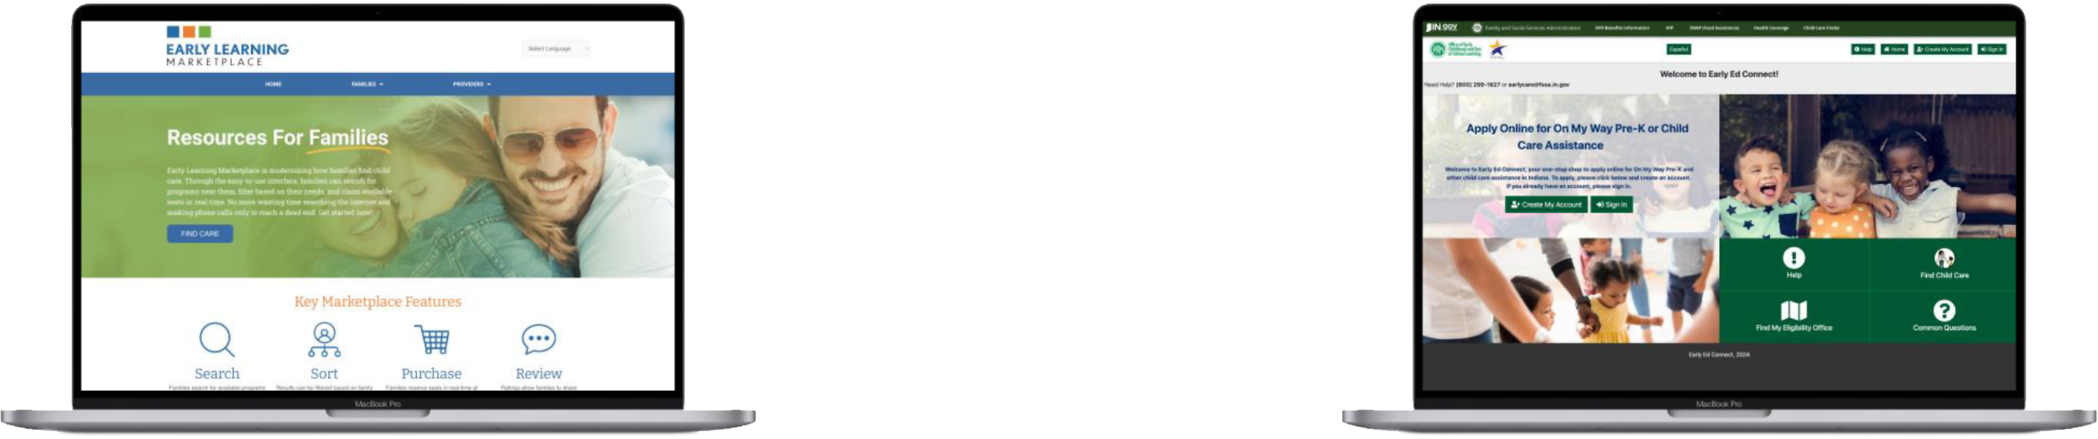
New access supports for families
In recent years, Indiana has made investments in modernized supports for families to find care and apply for child care assistance. These include:
Investing in the
Early Learning Marketplace
Online care-finding site for families to search for, review and enroll in local early learning programs.
Launching
Early Ed Connect
An online platform for families to quickly and easily see if they qualify for child care assistance and apply.
Notes:
MLTSS will provide members with a lot of additional support to help navigate the complex health care system. The new system will provide for seamless coordination of benefits regardless of program or setting and is designed to help to reduce the confusion created by having multiple systems.
Each member will have access to a care coordinator who will help to support their health care needs. The care coordinators will also ensure that all Hoosiers have access to quality care and can achieve similar health outcomes regardless of race, entity, or geography.
The Service Coordinator will support your LTSS or waiver needs.
And there will be additional support for those who are in both Medicaid and Medicare to help coordinate both of the programs.

Slide 15
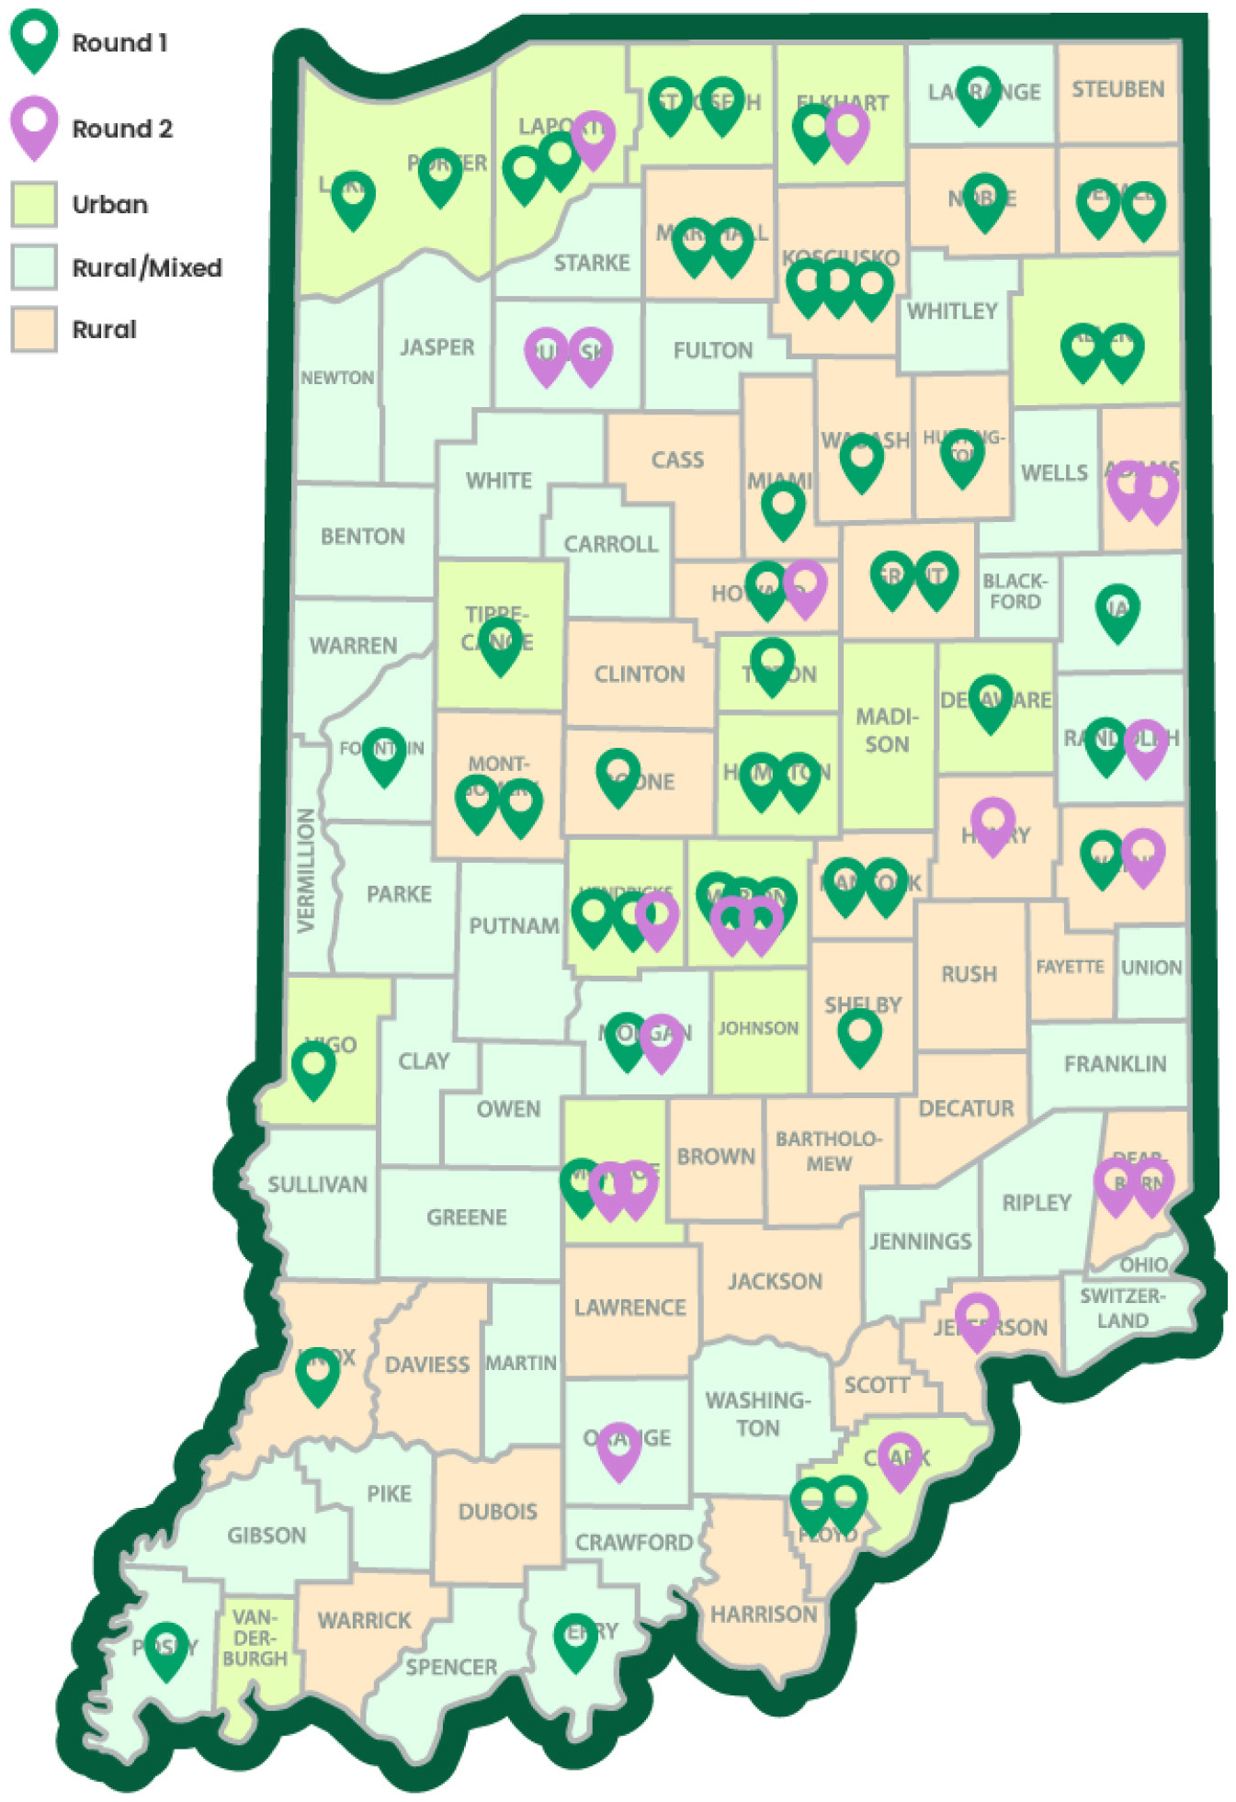
Employer-Sponsored Child Care Fund
Late last year, Indiana launched a $25 million competitive grant opportunity for businesses, school corporations and community groups to support child care solutions in their communities. Highlights include:
400,000+ Hoosier workers are projected to be impacted through the fund.
86 applicants were awarded, including 11 small employers and 10 in rural counties.
Nearly half of awarded employers plan to provide on-site child care. 15 will offer tuition benefits.

Slide 16

Tools and resources for your community

Slide 17

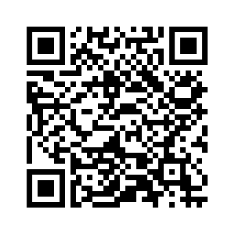
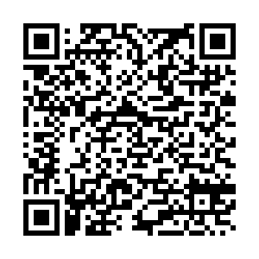
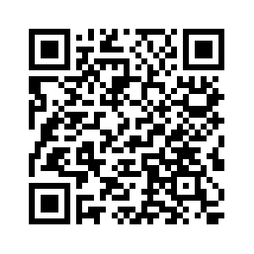
Stay engaged
Visit Indiana’s Early Learning Transformation webpage
Tune into an Early Learning Advisory Committee
Subscribe
to email
updates

Slide 18
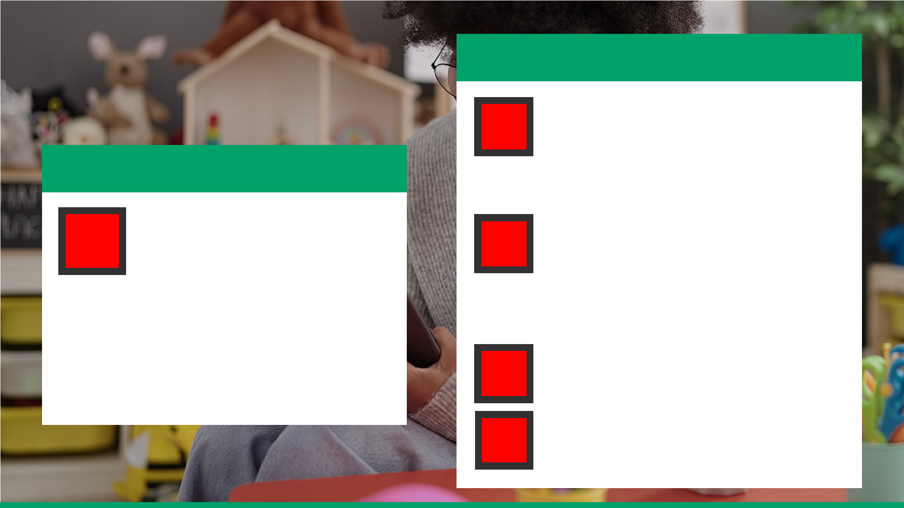
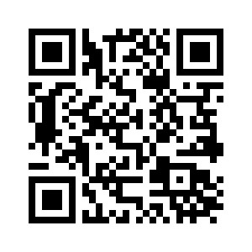
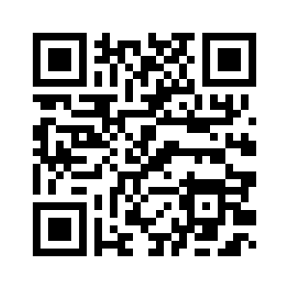
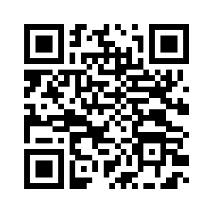
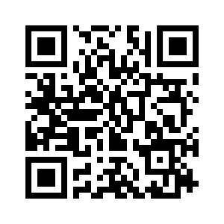
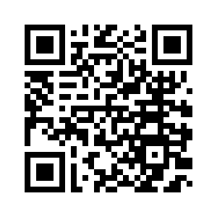
Provider and family tools
For Hoosier families
Visit Brighter Futures Indiana for early learning information and resources to support learning at home.
For early learning providers
SPARK Learning Lab is Indiana’s early learning training and technical assistance partner.
Apply for child care assistance at Early Ed Connect.
Finding care-finding supports at:
Providers can access live and online support by calling 800-299-1627 or visiting indianaspark.com/spark-help-desk/.
Early Learning Marketplace or
Child Care Finder

Slide 19

Questions
Please share your questions regarding today’s topics and early learning in your community.
Thank you!
Please contact us at oecoslproviderinquiry@fssa.in.gov with any additional questions.

