Slide 1

Non-Discrimination Compliance Information for INDOT Subrecipients
Presented by INDOT Prequalification Division
Taffanee L. Keys
Civil Rights Counsel
Title VI and ADA Coordinator

Slide 2
OVERVIEW
The purpose of this presentation is to,
ensure all subrecipients of the Federal Aid Highway Program are aware of the provisions of Title VI of the Civil Rights Act of 1964,
know the minimum requirements to be in compliance civil rights rules, laws, and regulations,
know how to integrate requirements into business practices, procedures, and activities,
know how requirements are enforced.

Slide 3

What is Title VI?
Title VI of the Civil Rights Act of 1964 (42 U.S. Code 2000d)
“No person in the United States shall, on the grounds of race, color, or national origin, be excluded from participation in, be denied the benefits of, or be subjected to discrimination under any program or activity receiving Federal financial assistance”
Ethnicity Complexion Origin or
perceived origin
foreign country (LEP)

Slide 4
Statutory and Regulatory Authorities
Title VI of the Civil Rights Act of 1964 is a federal law that protects individuals, groups, and organizations from discrimination on the basis of race, color or national origin in federally assisted programs and activities. (42 U.S.C. 2000d)
The Civil Rights Restoration Act of 1987, further clarified the intent of Title VI to include all programs and activities of entities whether those programs and activities are federally funded or not.
The 1970 Uniform Act (42 U.S.C. 4601) prohibits unfair and inequitable treatment of persons displaced or whose property will be acquired as a result of federally assisted programs or activities.
American with Disabilities Act of 1990 and Section 504 of the 1973 Rehabilitation Act (29 U.S.C. 790), as amended: Prohibits discrimination on the basis of disability.
Federal Highway Act of 1973 - Gender Added (23 U.S.C. 324): Prohibits discrimination on the basis of sex.
The 1975 Age Discrimination Act (42 U.S.C 6101), as amended: Prohibits discrimination on the basis of age.

Slide 5

How Does Title VI Apply & Who Must Comply?
Protections afforded under Title VI apply to anyone regardless of whether the individual is lawfully present in the United States, or a citizen of a state within the United States.
Applies to all programs and operations of entities that receive federal financial assistance, including recipients and subrecipients.
Recipients of federal funds must comply with:
1) Title VI of the Civil Rights Act of 1964
2) The Civil Rights Restoration Act of 1987
3) All related nondiscrimination statutes
Title VI Shall be applied institution-wide; it is not limited to programs that are federally funded.

Slide 6
How Does Title VI Apply & Who Must Comply?
Definitions–Program, Activity & Financial Assistance
Program or activity” is defined as:
A department, agency, special purpose district, or other instrumentality of a state or local government, or;
The entity of such state or local government that distributes such assistance and each department or agency (and each other state or local government entity) to which the assistance is extended…
“Federal Financial assistance”: means more than just money. It is also aid that enhances the ability to improve or expand allocation of a recipient’s own resources:
Award or grant of money
Any federal agreement, arrangement, or other contract which has as one of its purposes the provision of assistance
Loans, below fair market value subsidies
Use or rent of federal land or property
Training of employees
Loan of federal personnel
Tax incentives and tax exempt-status
Technical assistance
Other arrangements with the intention of providing assistance

Slide 7
Discriminatory Practices Under Title VI
Title VI Prohibits
Denying an individual any service, financial aid, or other benefit because of race, color or national origin.
Providing a different service or benefit or providing these in a different manner from those provided to others under the program.
Segregation or separate treatment in any manner related to receiving program services or benefits.
Requiring different standards or conditions as prerequisites for serving individuals.
Discriminatory activity in a facility built in whole or part with Federal funds.
Locating facilities in any way that would limit or impede access to a Federally funded service or benefit.

Slide 8

Discriminatory Practices Under Title VI
Types of Discrimination
Intentional Discrimination/
Disparate Treatment
  Engaging in treating persons differently because of their race, color, national origin, sex, disability, or another protected basis.
  Does not require evidence of “bad faith, ill will or any evil motive.”
  Where direct evidence is unavailable, may be shown with demonstration that similarly situated persons received benefit or more favorable treatment.

Slide 9

Discriminatory Practices Under Title VI
Types of Discrimination
Unintentional Discrimination/
Disparate Impact
Discrimination that occurs as a result of a neutral policy which appears harmless on the surface, but negatively affects a group.
Focus concerns the consequences of a recipient’s practices, rather than intent.

Slide 10

Discriminatory Practices Under Title VI
Retaliation
Occurs when a recipient or another person intimidates, threatens, coerces, or discriminates against any individual for the purpose of interfering with any right or privilege secured by Title VI, or because a person made a complaint, testified, assisted, or participated in any manner in an investigation or proceeding under Title VI.

Slide 11
Compliance Requirements
  1. Designate a Title VI Coordinator and ensure the Coordinator has received Title VI training.
  2. Develop a Title VI Nondiscrimination Policy Statement which must be made public.
  3. Develop and maintain a complaint process and complaint form and maintain a complaint log.
  4. Conduct regular training on Title VI and all related laws.
  5. 504 ADA Nondiscrimination Policy Statement which must be made public.
  6. Include Title VI Assurances in all contracts.
  7. Post Title VI “It’s the Law” Poster.
  8. Monitor Subrecipients to ensure that all of its’ (contractors and subcontractors) awarded INDOT funded contracts adhere to Title VI and all other applicable civil rights laws and regulations.

Slide 12

Title VI Coordinator & Duties
Title VI Coordinator ensures timely departmental updates on reportable activities, addressing areas of non-compliance, providing recurring training and offering expert advice to address civil rights challenges and policy needs.
Title VI Coordinator is responsible for providing leadership, direction and policy to ensure compliance with Title VI of the 1964 Civil Rights Act and environmental justice principles.

Slide 13
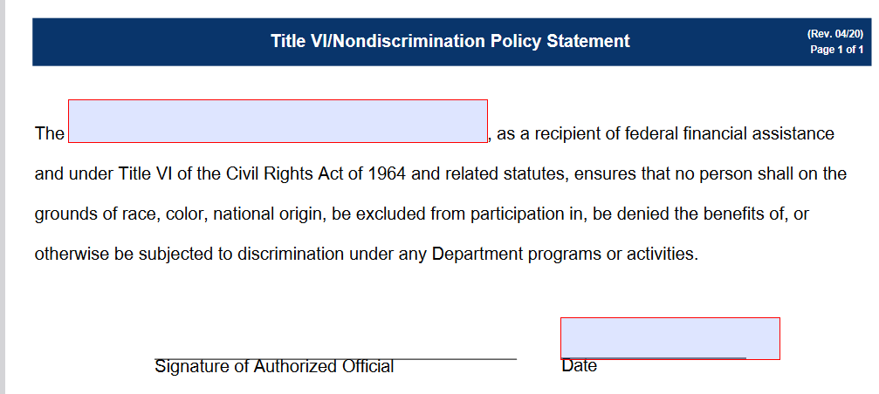
Title VI Nondiscrimination Policy
Title VI Nondiscrimination Policy Statement
A policy statement that assures nondiscrimination to the effect that no person shall on the grounds of race, color, national origin, sex, age, or disability be excluded from participation in, be denied the benefits of, or be otherwise subjected to discrimination or retaliation under any program or activity must be signed by the head of the agency and circulated internally and to the general public.

Slide 14
FHWA Nondiscrimination Complaint Process
FHWA Complaint Process
If a subrecipient of Federal Highway Administration (FHWA) funds receives a Title VI complaint, forward it to INDOT who will then forward the complaint to the FHWA Indiana Division Office.
All Title VI complaints received by the Division Office will be forwarded to Federal Highway Administration Office of Civil Rights (HCR) for processing and potential investigation.
If HCR determines a Title VI complaint against a subrecipient should be investigated by INDOT, HCR may delegate the task of investigating the complaint to INDOT. INDOT will conduct the investigation and forward the Report of Investigation to HCR for review and final disposition.
The disposition of all Title VI complaints will be undertaken by HCR, through either (1) informal resolution or (2) issuance of a Letter of Finding of compliance or noncompliance. A copy of the Letter of Finding will be sent to the Division Office.
USDOT regulations, 49 CFR 21.11(b), a complaint must be filed no later than 180 days after the date of the alleged discrimination.

Slide 15

Complaint Process, Complaint Form
All complaints are routed to the FHWA Headquarters Office of Civil Rights (HCR) for processing
HCR determines to accept, dismiss, transfer to INDOT for disposition
Complaints Hierarchy:
Complainant
to Subrecipient
Subrecipient to INDOT-
NDOT to FHWA Indiana Division Office
FHWA Division Office – FHWA HCR
Direct all complaints of discrimination pursuant to Title VI to:
Title VI Coordinator/ Program Manager
Indiana Department of Transportation
100 N. Senate, Room N755
Indianapolis, IN 46204
Email address: AccessForAll@indot.in.gov
And/or
Indiana Division
Federal Highway Administration
575 N. Pennsylvania Street
Room 254
Indianapolis, IN 46204
Phone: (317) 226-7475
And/or
Federal Highway Administration Headquarters - Office of Civil Rights
1200 New Jersey Avenue, SE HCR-40, Room E81-101
Washington, DC 20590
202-366-0693 or Fax: 202-366-1599
TTY: 202-366-5751

Slide 16
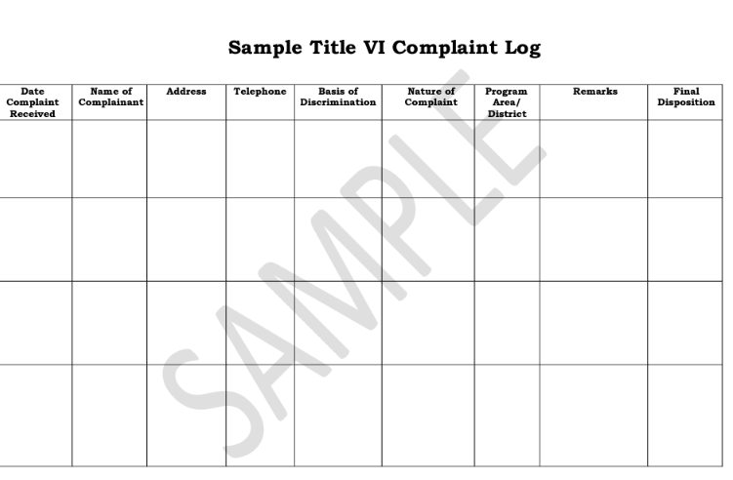
Complaint Process, Complaint Log
External Discrimination Complaints Process Includes:
A list of all external discrimination complaints and lawsuits filed against the agency must be maintained.
The information in this list should include:
the identification of each complainant by race, color, sex, or national origin; the name of the complainant;
the nature of the complaint;
the dates the complaint was filed, and the investigation was completed;
the disposition and date;
and other pertinent information.
Your external discrimination complaint processing procedures should also include a timeline for submitting a complaint.

Slide 17

Title VI Training is Mandatory
Civil rights training:
Title VI Coordinator Attend Title VI training,
Develop an effective staff training program,
Provide regular and comprehensive training,
Describe how and when agency will be trained on Title VI Program requirements and responsibilities,
Include procedures as to how and when training will be conducted.

Slide 18
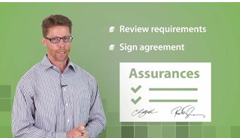
Required Contract Provisions Title VI Assurances
Nondiscrimination Assurances: Subrecipients must sign the U.S. DOT Standard Title VI
Assurances. General nondiscrimination language from the assurances must be included in all
solicitations for bid or requests for proposals. The clauses of Appendix A and Appendix E must
be included in every contract or agreement that you enter into. Form FHWA-1273 must also be
physically attached to all federal-aid construction contracts of $10,000 or more.

Slide 19
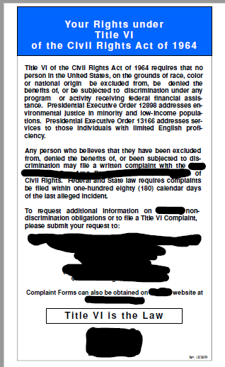
“IT’s The Law” Poster
Subrecipients must post the Title VI
“It’s the Law” poster at worksites

Slide 20
Limited English Proficiency
Limited English Proficiency" (LEP) means:
1. someone who does not speak English as their primary language, and
2. has a limited ability to read, speak, write, or understand English,
3. essentially making it difficult for them to communicate effectively in English.
Duty: Must provide language assistance services like interpreters or translated materials to effectively communicate with LEP individuals.

Slide 21
Title VI Compliance Review
The INDOT Civil Rights Counsel Prequalification Division conducts compliance reviews annually of selected subrecipients. A summarized review process is as follows:
Notification: Subrecipients are notified initially via email indicating if it is a desk audit or an on-site review.
Desk Audit: Subrecipients selected for desk audits are asked to provide electronic documents for INDOT’s review. If concerns are discovered during the documents review, an on-site review may be scheduled.
On-Site Reviews: The subrecipient’s site is visited, the compliance questionnaire is reviewed and discussed, and findings are documented.
Post On-site Review: If any deficiency is found, improvement opportunities are identified and assistance by INDOT is provided to meet compliance goals. A compliance letter will be emailed when the subrecipient is found in compliance.

Slide 22
Contractors’ Duty to Provide Information & Records
Contractors are required to:
provide all information and reports required by federal and state directives, laws, orders, regulations and/or rules,
permit access to books, records, accounts, other sources of information, as well as facilities, as determined by INDOT or FHWA to be pertinent to ascertain Title VI compliance.

Slide 23
INDOT’S Title VI Requirements
The Indianapolis Department of Transportation (INDOT) is the agency responsible for administering Federal financial assistance through the Federal Highway Administration (FHWA) and Federal Transit Administration (FTA) programs in the State.
23 CFR 200.9(b)(7) requires INDOT to conduct Title VI reviews of its subrecipients to effectively monitor compliance with Title VI/Nondiscrimination.
23 CFR 200.9(b)(9) requires INDOT to conduct training on Title VI and related statutes.

Slide 24
Quiz
Wrap-up to Title VI Compliance
1. Title VI of the Civil Rights Act of 1964, states that no person in the United States shall be excluded from participation in any programs, be denied the benefits of, or be subjected to discrimination based on what?
Religion
Disability
Age
Race, Color or National Origin
2. What ways can a sub-recipient disseminate Title VI information to the public?
Website and Poster
Utility Bill
Minority Community Newspaper, Radio and Television
All of the Above
3. Who is a Limited English Proficient (LEP) Person?
A person who does not speak English as their primary language and has the limited ability to speak, write or understand English
A person from the United States that cannot read
A person who does not speak English at all
All of the Above

Slide 25
Quiz
Wrap up to Title VI Compliance
4. How can you involve the public with the opportunity to provide input in a proposed project?
Public Meetings/Hearings in centralized locations
Advertisement with Local Media Resources and Minority Newspapers
Direct Mailings
Public Service Announcements
All of the Above
5. Subrecipients are not required to have a Title VI Coordinator.
True
False
6. Subrecipients are not required to submit Title VI Assurances.
True
False

Slide 26
Title VI Contact Information
Taffanee L. Keys
Contract Compliance Attorney
Prequalification Division
tkeys@indot.in.gov
317-941-451s or concerns

