Slide 1


Slide 2
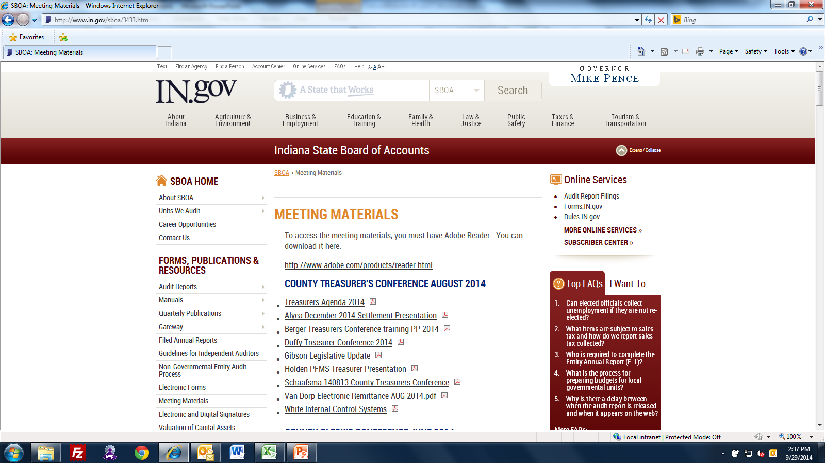

Slide 3
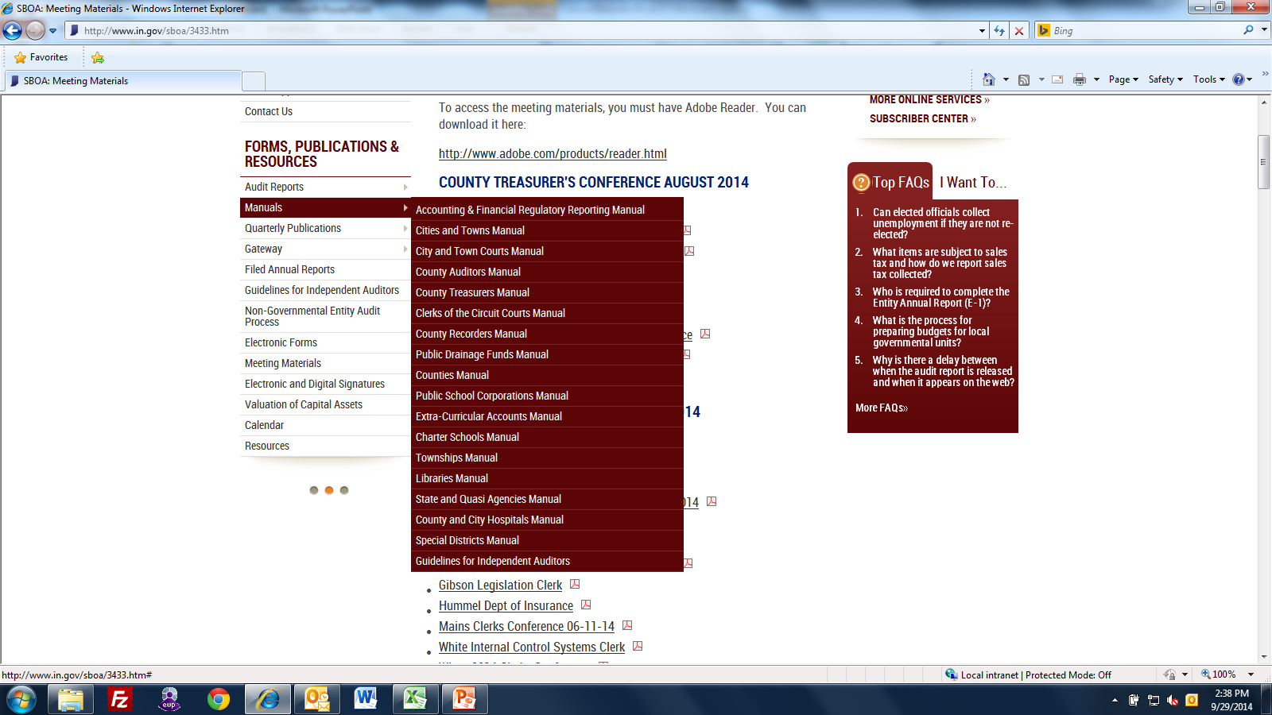

Slide 4
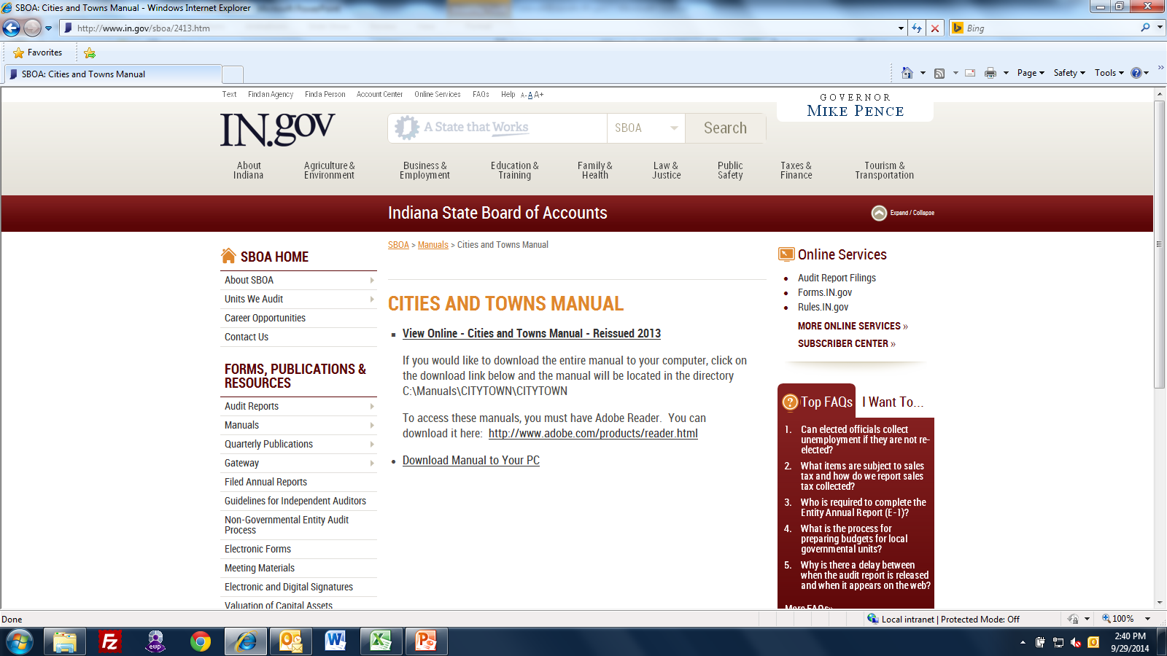

Slide 5
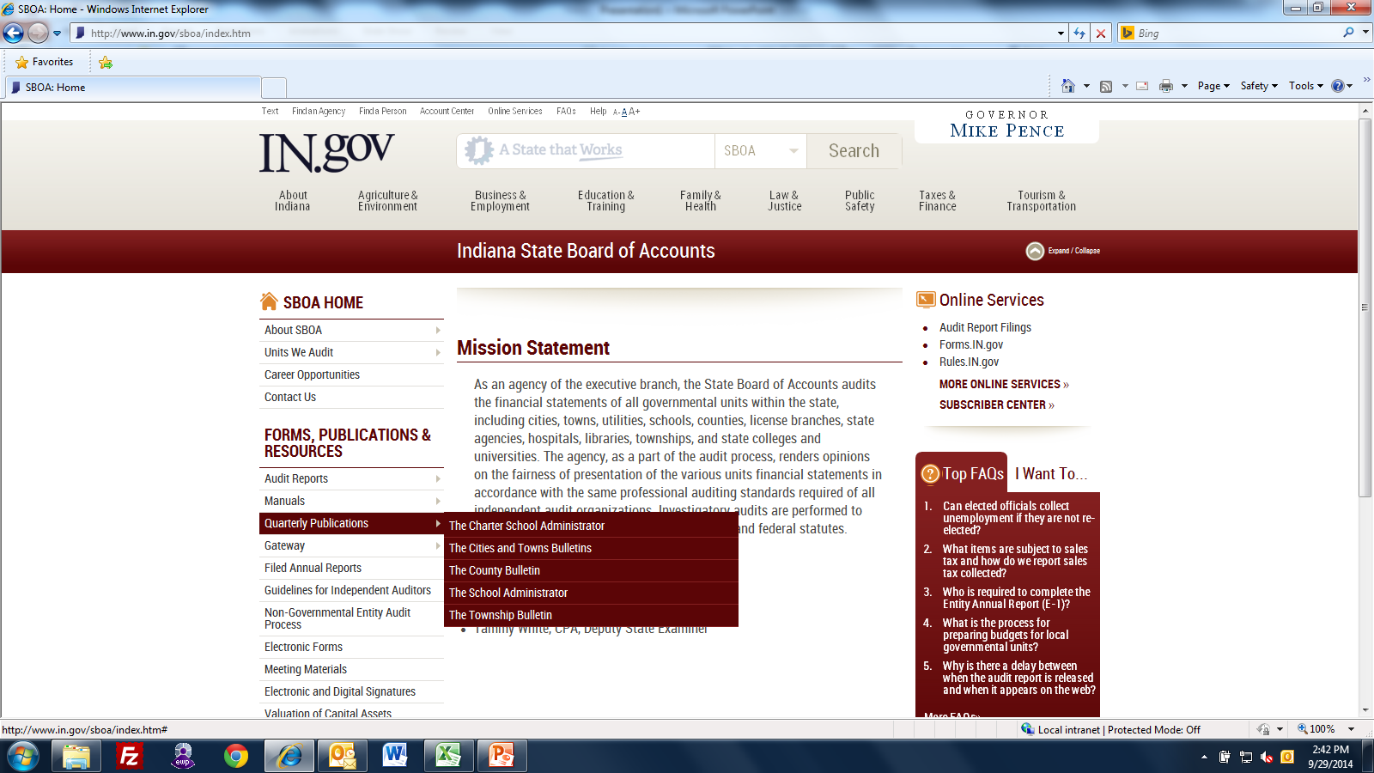

Slide 6
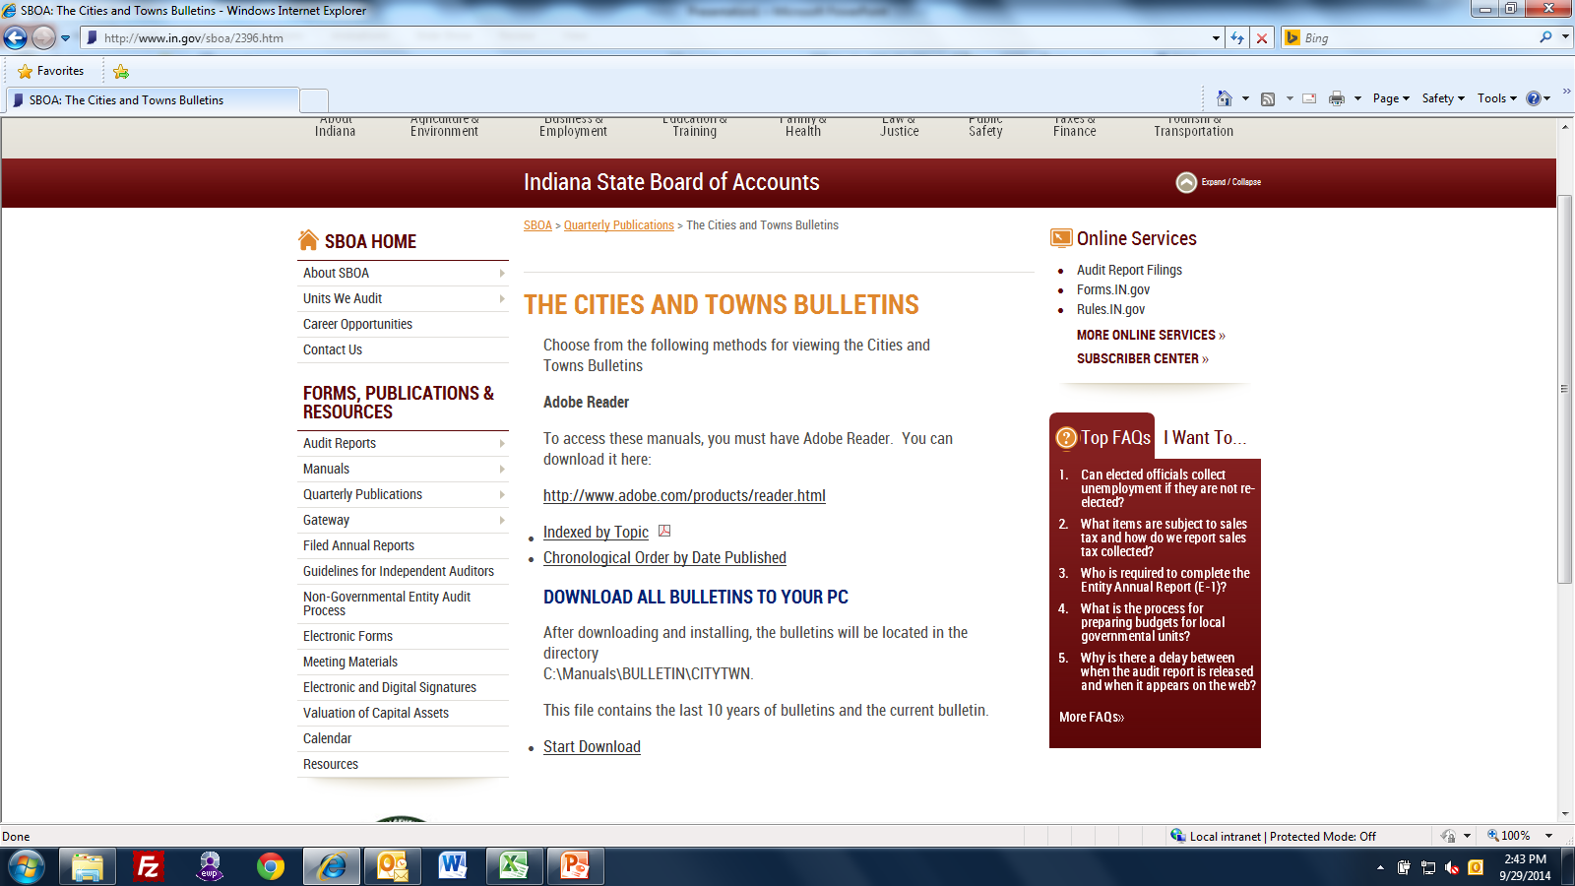

Slide 7
Email:
Todd Caldwell tcaldwell@sboa.in.gov
Susan Gordon sgordon@sboa.in.gov
Phone – (317) 232-2513
SBOA website – www.in.gov/sboa

